Slide 1

Toronto
Canada

Slide 2




Slide 3



Welcome to slide-show
S
S
for success
Notes:
<number>

Slide 4

our heroines are OUR PRIDE,
As life shaping role- model they are our Guide.
Bangladeshi origin
world famous successful people;
who are the proud legacy- for all of us and
Source of life-shaping inspiration
For our children.
They are the role-model for our children to emulate.
We hope; our children will keep continue
exemplifying the legacy to shape their fate.
Ladies and Gentlemen!
Please welcome
our heroes and heroines

Slide 5


S
WHAT
SUCCESS
LOOKS
LIKE ?

Slide 6

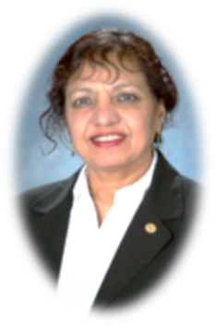

















Slide 7



Slide 8

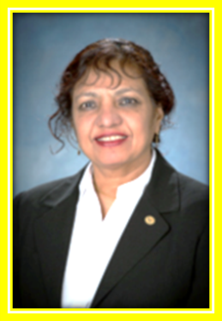
Dr. Sultana Nahar is known as
"The Iron Lady" by astronomers.
Physicists and astronomers around the world use her computationally
intensive mathematical models of the iron atom when interpreting
complicated spectra produced by high-energy astrophysical processes,
such as those occur near black holes at the centers of active galaxies.
*
She is ranked the top among Muslim
Women Astronomers and Astrophysicists
of 21st century

Slide 9
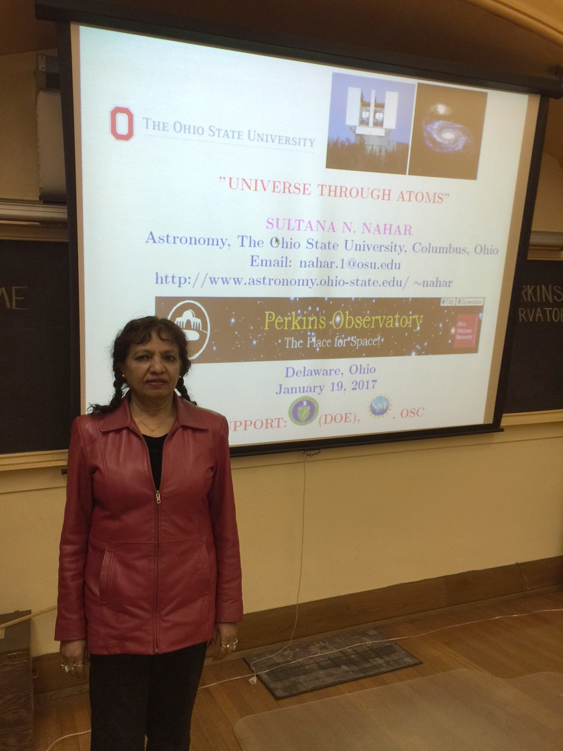
She studies the universe through atoms
(public lecture at Perkins Observatory, Ohio)
Notes:
She studies the universe through atoms,developed new ways to study atomic processes (Public lecture at Perkins Observatory, Ohio)
public lecture describing "universe
through atoms", Perkins Observatory, Ohio

Slide 10
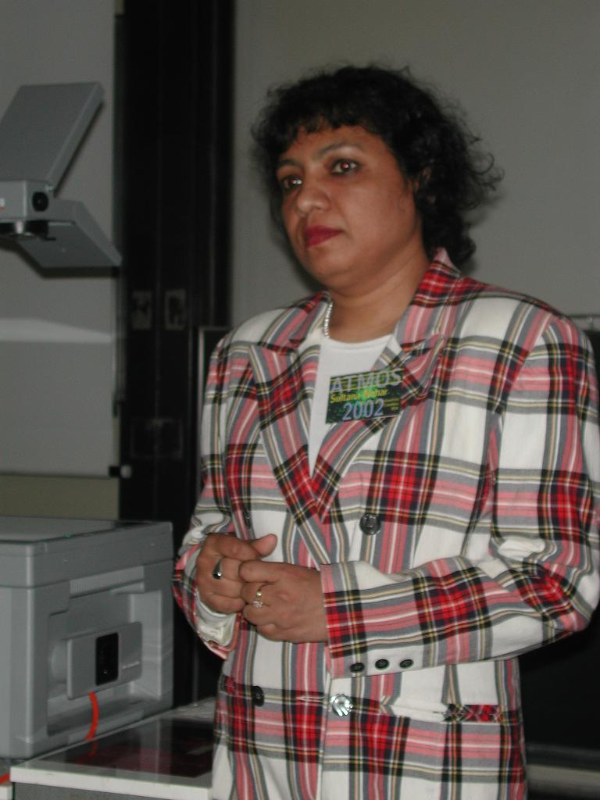
Question-Answer after an invited scientific presentation on atomic processes in Germany

Slide 11
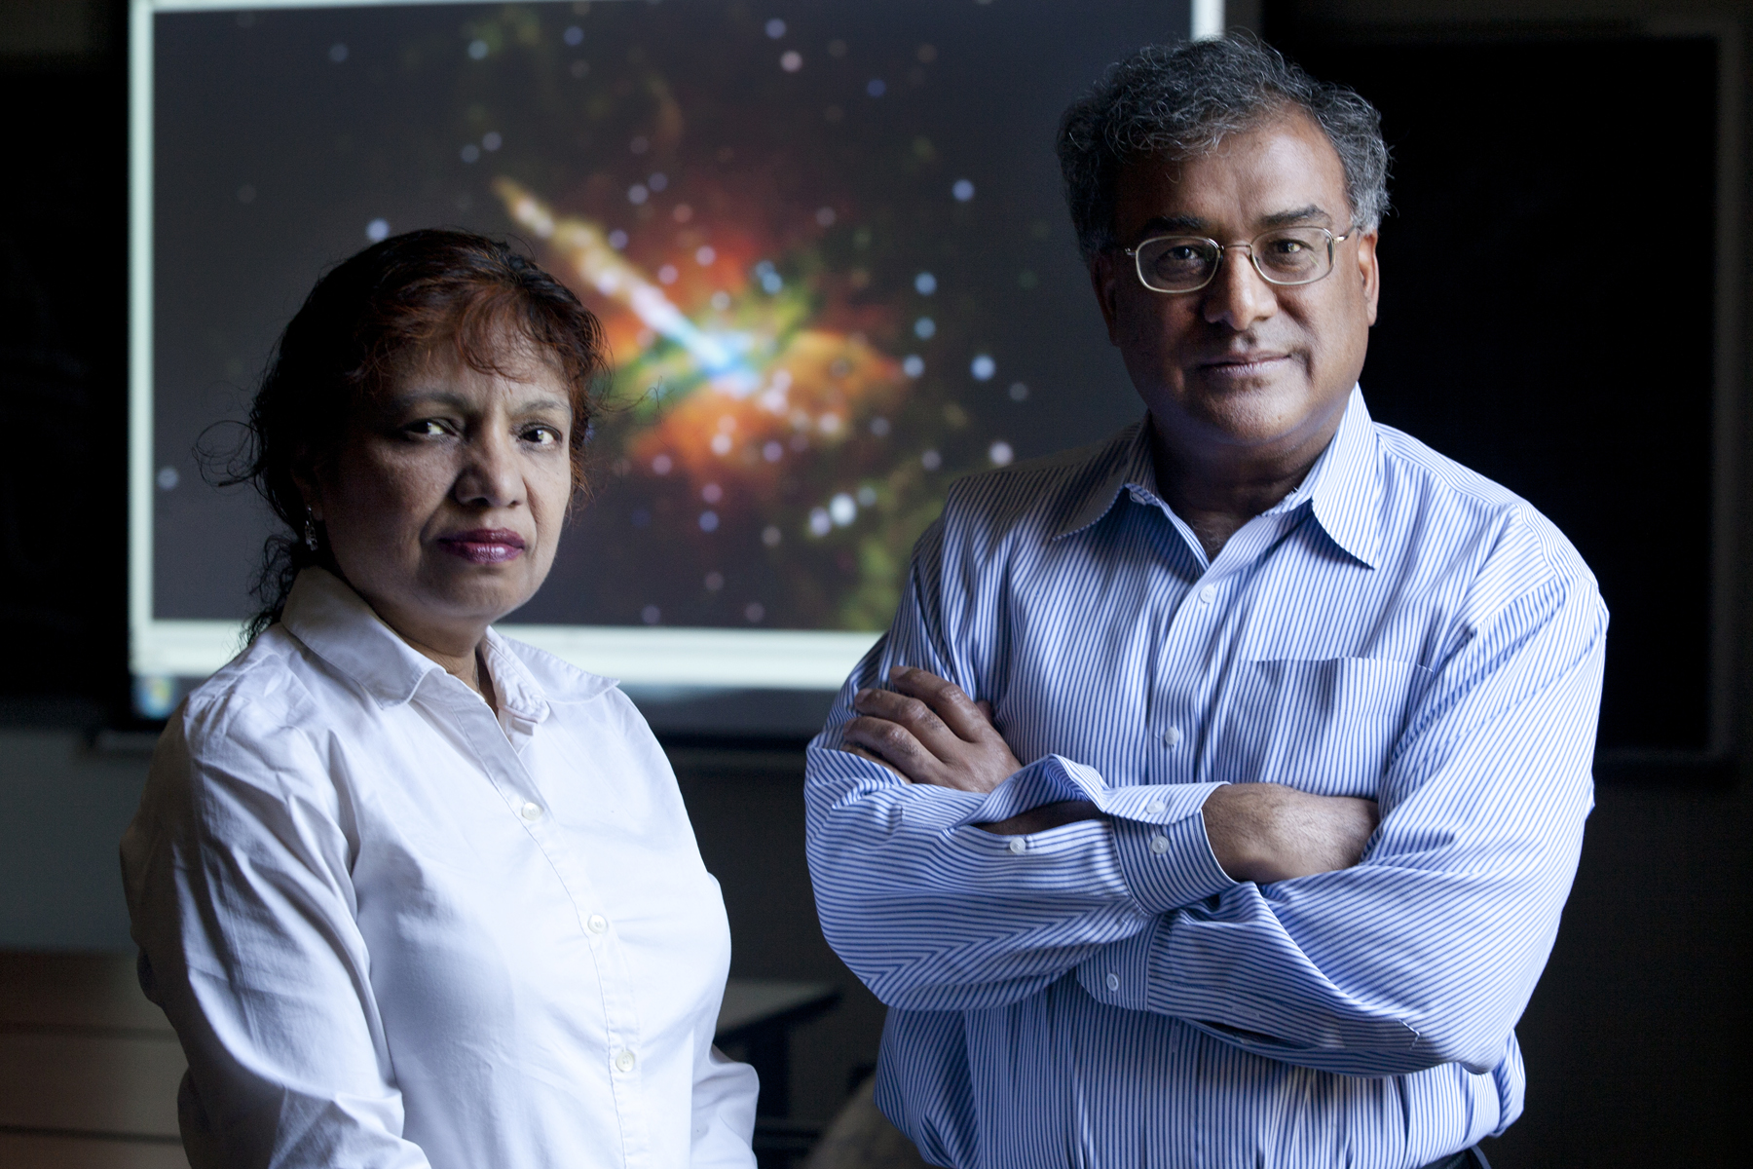
News title: "Astronomers reach for the stars to discover new cancer therapy" describes Anil Pradhan, Sultana Nahar, Yu Yan applying knowledge of stars, black holes to introduce a new method
Notes:
News title: "Astronomers reach for the stars to discover new cancer therapy" describes Anil Pradhan, Sultana Nahar, Yu Yan applying knowledge of stars, black holes to introduce a new method for cancer treatment

Slide 12




(Astrophysics is the study of the origins, physics, and evolution of planets, stars, galaxies, and the universe as a whole. The principal pursuits of the astronomer are
to extend our understanding of the physical nature of the universe).
EDUCATION:
SSC from Moniza Rahman Girls High School, Dhaka, Bangladesh
HSC from Central Women's College. Dhaka, Bangladesh
BSc. (Hon) in physics) 1977, 1st Class 1st, Dhaka University, Bangladesh
M.Sc. Theoretial Physics), 1979, 1st, Class 1st, Dhaka University, Bangladesh
Thesis: "Compton Scattering on Nucleons at Low Energies"
M.A. (Quantum Optics), 1982, Wayne State U., Detroit, Michigan USA
Thesis: "Nematic Liquid Crystal and Optical Nonlinearity"
Ph.D. (Atomic Theory), 1987, Wayne State U., Detroit, Michigan USA
Dissertation: "Electron and positron scattering from atoms"
Received Distinguished Alumni Award from Wayne State University
Continue to next Slide

Slide 13
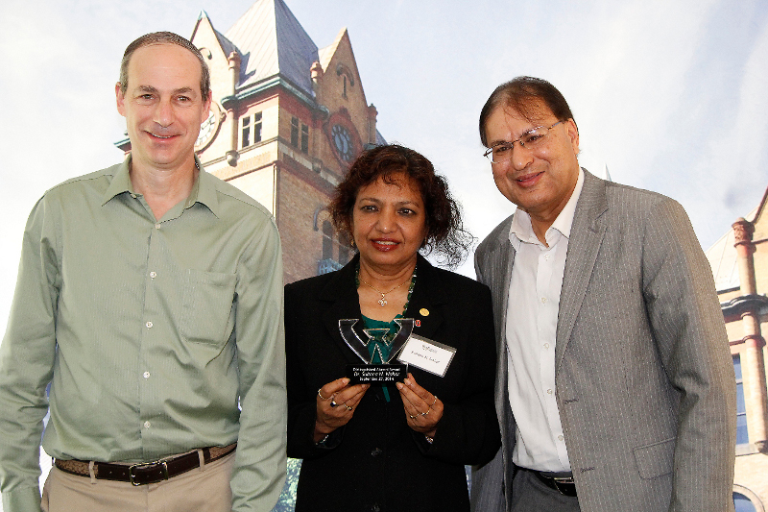
Distinguished Alumni Award, Wayne State University

Slide 14
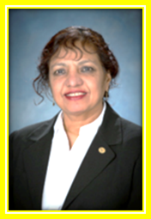
Dr. Sultana N Nahar
visited Aligarh Muslim University, in India
to implement the OBAMA-SINGH
21st Century Knowledge Initiative.
A pilot project named ‘STEM’
(Science, Technology, Engineering, Mathematics)
Training the Next Generation of STEM
Faculty at Higher Education Institutions in India.
Notes:
<number>

Slide 15

Dr. Sultana Nurun Nahar
is the Founder and sponsor of many educational-institutions, some are listed below:
TEACHER AWARDS IN PHYSICS and IN ARABIC, at Dhaka University, Bangladesh, established in 2011
‘STEM’ programs in six other educational institutions:
Kazi Nazrul Government College, Laxmi Bazar, Dhak
Maniza Rahman Girls High School, Dhaka
Panchdona Tah'fijul Quran Madrasa and Orphanage" Narsindhi, Dhaka,
Gandaria Government Primary School, Gandaria, Dhaka
Domdoma Primary School
She initiated “Razzaq-Shamsunahar Memorial Prizes” in 1995. The name
of the prize is given after her parents names- Abdur Razzaque and Shamsun Nahar.
(Abdur Razzaque and Shamsun Nahar Trust for Education.)
The Prize is open to any Bangladeshi for research publications in accredited physics journals to provide an incentive for research publications and presentations and to make Bangladeshi physicists visible.
Continue to next slide
Notes:
<number>

Slide 16
Dr. Sultana N. Nahar
Founder and sponsor Continue
DISTINGUISHED TEACHER OF THE YEAR AND AN UNDERGRADUATE STUDENT SCHOLARSHIP IN PHYSICS, at:
Jahangirnagar University,
Chittagong University,
Rajshahi University,
Jagannath University
Dr. Sultana N. Nahar is the founder of
The Science, Technology, Engineering and Mathmatics (STEM)
PROGRAM FOR EDUCATION AND RESEARCH:
TEACHERS AND STUDENTS PRIZES IN PHYSICS at”
Cairo University, Egypt
Al-Azhar University, Egypt
National Research Institute for Astronomy and Geophysics, Egypt
Islamic University in Gaza, Palestine
Aligarh Muslim University, Idia
University of Kashmir, India
Wayne State University, USA
Continue to next slide- Picture speaks with thousand words

Slide 17


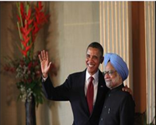



Slide 18
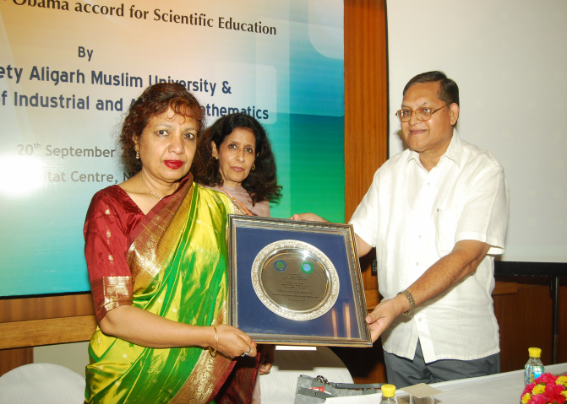
Dr. Sultana Nahar receives a recognition plaque
the Indian University Grant Commission delegate.
During her visit to Aligarh Muslim University, India

Slide 19
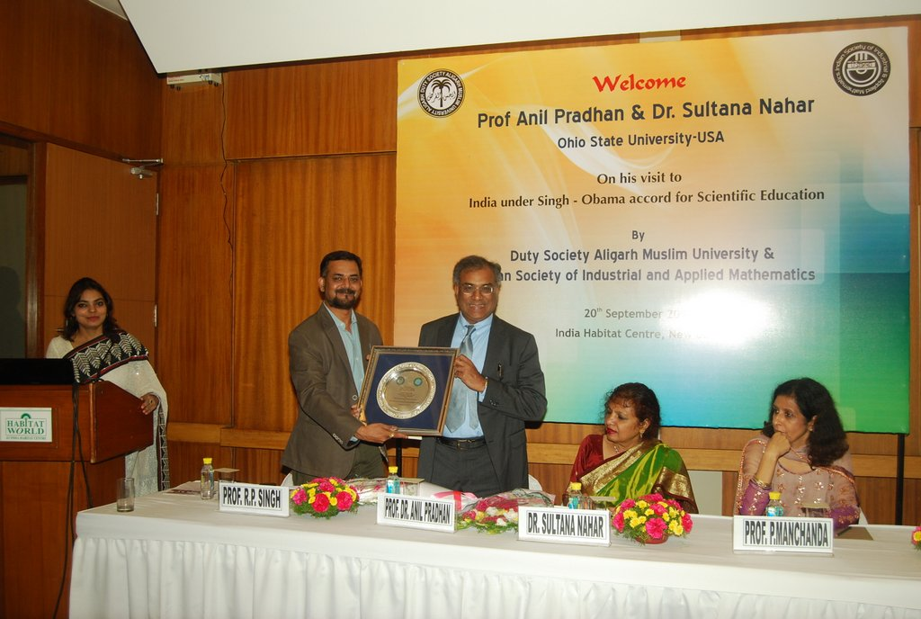
Award presented from Aligarh Muslim University and Indian Society of Industrial and Applied Mathematics(ISIAM) to Dr. Sultana Nurun Nahar and Dr. Anil Pradhan of Ohio State University USA. on 20th September 2013, during their visit to India to explore academic collaboration under the accord known as Singh-Obama educational accord.

Slide 20
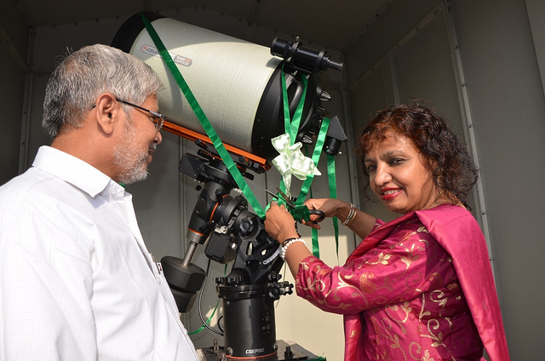
Dr. Sultana Nurun Nahar inaugurating the Telescope Facility
at the Department of Physics,
at Aligarh Muslim University, India.

Slide 21

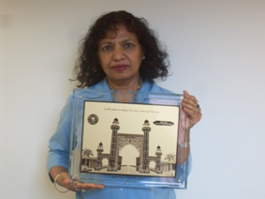
BAB-E-SYED
The plaque of Aligarh Muslim University,
In recognition of contribution of
‘OBAMA-SINGH’
21st Century Knowledge Initiative Award,
2013

Slide 22

UNIVERSITY
OF
KASHMIR
SRENAGAR, INDIA
Teacher and Student Awards in Physics
Under ‘STEME-ER’ Scheme
Established in 2013
Founder and sponsor:
Dr. Sultana N. Nahar

Slide 23
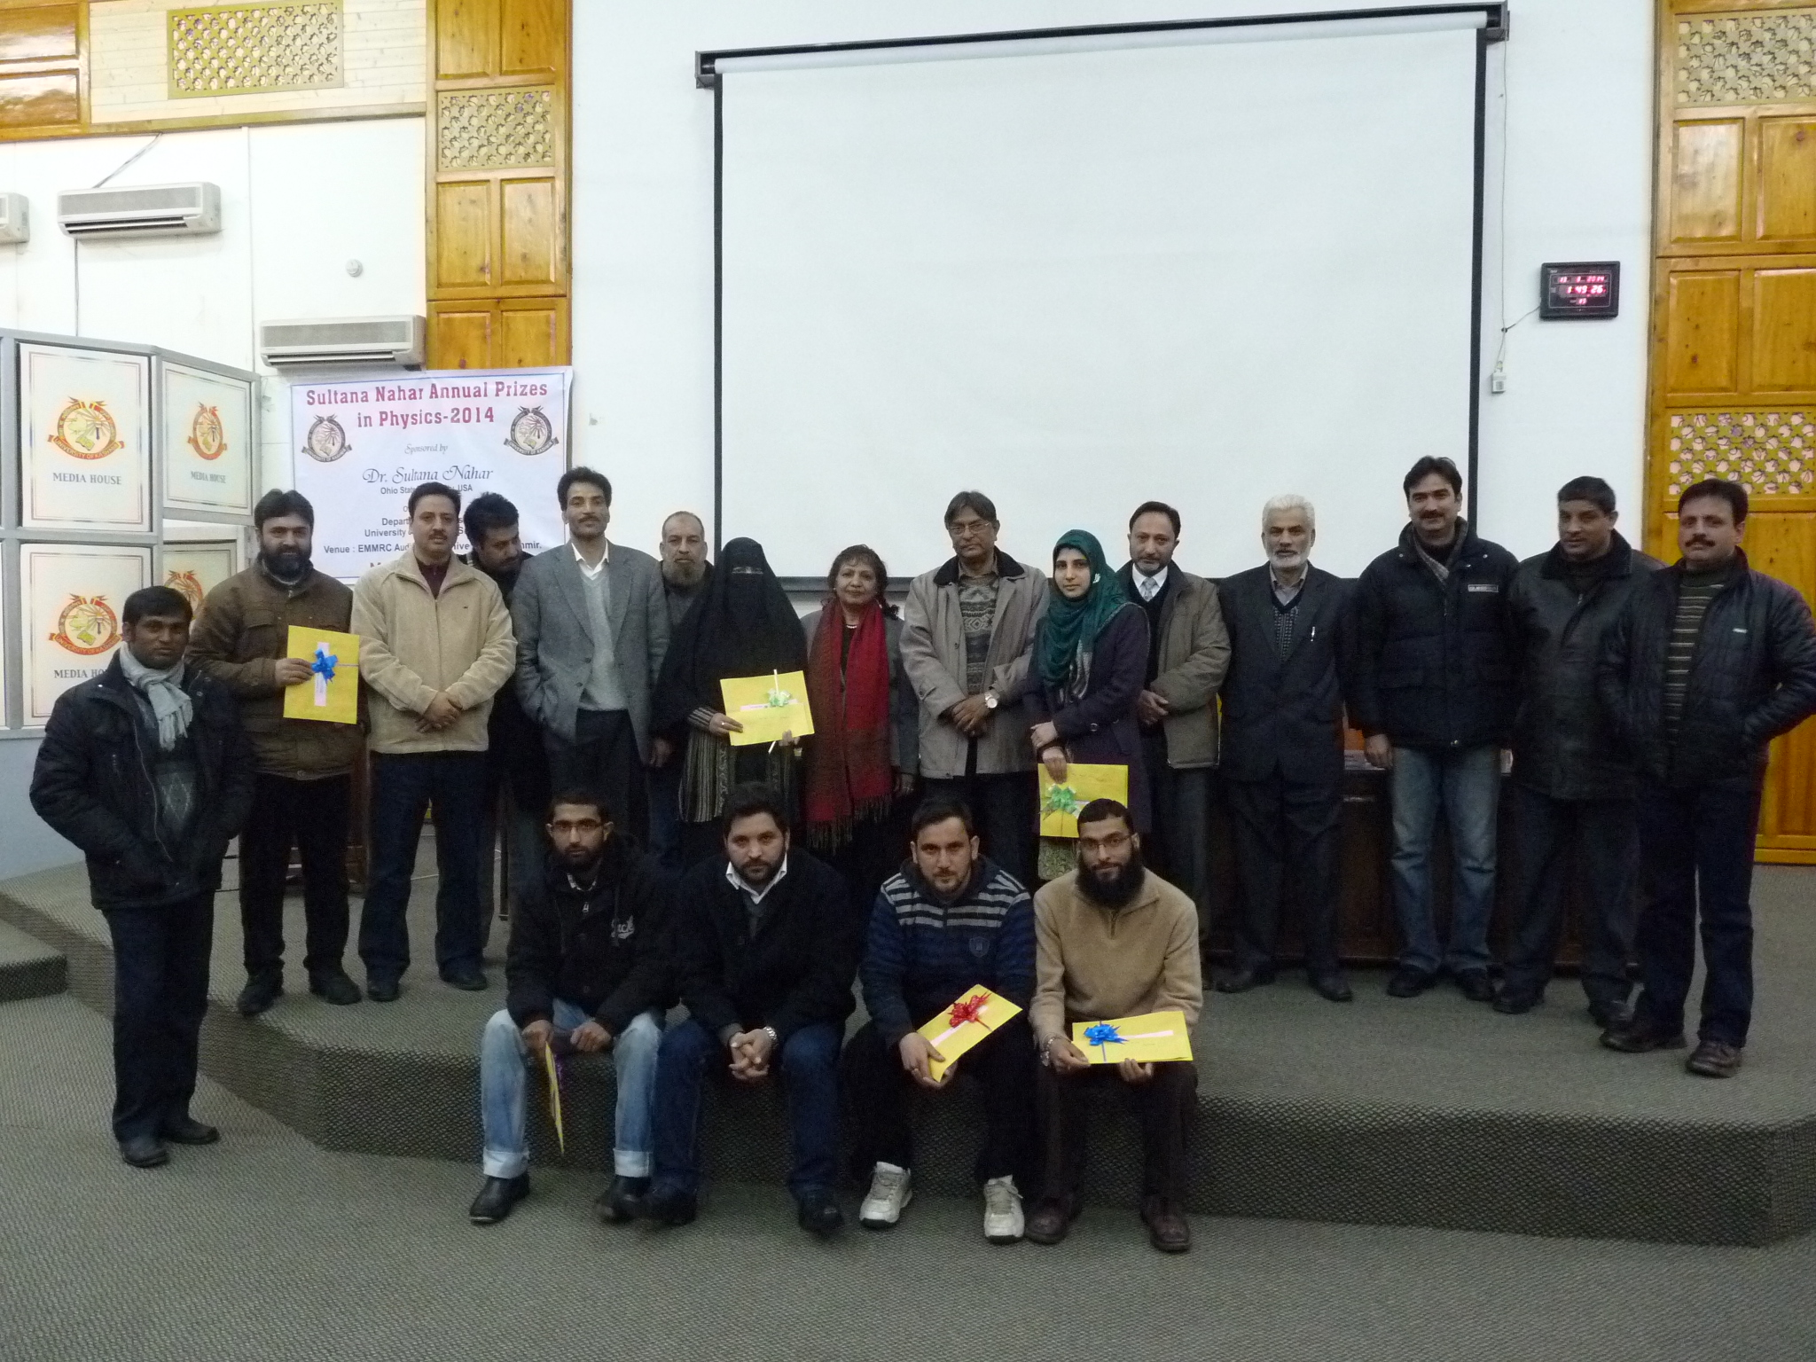
Winners of physics prizes (yellow envelops) at University of Kashmir introduced by Sultana

Slide 24


CAIRO UNIVERSITY
Giza, Egypt
STEM-ER PROGRAM
FOR EDUCATION AND RESEARCH:
TEACHERS AND STUDENTS PRIZES
IN PHYSICS
Establishment: April 12, 2012
Founder:
Dr. Sultana N. NahaT

Slide 25


Al-Azhar University
Cairo, Egypt
‘STEM’ Program for education and research:
Teacher & Student prizes in physics astronomy
Founder:
Dr. Sultan N. Nahar

Slide 26

Aligarh Muslim University
‘STEM’ Program for education and research:
Teacher & Student prizes in physics astronomy
Establishment, December 2011
Founder and sponsor:
Dr. Sultan N. Nahar

Slide 27
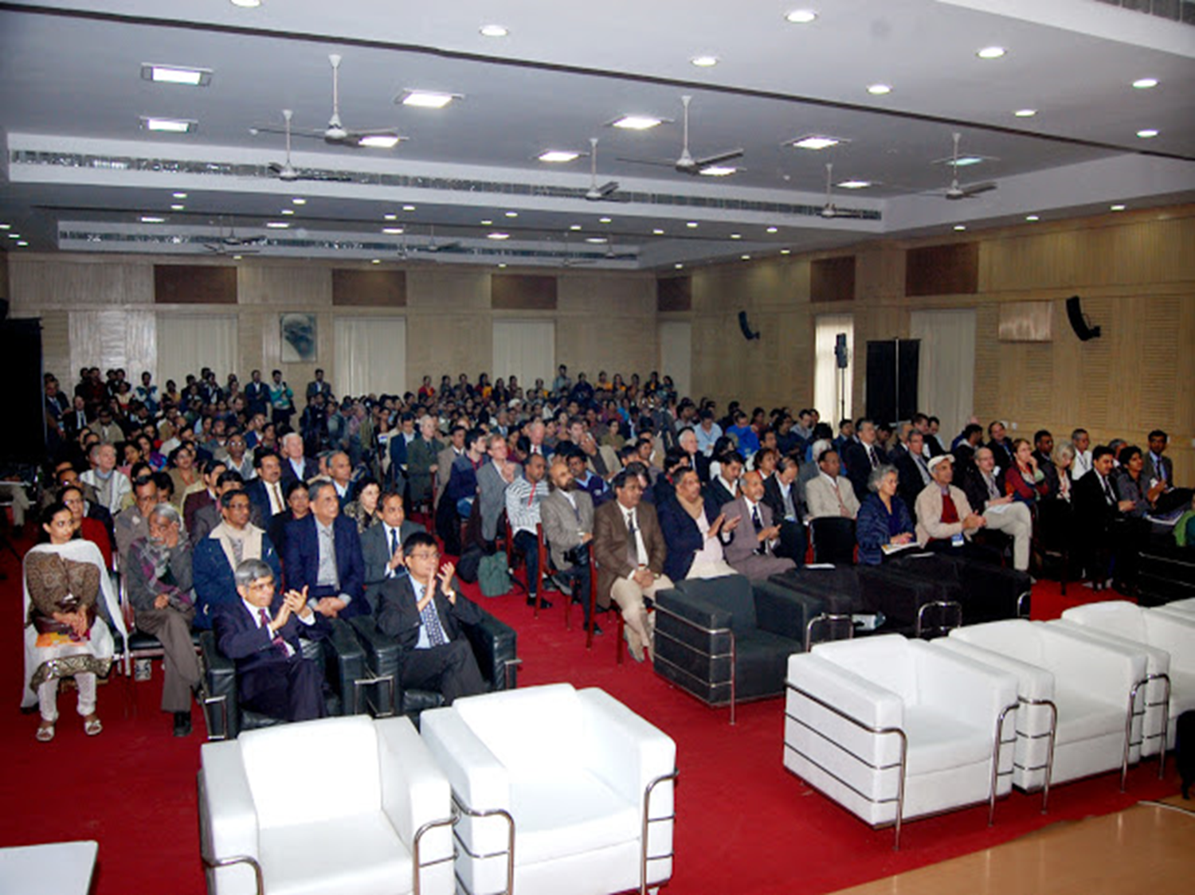
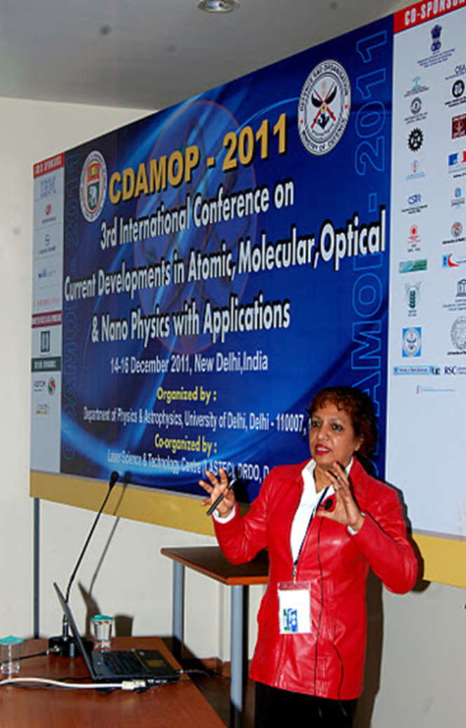
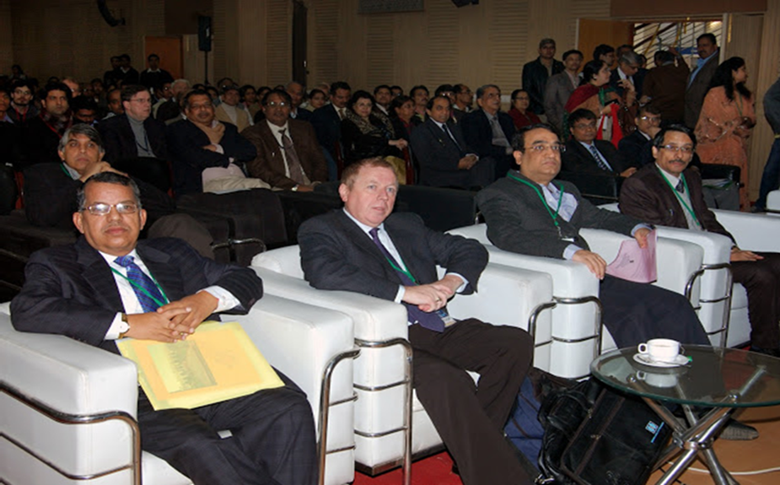
Dr. Sultana
Addressing
the conference
CDAMP – 2011
3rd International Conference on
Current Devolvement in Atomic,
Molecular, Optical & Nona Physics
with Application
14-16 December 2011,
New Delhi, India

Slide 28

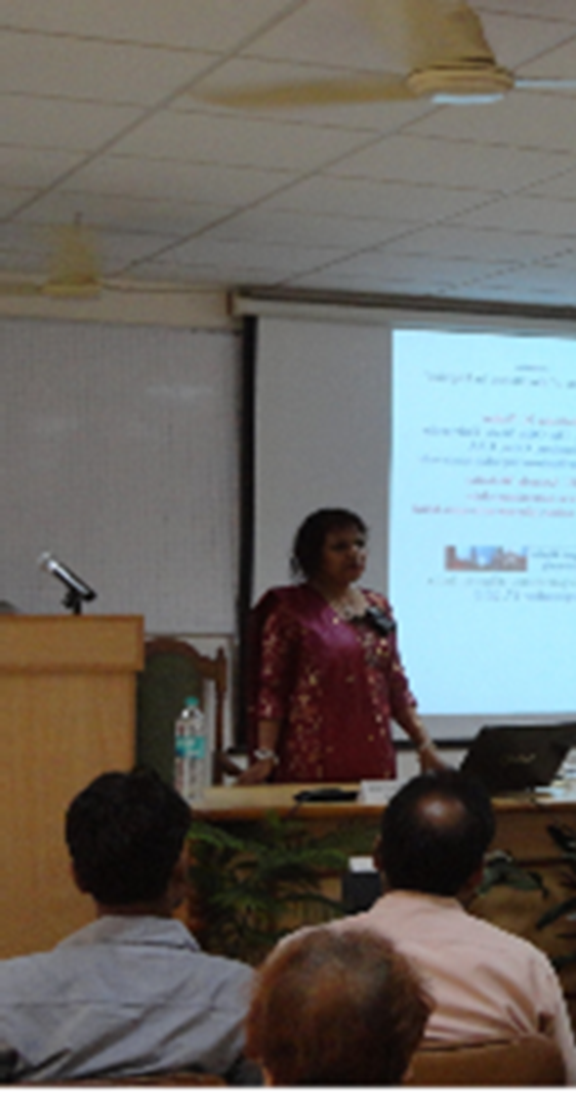
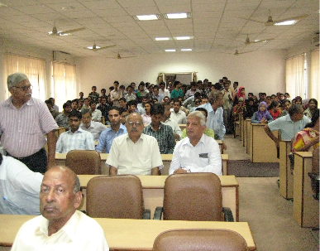
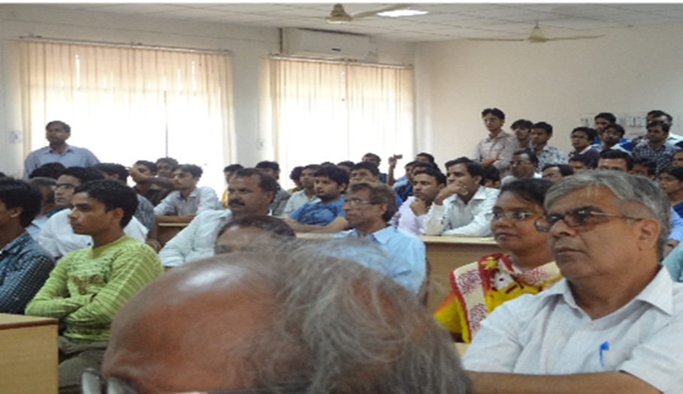

Slide 29

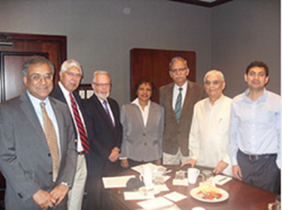
Notes:
<number>

Slide 30
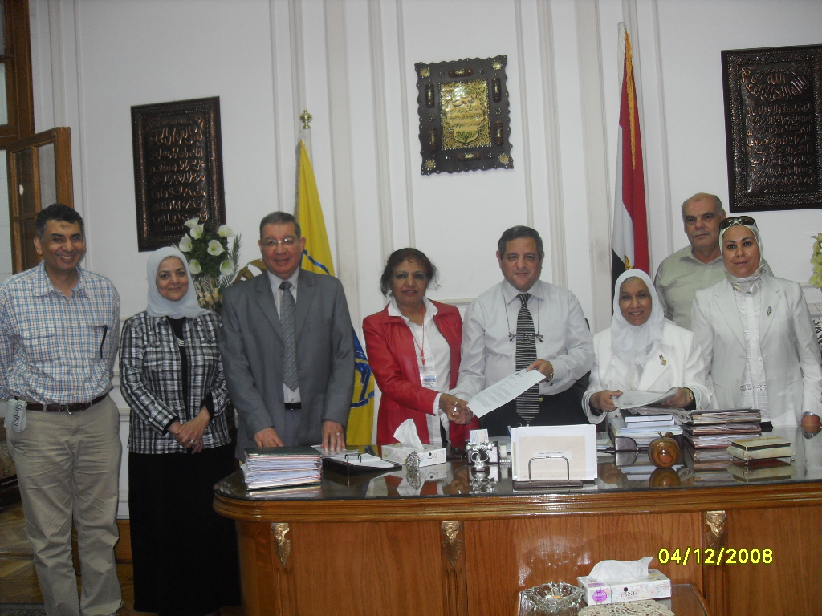

STEM PROGRAM FOR EDUCATION AND RESEARCH:
TEACHERS AND STUDENTS PRIZES IN PHYSICS
At CAIRO UNIVERSITY, Giza, Egypt
Establishment: April 12, 2012
STEM PROGRAM FOR EDUCATION AND RESEARCH:
TEACHERS AND STUDENTS PRIZES IN PHYSICS
At CAIRO UNIVERSITY, Giza, Egypt
Establishment: April 12, 2012
Founder: Dr. Sultana N. Nahar

Slide 31
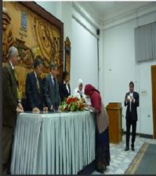
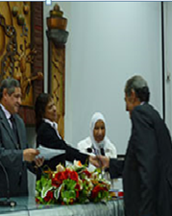

Slide 32
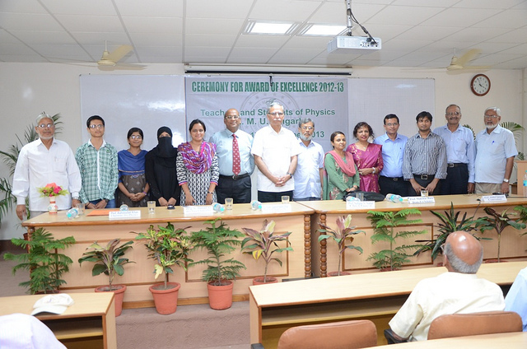
Dr. Sultana Nurun Nahar along with Vice Chancellor
of Aligarh Muslim University with the award winners.

Slide 33
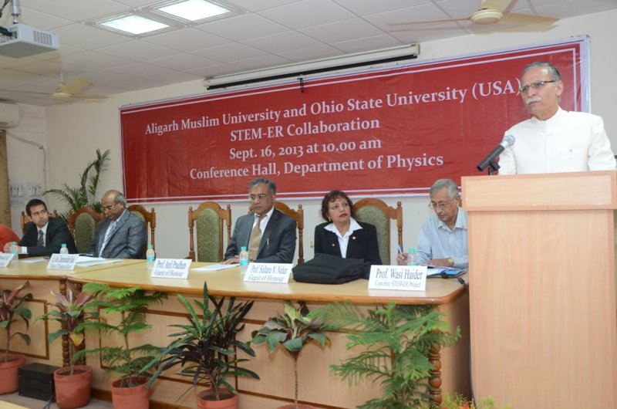
The Ohio State University (USA) and the Aligarh Muslim University has jointly
started One of the largest of research project STEM-ER.
(Science, Technology, Engineering Mathematics
Education Through Researh ).

Slide 34
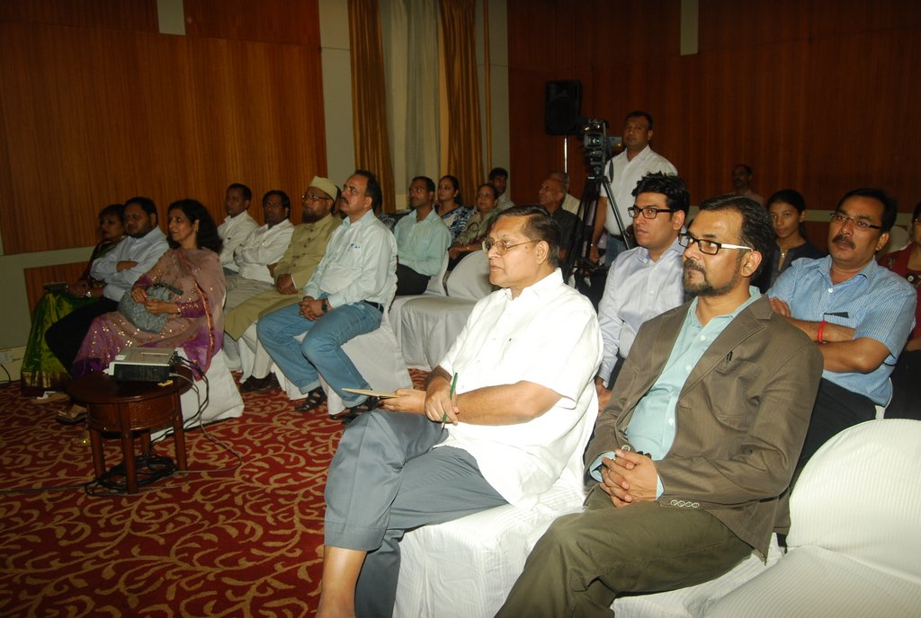
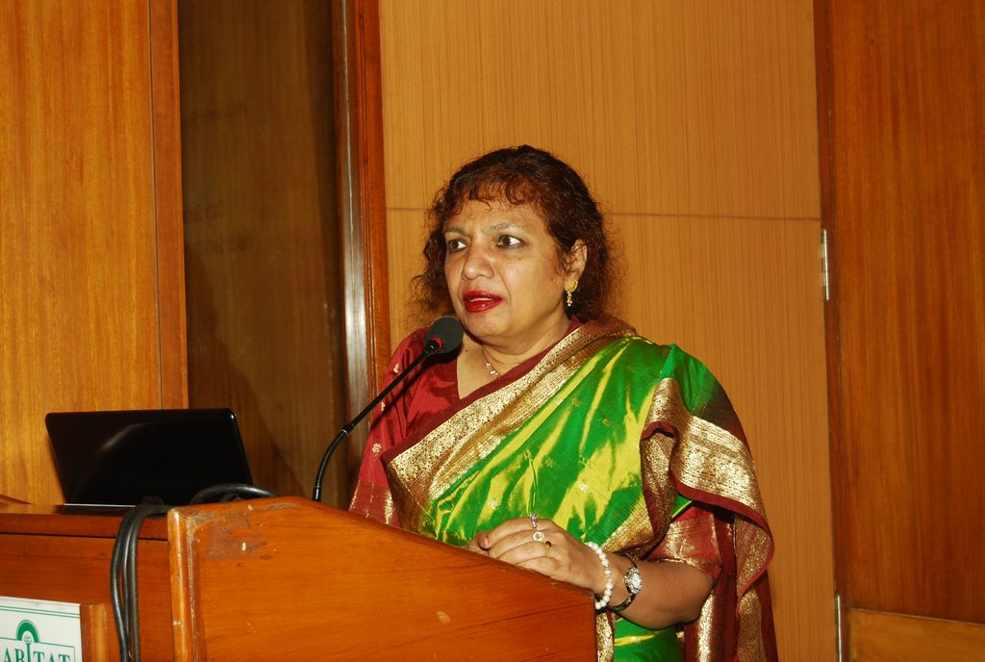
Dr. Nahar is addressing to distinguished scholars from various universities in an event in Delhi,
She informed about “THE STEM-FACULTYPROJECT:
Training the Next Generation of STEM Faculty at Higher
Educational Institutions in India.

Slide 35

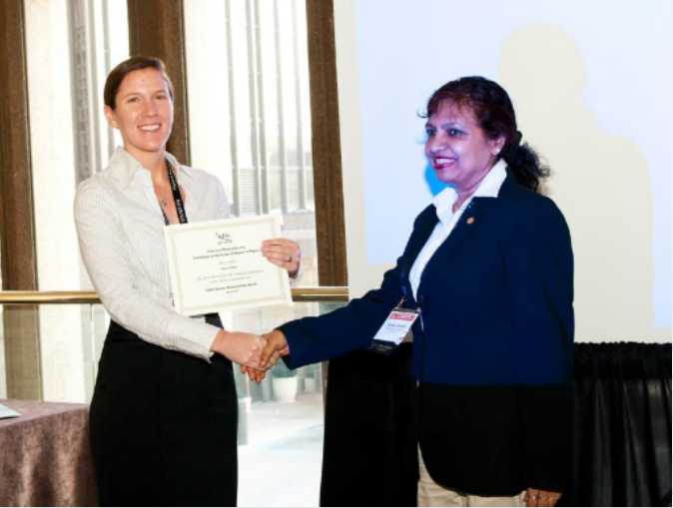

Slide 36



Slide 37
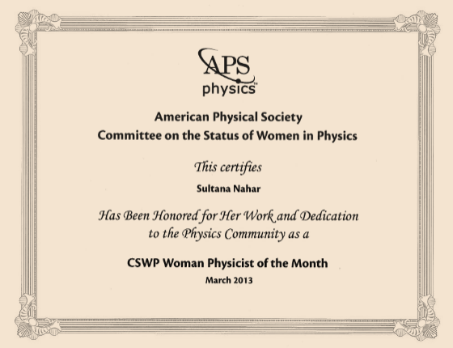

Slide 38
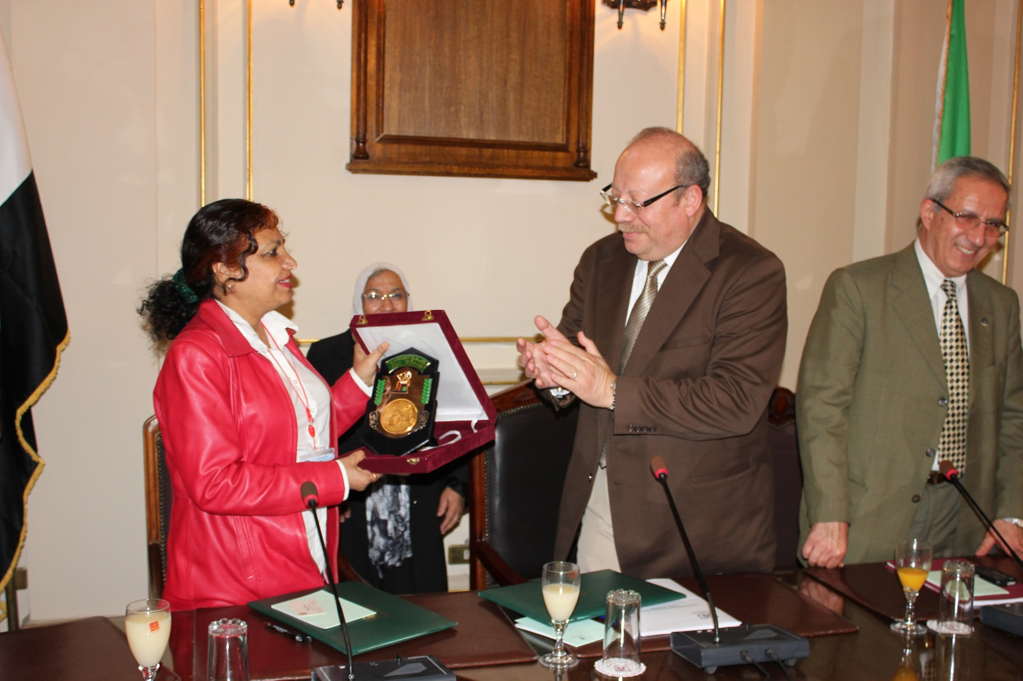
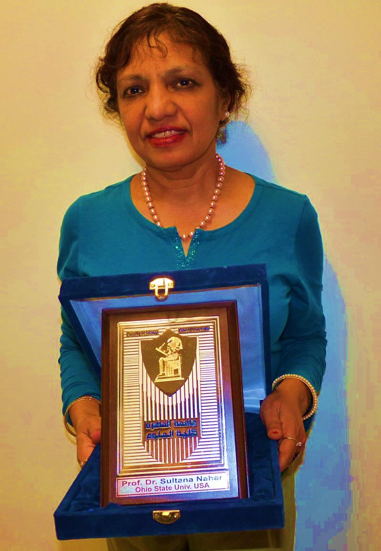
Receives Shield Award from Cairo University for all research related activities , Egypt
On March o2, 2012
Shield of Faculty of Science
Cairo University

Slide 39
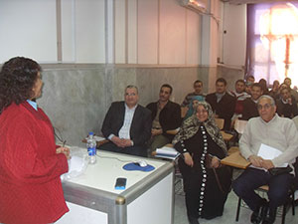
Course lecture in Cairo Univers

Slide 40
