Slide 1


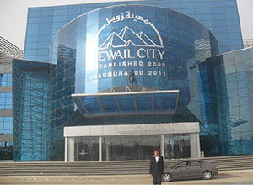
After seminar presentation at the ZEWAIL CITY of Science and Technology, CAIRO, EGYPT
Notes:
<number>

Slide 2


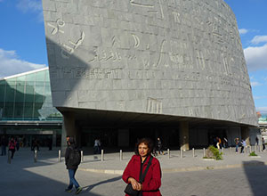

Slide 3


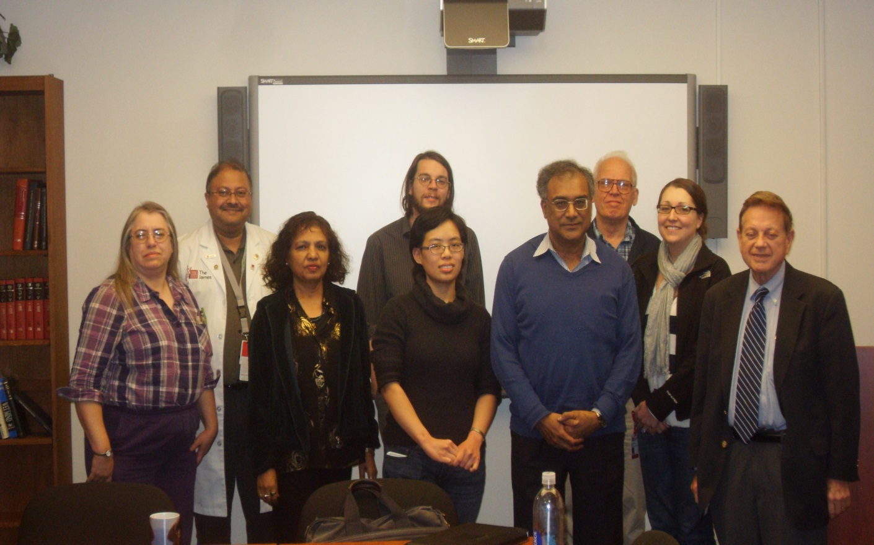

Slide 4

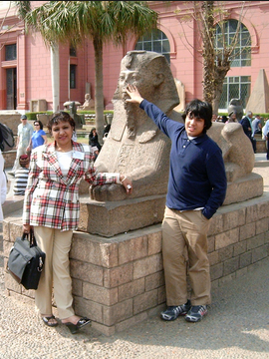

Sphinx at Egyptian Museum,Sultana and son Alburuj

Slide 5


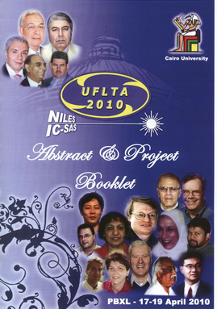

Slide 6
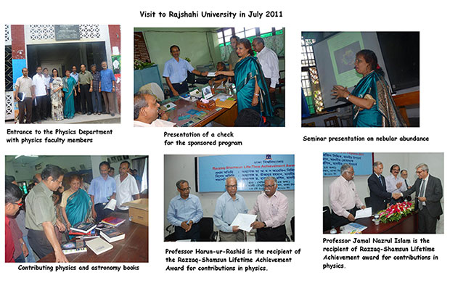
Dr. Sultana has published many scientific books and articles on her field; She donates valuable scientific books to the Colleges and UniversitiesIn Bangladesh, India and Arab Countries.

Slide 8
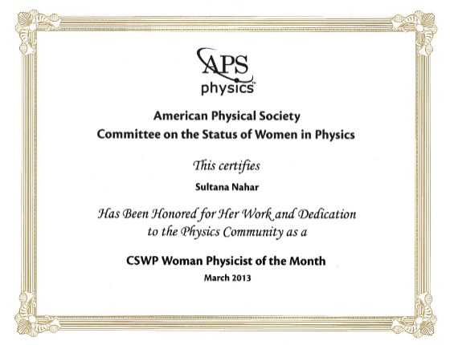



Slide 9

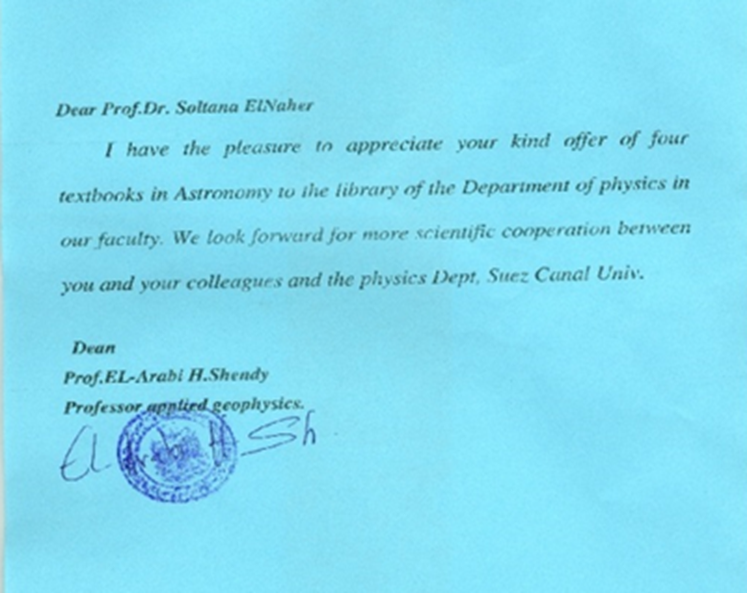



Slide 10
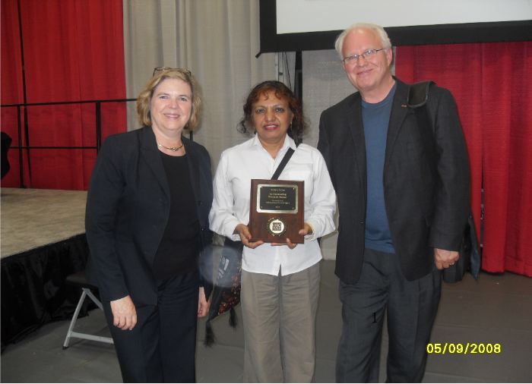
Outstanding Research Mentor Award, The Ohio State University

Slide 11
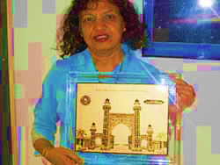
Dr. Sultana Nahar receives the prestigious Bab-e-Syed
Aligarh Muslim University memento symbolizing the
gate to the knowledge learning place with the line
of knowledge being spread worldwide like rain.

Slide 12
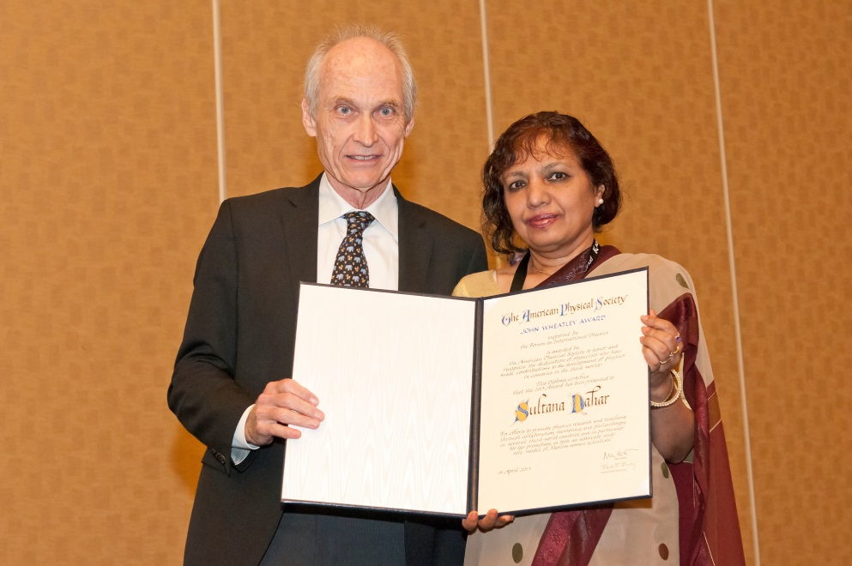
Certificate from the President of American Physical Society (APS) in 2013,
For her contribution in advancement of physical science and
as a role model Muslim Woman Scientist.

Slide 13

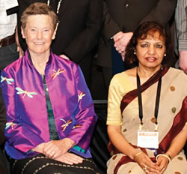


Slide 14
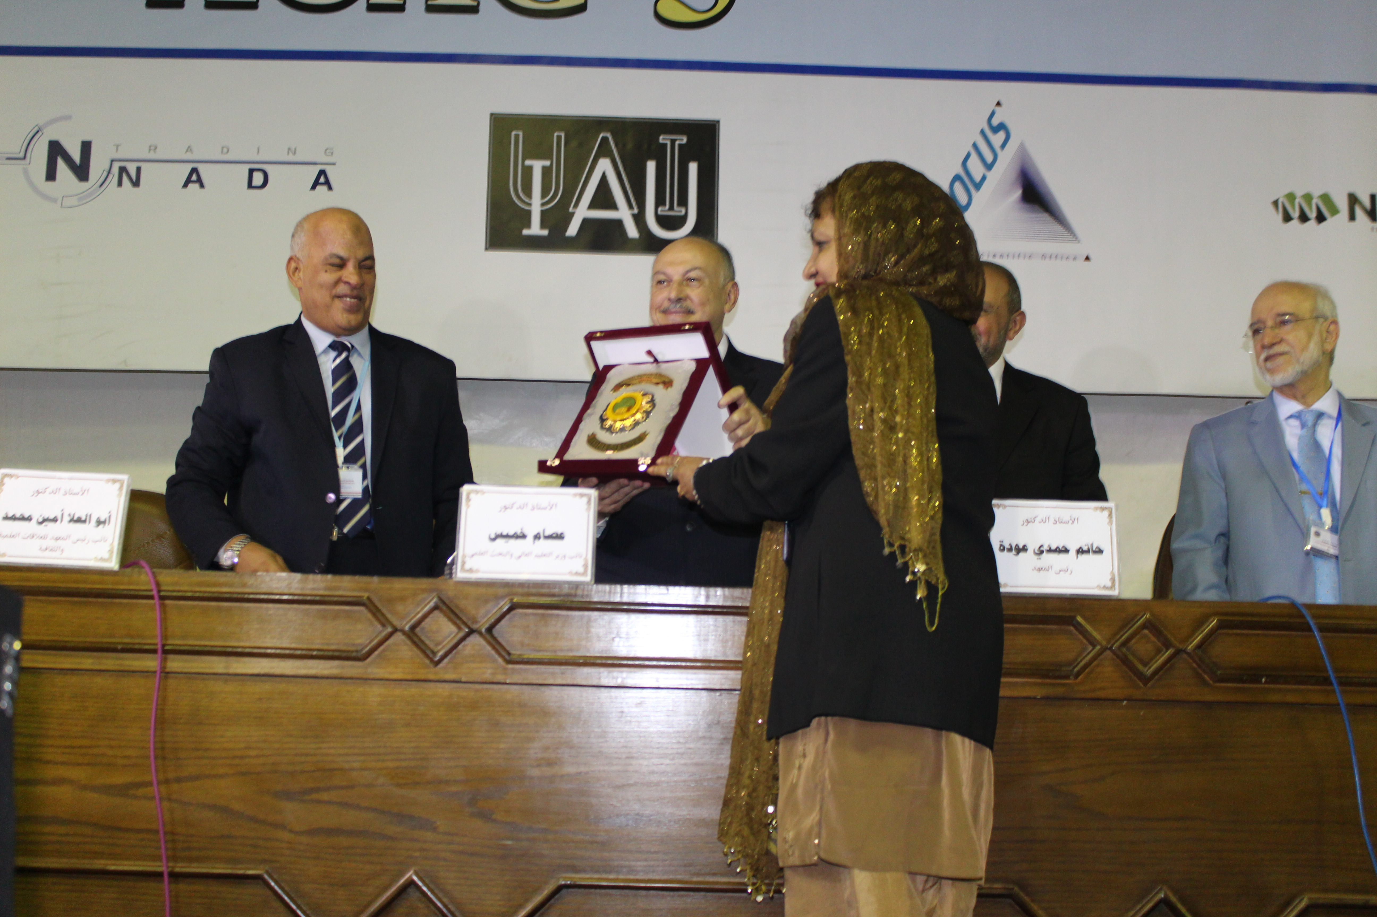
Recieved the Guest of Honor medal, Arab Conference in Astronomy and Geophysics

Slide 15
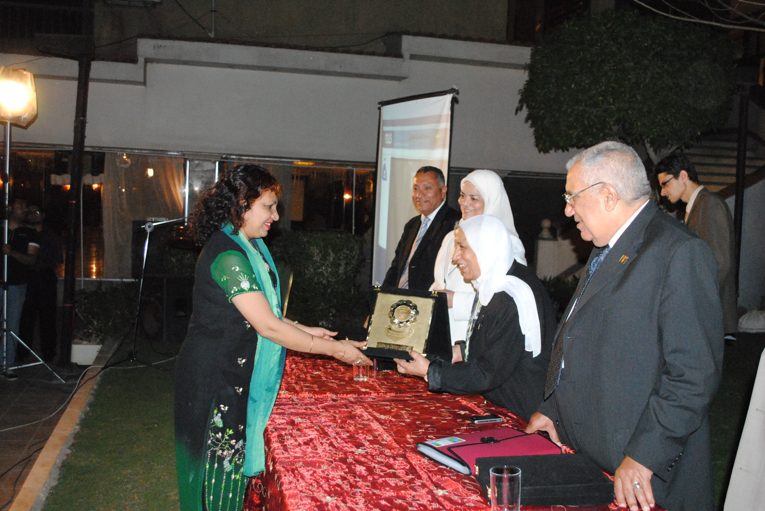
Highest Honor Gold Medal of Topical Society of Laser Sciences

Slide 16
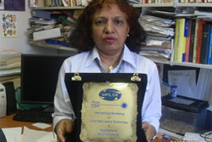
Dr. Nahar received “Shield of Ultrafast Laser Technologies and Applications (UFLTA),” award.
From The National Institute of Laser Enhanced Sciences in Egypt.

Slide 17

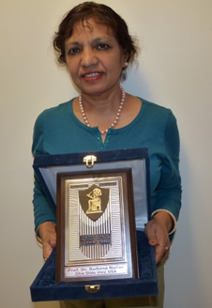

Slide 18
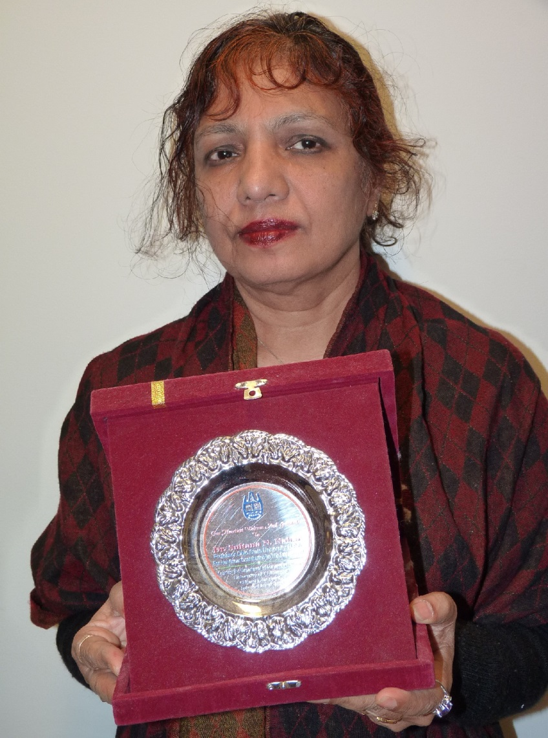
Chittagong, Bangladesh

Slide 19

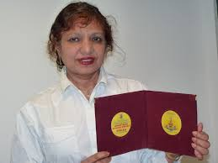
Recognition with monogram of “Modern Trends in Physics Research”

Slide 20
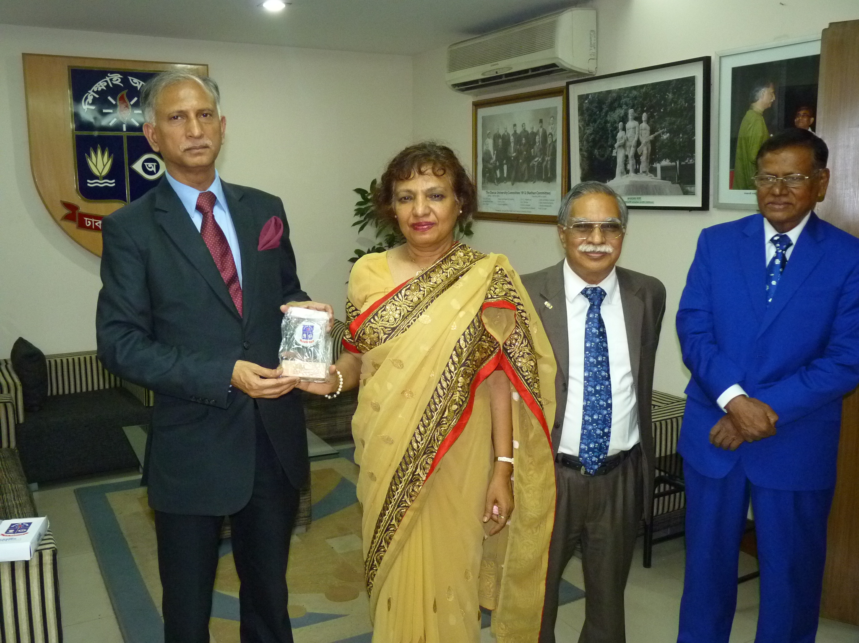
Received certificate and Medal of Dhaka University for promoting science research and education in whole Bangladesh, VC of Dhaka University

Slide 21
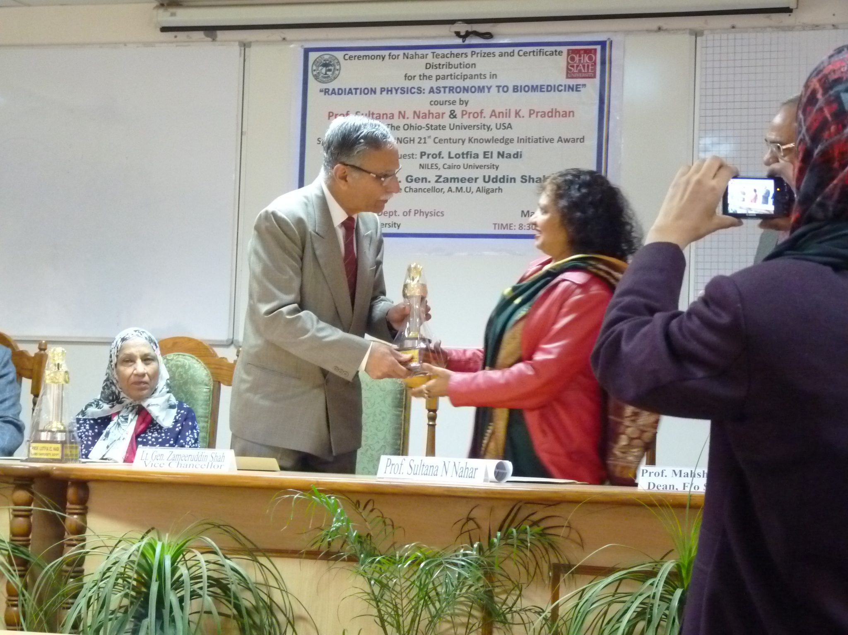
Indian National Emblem Trophy, VC of Aligarh Muslim University

Slide 22
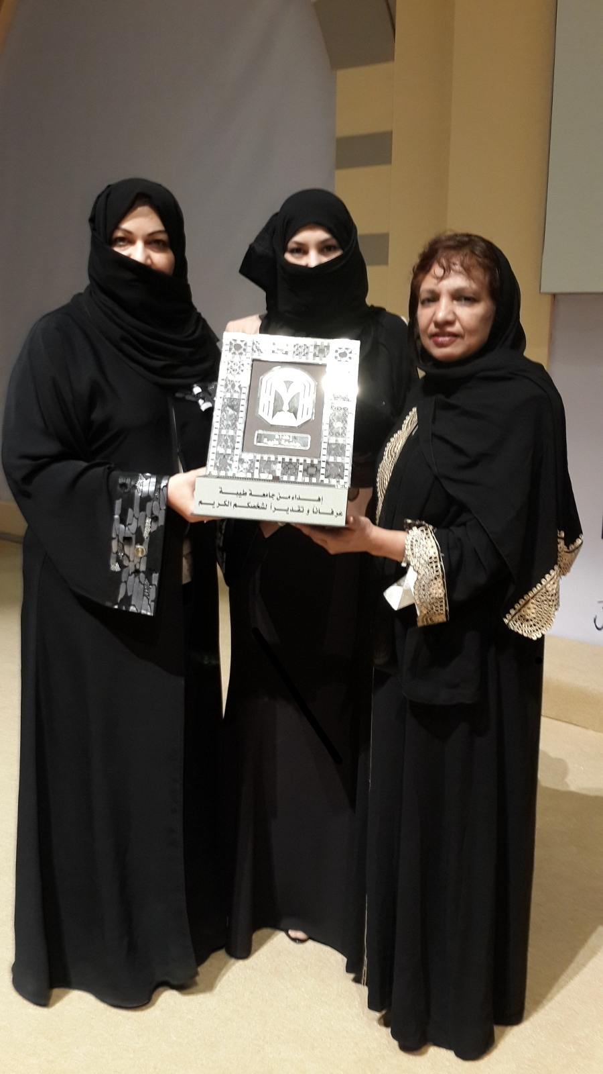
Monogram Trophy, President of Taibah University, Saudi Arabia

Slide 23
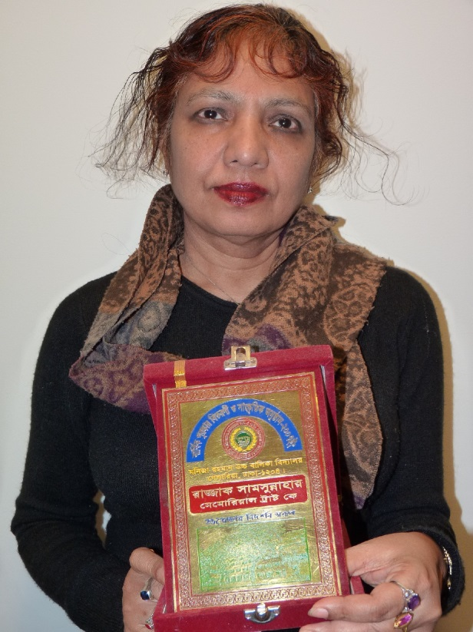
Plaque given by Maniza Rahman Girls High School for establishing Teachers awards

Slide 24

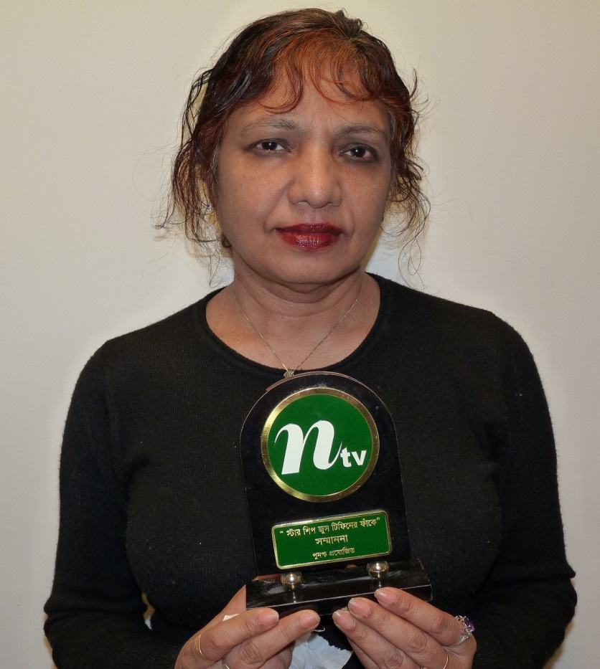
Successful Scientist Recognition by educational program “Tiffiner Faake” of N-TV, Bangladesh

Slide 25
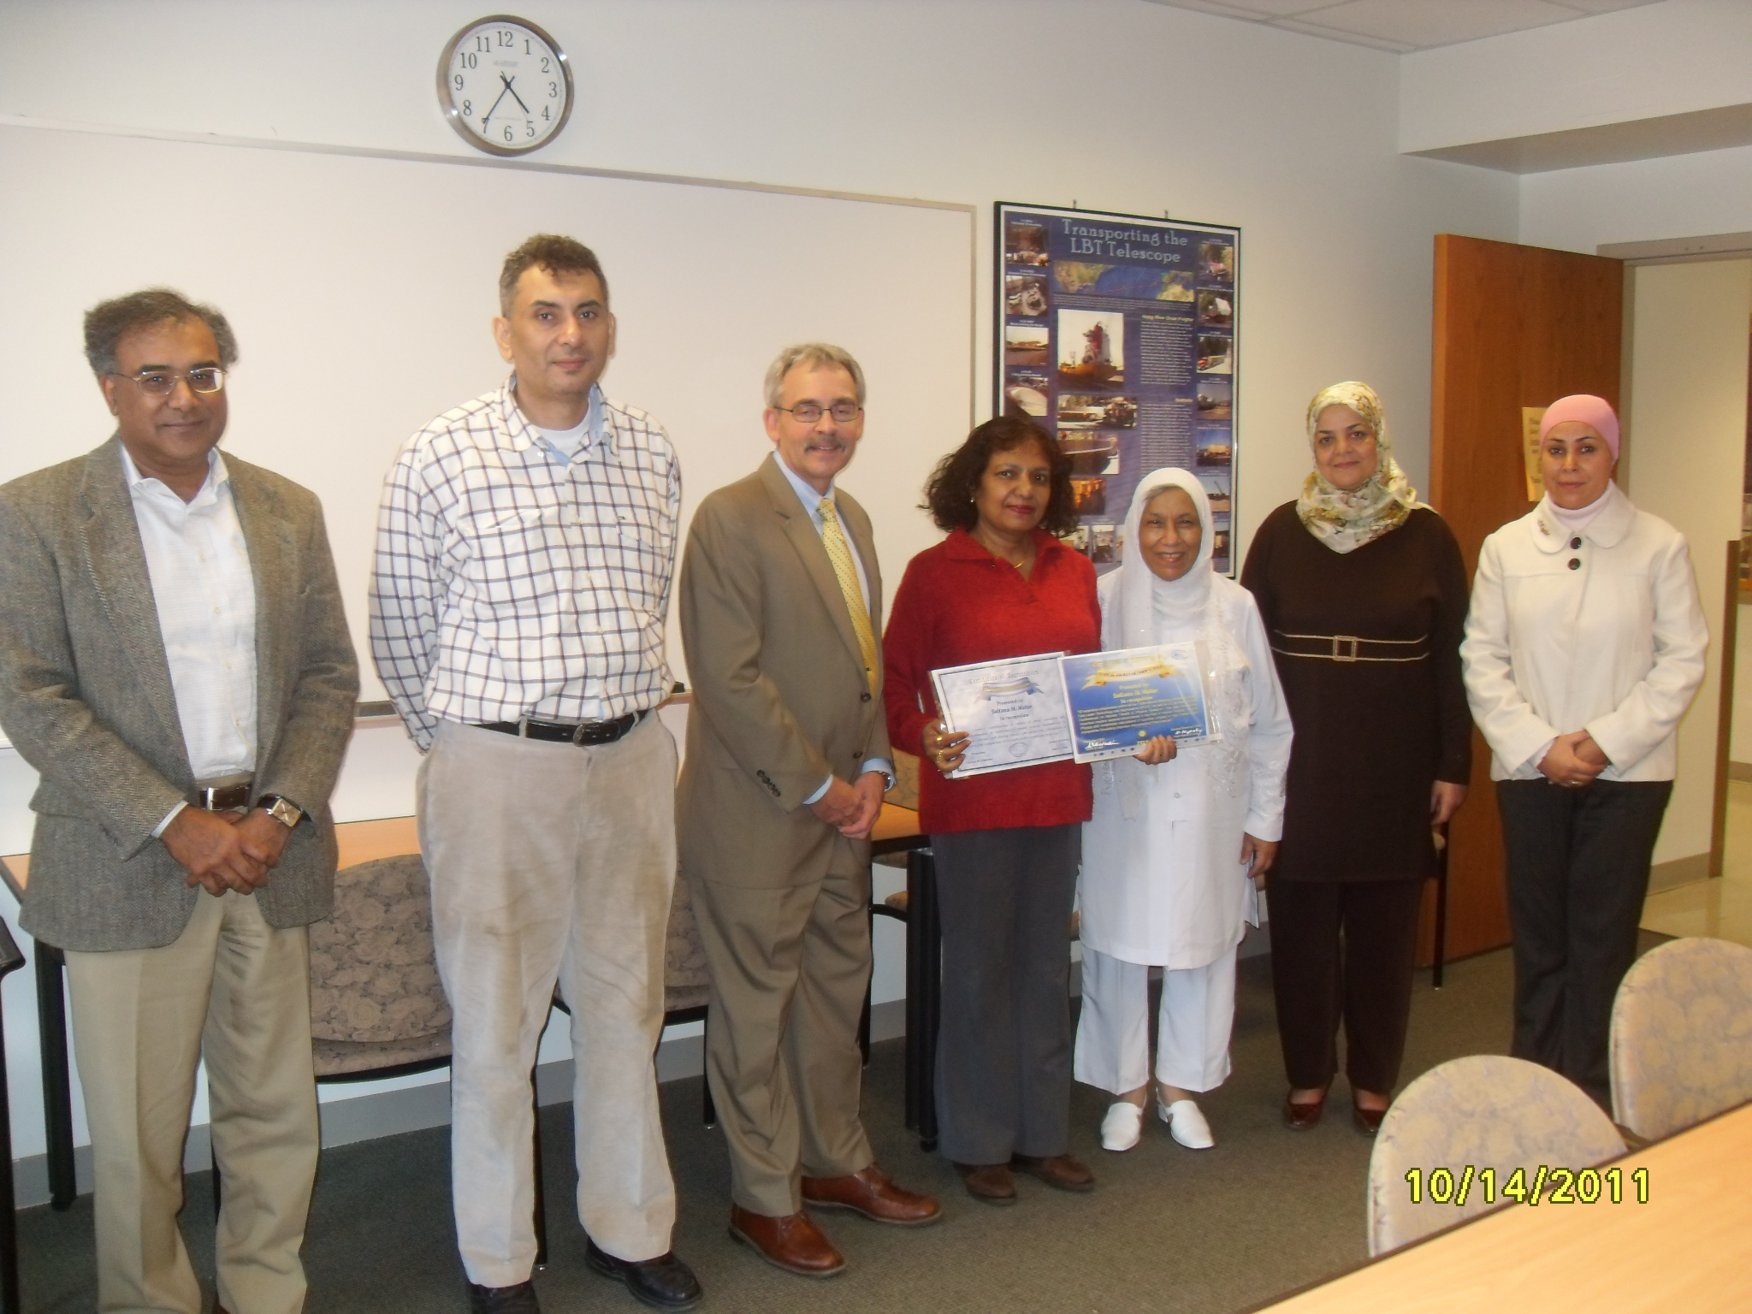
Recognition from Egyptian Physical Society and Topical Society of Laser Sciences

Slide 26
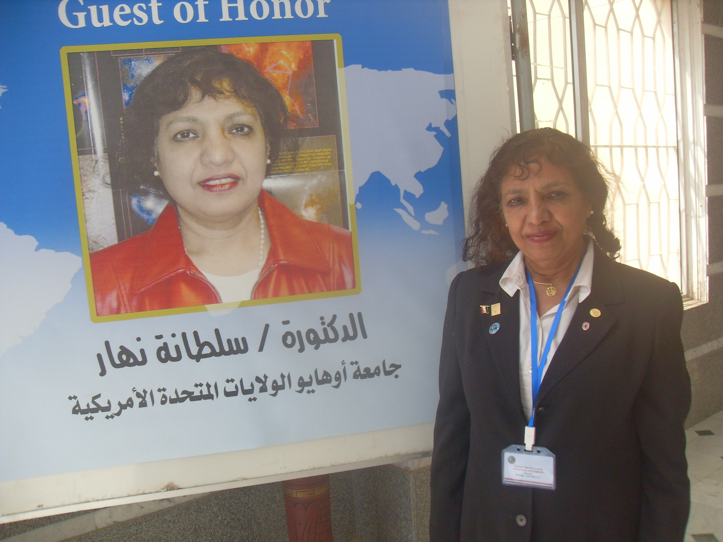
First female Guest of Honor in the Arab Conference on Astronomy and Geophysics (ACAG)

Slide 27
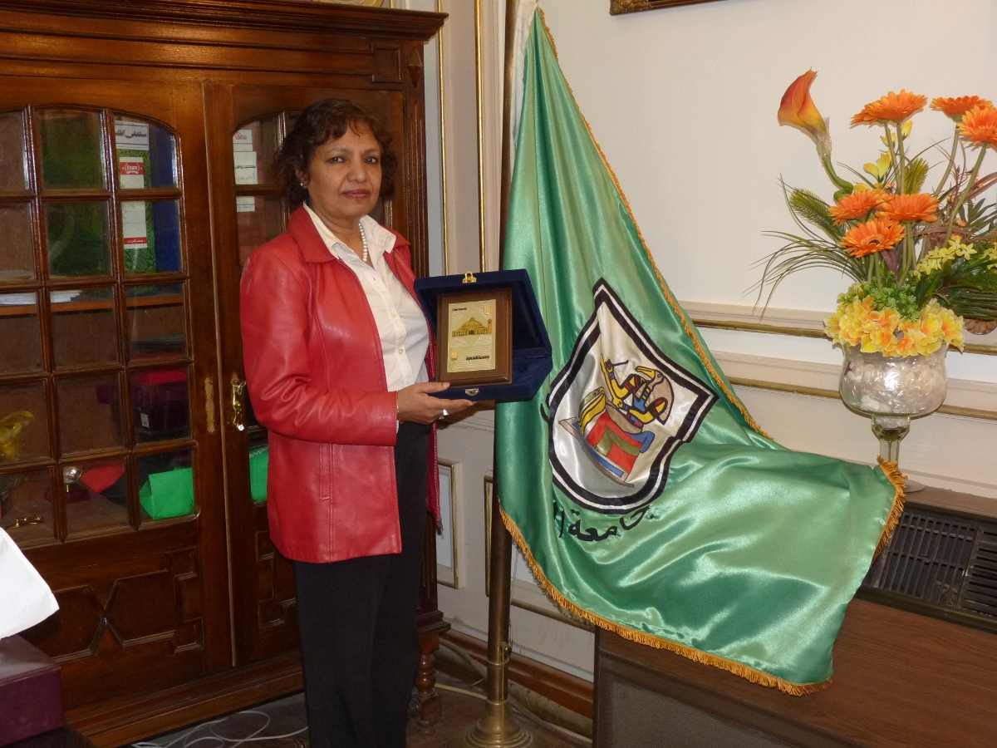
Highest honor Golden Dome plaque, President of Cairo University

Slide 28
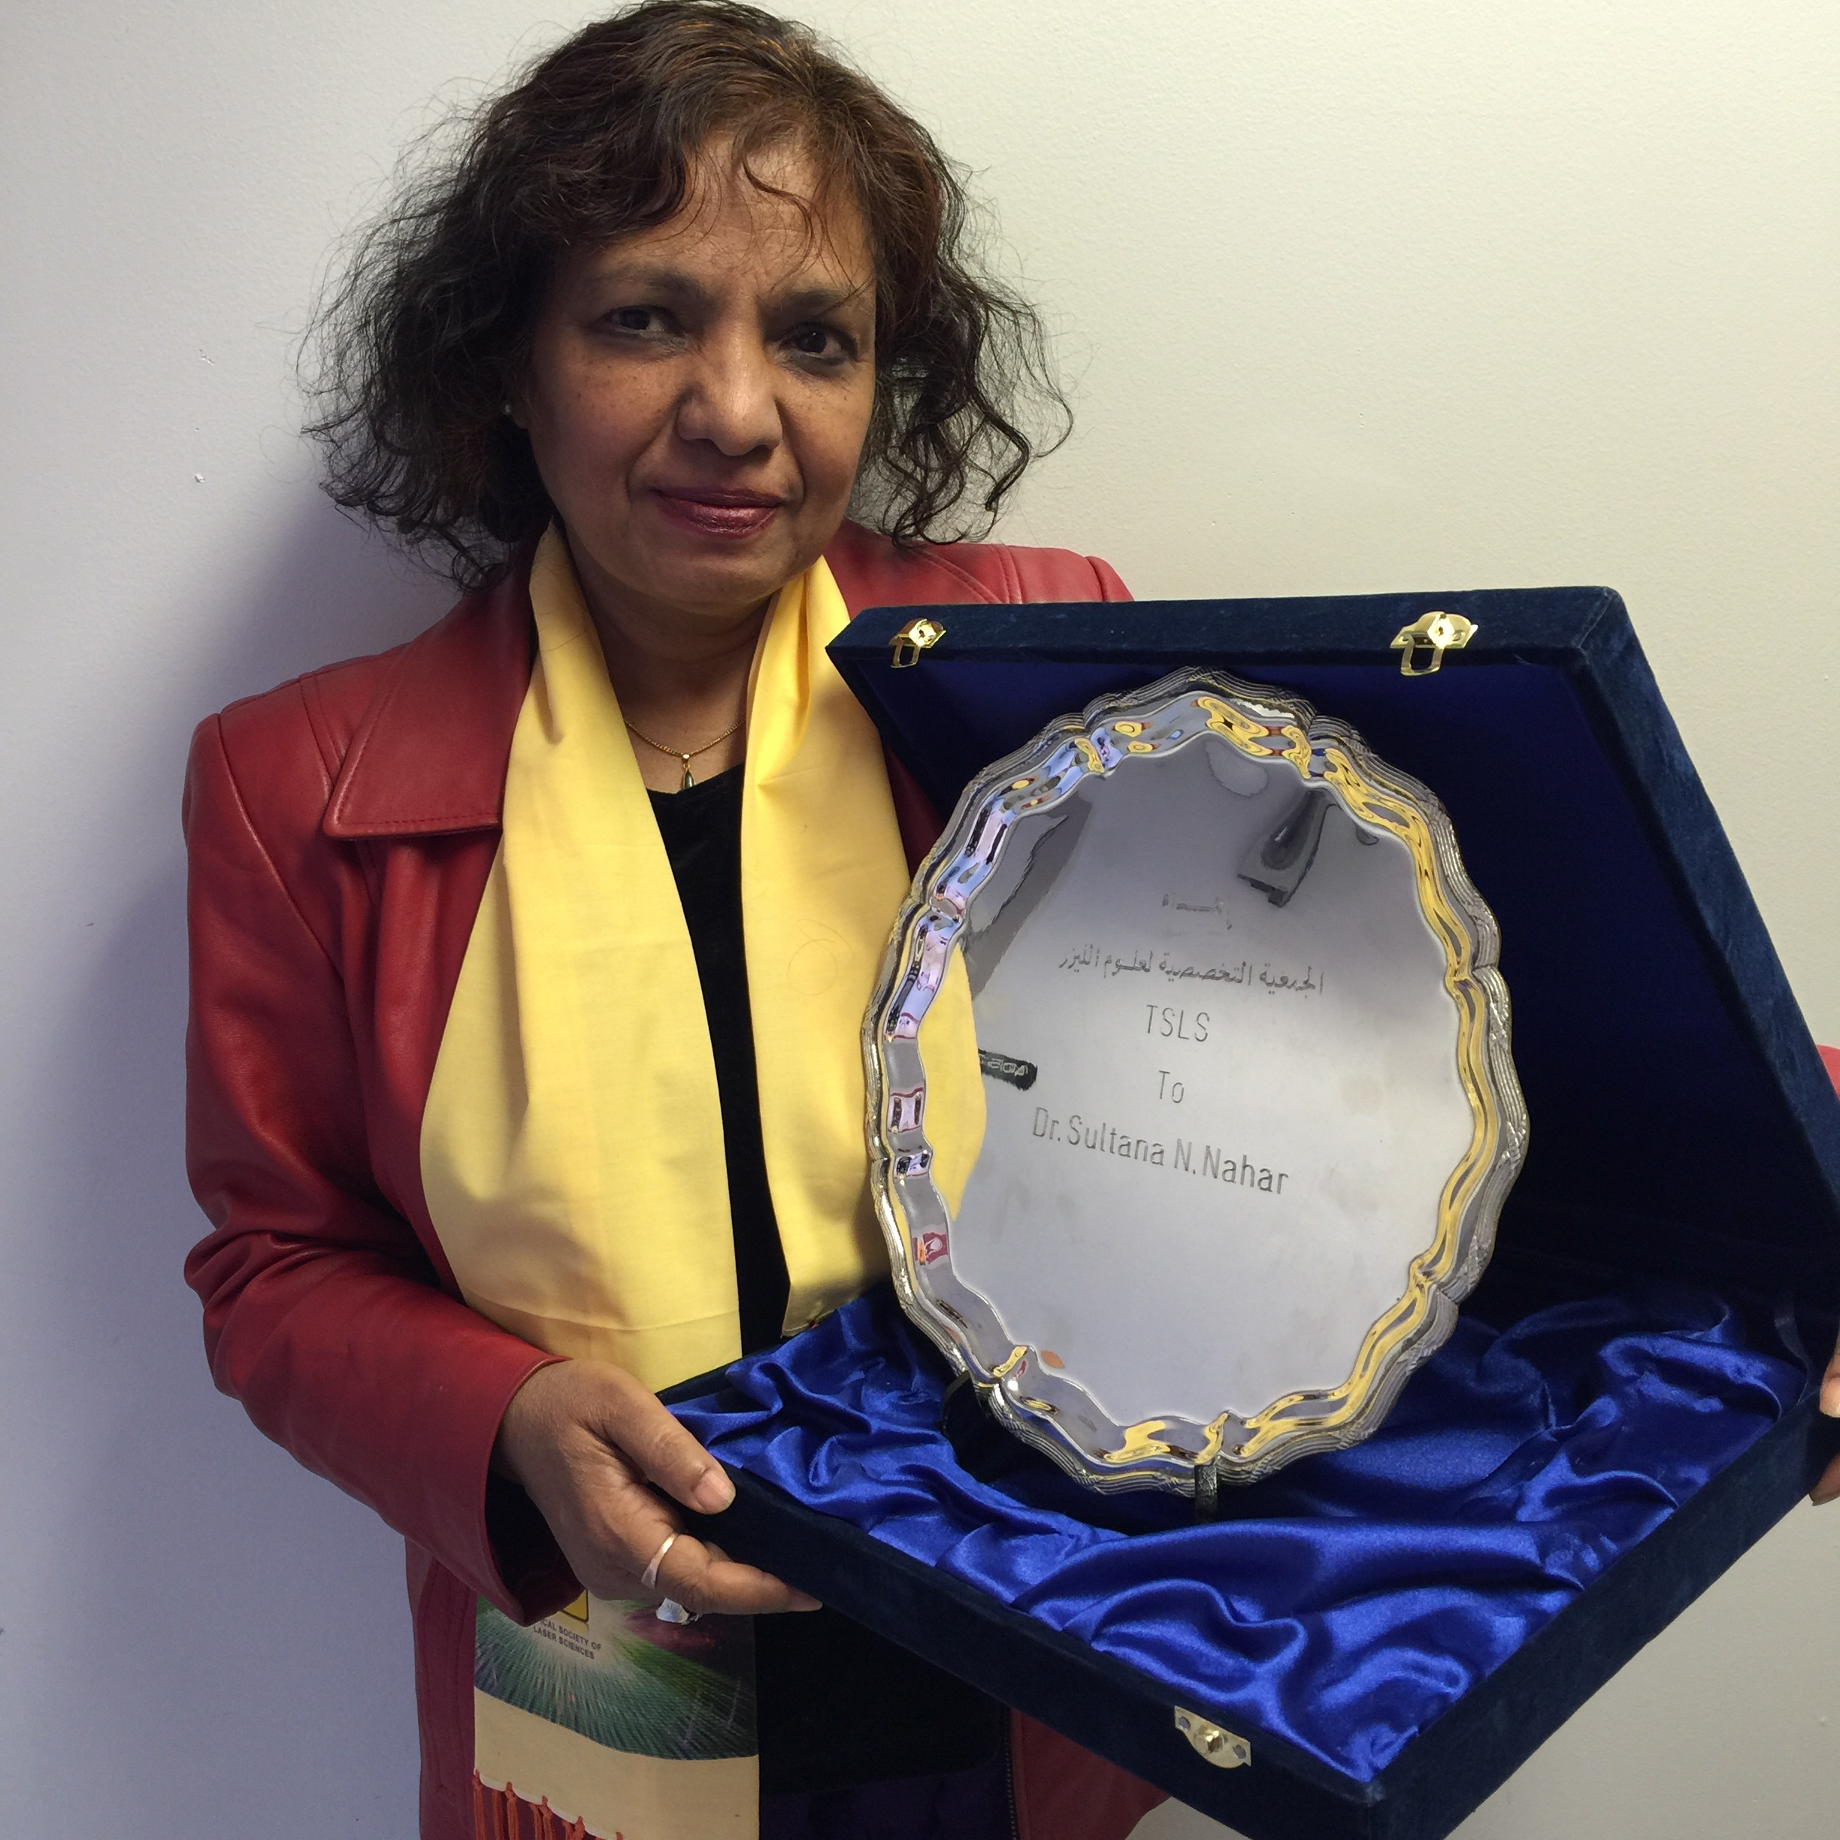
International Year of Light 2015 Recognition for contributions in atom-radiation interaction, Topical Society of Laser Sciences

Slide 29
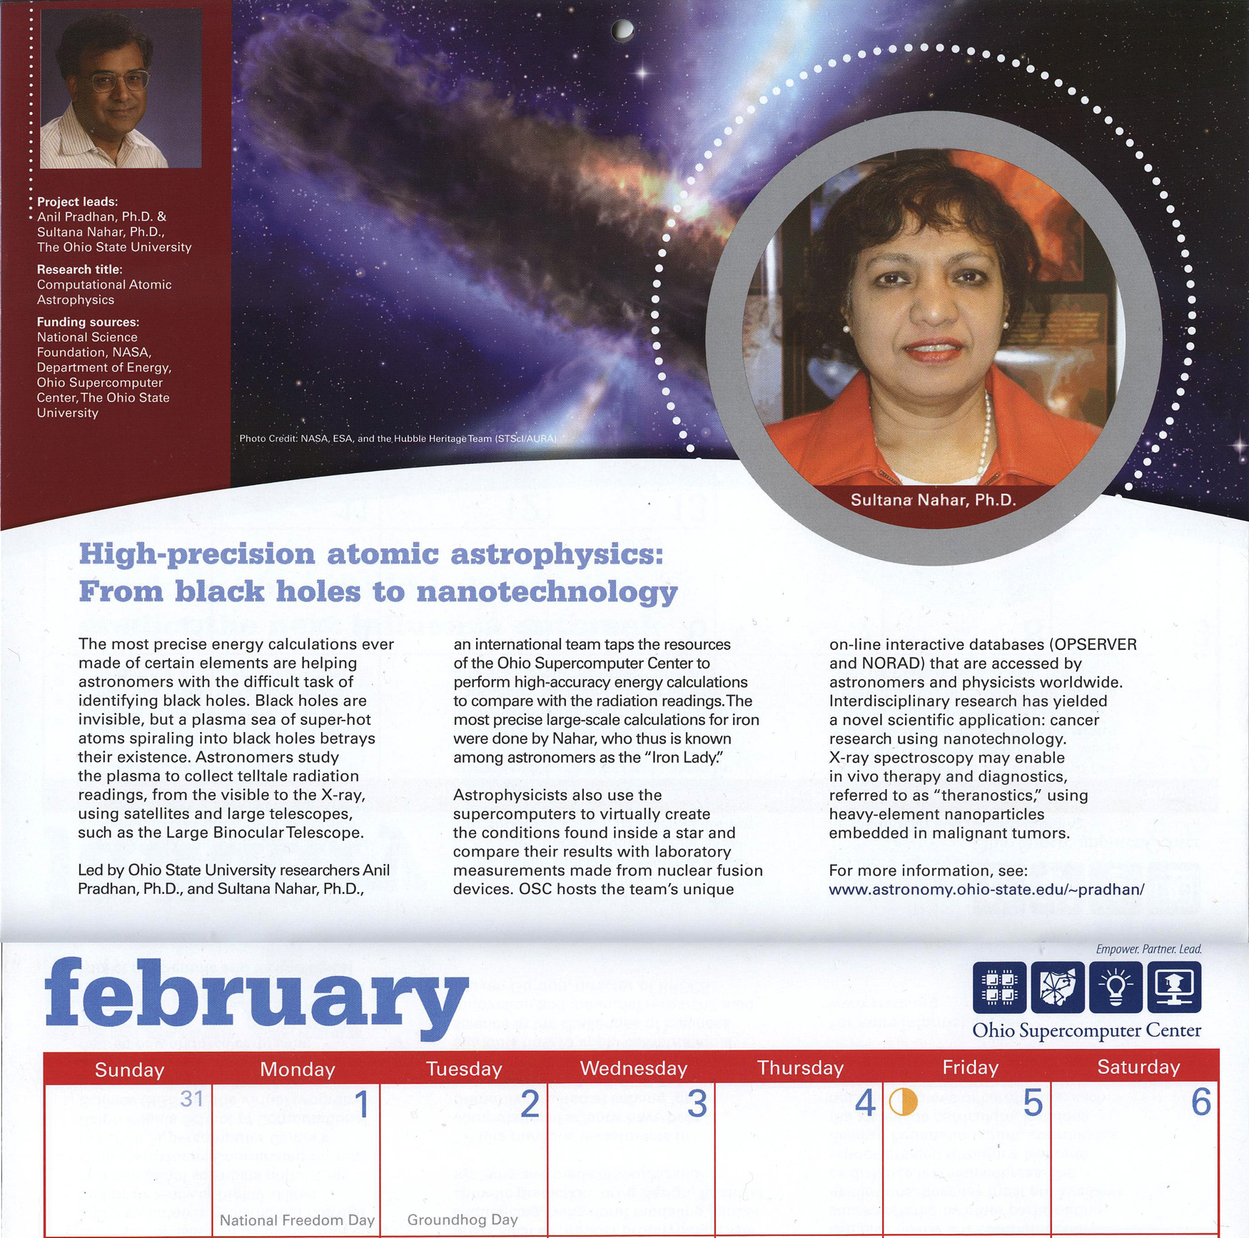
Recognizing one of the12 most remarkable projects, Ohio Supercomputer Center

Slide 30
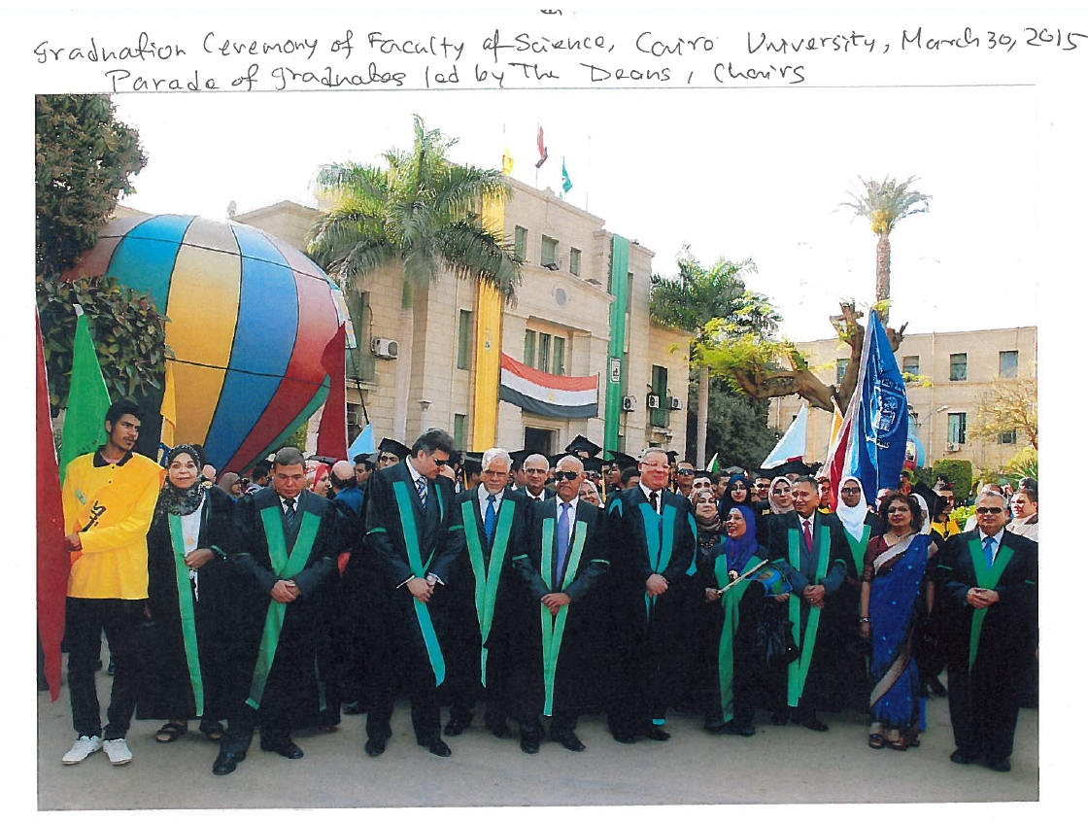
Sultana (only one non-Egyptian) in the Graduation Parade, Cairo University

Slide 31
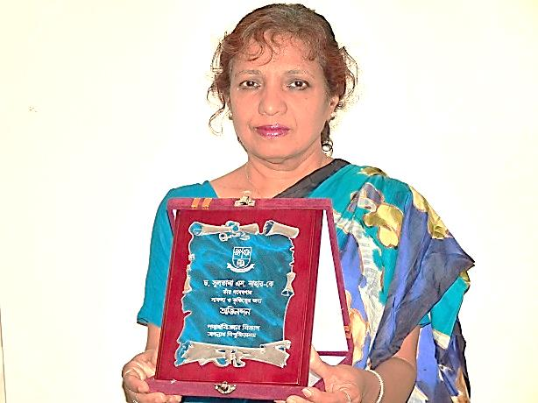
Recognition for scientific contributios, VC of Jagannath University, Bangladesh

Slide 32
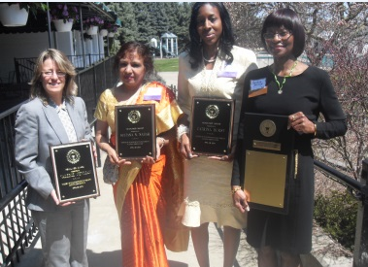
Headliner Award, Women Alumni Association of Wayne State University, michigan

Slide 33

To Dr Sultana Nurun Nahar, an Astriphyscist:
From Aligarh Muslim University (AMU), India
More Alig Than Aligs
It is a blessing of Allah(SWT) when some one loves you.
And for every blessing it is mandatory to thank
our Lord Most High.
Dr. Sultana N. Nahar did not study at AMU.
But she came to the Physics Department of AMU’.
She instituted two prizes for bright minority students
of the Physics Department - one boy and one girl.
She also gave about a dozen astronomy books
of excellent production and academic quality
to the Seminar Library of the same department,
including one of her own books.
Thank you Dr. Sultana Nurun Nahar
You are an Inspiration
Wednesday, December 14, 2011

Slide 34

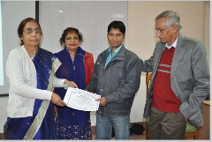

Slide 35


Sultana explains importance of science and what it can do. After such a speech in a village school, that she supports, students raised their hands at her question who wanted to be a scientist.

Slide 36


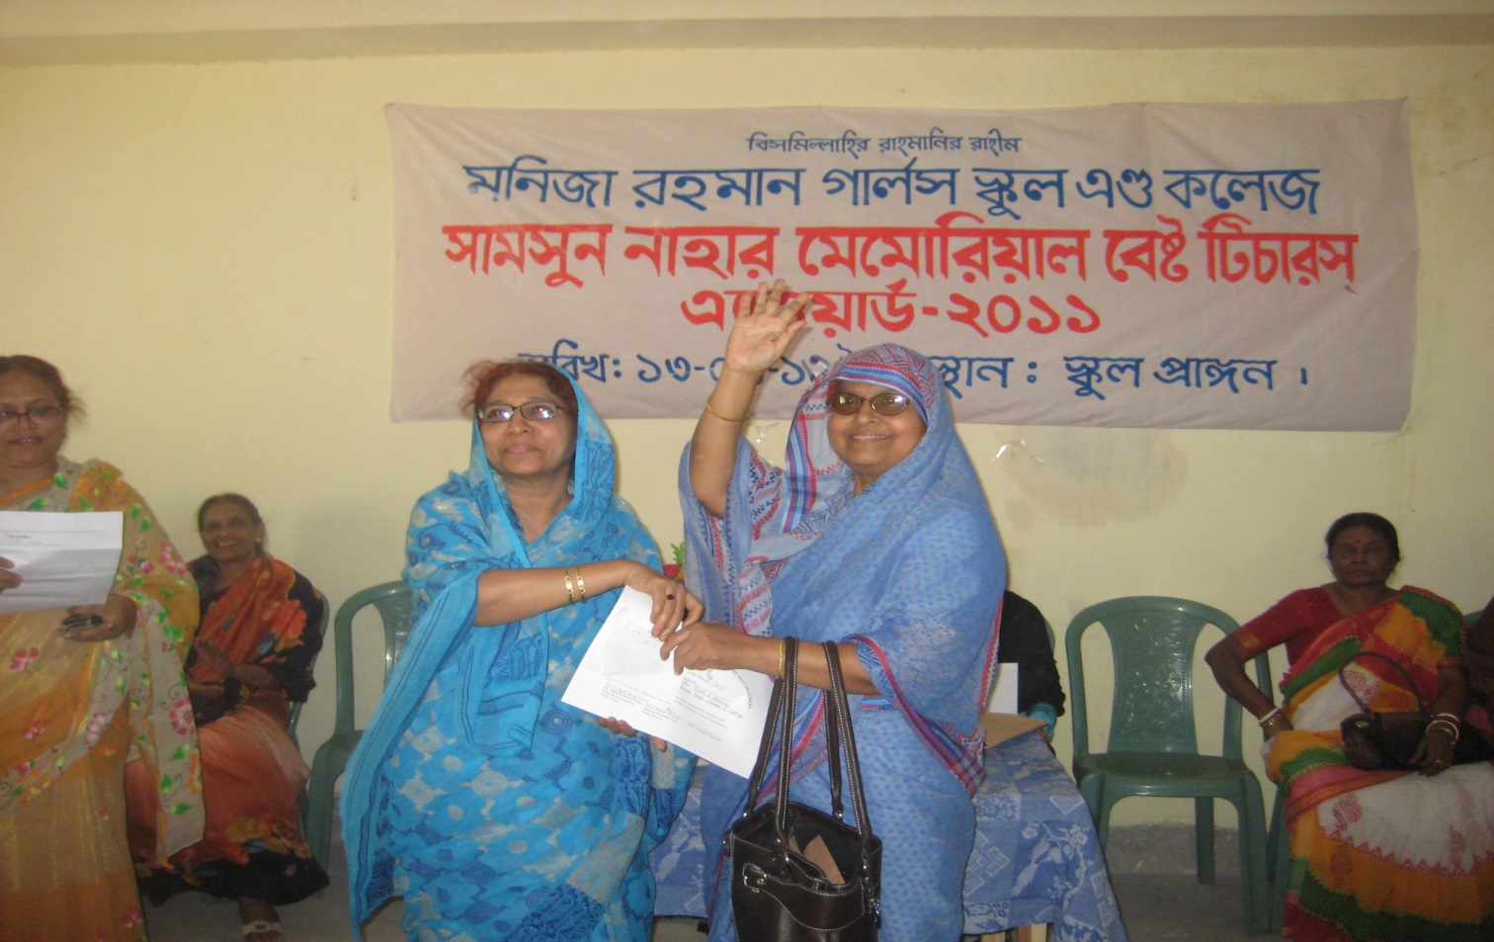
Best teacher award established by Sultana Nahar

Slide 37

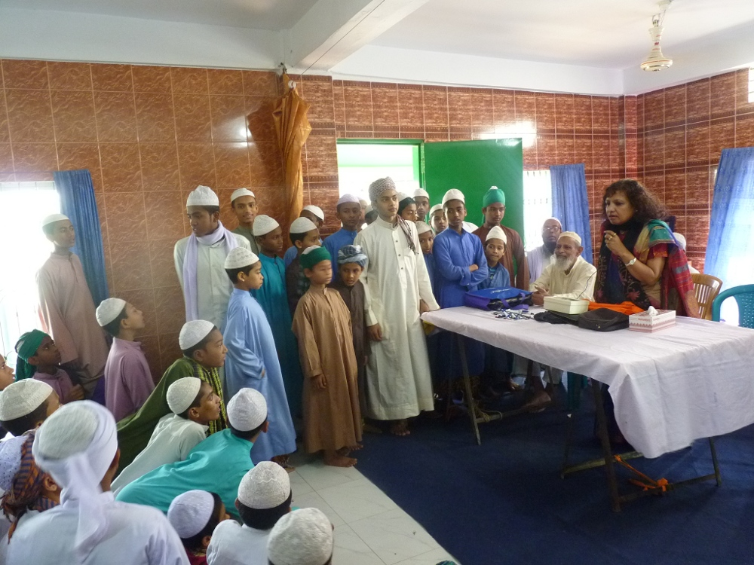
Sultana giving speech to students in the madrasa that she supports

Slide 38
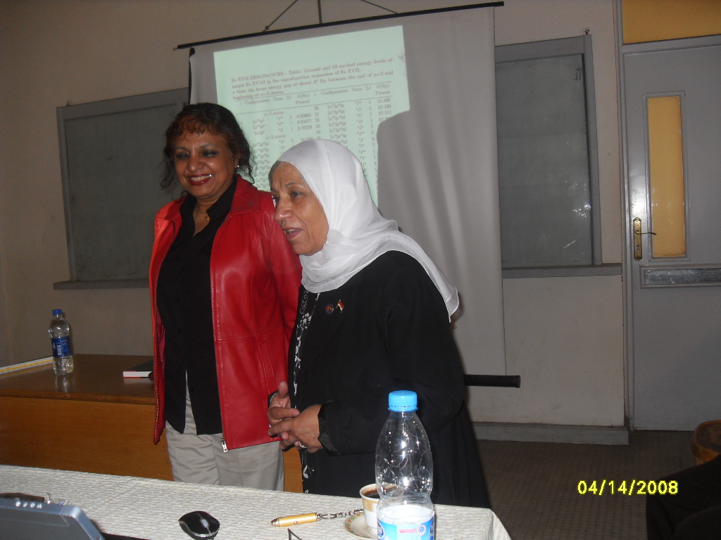
Dr. Sultana Nahar Ohio State University, and Dr. Lotfia El nadi, Cairo University,
Both of them are founder of
INTERNATIONAL SOCIETY OF ARAB WOMEN IN SCIENCE (ISAWS).
Dr. Sultana is founding president and its members are from more than 7 countries.

Slide 39
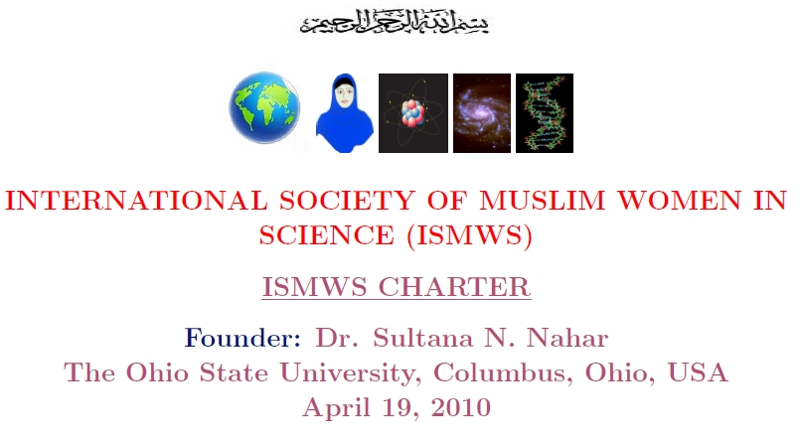
Sultana is the founder of International Society of Muslim Women in Science (ISMWS). It has members from 27 countries

Slide 40


Slide 41
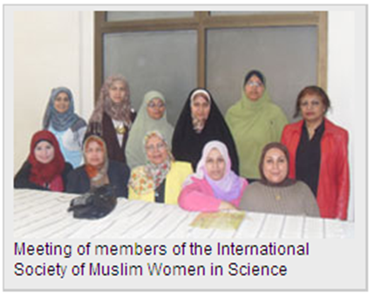
Members Meeting of International
Societyof Muslim Women in Science

Slide 42
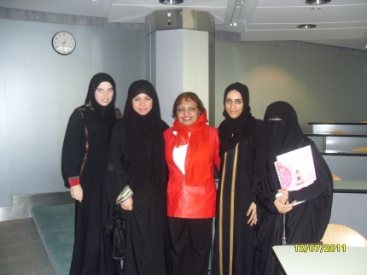
Al Ain, United Arab Emirate, Dec. 07, 2011
With Members International Society of Muslim Women in Science

Slide 43

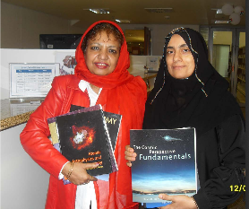

Slide 44


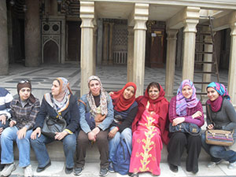
ISMWS members at the palace of Sultan
Qalauun complex, Cairo, Egypt

Slide 45



Slide 46

Dr. Sultana Nurun Nahar is in the list of “Pioneer Women in Bangladesh” for being the First Bangladeshi Woman Astronautic Scientist.

