Slide 1
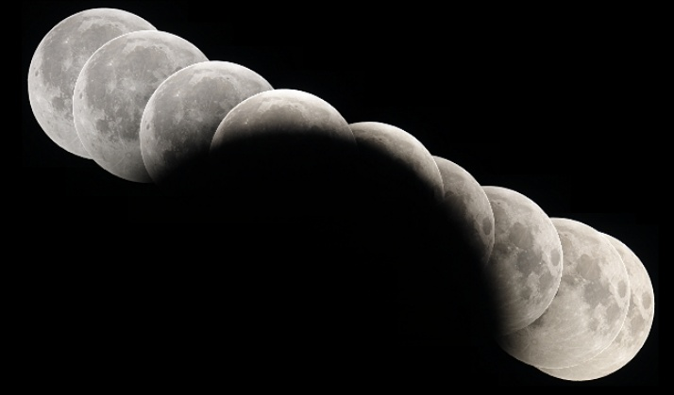
Composite Image
© Anthony Ayiomamitis

Slide 2
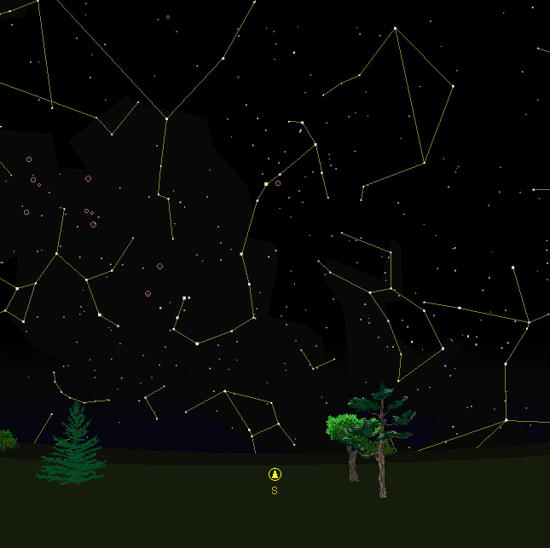
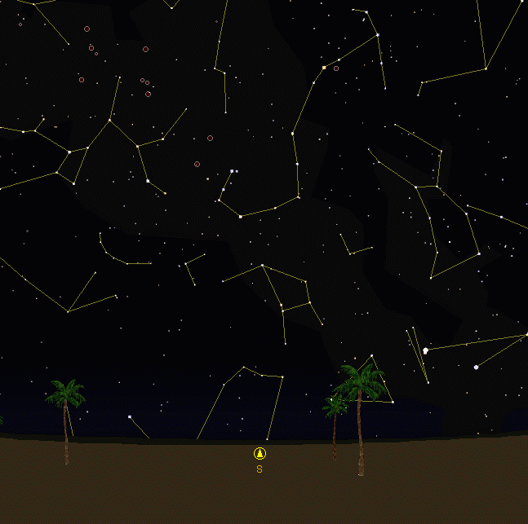
View from Athens Greece
View from Syene Egypt
Scorpius
Scorpius
Latitude: 38º N
Latitude: 24º N

Slide 3



Scorpius
Scorpius is
low in the sky
Scorpius is
high in the sky
Both see Scorpius high in the sky

Slide 4
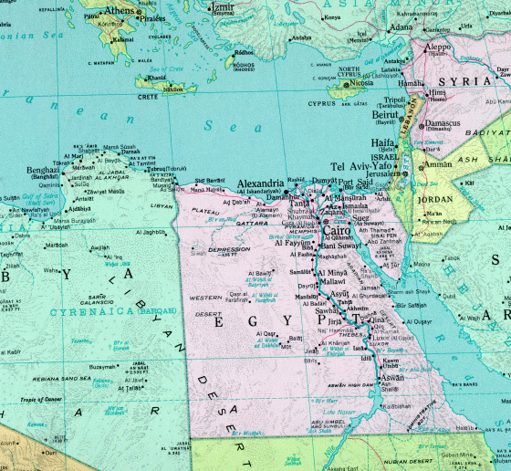
Cyrene
Alexandria
Syene
Tropic of Cancer

Slide 5
7 ¹⁴/₆₀º
Sunlight
Alexandria
Syene
Earth

Slide 6
North Pole
Equator
South Pole

Slide 7
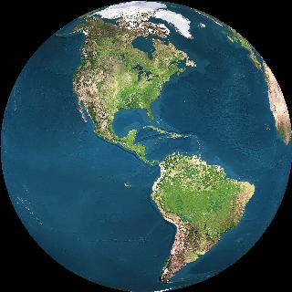
North Pole
Equator
South Pole

Slide 8
North Pole
Meridian
Equator
South Pole

Slide 9
North Pole
Meridian
Equator
South Pole

Slide 10
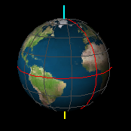
North Celestial Pole
Celestial
Sphere
Celestial
Equator
South Celestial Pole

Slide 11
NCP
Declination
CEq
Celestial
Meridian
SCP

Slide 12
Local Sky
Zenith
W
S
N
Horizon
E

Slide 13
Zenith
Meridian
N
W
E
Horizon
S
Nadir

Slide 14
NCP
Visible Half
of the Sky
Z
N
W
E
S
CEq
Below the
Horizon
SCP

Slide 15
Measuring
Latitude
Zenith
NCP
CEq
W
Latitude
S
N
Horizon
E

Slide 16
Z
NCP
Z
W
NCP
S
N
E
Z
NCP
Equator
North Pole
W
S
N
E
40º N Latitude

Slide 17
Zenith
Above Horizon for > 12^{h}
NCP
Above Horizon
for 12^{h}
Above Horizon
for < 12^{h}
W
Never Sets
S
N
Never Rises
E
CEq

Slide 18
NCP
Ecliptic
CEq
~23.5º
Obliquity of
the Ecliptic
SCP

Slide 19
March: Sun in Pisces
Pisces
Taurus
Aries
Aquarius
Capricorn
Gemini
Sagittarius
Cancer
Scorpius
Leo
Libra
Virgo

Slide 20
June: Sun in Gemini
Pisces
Taurus
Aries
Aquarius
Capricorn
Gemini
Sagittarius
Cancer
Scorpius
Leo
Libra
Virgo

Slide 21
September: Sun in Virgo
Pisces
Aquarius
Taurus
Aries
Capricorn
Gemini
Sagittarius
Cancer
Scorpius
Leo
Libra
Virgo

Slide 22
December: Sun in Sagittarius
Pisces
Aquarius
Taurus
Aries
Capricorn
Gemini
Sagittarius
Cancer
Scorpius
Leo
Libra
Virgo

Slide 23
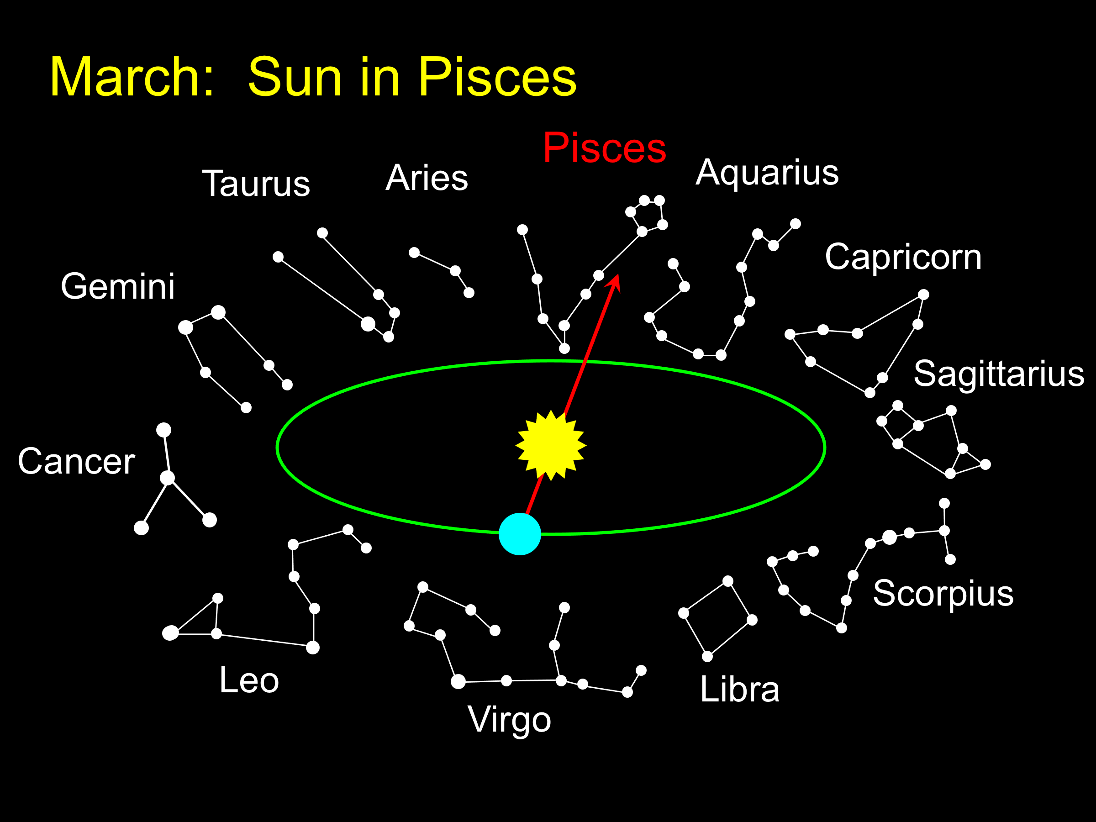
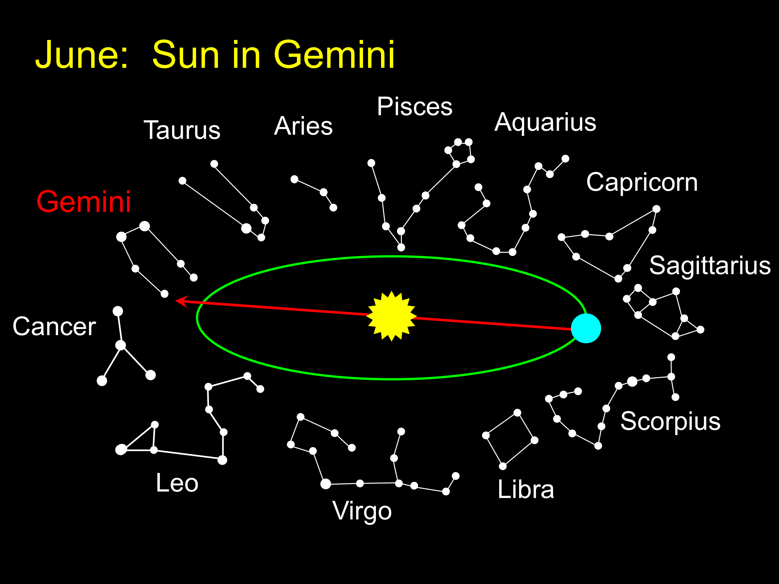
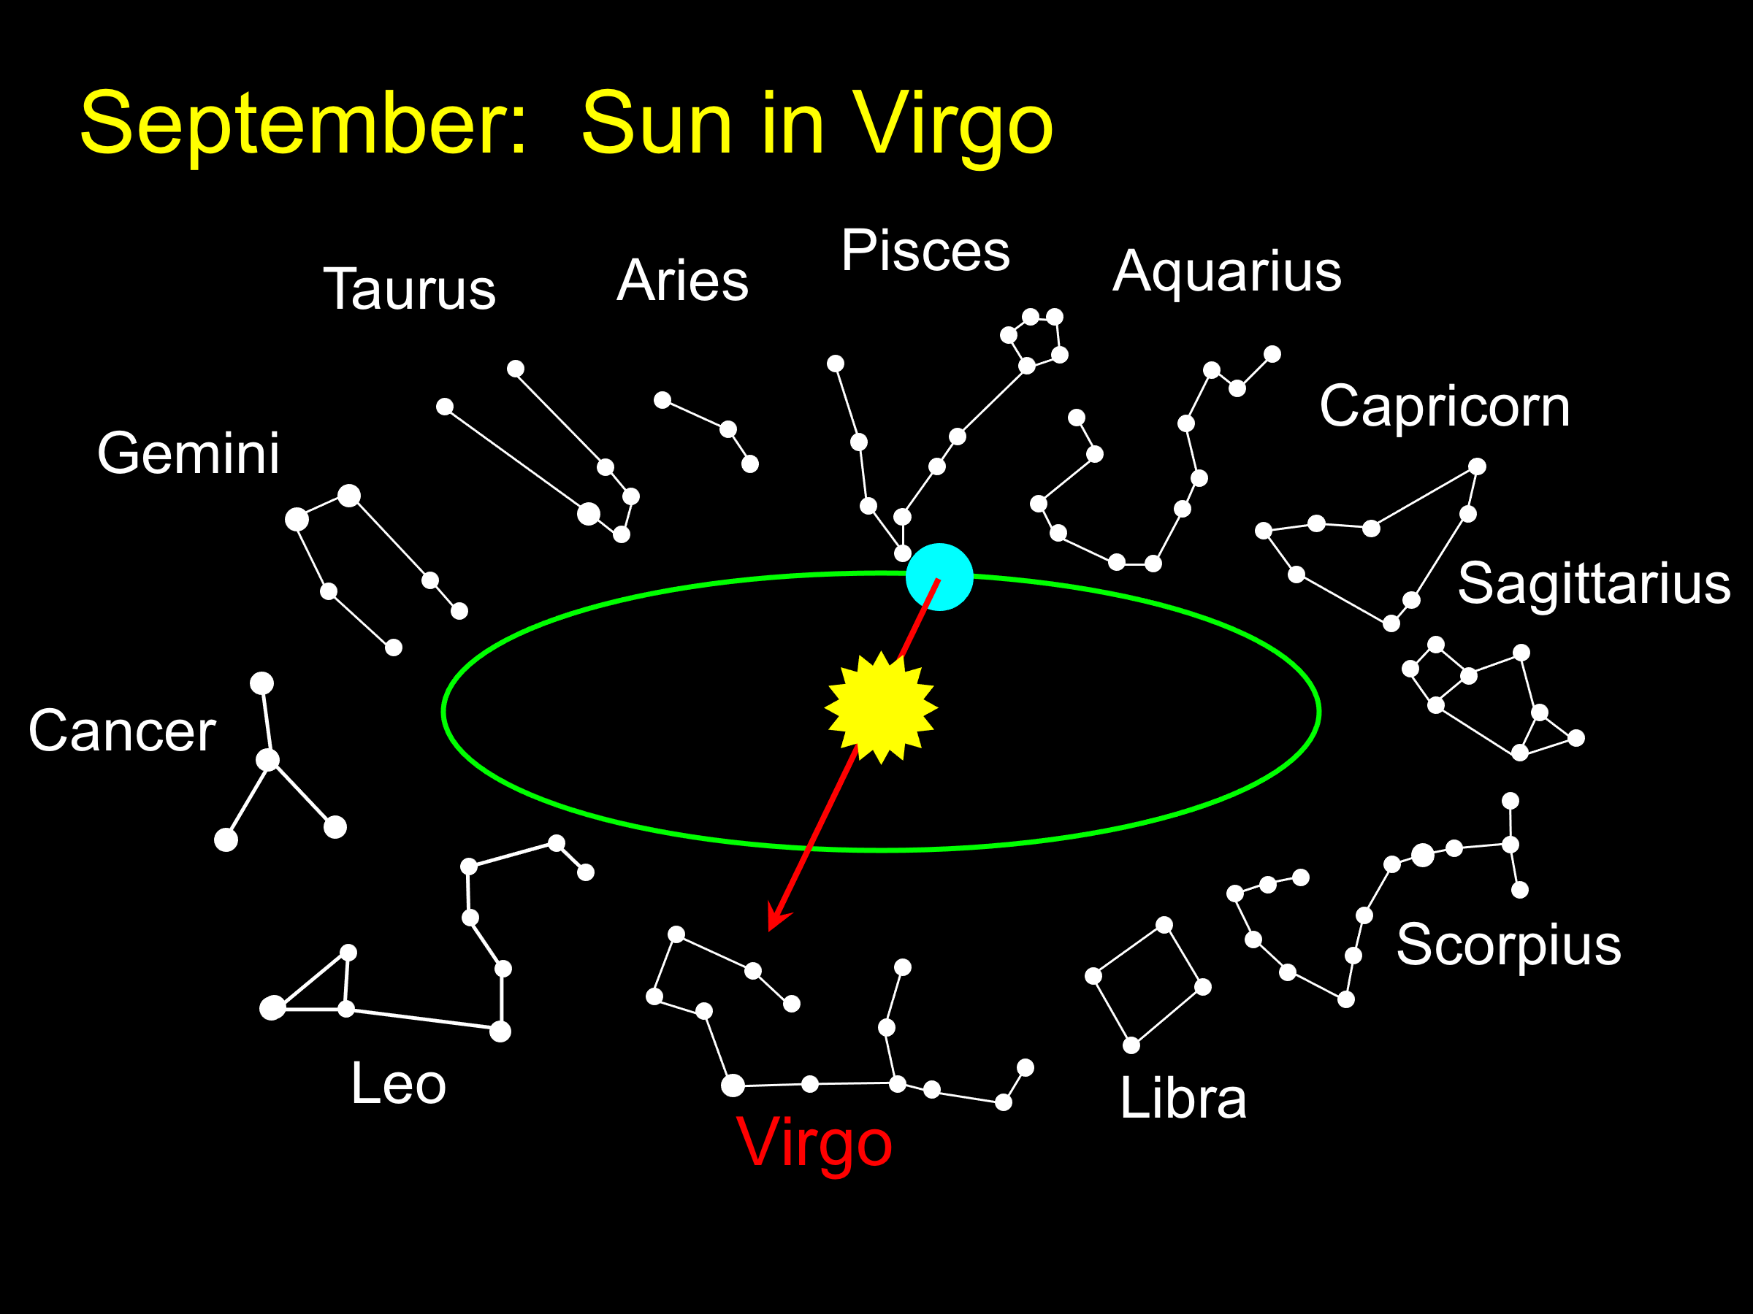
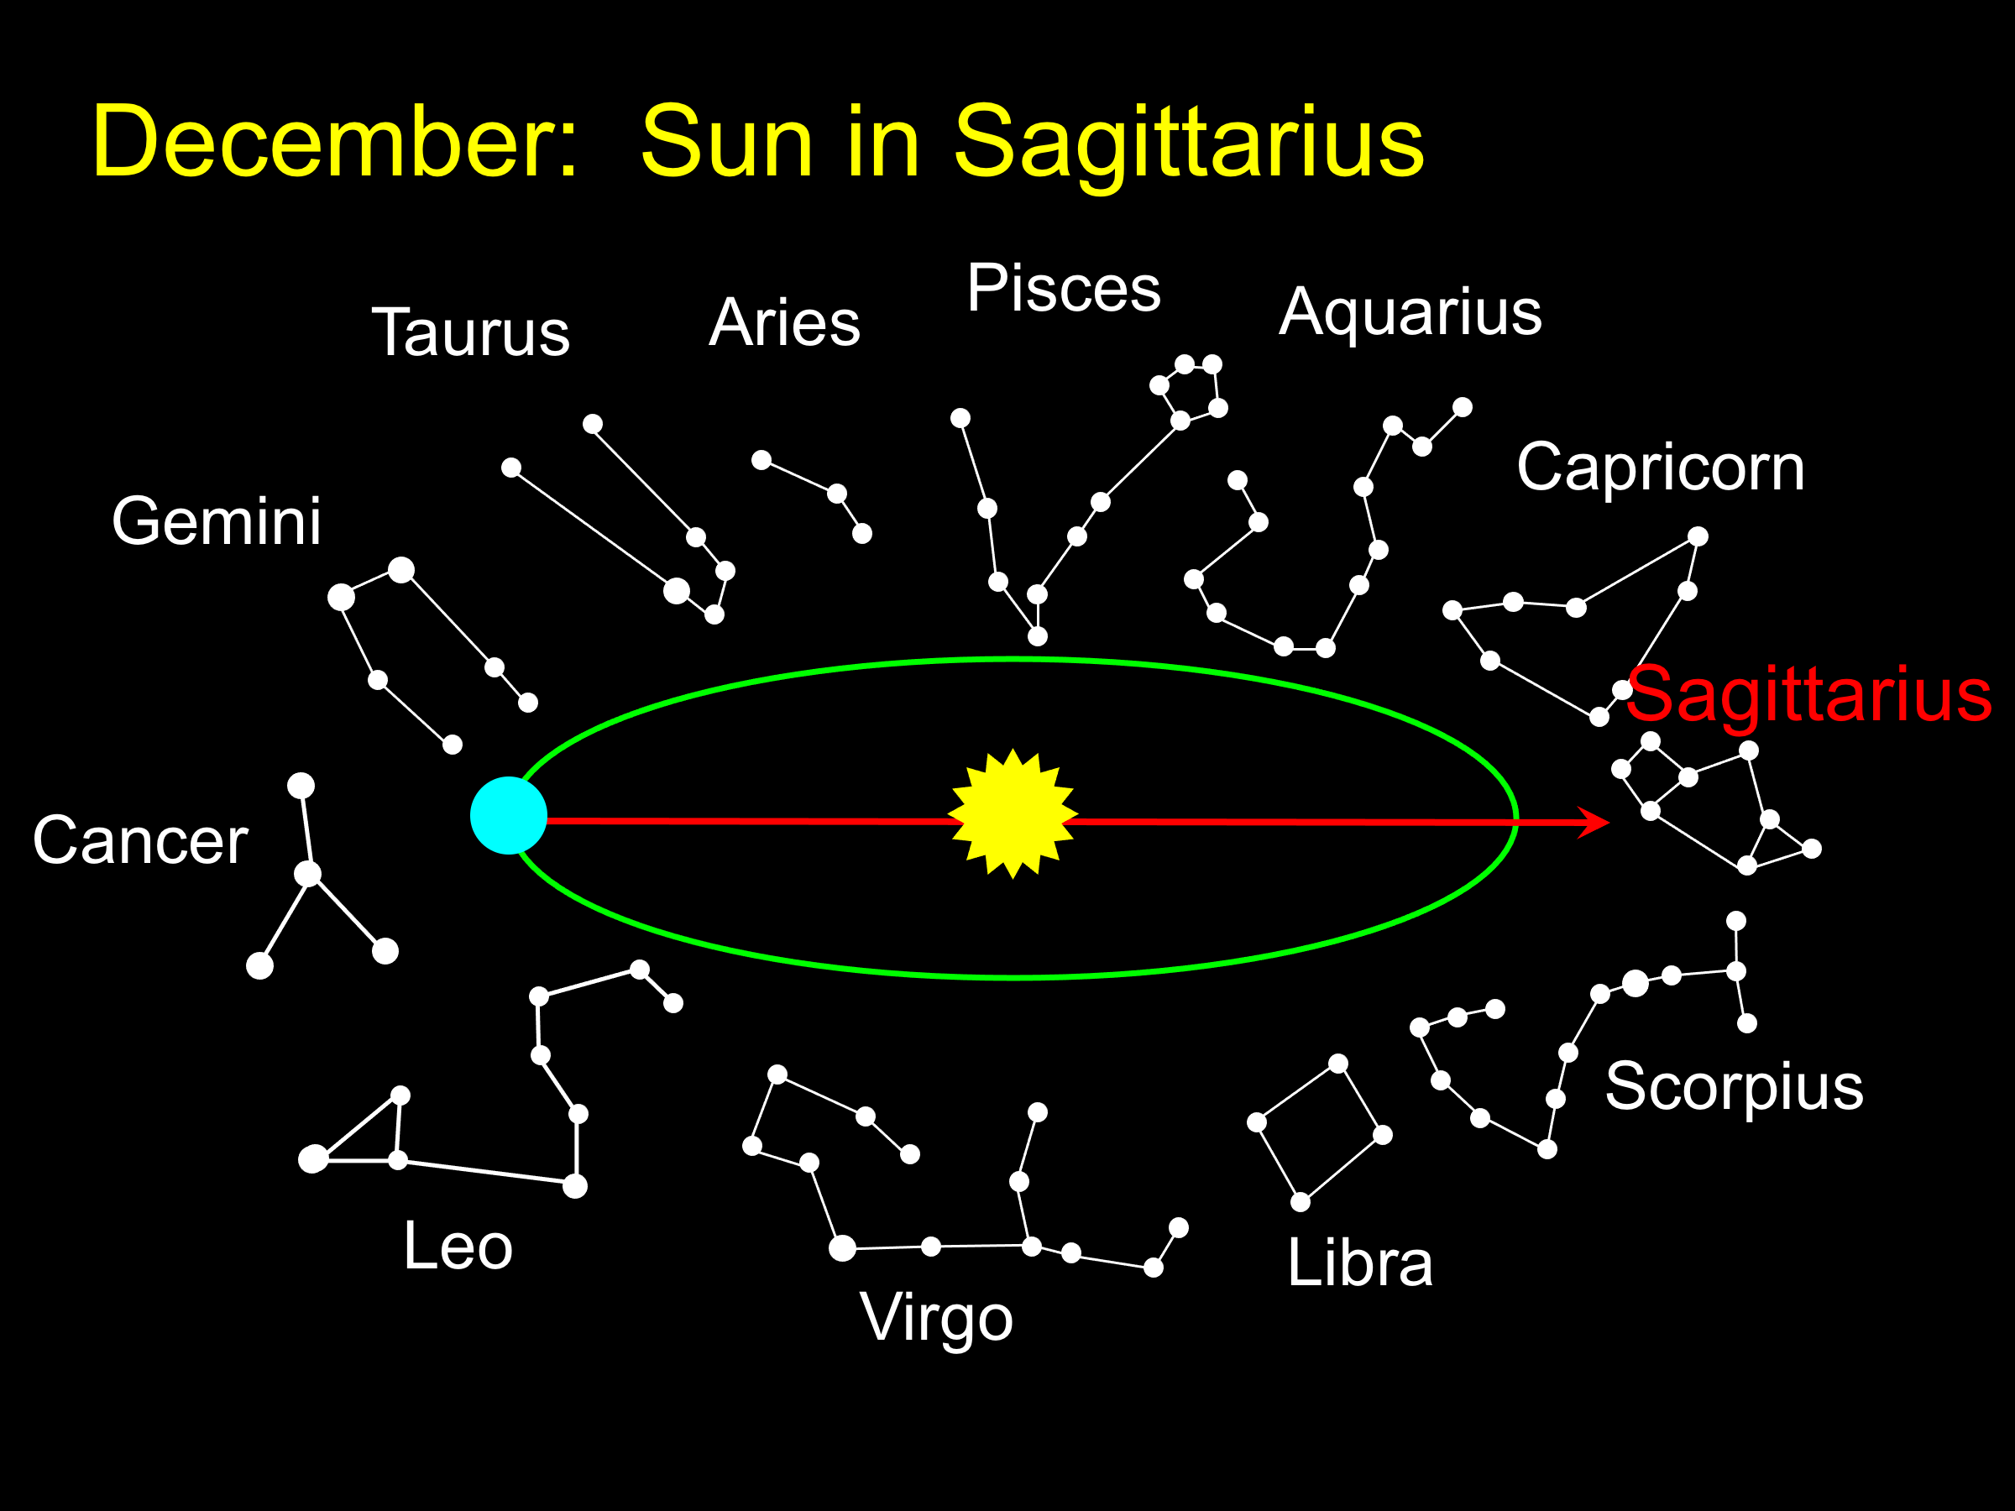

Slide 24
NCP
Summer
Solstice
Ecliptic
CEq
Winter
Solstice
SCP

Slide 25
NCP
Autumnal
Equinox
Summer
Solstice
Ecliptic
CEq
Winter
Solstice
Vernal
Equinox
SCP

Slide 26
Z
Summer Solstice
NCP
Equinoxes
CEq
W
Winter Solstice
S
N
E

Slide 27
Z
Summer Solstice
NCP
Equinoxes
W
Winter Solstice
S
N
E
CEq

Slide 28
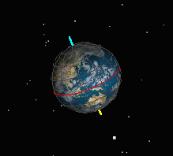
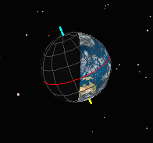
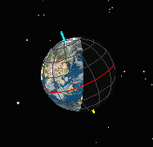
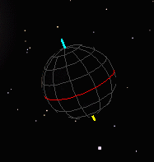
September
June
December
March

Slide 29
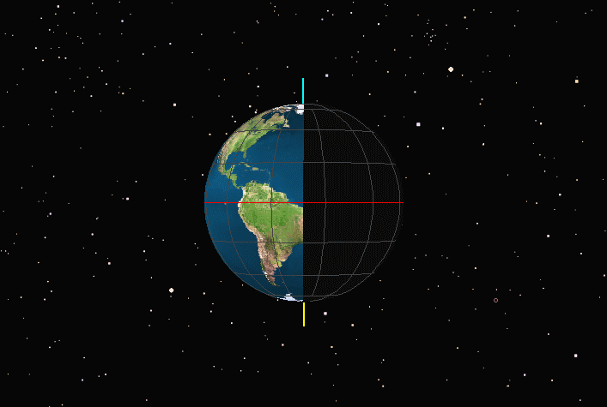
Equinoxes: March & September
Northern Spring/Fall
Southern Fall/Spring

Slide 30
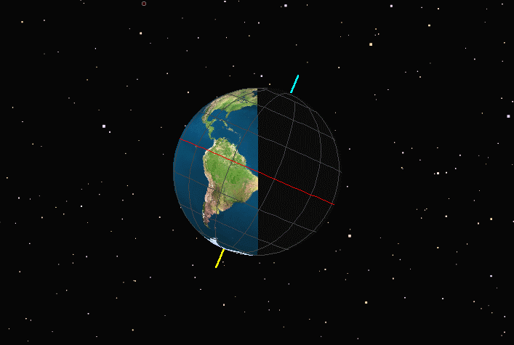
December Solstice
Northern Winter
Southern Summer

Slide 31
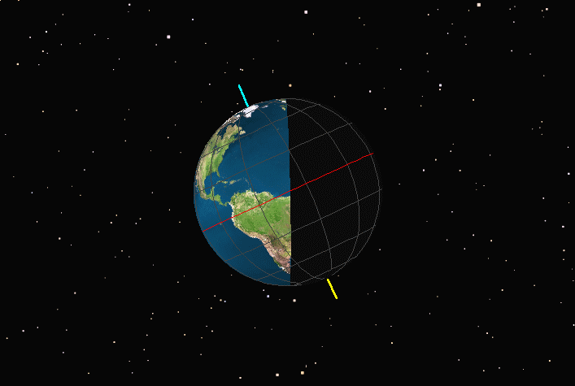
June Solstice
Northern Summer
Southern Winter

Slide 32
1 KW/m²
1 KW/m²
1 m²
2 m²

Slide 33
December Solstice
March Equinox
Winter
Spring
Summer
Autumn
June Solstice
September Equinox
Summer
Autumn
Winter
Spring

Slide 34
Cepheus
Draco
Ursa Minor
Polaris
2000 AD
Thuban
2700 BC

Slide 35
Precession of the Equinoxes

Slide 36
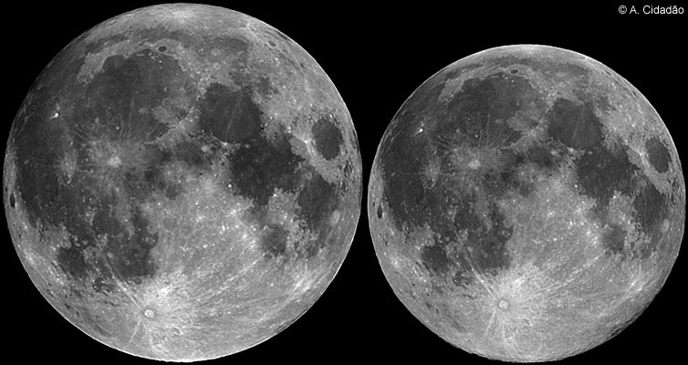
Moon at Perigee
Moon at Apogee

Slide 37
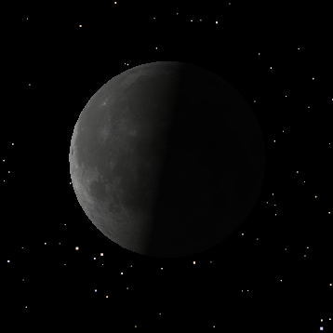
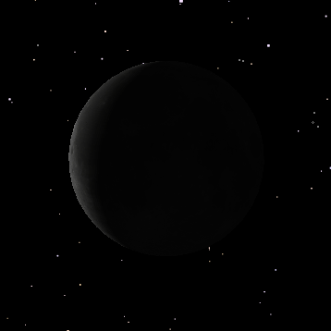
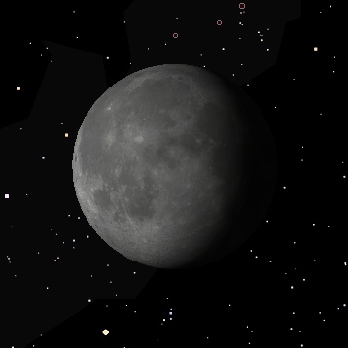
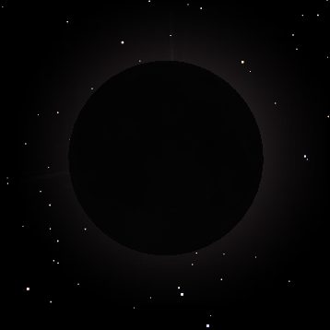
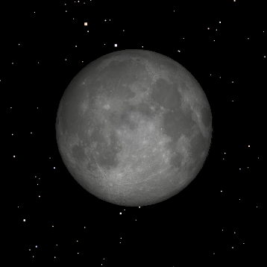
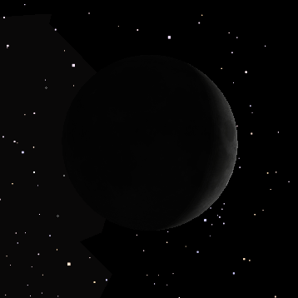
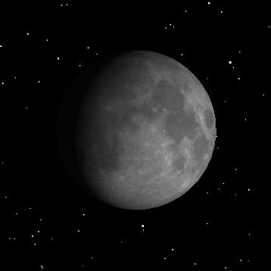
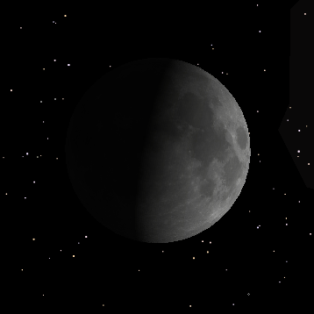
Last Quarter
Waning Crescent
Waning Gibbous
New Moon
Full Moon
Waxing Crescent
Waxing Gibbous
First Quarter

Slide 38
Moonrise & Moonset at 1st Quarter
Sunrise
Noon
Moonrise
Midnight
Moonset
Sunset

Slide 39
Moonrise & Moonset at Full Moon
Moonset
Sunrise
Noon
Midnight
Sunset
Moonrise

Slide 40
Sunrise
Noon
Moonset
Midnight
Moonrise
Sunset
Moonrise & Moonset at Last Quarter

Slide 41
Sidereal vs. Synodic Months
T=29.5^{d}
(Synodic)
T=27.3^{d}
(Sidereal)
T=0^{d}
New
Moon

Slide 42
Umbra
Penumbra
Sun
Earth

Slide 43
Uneclipsed Moon
Sunlight
Penumbral Eclipse
Total Lunar Eclipse
Partial Lunar Eclipse

Slide 44
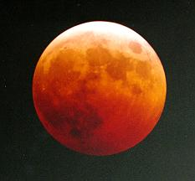
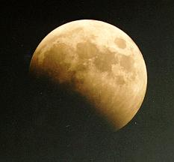
Total Lunar Eclipse
(Note the ruddy scattered sunlight)
Partial Lunar Eclipse

Slide 45
Umbra
Sunlight
Moon
Penumbra
Earth

Slide 46
NCP
Cross-Quarter
Days
Autumnal
Equinox
Summer
Solstice
3rd
4th
CEq
Ecliptic
2nd
Winter
Solstice
Vernal
Equinox
1st
SCP

Slide 47
Solar & Sidereal
Days
T=24^{h}
(Solar day)
T=23^{h} 56^{m} 04^{s}
(Sidereal Day)
Noon
T=0^{h}
Noon
Not to Scale

Slide 48
Earth
Inferior
Conjunction
Superior
Conjunction

Slide 49
Maximum
Eastern Elongation
Earth
Maximum Western
Elongation

Slide 50
Opposition
Conjunction
Earth

Slide 51
Eastern
Quadrature
Opposition
Conjunction
Earth
Western
Quadrature

Slide 52
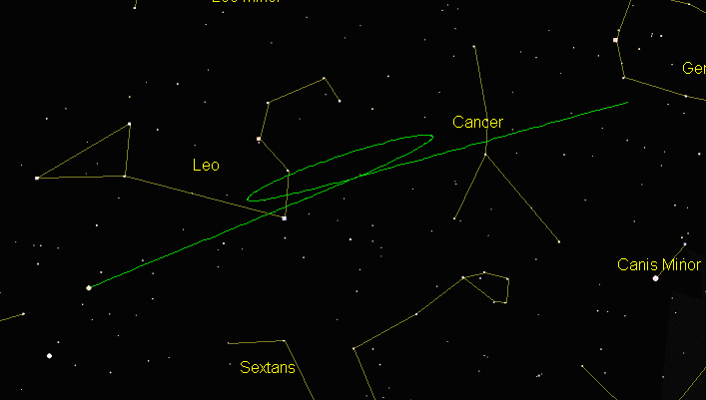
Mars Retrograde Motion in 1994/95
1995 Mar 24
1994 Sept 24
1995 Jan 2
1995 July 4

Slide 53
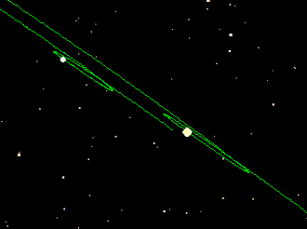
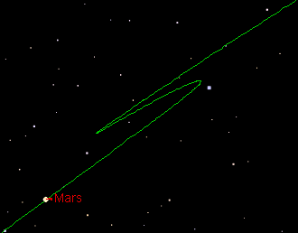
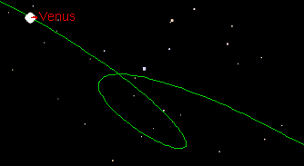
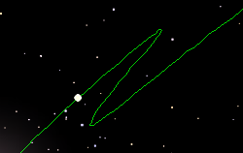
Mars
11/1998-10/1999
Saturn
Jupiter
Saturn & Jupiter
4/1999 - 6/2000
Venus
6-11/1999
Mercury
10-12/1999

Slide 54
m
90°
α=87°
E
S

Slide 55
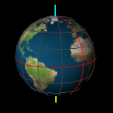
Notes:
Spheres within spheres – may echo Anaximander, but details of latter are lost

Slide 56
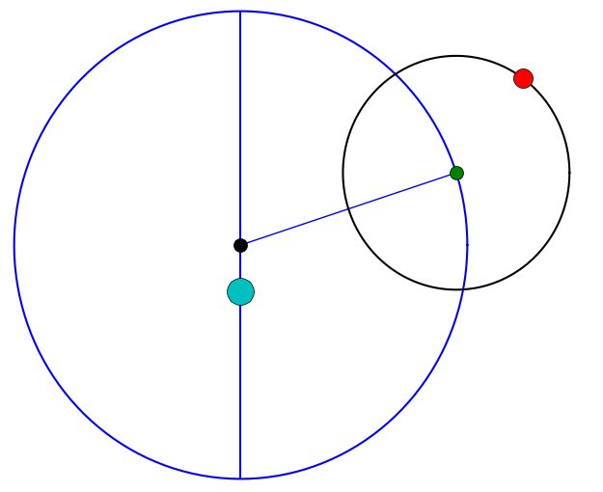
Planet
C
Epicycle
Earth
Deferent

Slide 57
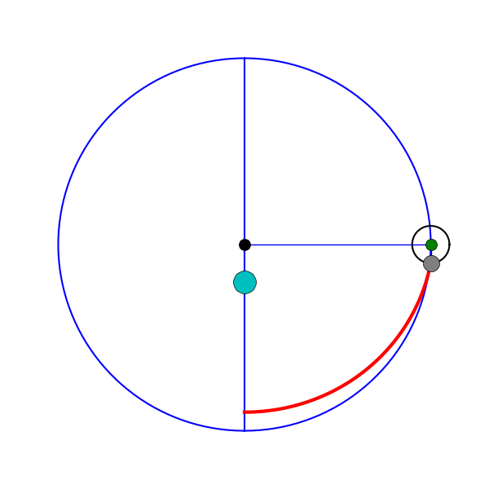
Earth-Moon System
Apogee
C
Earth
Perigee

Slide 58
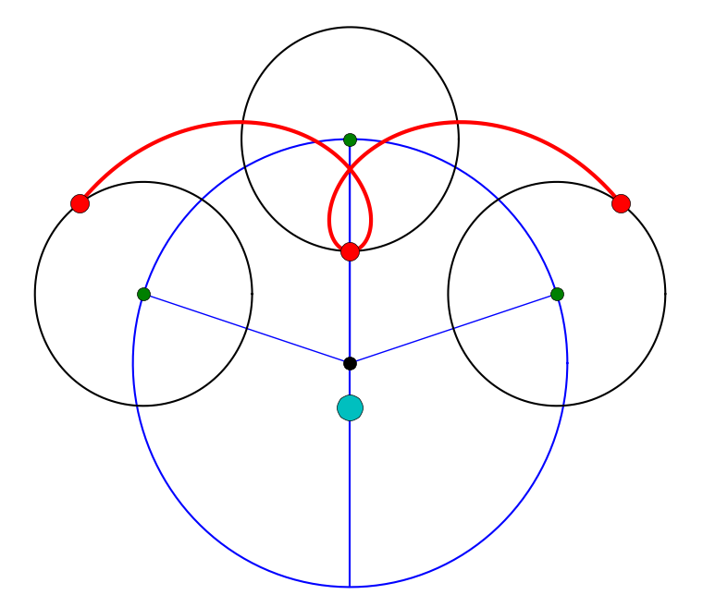
Planet
Epicycle
C
Earth
Deferent

Slide 59
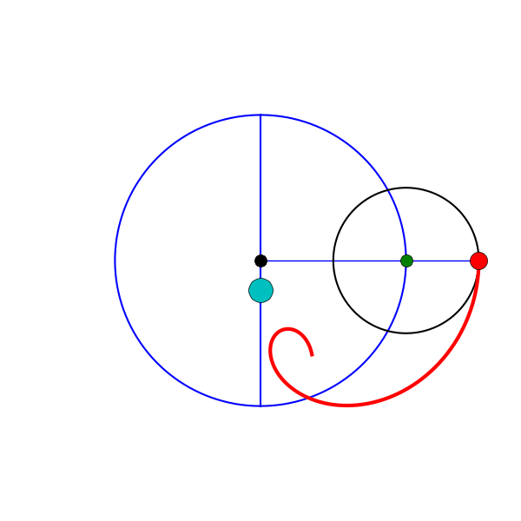
C
Earth

Slide 60
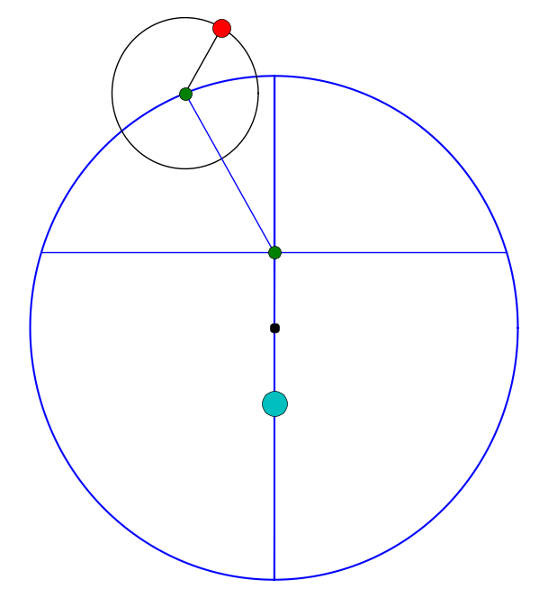
Equant
C
Earth

Slide 61
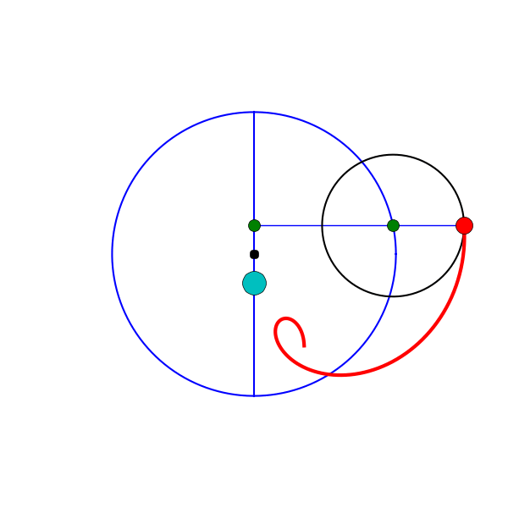
Equant
C
Earth

Slide 62
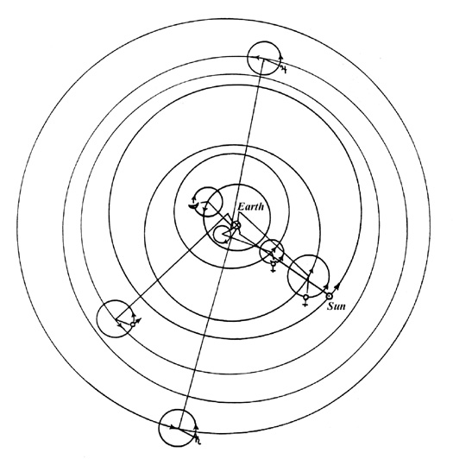
The Ptolemaic
Geocentric System
c. 150 AD
Jupiter
Moon
Mercury
Venus
Mars
Saturn
W.D. Stahlman, in
de Santillana (1955)

Slide 63
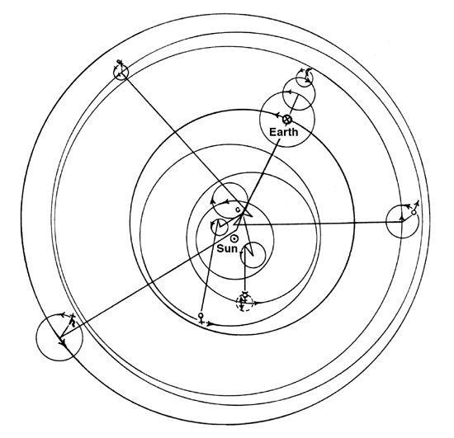
The Copernican
Heliocentric System
1543 AD
Jupiter
Moon
Mars
Mercury
Saturn
Venus
W.D. Stahlman, in
de Santillana (1955)

Slide 64
Geocentric
Heliocentric
Venus
Mercury
Venus
Mercury
Earth
Earth

Slide 65
Mars
Earth

Slide 66
d_{Venus}
46º
1 AU

Slide 67
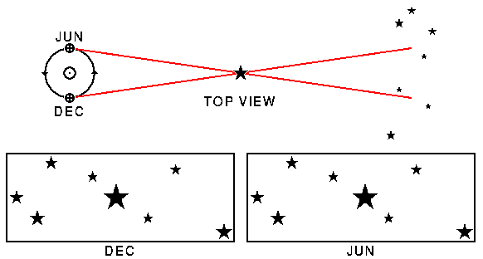
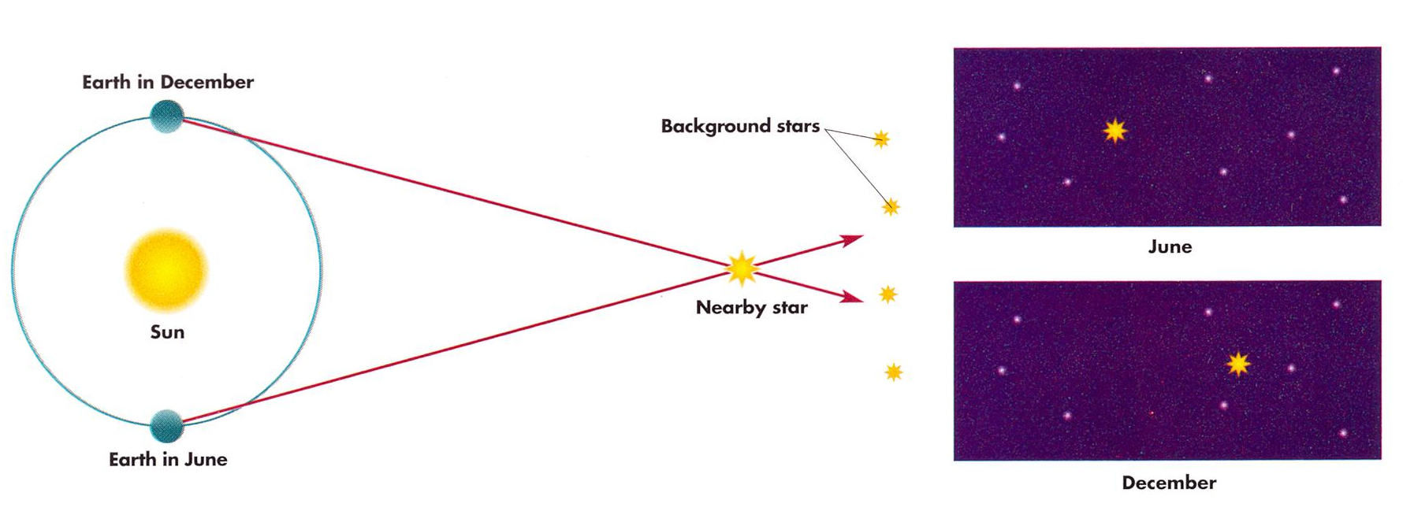
January 1
Background stars
July 1
Sun
Nearby
Star
July 1
January 1

Slide 68
Kepler’s First Law
a
ae
X
f₁
C
f₂
a = semimajor axis
e = eccentricity

Slide 69
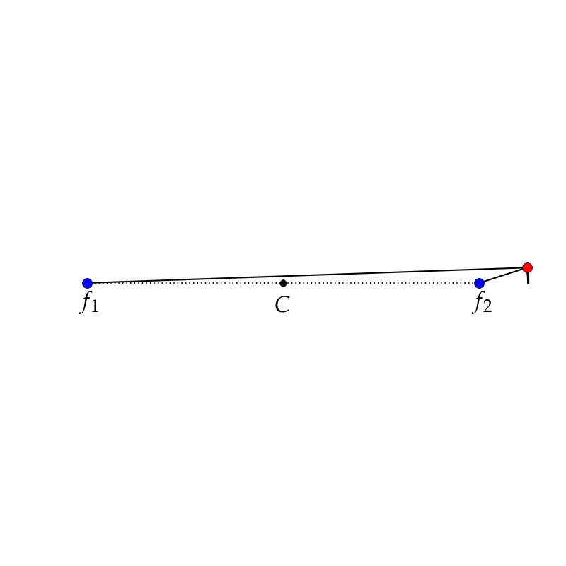
How to draw an Ellipse:

Slide 70
Circle: e=0
e=0.5
e=0.9
0.9a
a
X
f₁
f₁
C
f₂
f₂
0.5a

Slide 71
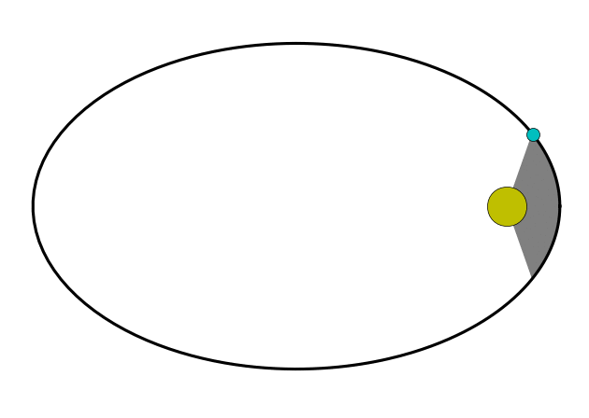
Kepler’s Second Law

Slide 72
Kepler’s Third Law
Planet | a (AU) | P (yr) | a³ | P²
Mercury | 0.387 | 0.241 | 0.0580 | 0.0580
Venus | 0.723 | 0.615 | 0.3785 | 0.3785
Earth | 1.000 | 1.000 | 1.0000 | 1.0000
Mars | 1.524 | 1.881 | 3.5373 | 3.5376
Jupiter | 5.203 | 11.863 | 140.88 | 140.72
Saturn | 9.537 | 29.447 | 867.45 | 867.16

Slide 73
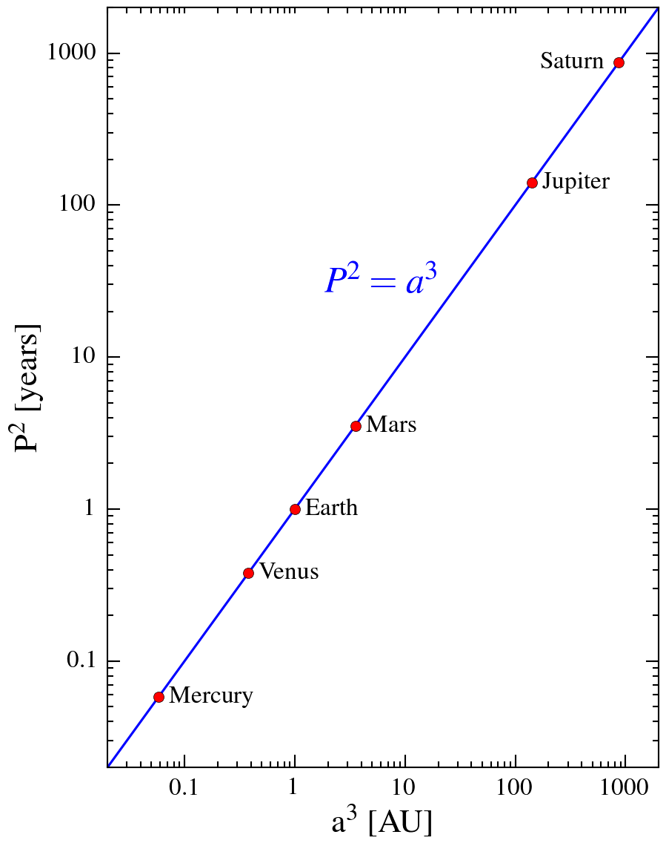

Slide 74
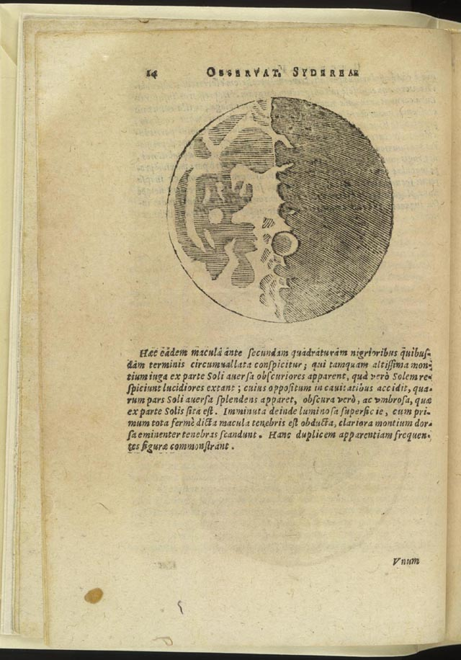
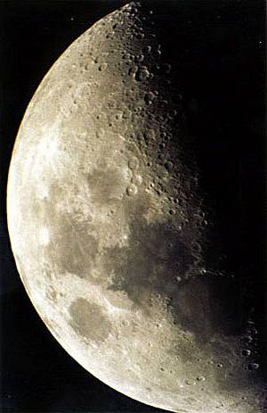

Slide 75
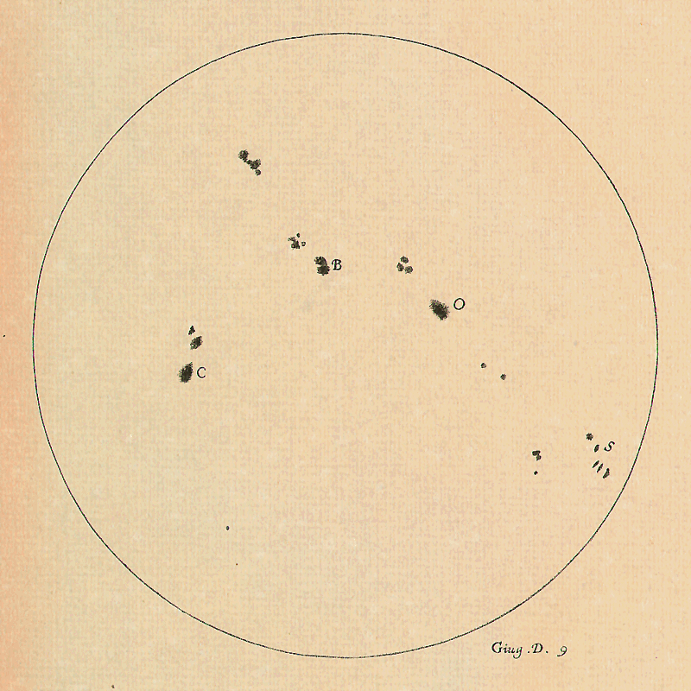

9 June 1613
11 June 1613

Slide 76






Slide 77



Slide 78
Copernican System
Ptolemaic System
6
5
4
3
2
1
6
5
4
3
2
1
4
3
4
3
5
2
5
2
6
1
6
1

Slide 79

acceleration = Force / mass
a = F / m
F
BIG mass
small acceleration
Same Force
Different acceleration
F
small mass
BIG acceleration

Slide 80
Changing Speed
(apple’s speed is faster the farther it falls)
Constant Direction
(apples always falls toward the Earth)

Slide 81

Equal and Opposite
Force from the Table
Net Force is Zero,
No Net Motion
Force = (apple’s mass) × (acceleration due to gravity)

Slide 82
Constant speed
V
F
Changing direction

Slide 83
M₁
M₂
d

Slide 84
2M₁
M₁
M₂
d

Slide 85
2M₁
M₁
2M₂
d

Slide 86
M₁
M₂
d/2

Slide 87
M₁
M₂
2d

Slide 88

F_{Gravity}

Slide 89
Moon
Earth

Slide 90

Closed Curves:
  Circle (e=0)
  Ellipses (0<e<1)
Open Curves:
Parabola (e=1)
Hyperbolae (e>1)

Slide 91
Circle
Ellipse
Hyperbola
Parabola

Slide 92
  v = v_{C}
r
  v < v_{C}
  v_{C}<v<v_{E}

Slide 93
M
r
Parabola
v=v_{E}
Hyperbola
v>v_{E}

Slide 94

An object can change its orbit by
changing its speed.
Use rocket engines or gravity
assist fly-bys to change speed.
v=v_{C}
v_{E}>v>v_{C}
v<v_{C}
v=v_{E}
v>v_{E}

Slide 95
Burn 1:
v₁>v_{C,1}
r₁
Burn 2:
v₂=v_{C,2}
v₁<v_{C,2}
v₀=v_{C,1}
r₂

Slide 96
a₂
a₁
a
M₂
M₁
C-o-M
  a = a₁ + a₂
  a₂ / a₁ = M₁ / M₂

Slide 97


Slide 98

Drawn to Scale

Slide 99

Drawn to Scale

Slide 100

Arctic Circle
66.5º N: 666 km/h
Columbus, Ohio
40º N: 1280 km/h
Equator
1670 km/h

Slide 102


Towards Sirius
6 hours later

Slide 103
a
λ
a = amplitude = height of crest above trough
λ (lambda) = wavelength = distance from crest-to-crest
f = frequency = number of crests passing per second

Slide 104

The Electromagnetic Spectrum
Medical
X rays
Thermal
Imager
WOSU
UVA
WiFi
Wikimedia Commons

Slide 105
d=1
B=1
d=2
B=1/4
d=3
B=1/9

Slide 106


d
“B”
“B/2² = B/4”
2d
d/3
“B/(1/3)² = 9 B”

Slide 107
Stationary
Source
Same Pitch
Same Pitch

Slide 108
Moving
Source
High Pitch
(short waves)
Low Pitch
(long waves)

Slide 109


Blue
Red
Star at Rest
Star moving
away from us
“Redshift”
Star moving
away toward us
“Blueshift”

Slide 110
Cool Gas
Slow Average Speeds
Hot Gas
Faster Average Speeds

Slide 111

Prisms disperse light into its component colors
White
Light
Spectrum
Prism

Slide 112

Continuous Spectrum
Emission-line Spectrum
Continuum
Source
Cloud of
Hydrogen Gas
Absorption-line
Spectrum

Slide 113
Hydrogen
Helium
Oxygen
Neon
Iron

Slide 114
Lamp emits light at all energies
Lamp
Light
Absorbed
by
Hydrogen
Atoms
in the
Cloud
Continuum
Source
Cloud of
Hydrogen Gas

Slide 115

Visible
UV
Infrared

Slide 116
Energy Level
Diagram of ¹H
Continuum
n=∞
n=5
n=4
n=3 (2nd excited state)
n=2 (1st excited state)
n=1 (Ground State)

Slide 117
6→2
5→2
4→2
n=3→2
n=6
n=5
n=4
n=3 (2nd excited state)
n=2 (1st excited state)
Larger Jump = More Energy = Bluer Wavelength
n=1 (Ground State)

Slide 118
2→6
2→5
2→4
n=2→3
n=6
n=5
n=4
n=3 (2nd excited state)
n=2 (1st excited state)
Photons of all other energies (wavelengths) are
ignored and pass on by unabsorbed.
n=1 (Ground State)

Slide 119


Visible
UV
Infrared

Slide 120

The Sun’s Spectrum
NOIRLab

Slide 121


Spectrum of a Fluorescent Light

Slide 122


Retina
Collecting Area
Lens

Slide 123
Simple Refracting Telescope
Focus
Secondary Lens
(Eyepiece)
Objective Lens

Slide 124
Primary
Mirror
Prime
Focus
Secondary
Mirror
Cassegrain
Focus

Slide 125

4.5 Billion Years Ago
Today
²³⁸U
²³⁵U
²³⁸U
²³⁵U
50% left
1.2% left
²⁰⁶Pb
²⁰⁷Pb
²⁰⁶Pb
²⁰⁷Pb
1 half-life
6.3 half-lives

Slide 126
Seismic Station
Crust
P-waves
Lower
Mantle
Upper
Mantle
Core
Surface
Waves
P & S
waves
S waves
Seismic Station
Earthquake!

Slide 127


Two Faces of the Moon
Maria
Impact Basin
Cratered
Highlands
Near Side
Far Side

Slide 128

Apollo and Luna Landing Sites
A15
A17
L24
L20
A11
L16
A12
A14
A16

Slide 129

Terrestrials
Ice Giants
Gas Giants
Dwarf Planets

Slide 130


Neptune
Mars
Uranus
Earth
Venus
Saturn
Mercury
Jupiter

Slide 131

Pluto
Ecliptic

Slide 132

Dwarf Planets

Slide 133

Dwarf Planets
Eris
Neptune
Pluto
Uranus
Saturn
Ceres

Slide 134

Main Belt and
Trojan Asteroids
Jupiter

Slide 135

Trans-Neptunian
Objects

Slide 136


Slide 137




Terrestrial Planets
Solid inner core
Liquid outer
core
Venus
Earth
Moon
Mercury
Mars
Notes:
Earth: internal energy 44 TW
About half of Earth’s internal heat, ~20TW, from radioactive decay, roughly 8TW 238U, 8TW 232Th, and 4TW 40K
Remaining half is residual heat of formation

Slide 138



Gas Giants
Saturn
95.2 M_{E}
9.44 R_{E}
687 kg m⁻³
Earth to scale
Jupiter
318 M_{E}
11.2 R_{E}
1326 kg m⁻³

Slide 139



Cloud Tops
Molecular
Hydrogen
Metallic
Hydrogen
Rock
& Ice
Cores
Jupiter
Saturn

Slide 140



Ice Giants
Uranus
Neptune
14.5 M_{E}
4.01 R_{E}
1420 kg m⁻³
17.1 M_{E}
3.88 R_{E}
1638 kg m⁻³
Earth to scale

Slide 141
Molecular
Hydrogen
Rocky
Core
Slushy
“Ice”Mantles
Uranus
Neptune

Slide 142


Earth
Uranus
Neptune
Saturn
Jupiter

Slide 143
Star’s spectrum red-shifted
S
observed
rest
p
p
Star’s spectrum blue-shifted
observed
rest
S

