Slide 1
Stars
Introduction
To
“Atomic Astrophysics and Spectroscopy”
(AAS)
Anil Pradhan and Sultana Nahar
Cambridge University Press 2011
Details at:
www.astronomy.ohio-state.edu/~pradhan/Book/book.html

Slide 2
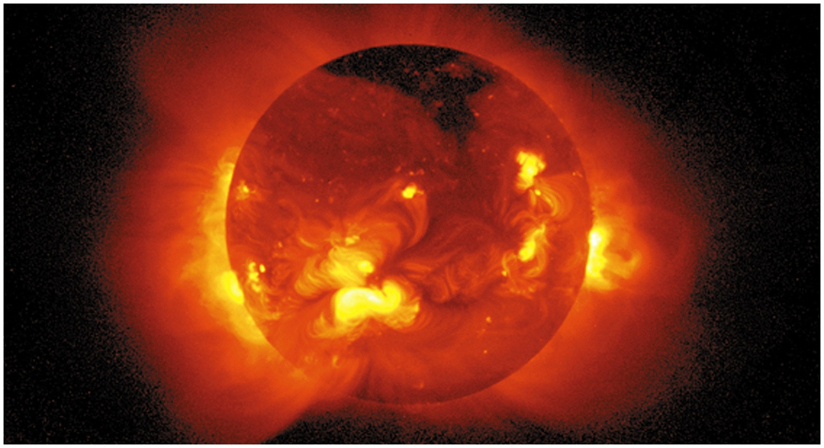
The Sun – X-Ray Image
(YOHKOH Satellite)
Though the surface temperature of the Sun is 5,770 degrees Kelvin, the Sun is surrounded by
very hot gas in the solar corona at more than a million degrees. Solar flares and coronal mass
ejections (CMEs) frequently erupt from the Sun emitting intense radiation and charged particles.

Slide 3
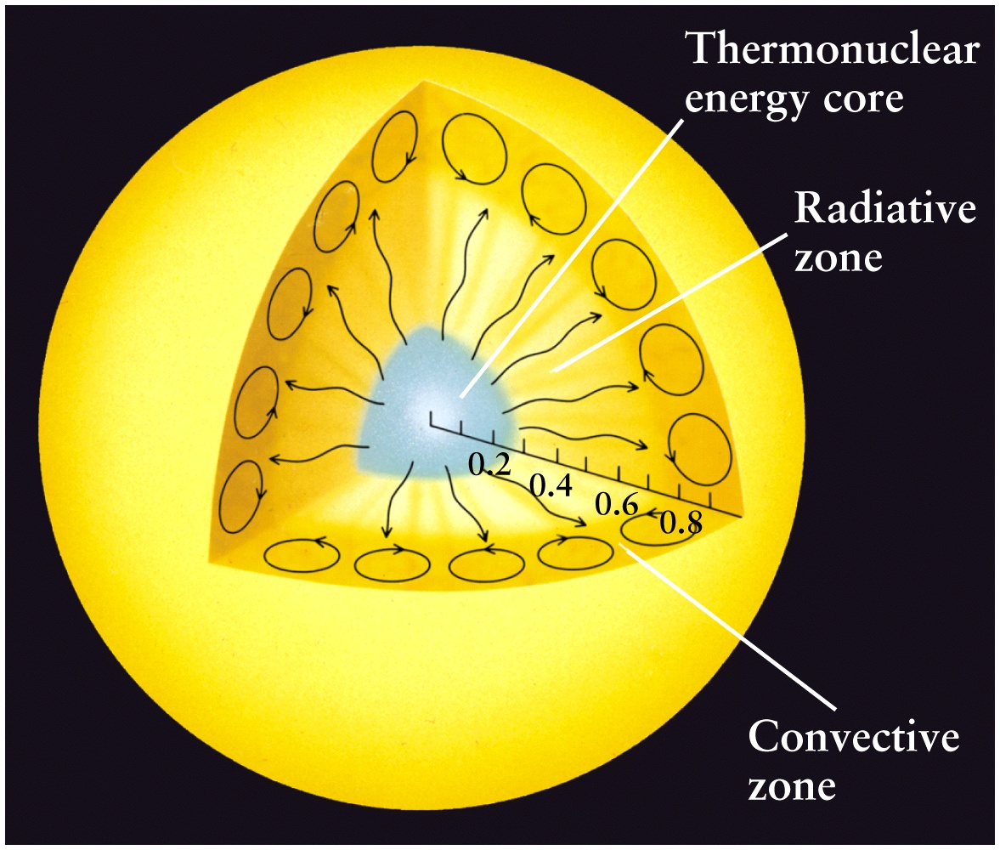
Structure of the Sun: Three Zones
Core, Radiative, Convective
Energy is produced in the core
via thermonuclear reactions and
radiates out through the star
Radiation diffuses through
the Radiative zone via light-
matter interactions
Convection occurs in the outer-
most regions before radiation
emerges through the
stellar atmosphere (not shown)

Slide 4
Brightness and Temperature
Brightness is the total energy emitted, or the luminosity of an object
The luminosity is related to the (blackbody) temperature of the object
L = σ T⁴ (σ is a constant)
Stefan-Boltzmann Law
where T is the temperature in thermal equilibrium (like an oven or a star)
The Sun is nearly a blackbody at 5,550 K
(Fig. 10.1, AAS)

Slide 5
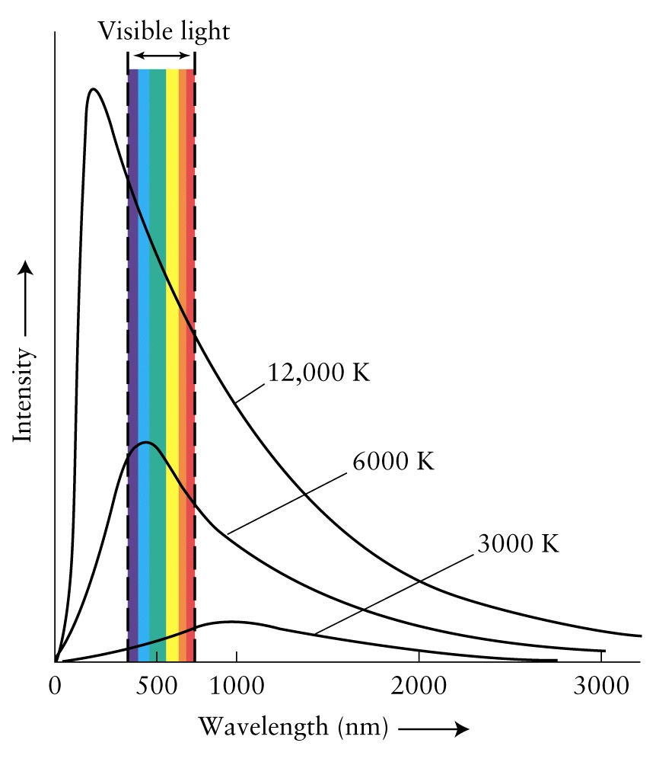
Color Indicates Temperature and Energy of the Source
Blackbody: Perfect
absorber and emitter
of radiation at
Temperature T
Surface T (Sun) = 5700 K
Objects generally emit radiation at all wavelengths, but mostly at one peak
wavelength depending on their temperature (e.g. blue – hot, red – cool)

Slide 6
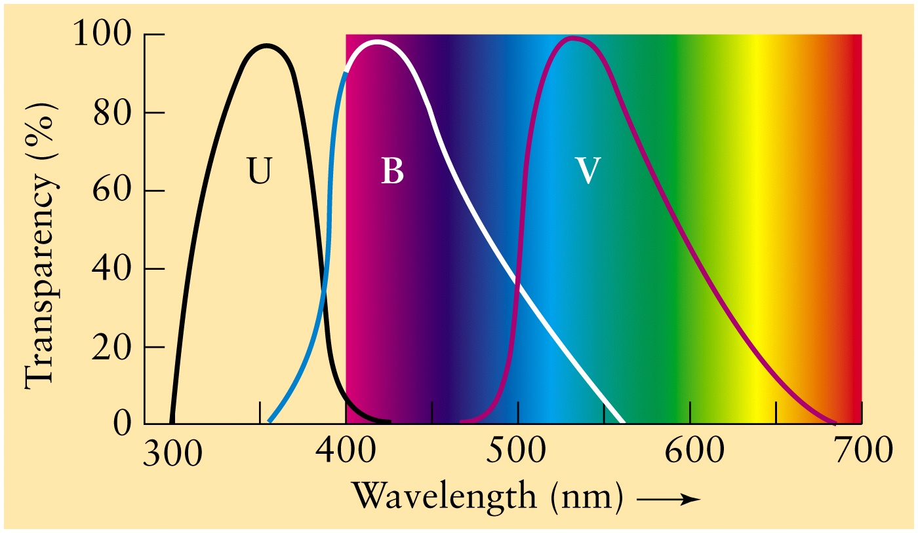
Color vs. Peak emission wavelength (energy)

Slide 7
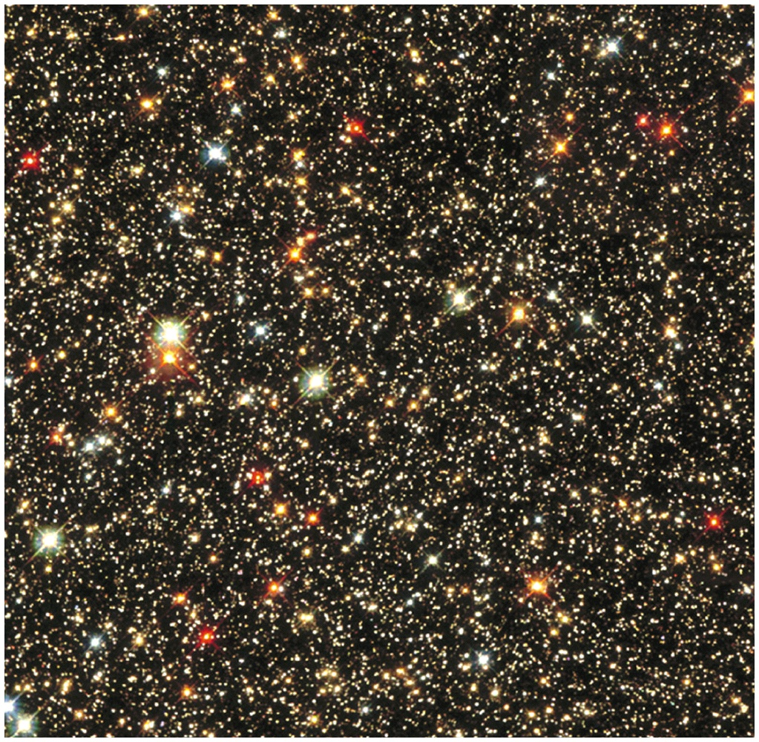
Colors of stars

Slide 8
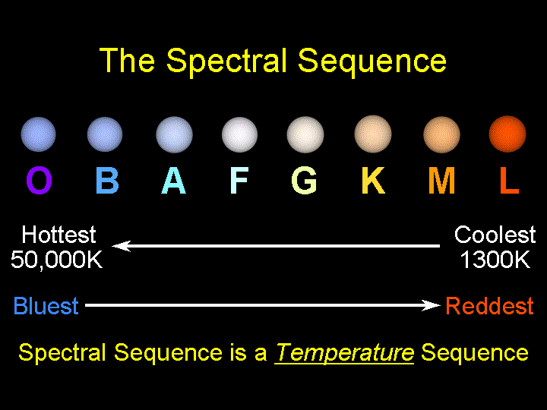
Stars are labeled according to color-temperature-luminosity (O – L)

Slide 9
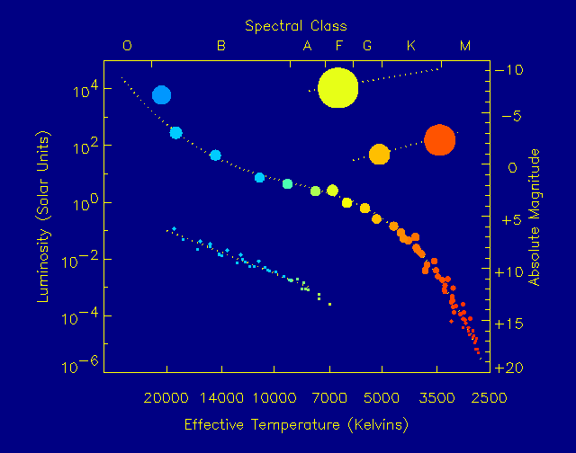
The Hertzsprung-Russell (HR) Diagram
The HR diagram
assigns stellar
temperature (color) to spectral classes
(bottom and top), related to luminosity (left) measured in absolute magnitudes (right)

Slide 10
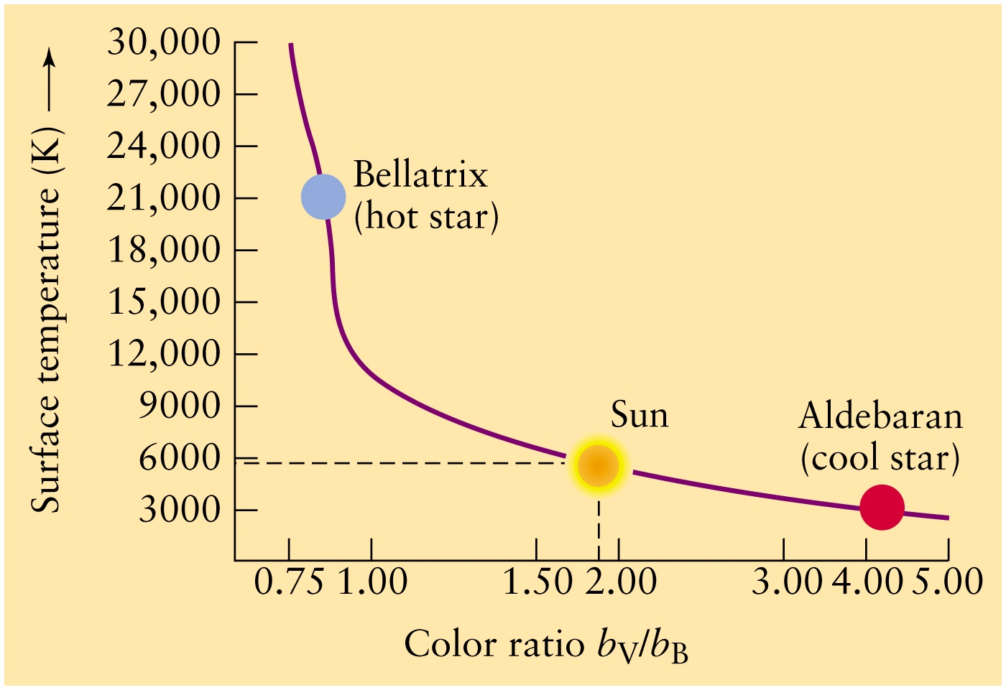
Temperature vs. color (visible/blue)

Slide 11
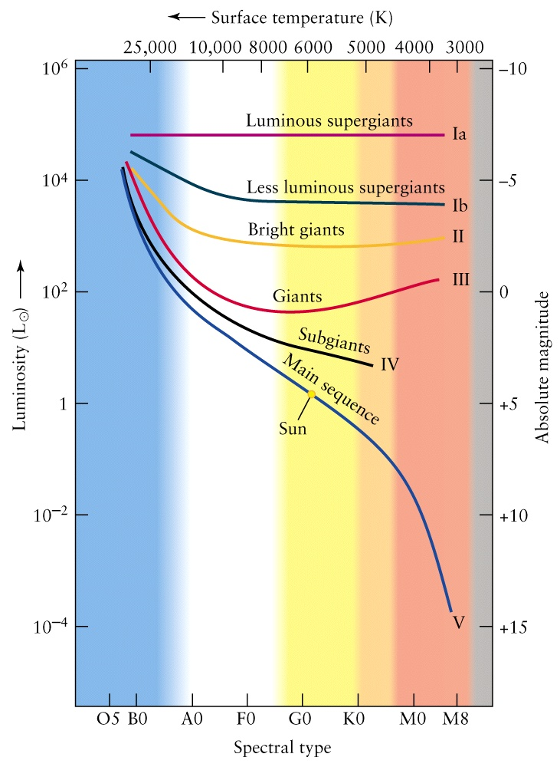
Luminosity Classes I – V and Spectral Types O-M
Τhe Sun is
a G2V star

Slide 12
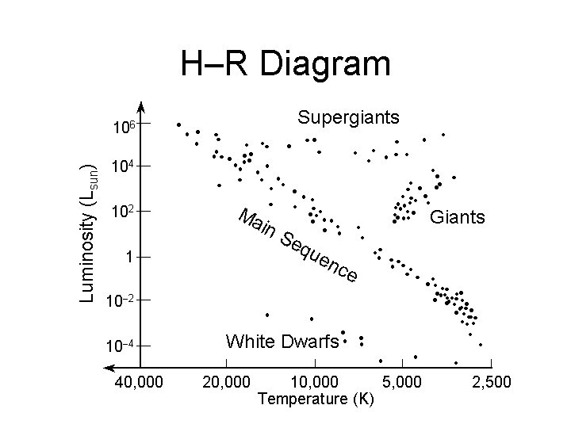
Stellar classes (cf. Fig. 10.2, AAS)

Slide 13
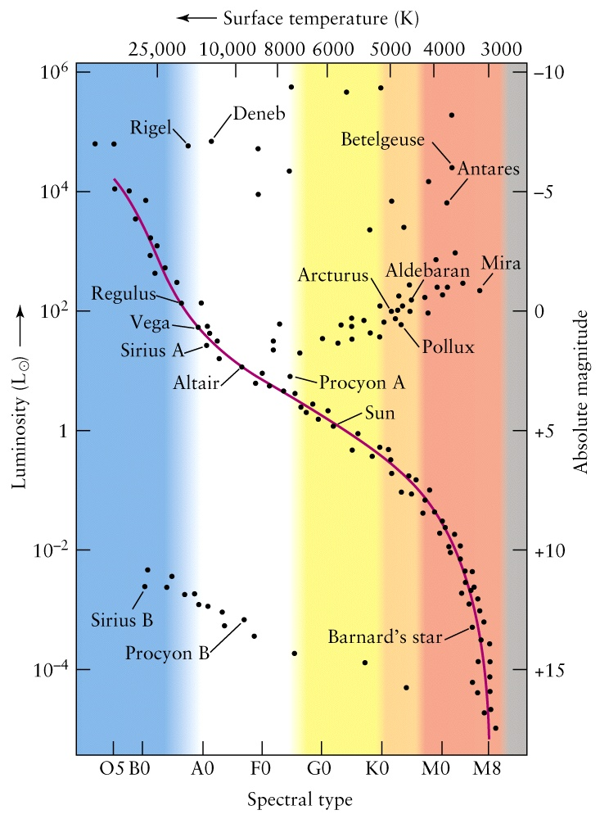
Luminosity vs. Spectral Class (color-temperature):
O,B,A,F,G,K,M
Thermonuclear fusion
drives stellar activity,
structure, and properties
(Ch. 10-11, AAS).
Most stars spend most
of their lives on the
Main Sequence in the
H → He “burning” phase,
fusion of hydrogen into
helium which converts
some mass into energy
according to the Einstein
relation E = mc² .
The Hertzsprung-Russell Diagram

Slide 14
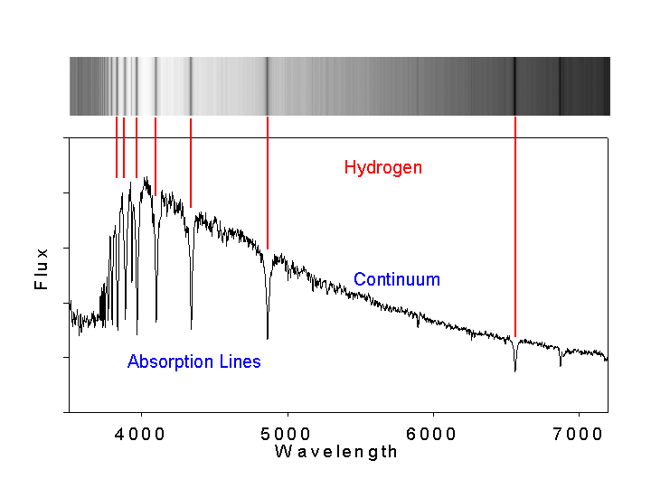
Visible Spectrum: Balmer Series of Absorption Lines of H
Hβ
Hα

Slide 15

Spectrum of A1 Star: Strong H Lines

Slide 16

Spectrum of a G0 Star: No H, neutral and ionized metals
Temperature About 6000K. The Sun is a G2 star.
See Fig. 1.1 in AAS on Fraunhofer lines in the Sun, and Fig. 10.3 on G to K spectral types.

Slide 17
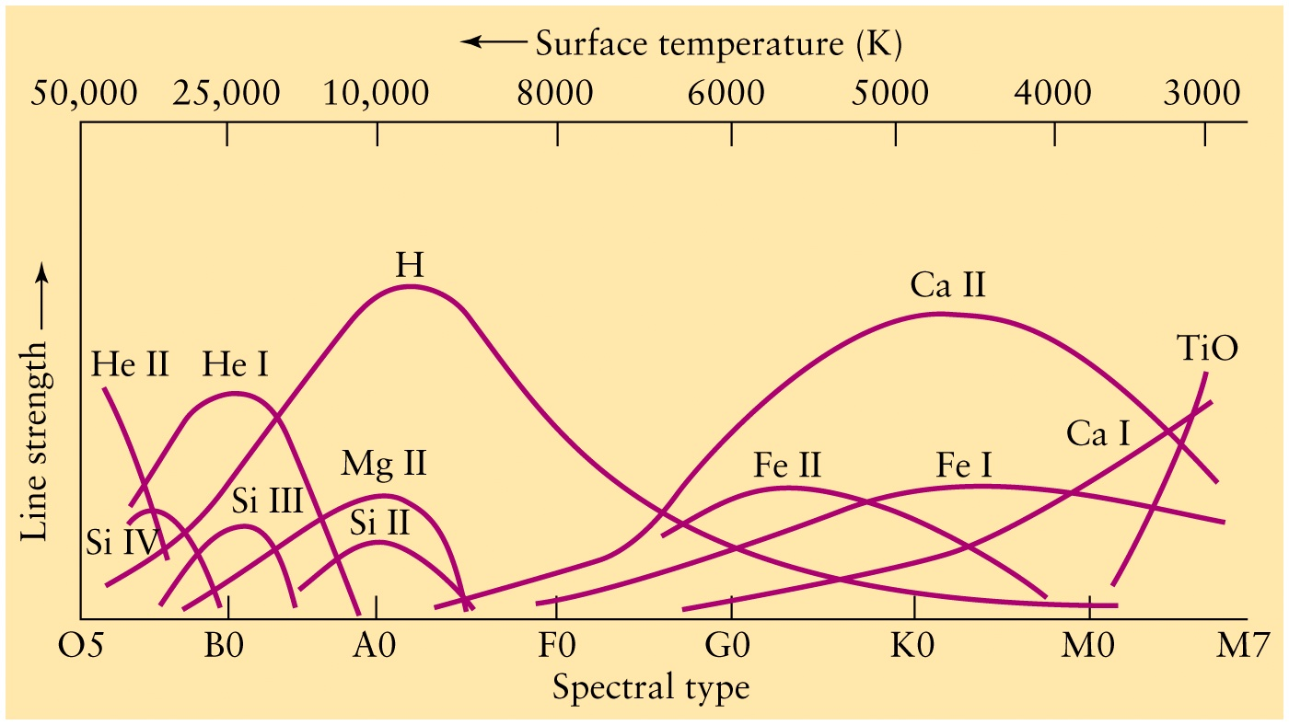
Atoms and Stellar Spectral Types

Slide 18
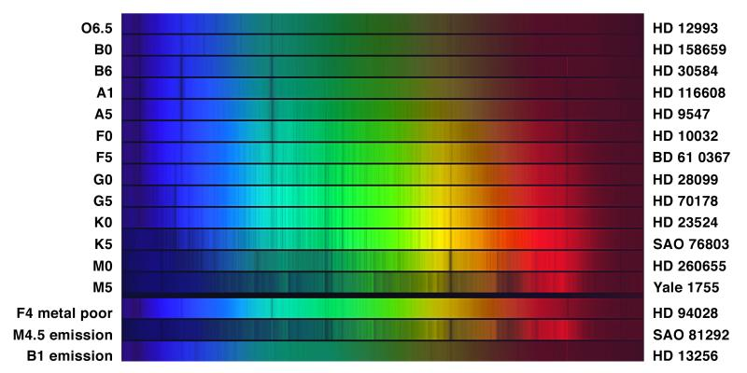
Colors and Spectral Types of Some Stars

Slide 19
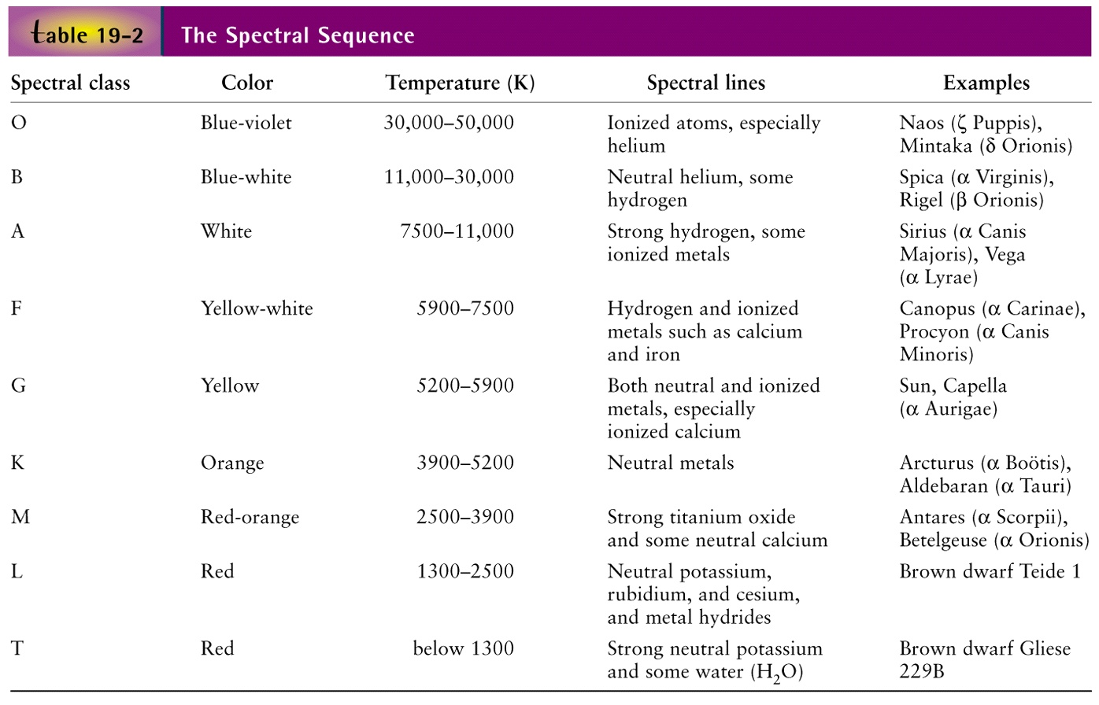
Summary of spectral properties of stars
(c.f. Table 10.1, AAS)
With decreasing T observed spectra reveal Ions → Neutral Atoms → Molecules

