Slide 1
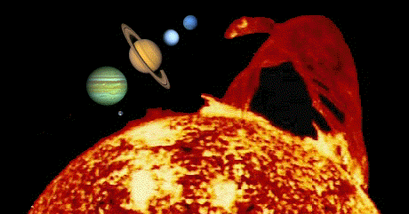
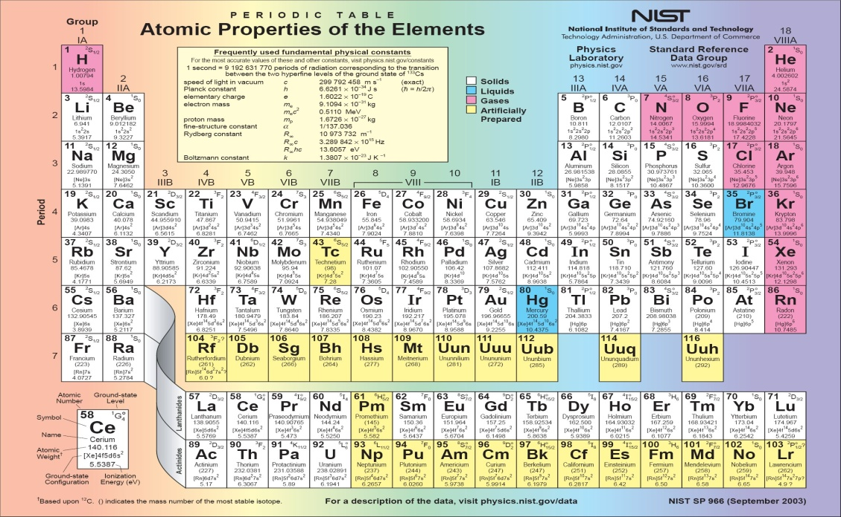
Ohio State University
And
Indo-US OSU-AMU APJ Abdul Kalam Center for STEM Education and Research
Atomic and Molecular Astrophysics and Spectroscopy
www.astronomy.ohio-state.edu/~pradhan

Slide 2
Atomic and Molecular Astro-Plasma Physics
Spectral Diagnostics: Overview and Applications
James Webb Space Telescope (JWST) Spectra
- High-redshift galaxies and origin of the Universe ?
Exoplanetary Spectroscopy → Atoms, Ions, Molecules
→ 5600 exoplanets discovered (Earth-like?)
High-Energy-Density (HED) plasma sources
→ Inertial Confinement Fusion (ICF) Plasmas
→ Fusion energy ?
Stellar interiors
→ Elemental abundances in the Sun and Opacity?

Slide 3
Astronomy
Back to the Beginning: Big Bang
Misnomer! Expansion not explosion
Galaxies are receding from one another, but not moving: space itself is expanding (like dots on balloon)
Hubble’s Law: v_{exp} = H_{o} d (velocity of expansion is proportional to distance, H_{o} = 70 km/sec/Mpc)
Age of the Universe = 1/H_{o} = 13.8 billion years
No center or edges: Cosmic Microwave Background is isotropic
Doppler redshift of spectral lines → recession velocity
Redshift: z = λ (obs) − λ (rest)
λ (rest)
λ (obs) = (1+ z) λ (rest)
For v << c and z < 1: v = cz (see Pg. 307, AAS)

Slide 4
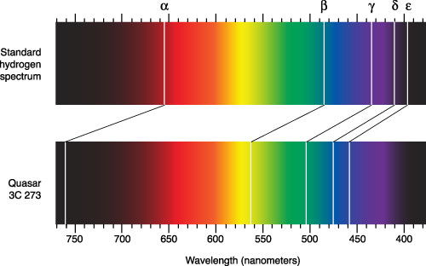
Redshifted hydrogen Balmer Series lines:
Quasar 3C273 – Active galactic nucleus powered by a supermassive black hole
H

Slide 5
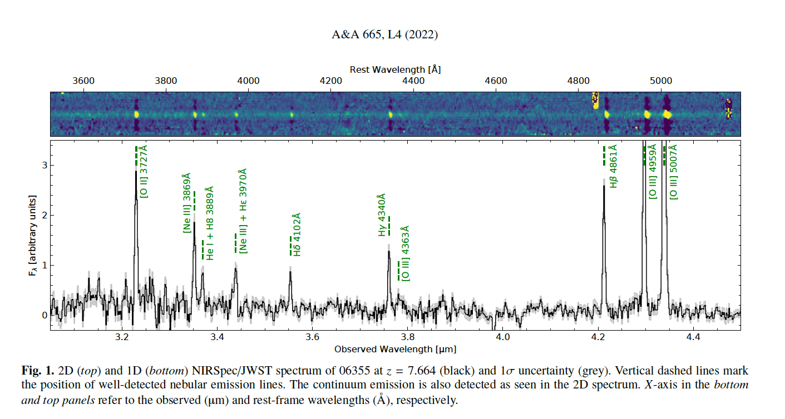
Redshift z=8 galaxy JWST Spectrum:
[O III] rest wavelength 4363A, observed at 38000A
Galaxy ~10 billion light years away

Slide 6
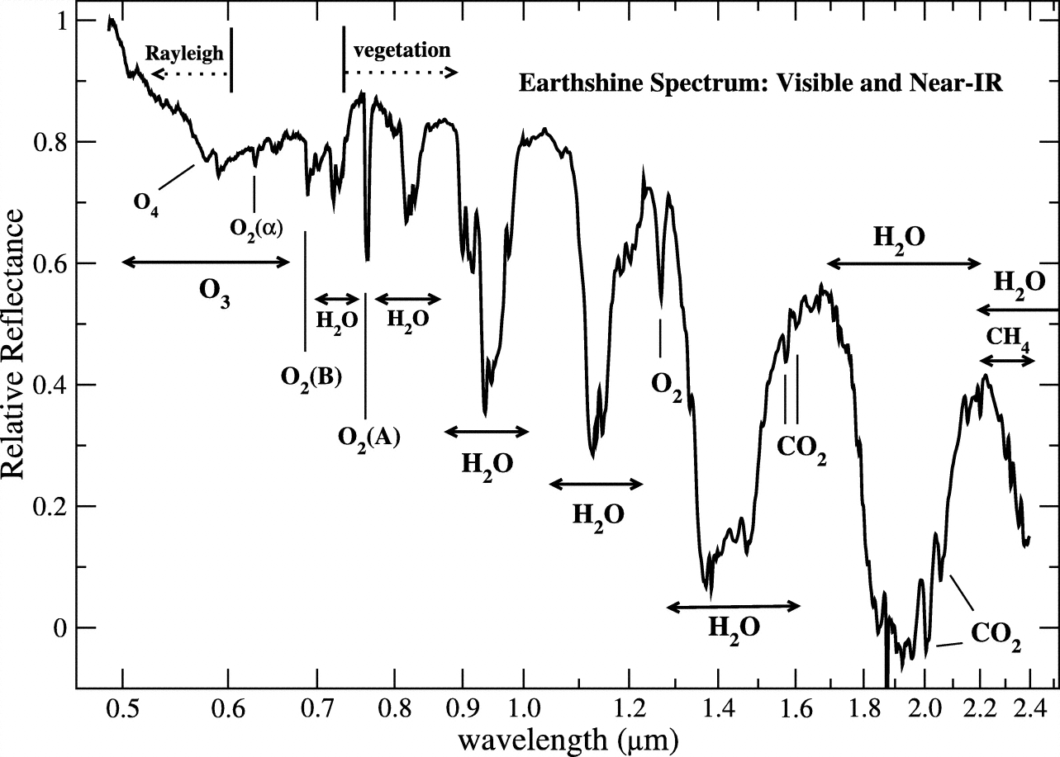
Extra-solar planets: > 5600 found
Earth-like Exoplanets Biomarker Spectra

Slide 7
Molecular Structure and Spectra
Too many atoms!
No spherical symmetry (spherical harmonics)
3-D instead of atomic 1-D (radial, electronic levels)
Molecular energy levels:
- electronic, vibrational, rotational
- symmetric and asymmetric stretching and bending

Slide 8
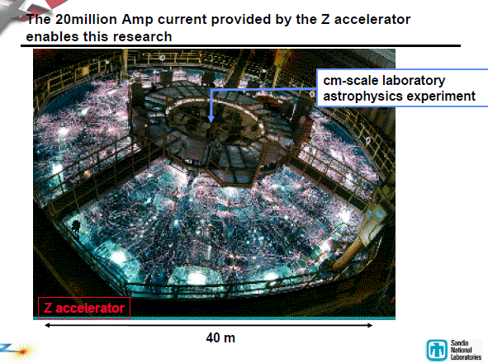
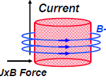
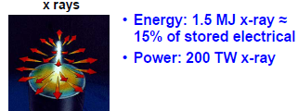
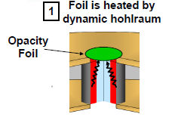
High-Energy-Density Physics
Inertial Confinement Fusion (ICF)
Sandia Z-Pinch Opacity Measurements
Z-pinch
Iron
Mix

Slide 9
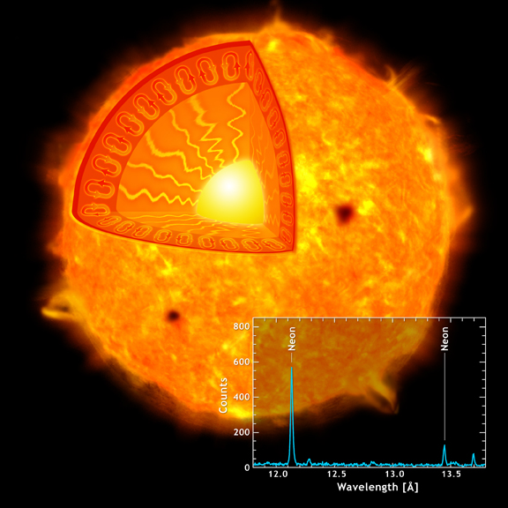
Stellar Interiors: Solar Structure
Stellar
Envelope:
RZ + CZ
Isolated
atoms +
plasma
interactions
Atmosphere
+ Corona
Convection
Zone (CZ)
Radiative
Zone (RZ)
Nuclear Core
Drake et al. 2005 (Nature 436/Chandra)

Slide 10
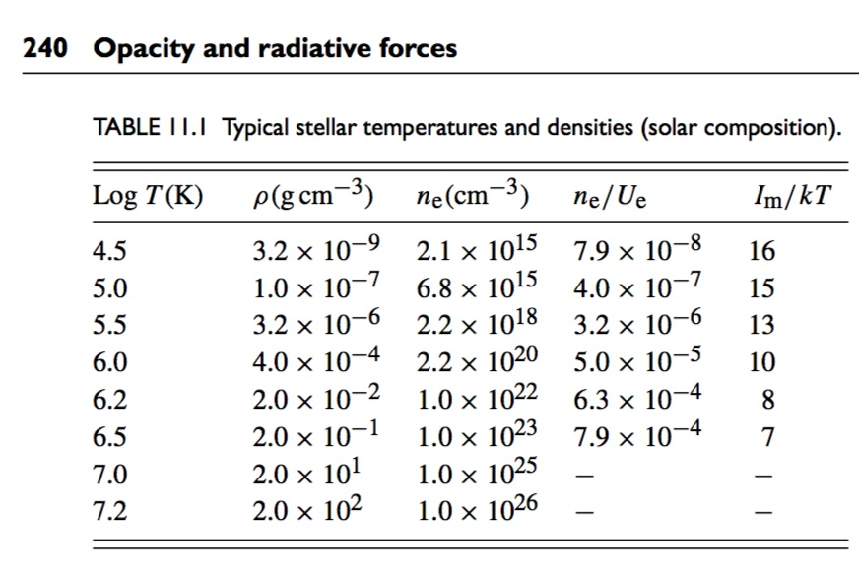
Solar Temperatures and Densities:
Atmosphere to Thermonuclear Core
Solar
Core
Core: Temp = 15 million K, Density > 150 g/cc

Slide 11
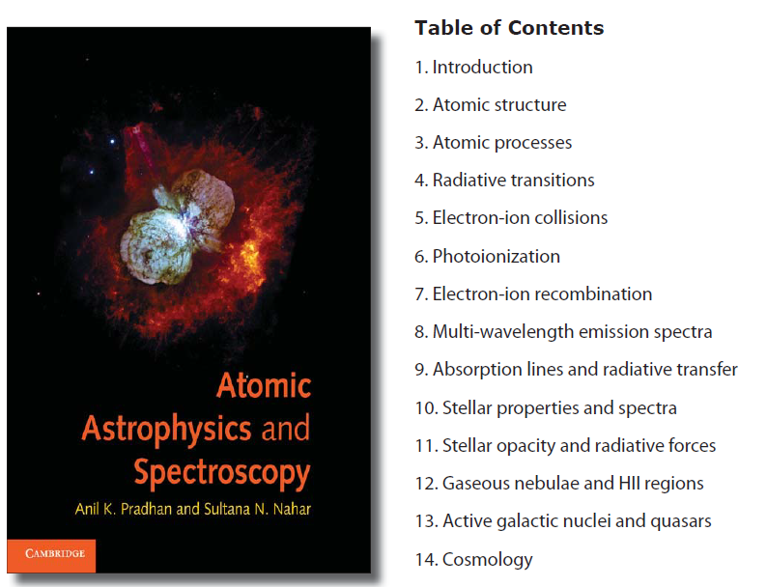
Opacity
AAS

Slide 12
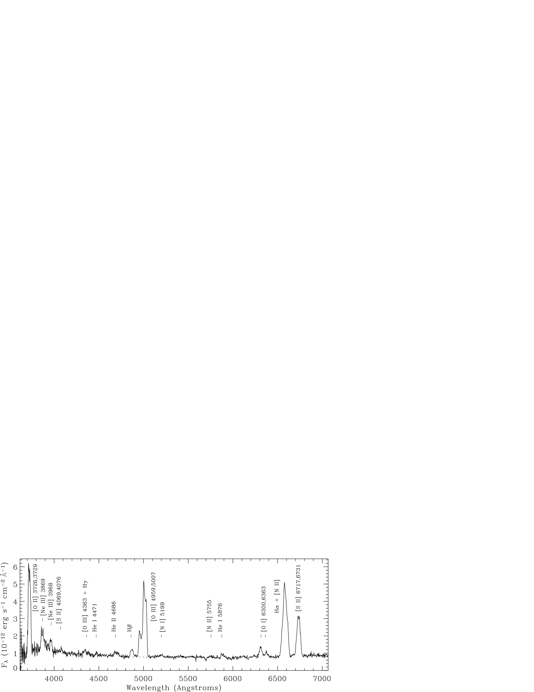
Spectral Density and Temperature Diagnostics
Visible (Optical) Emission Spectra
Wavelengths
Blue – 4000A, Red - 7000A
Fine structure doublets
1s²2s²2p3 (²Dº_{3/2,5/2} → ⁴Sº_{3/2})
Blue: O II – 3726, 3729
Red: S II – 6717, 6731 A
Green O III Lines - 4363, 4959, 5007
AAS
Energy Levels
O II, S II - Pg. 180
OIII - Pg. 273
Crab Pulsar Nebula Optical Spectrum

Slide 13
Opacity: Theory and Astrophysics
Ch. 11 From AAS: Opacity and Radiative Forces
Stellar astrophysics and structure:
Mass Conservation
Energy Generation and Luminosity
Hydrostatic Equilibrium
Radiation Transport
→ Radiative Diffusion
→ Convection

Slide 14
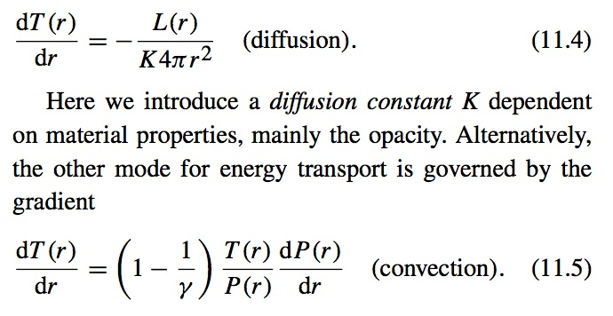
Radiation Transport in Stars
Equations of Stellar Structure
Mass conservation
Energy generation
Hydro equilibrium
Radiation Transport

Slide 15
Temperature and density profile of the Sun
1200
measured boundary
R_{CZ} = 0.713 + 0.001
Predicted R_{CZ}= 0.726
Thirteen σ difference
n_{e}
10²⁵
800
10²⁴
T_{e} (eV)
n_{e} (cm⁻³)
400
T_{e}
Temperature and density
at R_{CZ} (Helioseismology)
10²³
0
10²²
0.0
0.2
0.4
0.6
0.8
1
Bahcall et al, ApJ 614, 464 (2004).
Basu & Antia ApJ 606, L85 (2004).
R/R₀
radiation
convection
Boundary location depends on radiation transport
A 1% opacity change leads to observable RCZ changes.
This accuracy is a challenge – experiments are needed to know if the solar problem arises in the opacities or elsewhere.

Slide 16
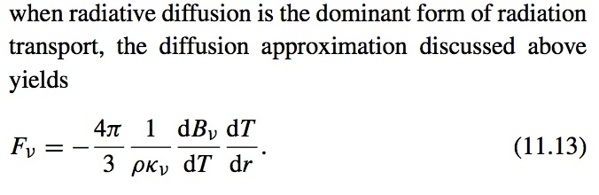
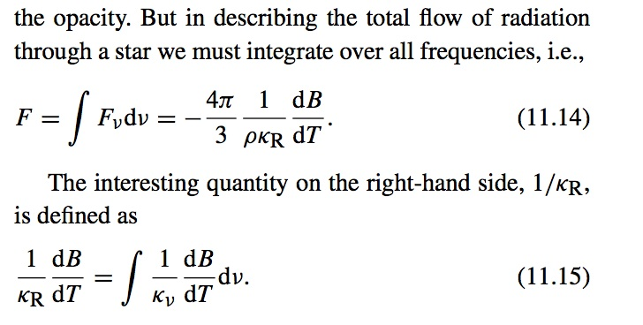
Rosseland Mean Opacity (RMO) κ_{R} in Eq. (11.15) governs the flow of radiation through matter with frequency-dependent opacity.
RMO is a harmonic mean of monochromatic opacity 1/κ_{ν}
averaged over the derivative of the Planck function B_{ν}(T).
RMO is analogous to the harmonic mean over electric current flowing through parallel resistors.

Slide 17
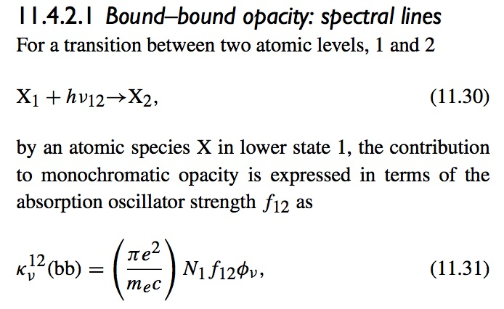
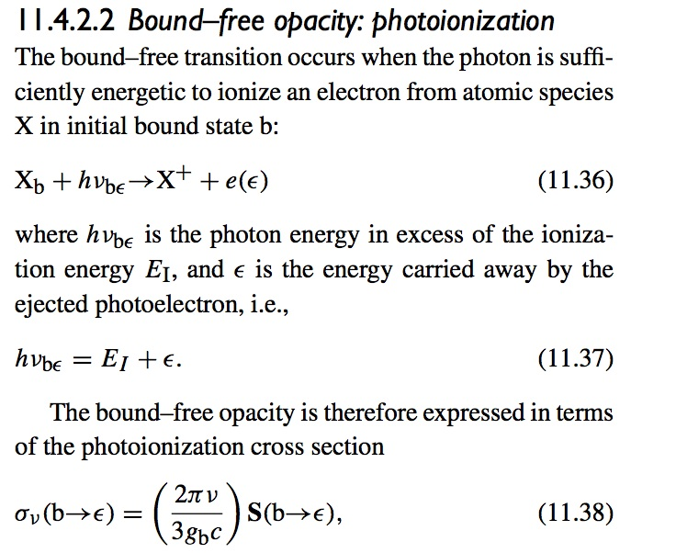
Atomic Physics of Opacity:
Bound-Bound and Bound-Free

Slide 18
Atomic Physics of Opacities
Recall that the total monochromtic opacity is:
bb → bound-bound → oscillator strengths
bf → bound-free → photoionization cross sections
ff → free-free → inverse bremsstrahlung
sc → scattering → Thomson, Rayleigh, Compton
May compute ff and sc with simple approximations
But need to calculate bb and bf with high accuracy

Slide 19
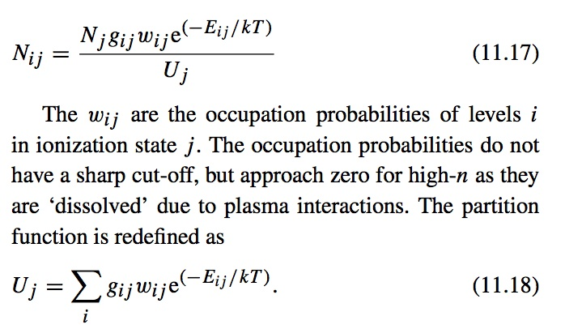
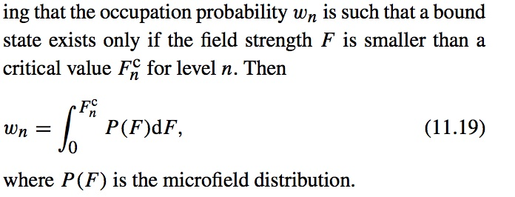
Equation-of-State (EOS)
Need an EOS that describes
the ionization state and atomic
level populations at all
relevant temperatures and
densities.
Modified Saha-Boltzmann
Mihalas-Hummer-Dappen (MHD)
“chemical picture” and
occupation probability w_{ij}
“Stellar Envelope”: Where Atoms exist and are not markedly perturbed by
plasma environment
(SYMP94)

Slide 20
Radiation Physics of Stellar Interiors
Propagation of radiation through matter
→ Opacities
- Frequency dependent absorption
- All elements (H-Ni) , all ions, all transitions
→ Equation-of-state
- Local Thermodynamic Equilibrium (LTE)
- Ionization states and occupation probabilities
- Mihalas-Hummer-Dappen: “chemical picture”
→ Iron most important contributor to stellar opacity

Slide 21
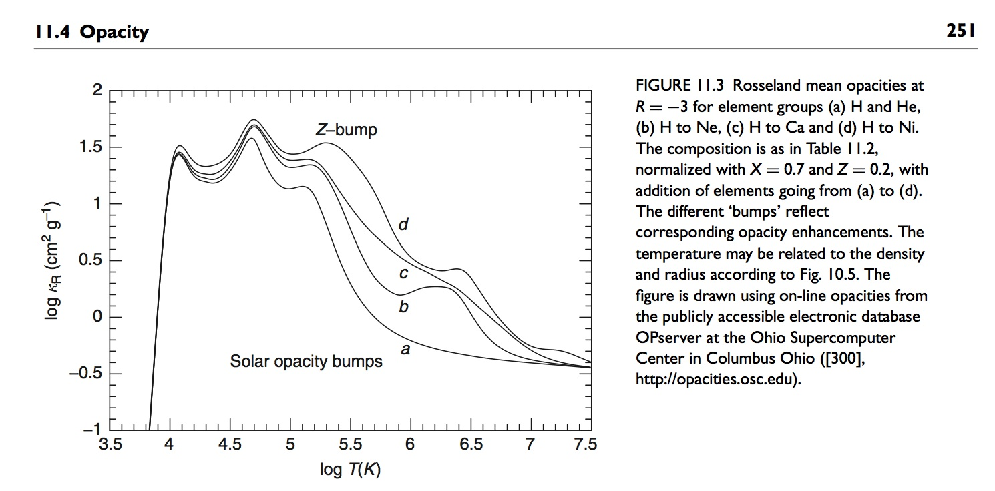
Elemental Stellar Opacity
H
He

Slide 22
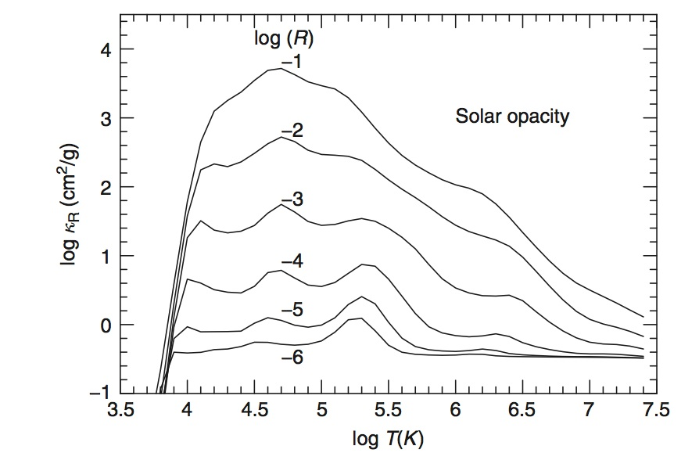
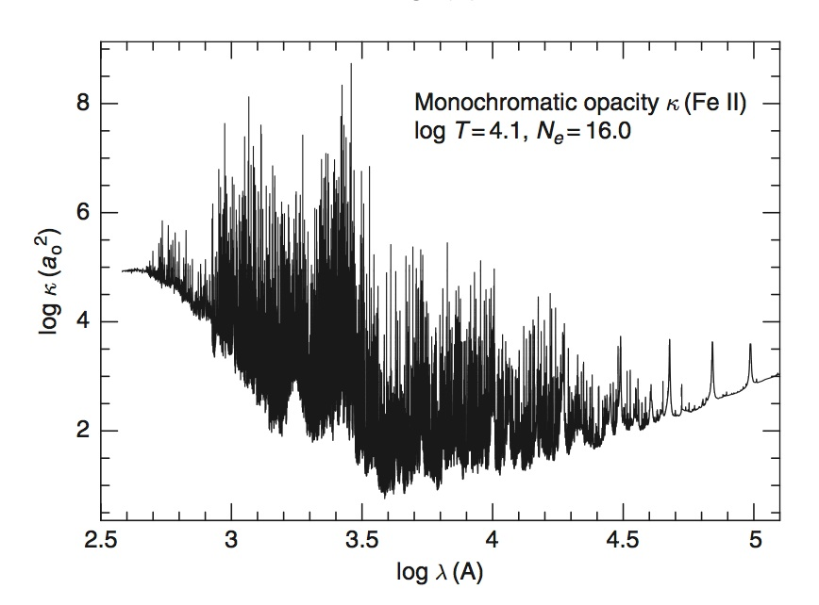
Rosseland Mean and Monochromatic Opacity
Log R
Log T
Monochromatic opacity
of Fe II
Rossseland Mean Opacities

Slide 23
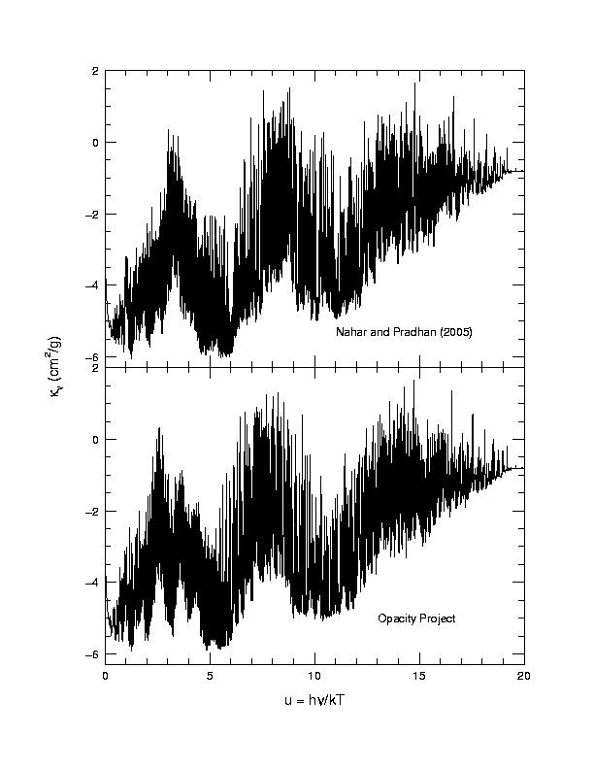
Recalculation of Opacities:
Monochromatic Opacity of Fe IV
Huge amount of atomic data for each ion
(e.g. 1.5 million
f-values for Fe IV)

Slide 24
The Solar Abundances Problem !!
New solar abundances
→ Disordant with solar models, structure, opacities
Latest spectroscopic determination of Volatile light elements (Asplund, Grevesse, Sauval, & Scott 2009)
→ Solar spectroscopy + 3D NLTE Hydrodynamic models
→ 30- 50% lower abundances of C, N ,O, Ne
than “standard” solar abundances (Grevesse and Sauval 1992)
→ But Refractory elements Mg-Fe abundances agree (meteorites)
Discordant with precise Helioseismology: solar oscillations
→ Sound speed and Boundary of the Convection Zone (BCZ)
→ Require mean opacities to be higher by up to 50% to reconcile new abundances in stellar models
Inverse relation between opacities and abundances

Slide 25
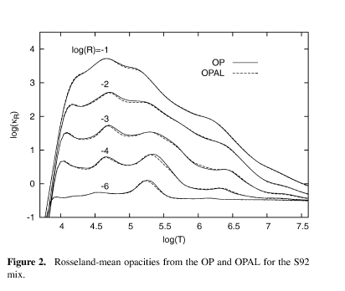
The Opacity Project (OP) and the LLNL-OPAL
Rosseland Mean Opacities (Standard Solar Mixture)
Log κ_{R} vs.
Log T
at
Log R =
ρ / (Τ/10⁶)³
Z
Solar
Core
OP and OPAL
Agree
3-5%
“Customized opacities for arbitrary mixture of elements
From on-line database OPSERVER at
Ohio Supercomputer Center: http://opacities.osc.edu

Slide 26
Accuracy of Opacities
Are existing opacities accurate?
Laboratory tests: Z-pinch experiments (Bailey et al.)
Uncertainty in heavy element opacities
What might be the problem ?
All opacities codes employ the same basic atomic physics: similar atomic structure codes
Fundamental physics of resonances missing from opacities calculations
Resonances treated as (bound-bound) lines
Resonances also affect the bound-free background

Slide 27
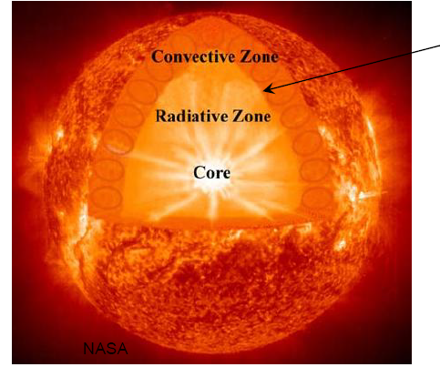
Stellar Radiation Transport and Opacities
Convection / Radiation
boundary R(BCZ) is highly
sensitive to opacity:
Measured → 0.713 +/- 0.001
Theory → 0.726 * R(Sun)
Helioseismology can reveal
differences at < 1%
KEPLER: Astroseismology
solar-type stars’ mass-radius
(with earth-like planets)
Opacities depend on
(i) Element abundances : Hydrogen to Nickel
(ii) Equation-of-state, (iii) Atomic physics: H – Ni
All elements, all ions, all transitions

Slide 28
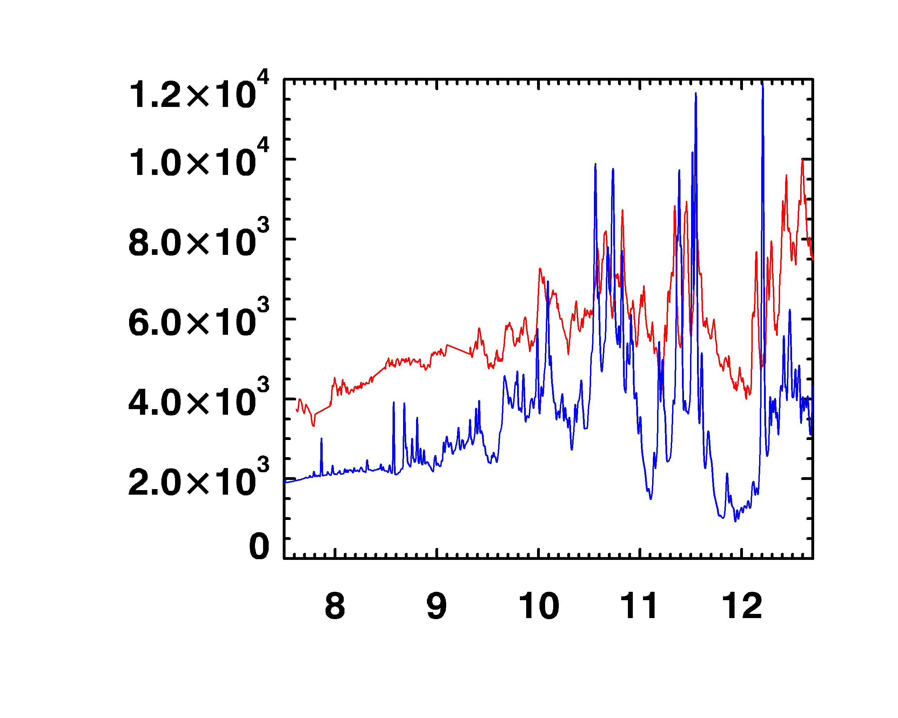
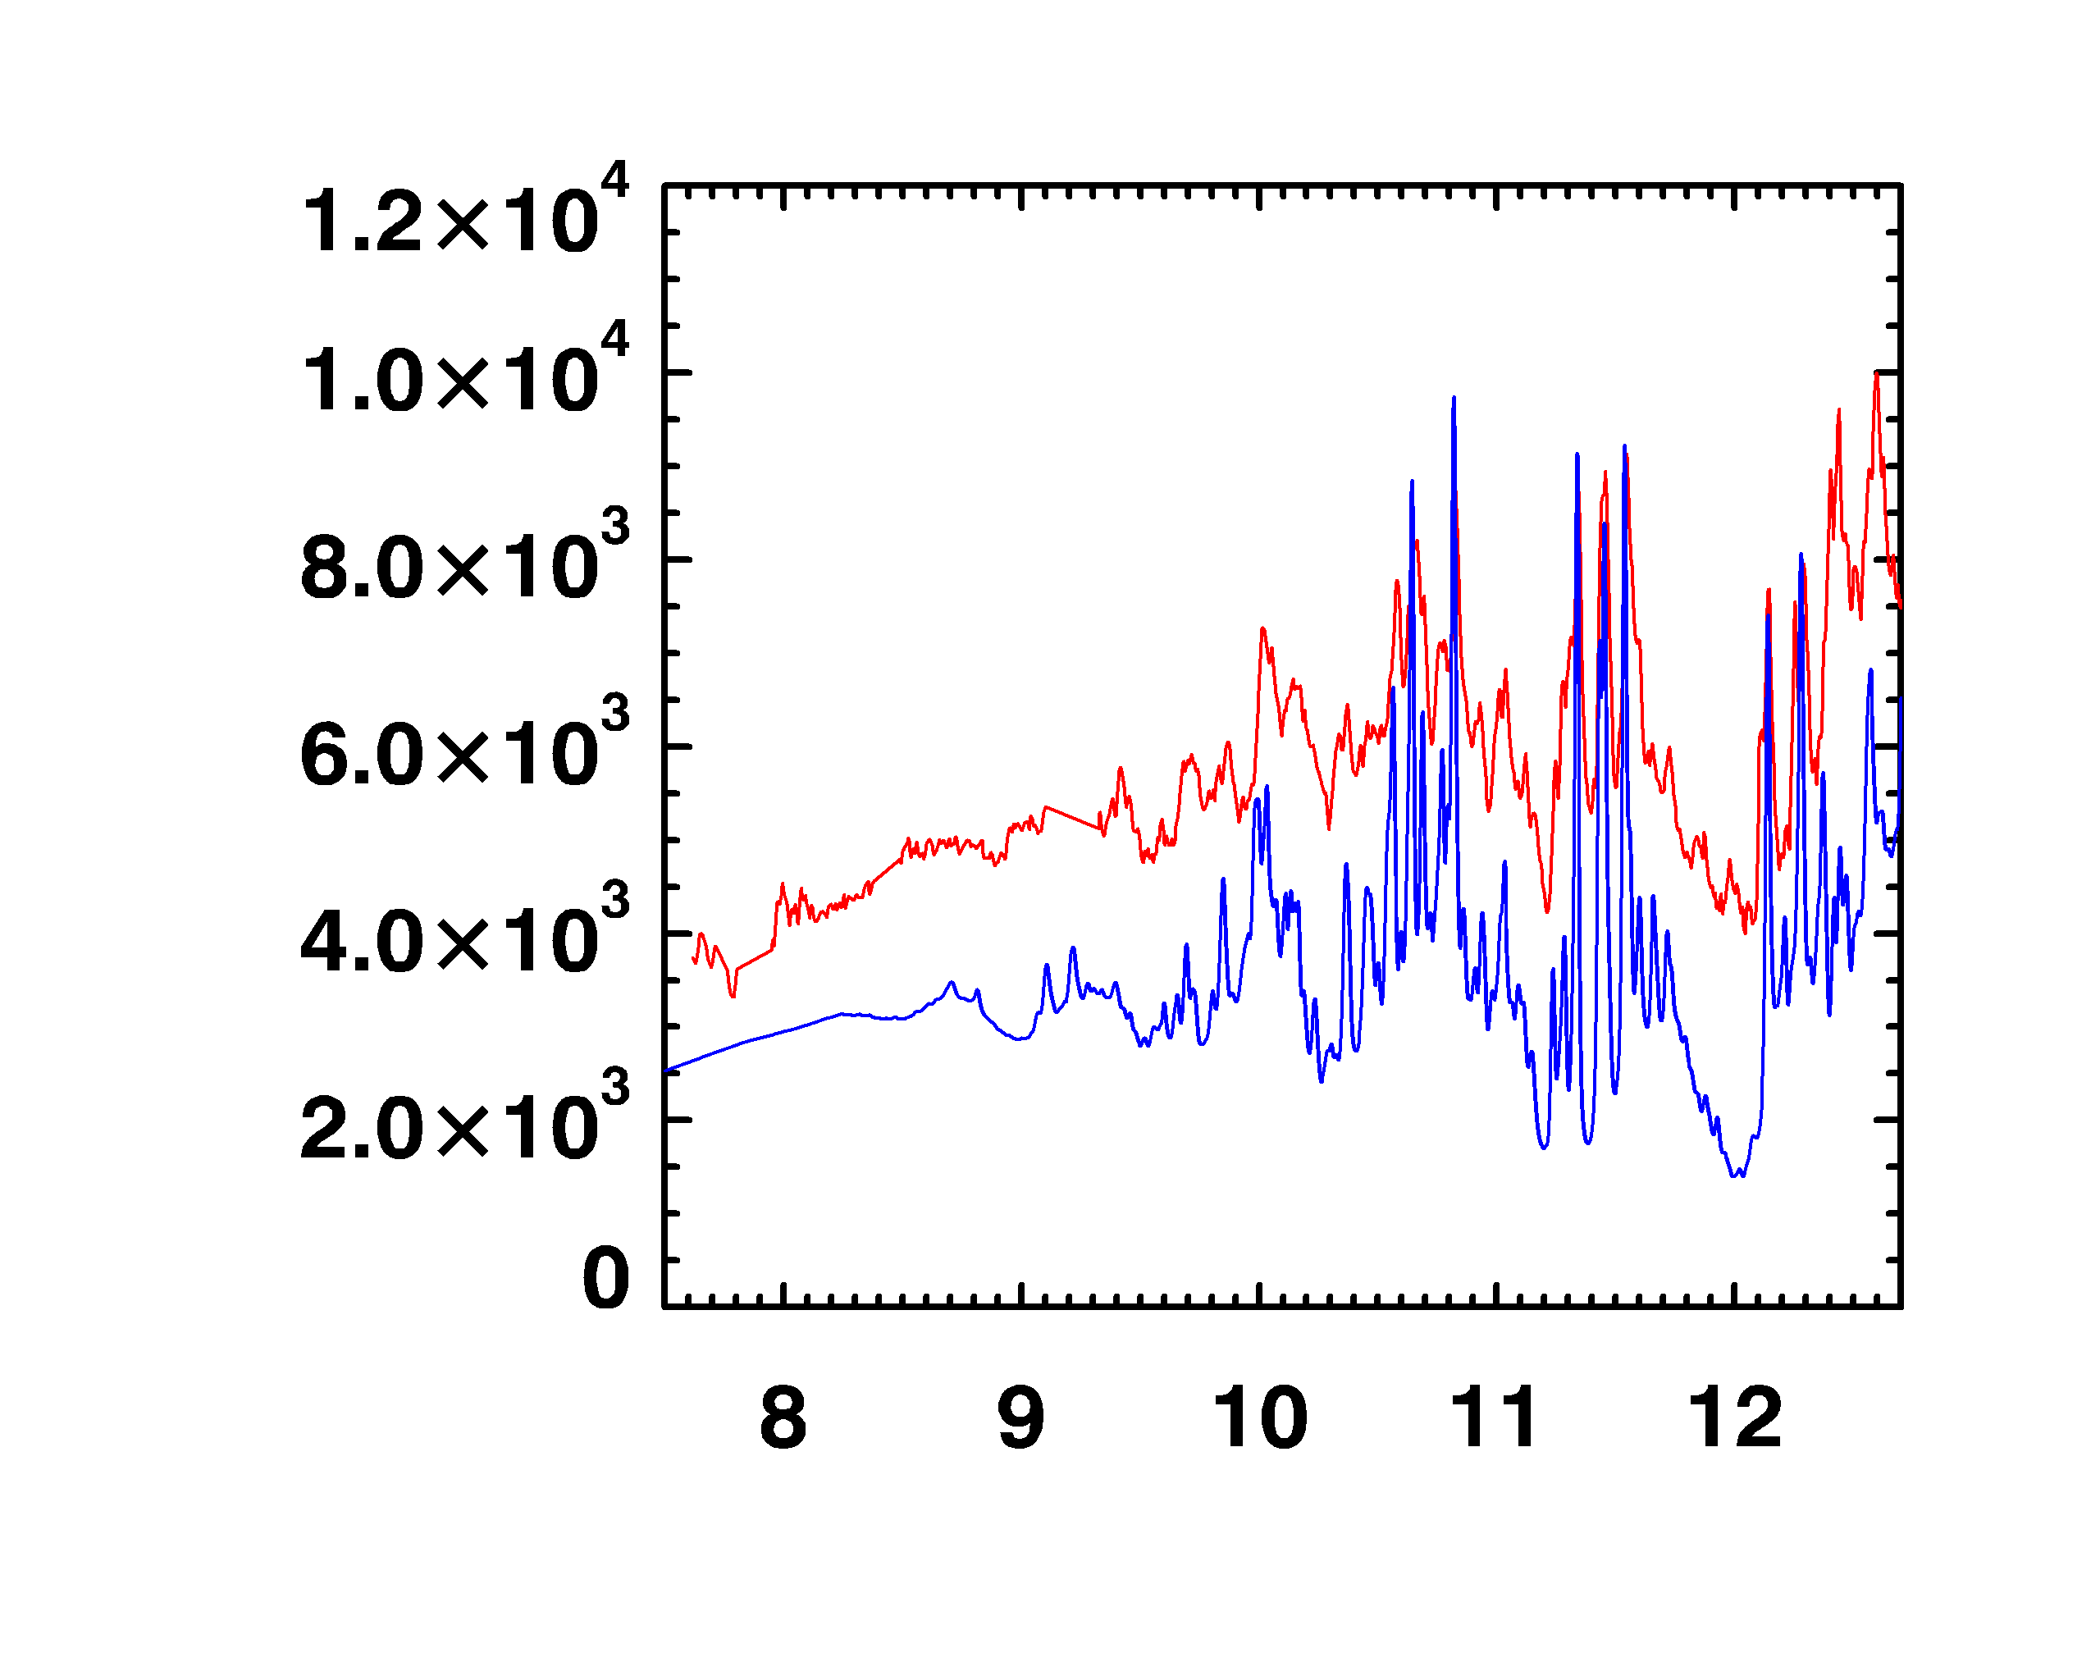
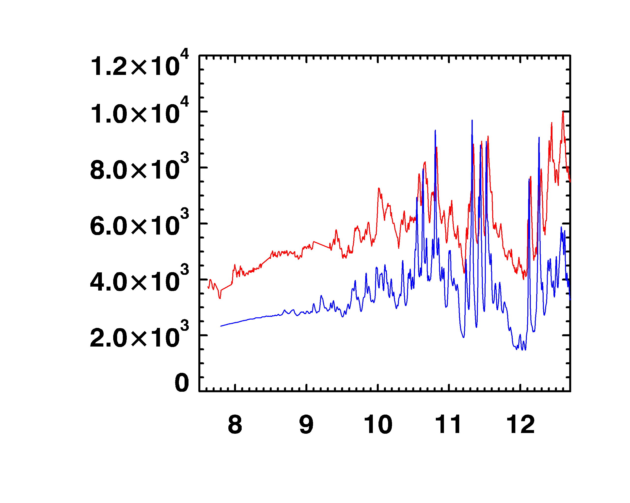
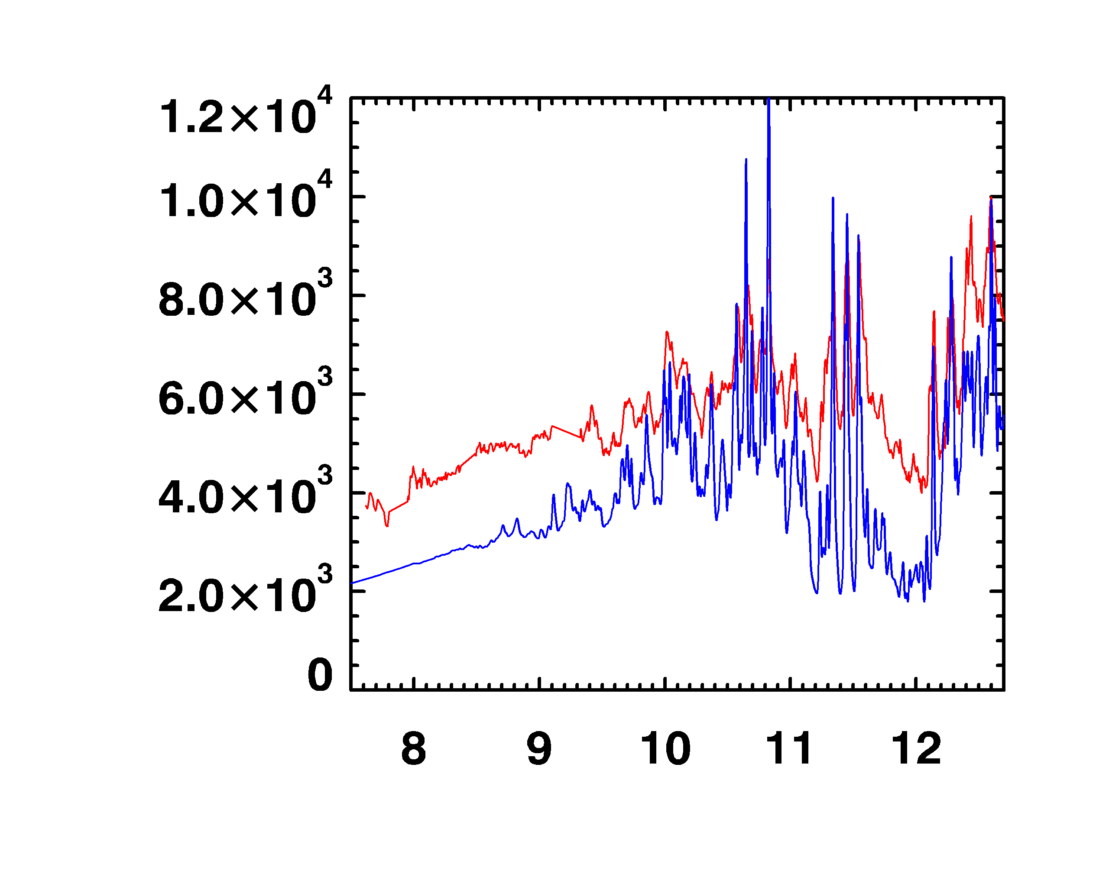
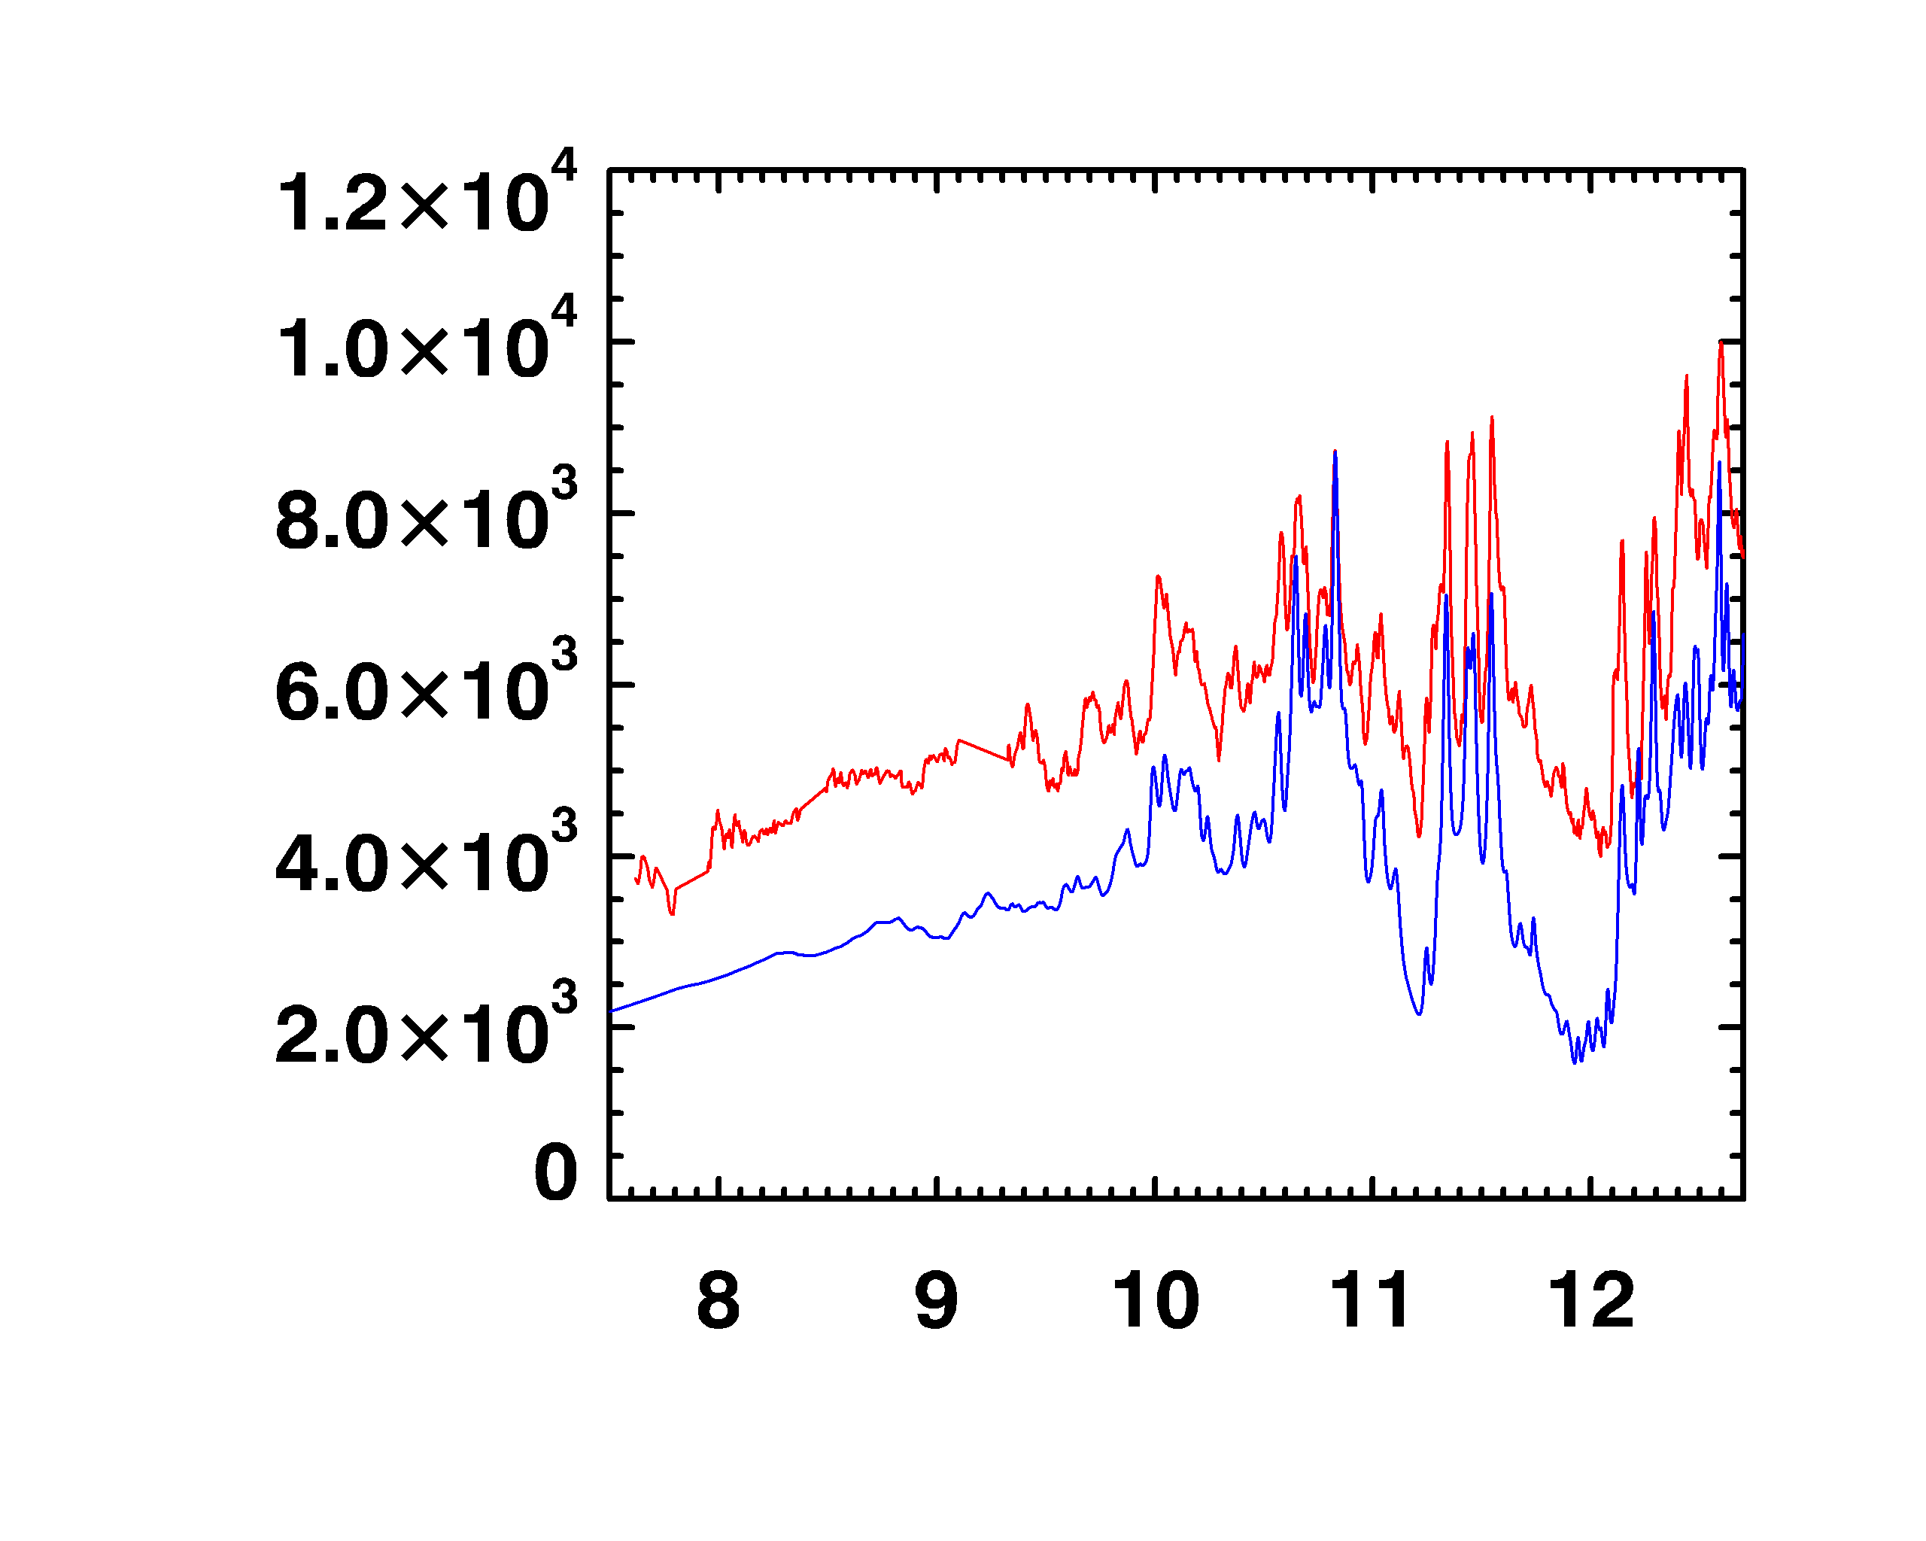
All opacity calculations disagree with Sandia-Z experiments
Measured
opacity is higher
than computed
Measured
bound-free is
greater than
computed
Theoretically
Redistribution
from b-b → b-f ?
Resonances !
Z;Be tamper 182 eV, 3x10²²cm⁻³
0.8
0.4
OP
0.0
0.8
0.4
SCRAM
0.0
0.8
Opacity (10⁴ cm2/g)
0.4
ATOMIC
0.0
0.8
0.4
OPAS
0.0
0.8
0.4
SCO-RCG
0.0
8
9
10
11
12
photon wavelength (Å)

Slide 29
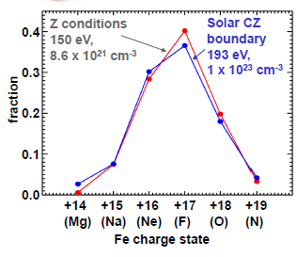
Iron Ions Dominant At The Base of the
Solar Convection Zone

Slide 30
Transitions in Fe with L shell vacancies influence the radiation/convection boundary opacity
solar interior
182 eV, 9x10²² cm⁻³
4
M-shell
10⁵
b-f
(ground states)
b-f
(excited states)
10⁴
2
10³
L-shell
0
opacity (cm²/g)
intensity (10¹⁰ Watts/cm²/eV)
Z conditions
155 eV, 1x10²² cm⁻³
10⁶
2
10⁵
10⁴
1
10³
0
200
600
1000
1400
hν (eV)

Slide 31
Atomic Physics of Plasmas
Why high accuracy on large-scale?
1. Rules out errors in atomic physics
→ focus on plasma or astro modeling
2. Neglected physical effects may be important, viz. channel coupling
→ resonances and bound-free background
3. Accurate data may be applicable for other scientific and technological applications
→ high-intensity laser-induced fusion

Slide 32
Atomic Calculations for opacities
Recall that we need bb and bf atomic data
Compute bb line oscillator strengths
→ Many atomic structure codes
Compute background bf cross sections
→ Central-field approximations
PROBLEM
Quantum mechanical interference between the bb and the bf → Resonances

Slide 33
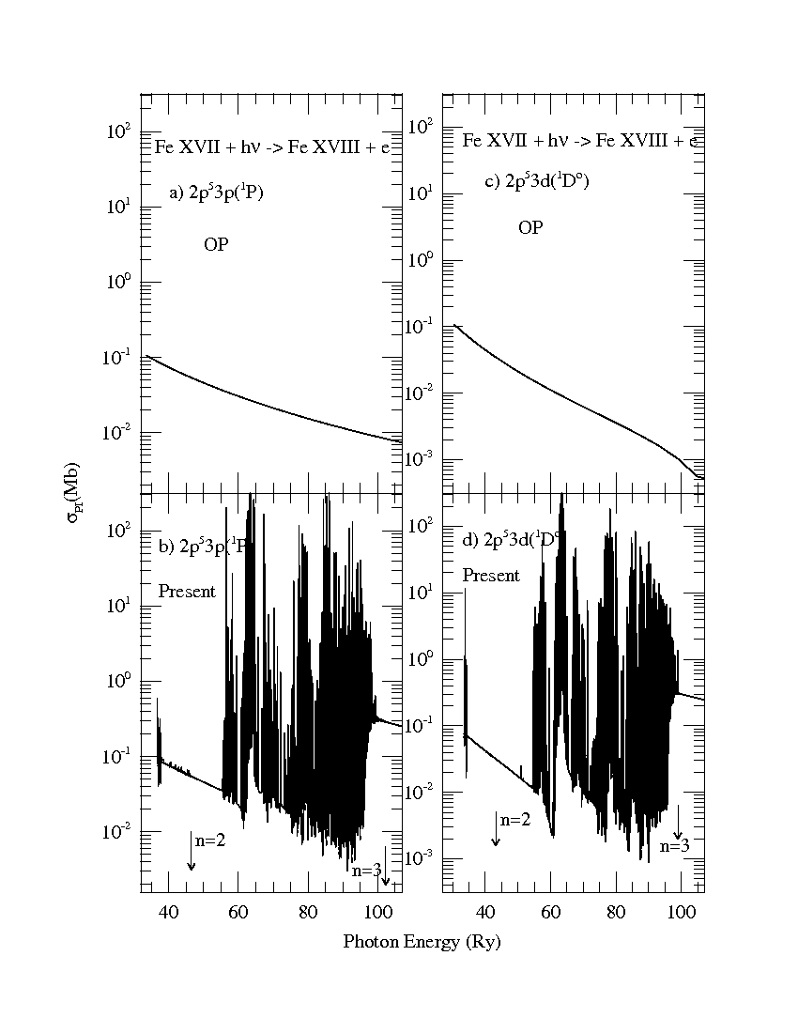
Bound-free opacity: Photoionization cross sections with Resonances
Opacity Project:
No resonances
Relativistic
R-matrix
Method
New Iron Project
Calculations
(Nahar et.al. 2011)
Large resonance enhancement

Slide 34
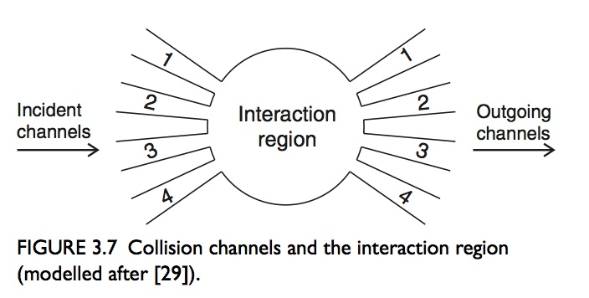
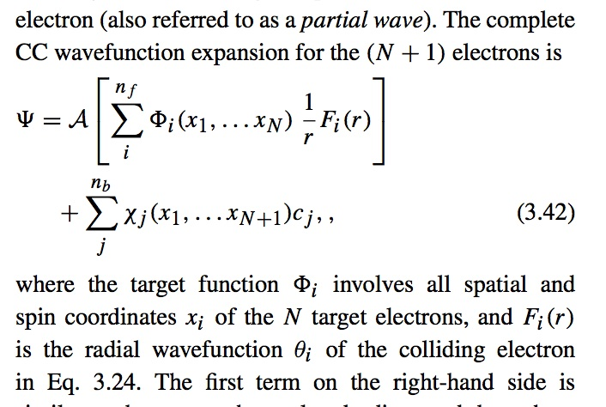
Coupled channel approximation: R-Matrix Method
Coupling between open
and closed channels
gives rise to resonances

Slide 35
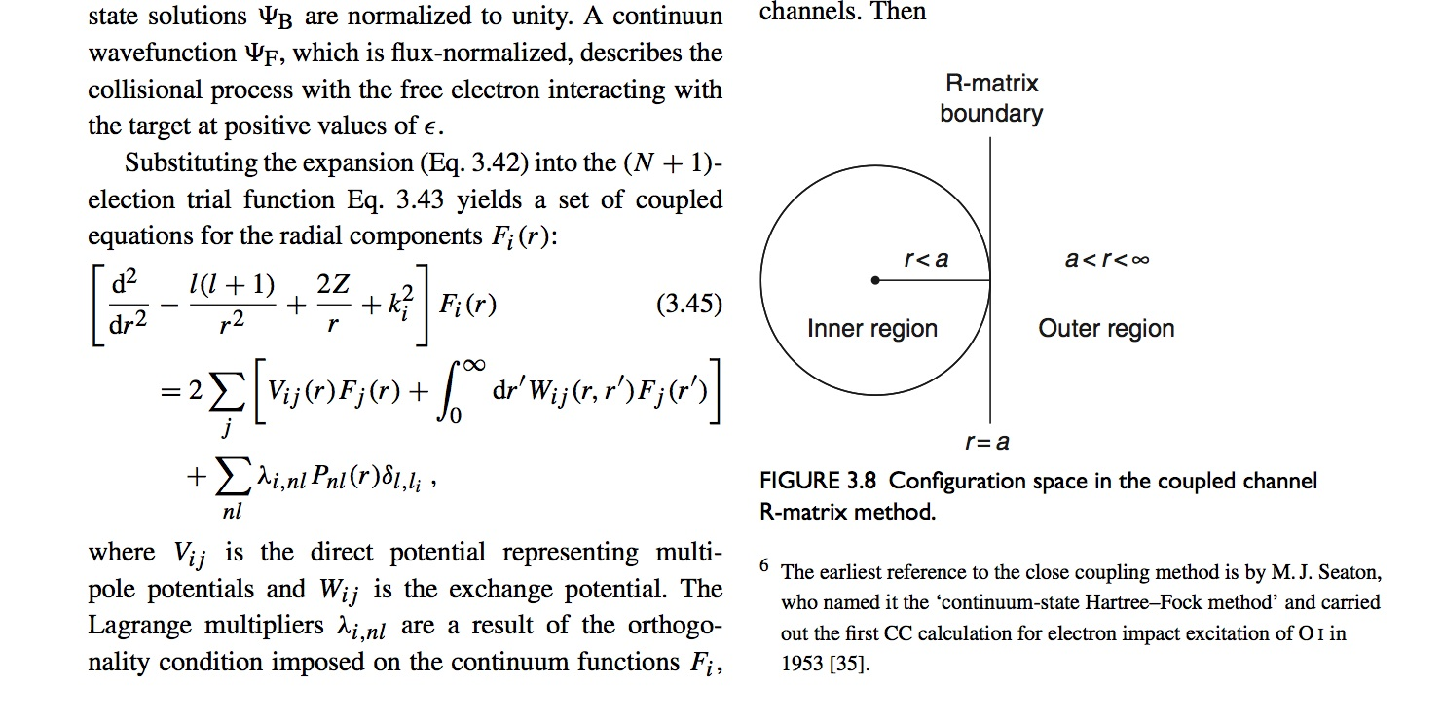
Coupled Integro-Differential Equations:
The R-Matrix Region and Boundary

Slide 36
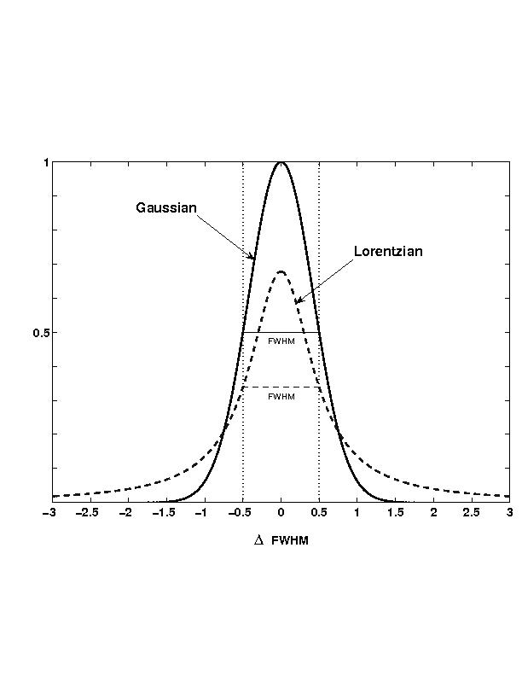
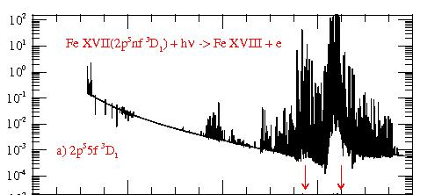
Resonances: Bound and continuum states
(Coupled wavefunctions)
Uncoupled bound states
Symmetric line profile
Coupled bound and continuum states (channels)
Autoionization
Asymmetric resonance profile
Coupled channel approximation:
The R-Matrix Method

Slide 37
Opacity and Resonances
Much of the opacity is through photoabsorption by inner-shell electrons in heavy ions
Inner-shell excitation leads to resonances in the bound-free continuum
BUT
These excitations are currently treated as
bound-bound transitions (lines)
Are the two equivalent?

Slide 38
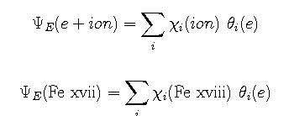
Photoexcitation-of-core (PEC) Resonances
n=4
levels
Coupled-channel wavefunction
n=3
(57 levels)
2s² 2p⁴ 3l
884 eV
PEC Resonances in
photoionization of
ALL excited bound states
n= 2
Fe XVIII
2s² 2p⁵
Fe XVII
2s² 2p⁶

Slide 39
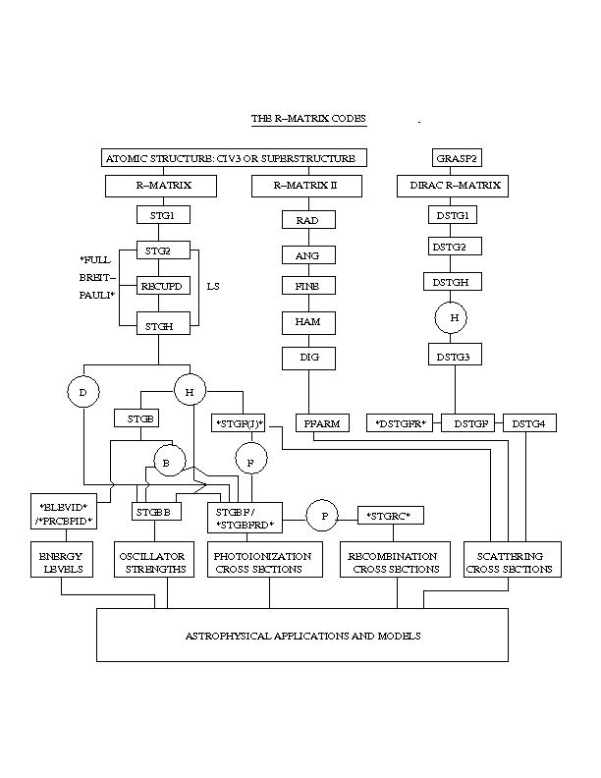
R-matrix Computational Package For Opacities:
Coupled-Channel Approximation

Slide 40
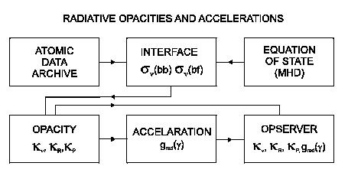
Opacity Project Codes

Slide 41
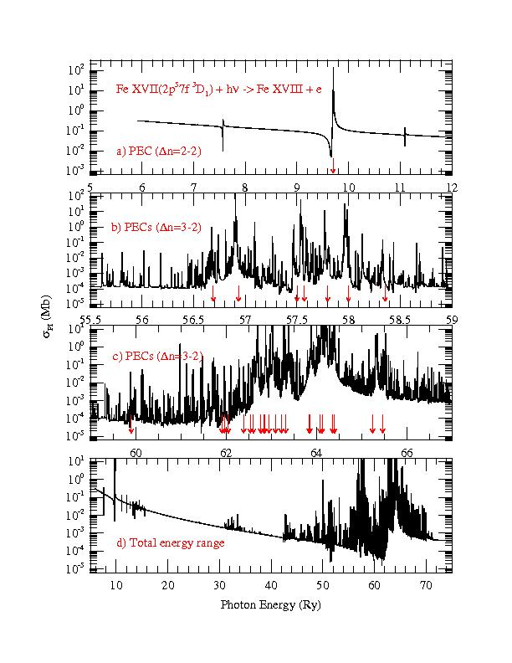
Resonances in photoionization cross section (Nahar et.al. 2011): hν + Fe XVII → e + Fe XVIII (core)
Distribution of resonance oscillator strengths is different from lines
(even if the integrated oscillator strength is the same)
Single level xsectn
Resonances due to
channel coupling
attenuate bound-free
continuum by orders of
magnitude over large
energy ranges
Arrays of strong dipole transitions in the core ion
Overlapping infinite
Rydberg series
Asymmetric profiles
at core transitions

Slide 42
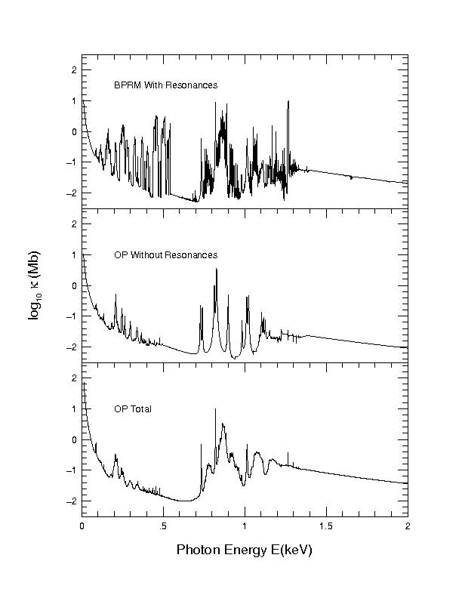
Breit-Pauli R-Matrix Opacities
(with fine structure resonances)
Nahar et.al. (Phys. Rev. A, 2011)
Monochromatic opacity
of Fe XVII
Plasma conditions
T = 2.25 MK
Log Ne = 23.0
Similar to solar BCZ and
the Sandia Z-pinch
Preliminary results (incomplete)

Slide 43
Consequences of Resonances in Opacities
Owing to quantum interference in the bound-free: channel coupling → autoionization
Intrinsically asymmetric resonance profiles
Giant PEC resonances → Much of the opacity may lie inthe bound-free
Monochromatic opacities energy distribution fundamentally different from lines
Resonances are broadened, smeared and wiped out more rapidly than lines
Continuum lowering of opacity below all thresholds in each ion

Slide 44
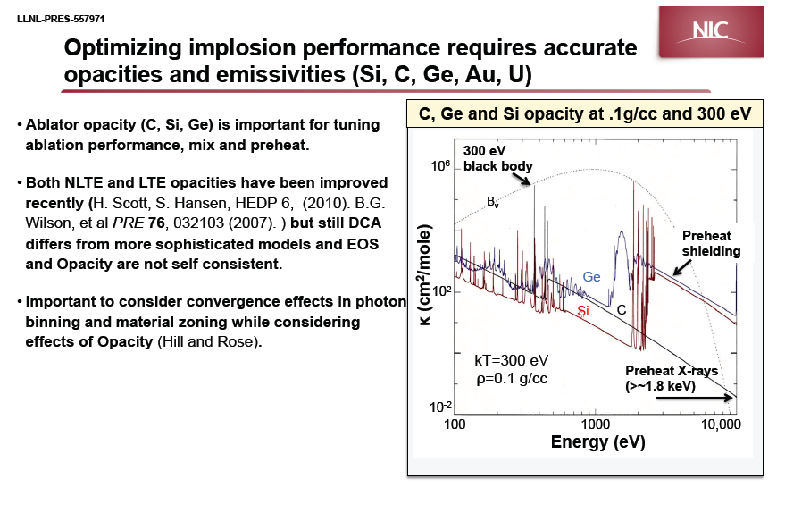
NIF Opacity Experiments

Slide 45
Summary: Theoretical and Astrophysical Opacity
Governs radiation transport through material media
Atomic-plasma-astro physics
Solar abundances problem → fundamental issues
→ Helioseismology models discordant
→ Z-pinch experimental benchmarks reveal problems
→ High-precision opacities needed in models
Missing atomic physics
→ Bound-free opacity not adequately treated
→ Resonances as bound-bound transitions (lines)
HED effects not fully incorporated
→ Plasma broadening of autoionizing resonances
The Iron Opacity Project

