Slide 1
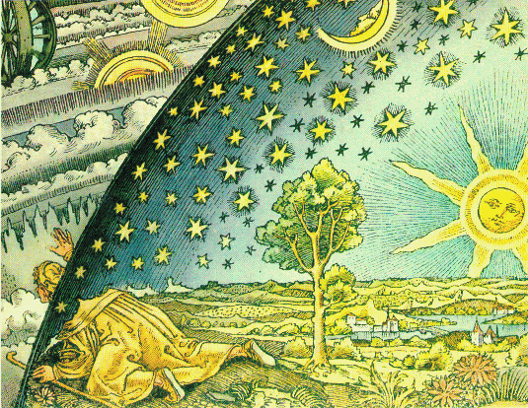
Alternative View of the Universe!

Slide 2
Back to the Beginning: Big Bang
Misnomer!
Expansion not explosion
No center or edges: isotropic and homogeneous
Redshift of galaxies and nuclei of galaxies with active black holes → recession velocity
Redshift: z = λ (obs) − λ (rest)
λ (rest)

Slide 3
“Three Pillars” of Big Bang Theory
Redshift of galaxies
Look for brightest active galaxies powerd by black holes
2. CMB (Cosmic Microwave Background)
Varies with look-back time and temperature
3. BBN (Big Bang Nucleosynthesis)
Primordial proportion of H, He and isotopes

Slide 4
The Big Bang: Empirical Evidence
All of the following observational facts would be difficult to explain but for the BB expansion
Recession of galaxies
Hubble expansion: Redshift-distance relation
No center or edge: Large-scale structure
Cosmic Microwave Background
Big Bang Nucleosynthesis (BBN): H, D, He, Li
Age of the Universe and stars
Olber’s paradox resolved

Slide 5
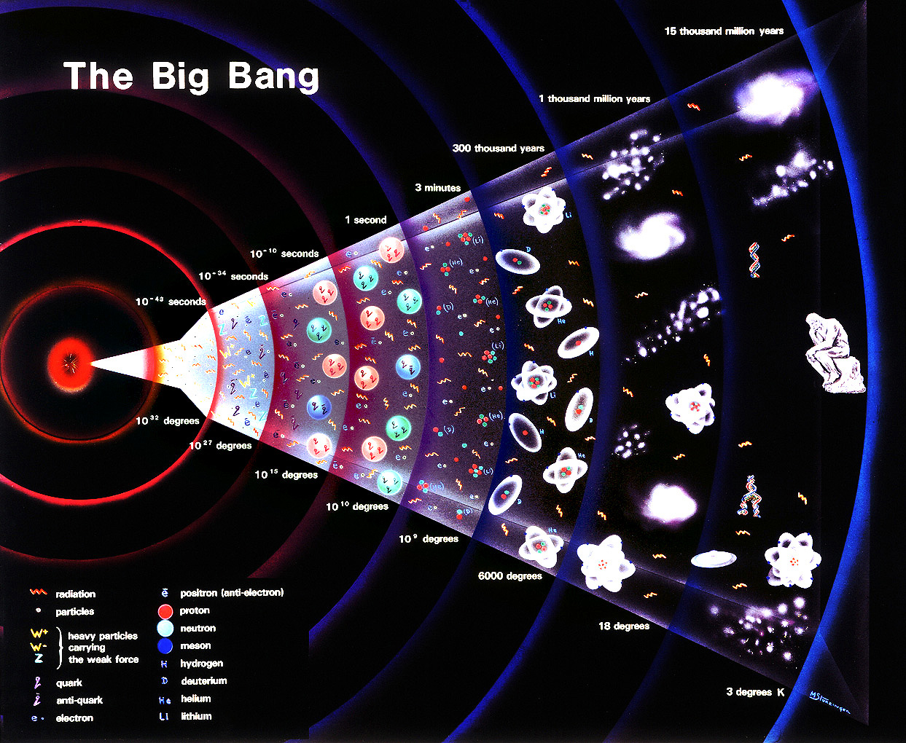

Slide 6
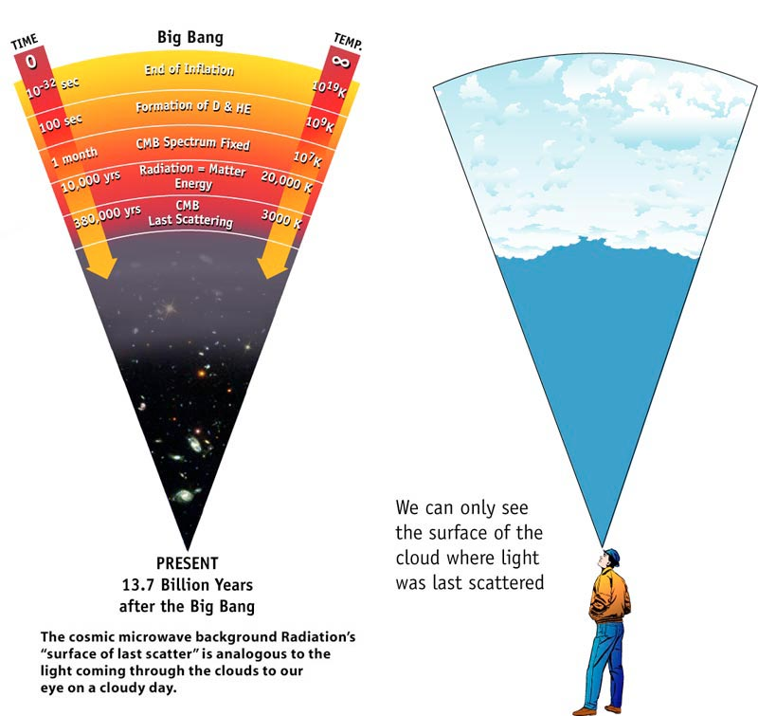

Slide 7
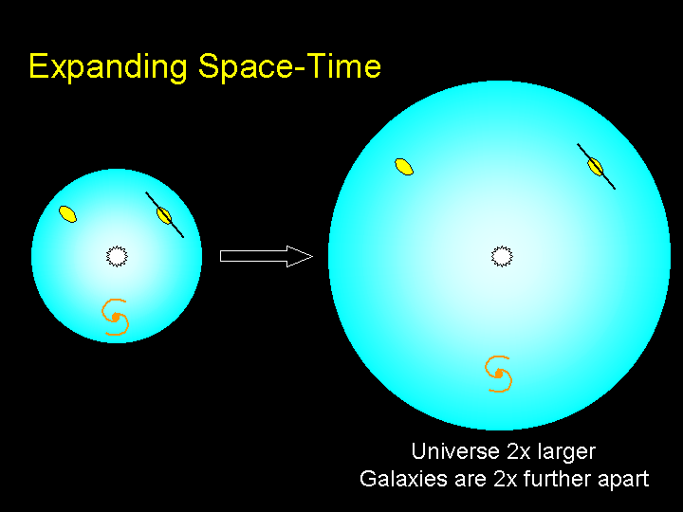

Slide 8
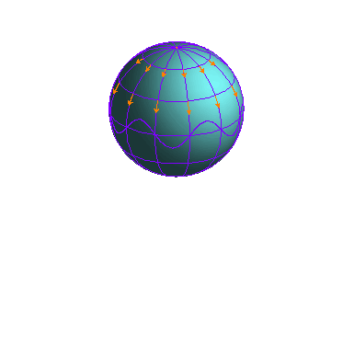

Slide 9
Olber’s Paradox Resolved
Universe is expanding and finite
Time since the Big Bang → Age of the Universe
“Observable” Universe distance: 13.7 LYs
Light from galaxies outside of this distance has not yet reached us
Actual size of the Universe greater than 13.7 Lys
Depends on expansion speed and acceleration or deceleration due to matter/energy density in the Universe

Slide 10
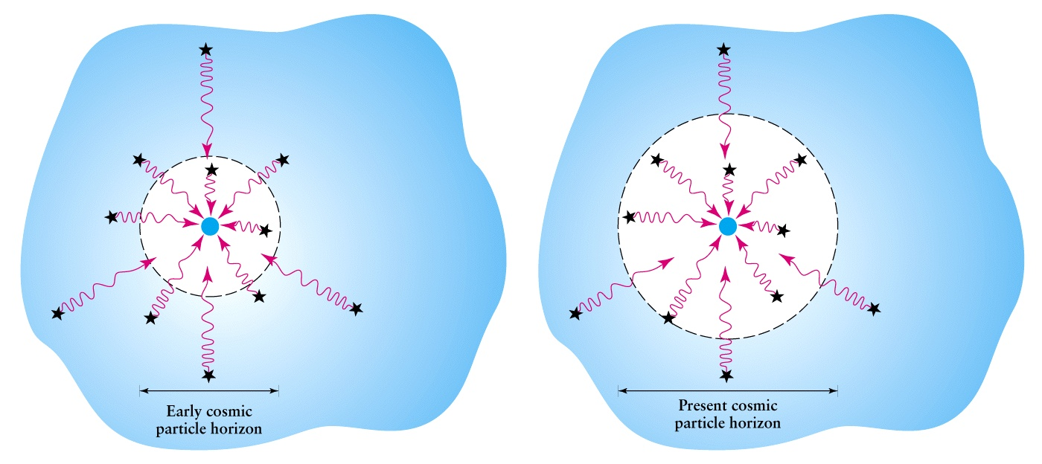
Cosmic Horizon: Farthest visible distance at a given time
Partial solution to Olber’s paradox: we can only see out to the cosmic Horizon at any given epoch in the history of the Universe; light from objects outside will not have reached us.

Slide 11
Background radiation and temperature of the Universe
Radiation from the Hot Big Bang must fill the whole universe
As the universe expands, the temperature must decrease
Temperature at past epochs: T (z) = T_{o} (1+z)
Must be able to detect this background radiation – signature of the Big Bang
Penzias and Wilson detected this Cosmic Microwave Background Radiation (CMBR)
But what about (slight) deviations from the otherwise smooth CMB ?

Slide 12
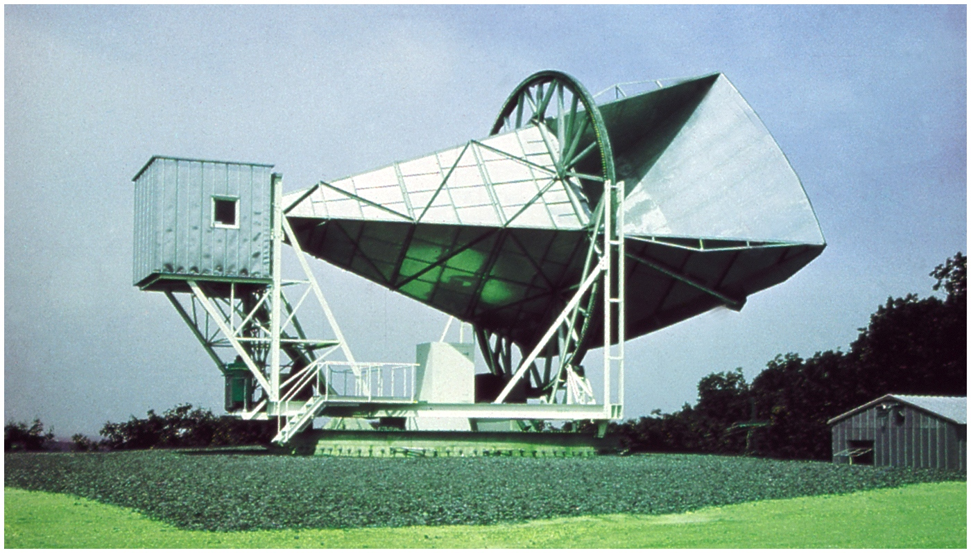
Microwave antenna used by Penzias and Wilson to detect the CMBR

Slide 13
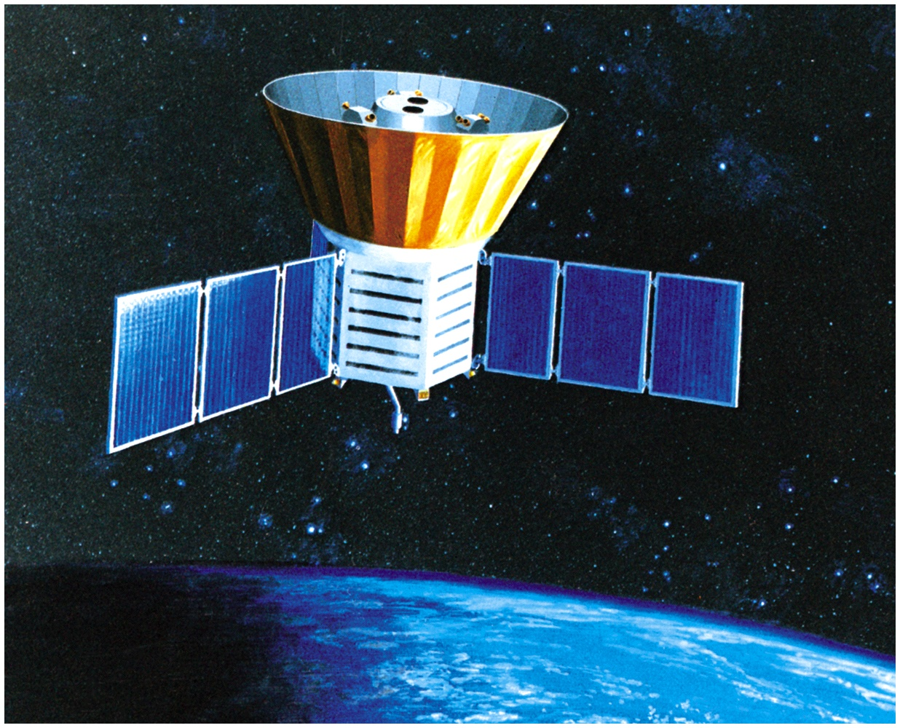
The Cosmic Background Explorer (COBE) Spacecraft

Slide 14
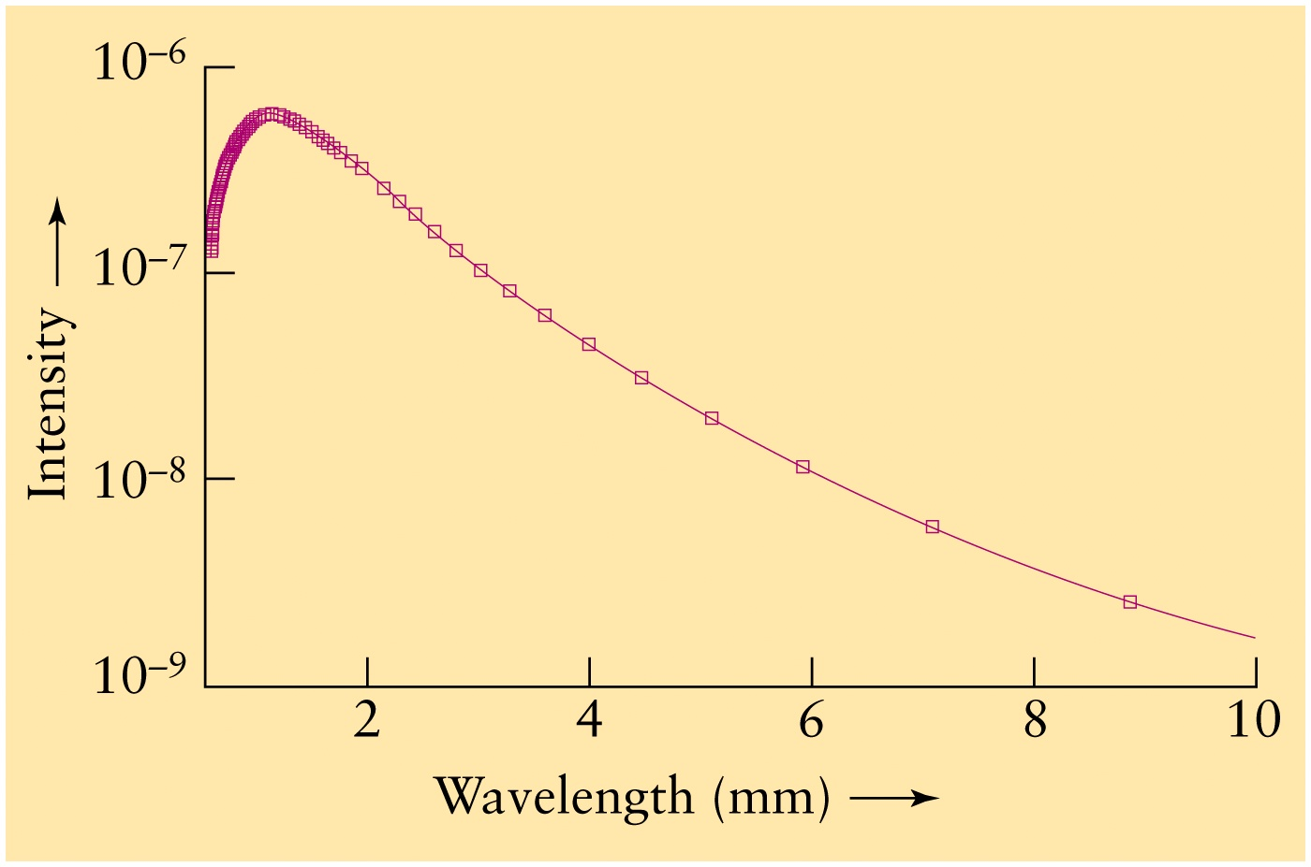
Cosmic Microwave Background Radiation (CMBR)
Black-Body radiation curve at 2.7 K
peak wavelength ~ 1 mm
COBE Results for the CMBR: The Universe is a perfect blackbody
at a radiation temperature of 2.73 K

Slide 15
Cosmic Microwave Background
Universe is filled with radiation
Extremely uniform, isotropic, and homogeneous
→ The Cosmological Principle
Perfect blackbody with temperature 2.73 K
Temperature increases with redshift
T(z) = T_{o} (1+z)
Universe cools as it expands

Slide 16
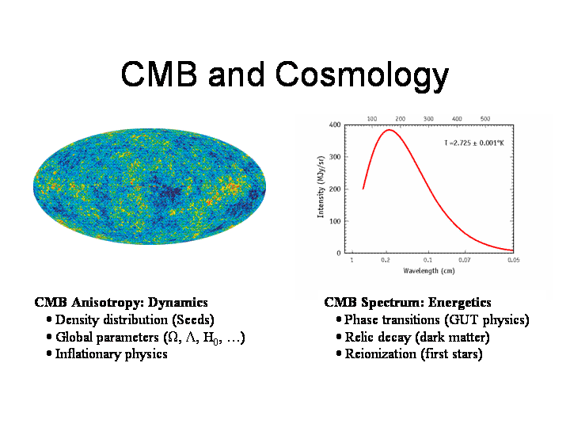

Slide 17
Hubble’s Law
All galaxies show a redshift in observed wavelengths → moving farther apart
Measured redshifts z related to velocity v and distances d → v = H_{o}d
Isotropic expansion, no observable center
Resolves a conundrum in General Relativity
How do we determine distances ?
Look for brightest stars and galaxies

Slide 18
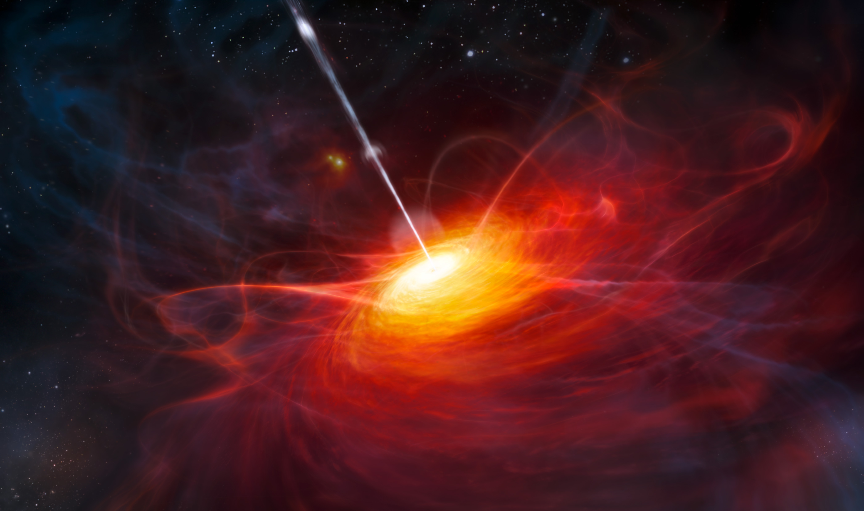
Artist’s rendition of an active galactic nucleus with jet of relativisitic particles powered by supermassive black hole (usually observed at radio wavelengths)

Slide 19
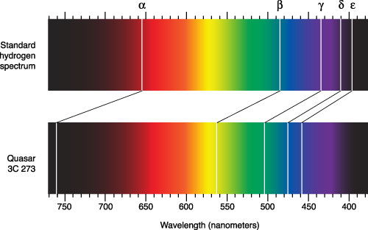
Redshifted hydrogen Balmer Series lines:
Quasar 3C273 – Active galactic nucleus powered by a supermassive black hole

Slide 20
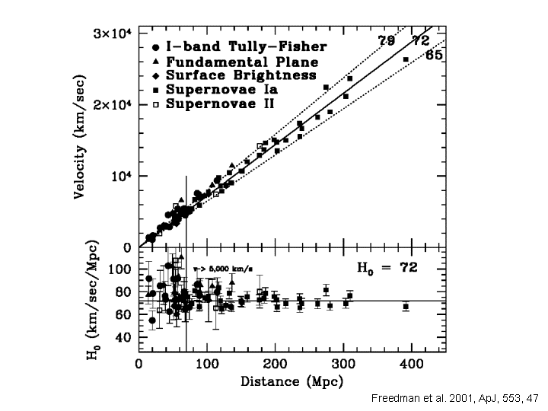
H_{o} depends
fit to data

Slide 21
Ages of the Universe and Stars
Hubble’s constant → Age = 1/H_{o} (13.7 Gyr)
Stellar astrophysics → Ages of stars
Oldest stars < 14 billion years
Universe is finite in space-time, but expanding
Need to measure H_{o} using Hubble’s law
Latest WMAP value: H_{o} = 70.4 +/- 1.4 km/s-Mpc
Calculate the range of the age of the Universe

Slide 22
Atomic Matter: Recombination
What were the first atoms formed?
Hot and dense CMB at Big Bang
→ Radiation and matter coupled
→ Matter: Fundamental particles – baryons, leptons (fermions, bosons)
→ baryons (protons, neutrons, etc.), leptons (electrons, muons, etc., )
→ Hot radiation cosmic background (redshifted photons)
Cooling to about z ~ 1000 or 400,000 yrs
→ T ~ 30,000 K
→ UV (not microwave) radiation background (CUB)
→ Atomic recombination
→ Neutral Hº (p⁺ + e⁻) or HI, He⁺ or HeII, Heº or HeI
Radiation and Matter de-couple
Universe becomes transparent to radiation flow
Recombination epoch: Last photon scatter

Slide 23
Big Bang Nucleosynthesis (BBN)
Lightest atoms formed first
Observationally, in same proportion
BBN → Primordial matter H: D: He: Li
Nuclei made of baryons: protons, neutrons
Matter/energy: Baryon-to-photon ratio η
Very small range of η accounts for primordial distribution of elements
BBN: η = 6 x 10⁻¹⁰ baryon-to-photon ratio

Slide 24
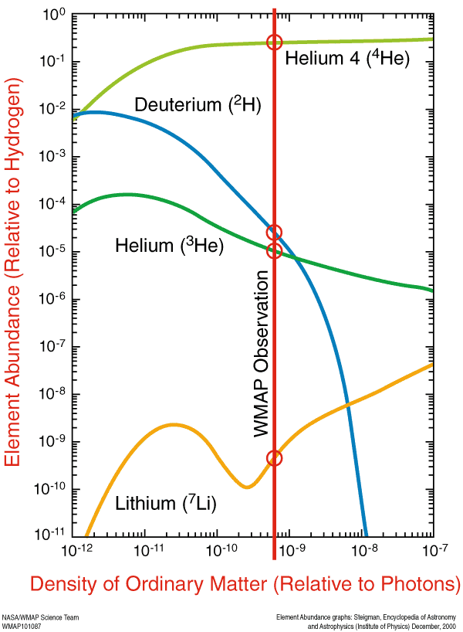
Big Bang
Nucleosynthesis &
baryon-photon ratio
Primordial Abundances
Helium
Number ⁴He:H → 7:90
Mass → 28:70
Deuterium
D(²H):H → ~ 0.0001

Slide 25
Cosmological Distance Ladder
Several methods:
- Trigonometric parallax (d = 1/p), Earth as baseline
up to 100 pc (gd based) - 1 kpc (Hipparcos Satellite)
- Spectroscopic parallax: spectral type of star gives absolute L on H-R diagram, up to 50-60 kpc
- Cepheids and RR Lyrae: up to ~30-40 Mpc (using Hubble Space Telescope), out to about Virgo cluster
- Tully-Fisher Relation: L is proportional to the Doppler width of the 21 cm H-line (proportional to mass and L)
- Supernovae: up to a few hundred Mpc (using HST); brightest light sources
Each step calibrates the next one – “bootstrap method”

Slide 26

Observed Flux and Luminosity
Distance Modulus: m – M = 5 Log (d/10)
m – measured (apparent) magnitude
M – absolute magnitude at 10 pc

Slide 27
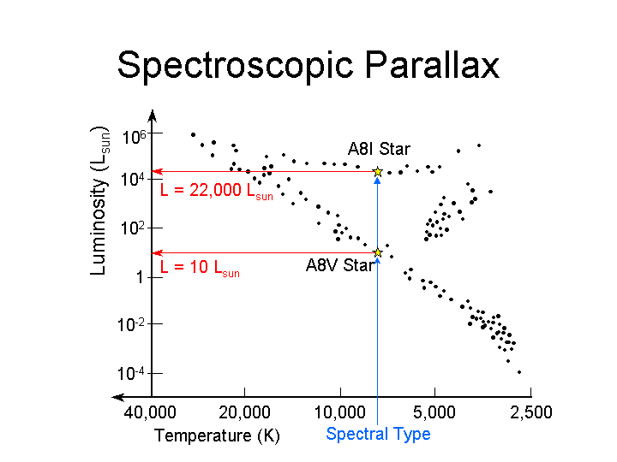
Determine spectral type and temperature → Absolute luminosity (M) on HR diagram

Slide 28
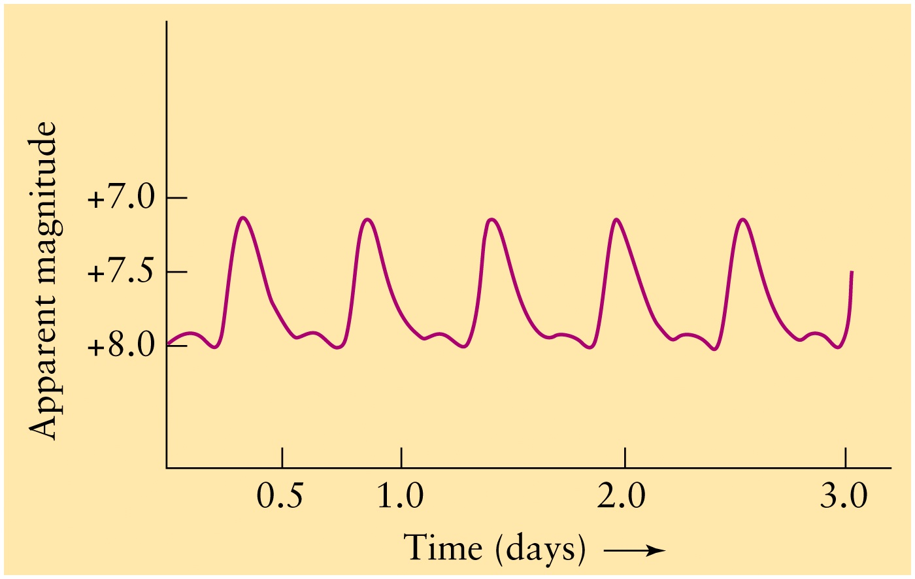
Cepheid Stars: Absolute Luminosity (M) Known from Period
Variable apparent magnitude (m) with Time (days)
Distance modulus: m-M = 5 log (d/10) → distance

Slide 29
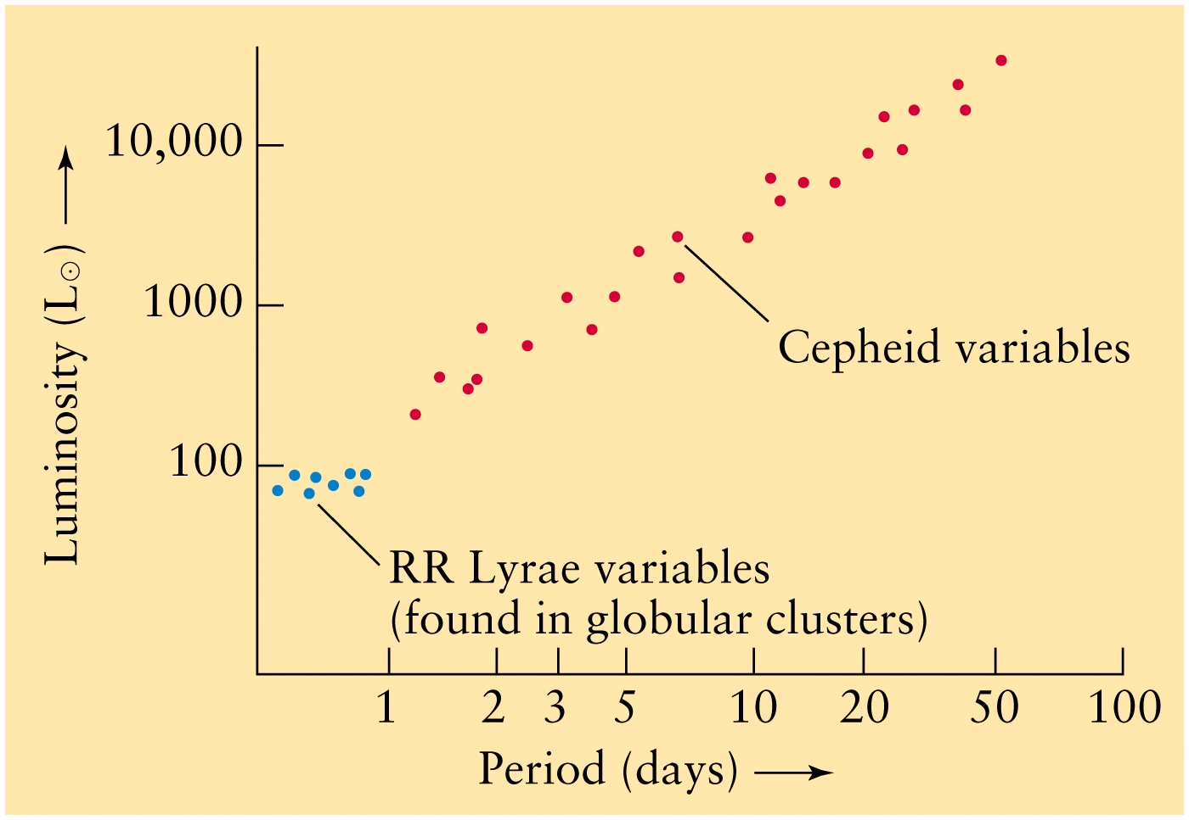
Period-Luminosity Relation:
Pulsating Cepheid, RR Lyrae Stars

Slide 30
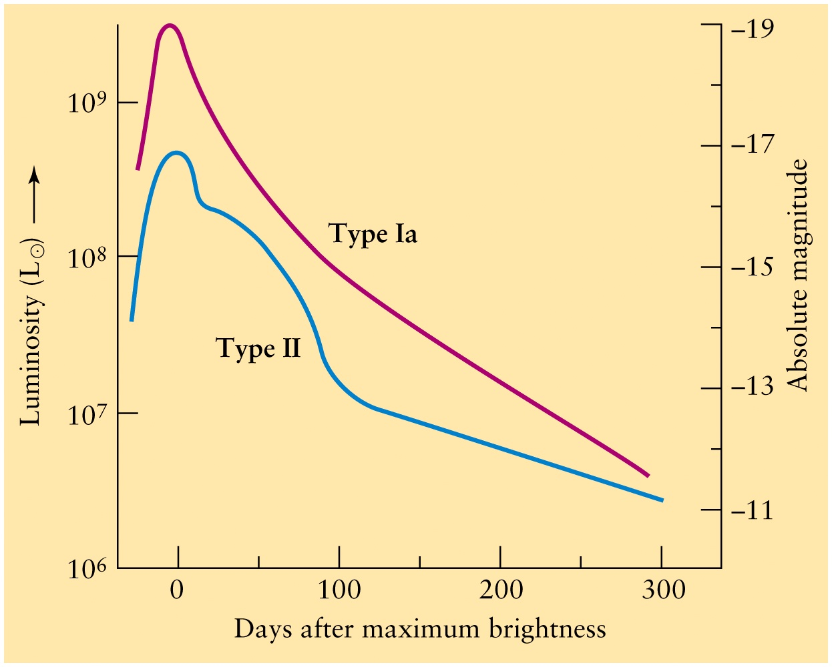
Light Curves of Supernovae
Light decay curves
with time (days) calibrated
to ascertain absolute
luminosity
Depends on progenitor
mass, related to the
Chandrasekhar limit
1.44 M(Sun)
White dwarf with
Companion star accretes
Matter until its mass exceeds
The Chandrasekhar limit and
Thermonuclear fusion ensues.
The star explodes as
Type 1a SN or SN 1a
Binary stars: WD + star
SN 1a: WD explosion
SN Type II: Massive star gravitational core collapse supernovae
that end up as neutron stars or black holes

Slide 31
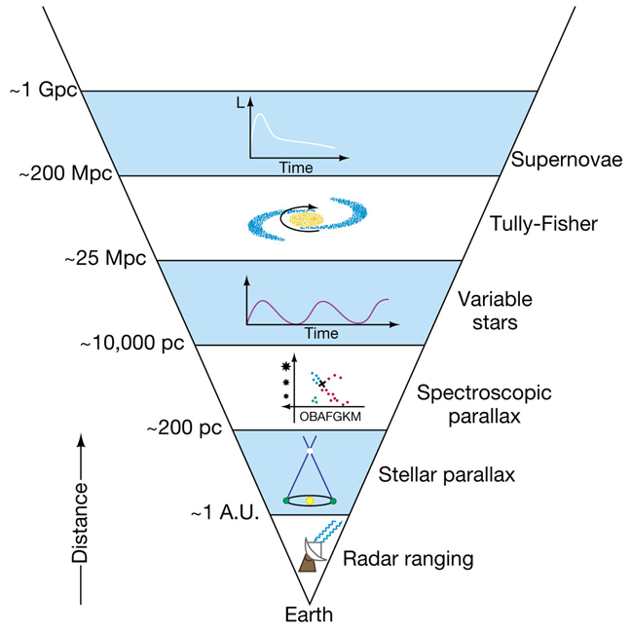
Determination of Cosmological Distances
Doppler width of 21 cm H line
maps rotation velocity and
luminosity of a galaxy
“Standard Candle”:
A light source of
known luminosity,
such as Cepheids or
SN 1a

Slide 32
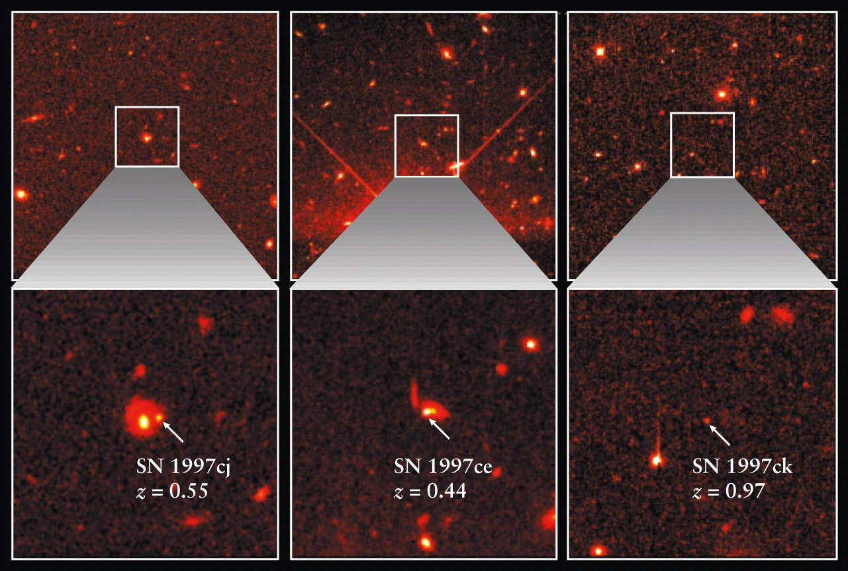
Supernovae vs. Redshift

Slide 33
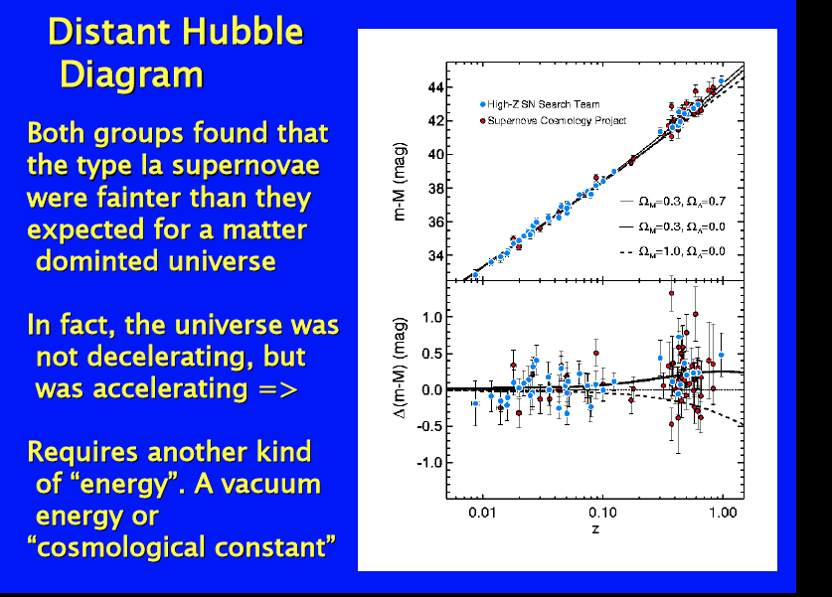
Acceleration of the Universe: Dark Energy
Accelerating
Uniform
Hubble
Expansion
Gravitational
Collapse

