Slide 1


Universe: Space-time, Matter, Energy
Very little matter-energy is observable
Critical matter-energy density balances expansion and gravitational collapse

Slide 2
Matter and Energy in the Universe
Uniform Hubble expansion allows us to determine the critical matter-energy density ρ_{c} required to just balance gravitational collapse
But that turns out to be far greater than the observable matter and energy in the Universe
However, Hubble’s law shows no large deviations from constant expansion, neither towards rapid acceleration nor deceleration due to gravity
Ergo: Ω → 1

Slide 3
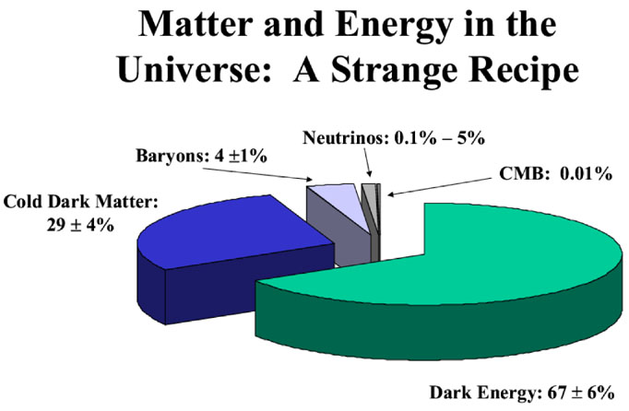
Only ~4% matter-energy is visibly detectable
Rest is “Dark”
Baryons: Protons, Neutrons → Atoms

Slide 4
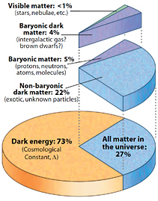
Matter and Energy

Slide 5
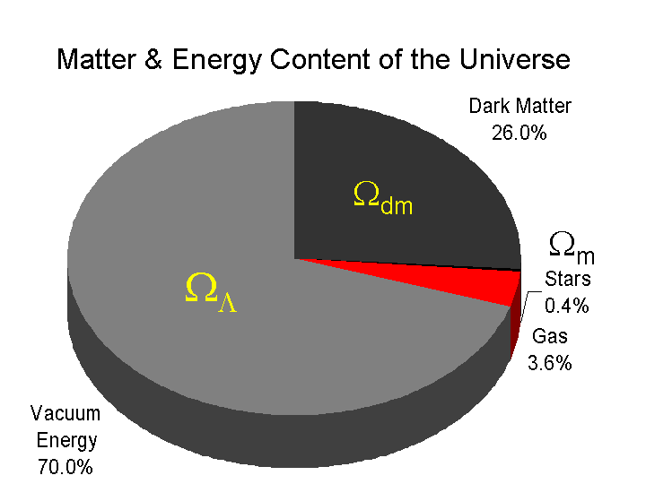
Densities of Visible Matter, Dark Matter, and Dark Energy

Slide 6

Ω And Curvature of the Universe
Density determines shape of the Universe
Ω = 1 → Flat (matter + energy density ρ = ρ_{c})
Ω > 1 → Closed (spherical)
Ω < 1 → Open (hyperbolic)
Visible matter + energy (0.05) + dark matter (0.25) , dark energy (0.7), i.e. Ω = Ω_{m}+ Ω_{Λ} ~ 0.3 + 0.7 = 1

Slide 7
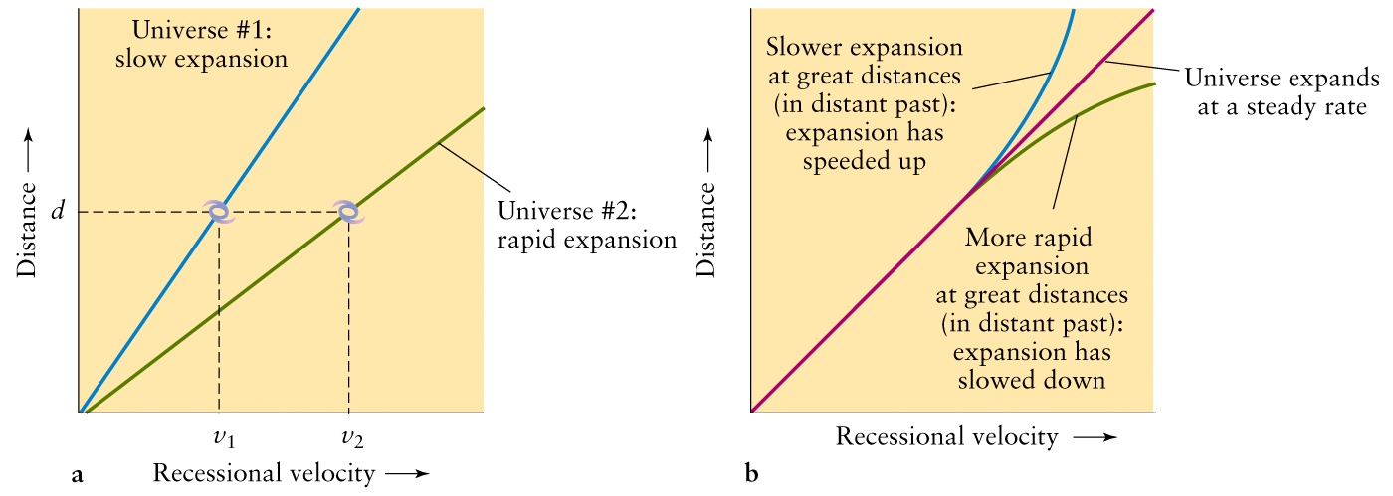
How rapid is the Expansion of the Universe? Was it the same always?
The answer depends on the matter/energy density of the Universe,
which will slow the expansion due to gravity. But what could cause
the observed acceleration ?

Slide 8
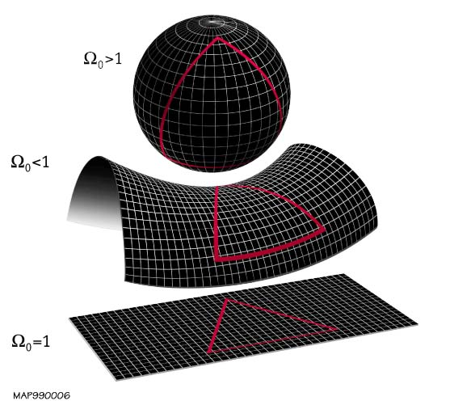
Matter-Energy density
and the “shape” of the
Universe
Flat → Euclidean
- Triangle 180º
Matter + energy density just right to balance expansion

Slide 9
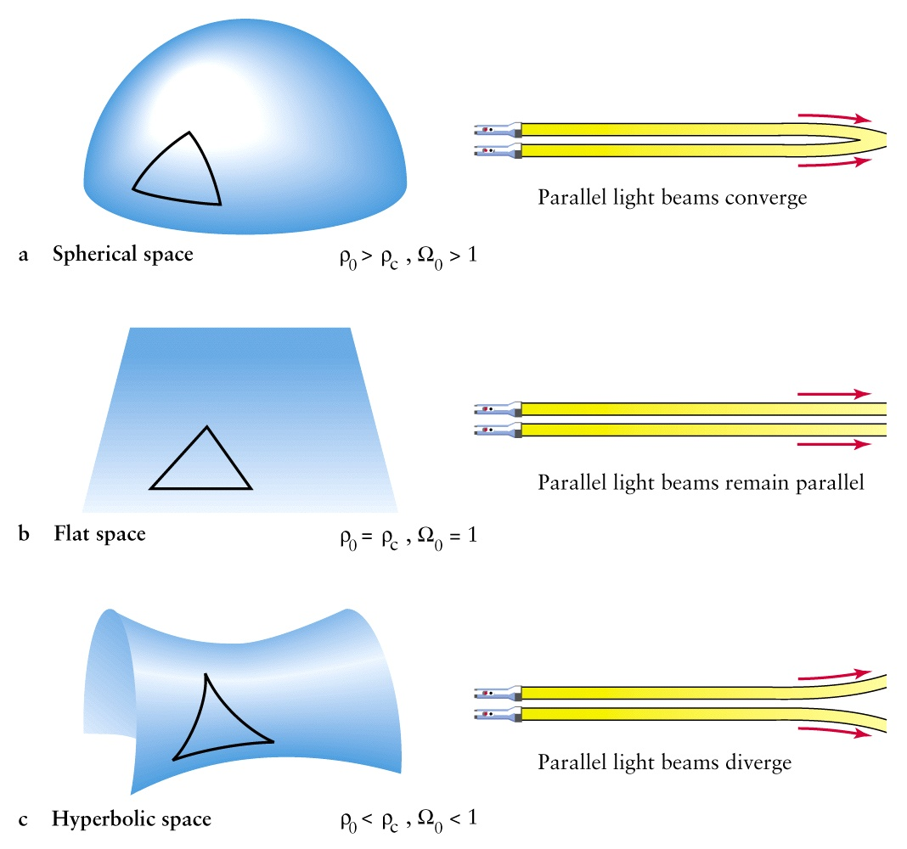

Slide 10
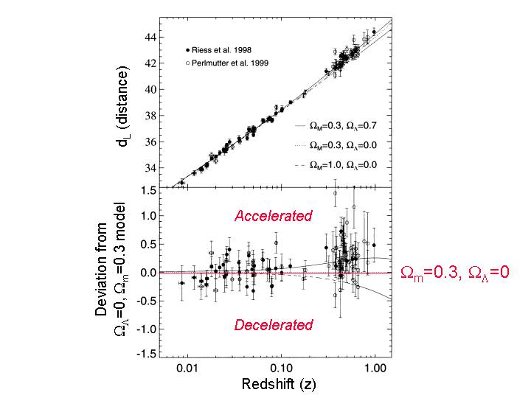

Slide 11
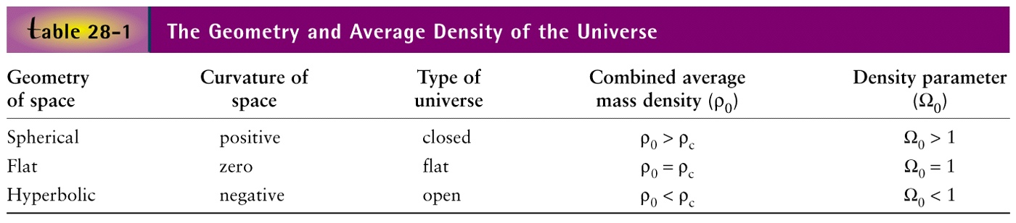
Mass Density/Critical Density:
Density Parameter
Critical density is the density of matter required to just ‘close’
the Universe; if < 1 then Universe will go on expanding;
if >1, it will stop expanding and will contract back (the Big Crunch!).

Slide 12
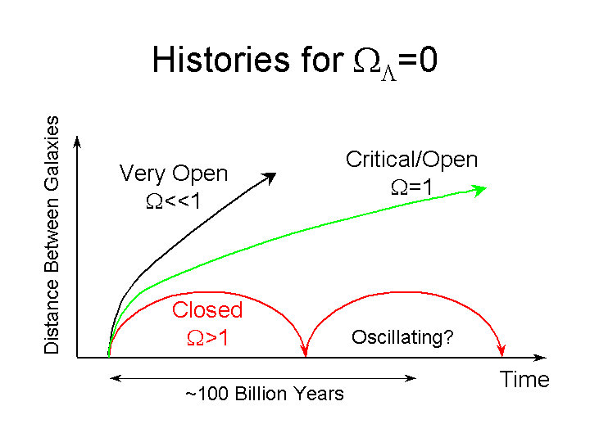
Expansion History with Different Matter/Energy Density

Slide 13
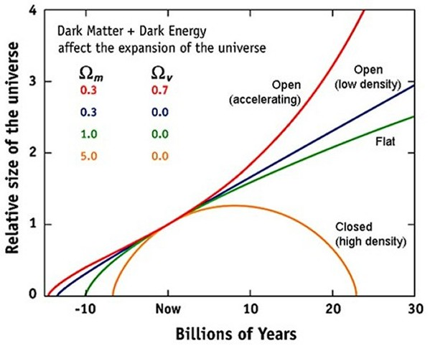

Slide 14
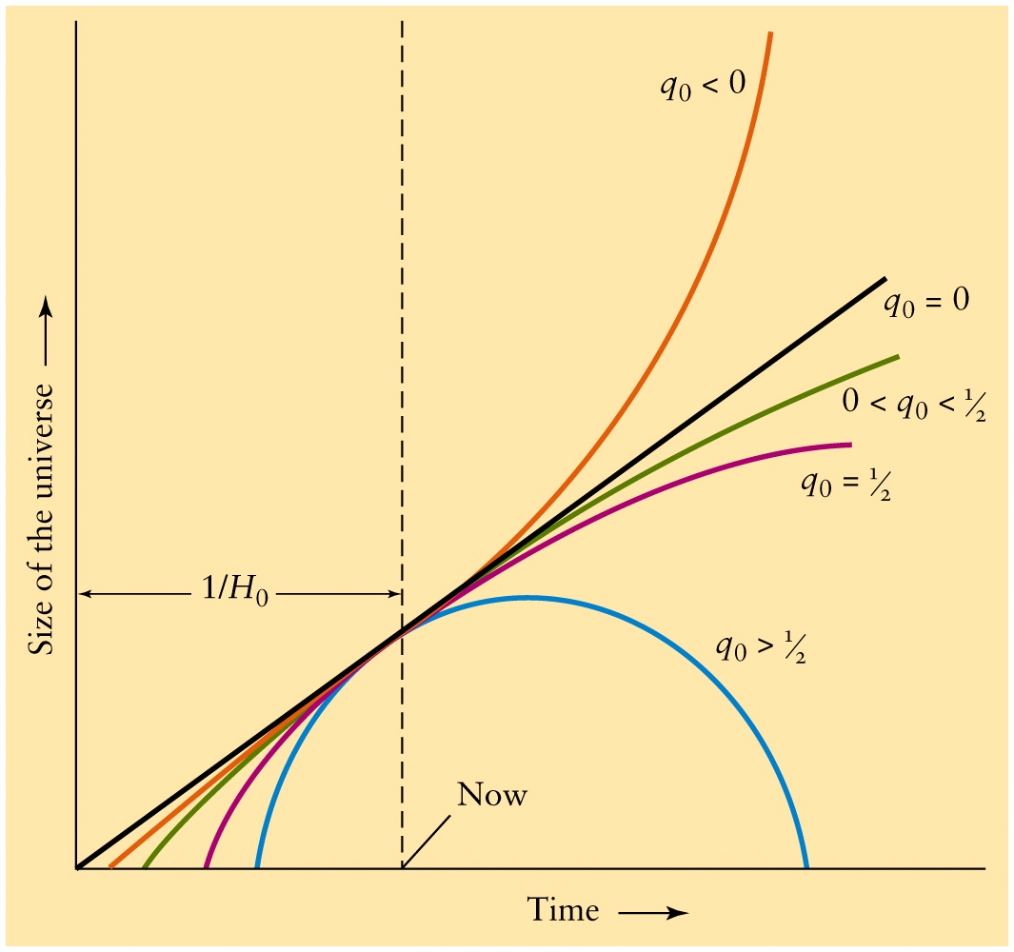
Deceleration (-acceleration) parameter q₀ determines rate of expansion
-ve q → acceleration
q₀ = 0, constant v
no acceleration
Measure q₀
observationally
+ve q → deceleration
gravitational collapse

Slide 15
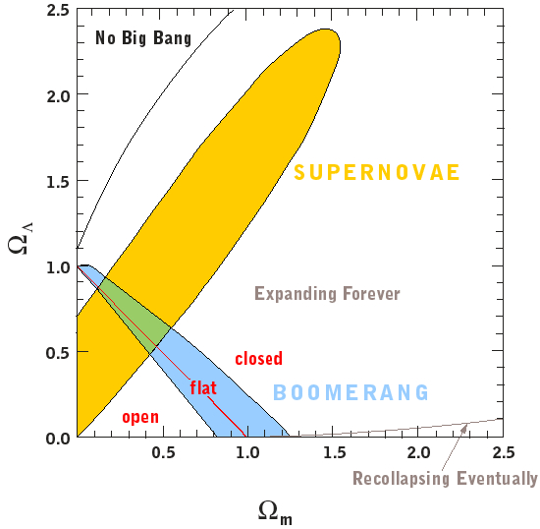
Different observations
to determine Ω
Ω_{m} = 0.3
Ω_{Λ} = 0.7
observationally
supported
overlapping
region

Slide 16
Space-time Distribution of Matter-Energy
Einstein’s General Relativity:
Space-time ←→ Matter-energy
Curvature ←→ Distribution
Assume homogeneous and isotropic distribution
Friedmann equations relate
Expansion + curvature ←→ Avg. matter-energy density
Scale factor a(t) describing change in space-time
Total average matter-energy density ρ_{total}
Complexity owing to dark (unseen) matter-energy

Slide 17
Curvature and Matter-Energy Density
Matter-energy curve space-time, which determines how matter-energy move
Hubble constant H is a measure of a(t) → expansion rate
Expansion rate, curvature and matter-density
H + Curvature ←→ ρ_{total}
If the curvature is zero the universe is flat
→ Critical density ρ_{critical}
Density Parameter:

Slide 18
Ω and Rate of Expansion
Flat universe implies Euclidean geometry
Current rate of expansion given by Hubble constant H_{o} shows density of the Universe to be close to critical density, and the universe expands forever
But recent supernovae observations show
ACCELERATING UNIVERSE ?
Dark energy
Einstein’s “cosmological constant” Λ

Slide 19
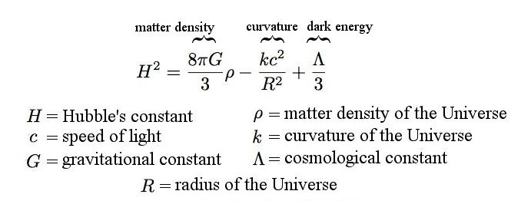
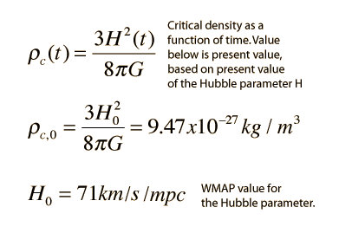
General Relativity: Friedmann Equations
No Curvature
No Λ
ρ_{c,0} << ρ_{c}
~5 H atoms/cc
including dark
matter; but observed
baryonic matter
~0.2 H atoms/cc

Slide 20
The Big Bang
Hubble expansion law depends on the amount of matter and energy (both are equivalent!) in the Universe; more precisely, on the
matter and energy density (and ??)
Define density parameter Ω and Critical Density ρ
Just after the BB the Universe must have been extremely hot and dense; as it expands it cools
Initially, radiation and matter are coupled together in a hot, dense soup; Universe is opaque
Later, atoms form and radiation can escape – Recombination Epoch → Dark Ages

Slide 21
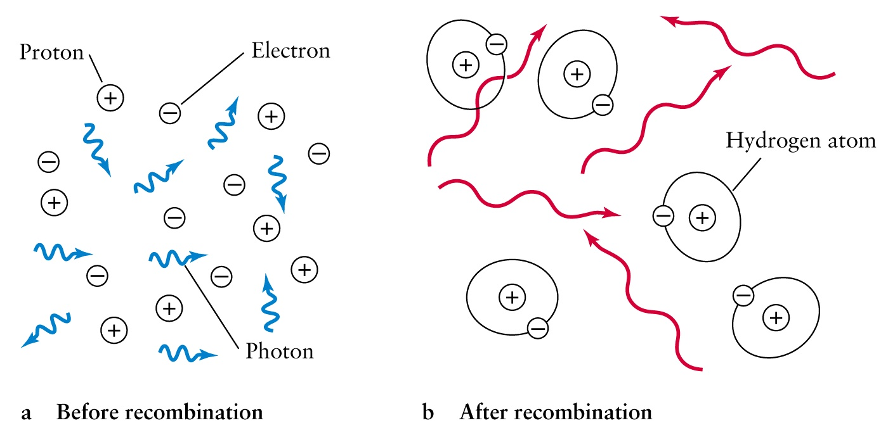
Recombination Epoch: Atomic formation (mainly hydrogen and helium) and radiation-matter decoupling; radiation escapes, leaving a ‘dark’ universe (Dark Ages)

Slide 22
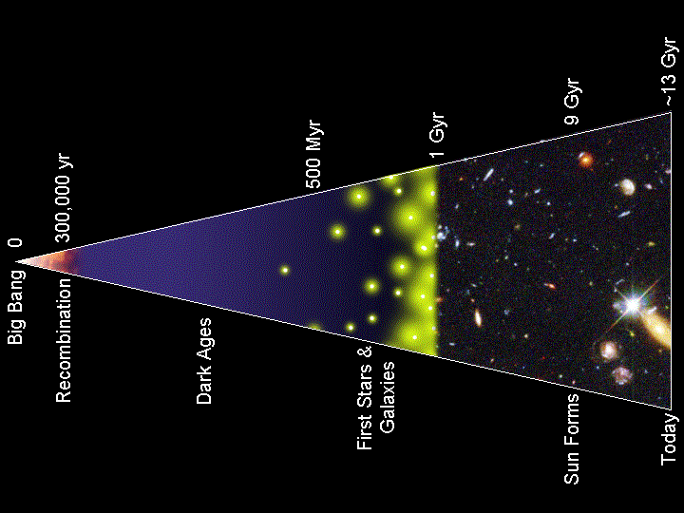
Can “see” up to Recombination Epoch

Slide 23
Matter and Energy Density Dominated Expansion
Primordial radiation dominated Universe
As the Universe expands: V ~ R³
Density = M/V
Matter density falls off as ~ M/R³
But energy density falls of as ~ E/R⁴
Photons redshift to lower energies as ~1/R
But “dark energy” may trump both

Slide 24
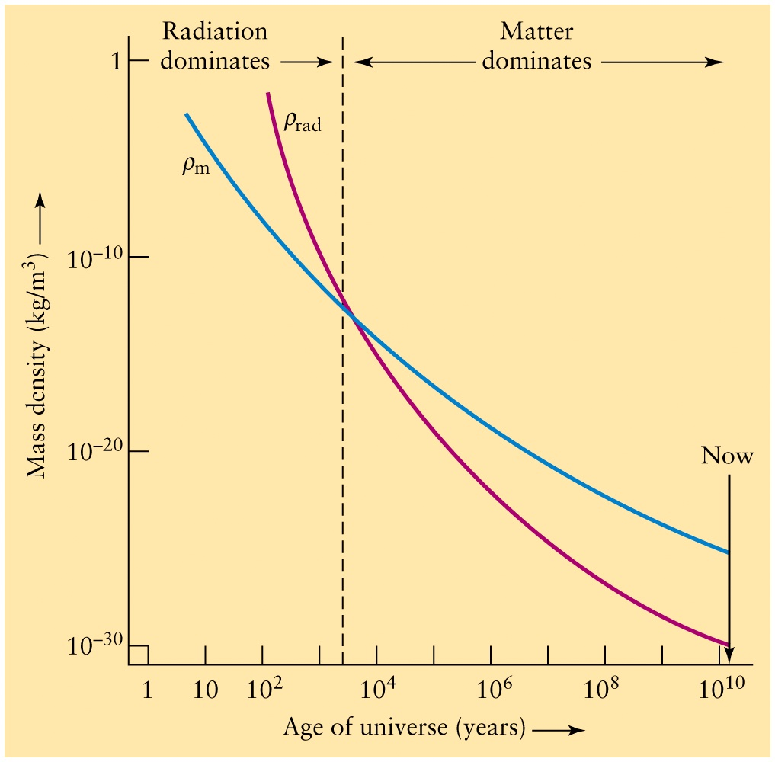
Matter and Energy Densities vs. Age and Volume of the Universe
ρ_{m} ∼ 1/R³
ρ_{rad} ∼ 1/R⁴

Slide 25
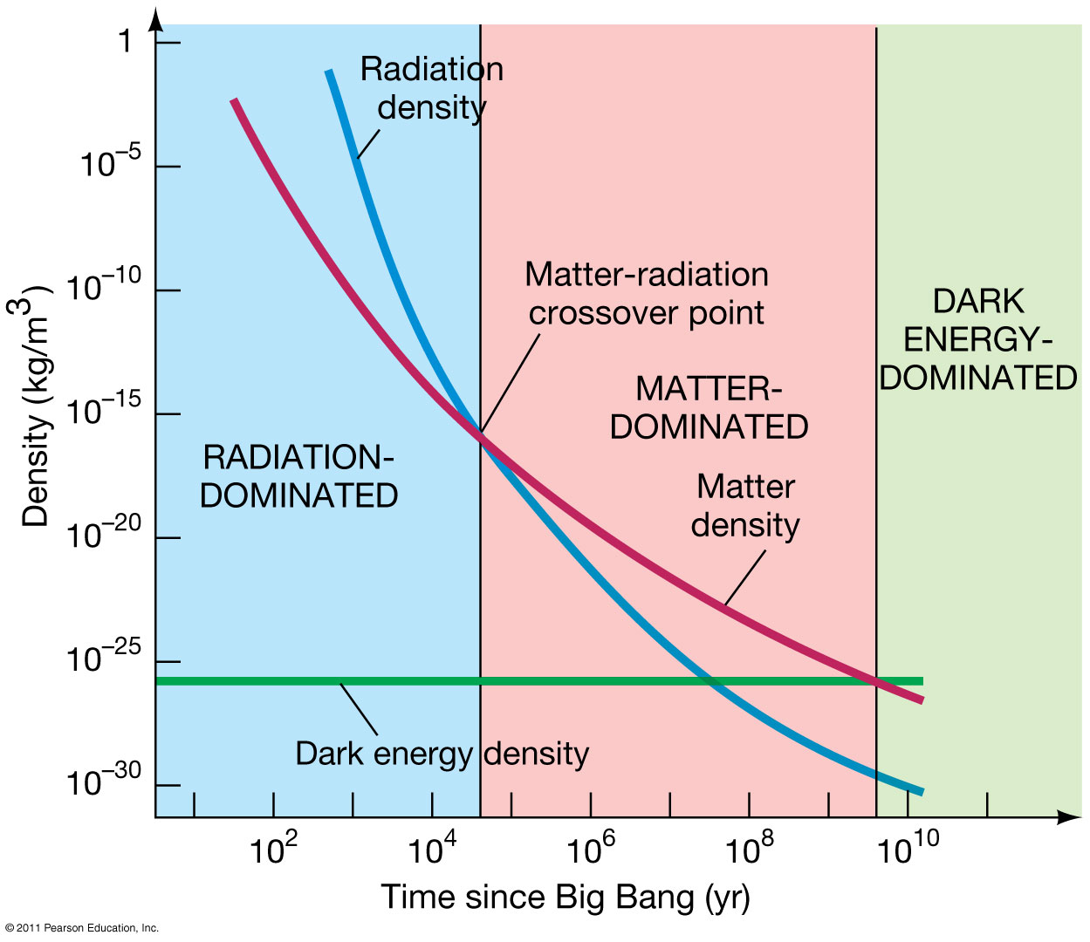
Vacuum
Energy
Dark energy is
property of empty space
or vacuum

Slide 26
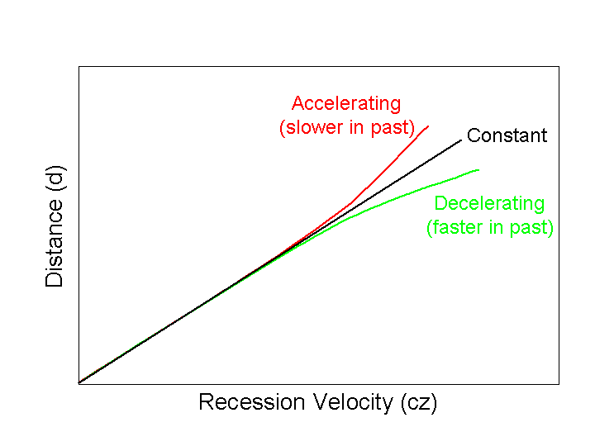
The End ?

