Slide 1
Inflation, Expansion, Acceleration
Two observed properties of the Universe, homogeneity and isotropy, constitute the Cosmological Principle
Manifest in Large-scale structure: Universe appears the same in every direction everywhere
What accounts for this uniformity, given the highly non-uniform distribution of matter-energy on smaller scales (stars, galaxies, etc.) ?

Slide 2
Large-Scale structure of the Universe
Galaxies group into Clusters
Milky Way is part of the Local Group: 39 galaxies out to ~ 1 Mpc
Large-Scale Structure:
- Groups: 3 to 30 bright galaxies
- Clusters: > 30 (up to 1000’s) of bright galaxies;
often with many more dwarf galaxies,
1 – 10 Mpc across;
~ 3000 clusters known
- Superclusters: Clusters of Clusters
- Voids, filaments, & Walls

Slide 3
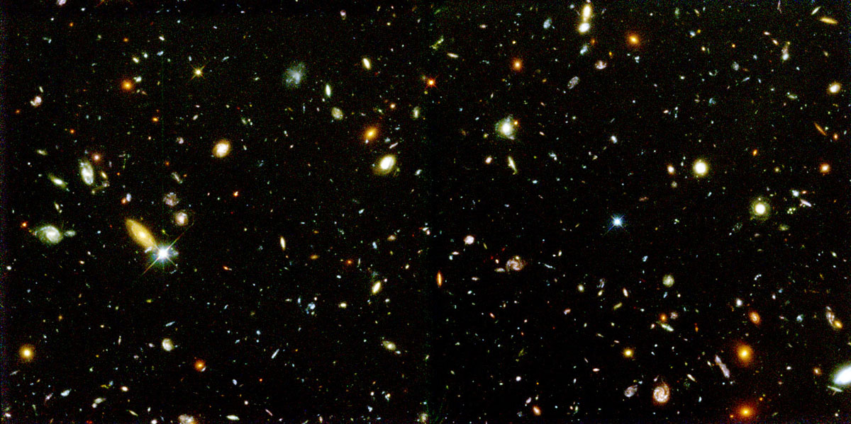
Large-Scale Structure:
Hubble Deep Field Survey

Slide 4
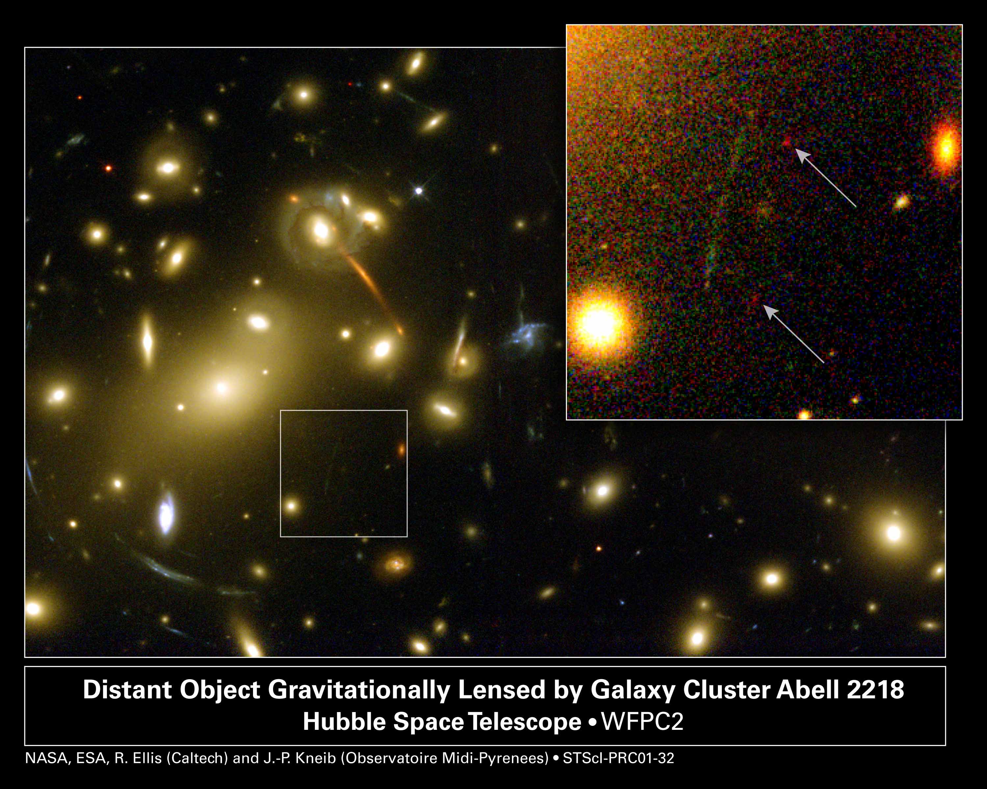

Slide 5
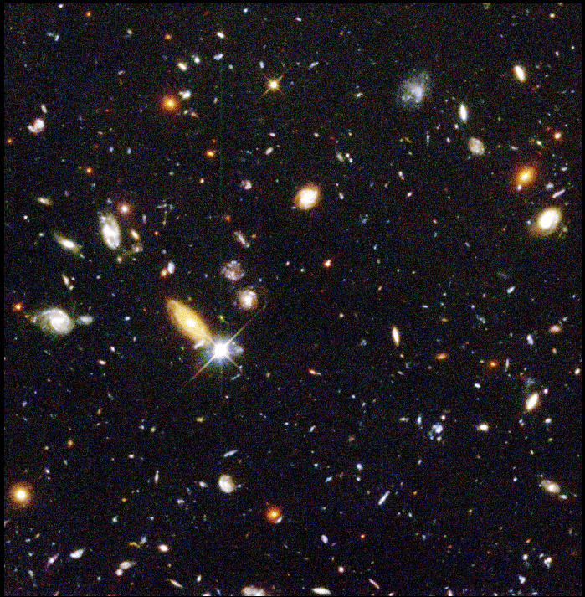

Slide 6
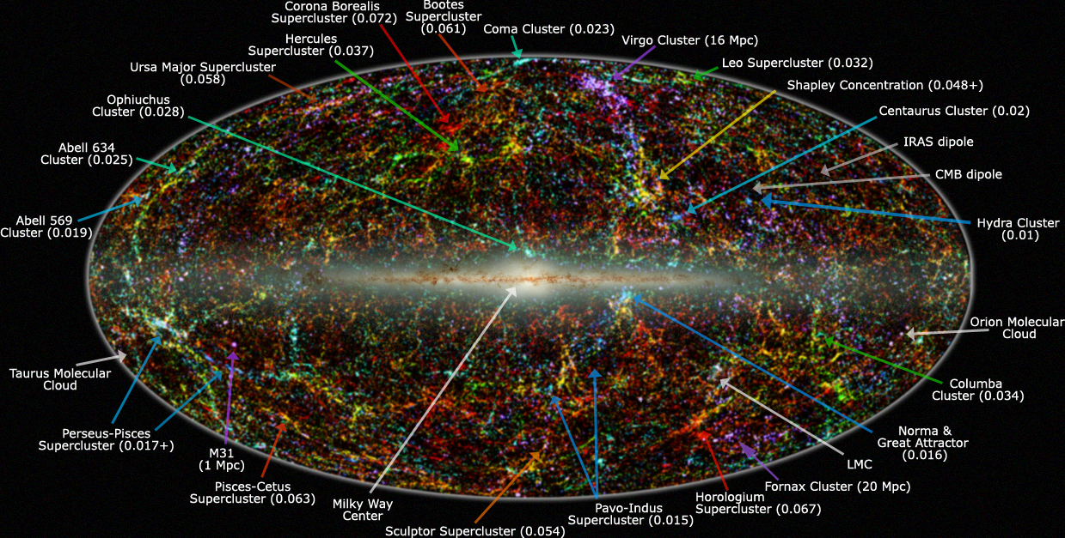
Galaxies, Clusters, Superclusters

Slide 7
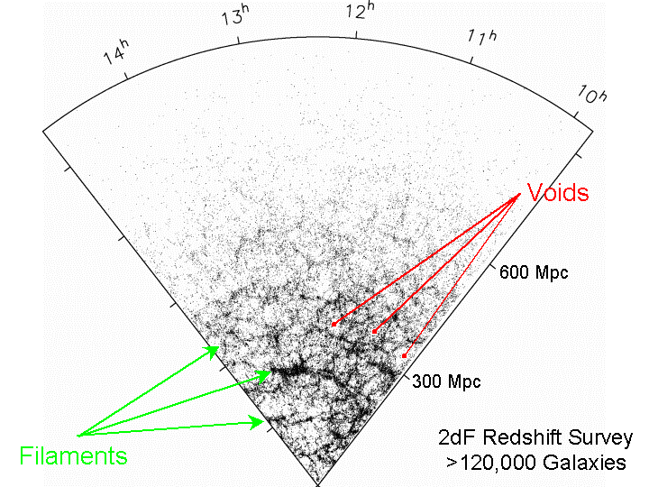
2dF Galaxy Redshift Survey

Slide 8
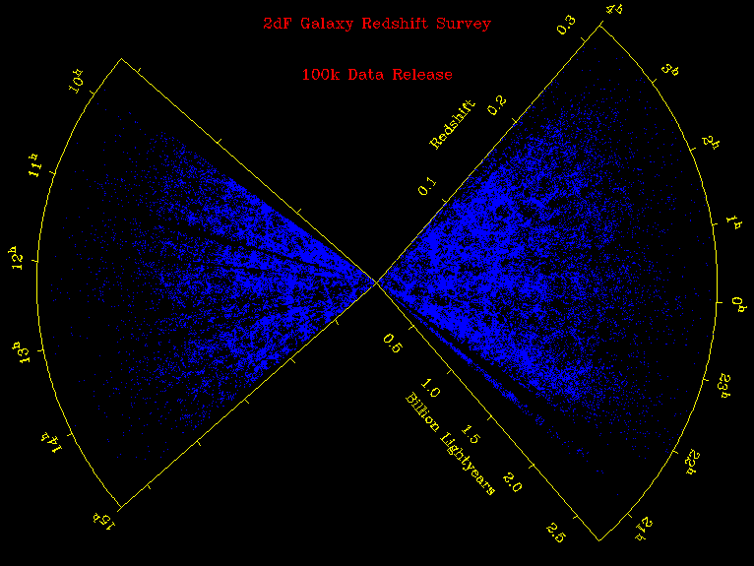

Slide 9
Large-Scale Structure
How did matter distribute on a universal scale?
How did the galaxies form and evolve?
How do we detect imprints of early universe?
Satellite: WMAP (Wilkinson Microwave Anisotropy Probe)
How do we determine large-scale structure?
Galaxy Redshift Surveys, e.g. 2dF, SDSS (Sloan Digital Sky Survey)

Slide 10
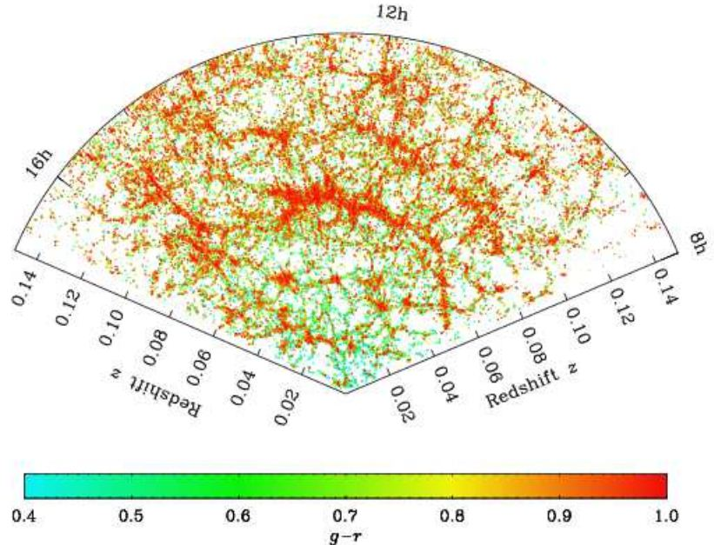

Slide 11
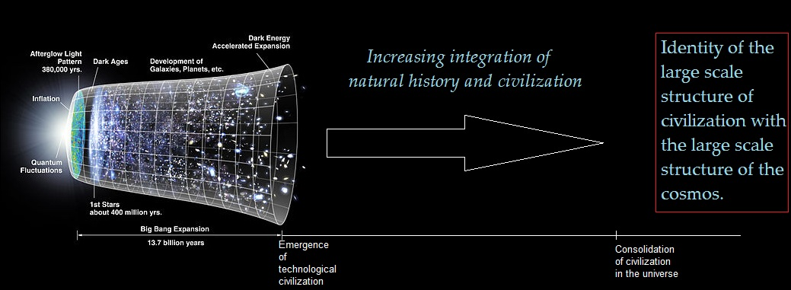

Slide 12
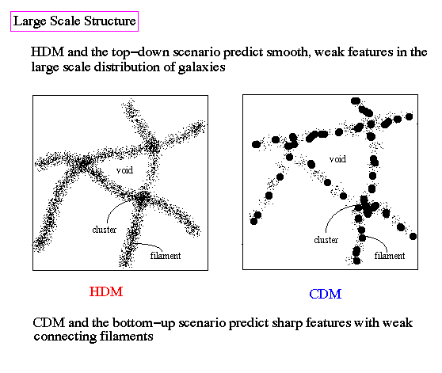
Hot Dark Matter (HDM), Cold Dark Matter (CDM)
Possible HDM:
Particles moving close
to c, speed of light
e.g. neutrinos with
very tiny mass
Possible CDM:
WIMP: (Weakly
Interacting Massive
Particles), like
neutrinos but more
massive
MACHO: (Massive
Compact Halo Objects)
Brown dwarfs or failed
stars

Slide 13
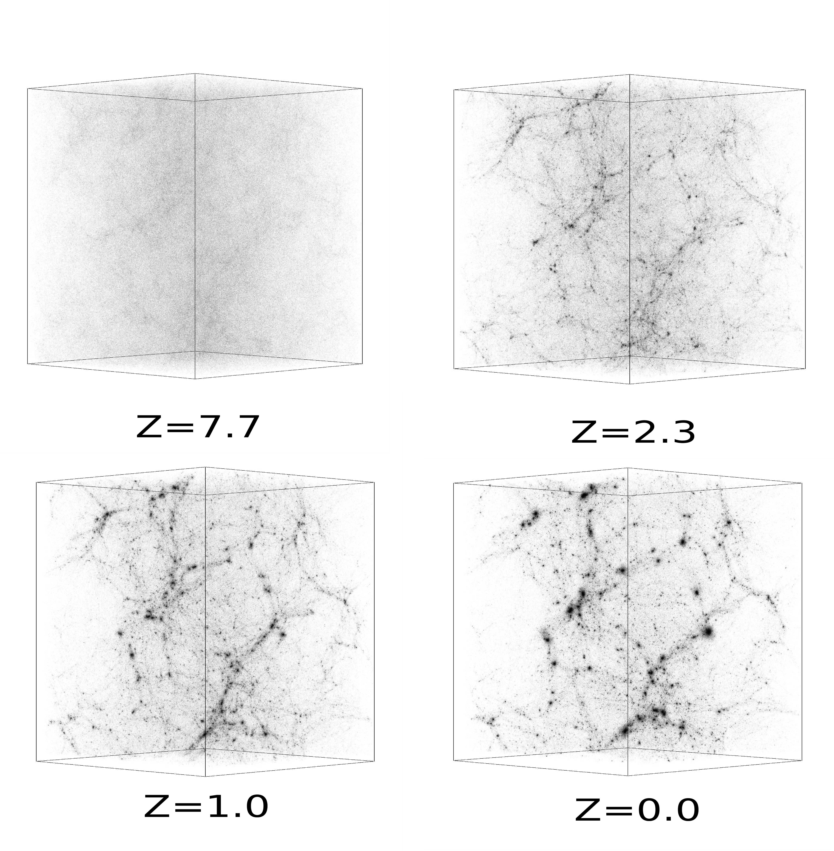
Numerical
Simulations
Computer
Models
At various
Redshift

Slide 14
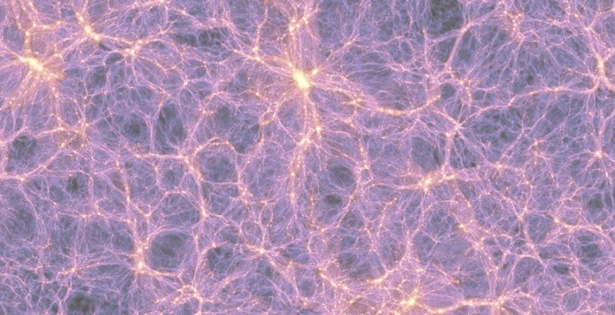

Slide 15
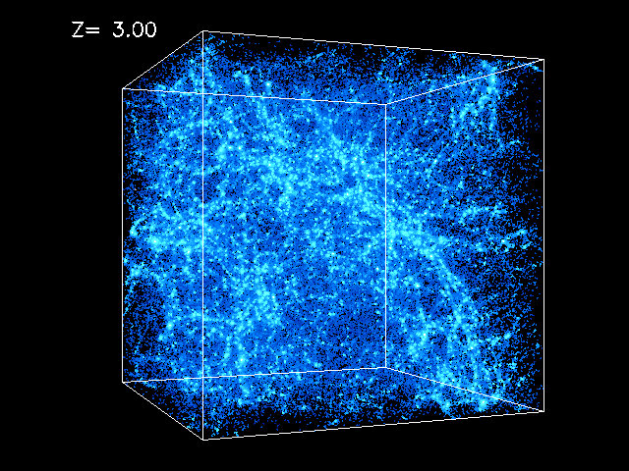

Slide 16
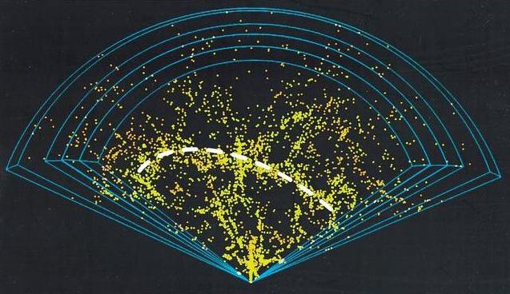

Slide 17
How did galaxies evolve?
Baryon-to-photon (matter to energy) ratio
η increases with time
Quantum fluctuations lead to inhomogeneity in the primordial radiation background
Compression and expansion of matter at characteristic frequencies (like musical sound waves)
Amplitude of fluctuations grows, manifest in temperature variations or power spectrum
Oscillations imprinted on the radiation background
Observed in present-day CMB → WMAP
→ PLANCK Satellite

Slide 18
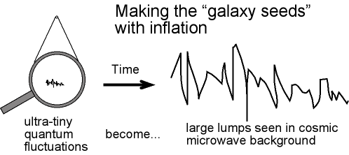
CMB is almost perfectly isotropic with quantum fluctuations
of order 1/100,000, but they grow over time to form the
observed large-scale structure

Slide 19
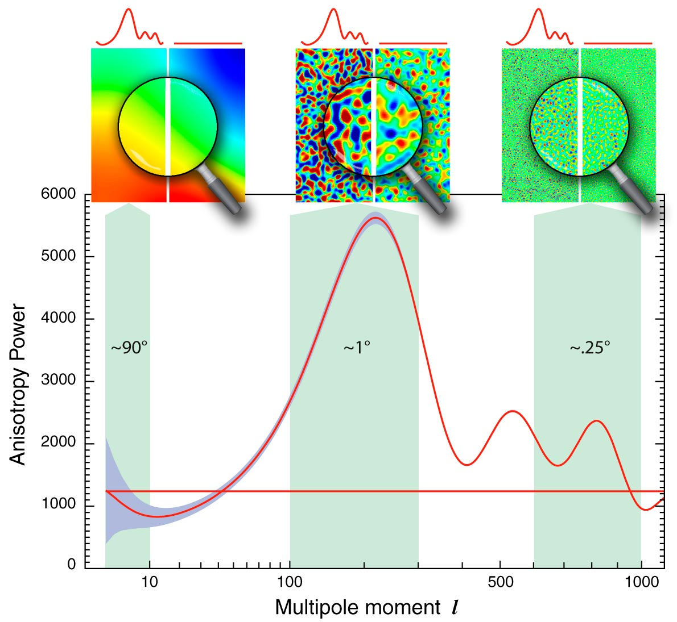

Slide 20
End of Dark Ages: Reionization
Dark Ages: After ~300,000 years following the atomic Recombination epoch, radiation and matter decoupled and radiation escaped leaving material universe unobservable or dark
Until the first stars lit up and formed galaxies, at a redshift z > 10, or ~500 million years after BB, atoms re-ionized → Reionization epoch
Hubble’s law for low z and low v << c
z = H_{o}d / c = v/c
Obviously not valid for z > 1 !

Slide 21
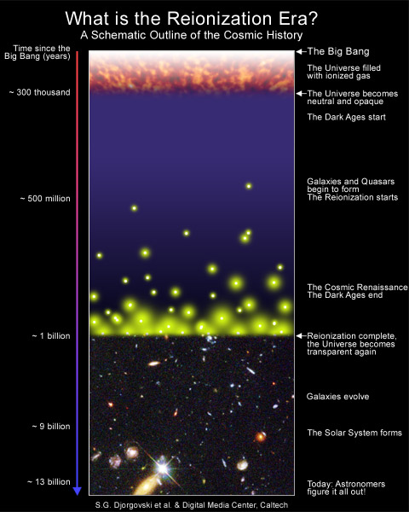
Reionization:
Formation of first
stars and galaxies
Ionized
neutral atoms
to ion-plasma
at about 500
million years after
Big Bang or
at z ~ 10

Slide 22
Hydrogen clouds at z > 0
Clouds of hydrogen that did not form stars or galaxies lie in between the Earth and far-away galaxies at redshift z > 0.
Their radiation is absorbed by H-atoms at wavelengths greater than rest wavelengths of H
The first transition n = 1 → 2 in H atom is
Lyman-α at λ = 1215 Angstroms
But H-clouds at z > 0 would absorb at λ > 1215
Multitude of redshifted “Lyman-alpha” clouds absorption is seen towards far-away galaxy

Slide 23
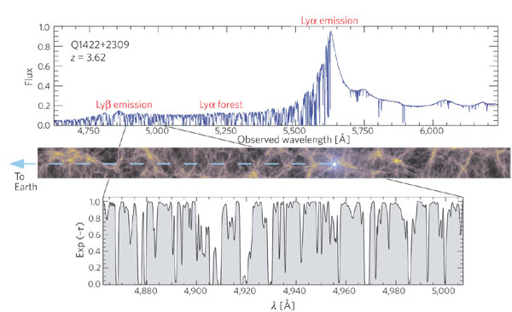
Lyman-alpha clouds: Red-shifted light absorption by neutral
Hydrogen of light from distant galaxies up to Reionization
(observed) = (1+ z) λ (rest)
λ_{rest} (Lyman alpha) emitted by distant galaxy is absorbed at λ > 1215 A
by H-clouds at various redshifts, resulting in a Lyman-alpha “forest”
of lines at different λ_{obs} > 1215 A.

