Slide 1
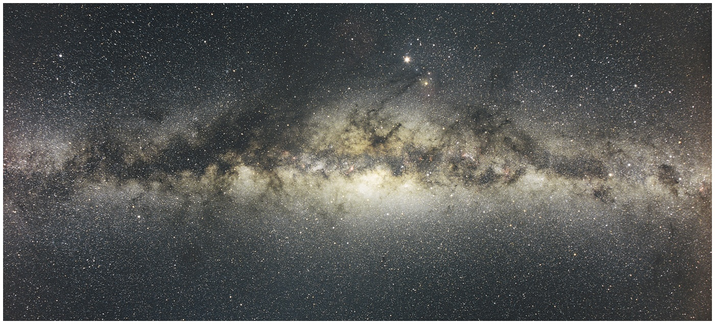
Milky Way: Bright Band Across Sky
(Resolved by Galileo)

Slide 2
Milky Way:
Galactic Structure and Dynamics
Milky Way has spiral structure
Galactic Bulge surrounds the Center
Powerful radio source Sagittarius A at Center
Contains Super-Massive Black Hole
M(SMBH) ~ 10⁶ M(Sun)

Slide 3
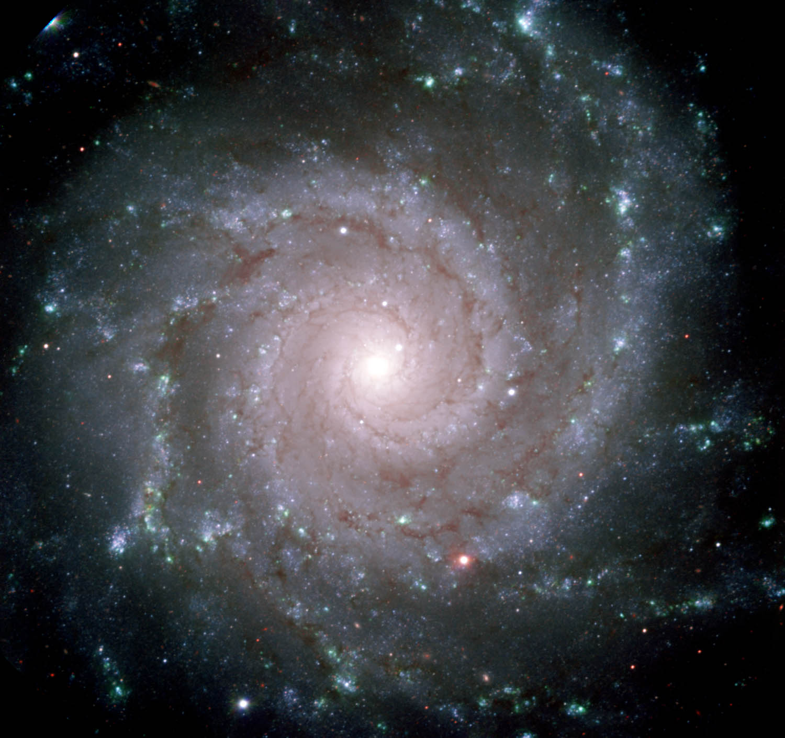

Slide 4
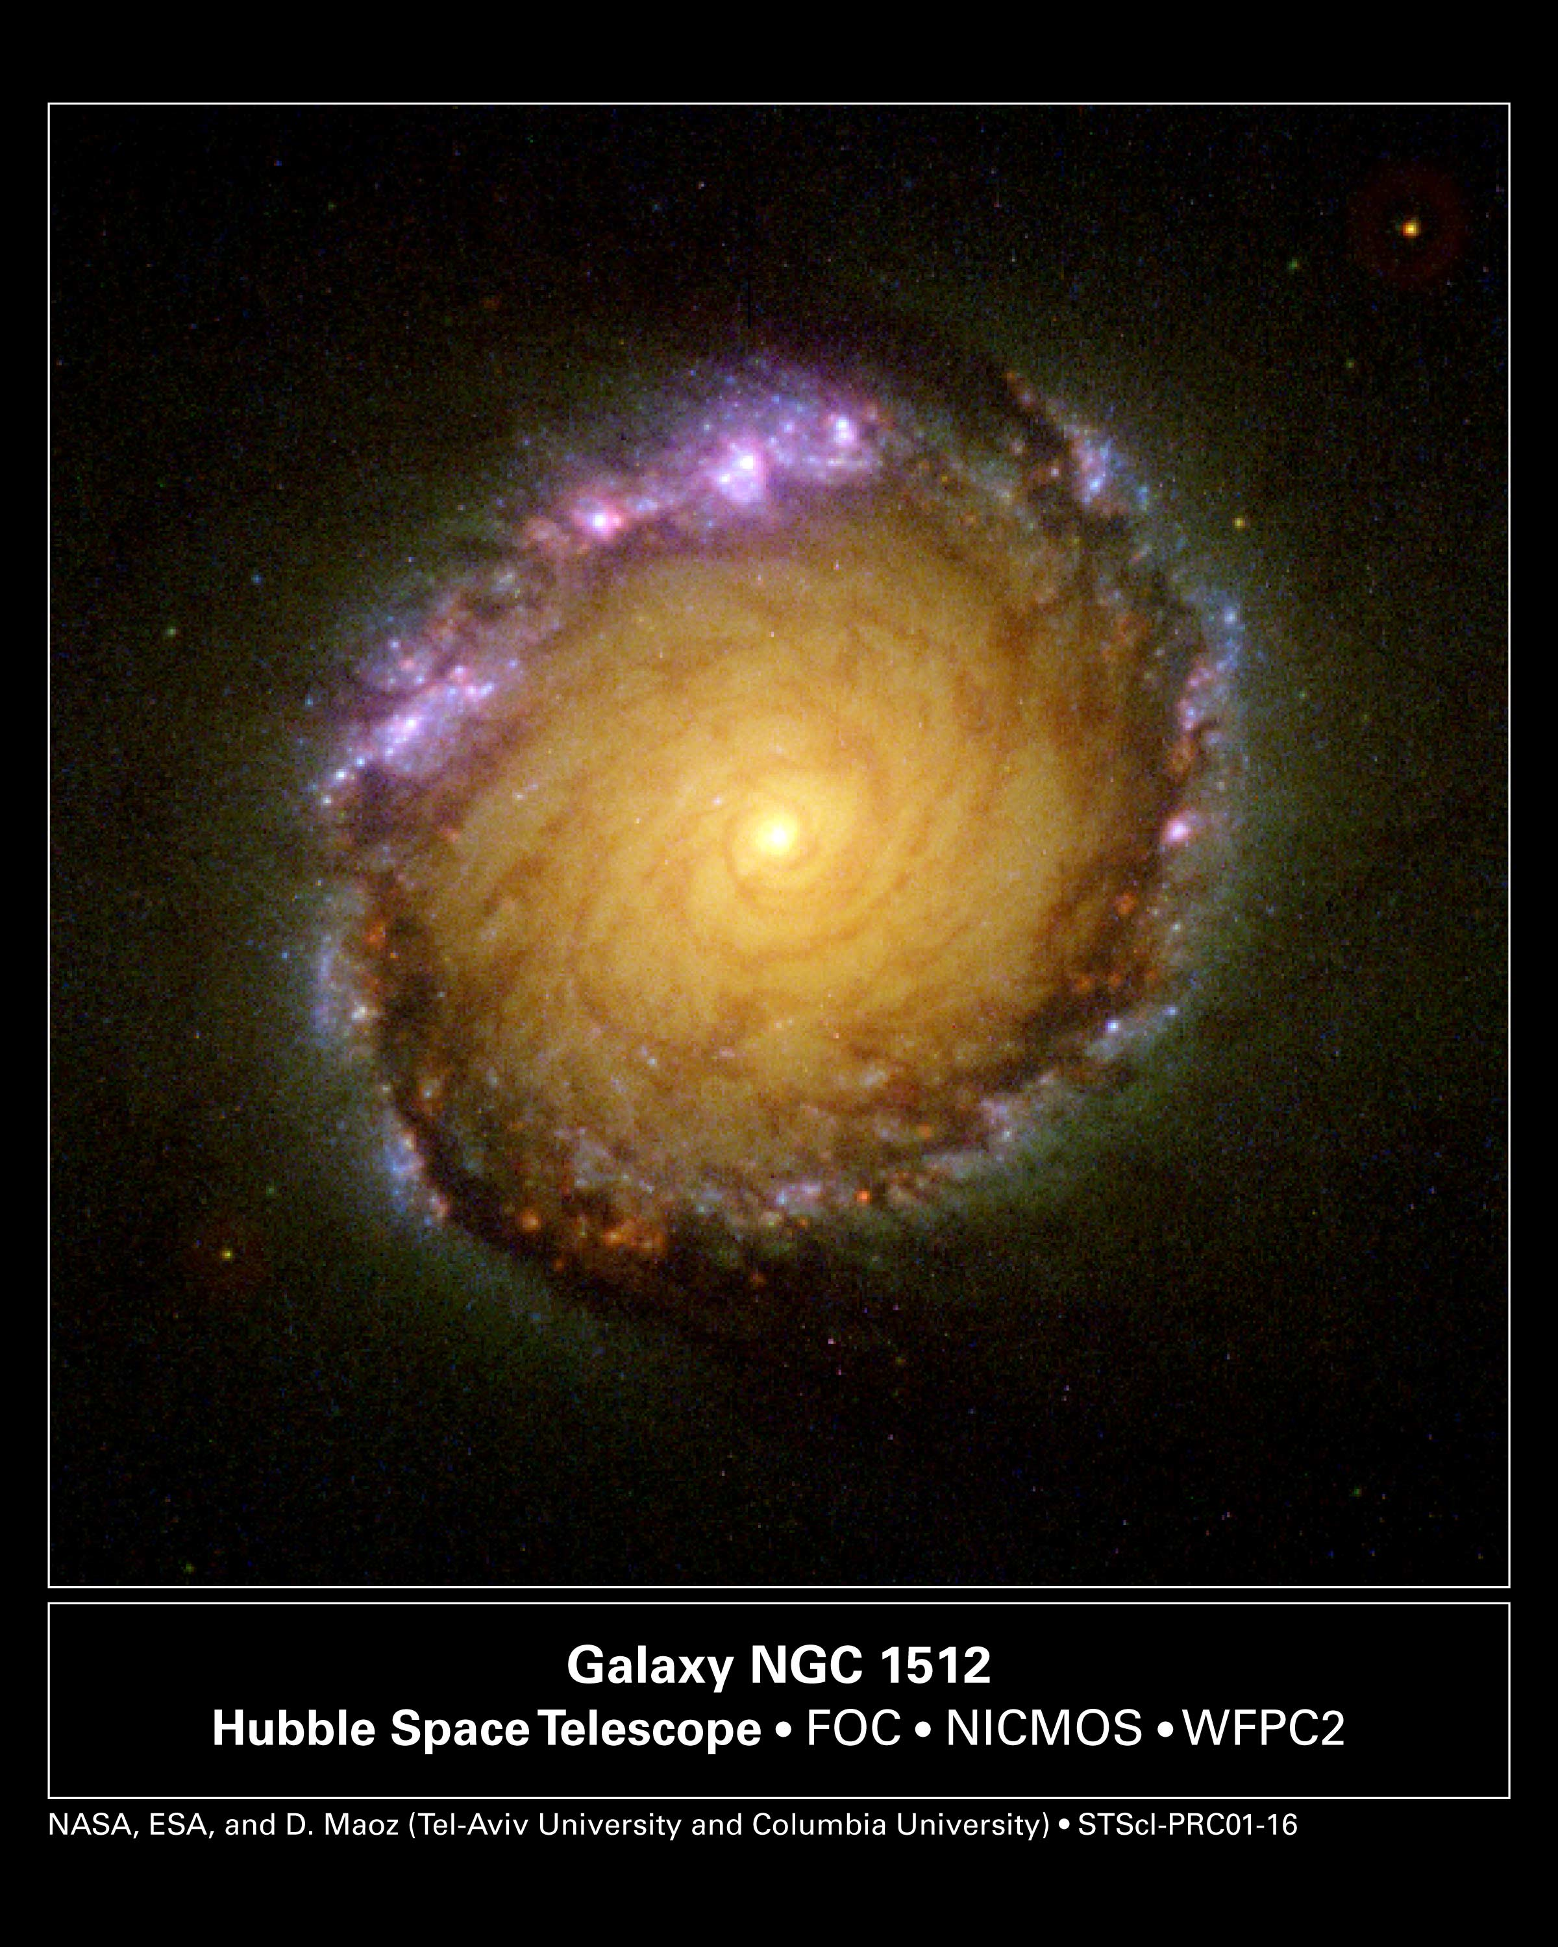

Slide 5
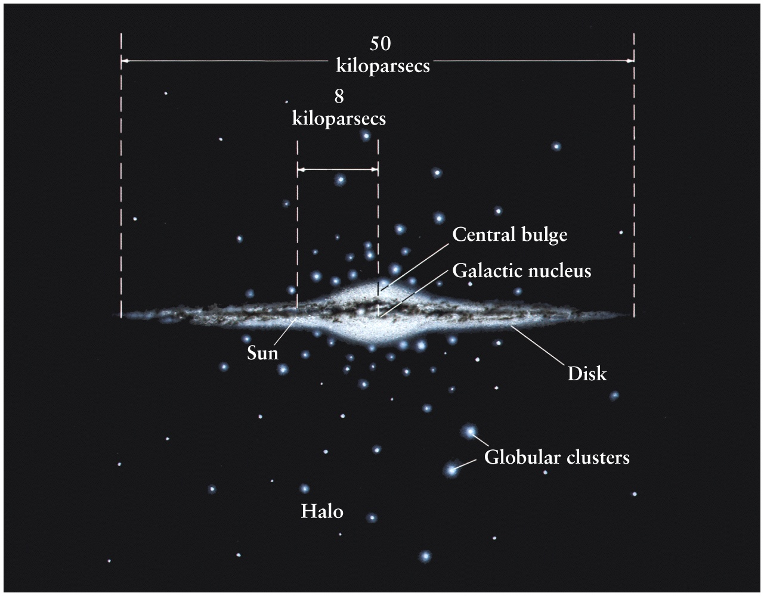

Slide 6
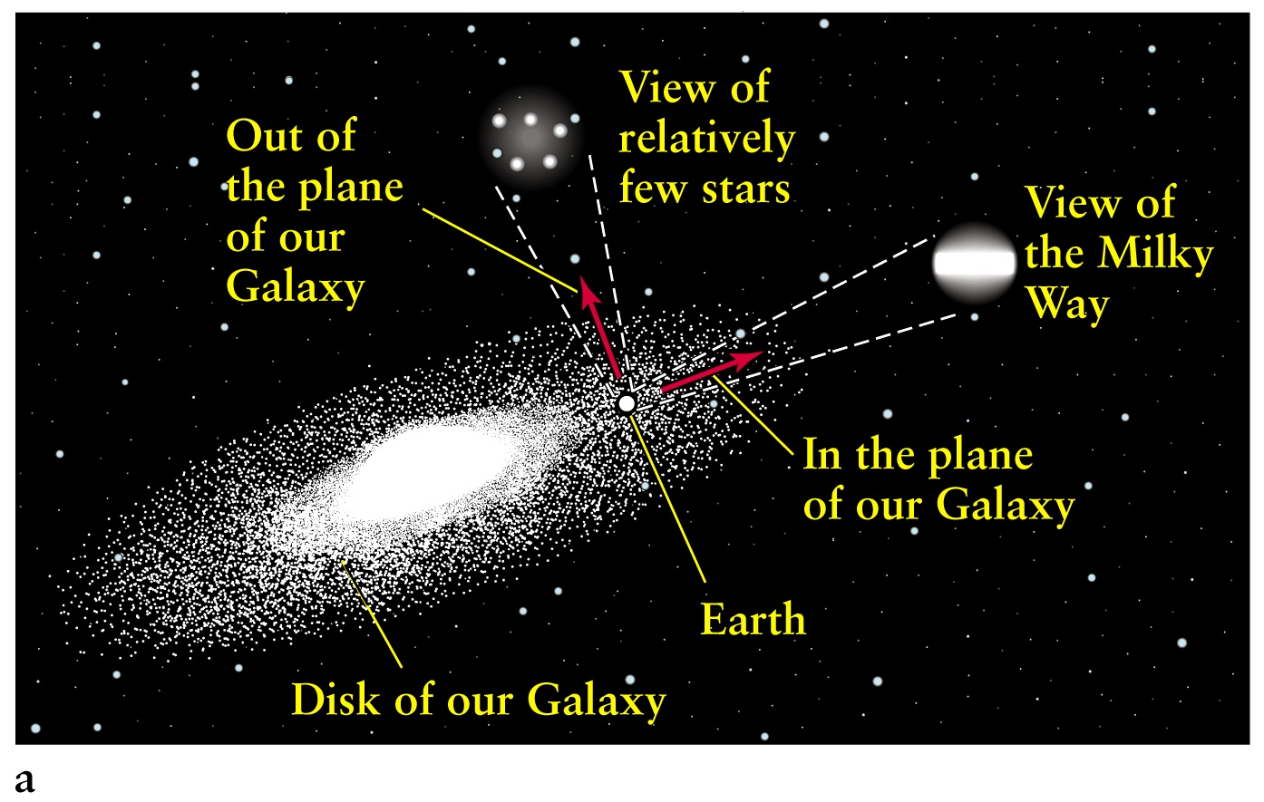
Milky Way: Galactic Structure

Slide 7
Our Galaxy – Milky Way
Spiral galaxy, e.g. Milky way, Andromeda
Sun is located in the disk, but far away from the center, about 8000 parsecs (1 pc = 3.28 LY)
~100,000 Lys in diameter
MW appears as a bright band across the sky
Determine the size of the galaxy from RR Lyrae stars in globular clusters that lie above the plane of the galaxy (a globular cluster has about a million stars)
Period-Luminosity relation for Cepheid variables and RR Lyrae gives the magnitude M of absolute luminosity L
Distance modulus relation relates the magnitude m of the apparent luminosity to distance d at 10 pc
m – M = 5 log (d/10)

Slide 8
Supermassive Black Holes (SMBH),
Spiral Arm and Halo Stars
Most galaxies have quiescent SMBH; about 10% have an Active Galactic Nucleus (AGN)
SMBH activity drives galaxy formation; leads to galactic structure
Old halo stars are in “Globular Clusters”; made of primordial H, He
Spiral arms contain massive, bright, young stars
Ongoing star formation → heavier elements produced in supernovae

Slide 9
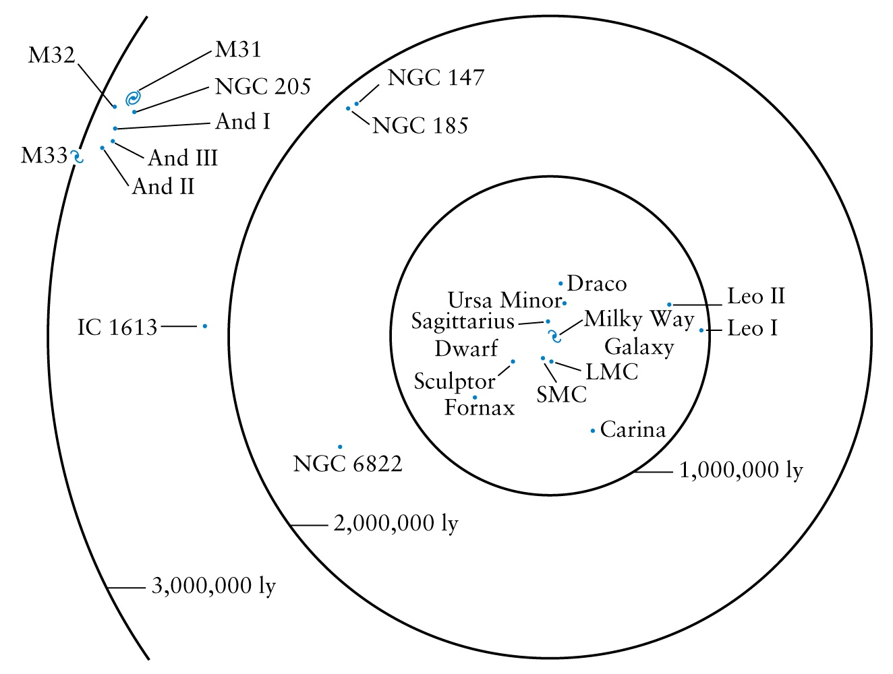
The Local Group of Galaxies
Andromeda (M31 or NGC 188)

Slide 10
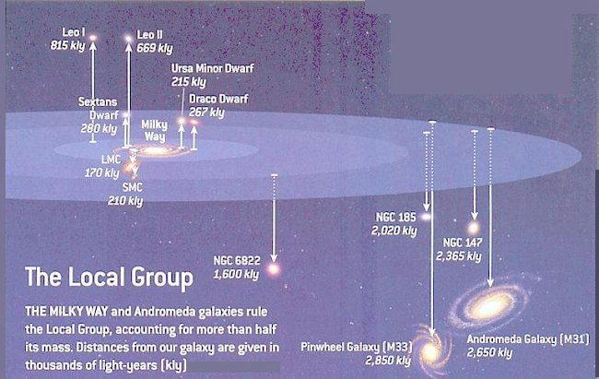
Local Group of Galaxies Around Milky Way

Slide 11
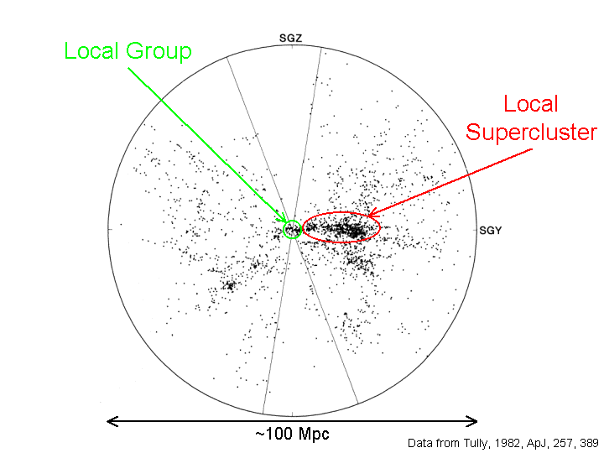

Slide 12
Galactic Dynamics
Nearest comparable cluster to the Local Group is the Virgo Cluster at about ~ 18 Mpc, size ~ 2 Mpc, ~ 2500 galaxies (mostly dwarfs), Mass ~ 100 trillion times M(Sun)
Galaxies are large compared to distance within a group; most galaxies within a group are separated by only ~ 20 times their diameter (by comparison most stars are separated by 10 million times the diameter)
Tidal interactions, collisions, cannibalization, splash encounters, starbursts, mergers, etc.
The MW and Andromeda are moving towards each other at ~120 Km/sec, and might have a close encounter in ~3-4 Gyr; tidal distortion and merger after 1-2 Gyr
Eventually only one galaxy might remain, most likely a medium-sized Elliptical

Slide 13
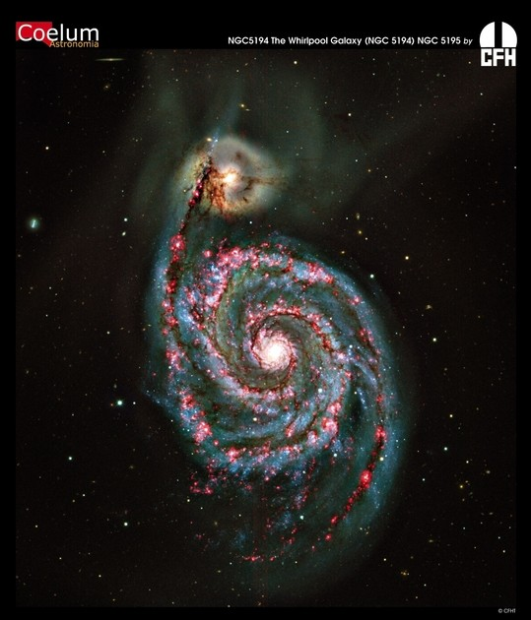
Twin galaxies: Spiral and Dwarf
Whirlpool Galaxy
disintegrates its
small neighbor

Slide 14
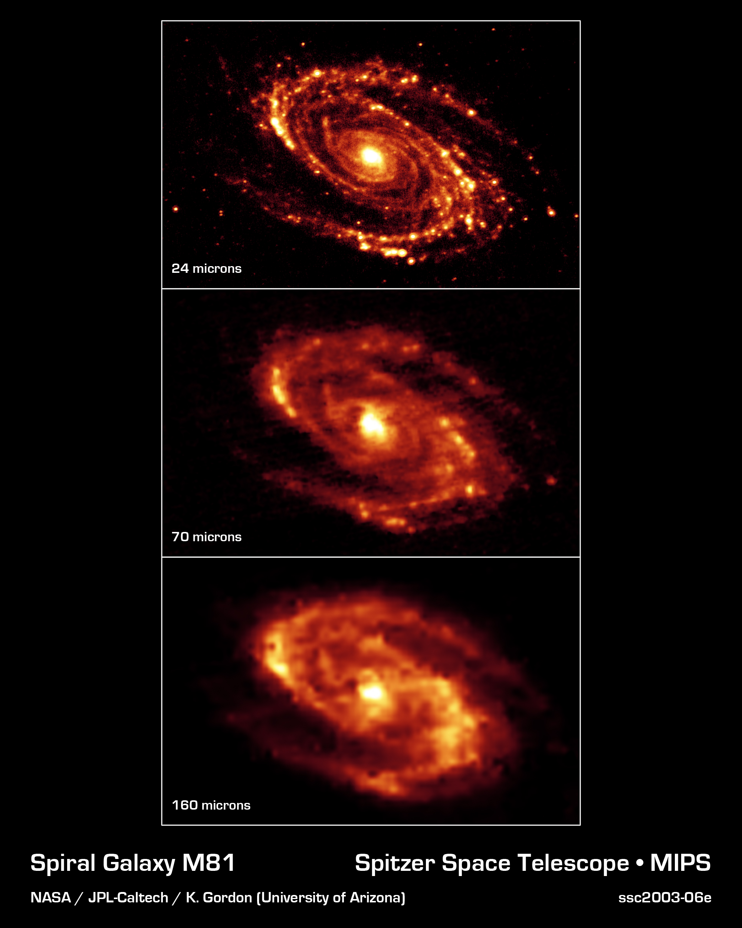
Mult-wavelength
Far-Infrared
map of M81
Bode’s Galaxy
12 million Lys
Ursa Major
constellation

Slide 15
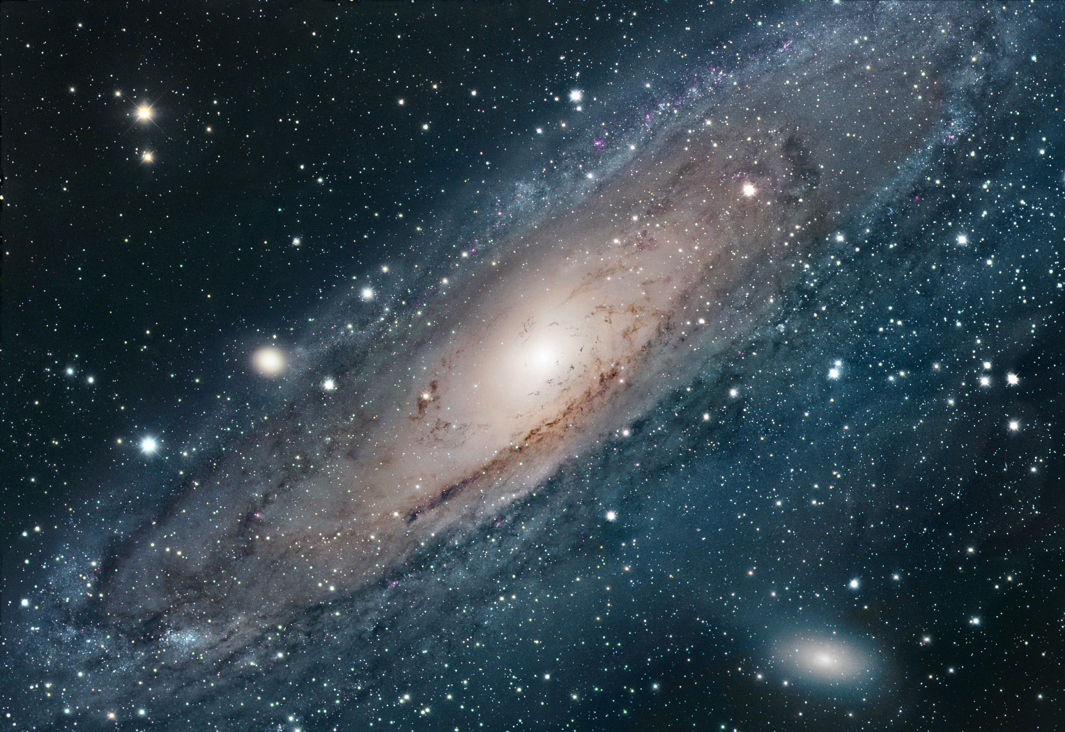
Andromeda (M31 or NGC 188)

Slide 16
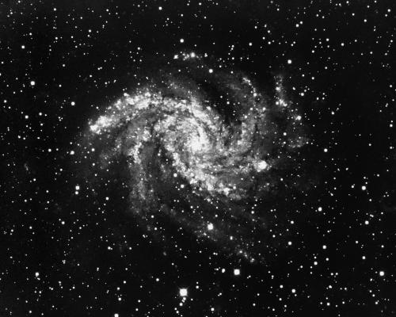
Variety of Spiral Galaxies

Slide 17
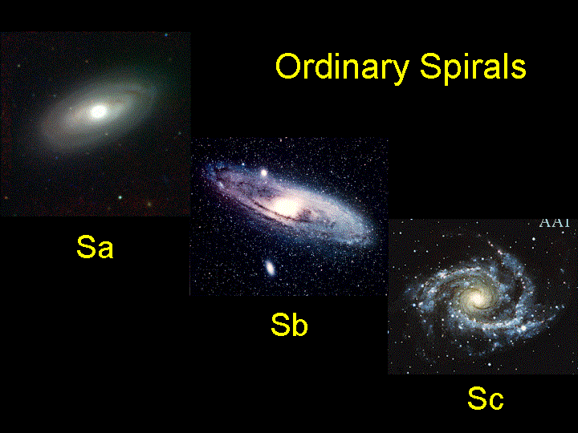

Slide 18
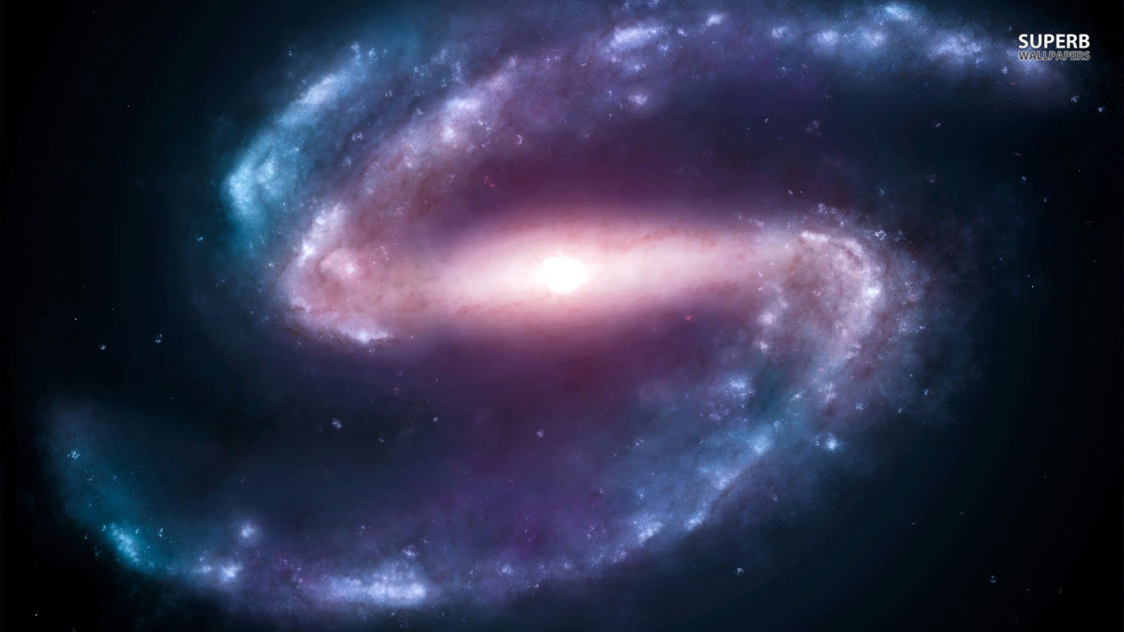
Barred Spirals: Powered by Rotating Jets

Slide 19
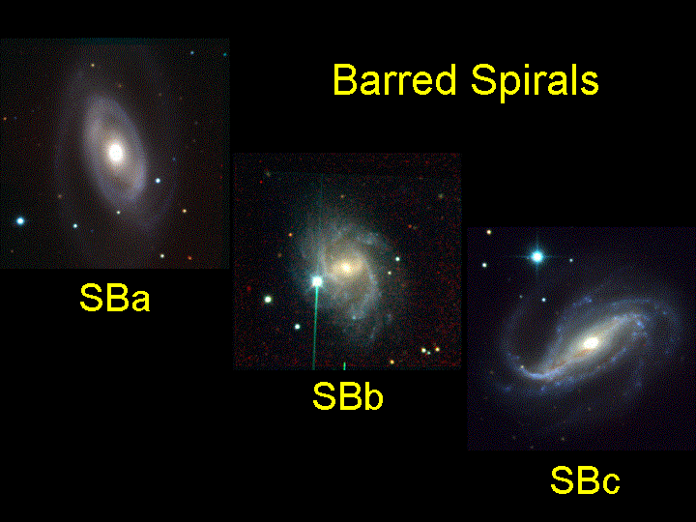

Slide 20
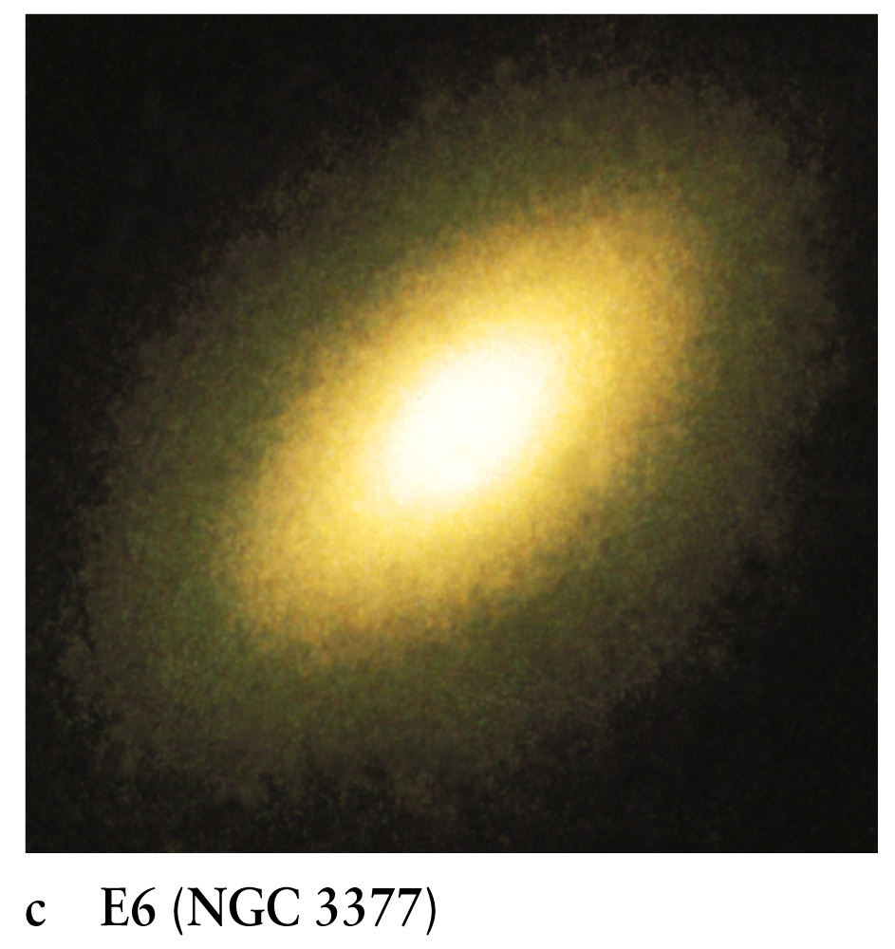
Elliptical Galaxies

Slide 21
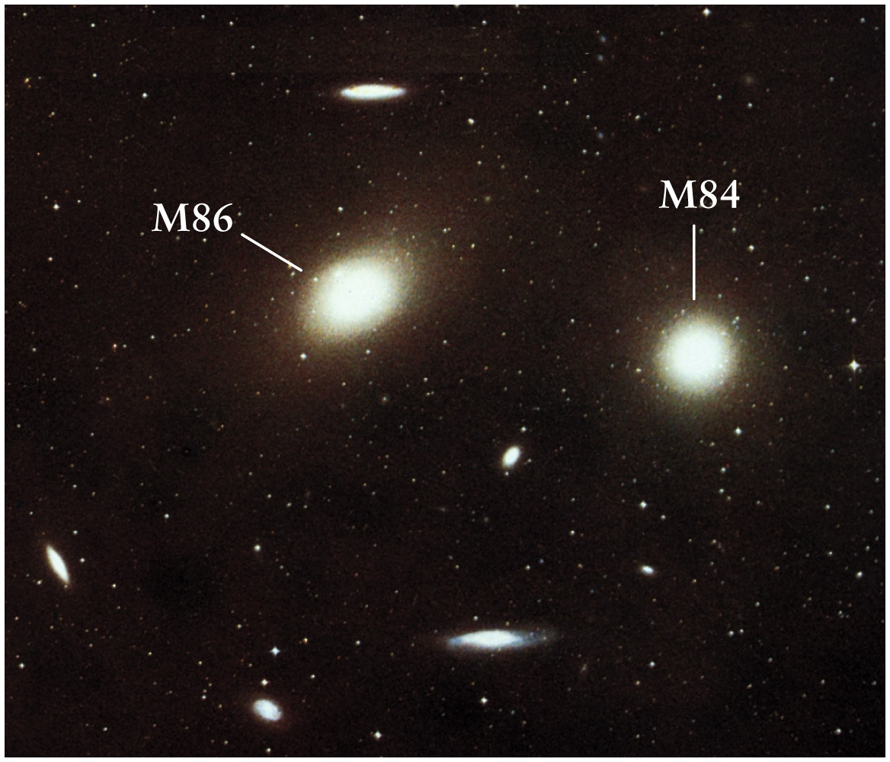

Slide 22
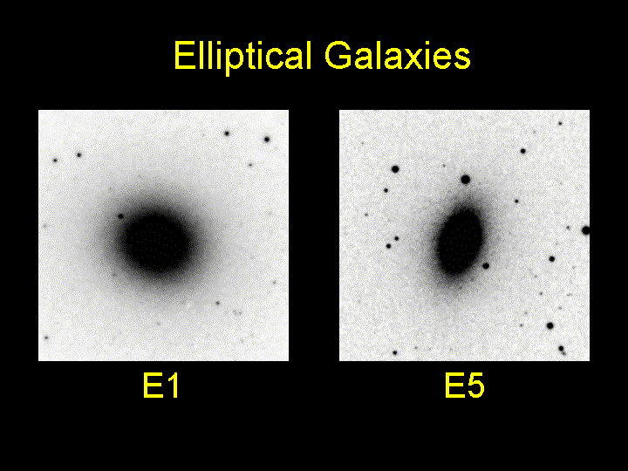

Slide 23
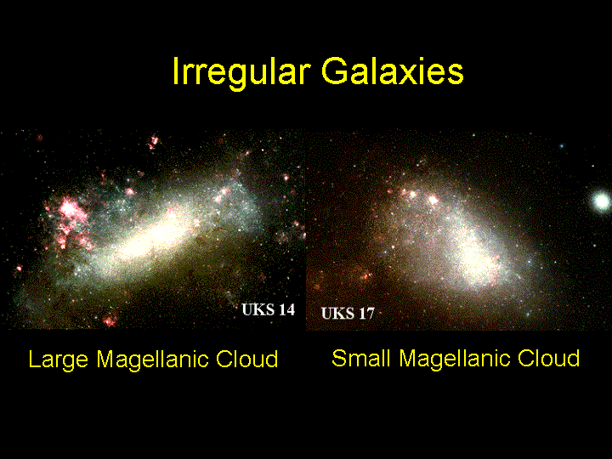

Slide 24
Types of Galaxies
Spirals – nucleus, bulge, halo, spiral arms
Barred Spirals – barred nucleus, …..”…..
Ellipticals – Inactive galaxies, various kinds of ellipticity, from near-circular E0 to highly oval and flat E7 (need to distinguish from edge-on view)
– no disks, spiral arms, dust lanes, or signs of activity
Irregulars – Not like spirals or ellipticals
Hubble Classification – Tuning Fork Diagram

Slide 25
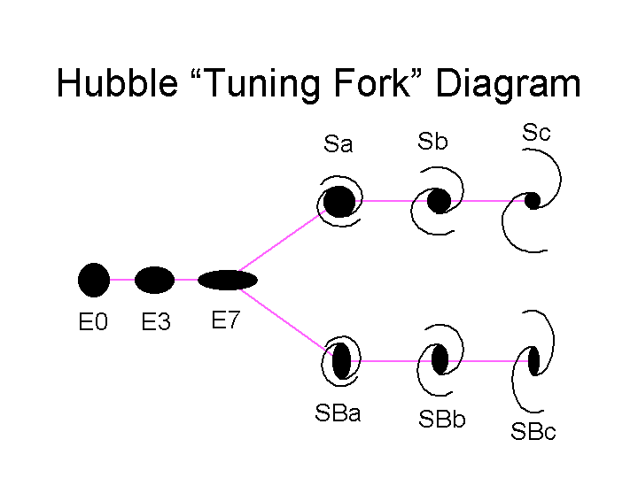
Ordinary Spirals
Ellipticals
Barred Spirals

Slide 26
Hubble Classification of Galaxies
Ordinary Spirals – classified according to relative bulge strength and tightness of spiral arms
- Sa: prominent bulge and tight but indistinct arms
- Sb: less prominent bulge and looser arm structure
- Sc: small bulge and loose and clearly seen arms
i.e. from Sa to Sc, from tight to unwinding arms
Barred Spirals – bar-shaped nucleus (jet??); as many as ordinary spirals; bar rotates like solid; spiral arms emerge from either end (SBa, SBb, SBc)
Ellipticals: No arms or dust lanes; old stars
Irregulars – chaotic structure, no systematic rotation, many dwarf irregular galaxies (classified as “dI”)

Slide 27
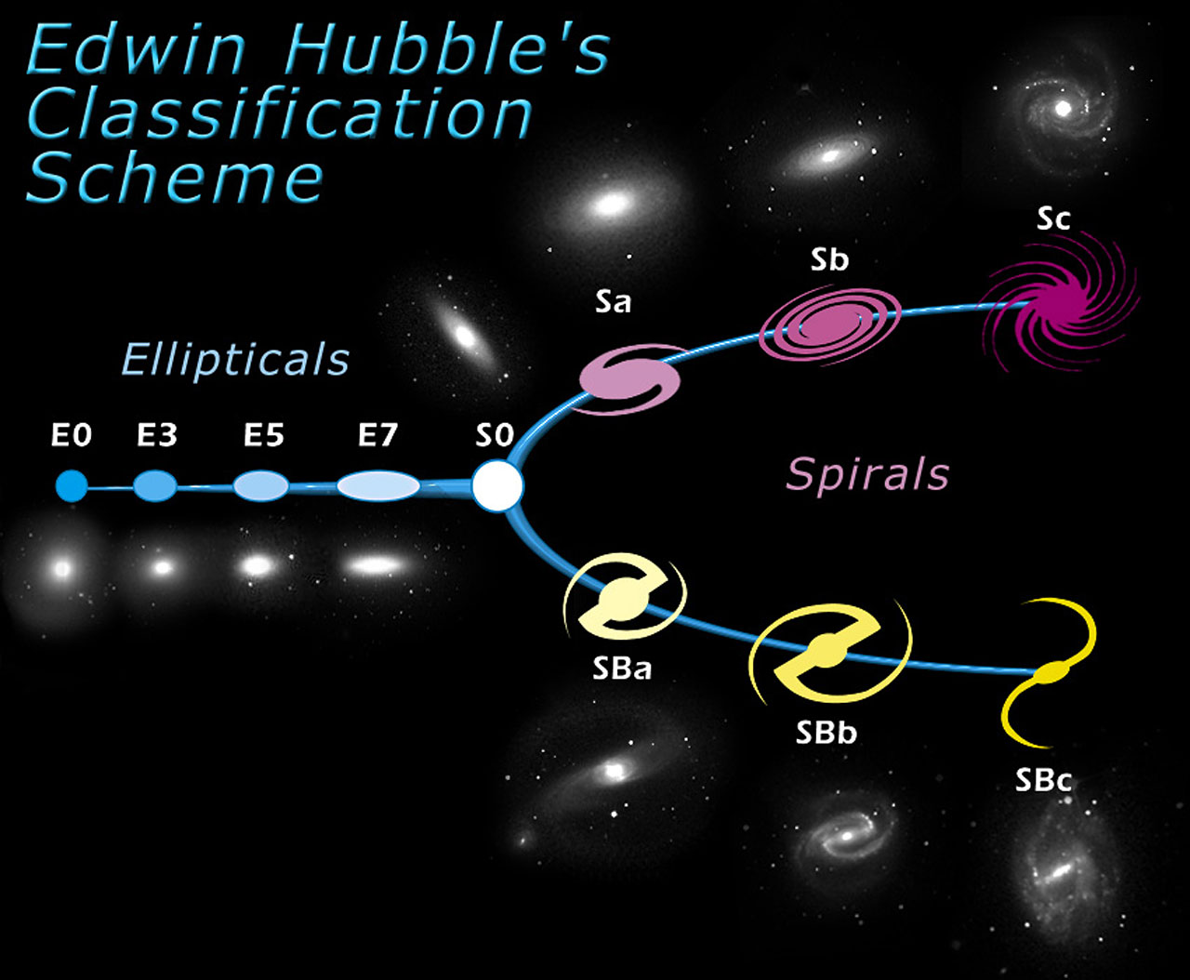

Slide 28
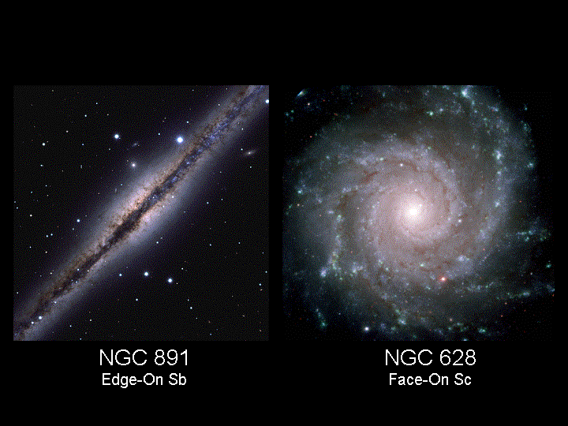

Slide 29
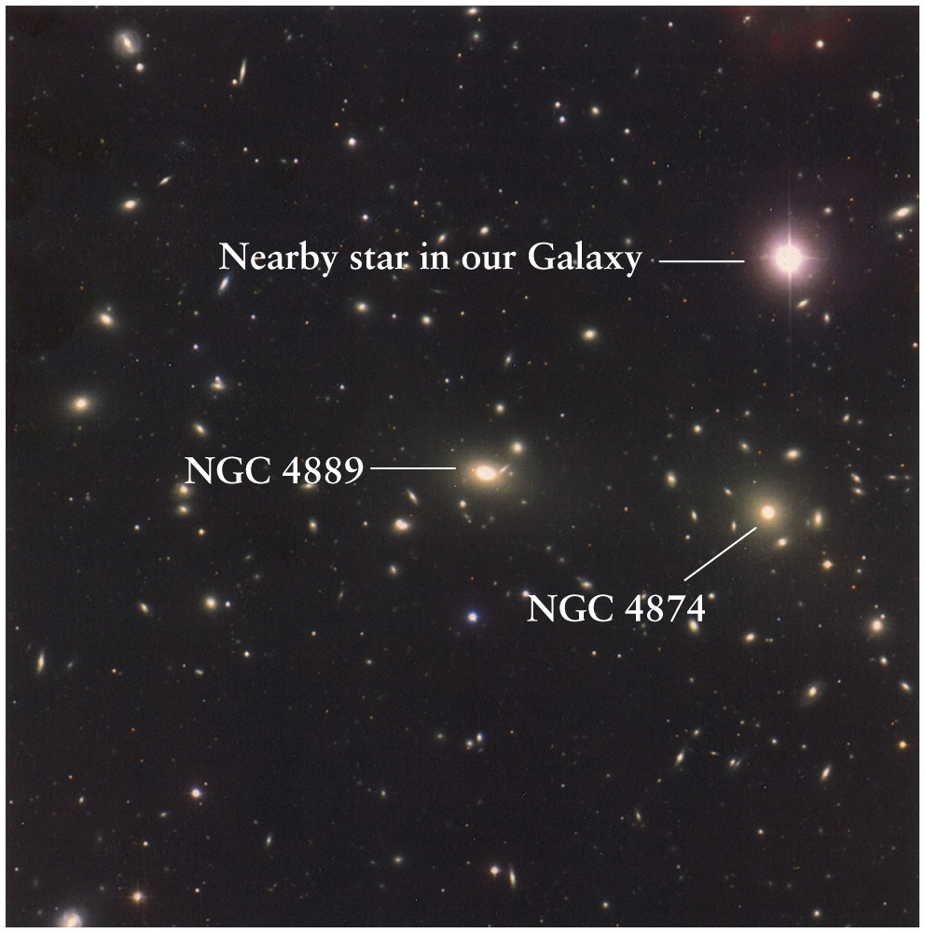
New Galaxy (General) Catalog (NGC)

Slide 30
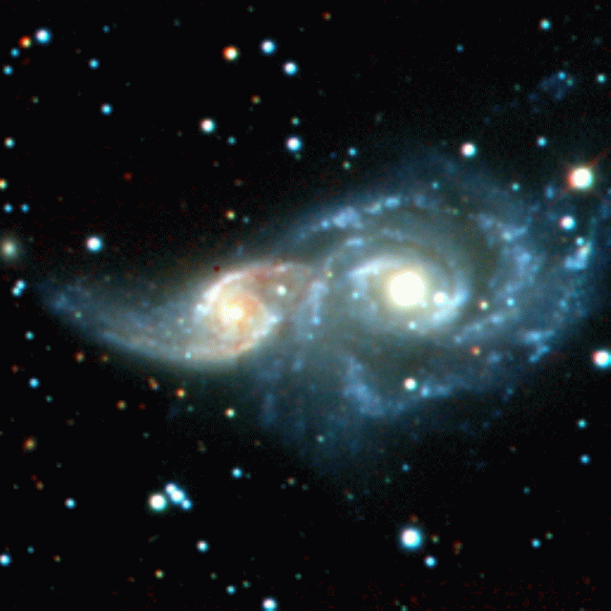
Collision of Galaxies
Galaxy-galaxy collision can induce gravitational tidal effects and lead to “starbursts” – rapid stellar formation

Slide 31
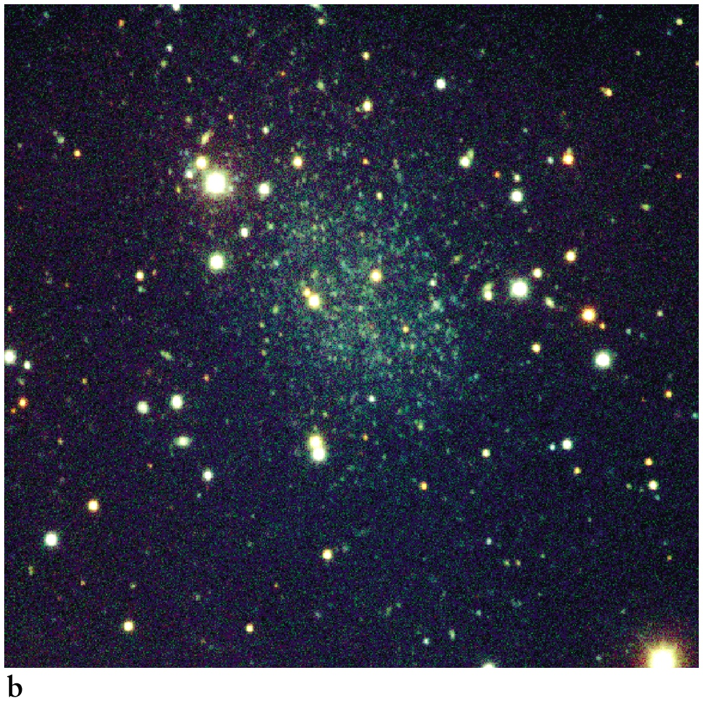

Slide 32
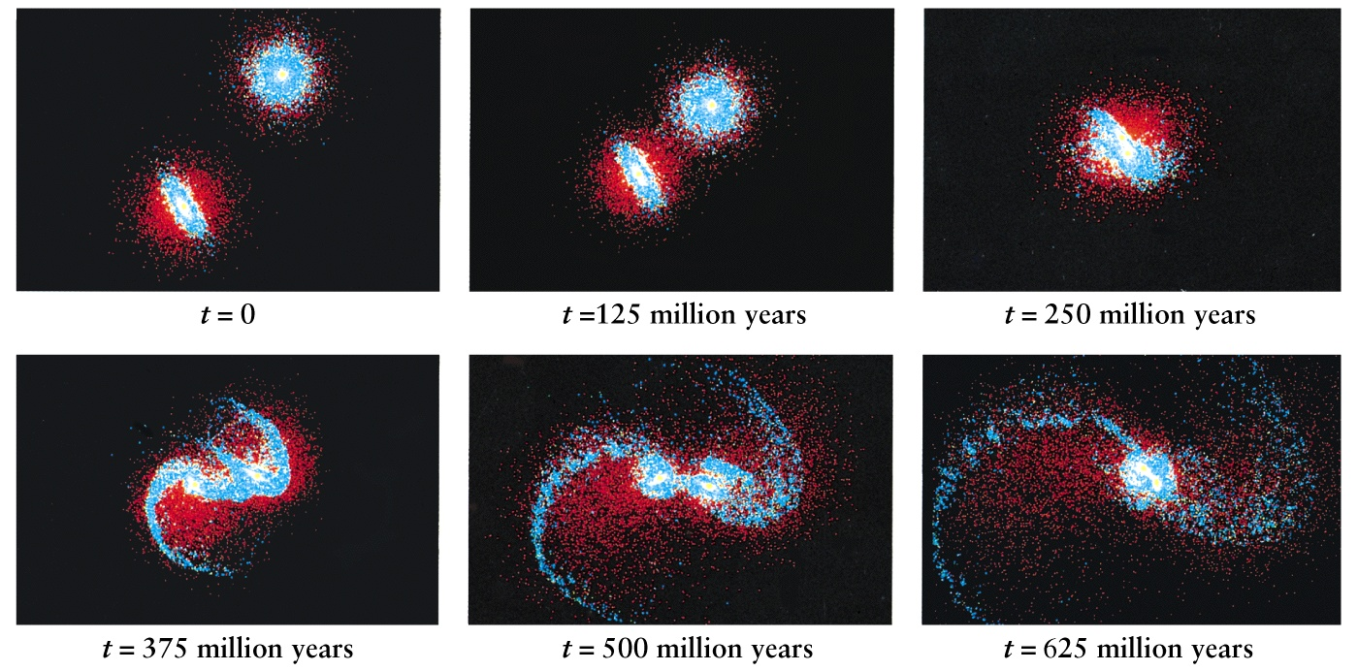
Colliding Galaxies (Simulations)

Slide 33
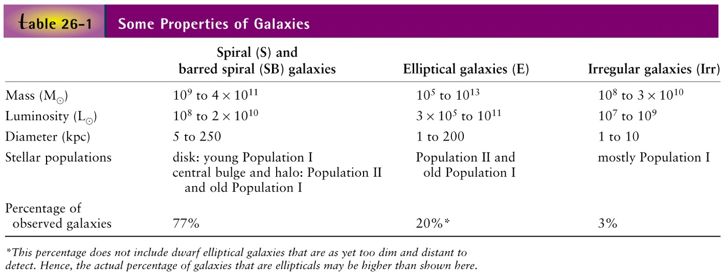
Properties of Galaxies
Population I – Young Stars in spiral arms, disk formation, metal-rich with elements
heavier than H, He (all called ‘metals’); The Sun is middle-aged Pop I star
Population II – Old Stars in globular clusters, above the disk, metal-poor,
ages > 10 billion yrs

Slide 34
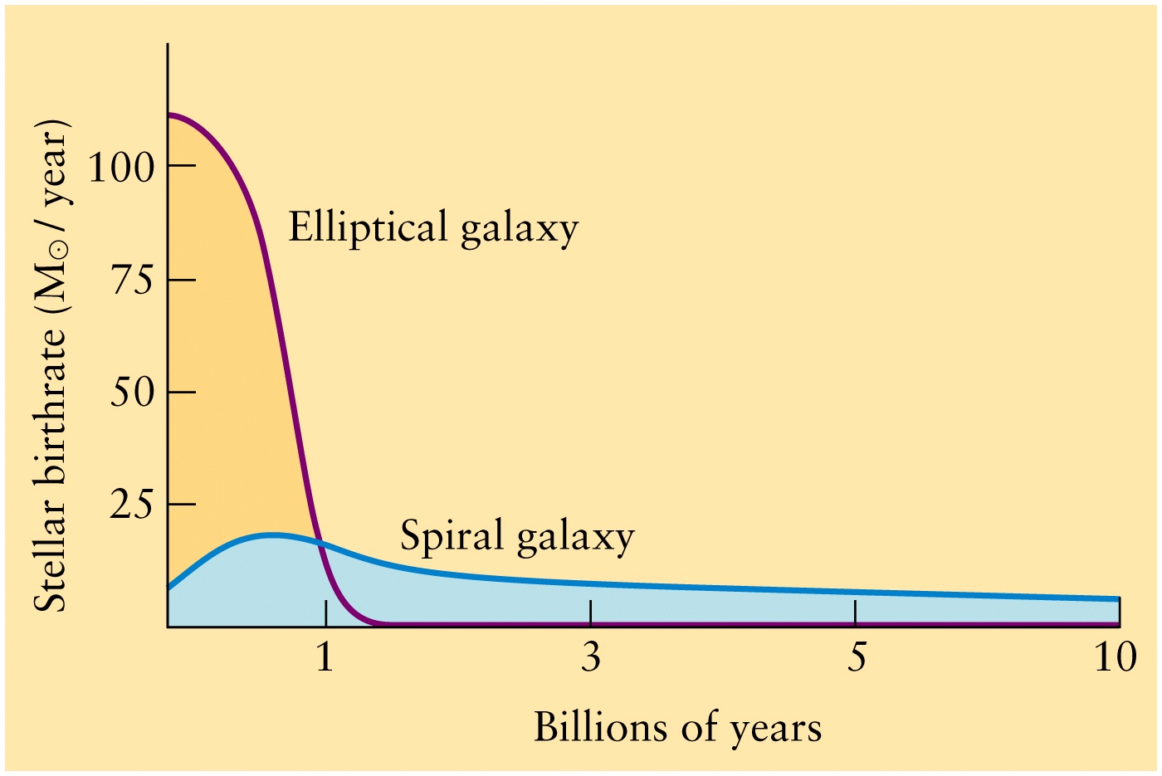
Stellar Birthrate: Ellipticals have older stars than spirals
No significant star formation after 1 billion years
Ongoing star formation

Slide 35
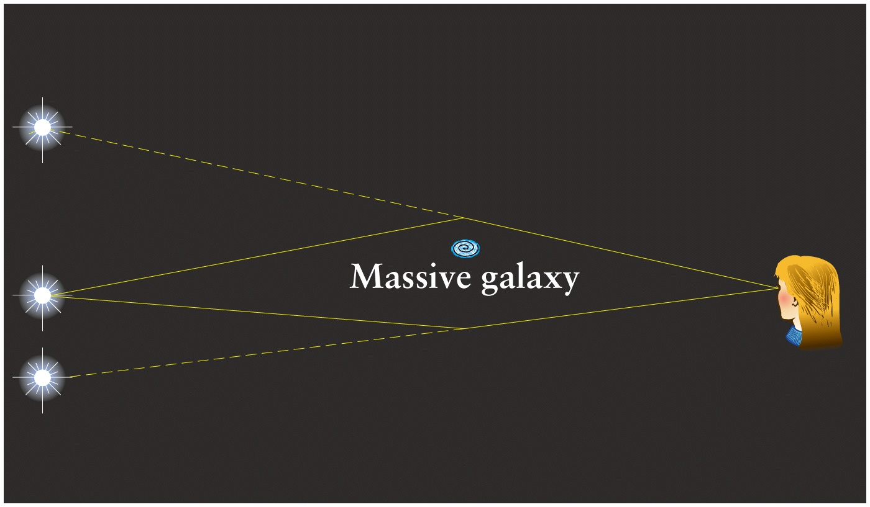
Multiple images by gravitational lensing

Slide 36
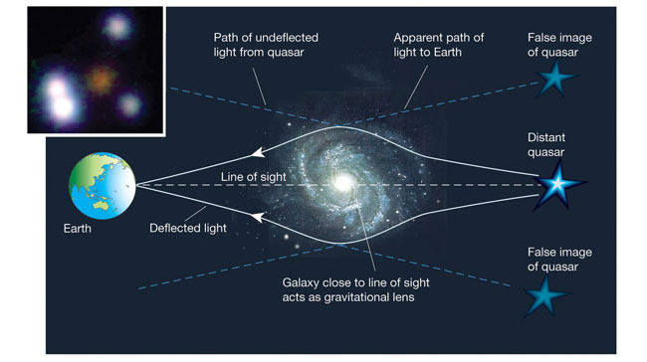
Gravitational Lensing and Multiple Images
Dark matter in halos of galaxies can also be detected by gravitational lensing

Slide 37
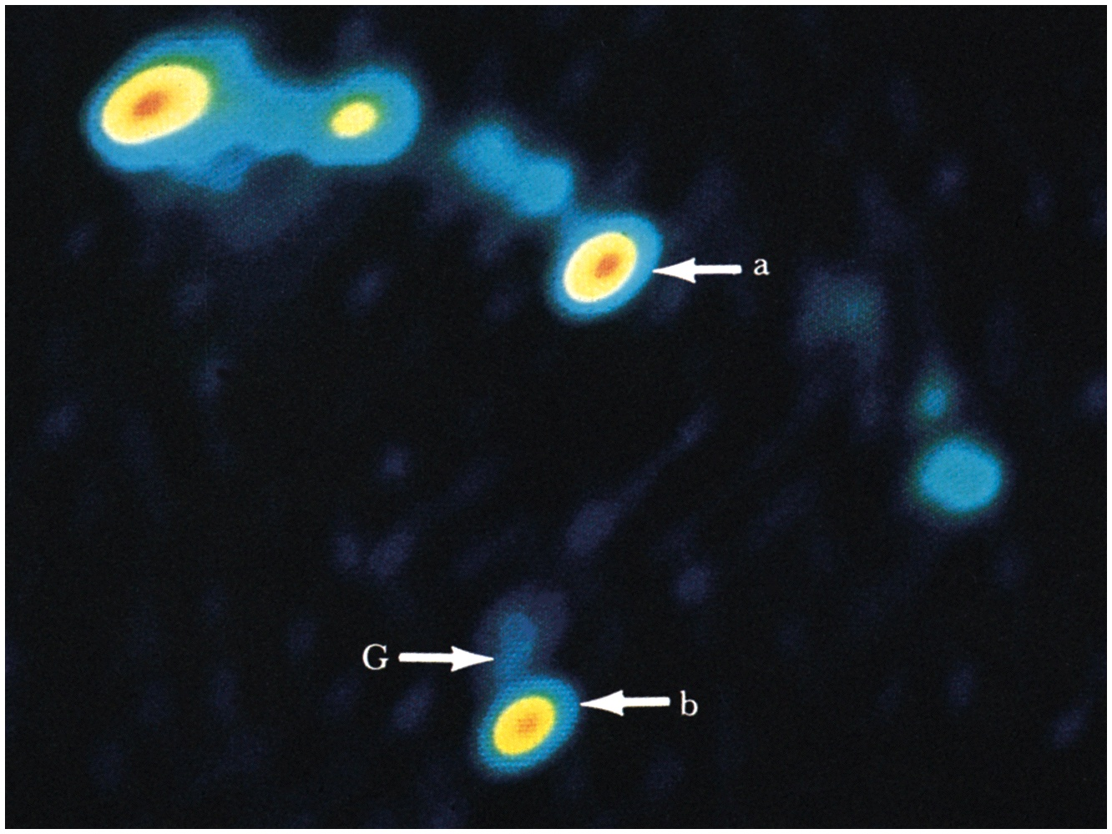
Gravitational lensing of a quasar – two images a,b

