Slide 1
Expansion and Acceleration of the Universe: Dark Energy
Homogeneous and uniform cosmic expansion
Hubble constant determines scale factor
Hubble diagram was based on a limited distance scale calibrated by Cepheid variable stars in relatively nearby galaxies
Cepheids are giant stars with periodically varying luminosity (pulsate); measuring the periods (days to months) calibrates absolute luminosity → Period-Luminosity relation

Slide 2
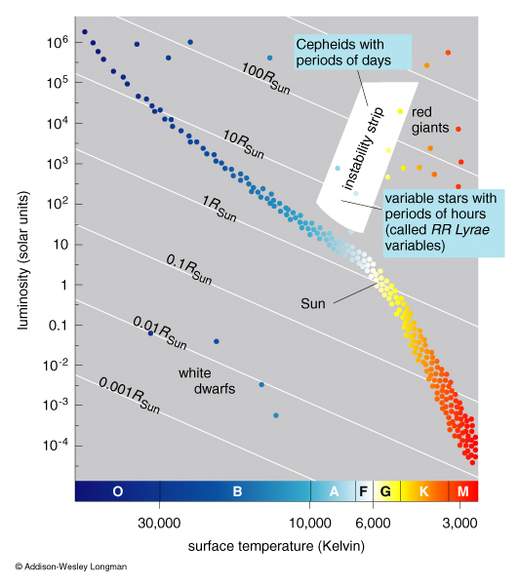
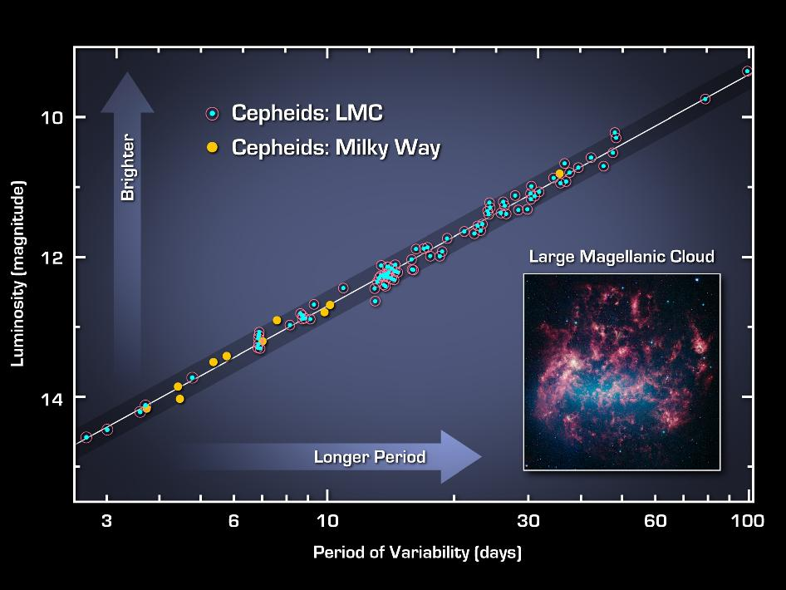
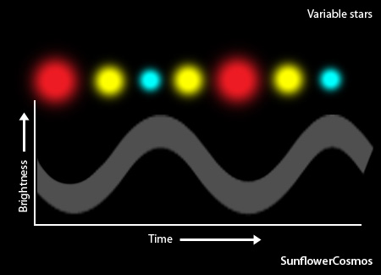
Cepheid Variable Stars
Period-Luminosity Relation
Longer the period, more luminous the Cepheid

Slide 3
Olber’s Paradox: Why is the Sky dark?
Infinite universe with infinite galaxies (stars) ?
Sky must be blindingly bright!
But it isn’t
Therein lies a paradox
Resolved by Big Bang cosmology
First, let’s examine Olber’s paradox
Assume infinite universe with infinite stars

Slide 4
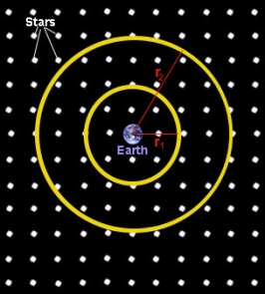
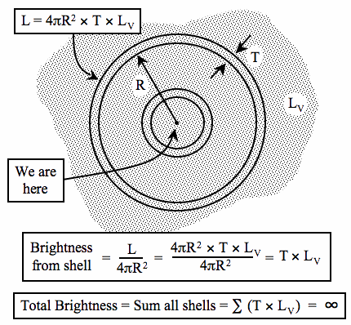
Q. Stars everywhere out to infinity ?
A. Then the sky must be infinitely bright !
Assume constant brightness L_{V}
and thickness of shells T

Slide 5
What is the solution to Olber’s paradox ?
Finite universal space-time
Finite spatial extent → observable universe
Finite lifetime → Age of the universe = 1/H₀
Paradox explained by expansion of the universe
- Light from distant stars is highly red-shifted and not reached us yet
- Hubble expansion implies age ~ 13.7 billion years
Following Big Bang: v = H_{o}d
Most recent value: H_{o} = 71 Km/s/MPc (note the units)

Slide 6
Hubble Expansion
Finite and expanding universe
Cosmological expansion of the universe itself
-- Not just galaxies moving away, but the Universe itself is expanding
Redshift of galaxies → photon wavelength received on Earth increases as emitted light travels towards us from faraway galaxies
Redshift: z = (λ_{r} − λ_{e}) / λ_{e}
Measure redshift z and infer velocities
z = 0 → present epoch; z > 0 → past
Universe was hotter at higher z: T(z) = T_{o}(1+z)
T_{o} = 2.73 K (CMB temperature)

Slide 7
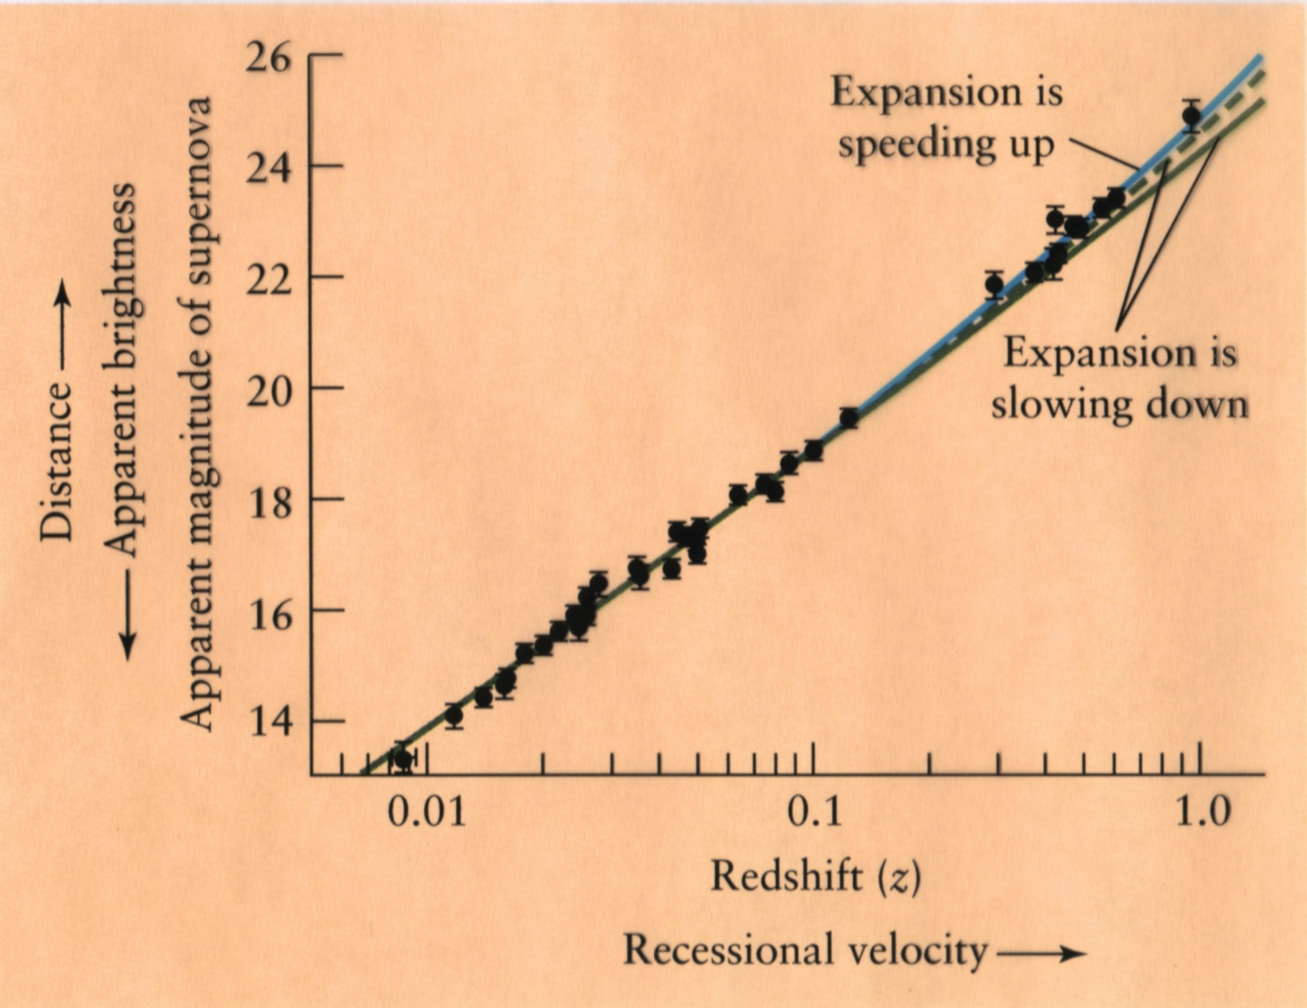
Hubble Diagram vs. Redshift
But
Universal expansion is not constant but accelerating

Slide 8
General Relativity Revisited
General Relativity (GR) did not include expansion of the Universe, thought to be static
But that caused a problem………………gravity
Attraction would make the Universe collapse
Einstein added an ad hoc repulsion term to GR
Cosmological constant Λ; “Greatest blunder”
But, Hubble’s discovery made that redundant
Or did it? What causes accelerated expansion?
Dark energy; reminiscent of Einstein’s Λ

Slide 9
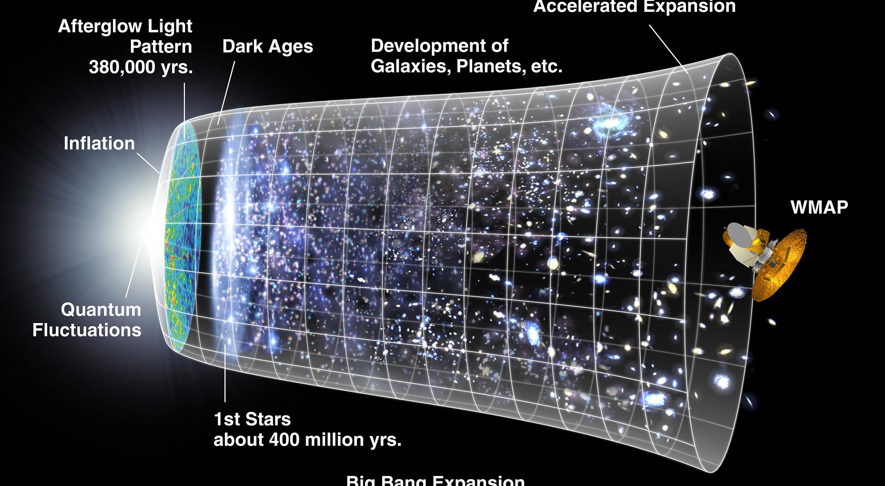
Universal 4D Spacetimeline

Slide 10
Curvature and Distribution of Matter
Matter and energy curve space locally
Curved space makes matter and energy move
Universe is almost flat otherwise
GR equations relate curvature of spacetime and distribution of matter and energy
Einstein equations of GR
Simplified by Friedmann assuming homogeneous and isotropic universe

