Slide 1
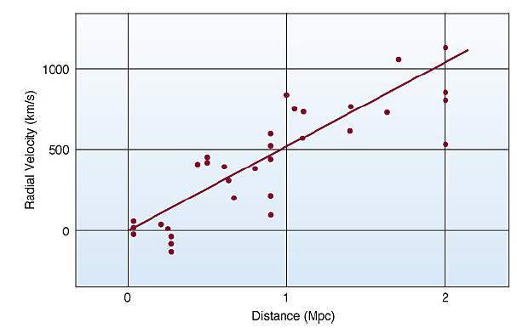
Hubble Diagram: Distribution of Galaxies

Slide 2
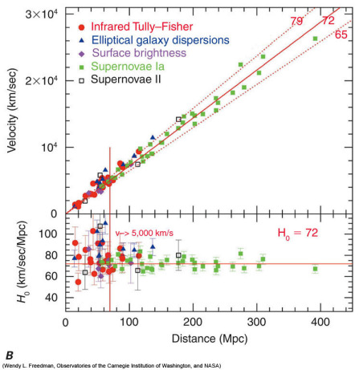
Hubble’s Law: v = H_{o}d
Velocity increases with distance

Slide 3
Expanding Universe
Hubble’s law → Universe is expanding
Universe had a beginning !
How long ago?
Age of the universe: 1/H_{o} (units of time)
Big Bang !!
How does one determine distances?
Redshift

Slide 4
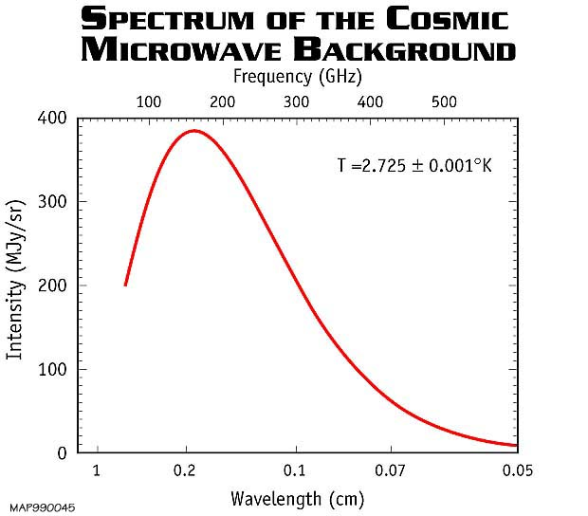
Cosmic Microwave Background (CMB):
Universal and Uniform Radiation

Slide 5
CMB Properties
The entire universe is filled with extremely uniform radiation
CMB radiation corresponds to a fixed temperature of 2.73 K (-270.3 ºC or -428.9 ºF)
Blackbody: uniform temperature oven
CMB radiation is also isotropic → same in all directions
But with extremely slight variations immediately following the Big Bang due to matter

Slide 6
Distribution of Matter in Galaxy
Stars rotate about the center of galaxy
Velocity determined by gravity: mass M_{c} and distance R_{c} from the center
KE = PE
½ m_{star} v² = G M_{c} m_{star} / R_{c}
Velocity v should decrease with radius R_{c}
Surprise !

Slide 7
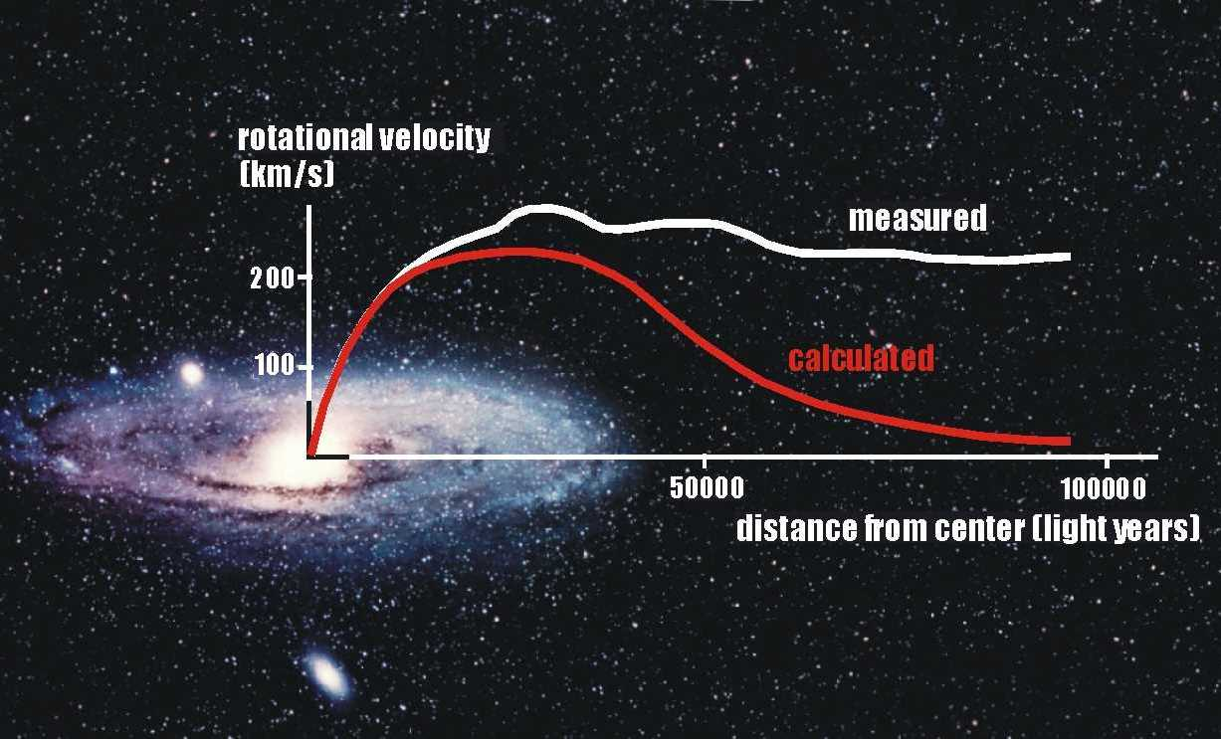
Evidence of Dark Matter: Rotation Curves of Galaxies

Slide 8
Dark Matter Halo
Rotation curves are flat out to distances beyond observable galaxies
Ergo: Galaxies have “dark matter” haloes
What is dark matter?

Slide 9
Einstein’s Theory of Relativity
Is there a maximum velocity in nature ?
If no, then one can travel or convey information over infinite distances in infinitesimally short time – Action at a distance as presupposed by Newton
But, do not observe instantaneous action implying infinite speed
But if yes, then what is the limiting velocity?

Slide 10
The Two Postulates of Relativity
Speed of light is the maximum speed in nature, and is constant regardless of the speed of the source or the observer
All physical laws are the same everywhere, and should have the same form (equations) when describing the same phenomenon (first proposed by Galileo) → Principle of Relativity
Changes our concept of space and time

Slide 11
Consequences of Relativity
Special Theory of relativity → constant velocities
Can not simply add velocities v1 + v2
v = (v1 + v2) / (1 + v1v2 / c²)
E = m c² → Energy and mass are equivalent
(example: atomic energy, A- and H-bombs)
No object with mass can attain the speed of light; its inertial mass becomes infinite
m = m(rest) / (1 – v²/c²)^{1/2}
Light is bent by gravity of a massive object such as the Sun

Slide 12
Relativity (Contd.)
General Theory of Relativity
→ Accelerating objects and gravity
Why are astronauts in the orbiting space shuttle weightless ?
They are continuously falling towards the Earth at the same rate as the floor of the space shuttle (e.g. like a freely falling elevator)
Gravity ←→ Acceleration (equivalent)
Basic idea: F = ma → W = mg

Slide 13
Relativity (Contd.)
Space and time are equivalent (simultaneity is relative, not absolute)
Example: Two observers, one on a moving train and the other stationary on the ground observe “simultaneous” flashes of light at different times → difference in space due to motion is “converted” to difference in time
Time ‘flows’ slower in a moving frame of reference (astronauts live slightly longer!), or near a massive object such as a black hole

Slide 14
Time Dilation and Space Contraction
A time interval in a moving frame of reference (platform moving with velocity v) gets longer as
t’ = t / [ 1 – (v/c)²]^{1/2}
But the space interval gets shorter as
x’ = x [ 1 – (v/c)²]^{1/2}

