Slide 1
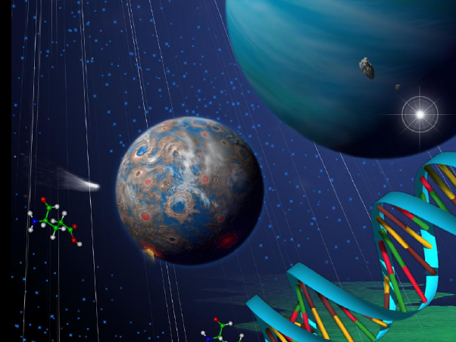
Astronomy 2141 AU24
Life in the Universe
Prof. Anil Pradhan
Homepage: www.astronomy.ohio-state.edu/~pradhan
Notes:
Video recording!

Slide 2
Course materials will be posted on Carmen and Homepage
carmen.osu.edu
Source for:
Lecture Notes
Exam Grades
Class Announcements
Calendar
Supplementary materials
All course documents
Class video recordings
Notes:
Poll here

Slide 3
Astronomy 1141 - FAQs
Syllabus: www.astronomy.ohio-state.edu/~pradhan
Chapters? Selected Topics. See daily outline and lecture notes on the website
Emails? Many per day! Please restrict to urgent ones. Preferably, see after class.
Ask TA’s first or visit during off. Hrs.
Absence? Follow lecture notes, and Contact someone in class for notes.
Emergencies? Send email to TA and me.

Slide 4

The question of life on other worlds is one of the oldest in astronomy.
Is there life on other planets or moons in our Solar System?
Are there planetary systems around other stars (exoplanets)?
Are exoplanetary systems like ours
or different?
Are any exoplanets like the Earth?
Has life arisen on any of these planets?
Warner Brothers

Slide 5
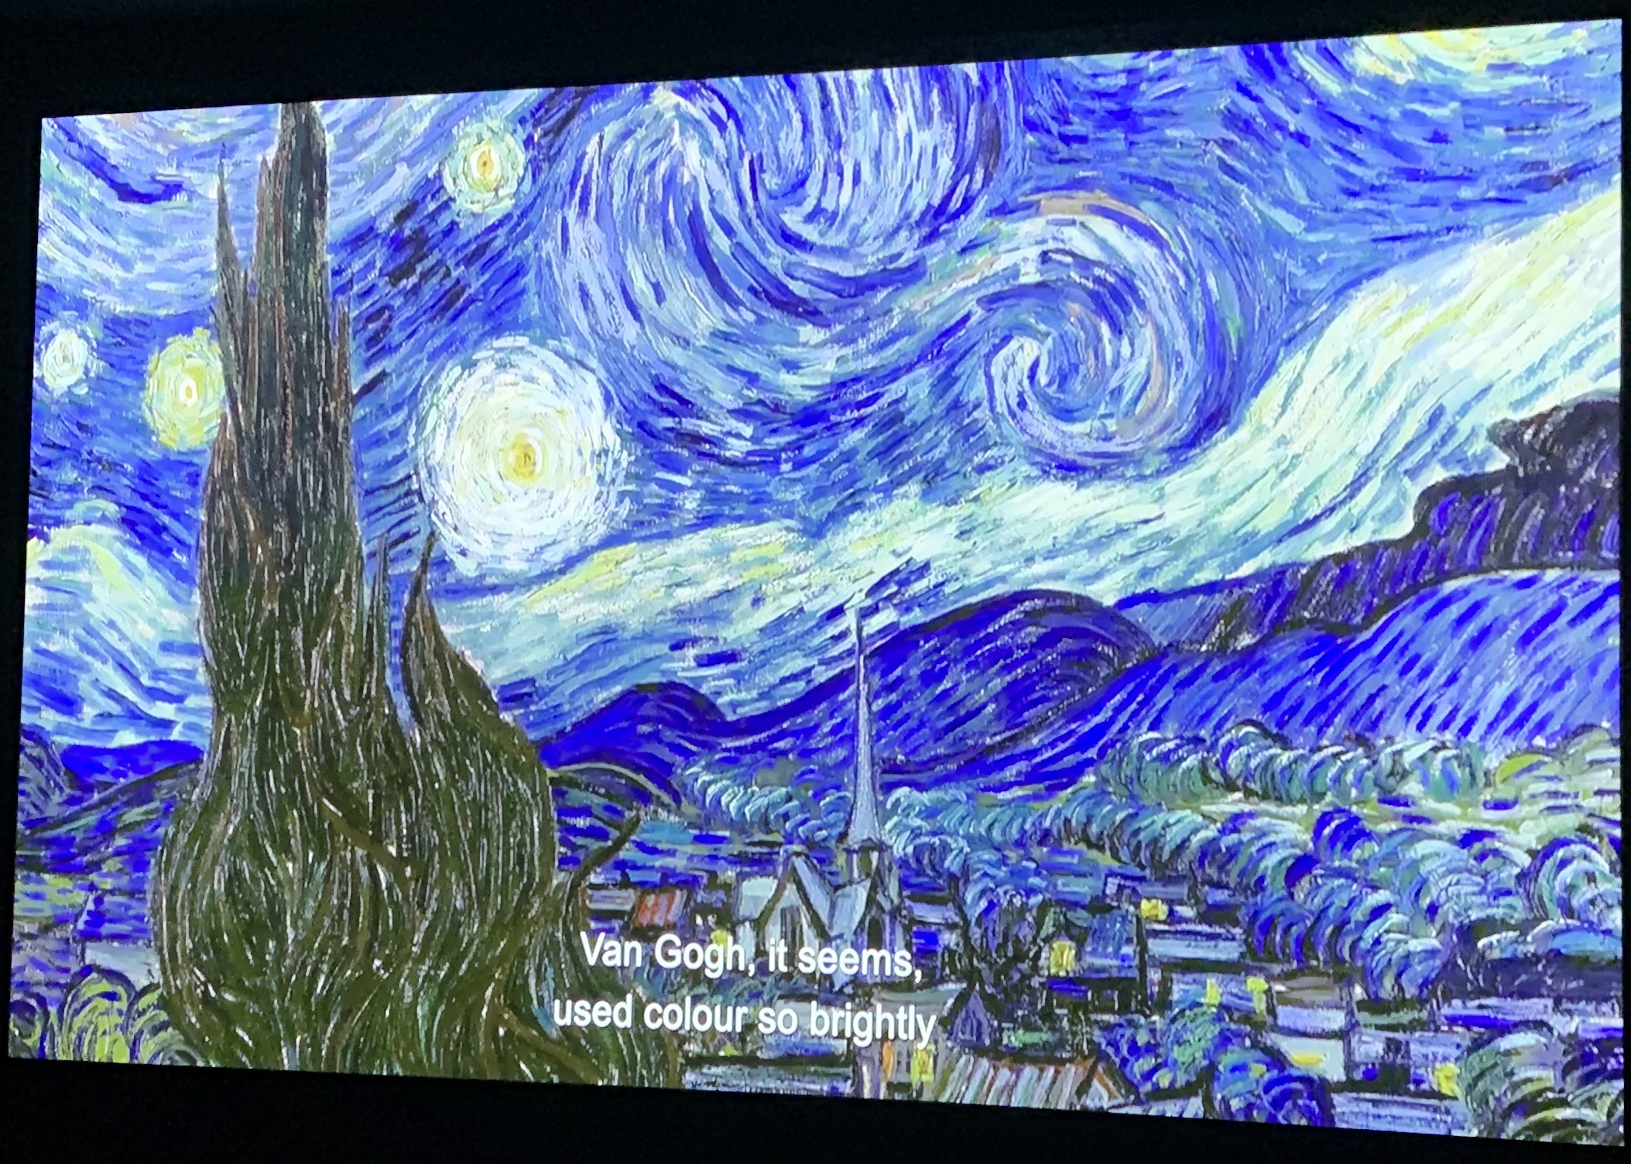
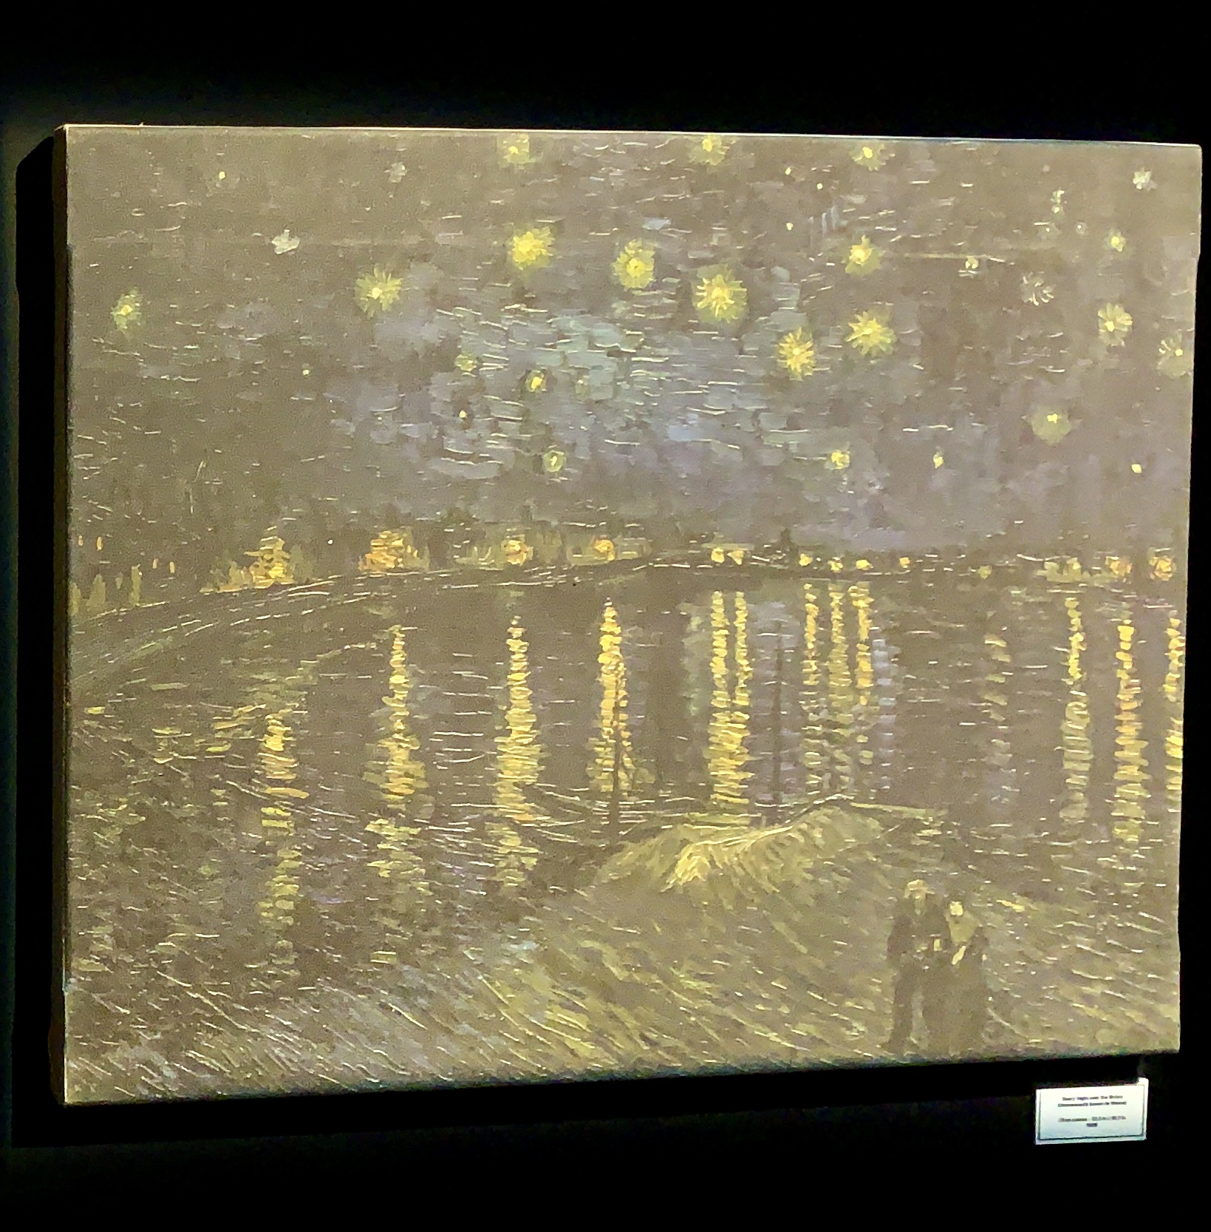
Night Sky: Vincent Van Gogh

Slide 6
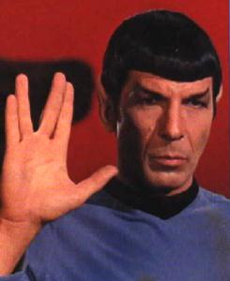
Is there intelligent life in the universe that we might someday come in contact with?
What are the requirements for life?
Where can life exist?
What is required for communication?
What is required for intelligence?
How long does it take for life to develop?
How long do intelligent civilizations last?
Paramount Studios

Slide 7
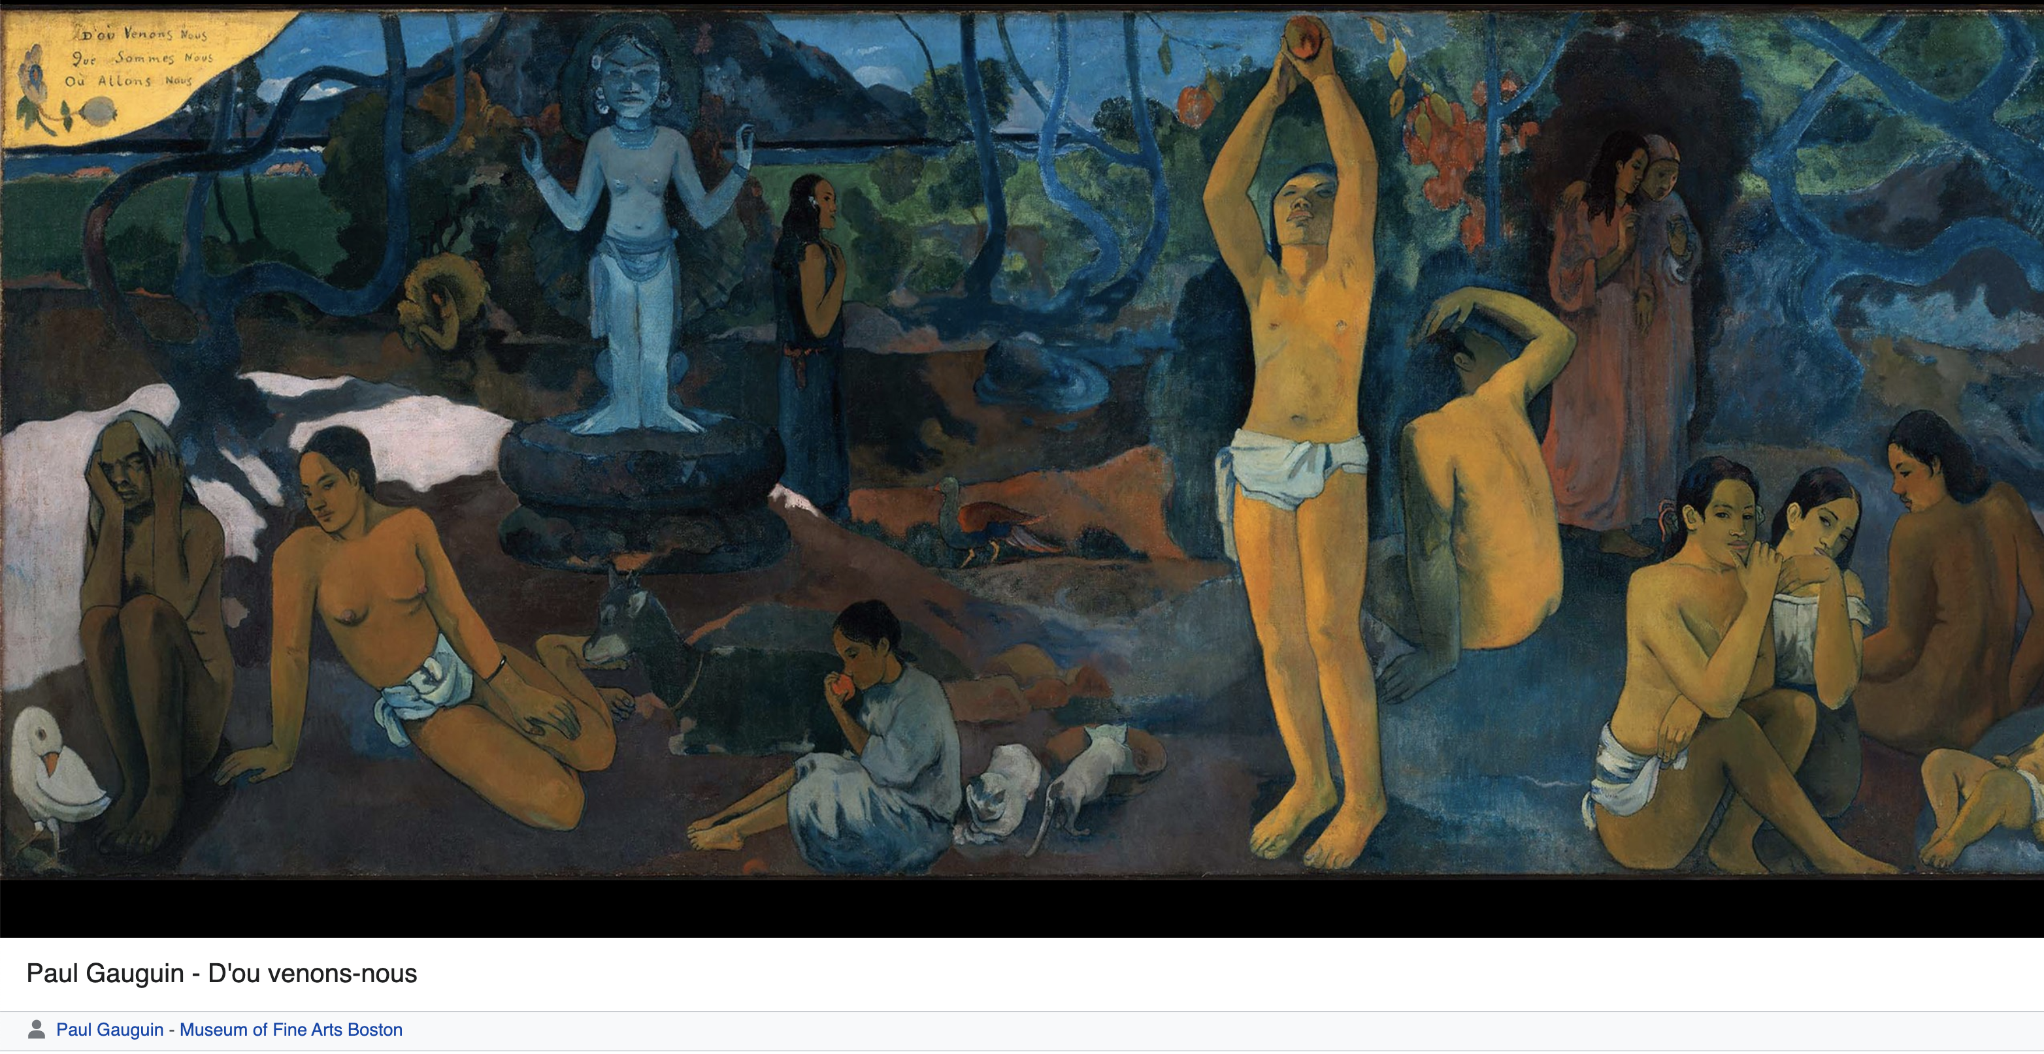
Where Do We Come From? What Are We?
Where Are We Going?

Slide 8
This course will explore the scientific progress toward answering that fundamental human question: Are we alone?
What is the cultural and historical background of this question; how does this inform (or bias) our inquiry?
What is the nature of Life on Earth?
Is there life elsewhere in the Solar System?
Is there life elsewhere in the Universe?
What is the future of life on Earth and in the Universe?
Notes:
Where Do We Come From? What Are We? Where Are We Going?

Slide 9
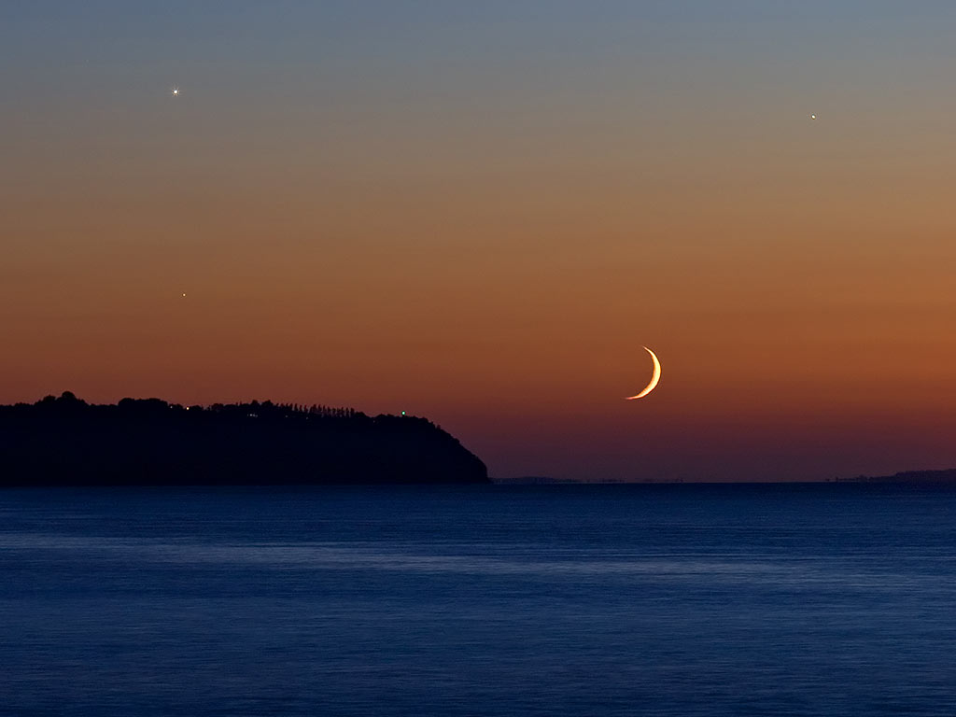
What is the historical and intellectual basis of the question of life in the universe?
What are our ideas about other worlds?
What is the nature of matter and energy?
What is our place in the cosmos?
Where are we in cosmic time?

Slide 10
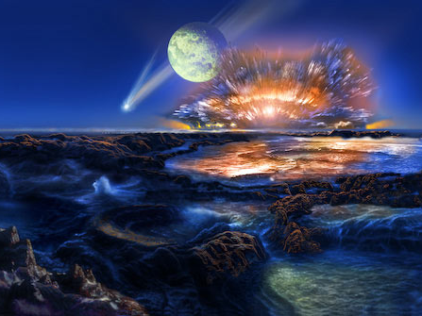
What is the nature and origin of life on Earth?
The History of the Earth
Geology, Climate, & Habitability
The Nature of Life on Earth
The Origin of Life on Earth
The Future of Life on Earth
NASA

Slide 11
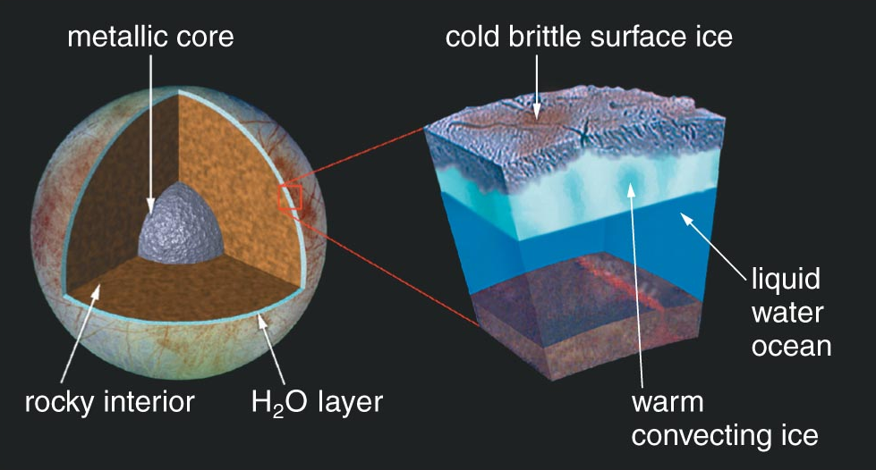
Is there life elsewhere in our Solar System?
What are the requirements for life?
Where else in the Solar System are these requirements satisfied?
Four Worlds:
Mars
Europa
Titan,
Enceladus
Why is Earth habitable but Mars and Venus not?

Slide 12
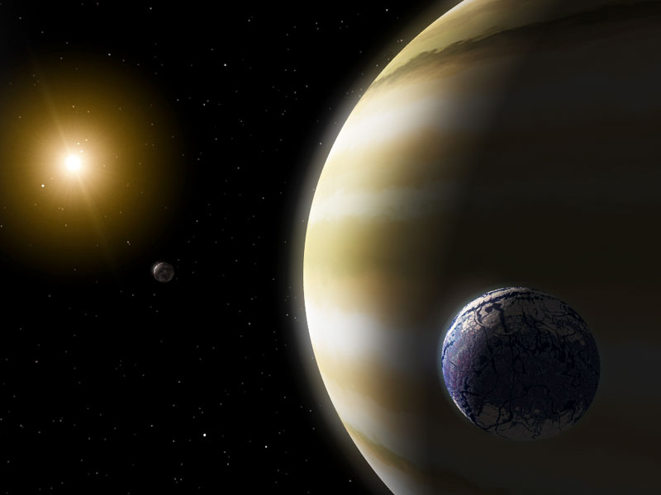
Is there life elsewhere in the universe?
Are there planets around
other stars?
Is there life on the
those planets?
How can we ever hope
to detect life on them?
Will we ever contact
other sentient beings?
What is the long-term future of life on
Earth and elsewhere in the Universe?
NASA/JPL Planet Quest

Slide 13
Science and Pseudo-Science
Science: Observable facts and verifiable theories
Pseudo-science: Belief and dogma based on faith, not subject to verification

Slide 14
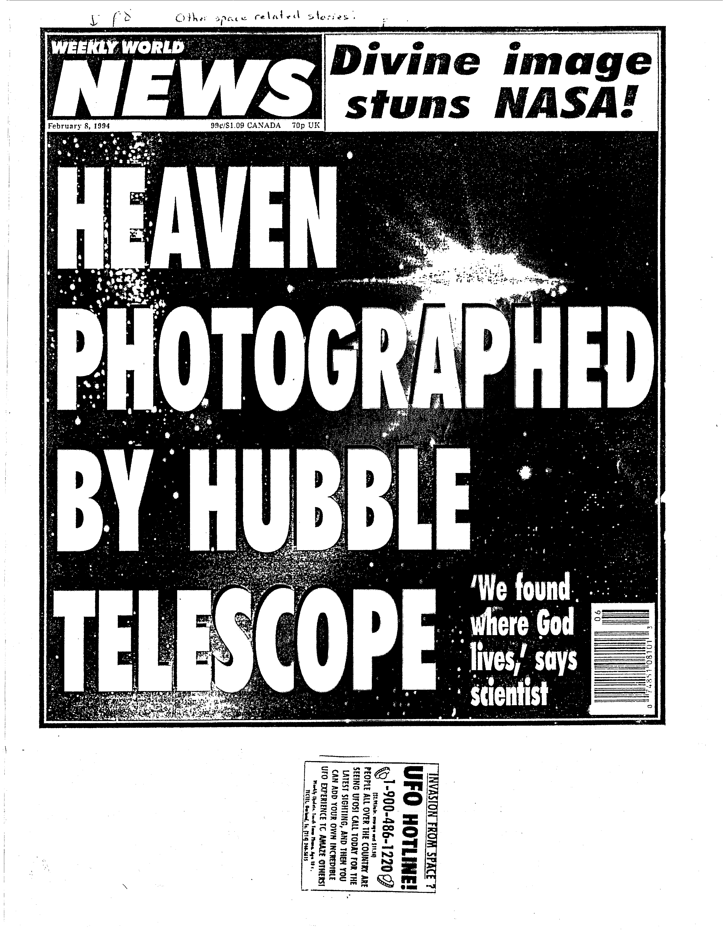

Slide 15
Astronomy vs. Astrology
No proven connection – NONE !
As it has been practiced for thousands of years, astrology is at odds with astronomy
Proof → The positions of stars and constellations have changed since ancient times; astrology does not account for that.
Example: Astrological birth signs → Revised dates !!

Slide 16
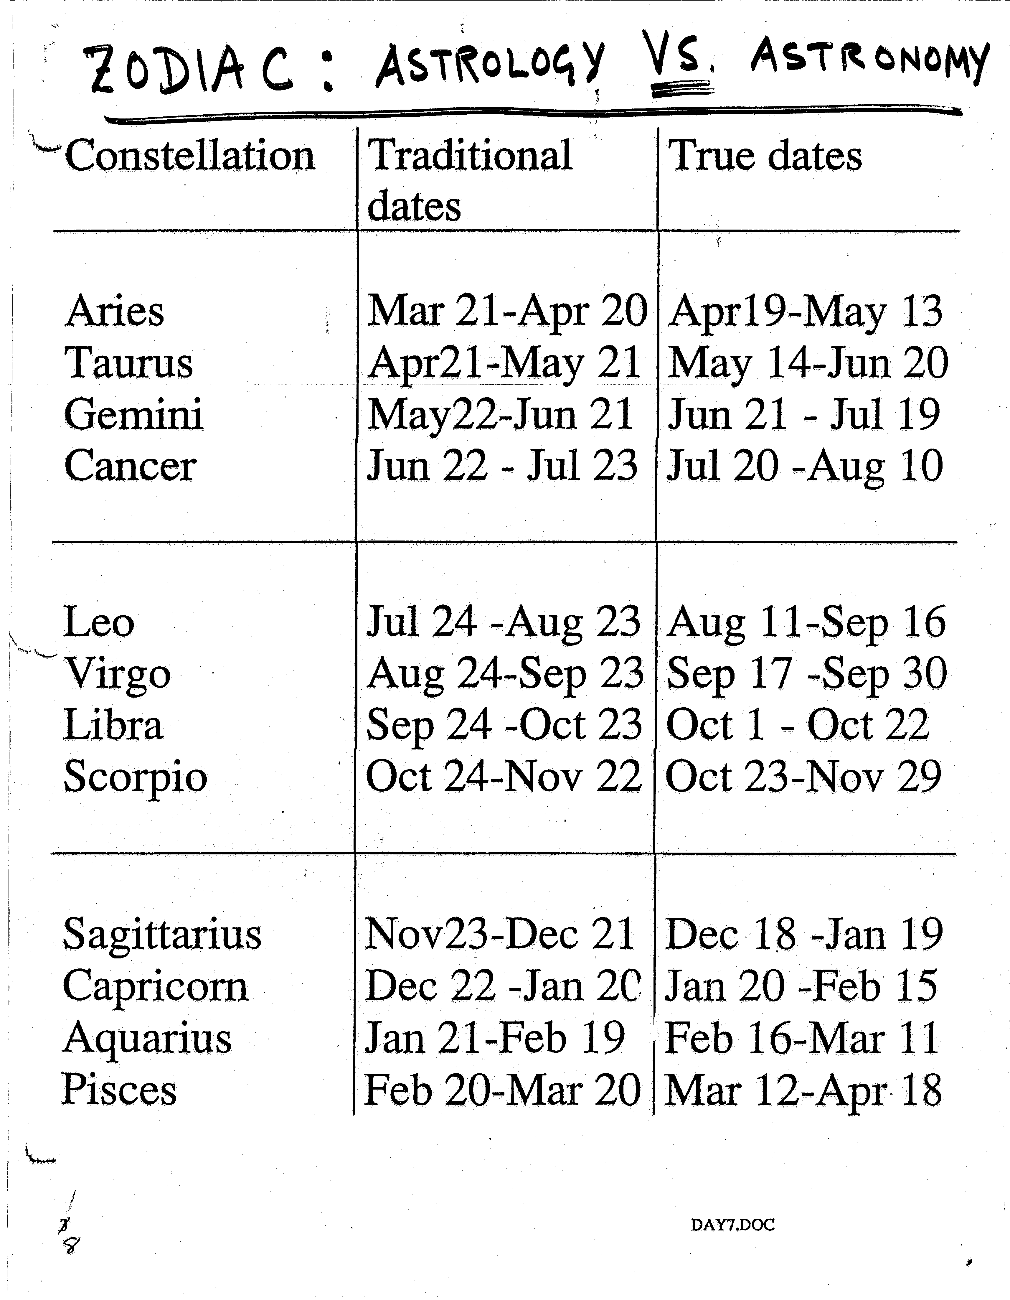
Sun and Constellations
Traditional dates
are almost exactly (but artificially) a month apart;
true dates vary.
Is there a problem?
See “Uptodate Zodiac Signs and Dates” on the webpage

Slide 17
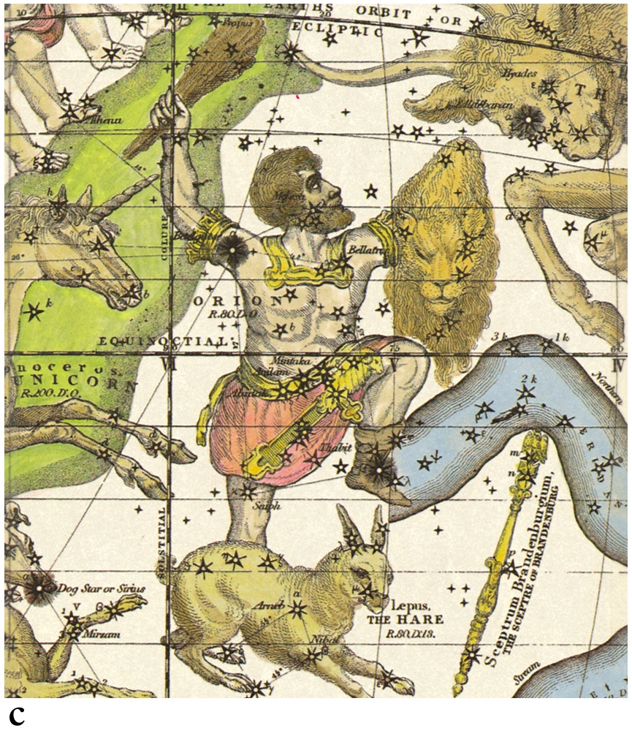
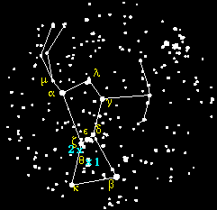
Ancient Constellations: Imaginary Figures
(Orion the hunter)
Three bright stars
in the Orion belt

Slide 18
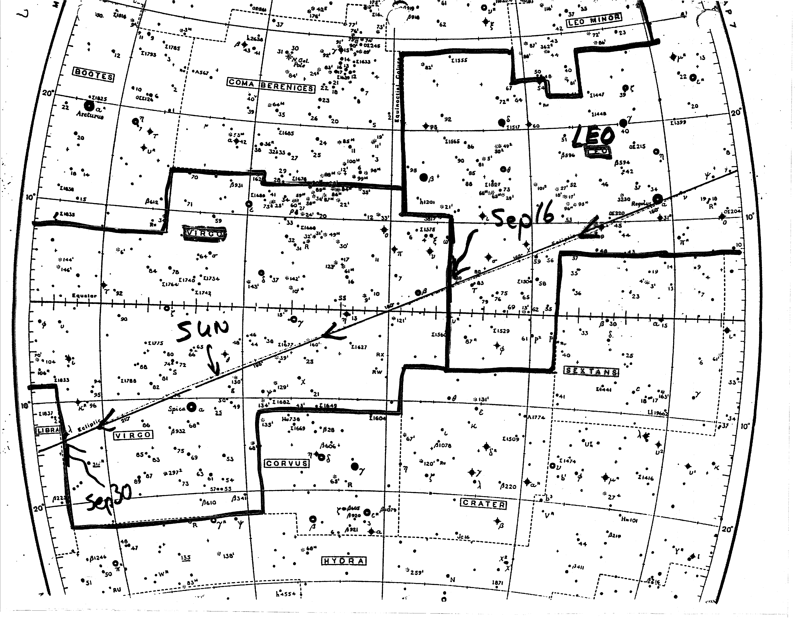
Sun moves thru Leo and Virgo:
(exit Leo Sep 16, exit Virgo Sep 30)
Leo
Virgo

Slide 19
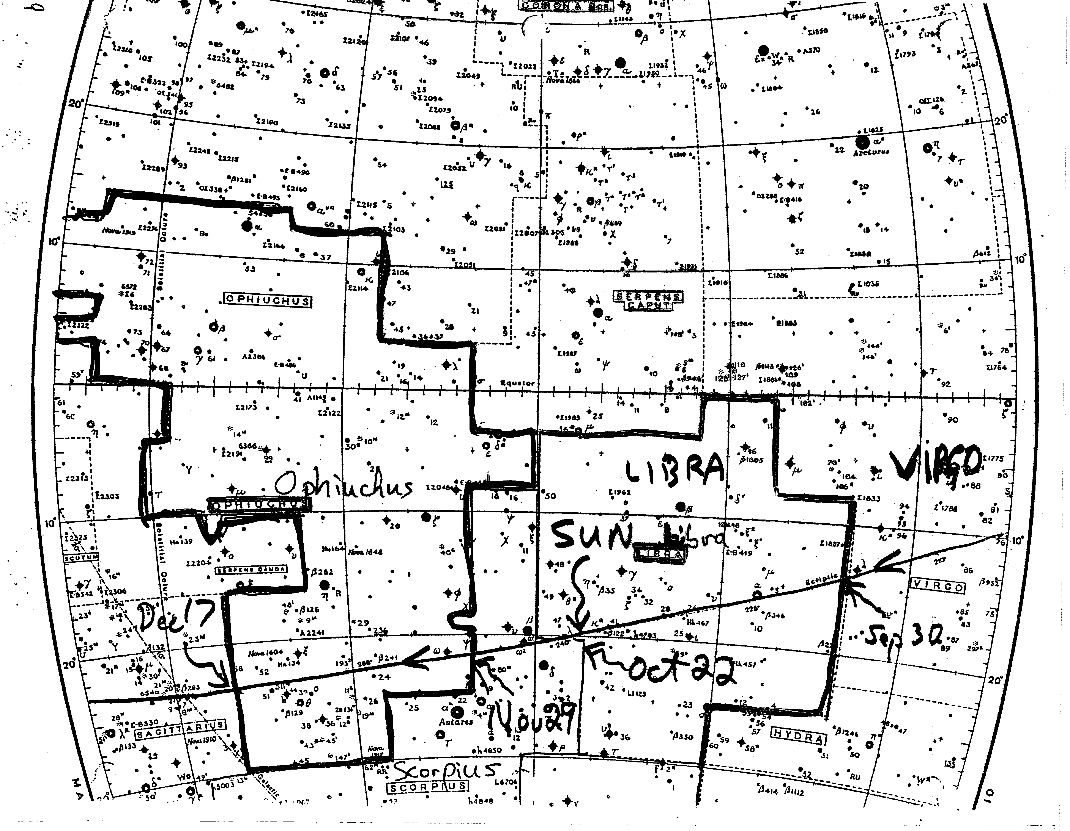
Sun thru Libra and Ophiuchus
(enter Ophiuchus Nov 29, exit Dec 17)
Virgo
Ophiuchus

Slide 20
Astrological Predictions: Ophiucheans!
Birth Sign → Ophiuchus (Nov. 30 – Dec. 17)
You are a kind, gentle, and naïve person!
Watch out for smooth operators out to get you
Send $49.95 for a complete horoscope to:
Anil Pradhan (“Stargazer for Suckers”)
Department of Astrology and Bogus Studies
OSU

Slide 21
History of Astronomy
Fundamental human conflict:
Faith vs. Inquiry (Religion and Science)
The “Dark Ages”, 1000 yrs before Copernicus
Ancient Astronomy: Before the Dark Ages
China, India, Arabia
Greeks systematized the study of science and math even as we study today

Slide 22
Geocentric vs. Heliocentric
The Greeks (Aristotle, Ptolemy) still held on to the Geocentric view. Why ?
→ Could not observe stars to move !
Copernicus, Galileo, Kepler
→ Heliocentric planetary model

Slide 23
Metric System – Powers of Ten
Name | Number | Exponent | Prefix
trillion | 1,000,000,000,000 | 10¹² | tera
billion | 1,000,000,000 | 10⁹ | giga
million | 1,000,000 | 10⁶ | mega
thousand | 1000 | 10³ | kilo
hundred | 100 | 10² | hecto
ten | 10 | 10¹ | deca
one | 1 | 10⁰ | ….
one-tenth | 1/10 | 10⁻¹ | deci
one-hundredth | 1/100 | 10⁻² | centi
one-thousandth | 1/1000 | 10⁻³ | milli
one-millionth | 1/1,000,000 | 10⁻⁶ | micro
one-billiionth | 1/1,000,000,000 | 10⁻⁹ | nano
one-trillionth | 1/1,000,000,000,000 | 10⁻¹² | pico

