Slide 1
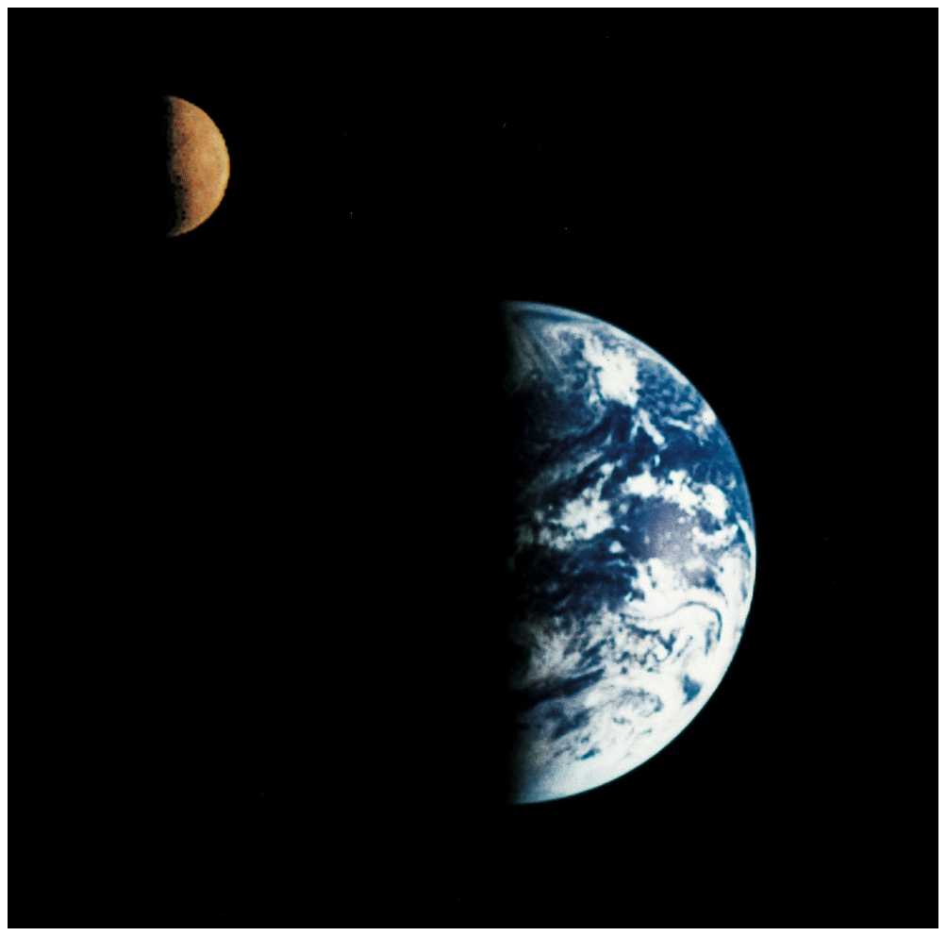
Earth-rise on Moon

Slide 2
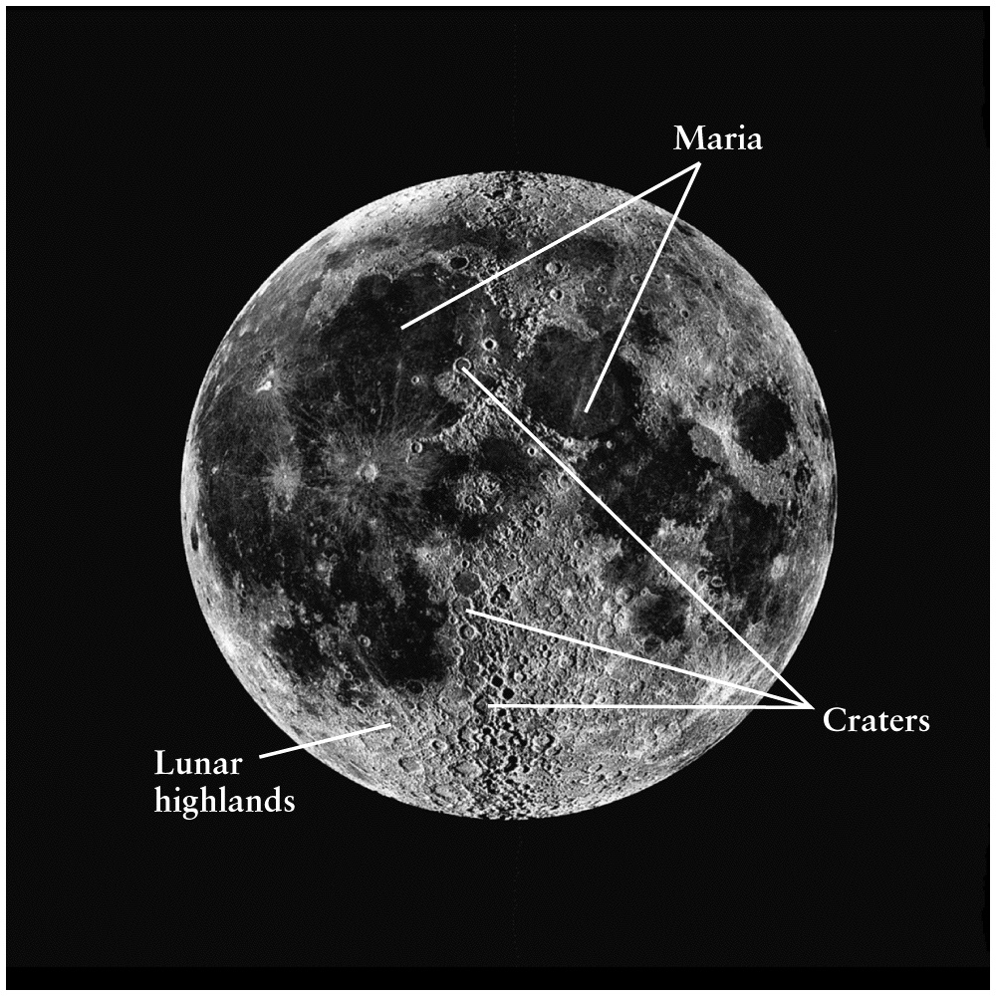
Cratered Highlands and Marias
Highlands are much older than marias. Why?

Slide 3
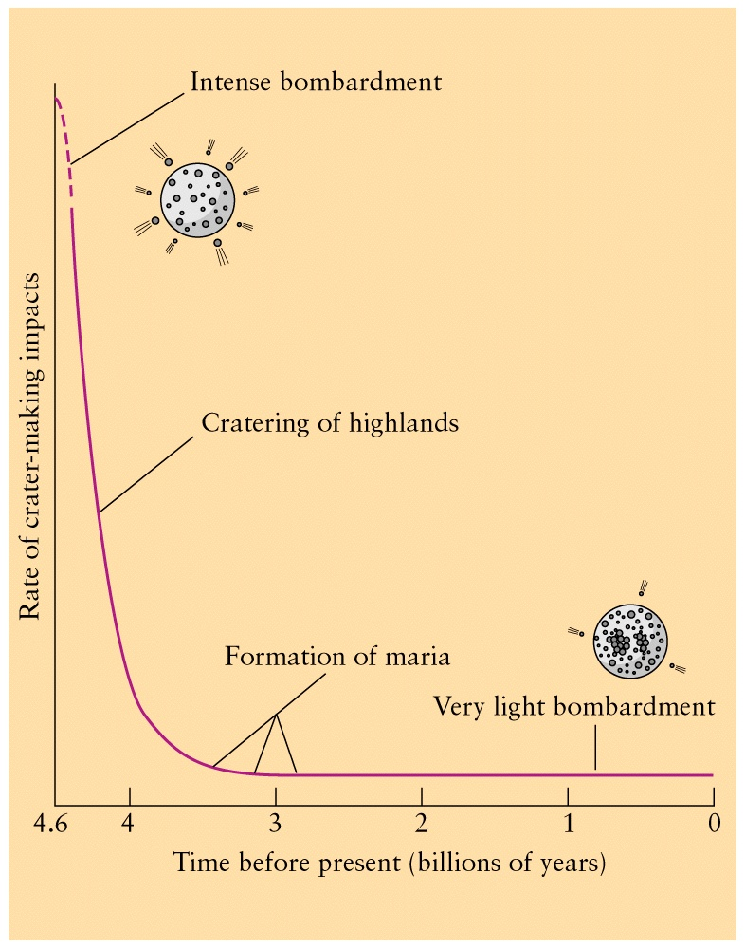
Evolution of highlands and maria

Slide 4
Craters and chronology (age)
Highlands are highly cratered regions that must be older than smoother regions of surface since most cratering activity was at the time of the formation of the solar system
Marias are much younger, and evolved later at places where large crater impact basins were formed and filled with lava from the interior

Slide 5
Atmospheres and Surfaces
Lack of atmosphere
- results in extreme temperatures
- exposes surface to meteoroid impact → craters
- lack of current geological activity and evolution (ceased long time ago)
Moon and Mercury lack atmosphere (too small and too close to the Sun)
Both have similar surface geology →
craters and marias

Slide 6
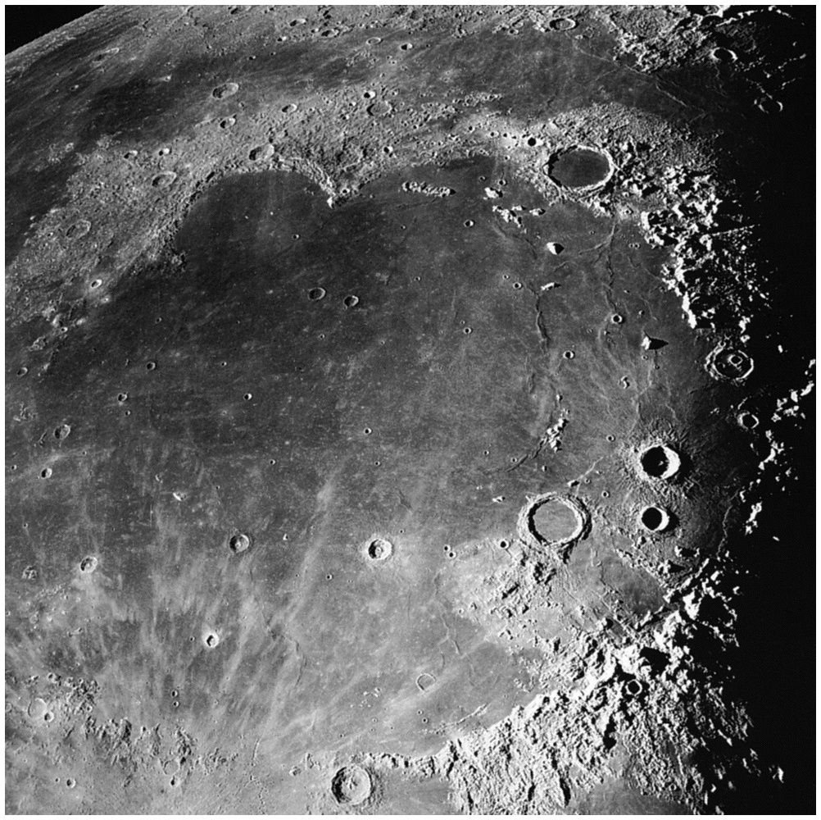
Maria – Lightly cratered smooth surface

Slide 7
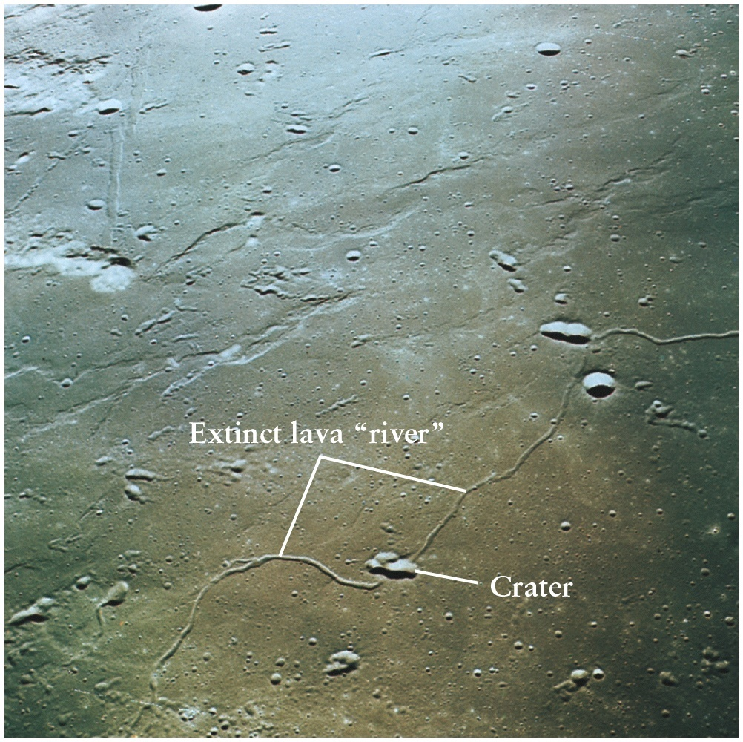
Lava River

Slide 8
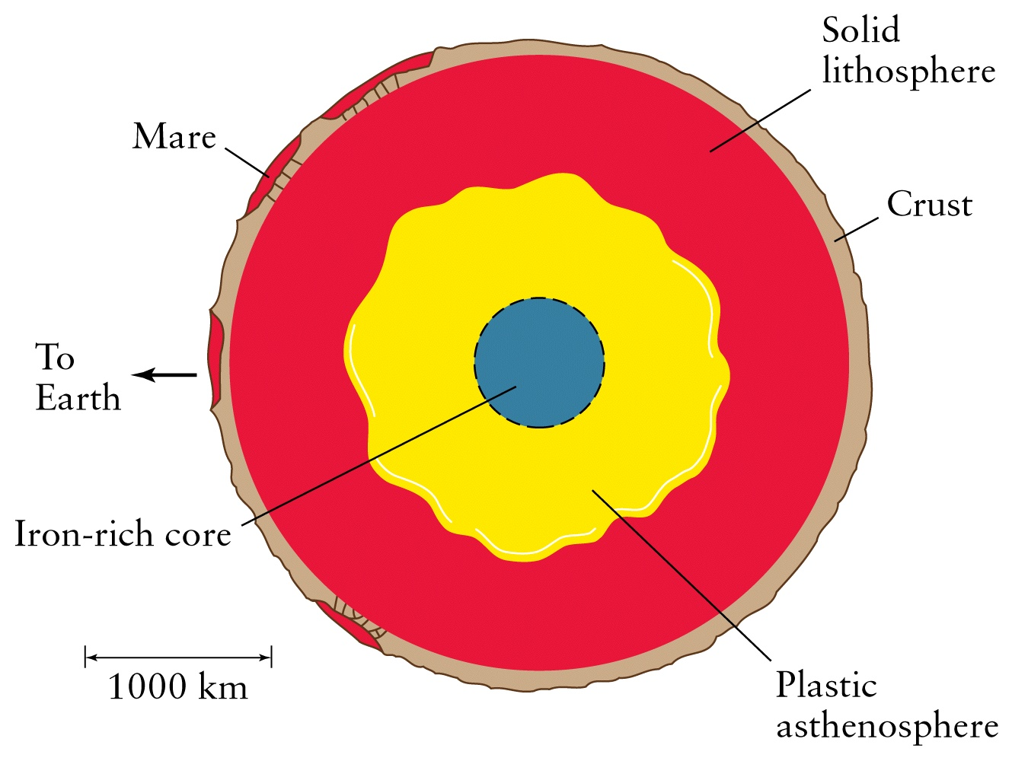
Lunar Geology

Slide 9
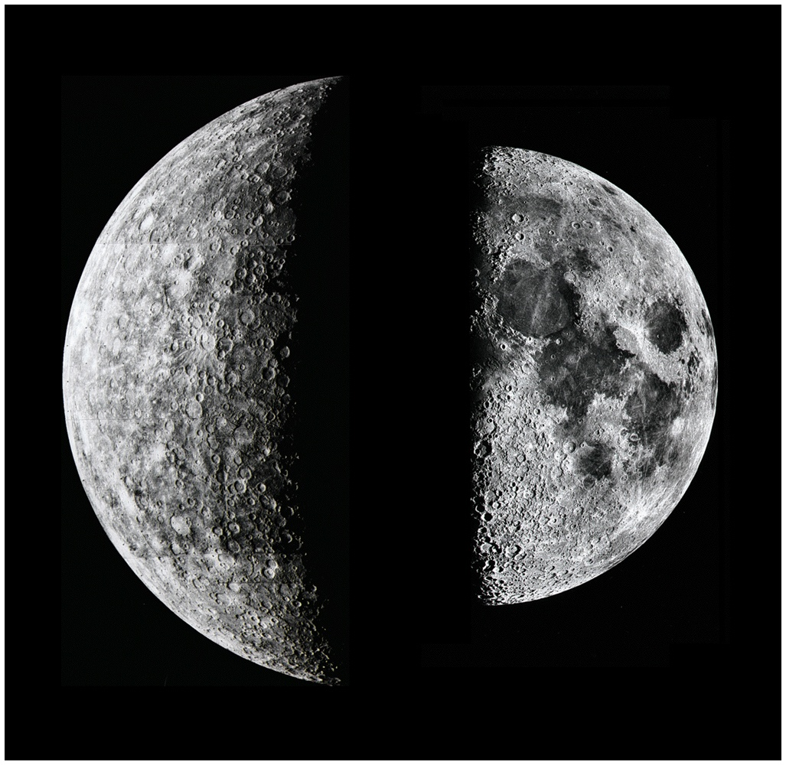
Another view of Moon ?
And, Mercury !

Slide 10
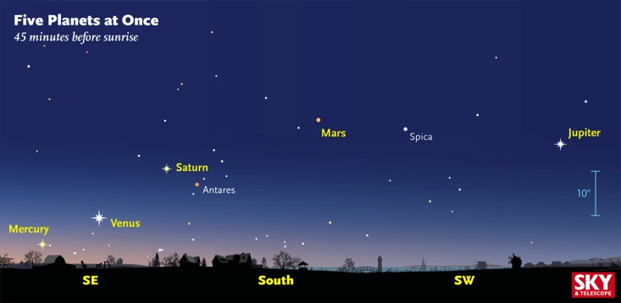

Slide 11
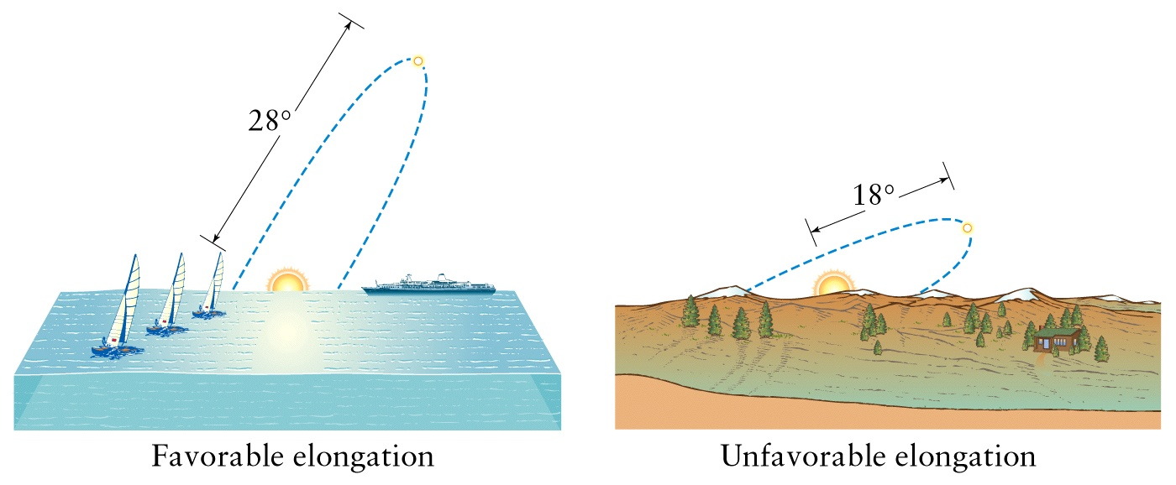
Greatest Elongations of Mercury
Optimum Mercury Sighting at Maximum Elongation, and/or just after sunset or before sunrise
NOT easily seen, like Venus as “evening star”: Mercury is too small,
too close to the Sun, and lacks atmosphere and hence has small albedo

Slide 12
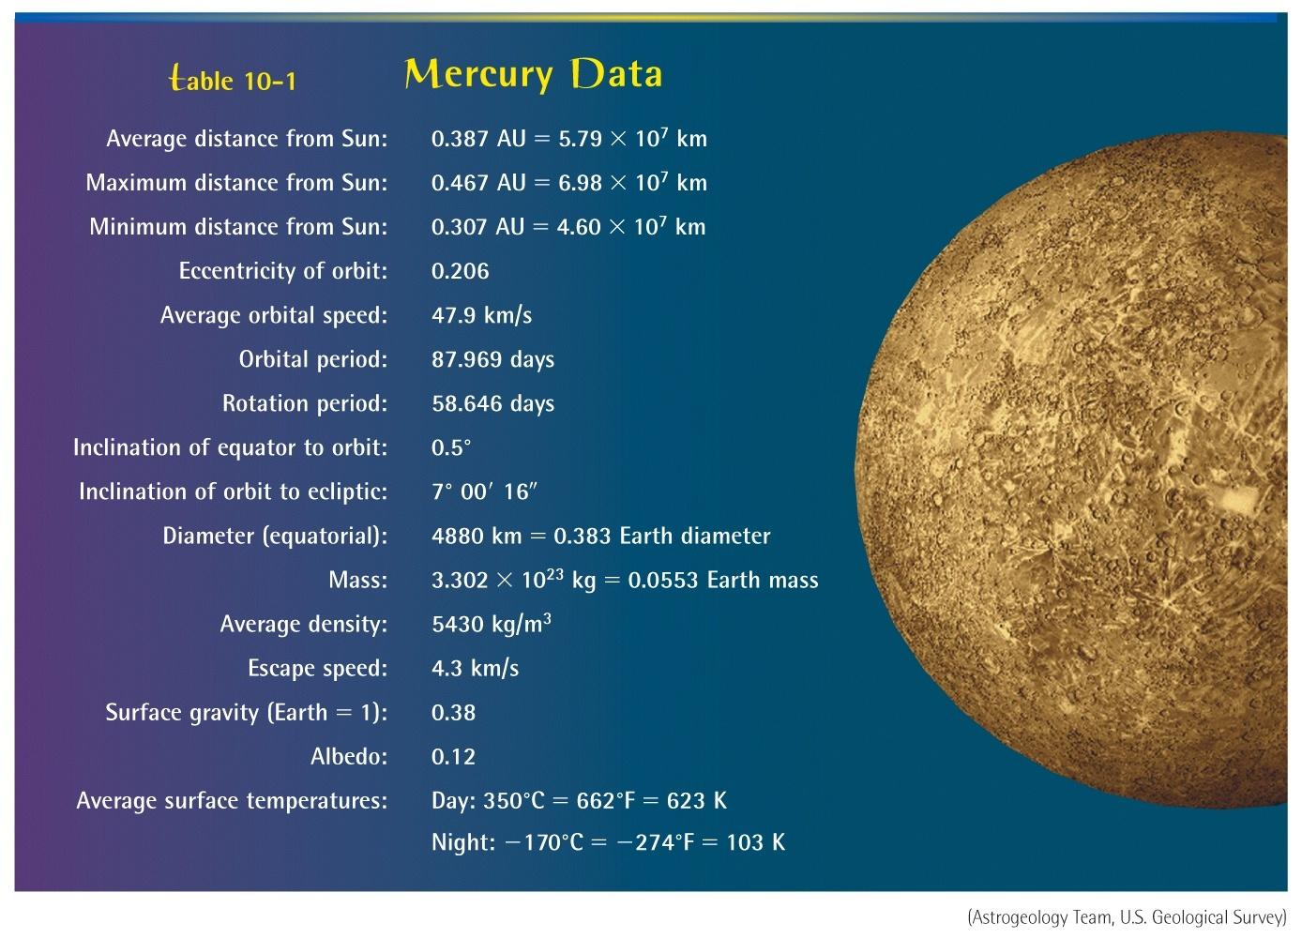

Slide 13
Mercury – Basic Statistics
Mass ~ 1/20 Earth’s
Diameter ~ 1/3 “
Density ~ 5.5 g/cc
Year ~ 88 Earth days
Day ~ 59 “
0.4 AU from the Sun
Surface T: Day → 700 F, Night → -300F

Slide 14
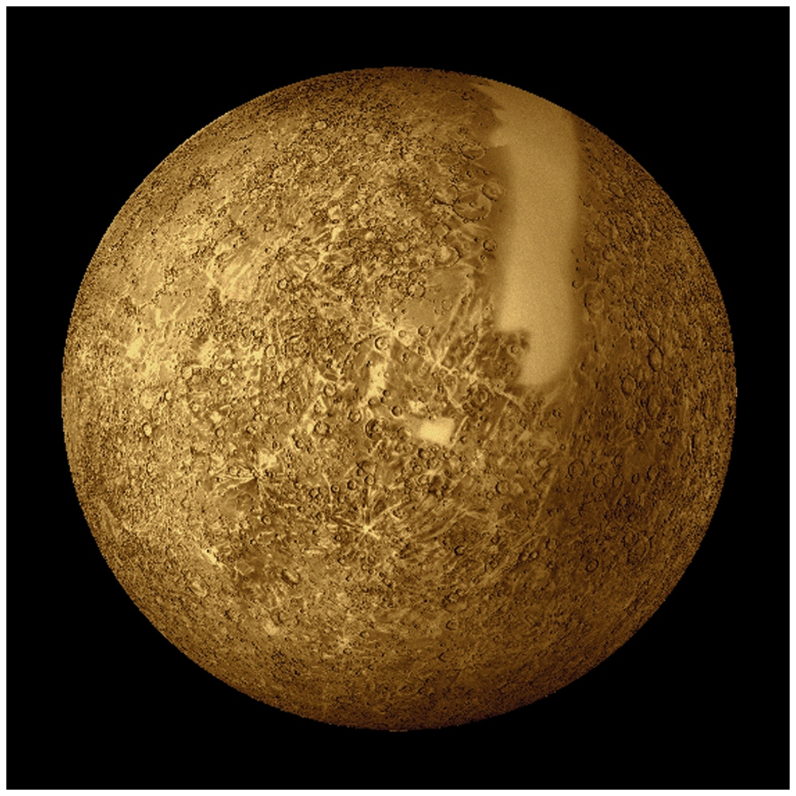
Mariner Fly-By Picture Mosaic

Slide 15
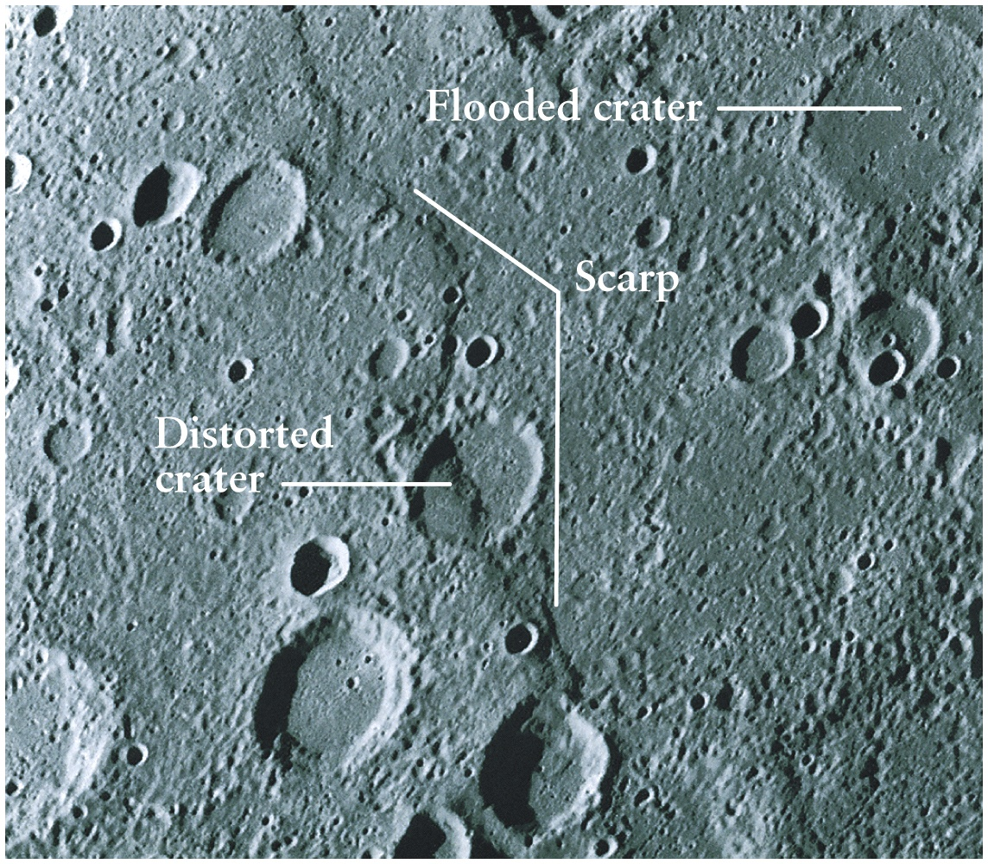
Cratered highlands of Mercury

Slide 16
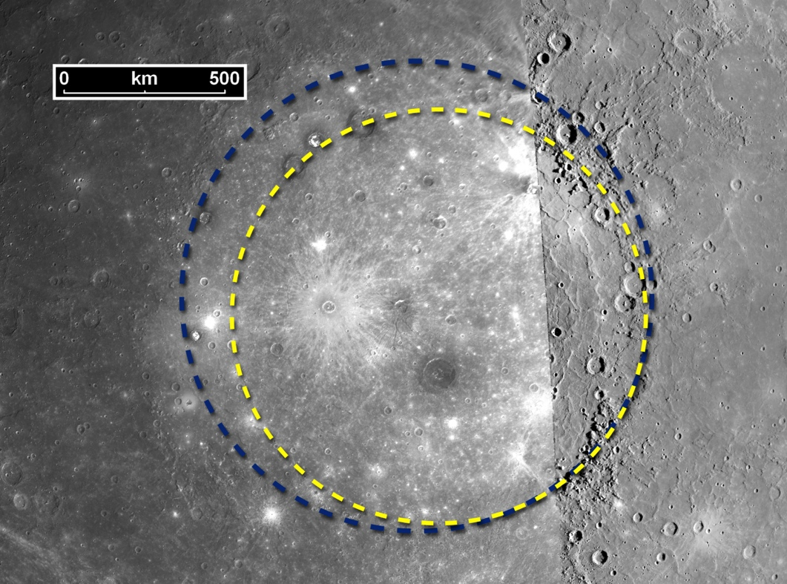
Mercury enigmas investigated by MESSENGER:
Mercury has a huge impact crater called Caloris Basin.
Diameter of crater = 1500 km
Diameter of impacting asteroid = 100 km

Slide 17
Mercury – Basic Features
Metal ball (mostly iron) surrounded by heavily cratered rocky crust like Moon
But weak magnetic field, why?
No molten, moving core!
Only refractory elements; volatile elements evaporated
Geology like the Moon, e.g. Caloris basin resembles lunar maria – large crater impact basin flooded later with lava
No Plate Tectonics, why?

Slide 18
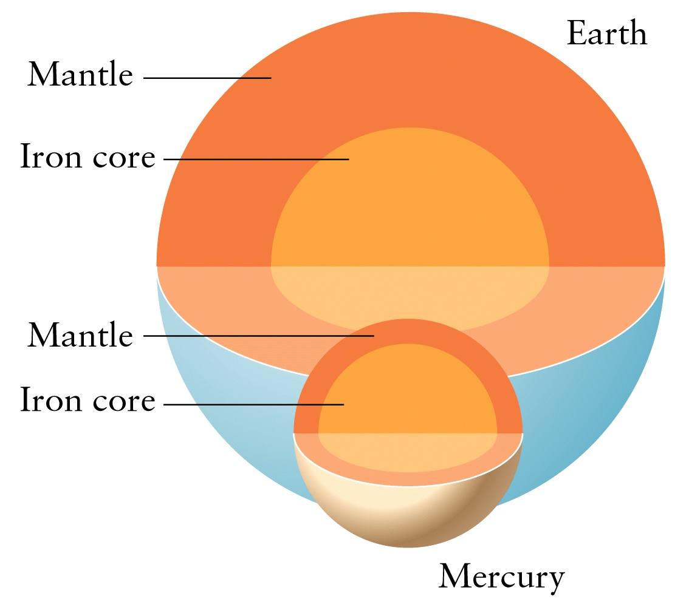
Interiors of Earth and Mercury

Slide 19
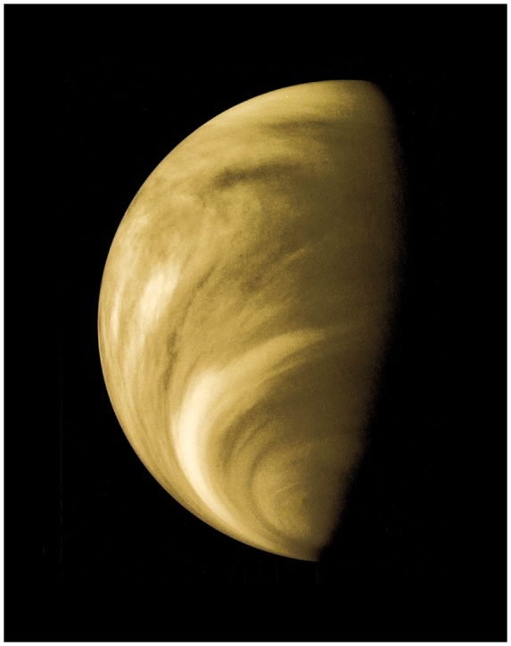
VENUS

Slide 20
VENUS
“Twin” or “Sister” planet of the earth → similar size, mass, density; interior should also be similar with iron core, mantle, crust
But totally different evolution!
Hottest planet (suface temperature on average)
> 800 F (~ 500 C) “Hot as Hell” (literally !)
(Mercury has the largest day/night variation)
What happened and why? → Earth’s past and future evolution
Current situation: very hot (hot enough to melt sulfur, lead!), dense, acidic atmosphere → 96% CO₂ + H₂SO₄
→ 90 atmospheres (atm) or bars (90 x earth’s atmospheric pressure on the surface)

Slide 21
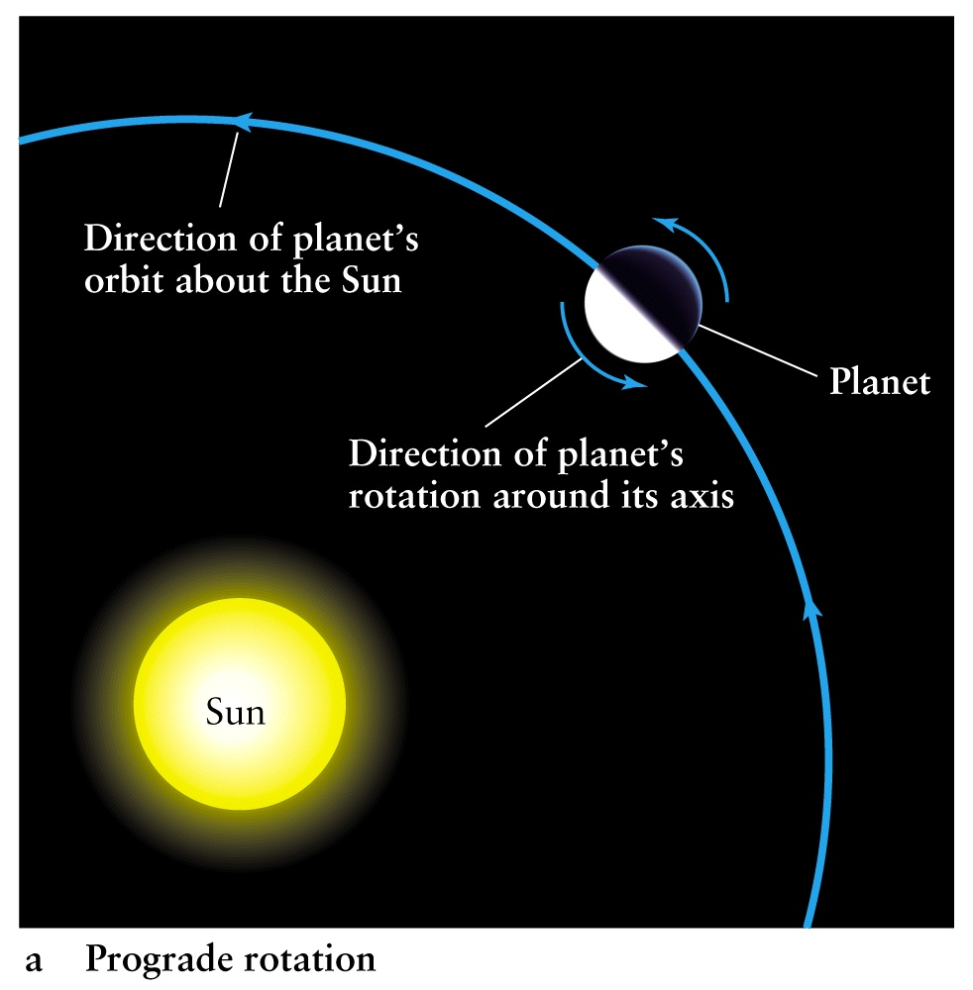
‘Normal’ direction of rotation

Slide 22
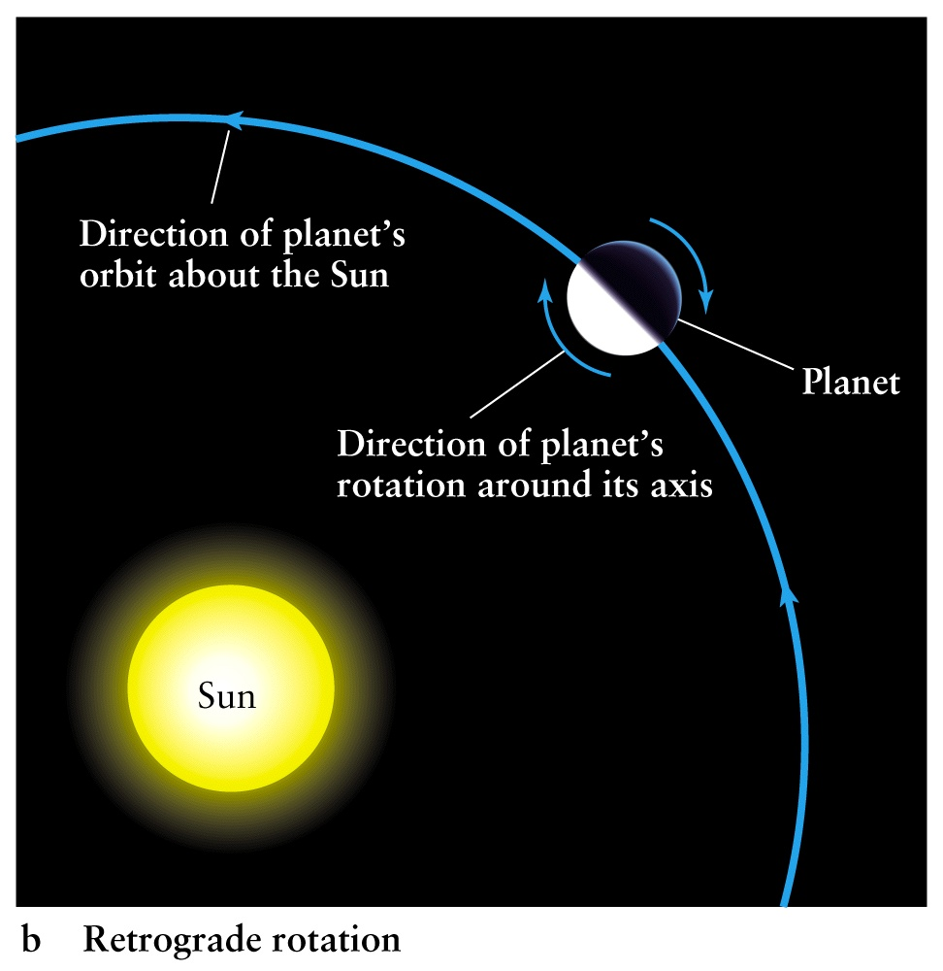
Backwards and Slow Rotation
Venus has a 176 degree tilt of its rotation axis with respect to the Sun
Slow Rotation Period: 243 days ! Consequences ?
Little or No Magnetic Field (no convective motions in the liquid iron core)

Slide 23
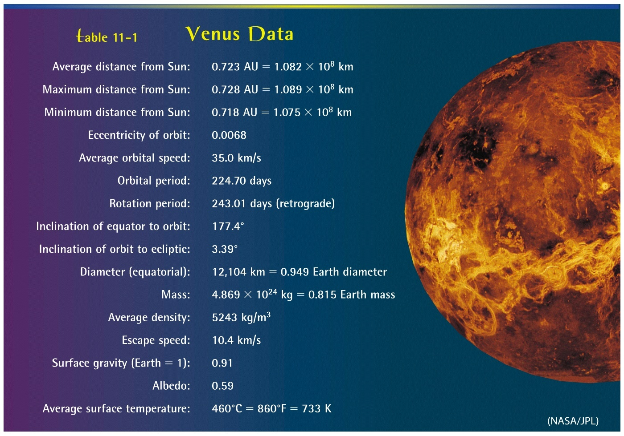
Venus Statistics

Slide 24
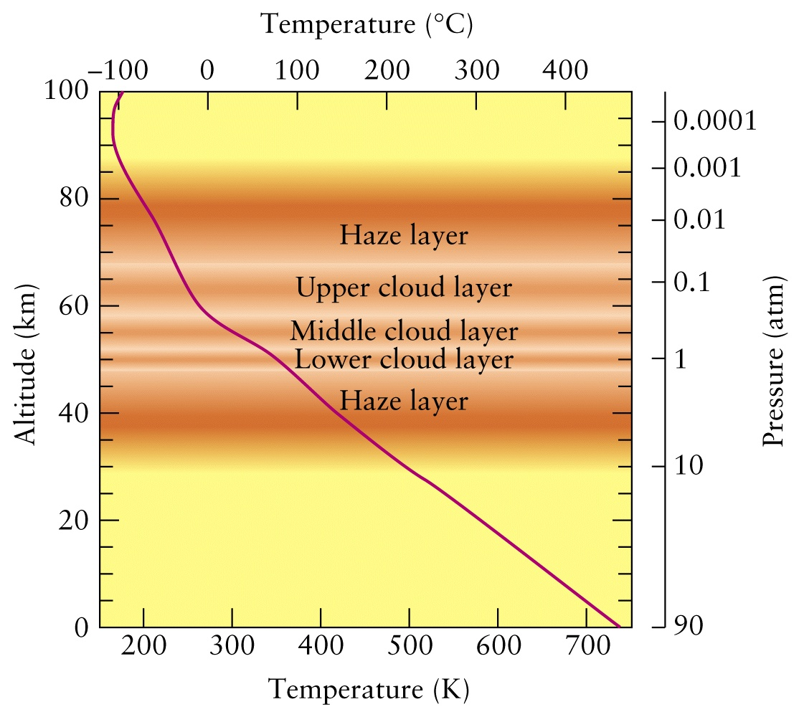
Clouds and more clouds: No distinct atmospheric layers as on Earth

Slide 25
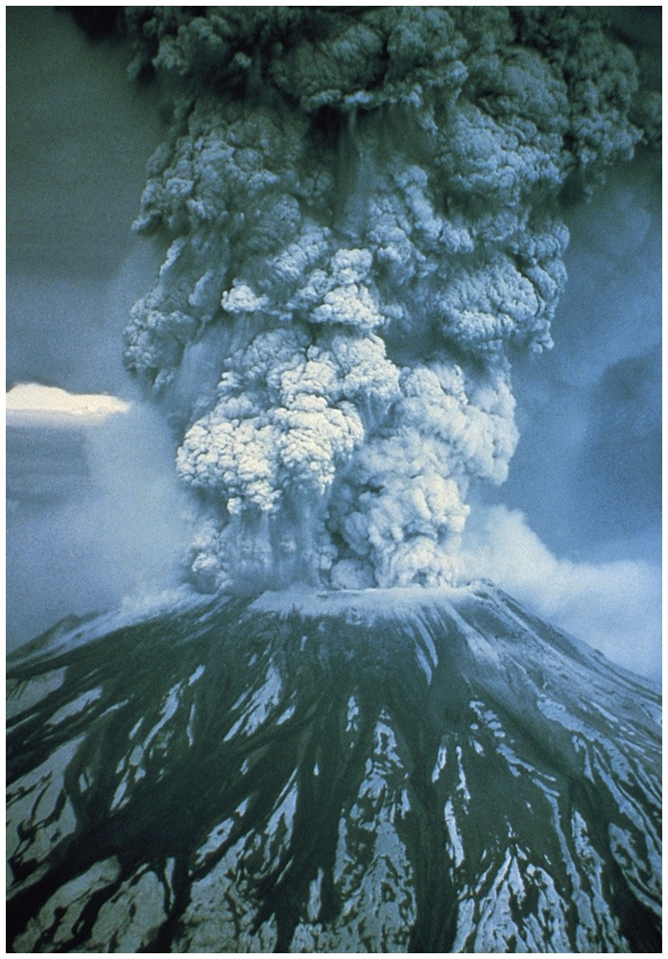
Earth - Mt. St. Helens (1980): Volcanic activity on Venus is NOT eruptive, but continuous

Slide 26
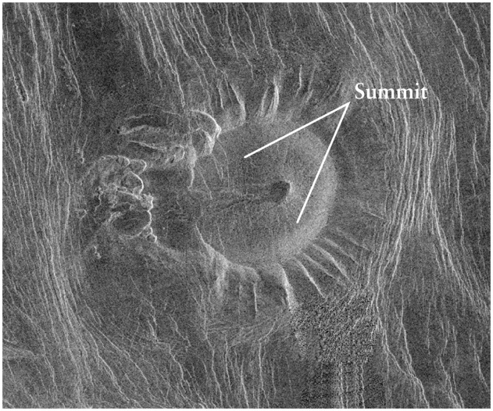
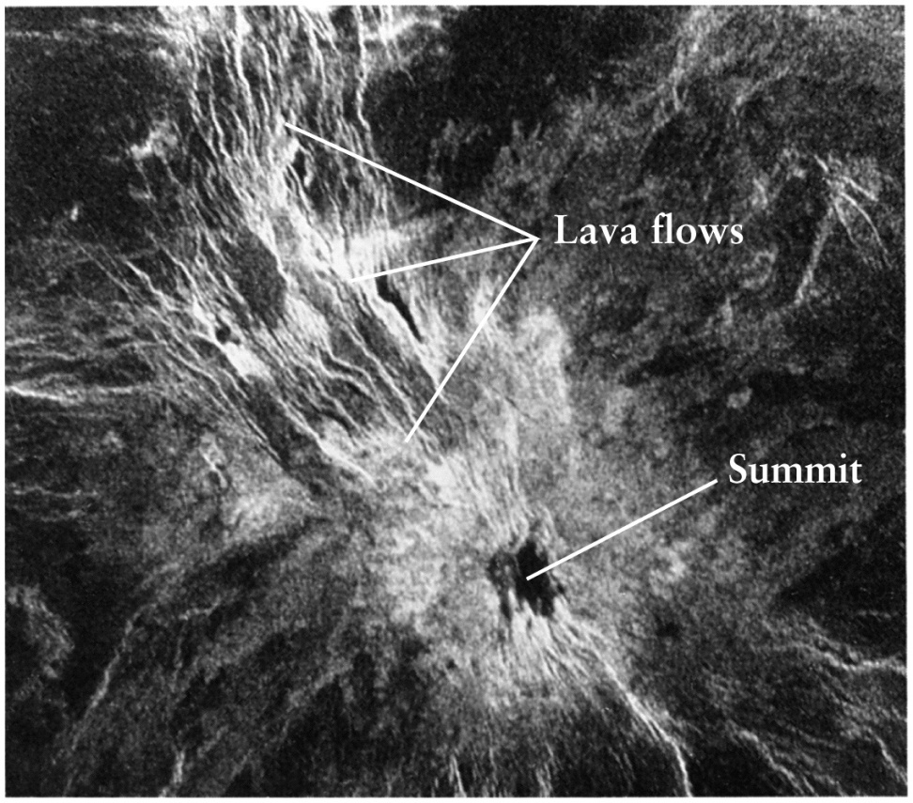
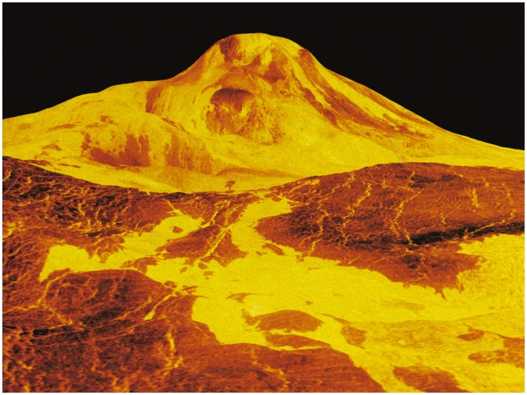
Lava flow on Venusian volcano:
“hot-spots” → huge “shield” volcanoes
Hawaiian islands are formed out of hot-spot volcanoes on the earth

Slide 27
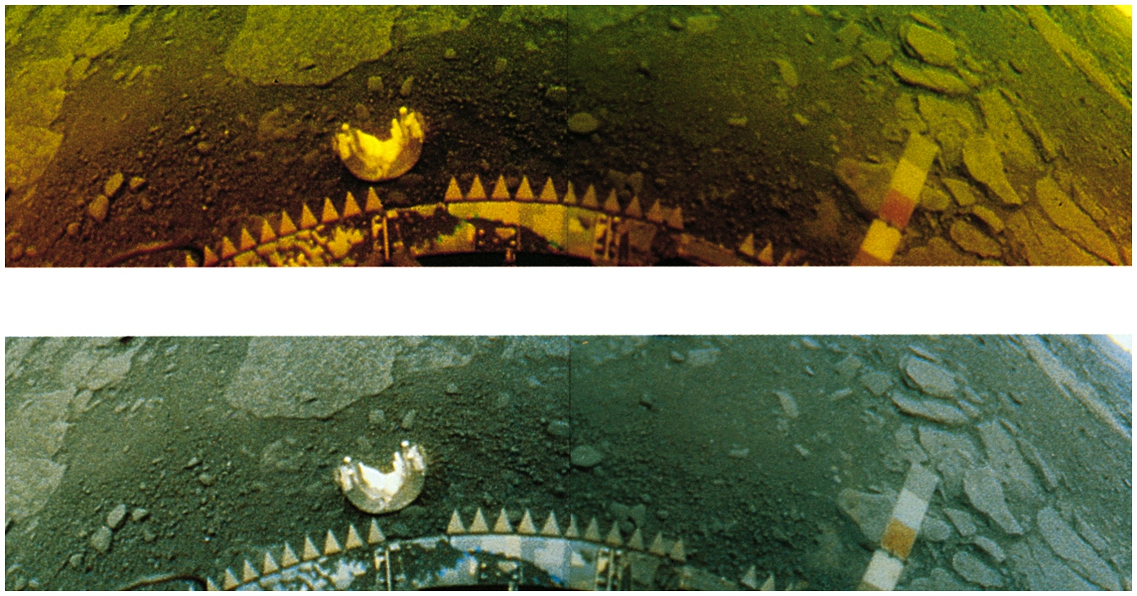
Venera Landers (USSR)
Landed without parachutes or landing rockets! Orange color everywhere; very little wind (why?)

Slide 28
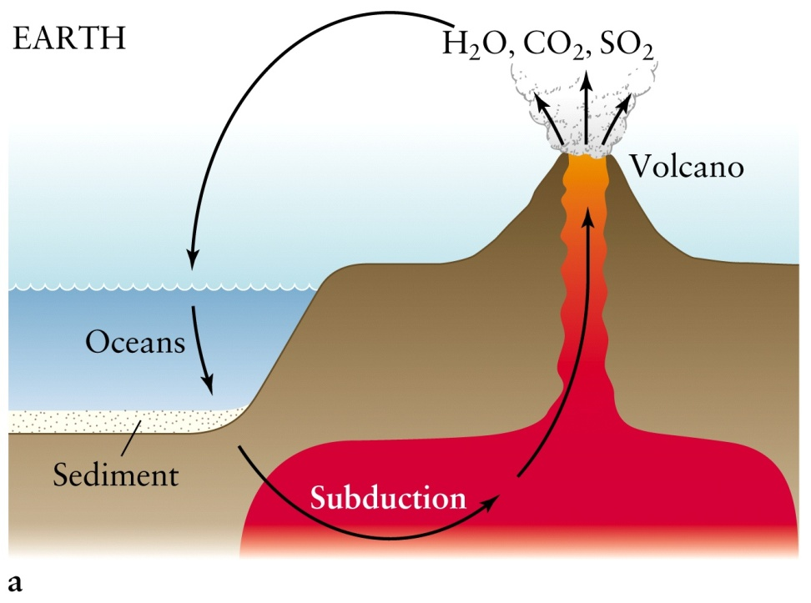
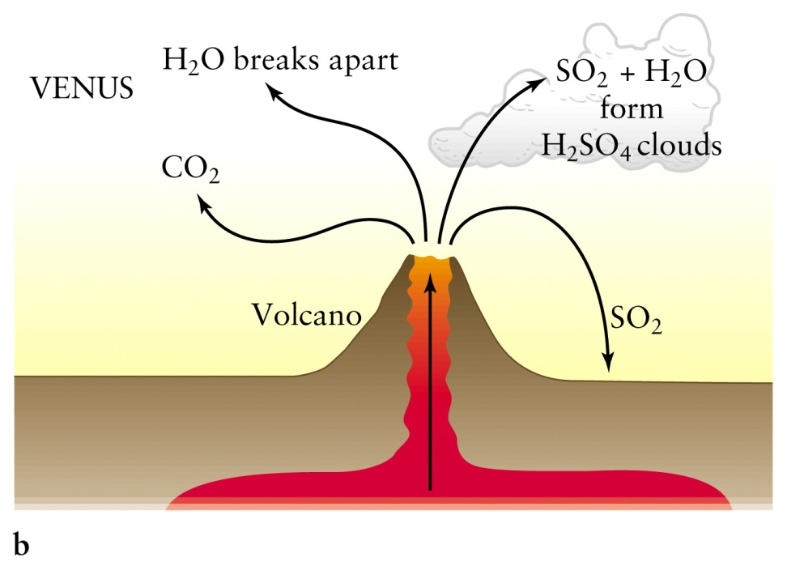
Volcanic material cycle on the Earth and Venus
Photosynthesis by plants breaks CO₂ → O₂
Water on earth recycles heavy compounds that absorb heat (IR radiation).
On Venus they remain and insulate the atmosphere, exacerbating the Greenhouse Effect which has gone into a “runaway” cycle.
SO₂ + 2 H₂O → H₂SO₄ (sulfuric acid clouds) + H₂ (escapes)

Slide 29
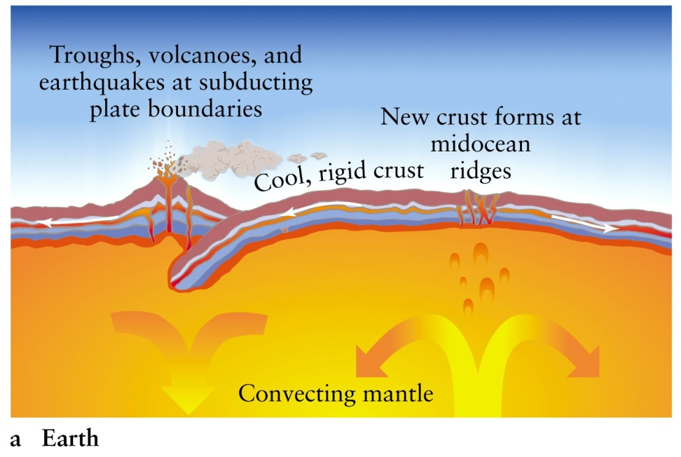
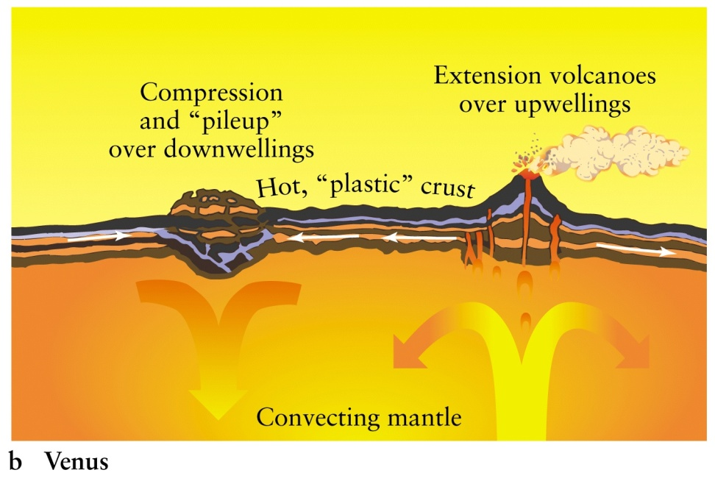
Surface Geology on Earth and Venus
Plate tectonics on the Earth due to
hard crustal plates moving on liquid
molten mantle
No Plate Tectonics; surface is too soft
due to heat to move as a rigid body

Slide 30
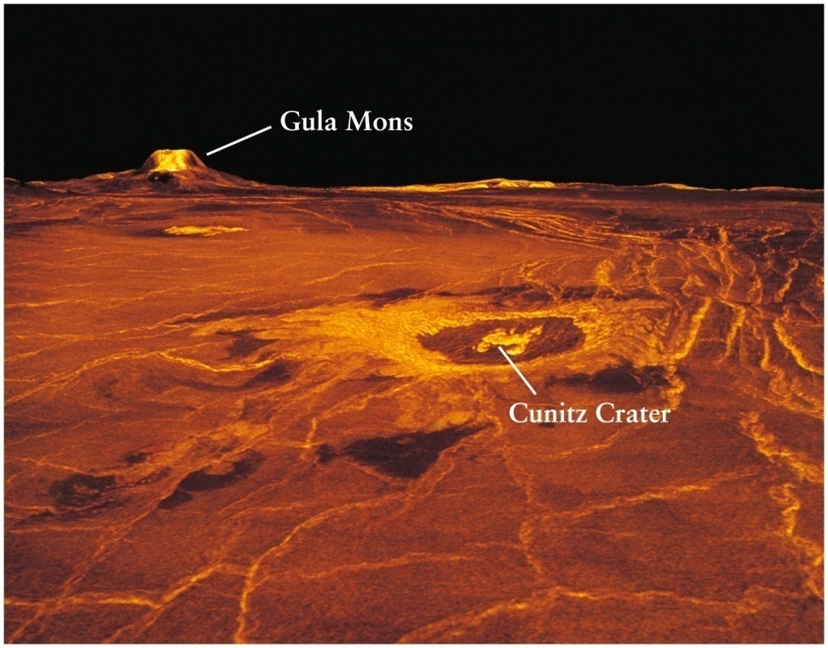
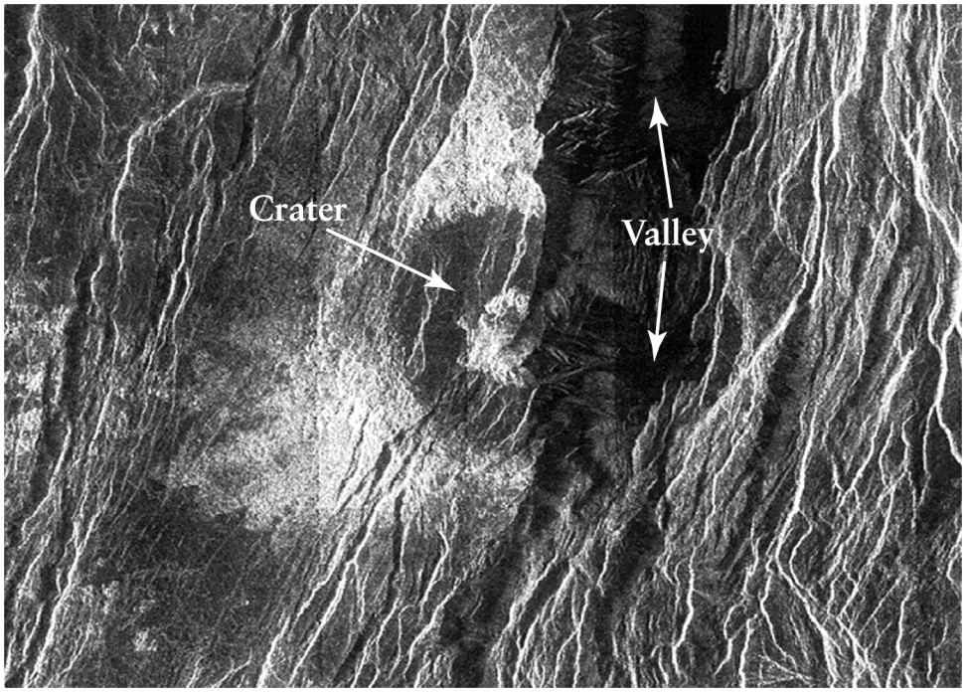
Volcanic craters and mountains
Thousands of shield volcanoes on Venus at “hot spots”; interior still active

Slide 31
Basic Geology of Venus
Heat flows from the interior to surface via conduction, not through edges of plates as on the Earth, and no Plate Tectonics
High temperature leads to soft, thin crust
Has little or no magnetic field; surprising since iron core must be molten. Why?
Slow rotation – 243 earth days! More than the orbital period; Ergo: day longer than year
Topography: Mostly flat, rolling plains similar to earth’s ocean floors
Impact crater density shows surface is about 800 million years old

Slide 32
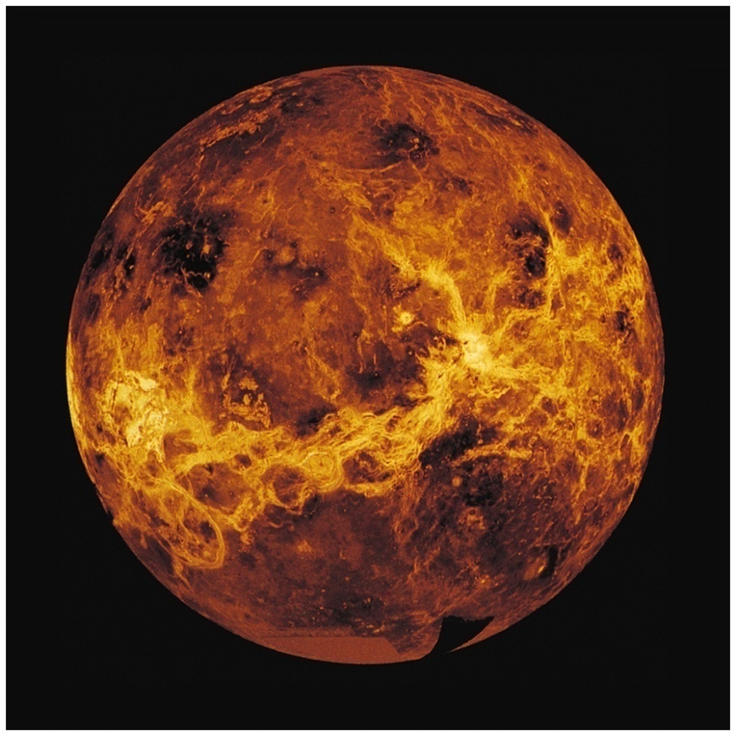
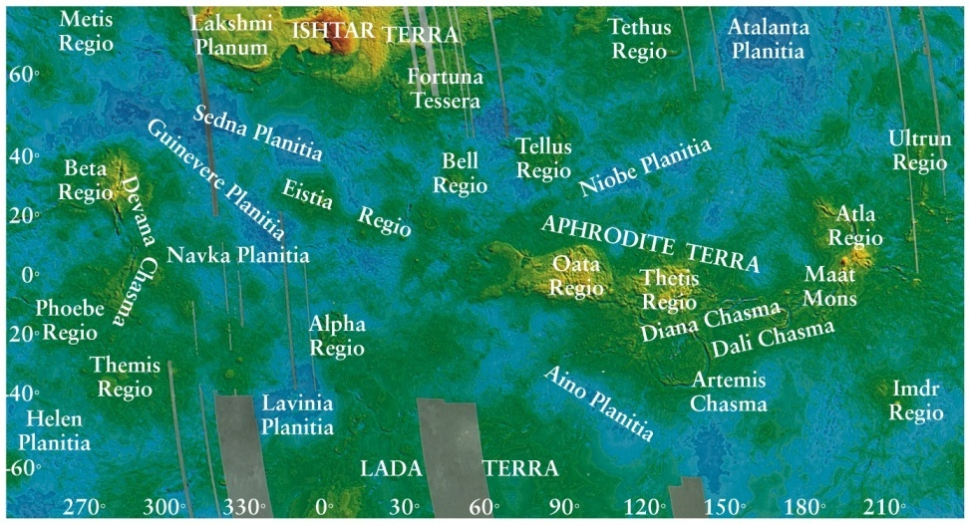
Map of Venus:
(red highest, blue lowest)
Volcanic plains cover 80% of the surface
Radar map showing highlands Aphrodite
Terra extending along the equator

Slide 33
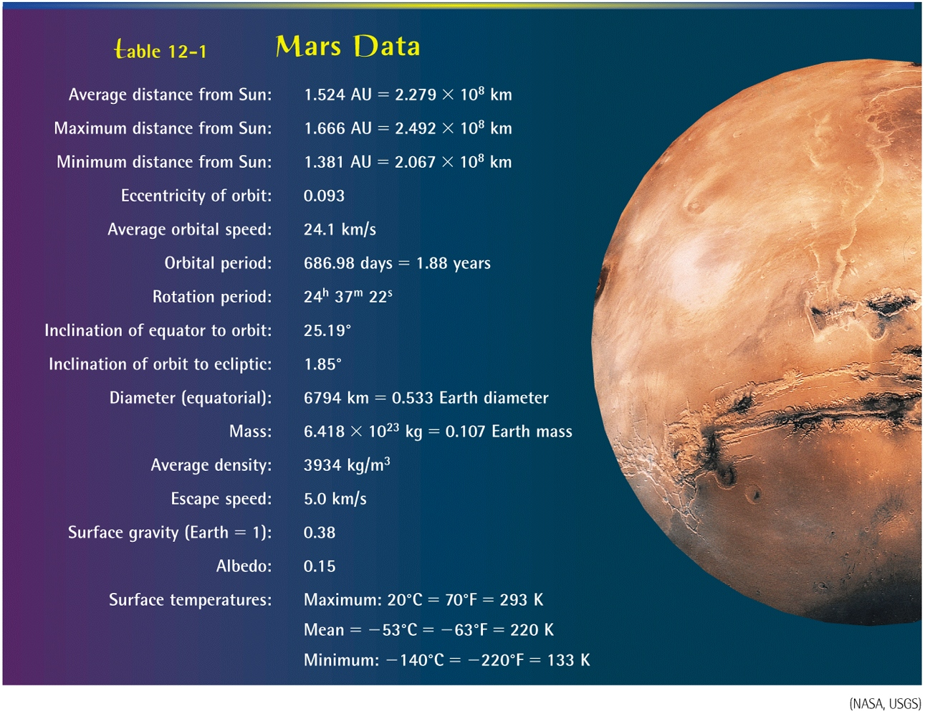
The Red Planet

Slide 34
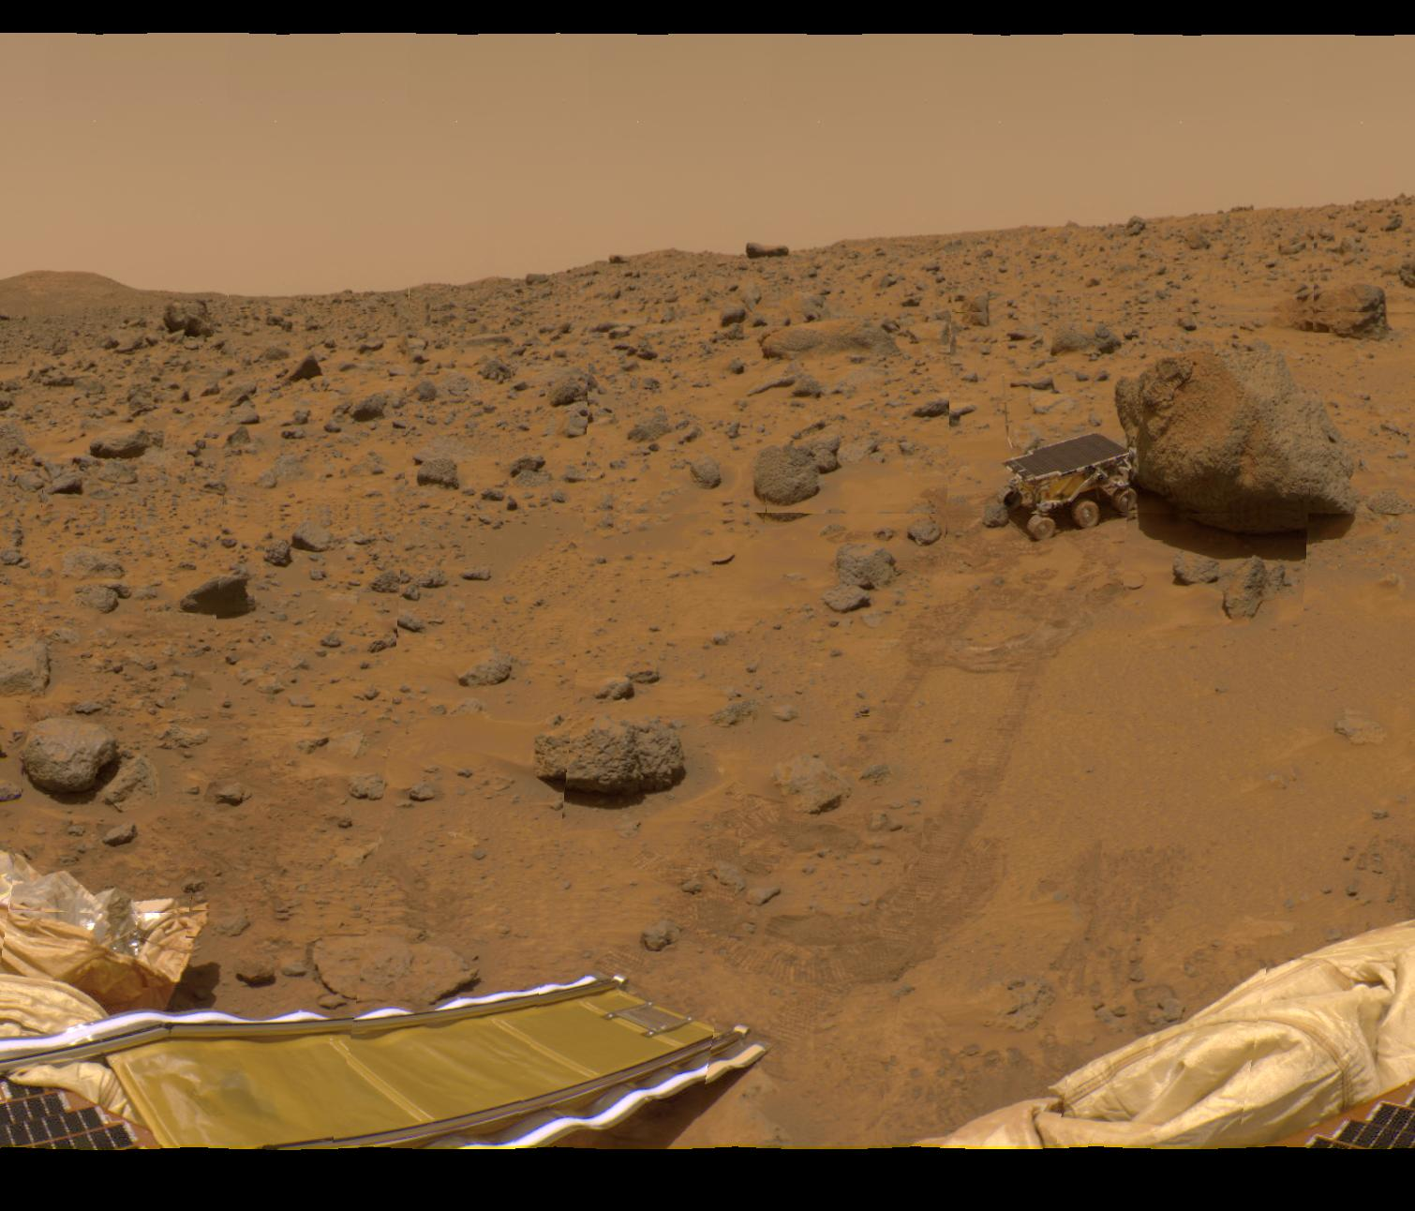
Robotic Missions to Mars

Slide 35
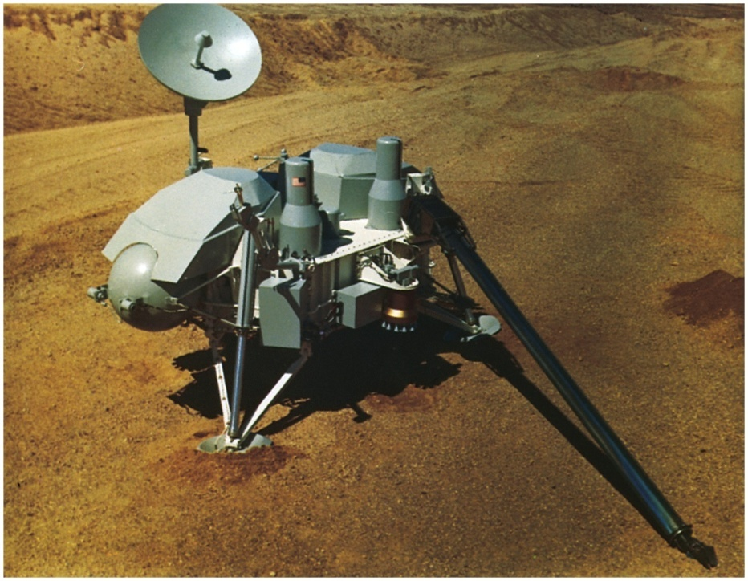
Viking Lander

Slide 36
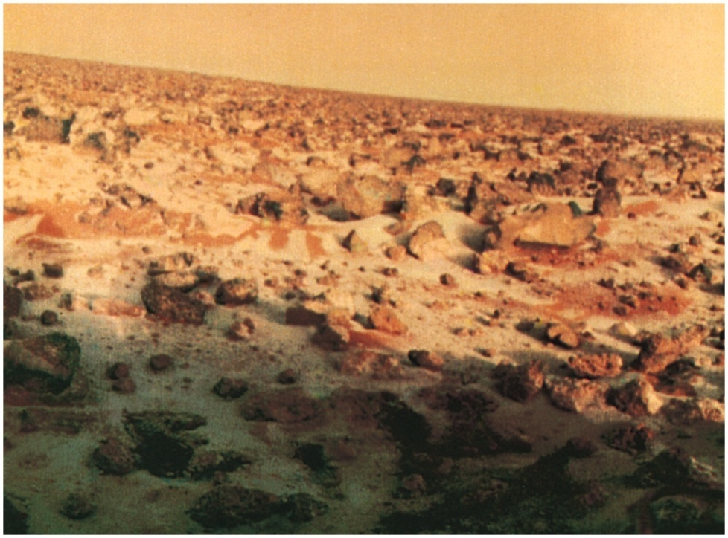
Martian landscape with frost

Slide 37
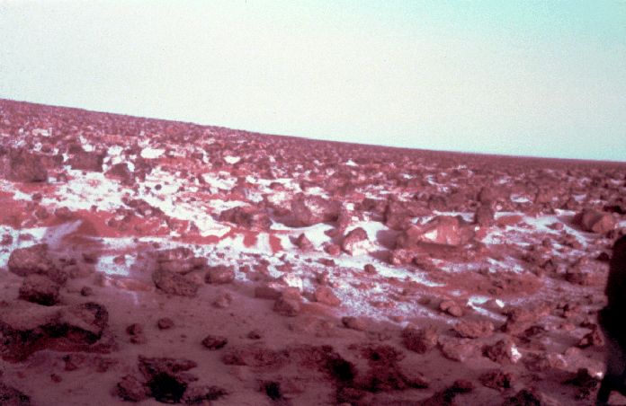

Slide 38
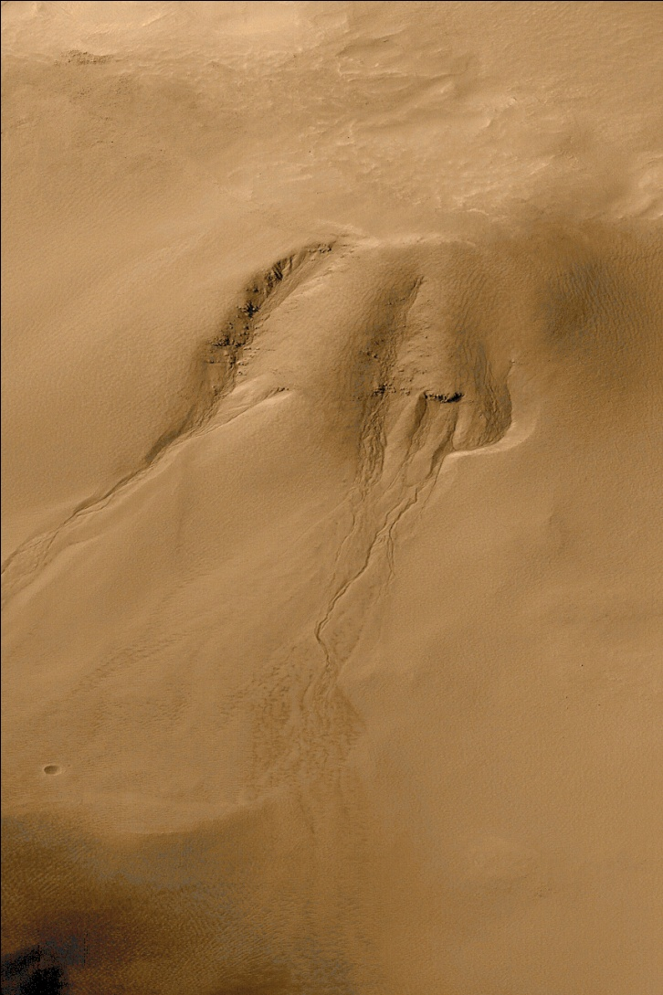
“Face” on Mars ?

Slide 39
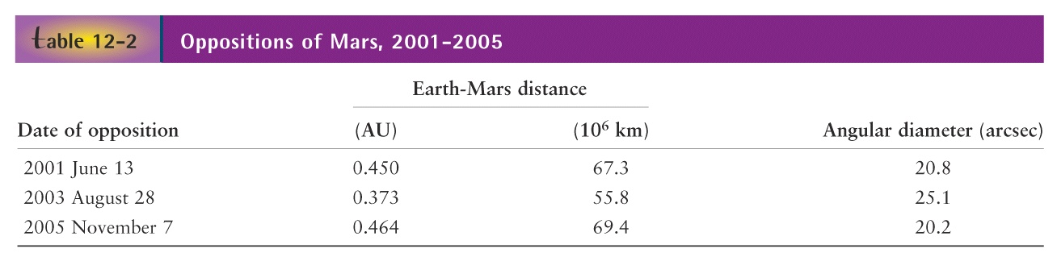
Oppositions of Mars (Best Viewing)
The best time to view a superior planet is at Opposition, whereas the
best time to view an inferior planet is at maximum elongation

Slide 40
Mars – Vital Statistics
Mass ~ 1/10 Earth’s
Diameter = 4200 mi, ½ Earth’s
Density = 3.9 x water
Year = 1.9 Earth years
Day = 24 hr 37 min
Distance to Sun = 1.5 AU (227 million Kms)
Surface gravity (g) = 0.38 Earth’s
Tilt of rotation axis = 25 degrees (seasons!)
Surface T: Max 70 F, but usually -100 to -220 F
Large variations in T (thin atmosphere)

Slide 41
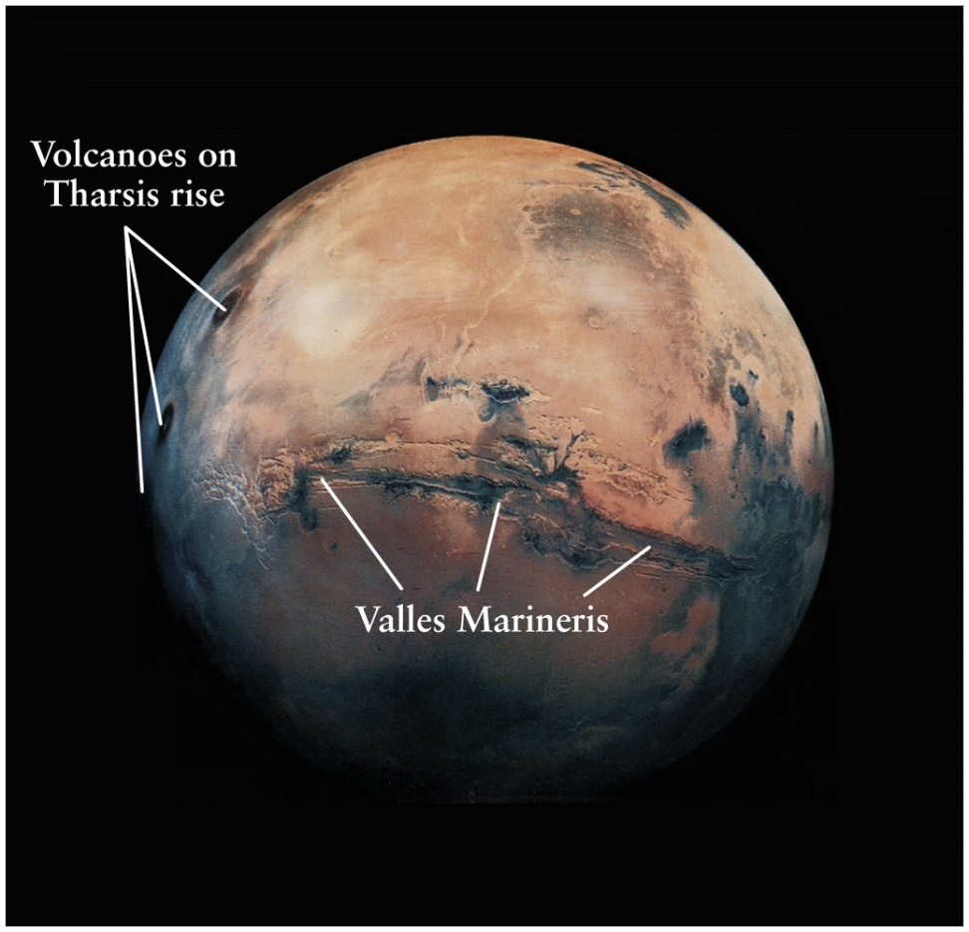
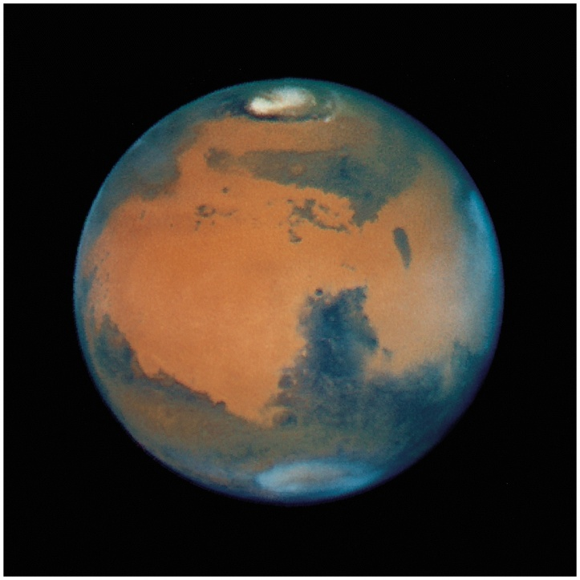
Mother of all canyons:
Valles Marineris
5000 Kms (coast-to-coast if in US)

Slide 42
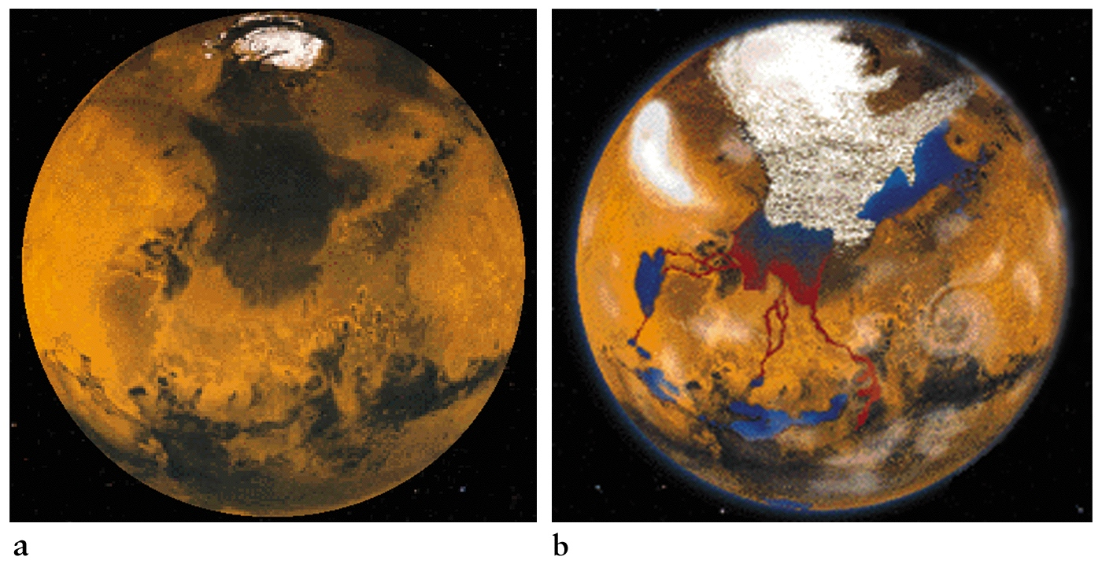
Polar “dry ice” caps (CO2)
Northern
Southern
Polar icecaps are dry ice on top and water ice underneath

Slide 43
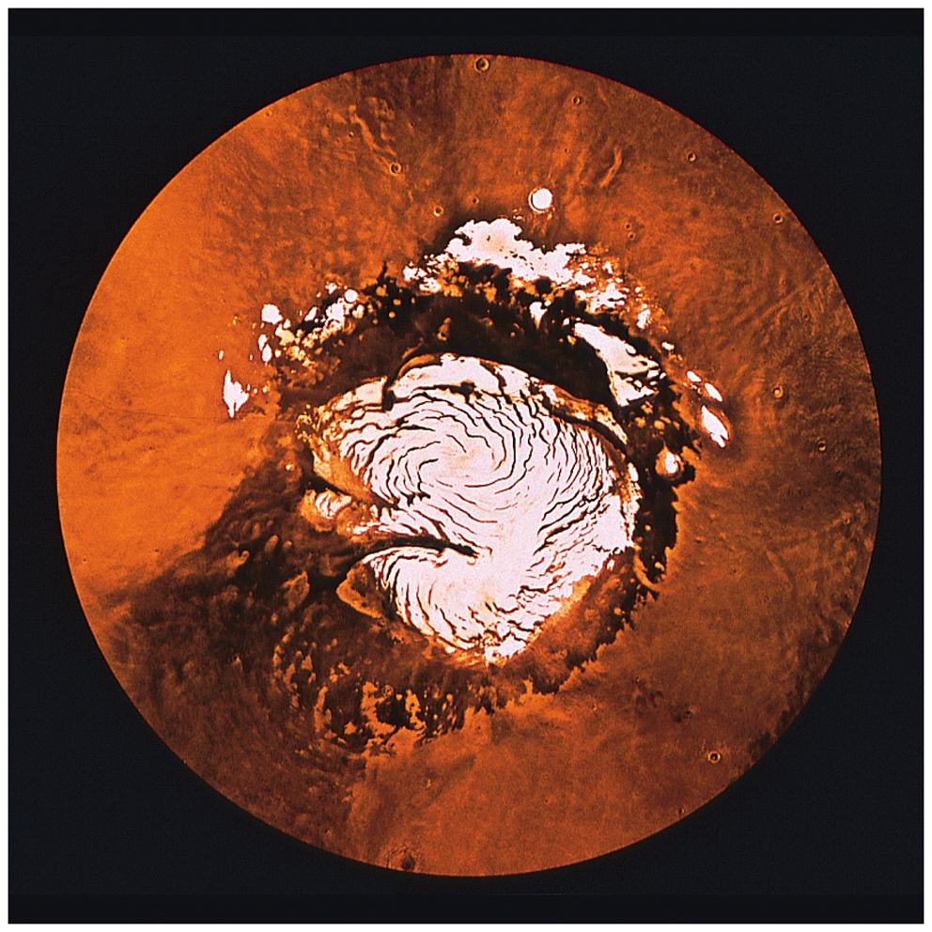
Polar cap with dust lanes

Slide 44
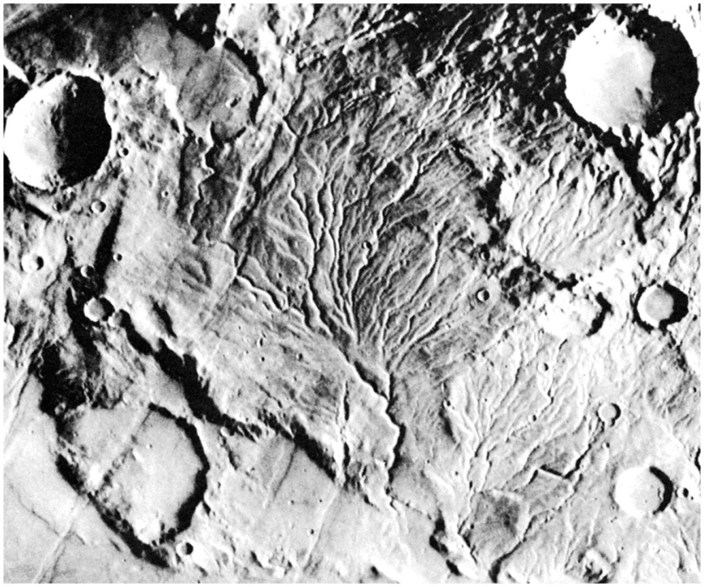
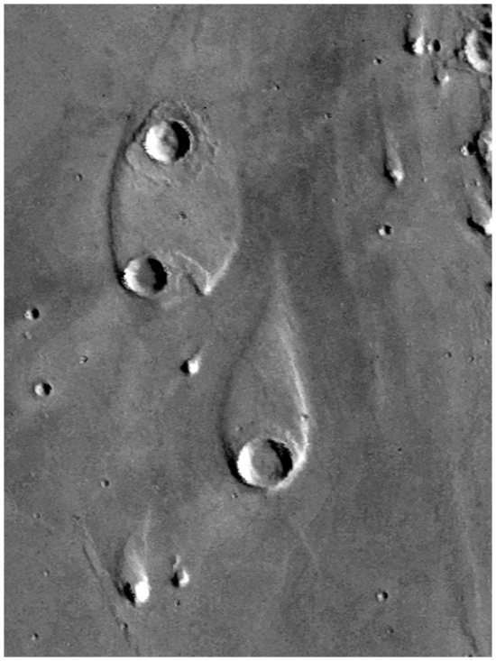
Evidence of ancient water flows on Mars
“Canal” type features (dried up riverbeds); Martian climate was warm and wet
in the past. Why did it change to the barren environment today ?
The atmosphere evaporated ! Anti-greenhouse Effect !! Opposite of Venus !!!

Slide 45
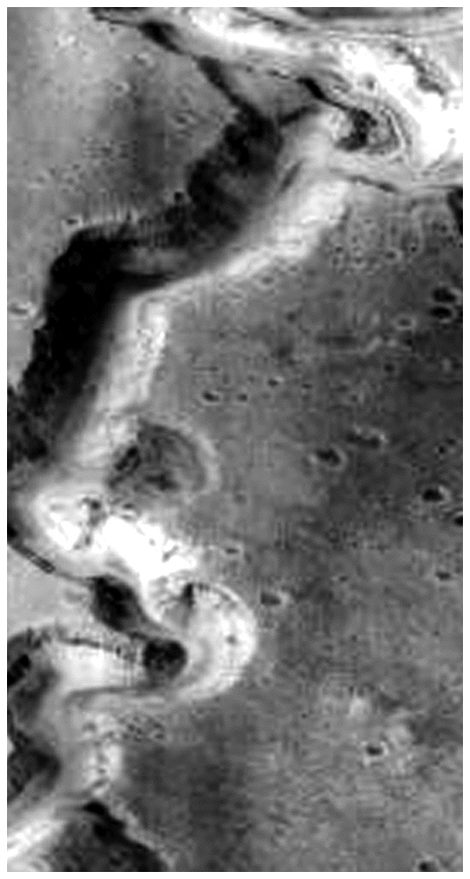
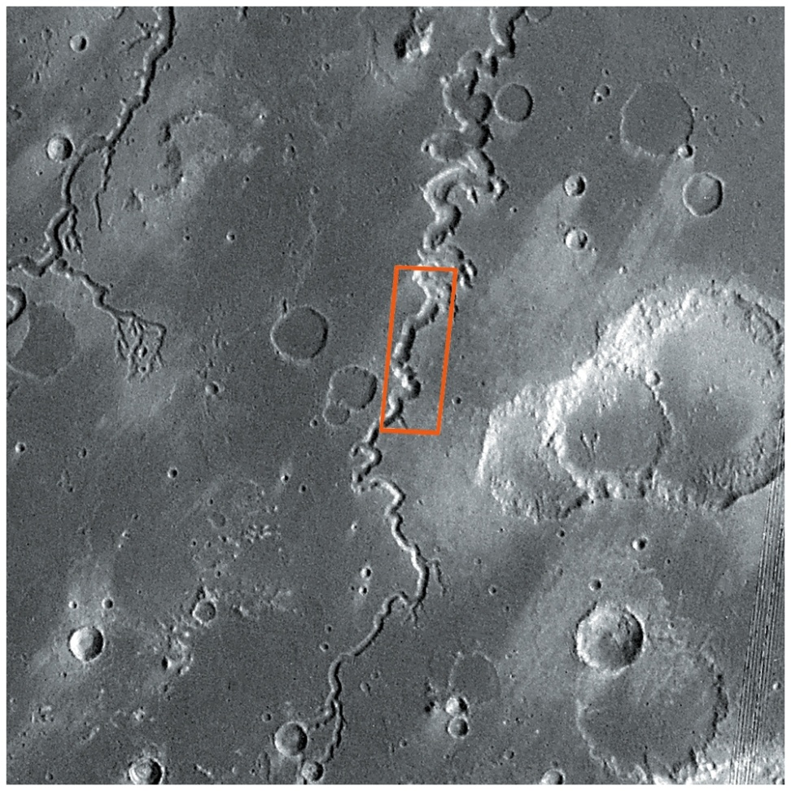
More evidence of water

Slide 46
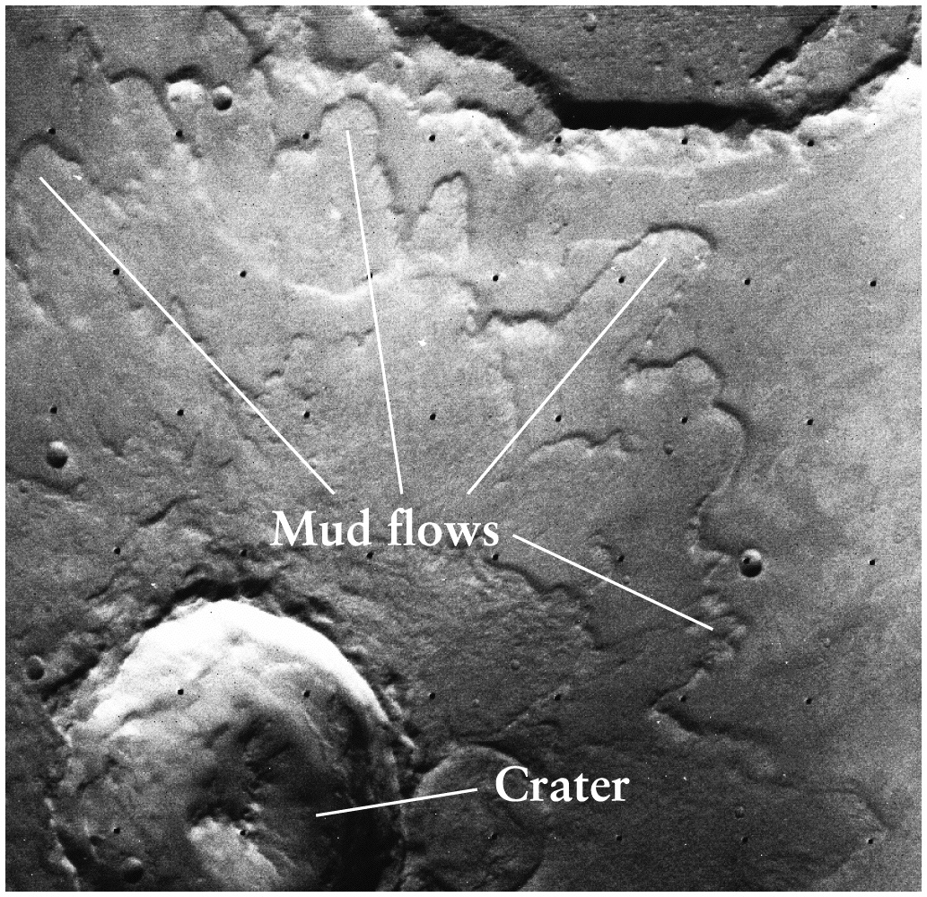
Ancient volcanic flows
Recent volcanic activity (~ 100 million yrs) with huge runny lava flows (why?)
Low gravity !

Slide 47
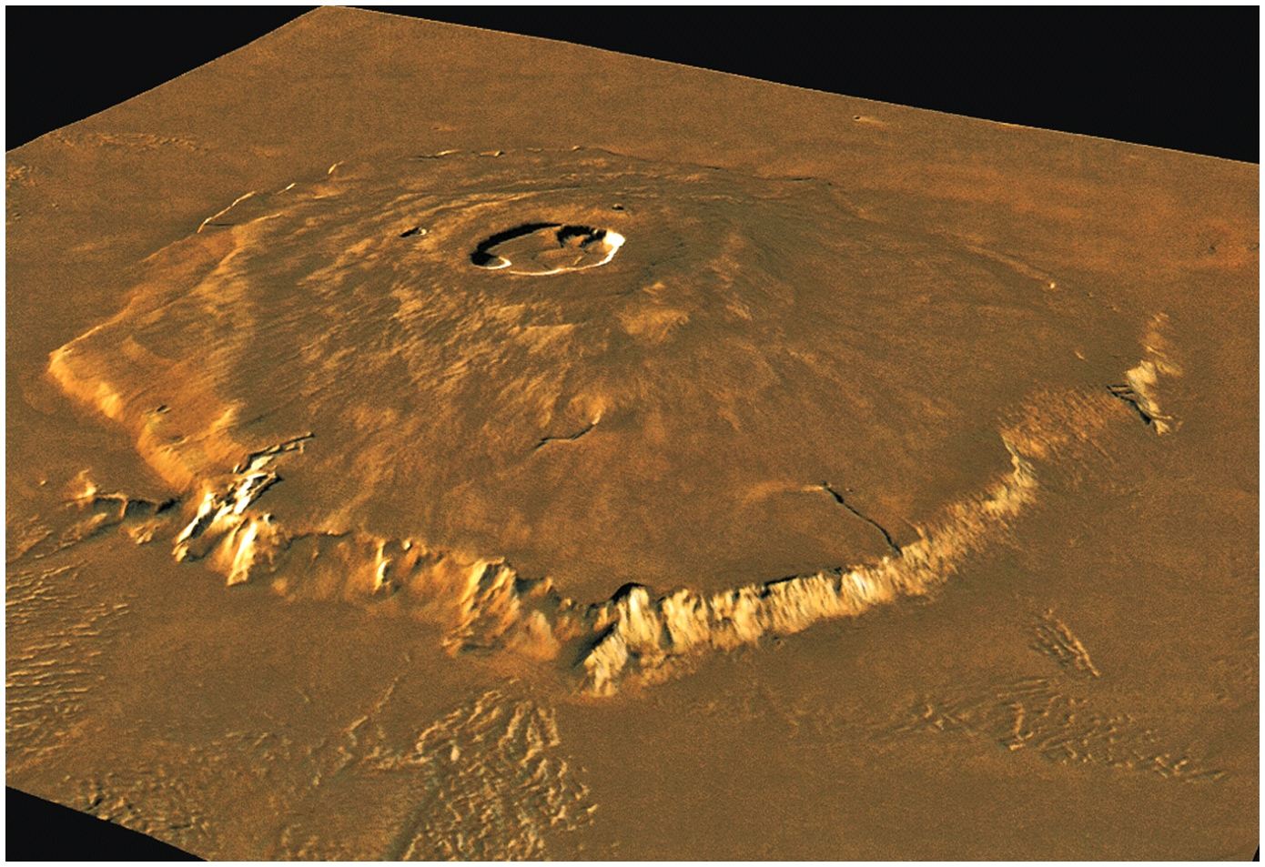
Mother of all volcanoes:
Olympus Mons
24 Kms high (3 times Mt. Everest), 600 Kms across (as big as Missouri)

Slide 48
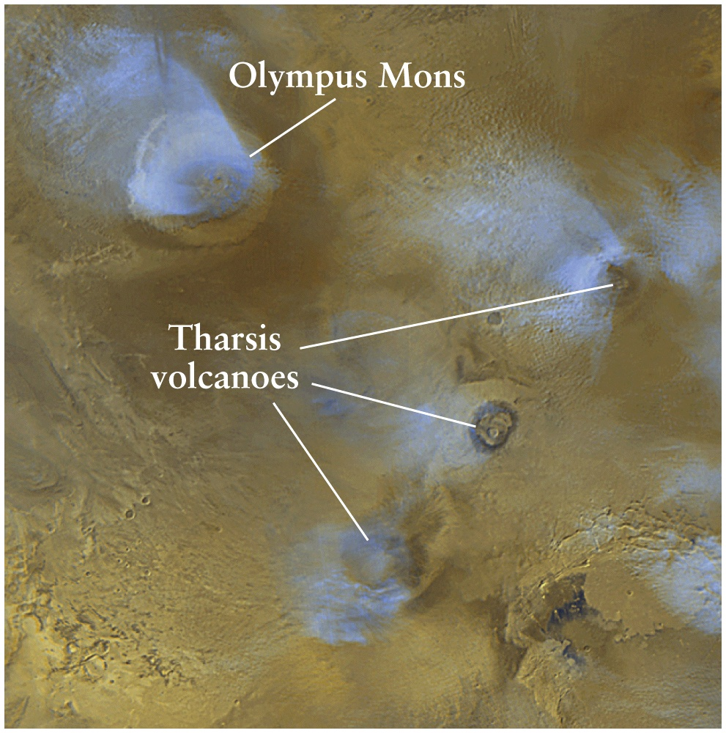
Volcanic Plains – Giagantic Shield Volcanoes
Summits capped with “Calderas” – flat, broad, collapsed craters

Slide 49

Topography: Warmer, Volcanic Northern Hemisphere and colder, cratered Southern Hemisphere

Slide 50
Some Basic Features of Mars
First superior planet, best seen at opposition
Most like Earth (season like on Earth, but twice as long)
Eccentricity = 0.09, 4.5 times that of Earth’s orbit; Mars is 20% closer to the Sun at perihelion; receives 44% more sunlight
Perihelion occurs during southern summers, which are shorter but hotter than northern summers, but southern winters are much longer; large variations in southern polar ice caps (may extend halfway to equator)
North is warmer than the south !

Slide 51

Recycling heavy compounds H₂O and CO₂ and the Greenhouse Effect
H₂O, N₂ remain in the atmosphere;
CO₂ is
recycled
on earth via
photosynthesis
EARTH
H₂O breaks up
from UV;
H₂, N₂, O₂
escape;
CO₂ freezes
on Mars as
permafrost,
or on polar icecaps
MARS
Martian atmosphere (0.007 bars) is 95% CO₂

Slide 52
Anti-Greehnouse Effect !
Whereas Venus displays one extreme, the “runaway” greenhouse effect which retains most of the re-radiated energy (heat) in the infrared, Mars has the manifestation of the opposite effect
How ?
Violent dust storms prevent sunlight from reaching the surface, and temperature inversion in atmosphere

Slide 53


Slide 54
Steps to a Martian Dust Storm:
Convection between night and day sides produces 50-200 MPH winds
Dust blown into upper atmosphere (no rain to clear!)
Sunlight blocked by dust → upper air gets warmer, surface cooler → “anti-greenhouse effect”
Temperature difference makes convection worse, so more dust blown into atmosphere
Nuclear Winter (nuclear war!)
Extinction of Dinosaurs (asteroid impact!)

Slide 55
Life on Mars
Viking Landers, Pathfinder, Rover and Spirit robotic missions
TV → Nothing big seen moving around (at least so far)
No organic compounds (C,H,O molecules) found
No micro-organisms found
Biological tests by robotic experiments are sensitive enough to have detected life in Antarctica

Slide 56
Terra-forming
Altering a planet’s environment to create a climate simulating Earth’s
Prescription for Mars:
Melt polar CO₂ to start greenhouse effect
Raises the temperature so rest of ice melts
Plant algae, etc. for photo-synthesis:
CO₂ → O₂ (Voila !)
How does one start step 1?

Slide 57

Small Moons of Mars
Moons of Mars are about the size of Columbus I-270 beltway

