Slide 1
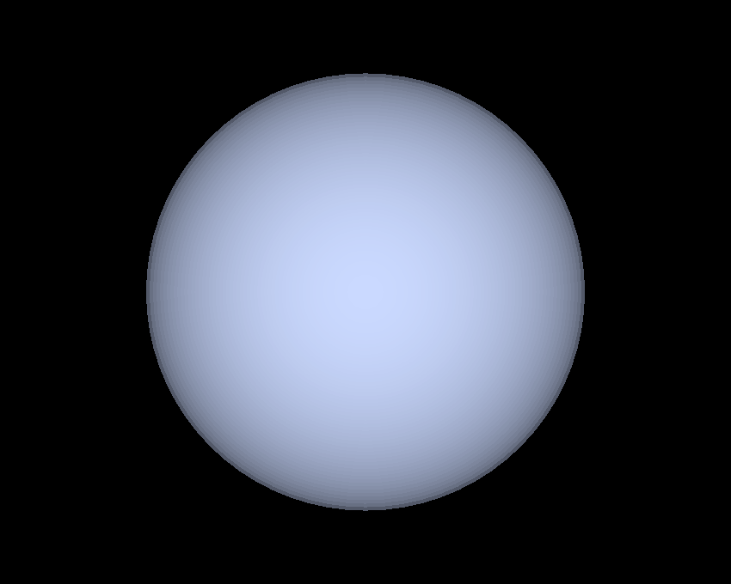

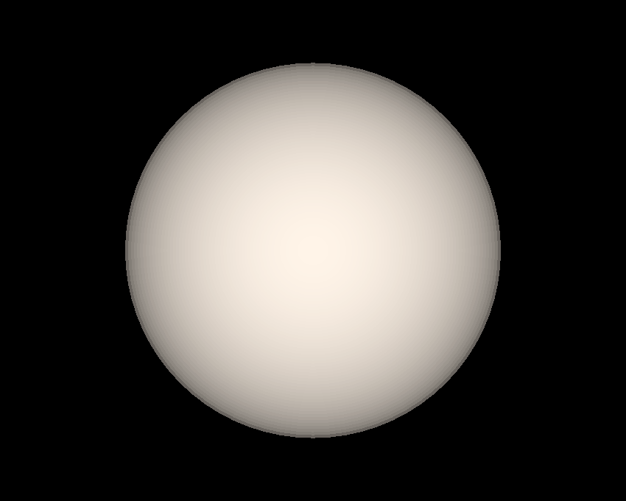
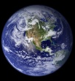
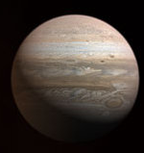
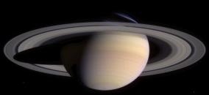

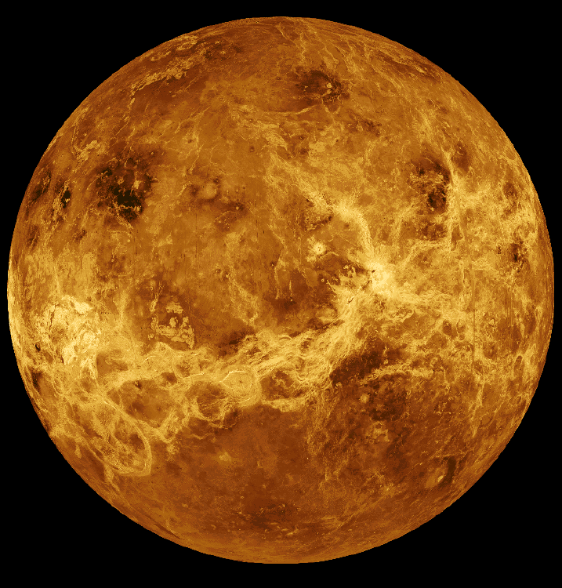
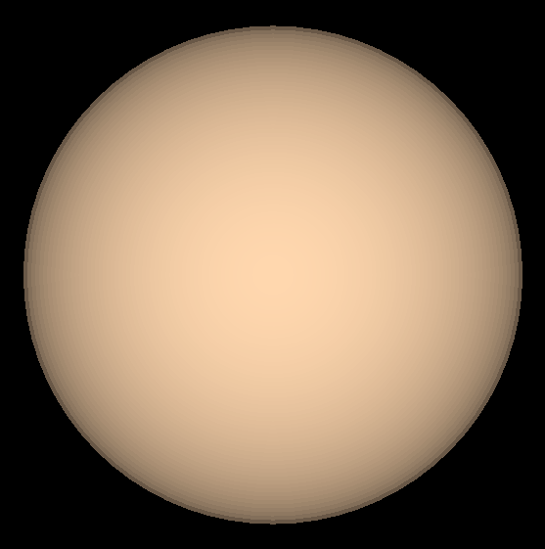
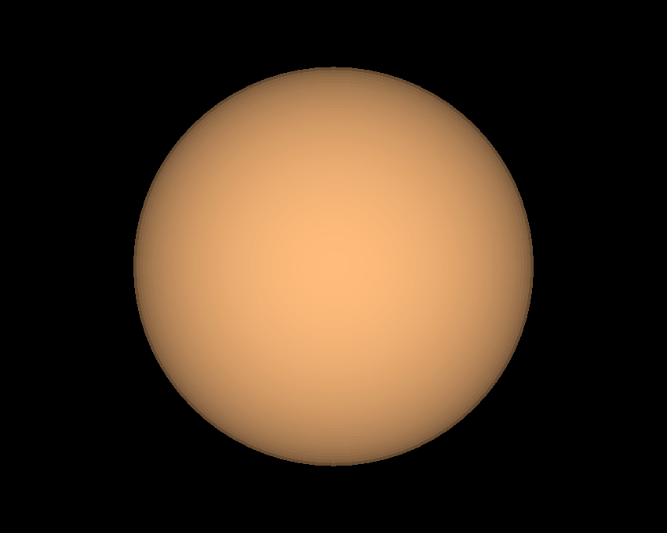
Habitable Zones Around Stars
A
F
G
K
M
0.1
1
10
AU
Astronomy 1141

Slide 2
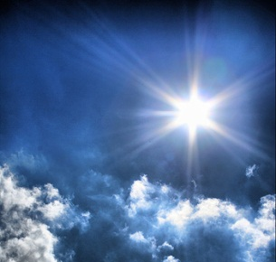

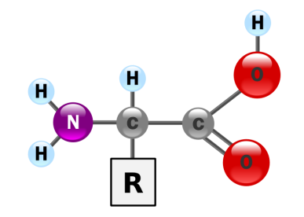
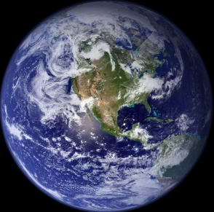
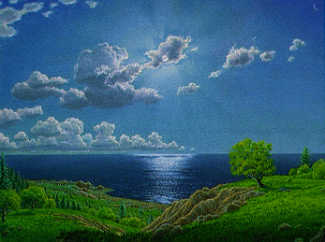
The Basic Requirements for Life:
A Stable, Long-lived Source of Energy
Energy to fuel chemical reactions
Warmth to permit liquid water
Complex Chemistry
Elements heavier than H and He
Carbon, liquid water, inorganics
A place for life to emerge
Oceans, land masses (place to swim/stand)
Benign Environmental Conditions
A stable, well-regulated climate
Protection from harmful UV radiation

Slide 3
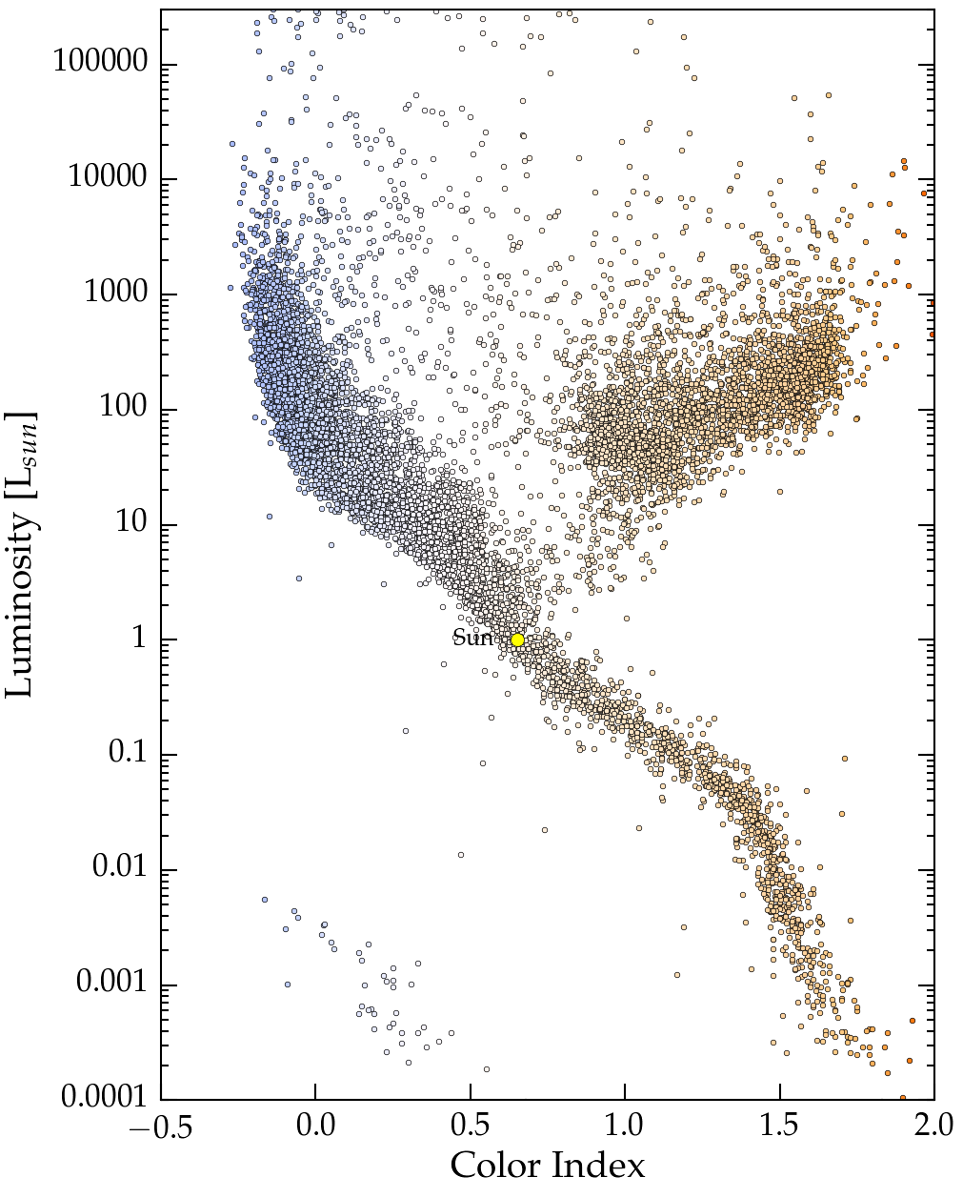
These conditions are found on the surfaces of rocky planets in the Habitable Zones of low-mass main sequence stars.
Low-mass stars (< 3M_{sun}) have main sequence
“lifetimes” longer than 500 Myr.
They provide a stable, long-lived energy source.
Main Sequence
Long enough for life to emerge.
Long enough for evolution to act.

Slide 4
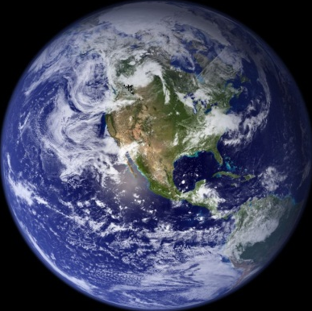
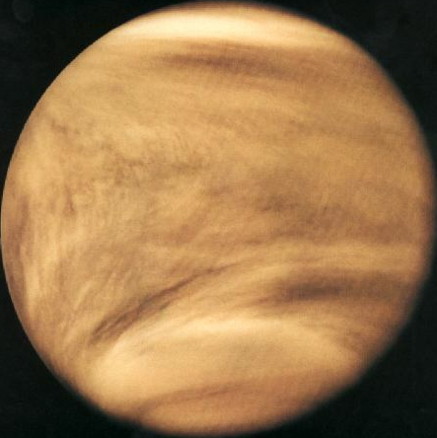
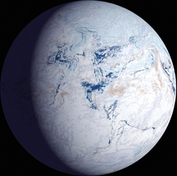
The Habitable Zone is the region around a star where liquid water is stable on a planet’s surface for long (geological) timescales.
Planet too close to its star:
Runaway greenhouse effect superheats the atmosphere and vaporizes all the water.
Planet too far from its star:
Runaway freeze-out No liquid water on the surface.

Slide 5
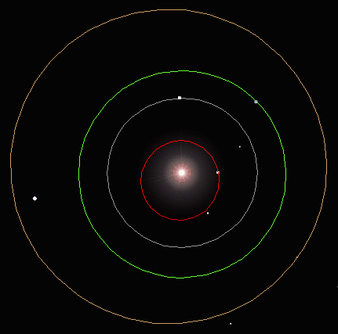
The Sun's Habitable Zone today:
Mars
Conservative:
0.95 – 1.4 AU
Earth
Venus
Mercury
Optimistic:
0.84 – 1.7 AU

Slide 6
The location of a star’s Habitable Zone depends on the star’s luminosity.
Inner edge of Habitable Zone:
Runaway
Greenhouse
Limit
Outer edge of Habitable Zone:
Runaway
Freeze-out
Limit
More luminous stars have more distant, wider Habitable Zones.

Slide 7
Examples:
Sun (G Star): L = L_{sun}, d_{HZ} = 0.95 – 1.4 AU
A Star: L = 80 L_{sun}, d_{HZ} = 8.5 – 12.5 AU
M Star: L = 0.008 L_{sun}, d_{HZ} = 0.08 – 0.12 AU

Slide 8
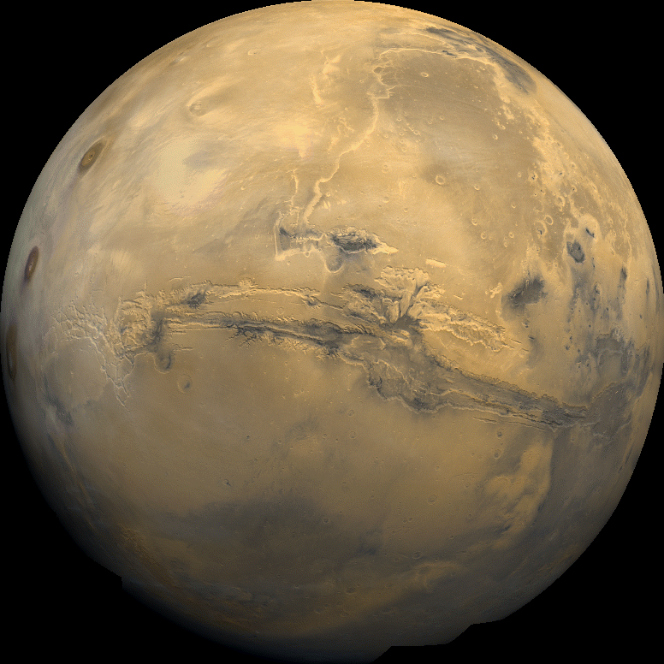
Habitable Zones of main sequence stars
(O & B stars are too short-lived to include)
A
8.5 – 12.5AU
F
1.5 – 2.2AU
G
0.95 – 1.4 AU
K
0.38 – 0.56AU
M
0.08–0.12AU
0.1
1
10
AU

Slide 9
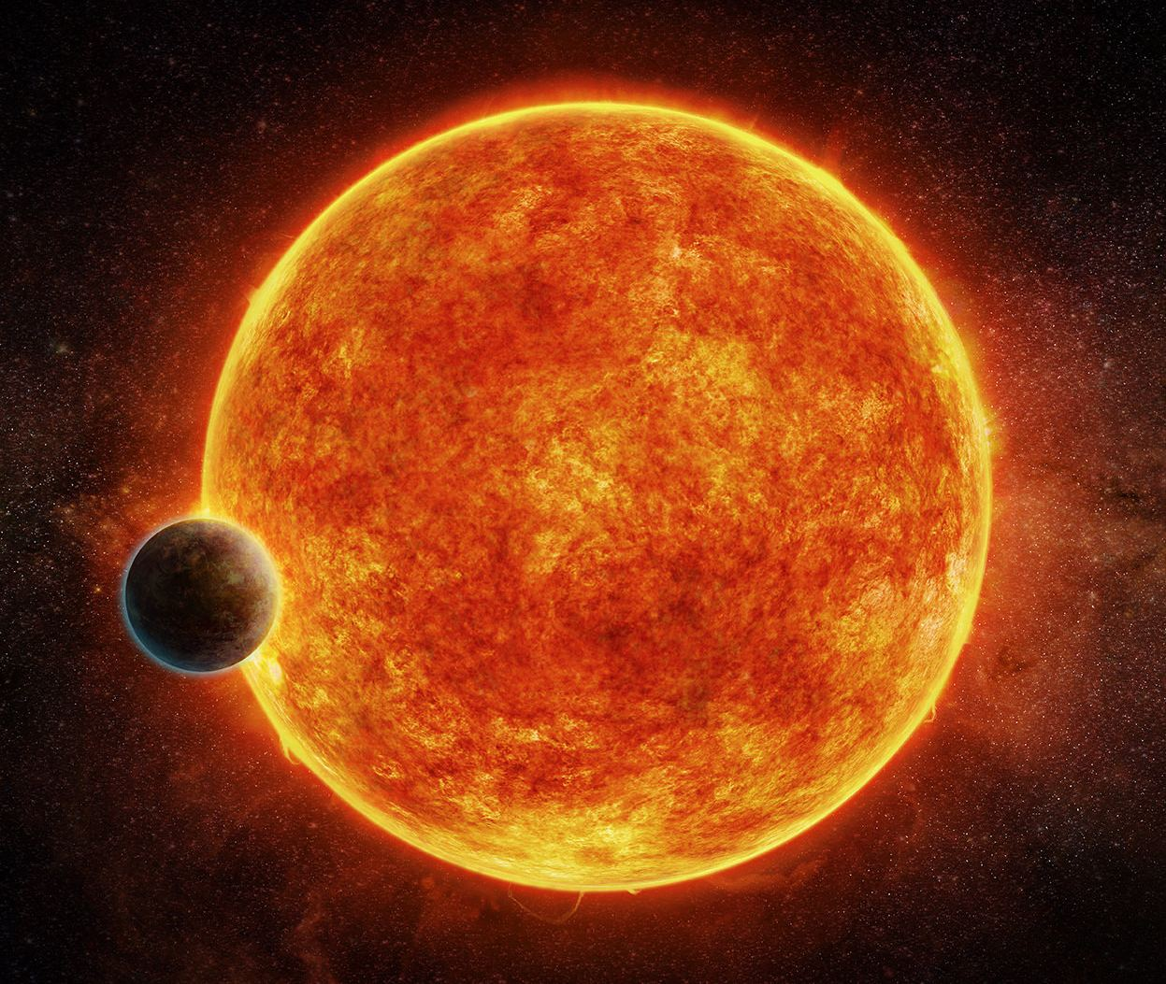
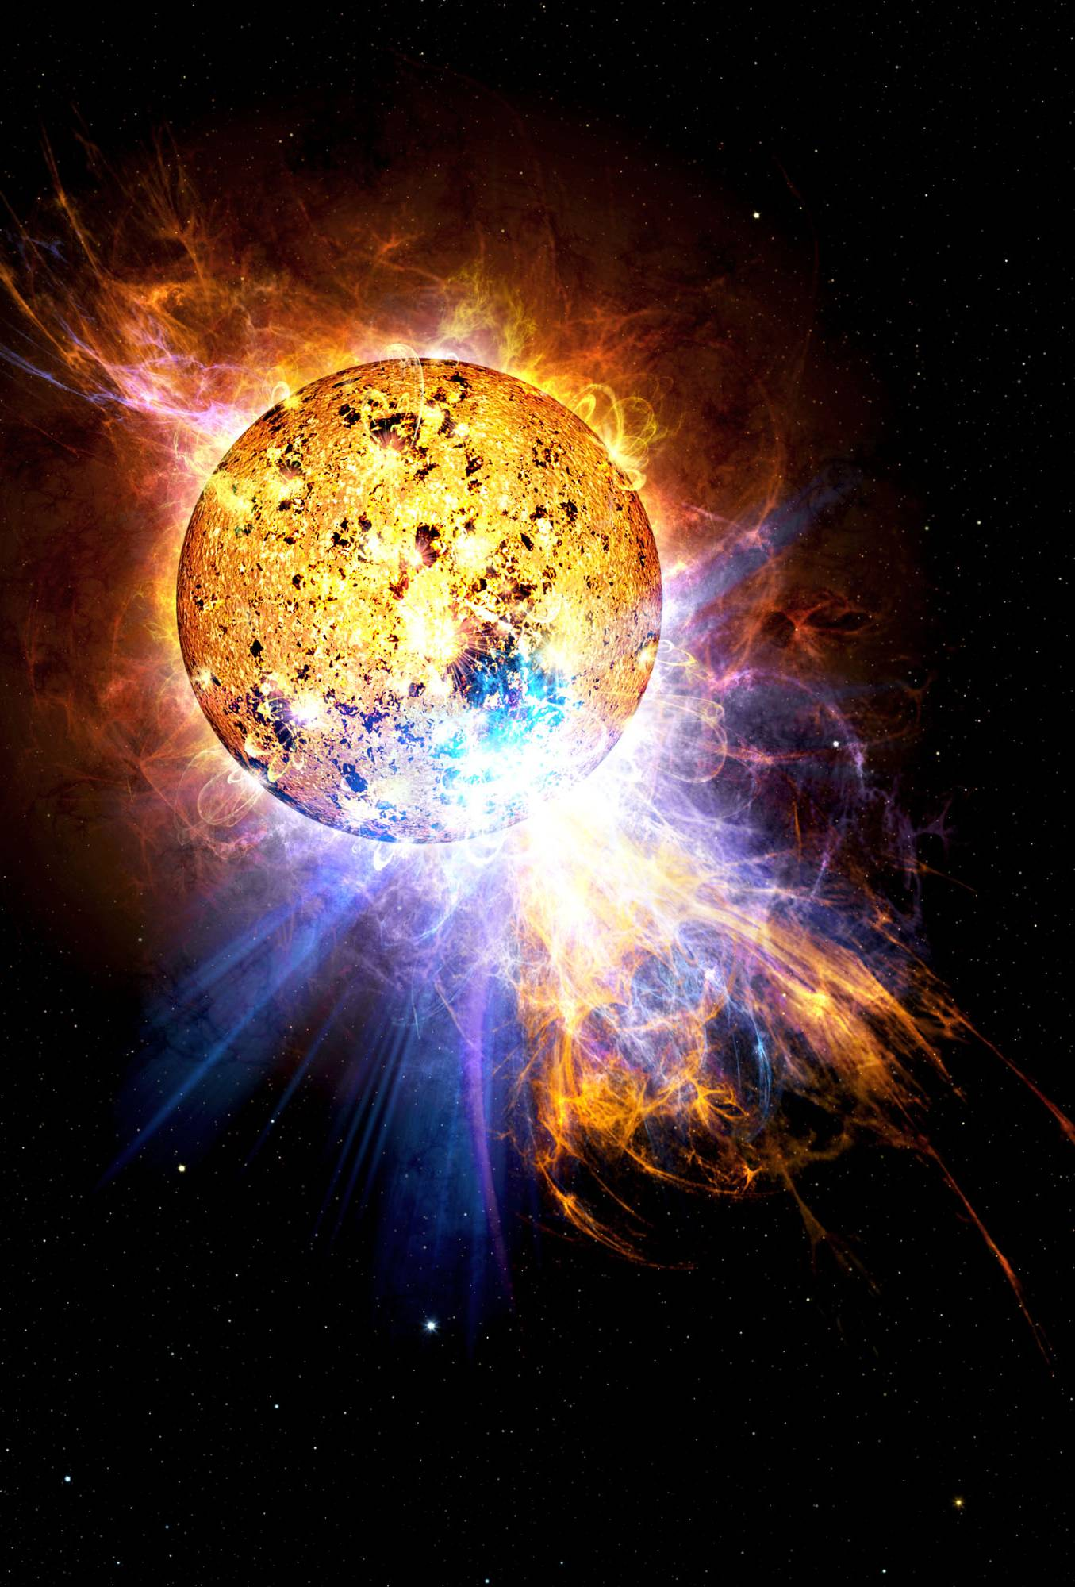
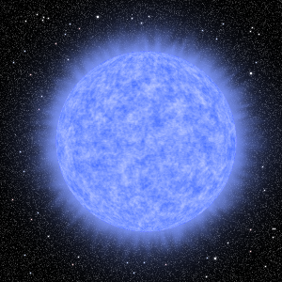
Liquid water is not enough! Other factors can critically influence a planet’s habitability.
Planets too close to their parent stars can become tidally locked.
Red dwarf (M-type) stars can produce powerful stellar flares that can potentially sterilize any planets.
Hot stars emit excess ultraviolet and X-ray light increasing the likelihood of dangerous mutations.

Slide 10
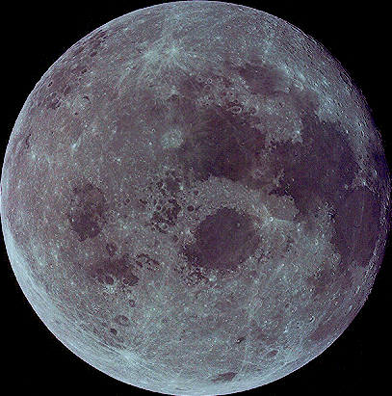
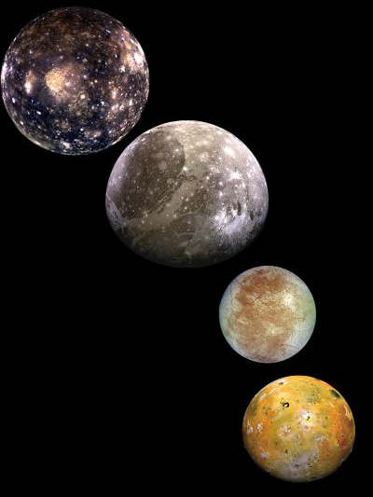
If a planet orbits too close to its parent star, its rotation will become tidally locked.
Examples:
The Moon’s always keeps the same face turned towards the Earth.
Io, Europa, Ganymede, & Callisto all keep the same face turned towards Jupiter.
What has locked them in this orientation? Tides!

Slide 11
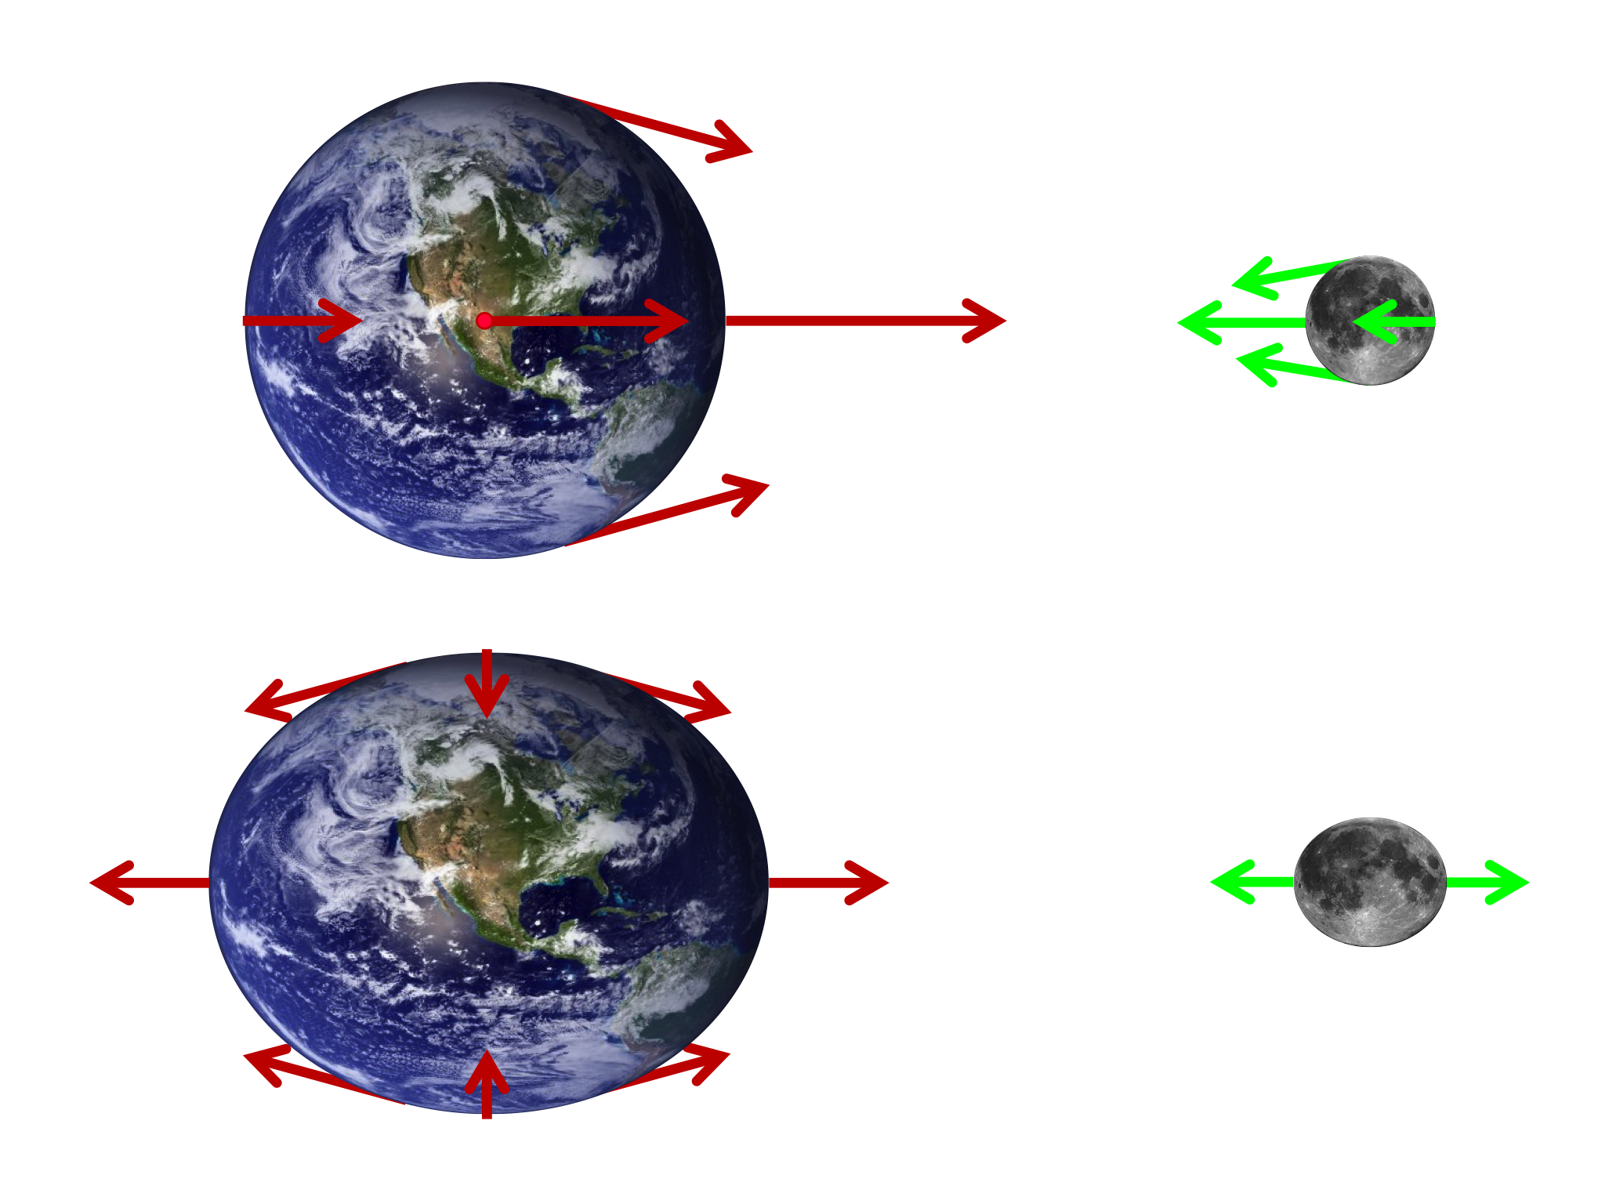
The Moon’s raises tides on the Earth, and the Earth raises tides on the Moon.

Slide 12
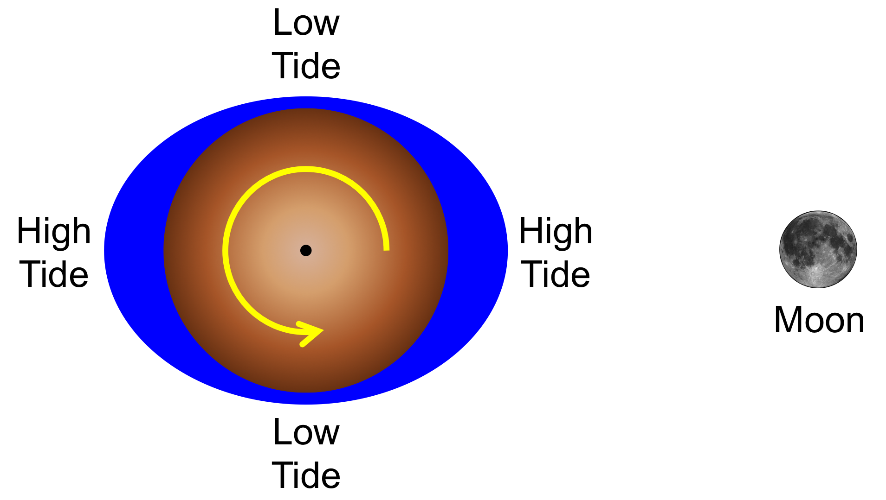
The tidal bulges of the Earth act like brake pads, producing friction that slows the Earth’s rotation.
The Moon’s rotation has already slowed to the point that it is tidally locked – one face always towards Earth.

Slide 13
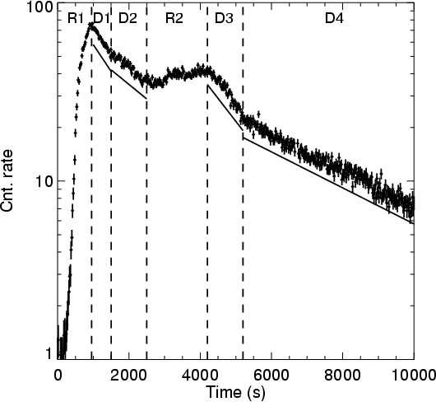
M-type main sequence stars are magnetically active, and can produce powerful stellar flares.
Stellar flares are outbursts of high-energy (X-ray & UV) light; small flares cause mutations, large flares can kill.
X-ray outburst from Proxima Centauri
But it could also stimulate evolution by increasing the mutation rate.
Notes:
M-star flares can be 10,000x more powerful than solar flares
Flare from Proxima Cen, XMM-Newton Data
Reale et al. 2004, A&A, 416, 733

Slide 14
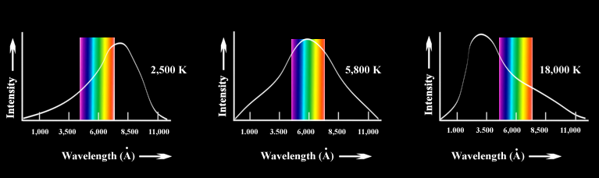
A-type main sequence stars are so hot they produce significant amounts of ultraviolet (UV) light.
UV
UV
UV
M star
G star
A star
Large doses of UV light will sterilize a planet’s surface.

Slide 15
Liquid water
Distance to the star
Greenhouse gas effect
Snowball effect
Tidal lock
One side being torched
But wind can help
Peak of radiation energy
Harmful dose of UV from A stars

Slide 16
How to search for stars with habitable planets:
Unstable
Exclude white dwarfs which lack a stable energy source.
The Sun is a MS G2V star.
It will expand to a Red Giant in
5 Gyr. After ejecting its
envelope, the core will cool to
a White Dwarf, a stellar corpse.
Lives too short
UV Radiation?
F, G, K
Exclude unstable stars like giants & supergiants.
Exclude short-lived, hot UV-bright O, B, & A stars.
Tidal Locking and Flares
No Stable Energy Source
Maybe exclude tidally-locked, flaring red dwarf (M) stars.

