Slide 1
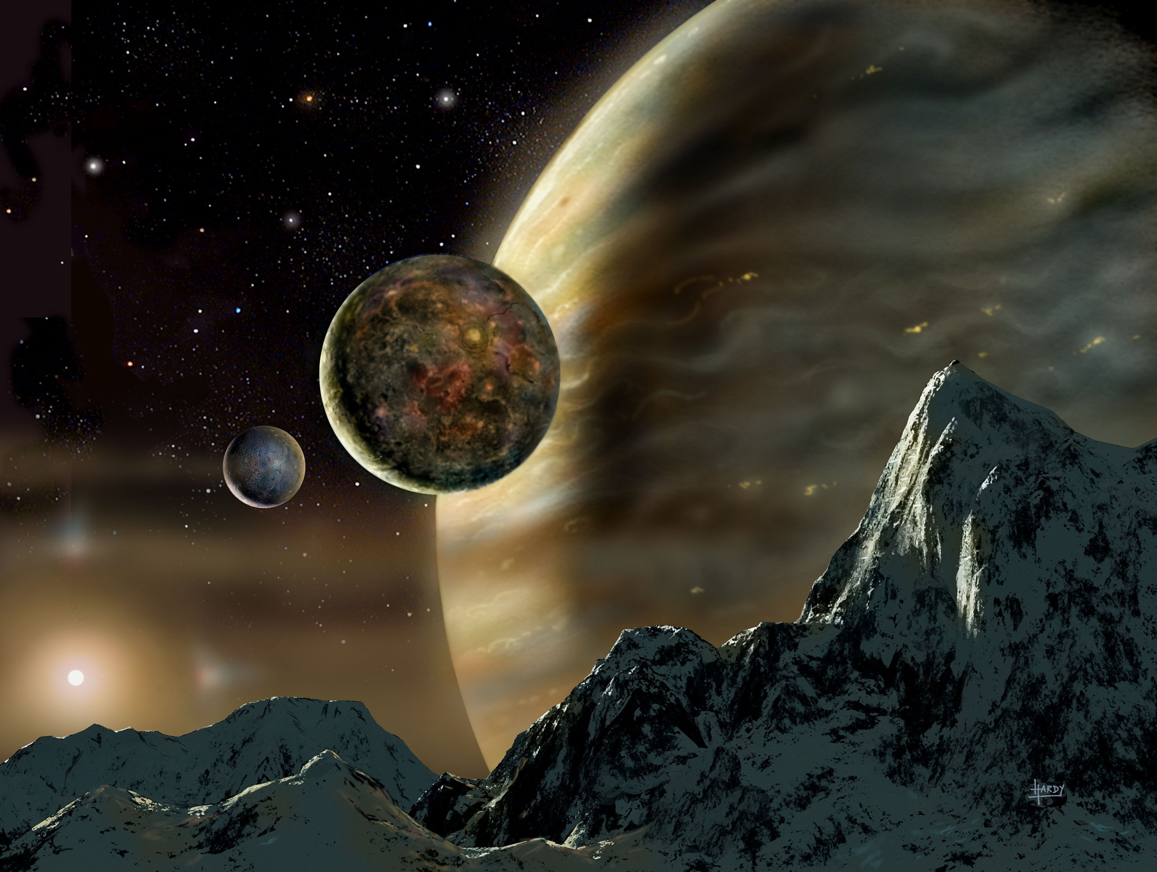
Exoplanets:
Planets Around Other Stars
Astronomy 1141
David A. Hardy, Astroart.org

Slide 2
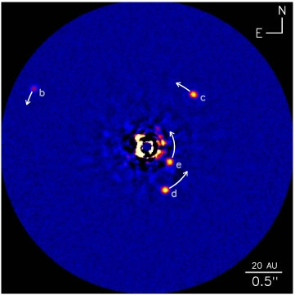
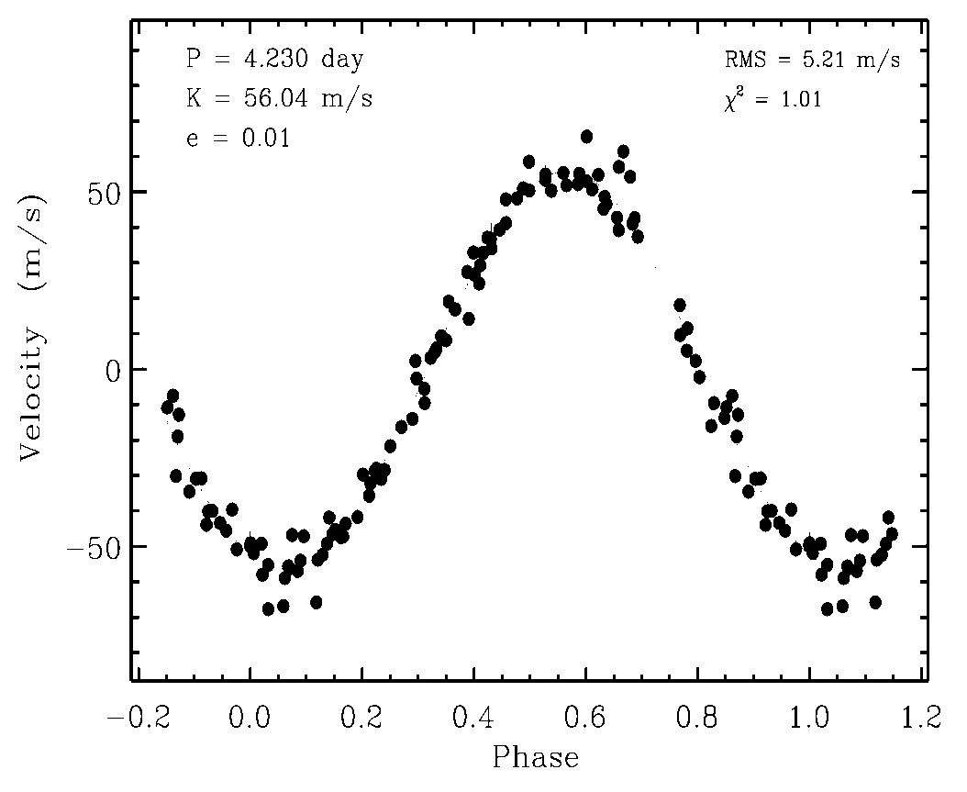
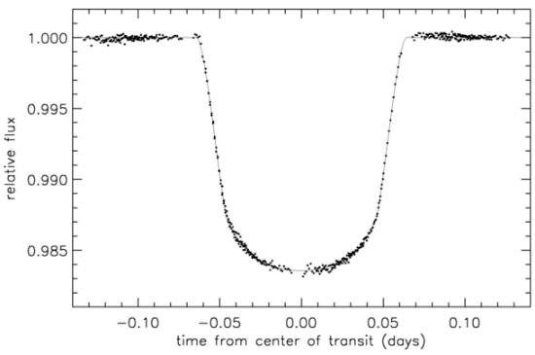
There are two basic methods used to search for planets around other stars.
Direct Detection:
Make images of planets orbiting other stars.
Indirect Detection:
Observe the orbital motions ("wobbling")
of the parent star due to the (unseen)
planet's gravity.
Observe brief dimming of light from the
parent star as the planet “transits”
between us and the star.

Slide 3
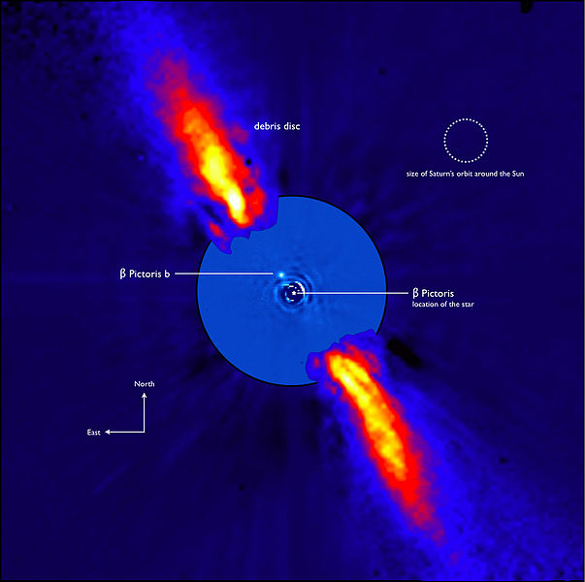
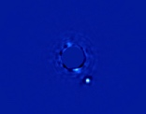
Direct Detection has only recently become possible with adaptive optics and space telescopes.
Challenge:
Finding a faint planet in
the glare of its parent
star.
Only 44 exoplanets
have been discovered
by direct imaging to date
Some are probably
just failed stars…
(brown dwarfs)
ESO

Slide 4

The Doppler Wobble or Radial Velocity (RV) method measures orbital motions using the Doppler Effect.
Star’s spectrum red-shifted
S
obs
rest
p
Half an orbit later…
p
Star’s spectrum blue-shifted
obs
rest
S

Slide 5
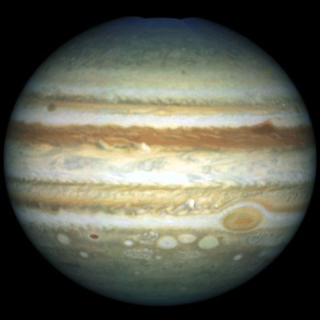
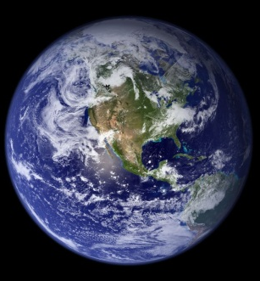
The greater mass of the star makes its orbital speed very small & challenging to measure.
Sun & Jupiter
Jupiter: 13 kilometers / second
Sun: 13 meters / second (30 mph)
Sun & Earth
Earth: 30 kilometers / second
Sun: 10 centimeters / second (0.22 mph)
Need to measure speeds with extremely high precision.
Current state-of-the-art is ~1 meters/sec, but not yet cm/sec.

Slide 6
In 1995, 51 Pegasi became the first Sun-like star with a planet detected by the RV method.
~40 light years away in
Pegasus
Orbital speed is 56 m/sec
Orbits once every 4.23 days!
Michel Mayor & Didier Queloz
(Geneva Observatory)
The period and speed make this is a 0.5 Jupiter-mass planet
orbiting only 0.05 AU from its parent star!

Slide 7
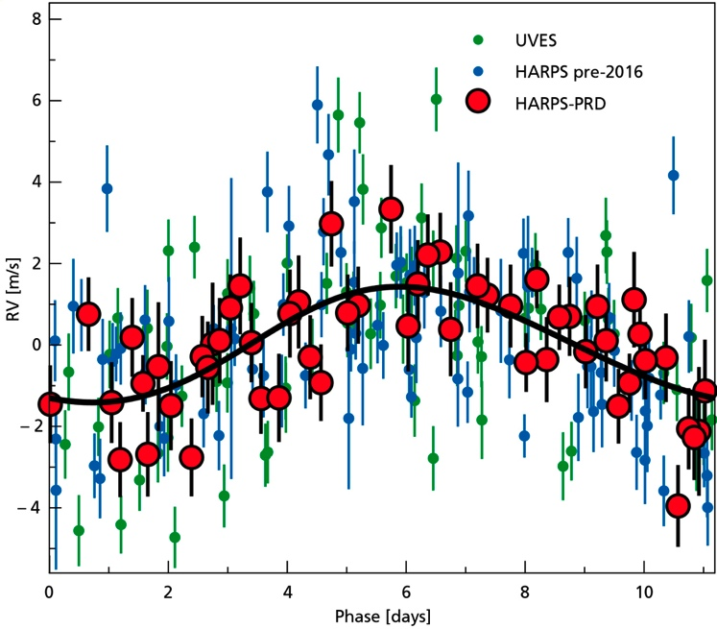
Proxima Centauri b, discovered by the RV method, is
a rocky exoplanet around the nearest star to the Sun.
d = 4.22 light years
v sin i = 1.38±0.21 m/s
P = 11.186±0.002 days
a = 0.0485 au
e < 0.35
M_{P} sin i = 1.27±0.18 M_{E}
G. Anglada-Escudé et al. 2016, Nature, 536, 437
If confirmed, it is the nearest exoplanet to the Earth.

Slide 8
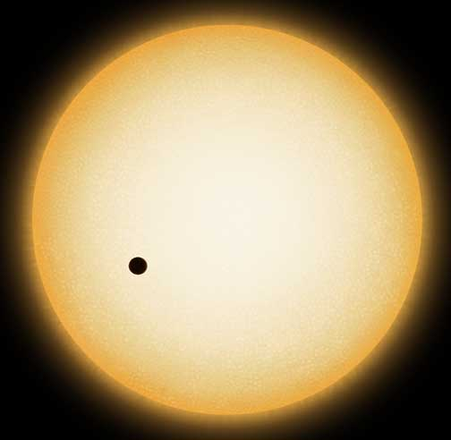

Planetary Transits occur when planet’s orbital plane is oriented edge-on to our line of sight.
The planet periodically transits
(crosses) the face of its parent star,
briefly dimming its brightness.
STScI
The transit method is the most successful to date.

Slide 9
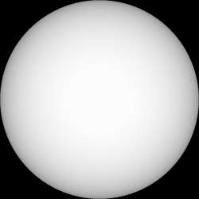
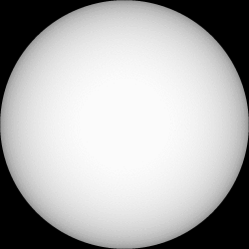
The transit depth measures the ratio of the areas of the planet and the star.
Jupiter: 0.1 R_{sun}
1% Transit Depth
Earth: 0.01 R_{sun}
0.01% Transit Depth
The transit method is now sensitive enough to allow us to
detect Earth-radius planets and smaller...

Slide 10
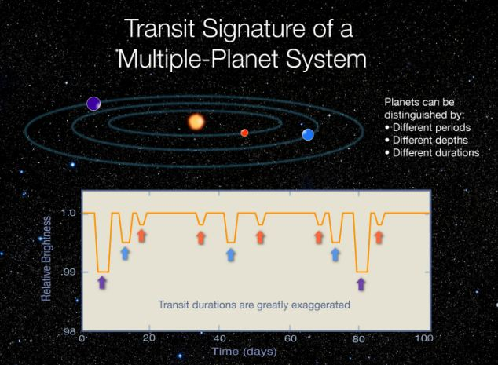
The transit method has also been good at detecting
multiple-planet systems.
Distinguish among
the planets by
Transit Period:
Different orbits
Transit Depth:
Bigger planet =
deeper transit
Transit Duration:
(cross the star at different locations across its disk)

Slide 11
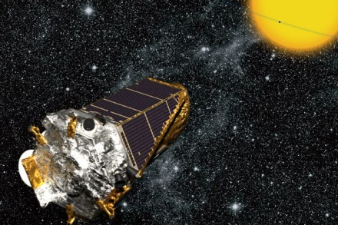
Most of the transiting exoplanets known to date have been discovered by the Kepler spacecraft.
Launched in 2008, its primary mission was to discover Earth-like planets in Earth-like orbits around Sun-like stars.
It has so far found many
thousands of planets, most
larger than Earth.
NASA
Kepler is very sensitive to close-in planets.
A few of the Kepler planets are the radius of Earth or smaller.

Slide 12
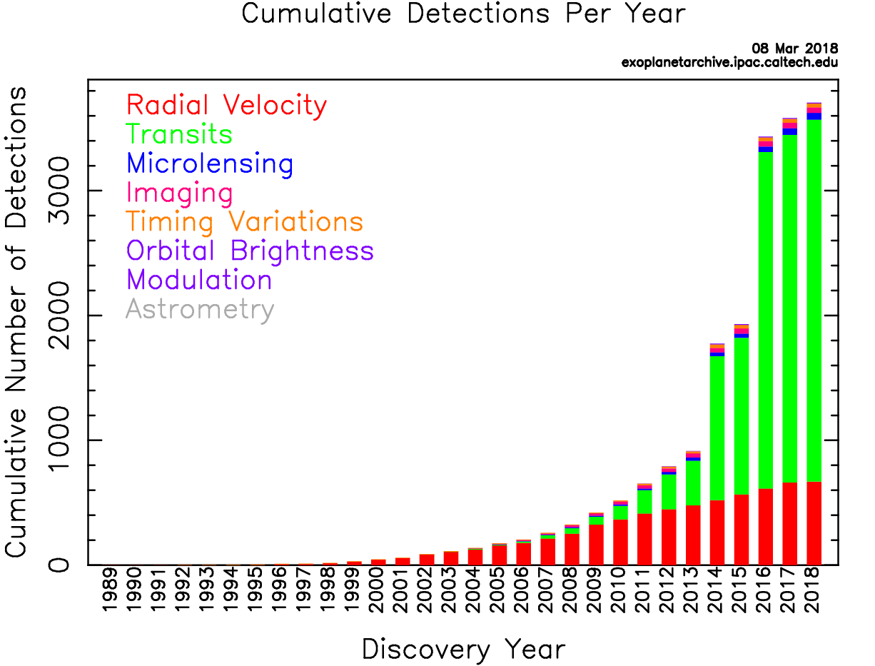
About 2900 of the 3700 known exoplanets were found using the transit method.

Slide 13
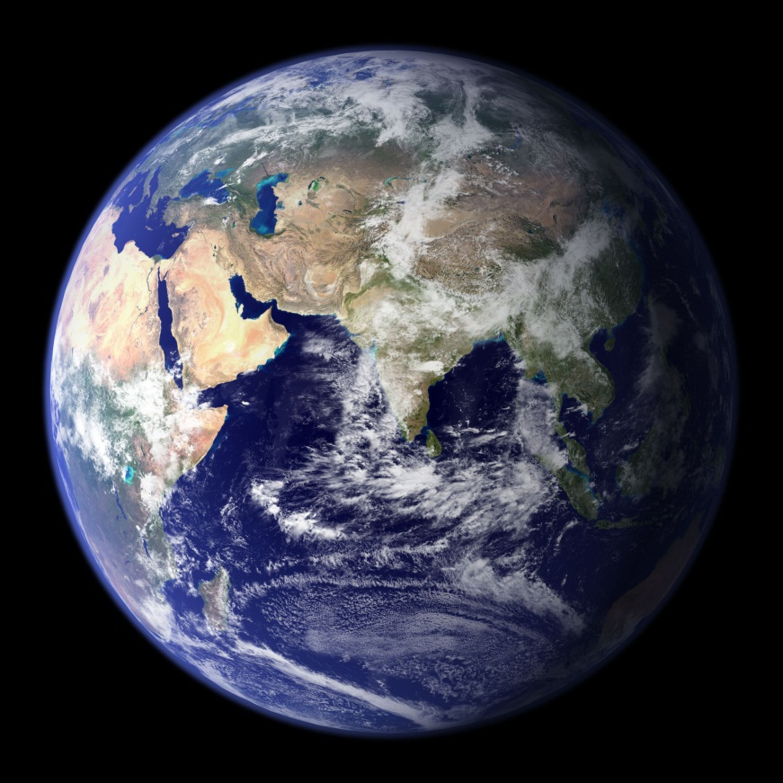
We have found only a very few confirmed Earth-mass planets around other stars
The ultimate goal is to find Earth-like
planets in Earth-like orbits around
their parent stars.
The RV Method is currently not
sensitive to Earth-mass planets.
The Transit Method from space is just sensitive enough, but
only to very close-in planets.

Slide 14
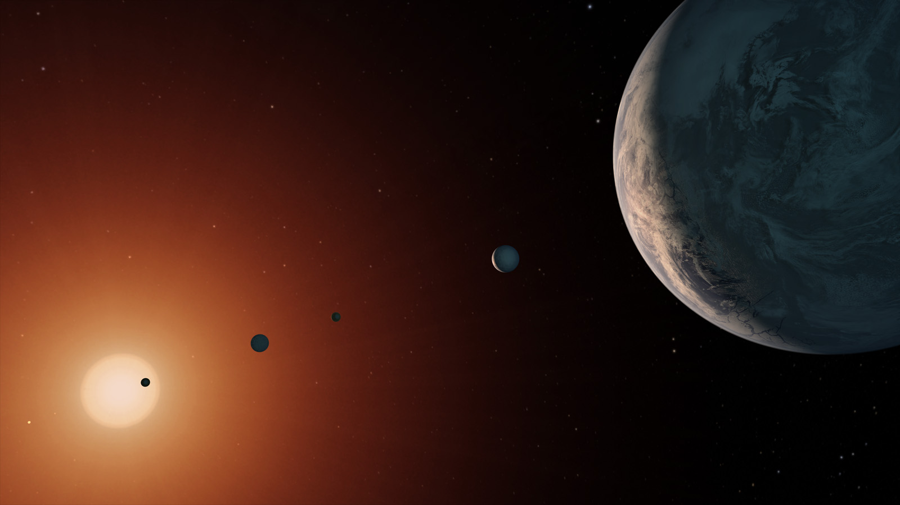
To date (April 2019), we have confirmed detections
of 3926 planets around 2925 stars.
David A. Hardy
Astroart.org
The ability to find Earth-like planets is within reach in the coming decade …
Notes:
TRAPPIST-1 system, NASA PIA21751

Slide 15
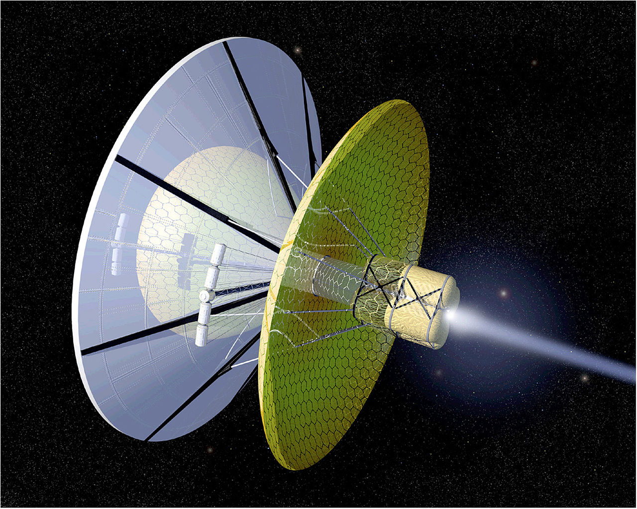
Interstellar Travel & Colonization
Wikimedia Commons
Astronomy 1141

Slide 16
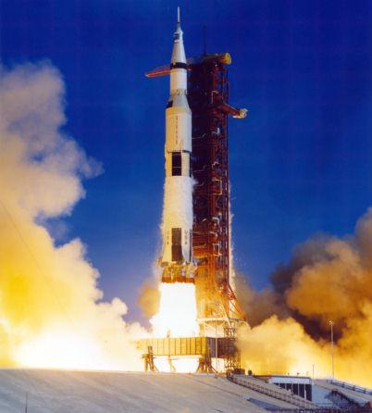
Getting there may be half the fun, but it is all of the problem of interstellar travel.
A problem of basic physics…
NASA
Spaceships have mass.
Accelerating a mass requires
you to apply a force.
Applying a force over a distance
means you are doing work.
Doing work requires a source
of energy.
30 trillion joules = 7 kilotons TNT
The larger the mass, the larger the energy required…

Slide 17
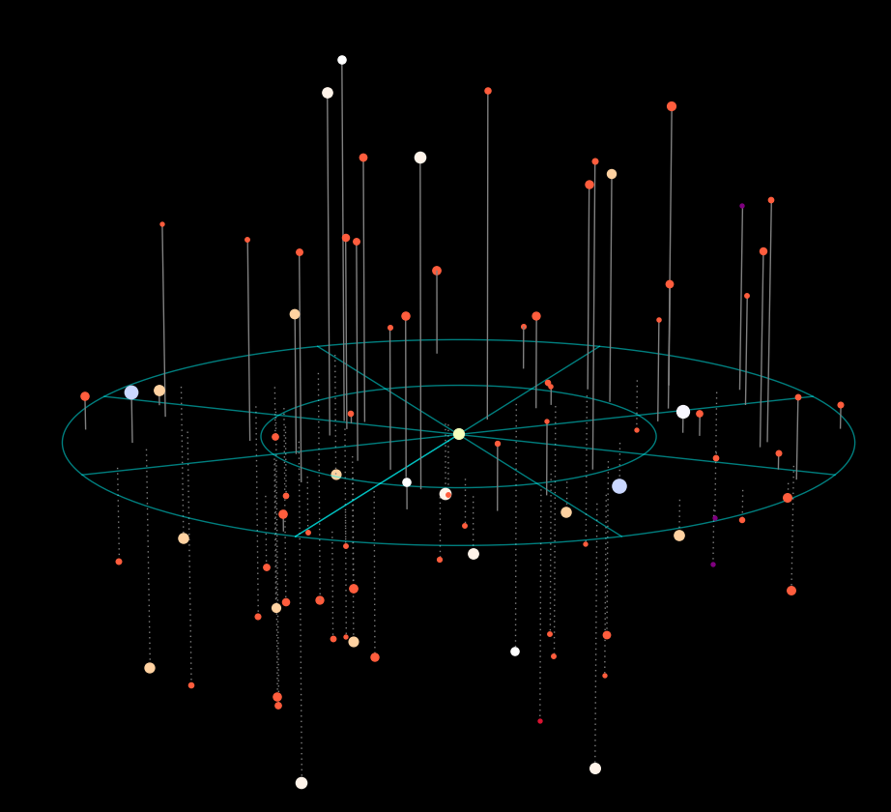
The 100 nearest stars
20 ly
On average, stars near the Sun
are about 6 light years apart.
Data: www.recons.org

Slide 18
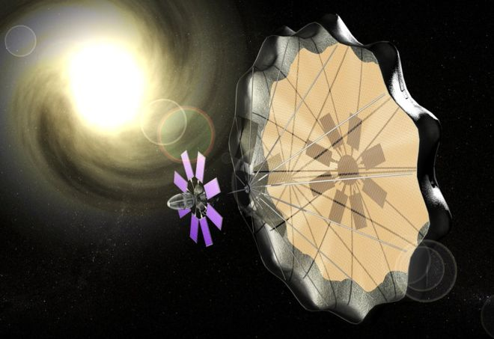
To bridge interstellar distances, you need to be able to accelerate a spacecraft to near light-speed (c).
breakthroughinitiatives.org
A speed of 0.2c (1/5th the speed of light) will get you to the nearest star, Proxima Centauri, in about 20 years.

Slide 19
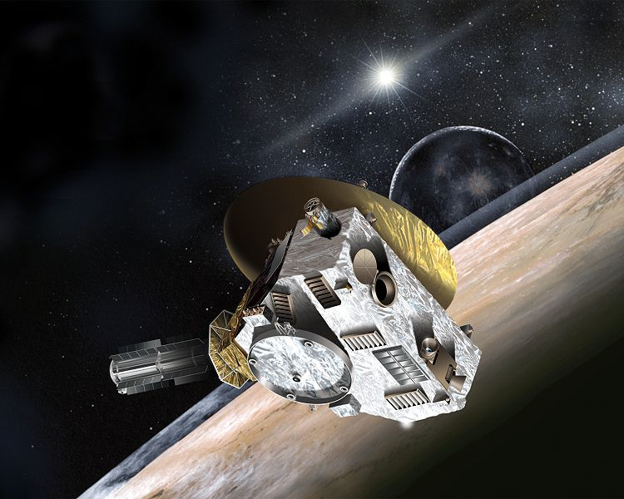
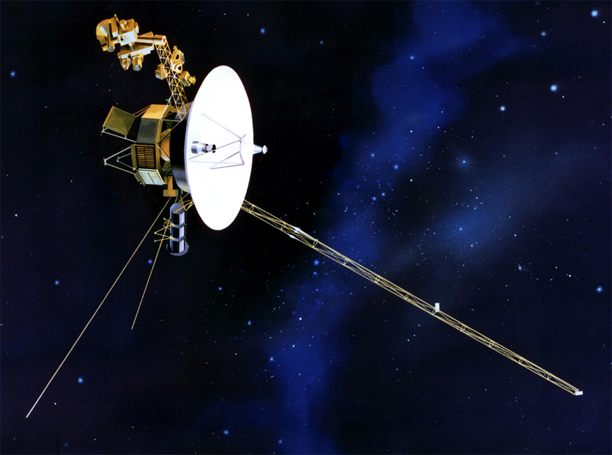
Current state-of-the-art spacecraft are very slow and impractical for interstellar travel.
New Horizons:
Launched: 2006 Jan 19
Jupiter Encounter: 2007 Feb 28
Pluto Flyby: 2015 July 14
Leaves the Solar System: 2029
NASA/JHU
Voyager 1:
Speed: 61,400 km/h (38,200 mph).
Proxima Centauri is 4.24 ly away
It would take 74,000 years to reach
Proxima Centauri.
NASA/JPL
Notes:
Talk is cheap, and seti gains traction

Slide 20
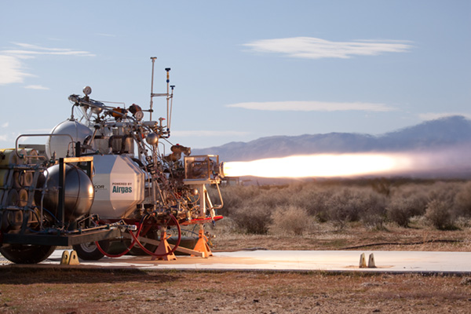
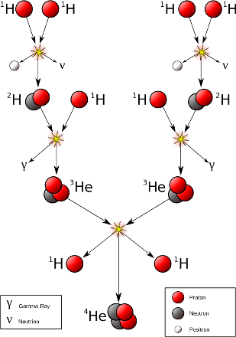
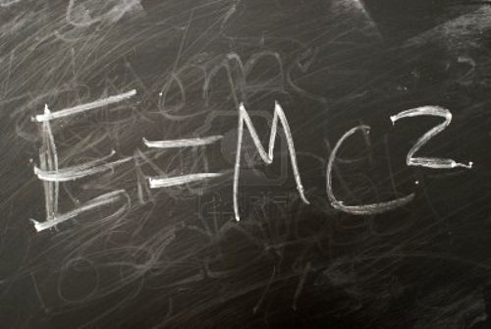
How much energy is in one gram of hydrogen gas?
(about 1 tablespoon at 1 atmosphere pressure)
Combustion (oxidization) of hydrogen:
140 thousand joules per gram.
Mike Massee/XCOR
Fusion of hydrogen into helium:
620 billion joules per gram.
Complete matter-to-energy conversion:
90 trillion joules per gram.

Slide 21
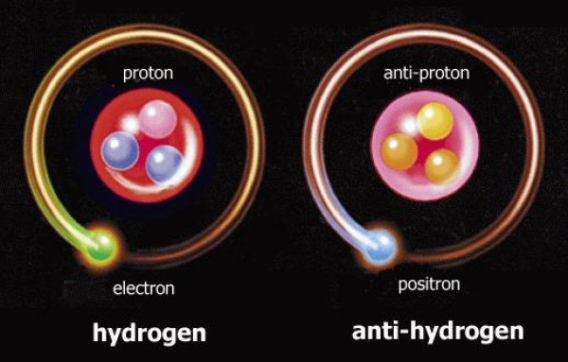
Matter/antimatter annihilation is the most efficient energy source imaginable.
When matter (protons & electrons) and antimatter (antiprotons & positrons) collide, they annihilate and convert 100% of their combined mass into pure energy (E=mc²).

Slide 22
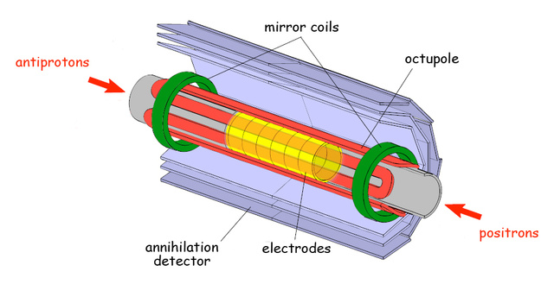
But, antimatter is notoriously difficult to handle (you cannot store antimatter in a bottle made of matter).
Current world production of antimatter is only a few nanograms (billionths of a gram) per year.

Slide 23
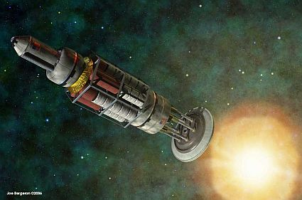
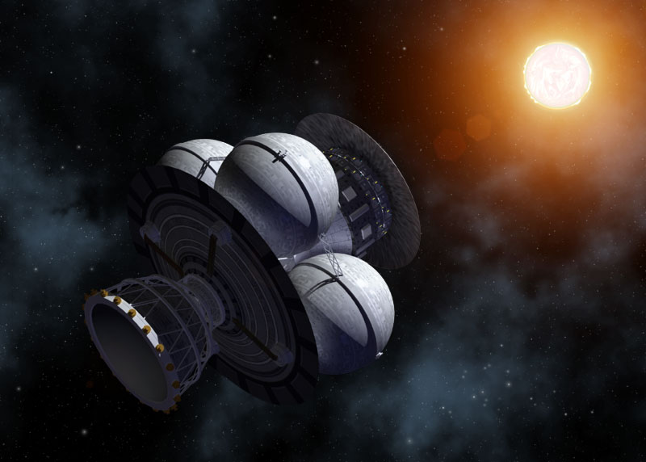
Concepts for nuclear starships have been seriously studied (but none have been built).
Project Orion (US: 1960s)
Project Daedalus (UK: 1970s)
Jim Bergmann
Nuclear Pusher-Plate drive
Alpha Centauri in 100 years
Adrian Mann
Pulsed Nuclear Fusion plasma drive
Barnard’s Star (6 ly) in 50 years

Slide 24
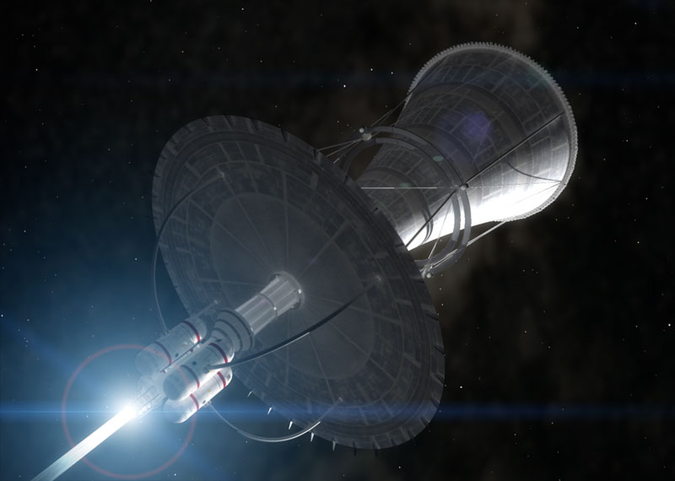
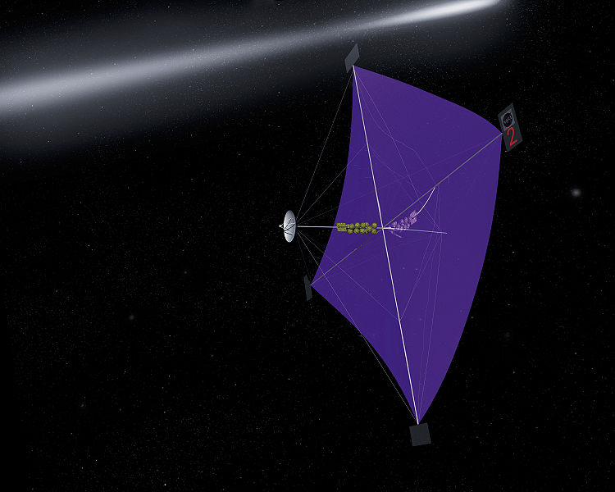
An alternative solution is to use means of propulsion that don’t require you to carry all of your fuel.
Light Sails:
Use photons from the Sun or
giant lasers to push your craft.
Adrian Mann
Bussard Ramjet:
Scoop up interstellar hydrogen to
fuel nuclear fusion as you go.
NASA/MSFC

Slide 25
The Breakthrough Starshot Initiative is studying designs for small-scale interstellar light sails.
breakthroughinitiatives.org
The goal is to design & build laser-powered light-sail nanocraft
to reach Alpha Centauri in 20 years (0.2 c)

Slide 26
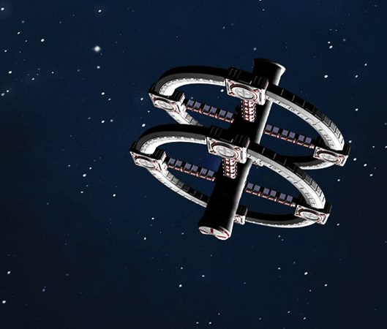
Colonization can occur rapidly even using relatively slow (non-relativitistic) starships.
Build generation ships (“arks”)
that travel at 1% c.
It would take 500 years to get
to the nearest star systems.
Wait about 4500 years then
dispatch another pair of arks.
The inhabited frontier would grow at 0.1% the speed of light.
Even this relatively slow star-faring civilization could colonize an entire galaxy in 100 million years.
Notes:
For a thoughtful take on generation ships and their challenges, see Kim Stanley Robinson, Aurora (2015)

Slide 27
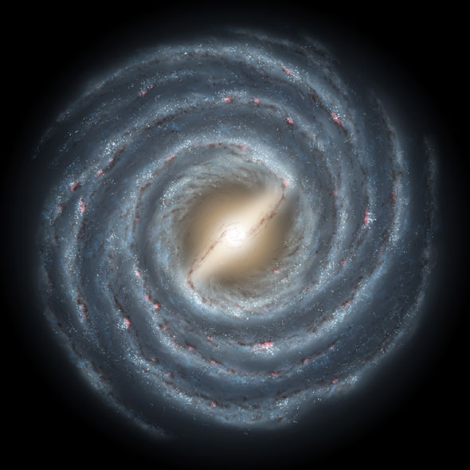
Even if the colonized region expanded at the leisurely rate of 0.0001c, it would take only 1 billion years to colonize our entire galaxy.
Our galaxy is about
10 billion years old.
More than enough time to have been colonized many times over.

