Slide 1
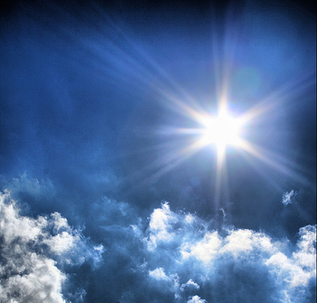
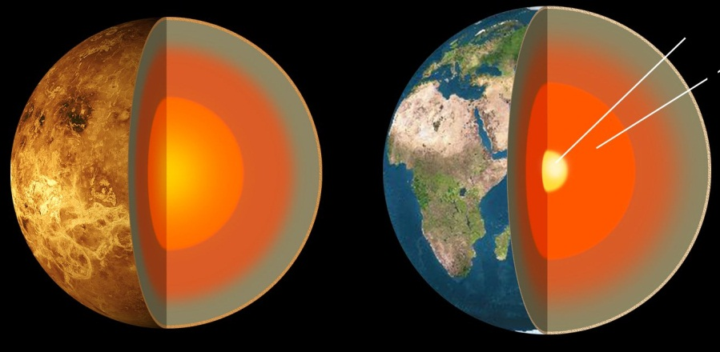
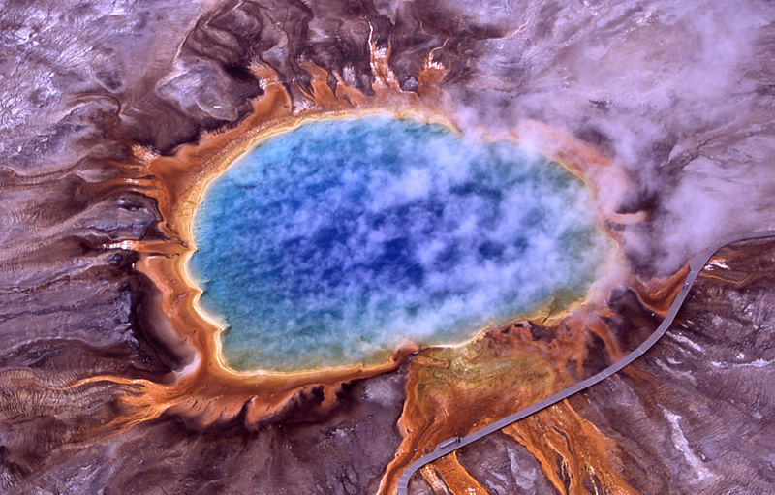
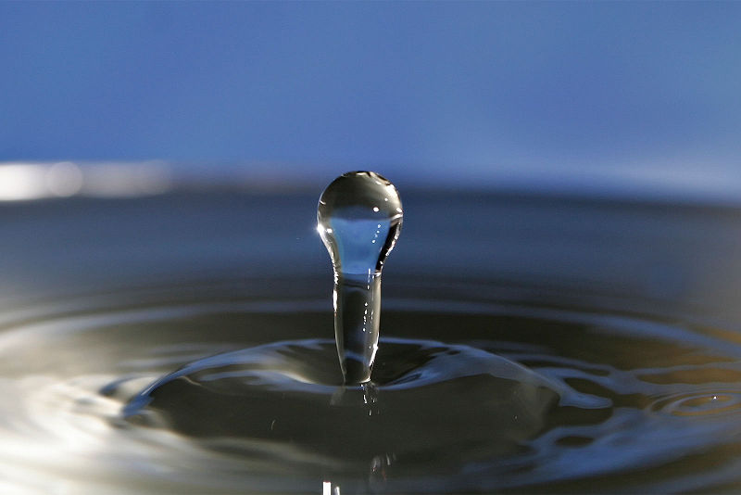
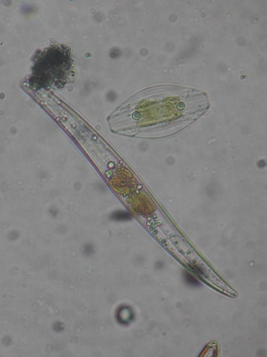
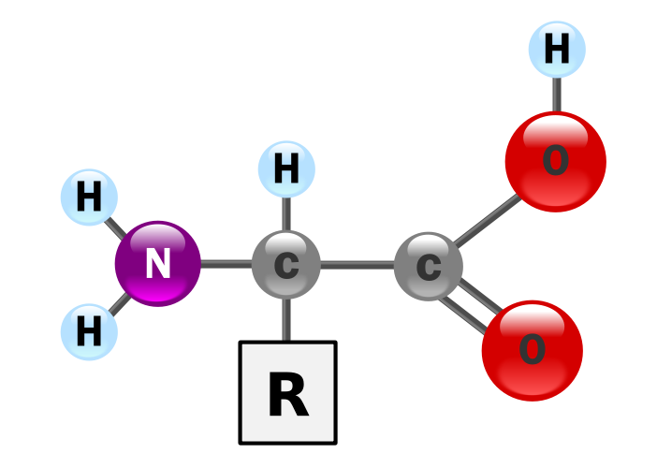
The Requirements for Life
Astronomy 1141

Slide 2
In class activity: why are we interested in exploring Mars, Europa, Enceladus, and Earth (of course)?

Slide 3

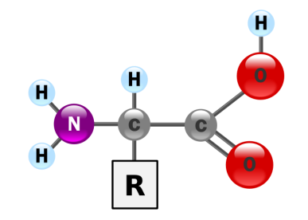

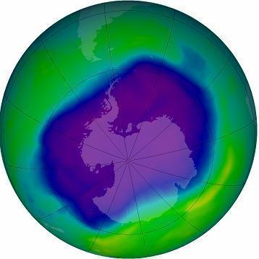
The Basic Requirements for Life
A Source of Energy
  Energy to fuel chemical reactions
  Warmth to permit liquid water (other liquids?)
Complex Chemistry
Elements heavier than H and He
Carbon as the building block of complex molecules
A Liquid Solvent Medium
Place for complex chemistry to occur
Protection from harmful UV light
Mutations from UV radiation inhibit the emergence of life
Shield with an ozone layer, water oceans, or underground

Slide 4
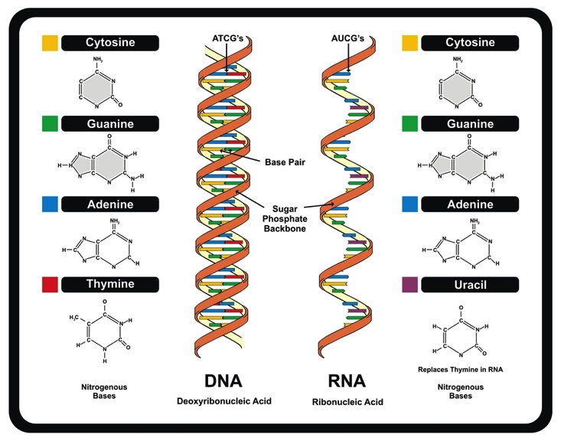
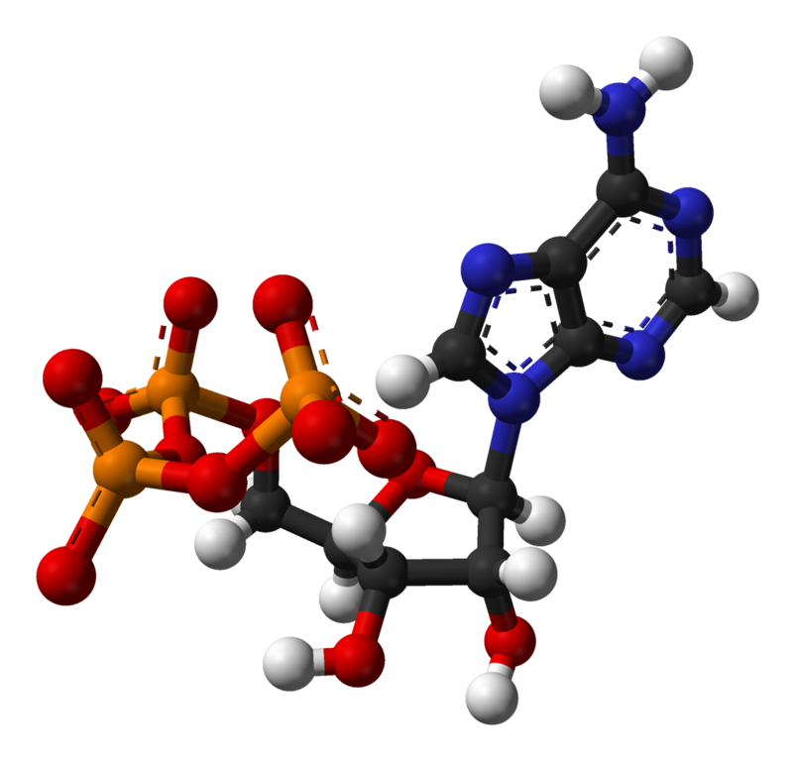
All Earth life uses DNA & RNA to store genetic information, and ATP to transport energy within cells.
ATP
udaix (shutterstock)
Wikimedia commons
Other molecules could do the same jobs:
DNA, RNA, & ATP are not absolutely required for life in the universe.

Slide 5
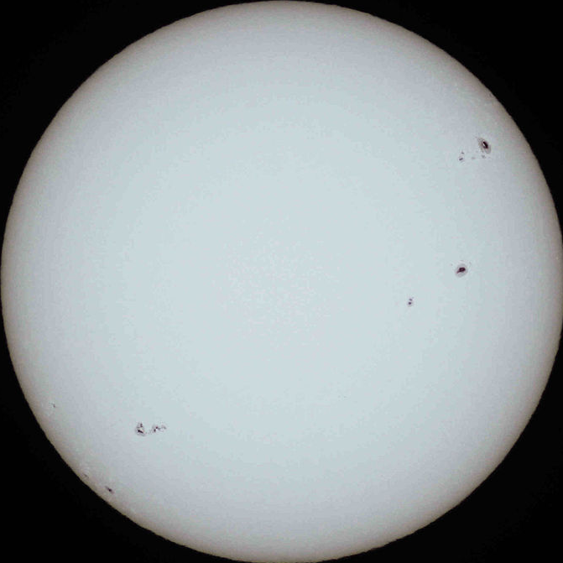
The Sun is the main energy source in the solar system. How much energy depends on your distance.
The Sun’s brightness
depends your distance
from it.
B = Brightness of Sunlight
L = Sun’s Luminosity
D = Distance from Sun
Inverse-Square Law of Brightness

Slide 6
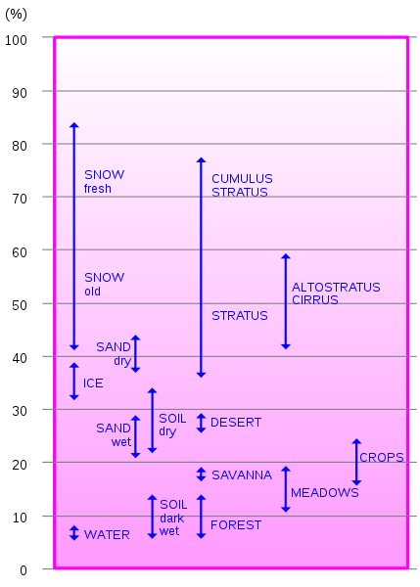
The amount of solar heating you receive depends on your distance from the Sun and how shiny you are.
D = distance in AU
A_{b} = Albedo
Albedo measures how efficiently
a body reflects light.
More distant objects are cooler.
Shinier objects are cooler.
Hannes Grobe (wikipedia)

Slide 7
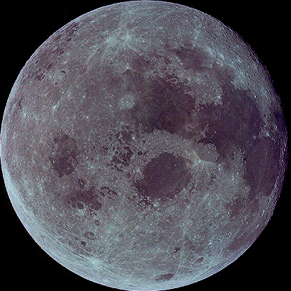
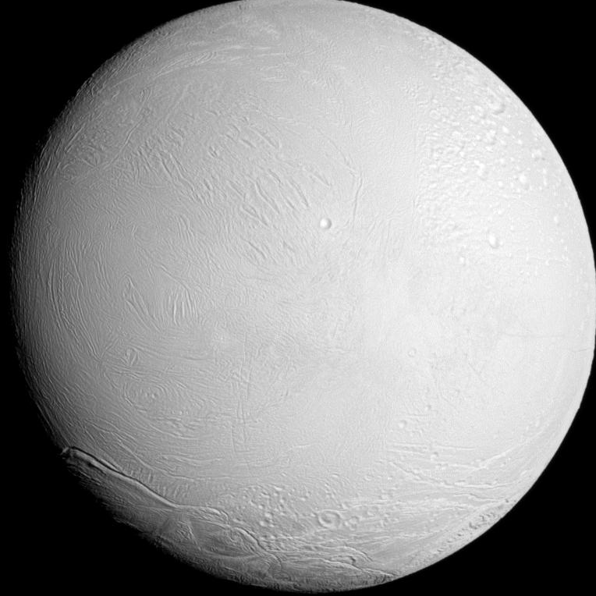

Examples:
The Moon
(dark rock)
D = 1 AU
A_{b} = 0.12
T_{eq} = 270 K
Enceladus (moon of Saturn)
(shiny water ice)
D = 9.54 AU
A_{b} = 0.99
T_{eq} = 30 K
An atmosphere with a greenhouse effect would increase these equilibrium temperatures.

Slide 8
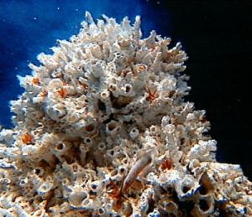
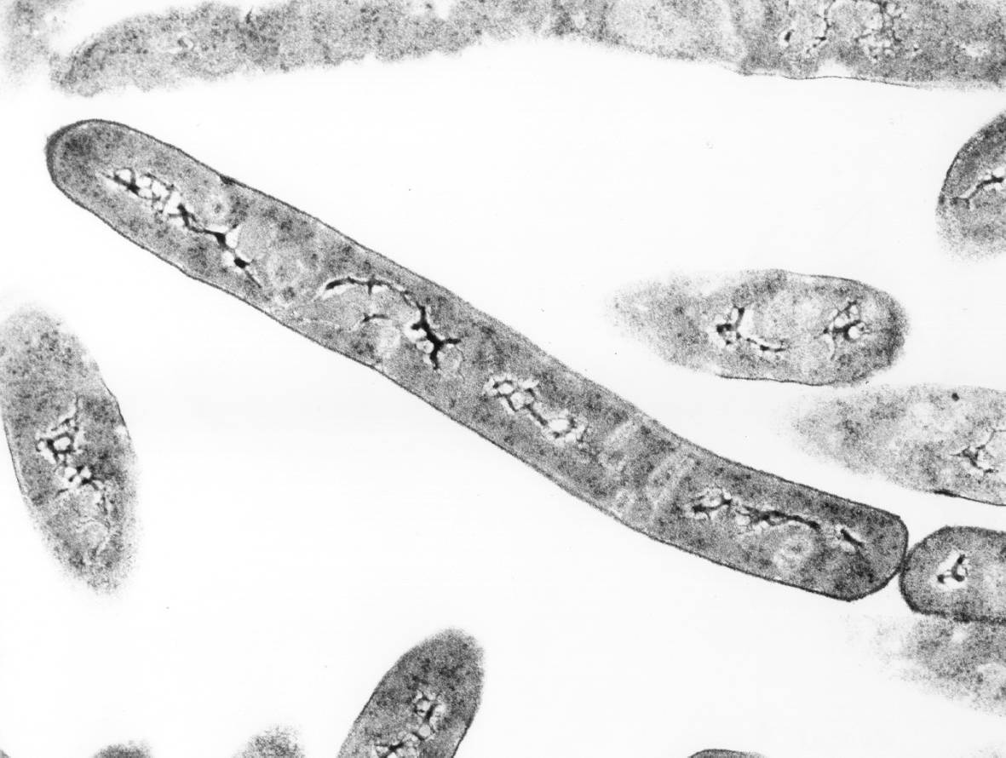
Extremophiles on Earth remind us that sunlight is not the only energy source.
Hot Life:
Organisms surviving in hot springs
and deep-ocean thermal vents.
Dark Life:
Organisms that thrive many kilometers
underground or deep under polar ice.

Slide 9

The complex chemistry of life requires a liquid solvent to occur in.
Provides a medium for chemical
reactions.
Carries nutrients into and wastes out of the organism.
Helps maintain proper thermal
balance (high heat capacity).
Provides protection from the
outside environment.

Slide 10
Liquid water is the ideal solvent for the chemistry of life.
Water is very abundant.
It is liquid from 0 – 100°C
(ideal for most reactions)
Most organics dissolve in
liquid water.
It has a large heat capacity.
It floats when frozen.

Slide 11
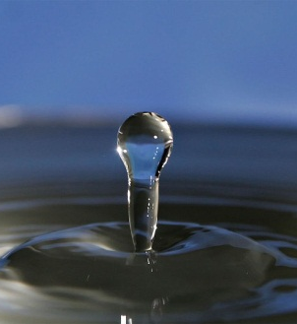
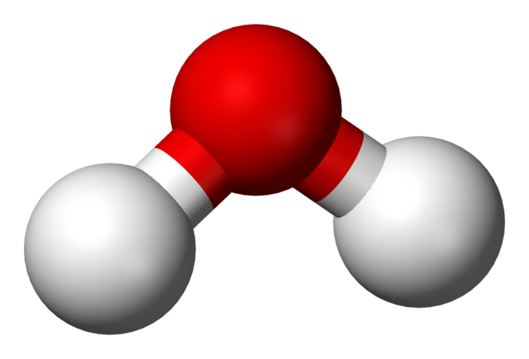
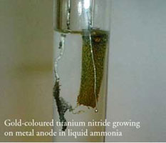
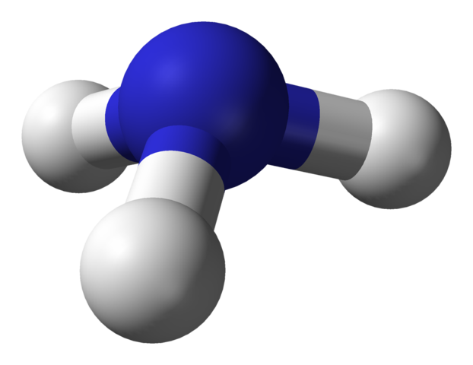
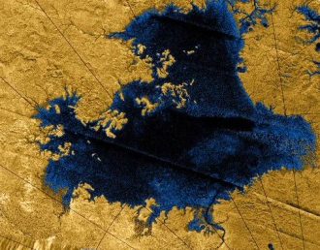
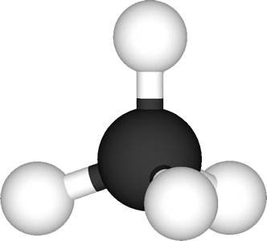
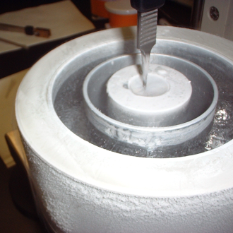
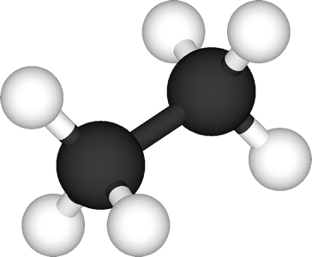
But, there are other possible liquid solvents…
Water (H₂O):
liquid from 0 to 100°C
(100°C range)
Ammonia (NH₃):
liquid from -78 to -33°C
(45°C range)
Methane (CH₄):
liquid from -182 to -164°C
(18°C range)
Ethane (C₂H₆):
liquid from -183 to -89°C
(94°C range)

Slide 12
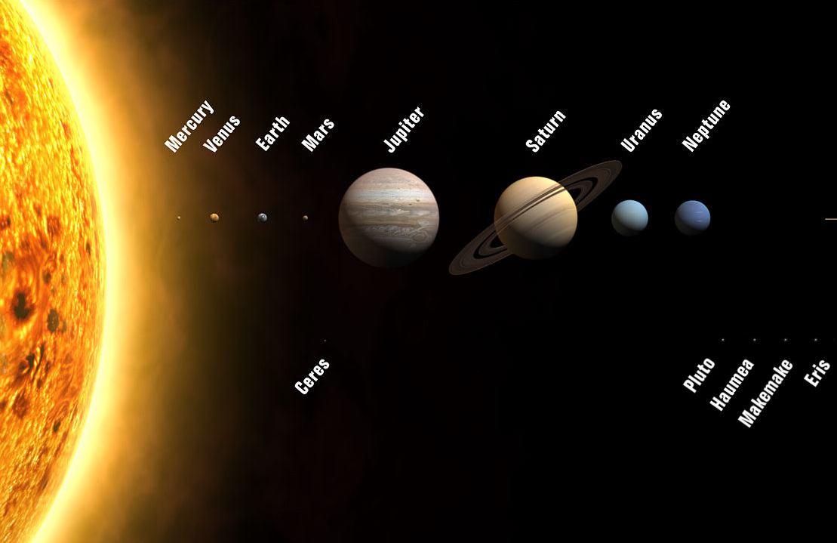




Life also needs a place to stand (or swim)…
Large, No Solid Surfaces
Small & Rocky
Very Small, Rocky / Icy

Slide 13
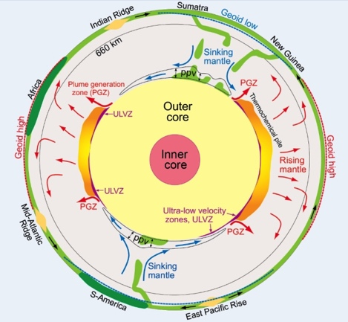
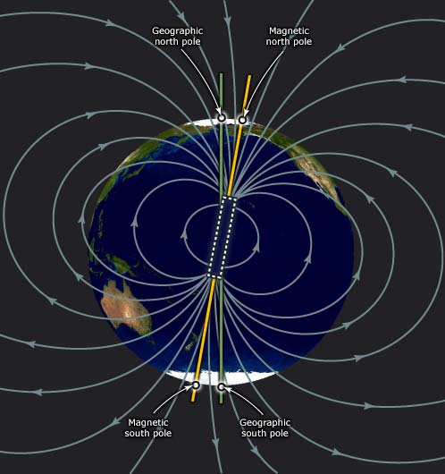
The internal heat of a planet is a factor in its potential for habitability.
Internal heat drives convection.
Convection drives plate tectonics.
The CO₂ cycle that regulates global climate requires plate tectonics.
Convection and rapid rotation combined
generate a planetary magnetic field.
Magnetic fields protect atmospheres from erosion by the solar wind.

Slide 14
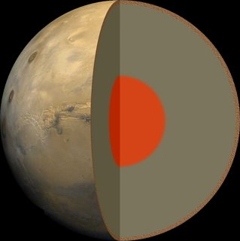
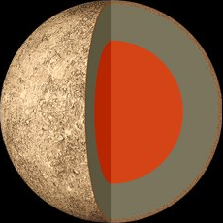
The cooling time of a terrestrial planet scales with the size of the planet.
Planets or moons more than 50%
the mass of the Earth are still hot
and molten inside today.
Venus
Earth
Planets or moons less than 50% the
mass of the Earth have solidified by
the present day.
Mars
Mercury

Slide 15
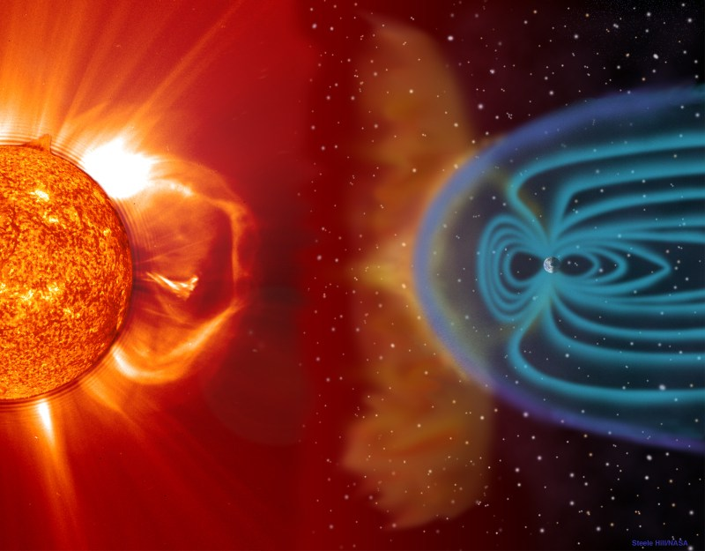
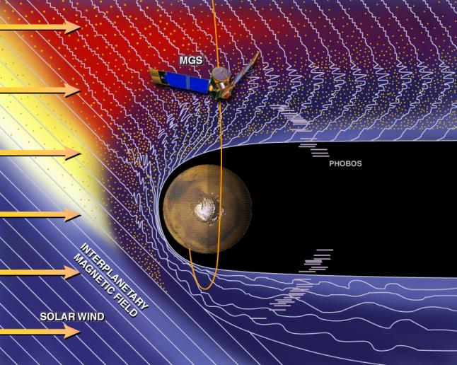
Planetary magnetic fields protect atmospheres from stripping by the solar wind.
The solar wind is made of charged particles, but charged
particles cannot cross magnetic field lines.
Earth’s magnetic field shields our
atmosphere erosion by the solar wind.
Today, Mars’s interior is cold & solid,
and has no global magnetic field.
The solar wind accelerated the loss
of most of Mars’ early atmosphere.

Slide 16
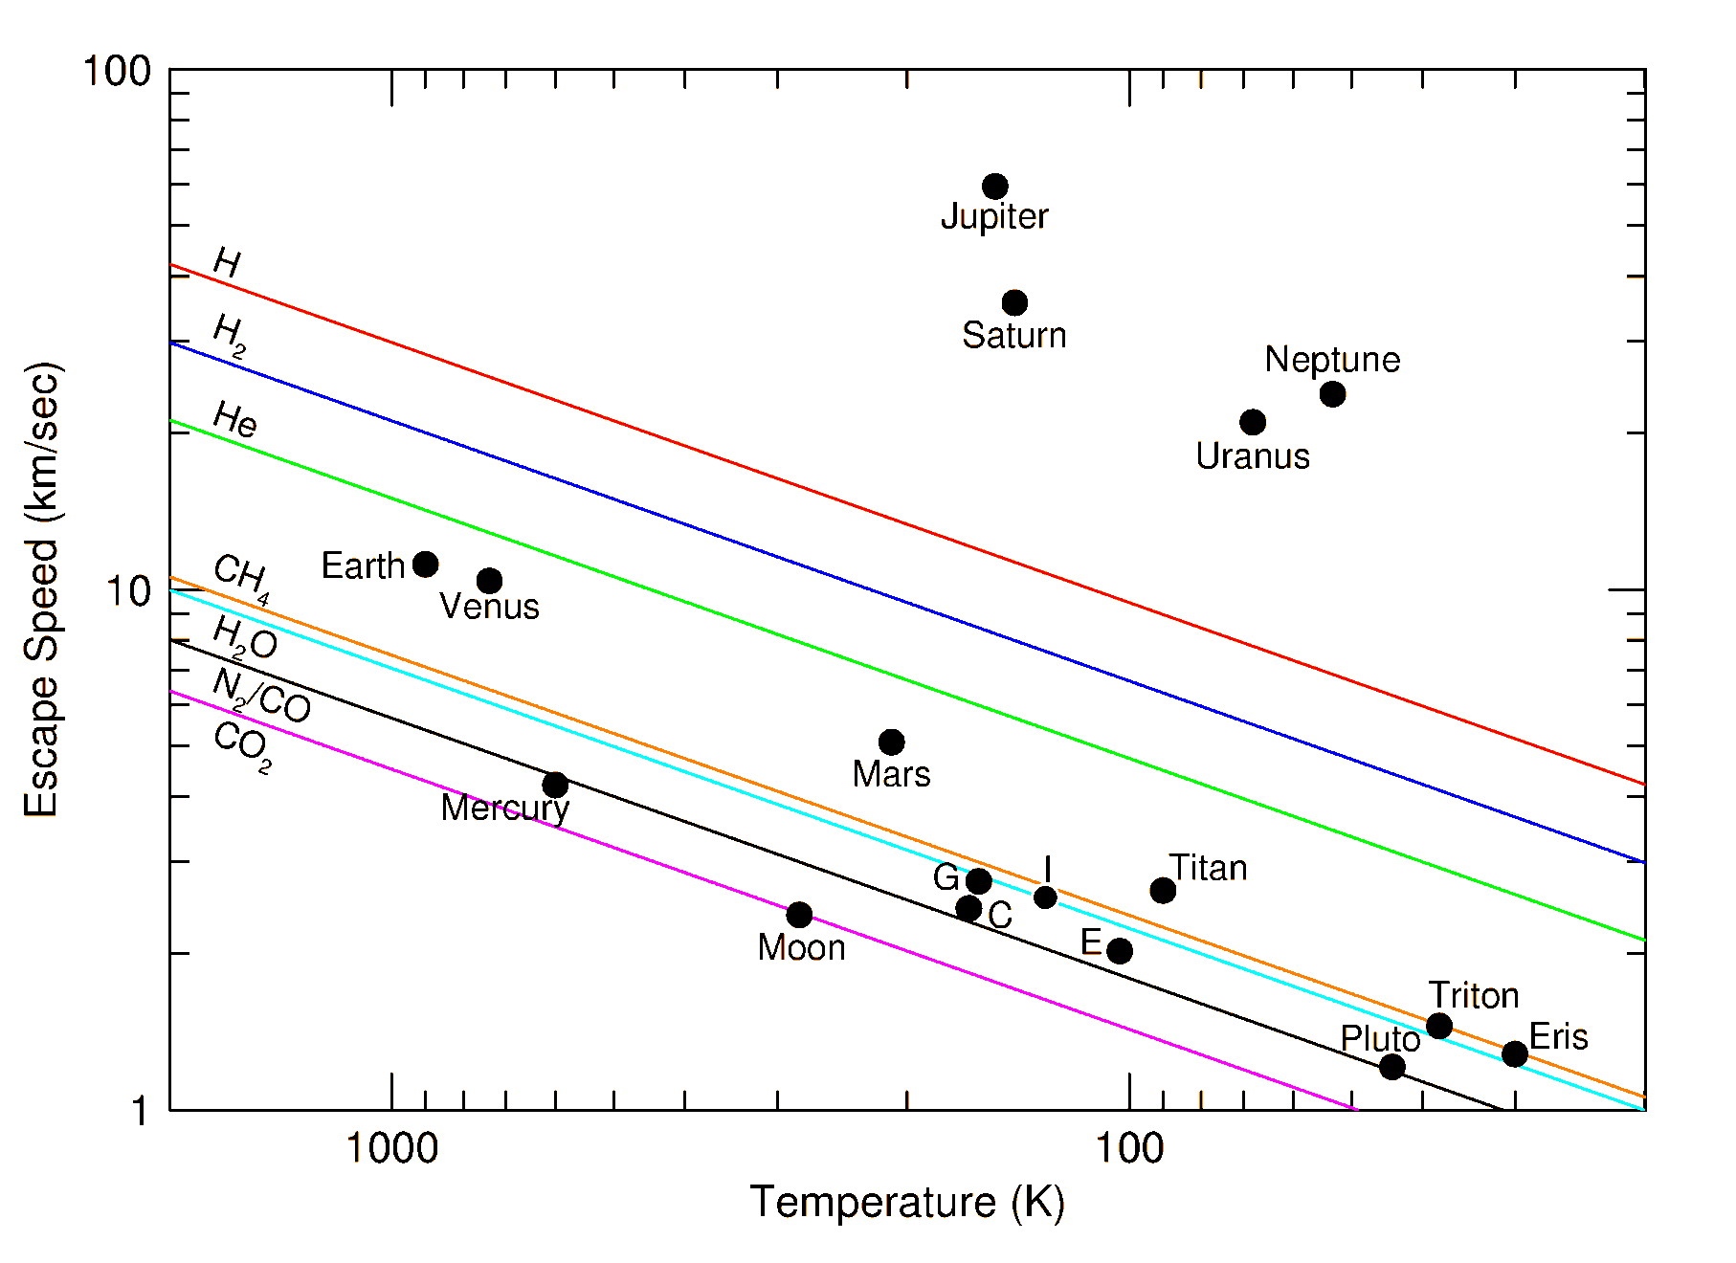
The ability of a planet to retain an atmosphere depends on its mass and its temperature.

Slide 17
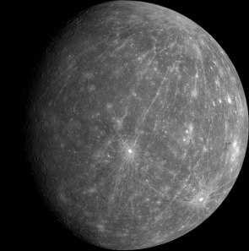
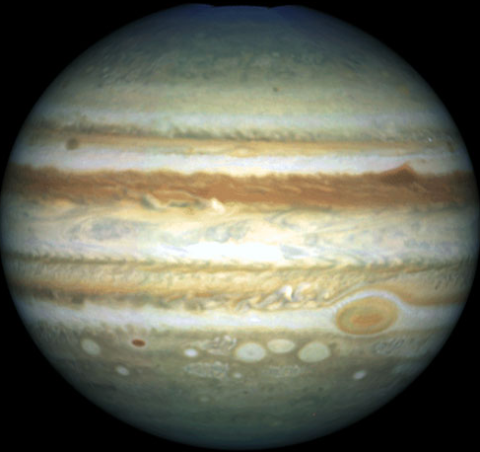
Another important factor in a body’s habitability is the size of the atmosphere it can retain.
If a planet is small and hot:
Gravity is too weak to hold onto an atmosphere (has to be very cold).
Mercury
If a planet is massive and cold:
Builds a heavy hydrogen-rich atmosphere.
Conditions are too hot and too high pressure
for stable liquid water.
Jupiter
Reducing chemistry instead of oxidizing chemistry.

Slide 18
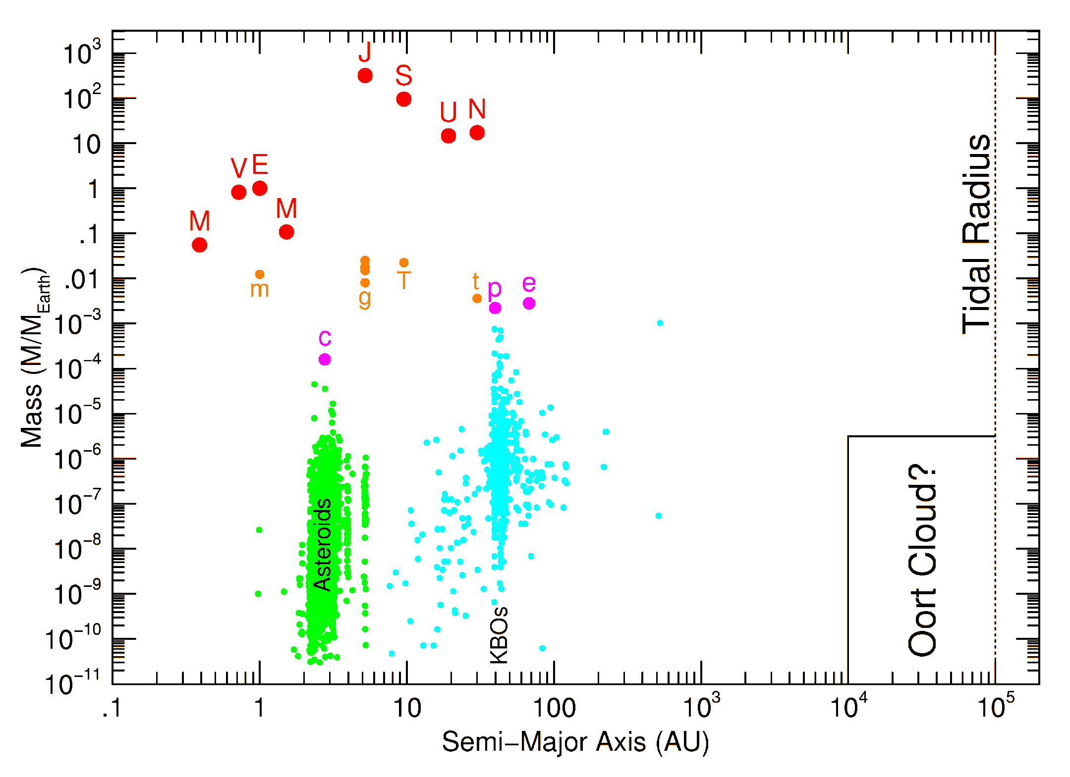
Liquid H₂O @ 1atm
Liquid CH₄ or Ethane @ 1atm
Too Big
Heavy Atmosphere
Cold Interior
Too Small
No Atmosphere

Slide 19
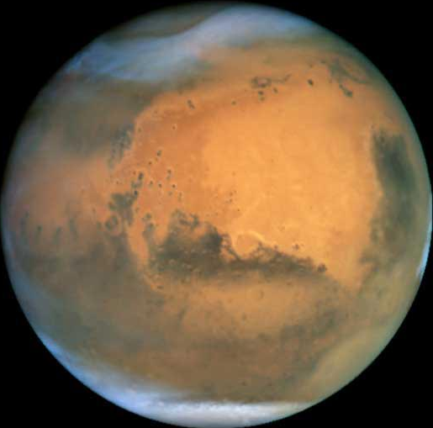
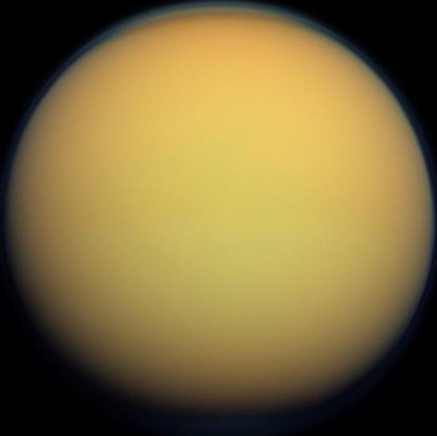
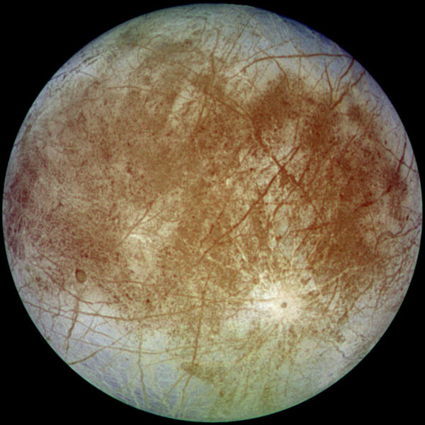
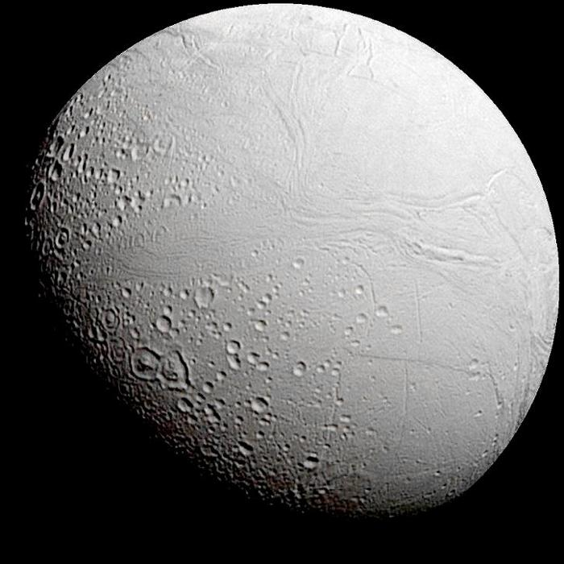
Where should we search for life in the Solar System?
Mars may have had surface liquid water & a thick, warm atmosphere in the distant past.
Titan (moon of Saturn) has a cold, thick N₂ atmosphere and lakes of methane & ethane.
Europa (moon of Jupiter) and Enceladus (moon of Saturn) may have liquid water under icy crusts.

