Slide 1
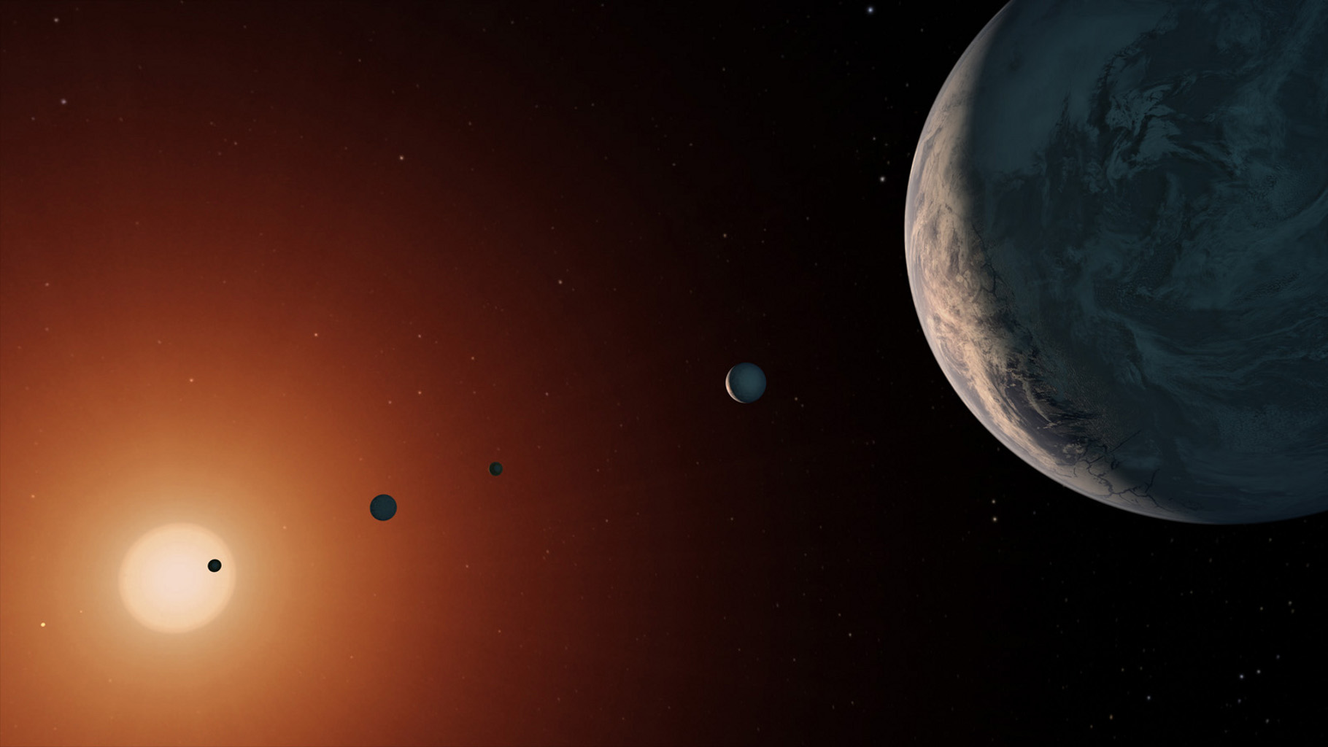
Strange New Worlds:
An Exoplanet Census
Astronomy 1141
NASA

Slide 2
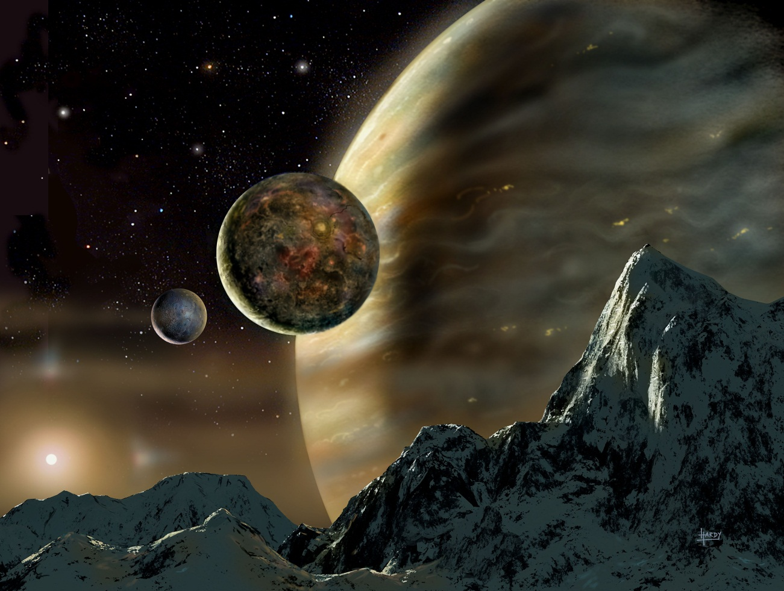
To date (2019), we have confirmed detections of 3926planets around 2925 stars.
About 2200 are single
planet detections.
Another 700 stars have
multi-planet systems
of 2 to 8 planets.
Most range in mass
from super-Jupiters to
super-Earths.
David A. Hardy
Astroart.org
The first few candidate Earth-mass (and smaller) planets are just now being identified...
Notes:
About 4000 unconfirmed candidates waiting confirmatory data, so ~7000 total potential planets.

Slide 3
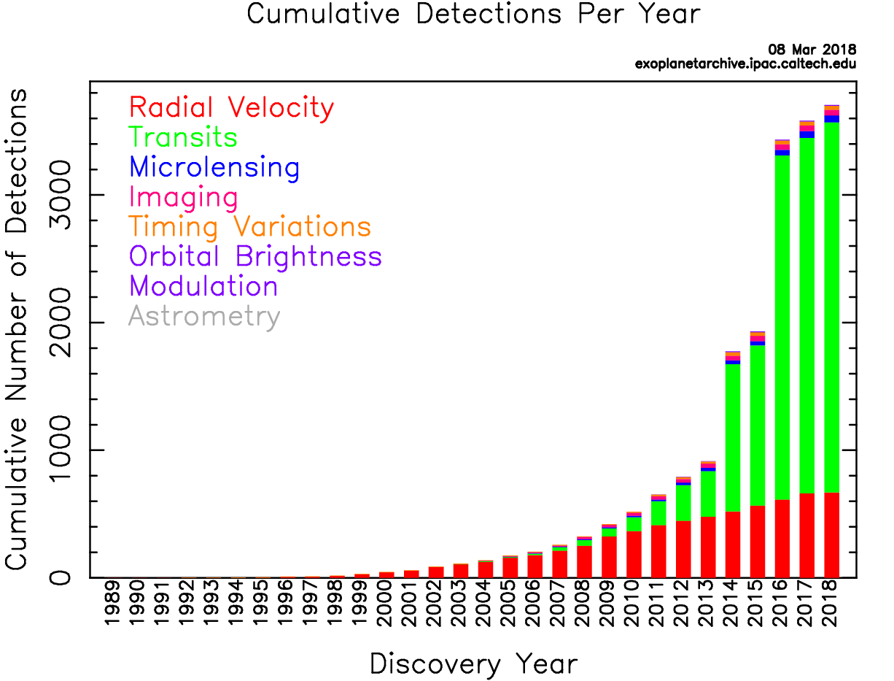
We are in the midst of an exoplanet discovery boom!

Slide 4
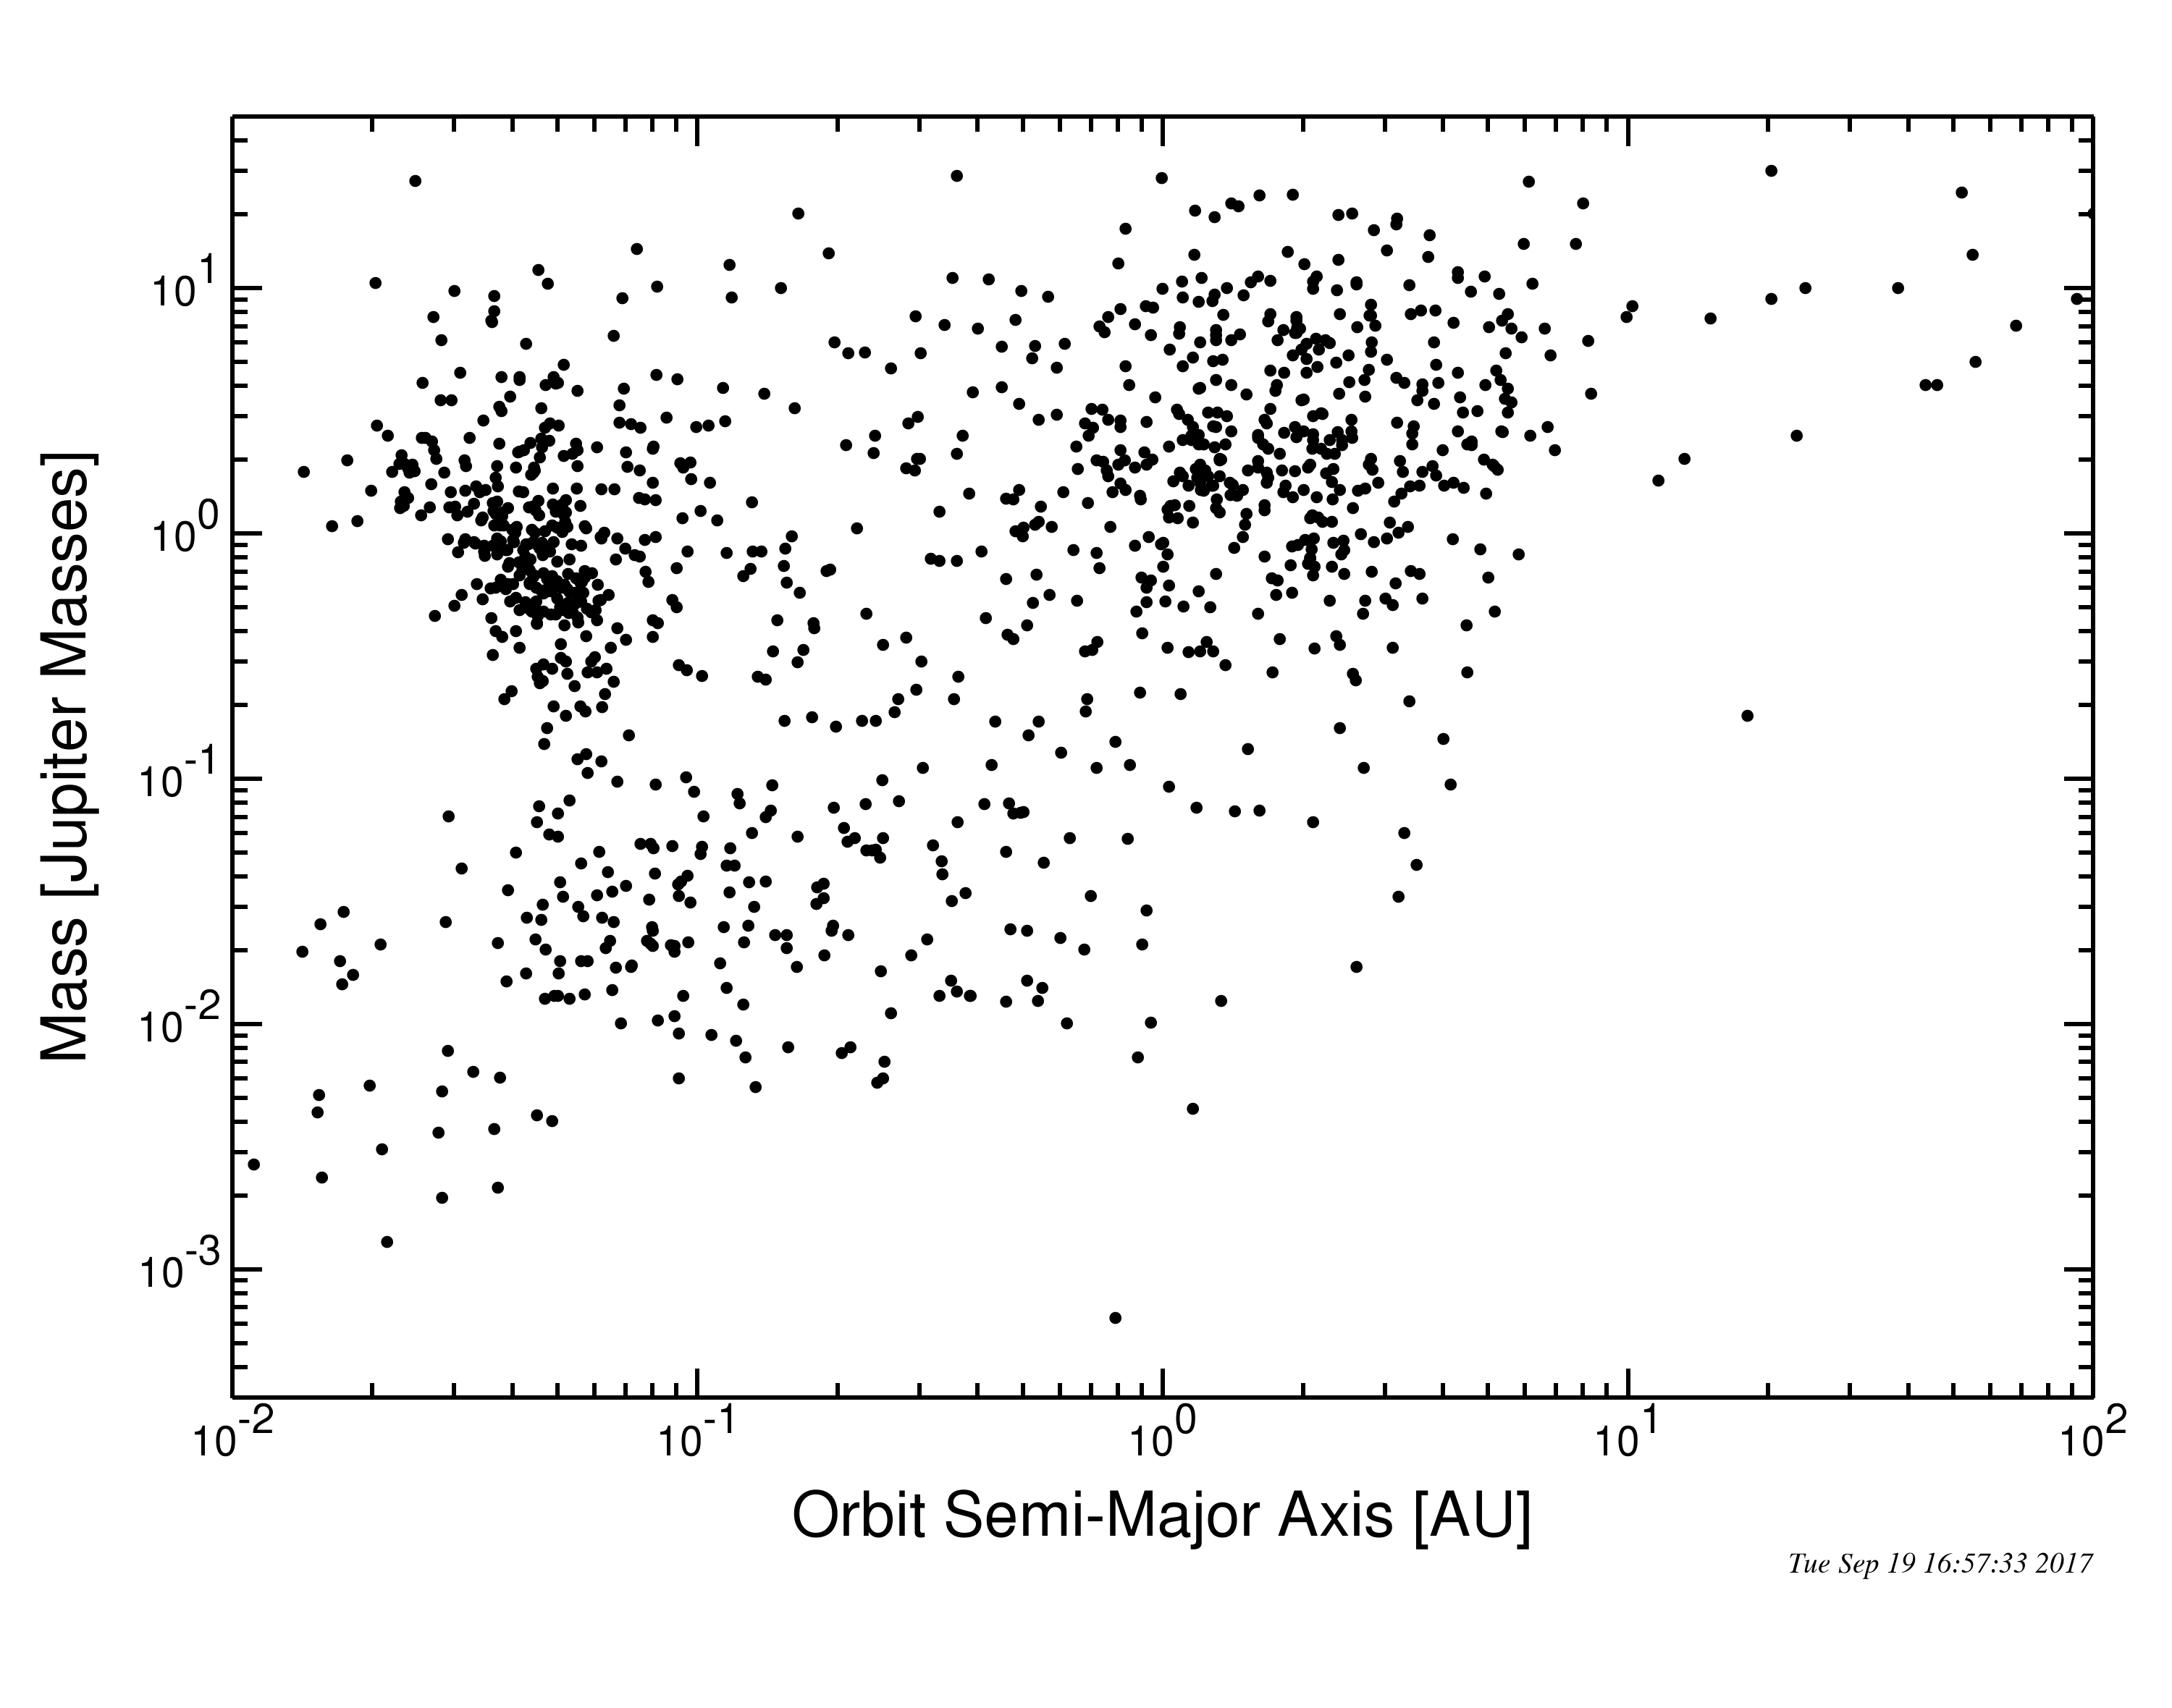
The properties of the known exoplanet systems show a great deal of diversity.
Hot Jupiters
J
S
Hot Neptunes
N
U
Super-Earths
V
E
M
exoplanetarchive.ipac.caltech.edu

Slide 5
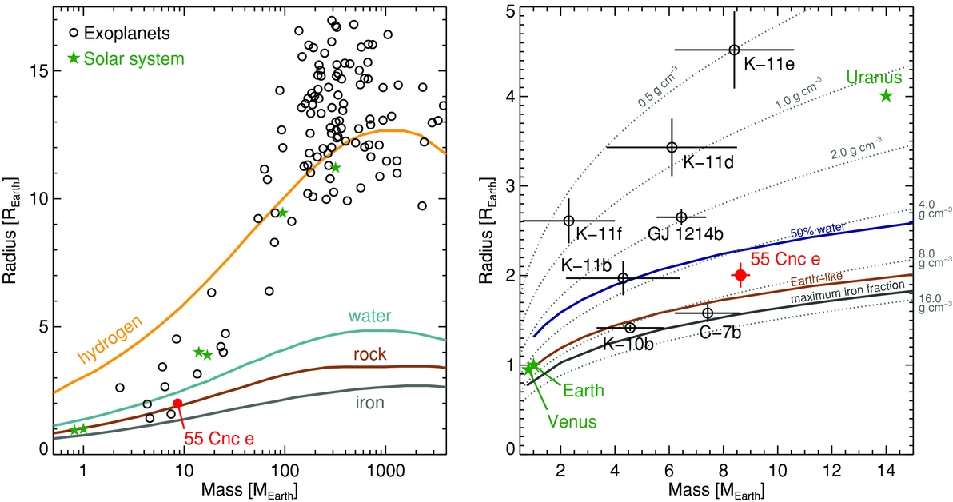
We see gas giants, ice giants, and rocky planets of
all sizes.
Gas Giants
Gas Planets
Ice Planets
Ice Giants
Rocky Planets
Winn et al. 2011, ApJ, 737, L18 Fig 3.

Slide 6
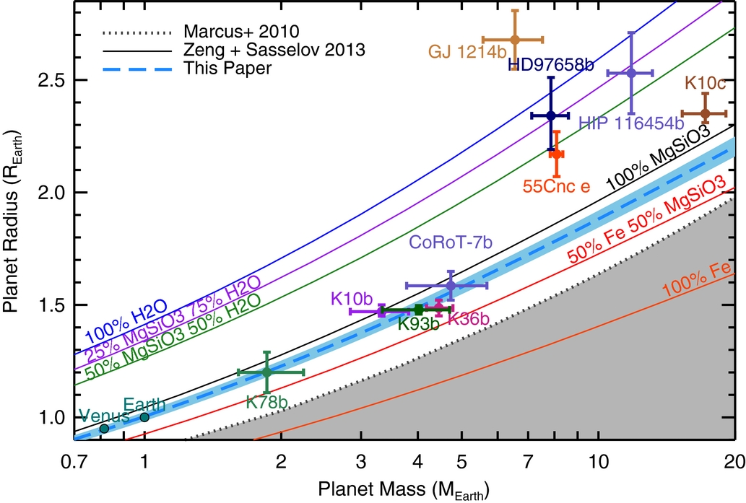
Rocky planets are now being found with a similar composition to Earth, if larger masses.
Figure 4 from The Mass of Kepler-93b and The Composition of Terrestrial Planets
Courtney D. Dressing et al. 2015 ApJ 800 135, doi:10.1088/0004-637X/800/2/135

Slide 7
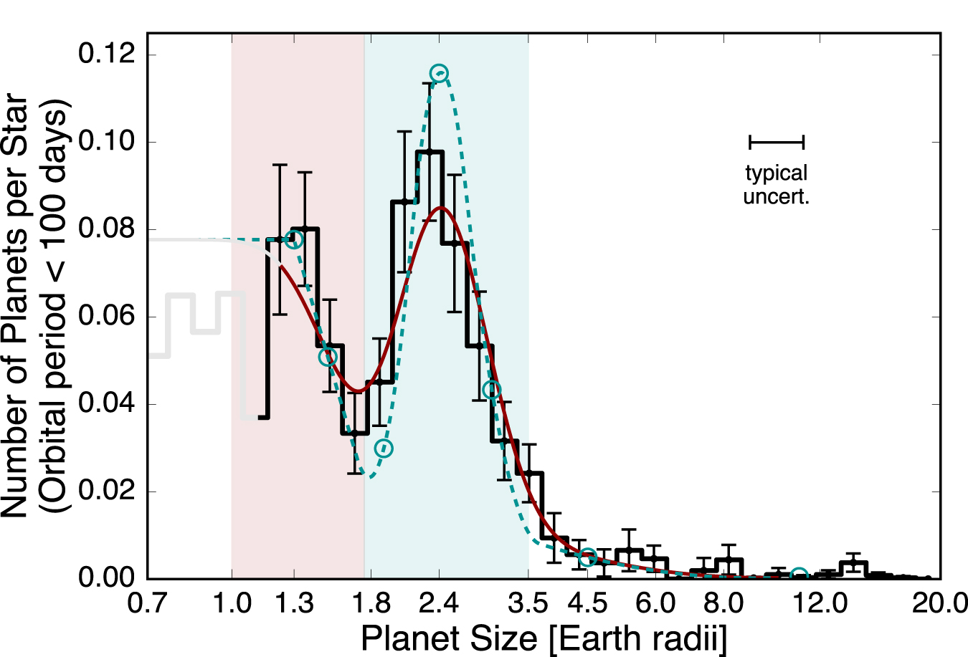
Close-in small planets are either Super-Earths or
Mini-Neptunes.
Super-
Earths
Mini-
Neptunes
Figure 7 from The California-Kepler Survey. III. A Gap in the Radius Distribution of Small Planets
Benjamin J. Fulton et al. 2017 AJ 154 109 doi:10.3847/1538-3881/aa80eb

Slide 8
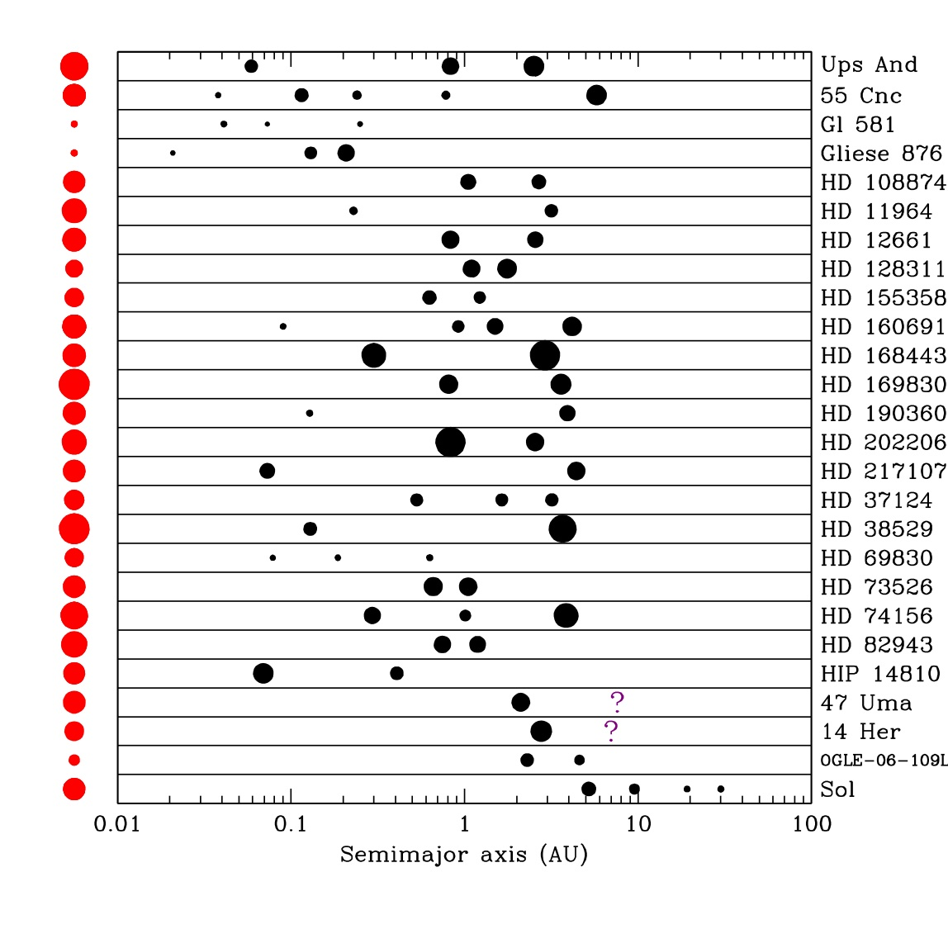
A selection of multi-planet systems
m
E
J
S
Solar System

Slide 9
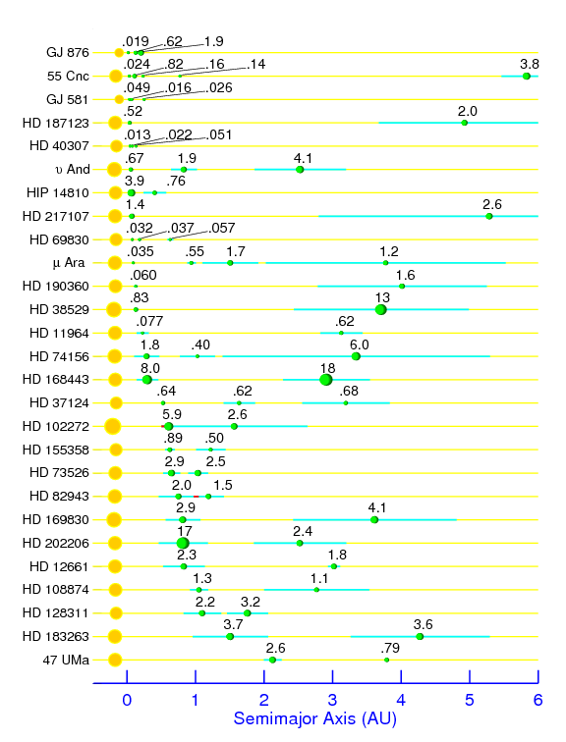
Surprise #1:
Many Gas and Ice Giants are within 5 AU of their parent stars!
Orbital Periods < 10 days
Closer than Mercury to their
parent stars.
Hot Jupiters & Hot Neptunes
Selection effect?
How does a giant gas/ice
planet get so close to its
parent star?
Notes:
Figure 1 from Wright, J.T. et al. 2009, ApJ, 693, 1084

Slide 10
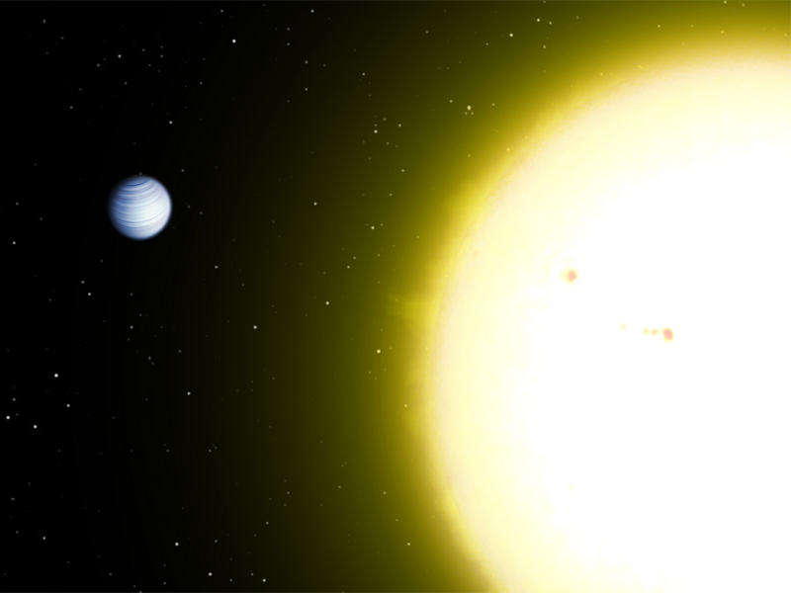
51 Pegasi b is only ~10 stellar radii
away from its parent star!
Wikimedia Commons

Slide 11
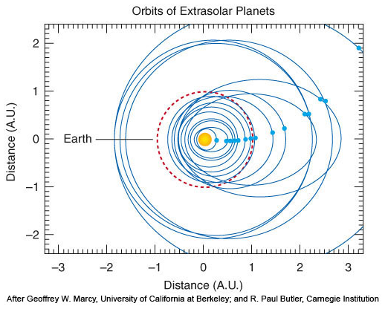
Surprise #2:
A large number of gas giants have very eccentric (elliptical) orbits!
In our Solar System the
Jovian & Terrestrial planet
orbits are nearly circular.
Among known exoplanets
very elliptical orbits are
common.
Some have orbits as elliptical as a comets!

Slide 12
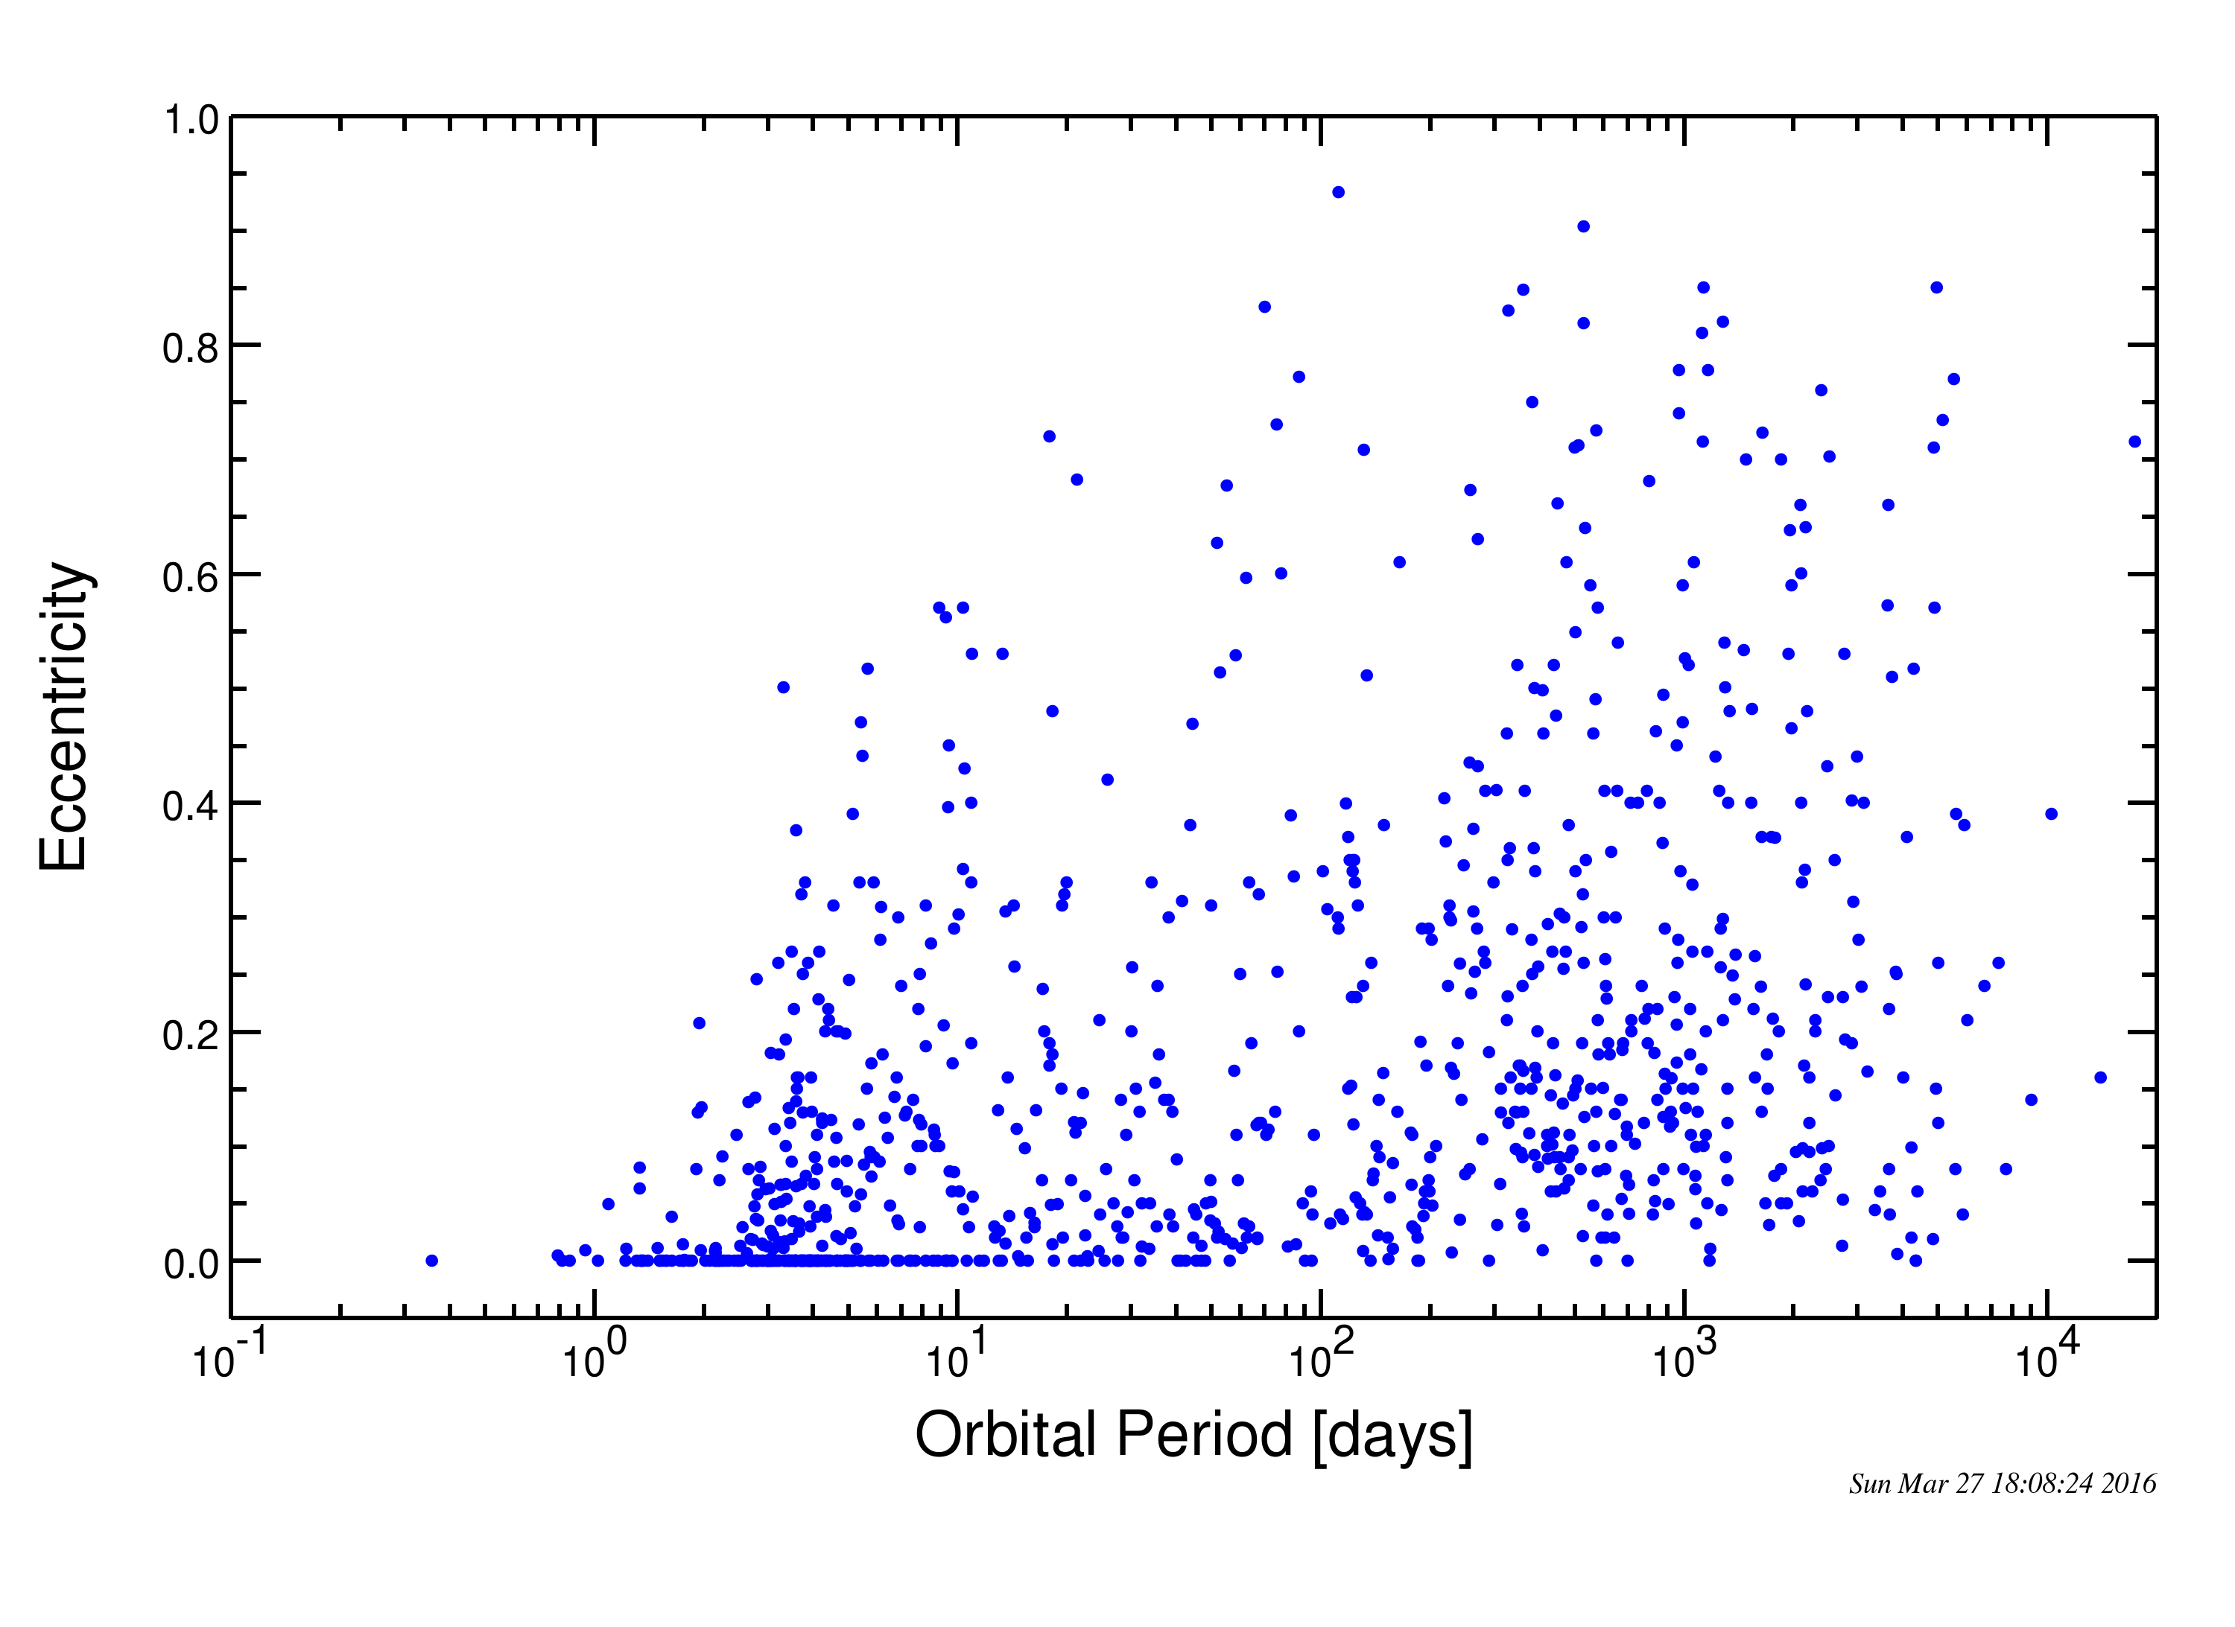
Orbit eccentricity vs. Orbit period
closest = 0.04 AU farthest = 2.72 AU
E
J
exoplanetarchive.ipac.caltech.edu

Slide 13
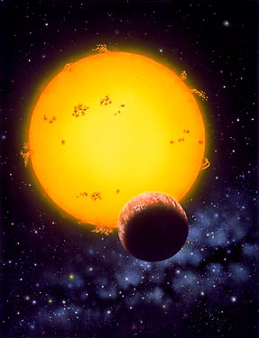
With a few exceptions, very few of the systems found so far resemble the Solar System.
The large orbit eccentricities
are very hard to explain.
The biggest surprise is
Jupiter-sized planets orbiting
close to their parent stars.
Most are deep inside the
“Snow Line” where Jupiter-sized
planets should not form.
What is going on?

Slide 14
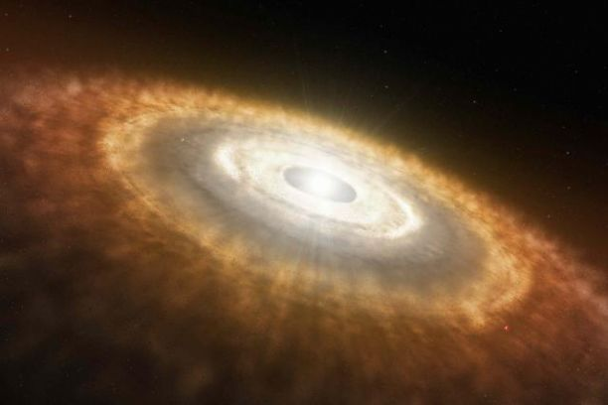
Did the gas planets formed far out, then migrate inwards by interacting with the protoplanetary disk?
UA/LPL

Slide 15
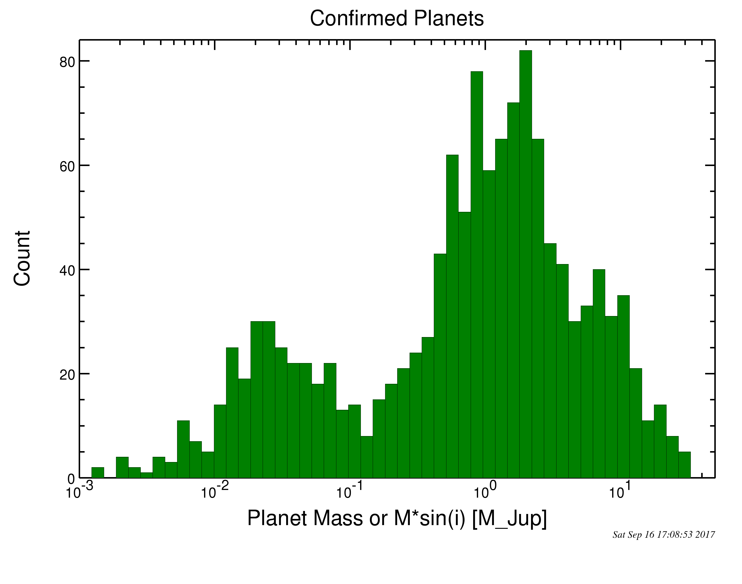
Current methods of exoplanet detection are only now
becoming sensitive to Earth-sized planets.
Jupiter
Radial Velocity methods
must become ~10x more
precise to detect Earths.
Saturn
Neptune
Earth
The Transit Method has
recently found the first
Earth-sized candidates.
Alternative techniques like gravitational microlensing are very promising, but a few years away from delivering.

Slide 16
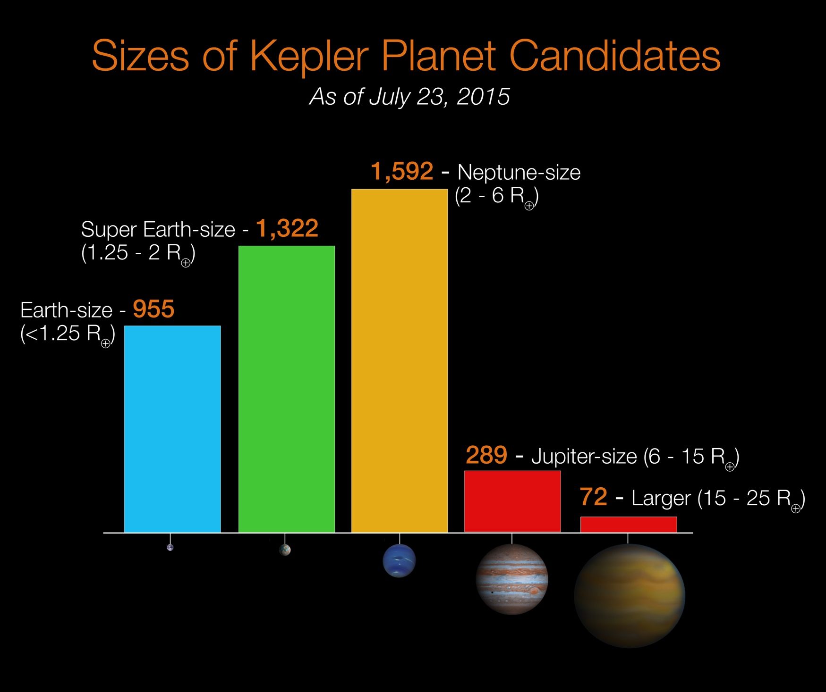
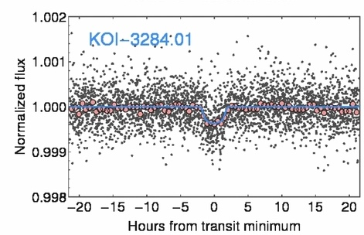
Kepler was sensitive enough to find Earth-radius
exoplanets.
NASA Ames/W. Stenzel
Most of these planets, however, are “hot Earths” that orbit very close to their parent stars, or super-Earths and mini-Neptunes.

Slide 17
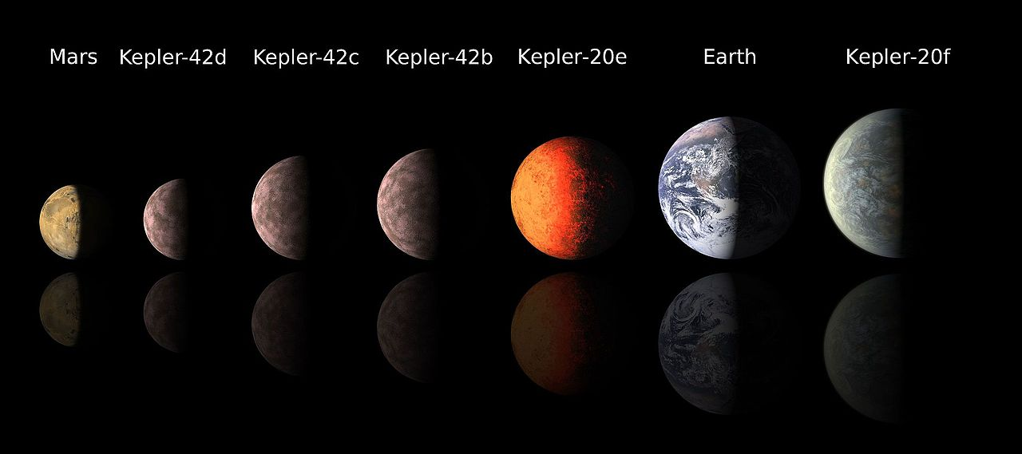
Kepler-20 System
5 planets, with 2 near-Earth-radius planets around a
Sun-like G star, all close-in “hot” planets.
NASA
Kepler 42 System
3 planets: Earth to near-Mars radius around a
red dwarf star, all close-in “hot” planets.

Slide 18
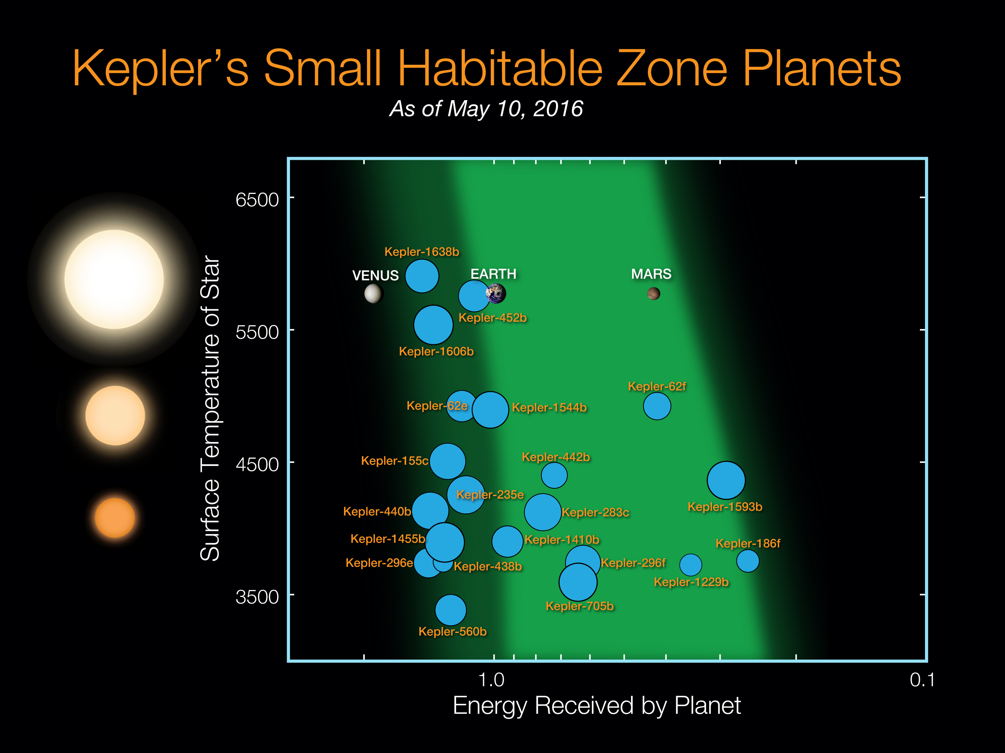

Slide 19
Best exo-Earth candidate system: TRAPPIST-1
Ultra-cool Red Dwarf, ~40 light years away
7 rocky planets close to their parent star

Slide 20
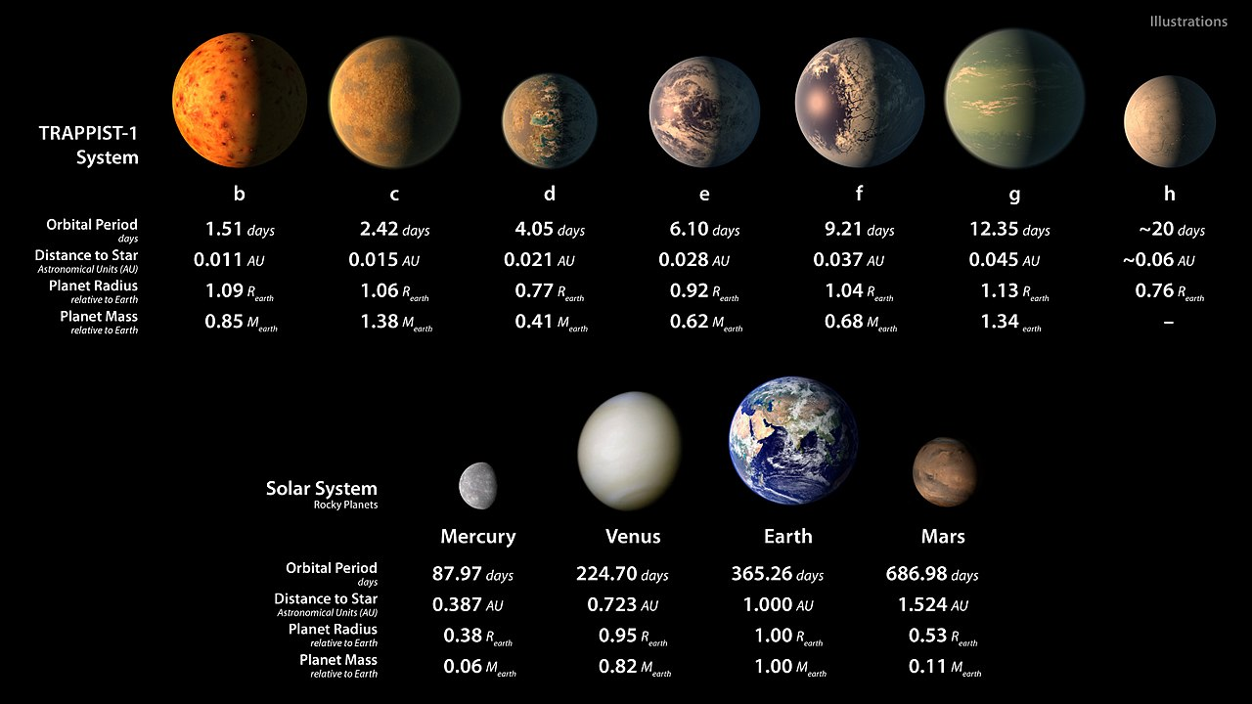
Best exo-Earth candidate system: TRAPPIST-1
Ultra-cool Red Dwarf, ~40 light years away
7 rocky planets: 0.76 to 1.13 R_{E}, 0.4 to 1.38 M_{E}?

Slide 21
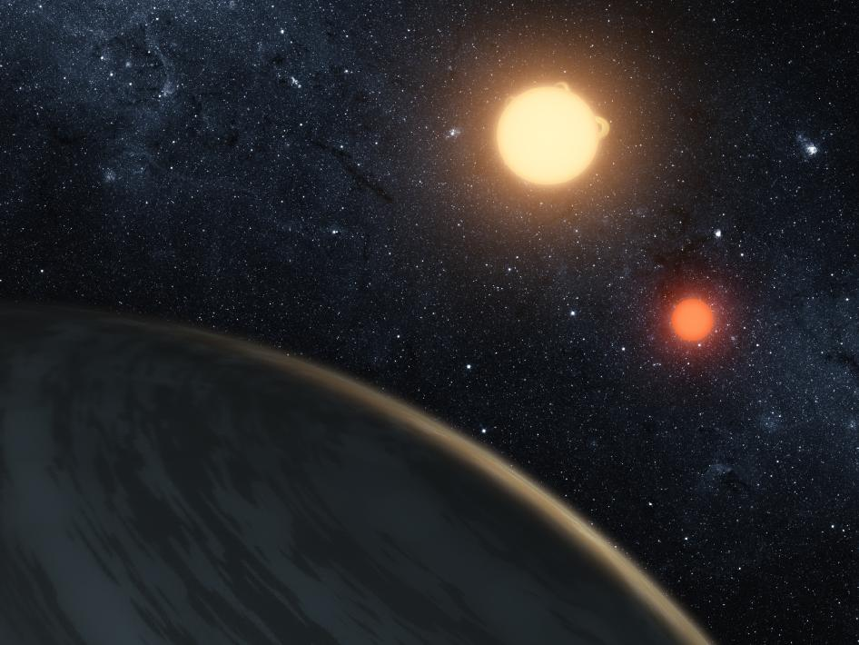
Kepler 16:
0.3M_{J} planet orbiting
a binary star system.
NASA

Slide 22
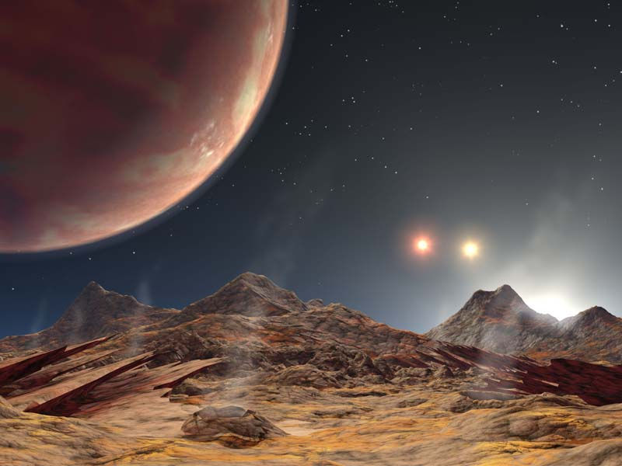
KELT-4Ab – a puffy hot
Jupiter orbiting a triple
star system.
Eastman et al. 2016, AJ, 151, 45 (NASA/JPL graphic)

Slide 23
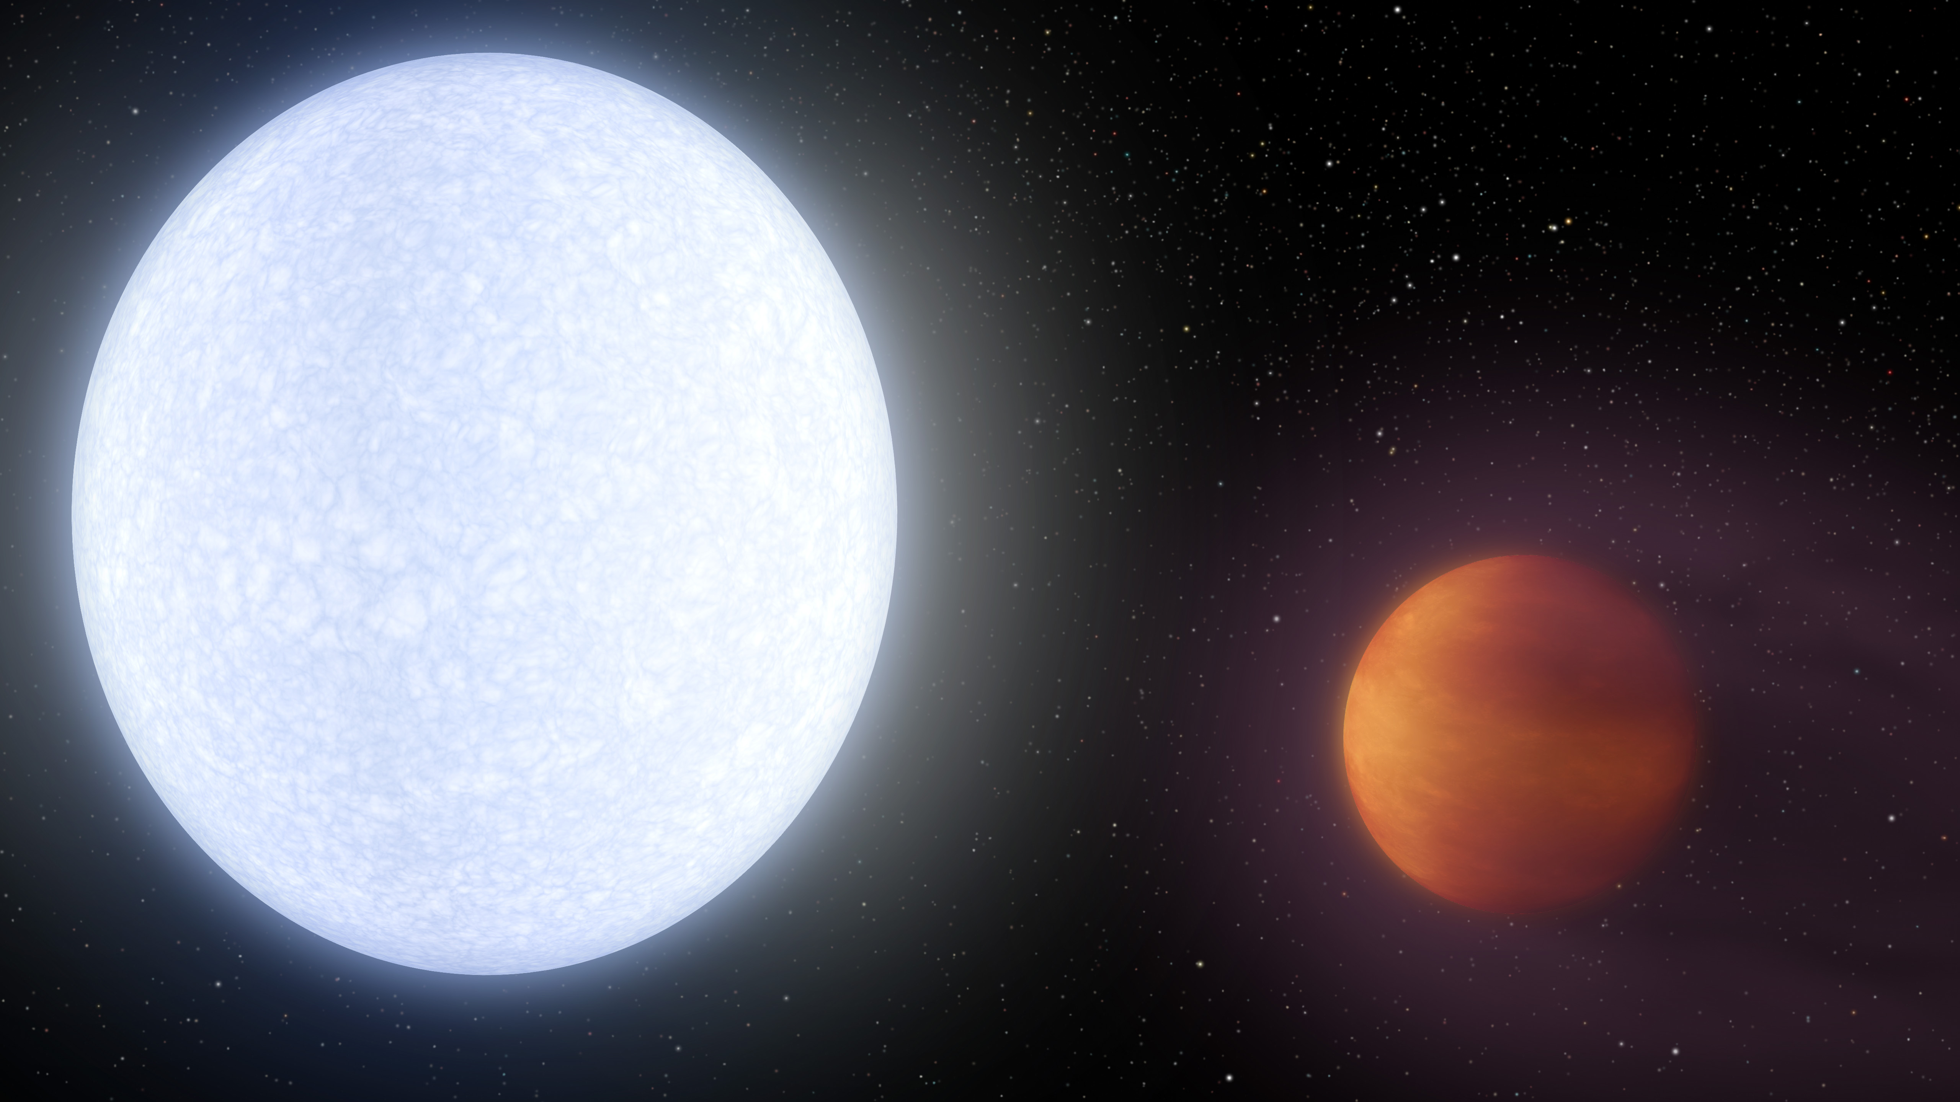
KELT-9b: the hottest exoplanet known
2.8 Jupiter-masses, temperature is 7800℉ (star-like)!
Discovered in 2014 by a joint OSU/Vanderbilt team

Slide 24
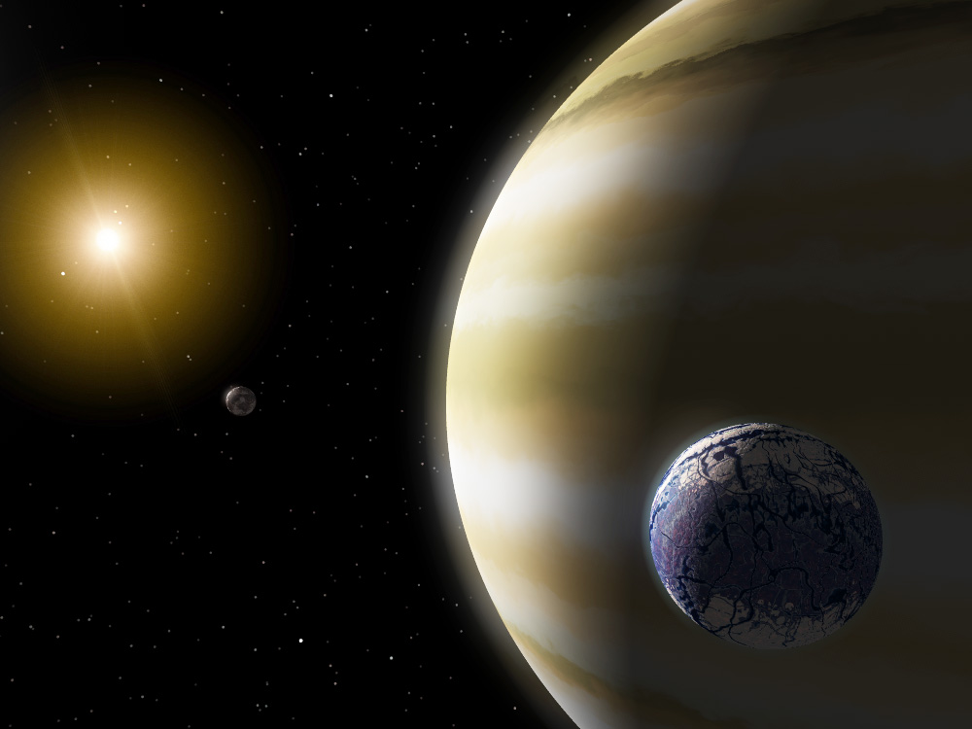
The hunt is on for Earth-like planets in the habitable zones of their parent stars…
The search for other planetary systems continues using many
complementary methods.
We want to find more systems
like our own…are we unusual?
How common are planets?
NASA/JPL
The ultimate goal is to find other Earth’s capable of
harboring life…

