Slide 1
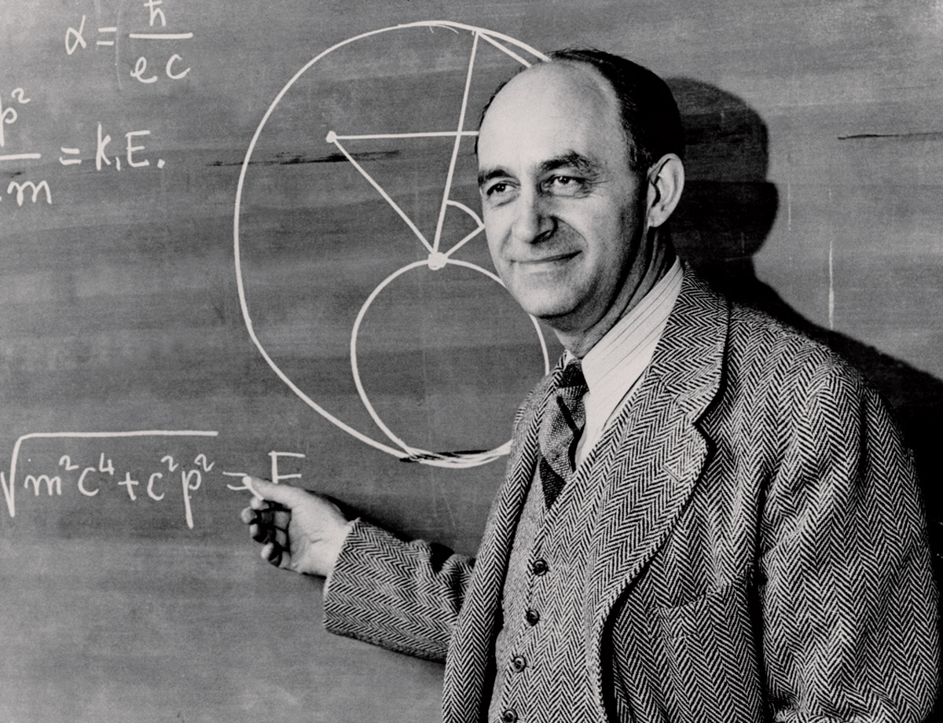
“Where are they?”
The Fermi Paradox
Astronomy 1141

Slide 2
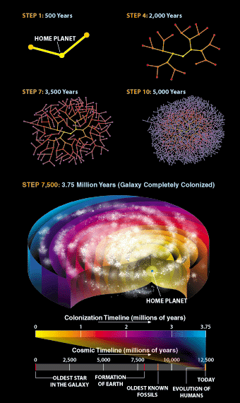
Colonization is a rapid,
exponential process.
Start by colonizing two stars.
After 1 generation, each colony sends out 2 expeditions:
N=2 x 2 = 2² = 4 colonies
The 2nd generation then sends out 2 expeditions each:
  N=2 x 2 x 2 = 2³ = 8 colonies
After 10 generations:
  N= 2¹⁰ = 1024 colonies
After 20 generations:
  N= 2²⁰ ~ 1 million colonies
Notes:
Picture credit: Ian Crawford, Where are They?, Scientific American 283, 38 - 43 (2000) doi:10.1038/scientificamerican0700-38
An exponential process is one in which the rate of change of a parameter is proportional to the parameter itself.

Slide 3
Colonization of our galaxy can occur rapidly once you achieve near light-speed star flight.
Ships that travel at 10% c take ~50 years
to reach the nearest star system.
Wait ~450 years to launch the next ships.
The frontier of the inhabited region grows at ~1% the speed of light!
Unchecked, an entire galaxy could be
colonized in about 10 million years!
NASA

Slide 4
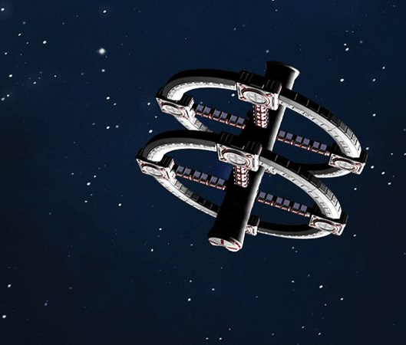
Colonization can occur rapidly even using relatively slow (non-relativitistic) starships.
Build generation ships (“arks”)
that travel at 1% c.
It would take 500 years to get
to the nearest star systems.
Wait about 4500 years then
dispatch another pair of arks.
The inhabited frontier would grow at 0.1% the speed of light.
Even this relatively slow star-faring civilization could colonize an entire galaxy in 100 million years.
Notes:
For a thoughtful take on generation ships and their challenges, see Kim Stanley Robinson, Aurora (2015)

Slide 5
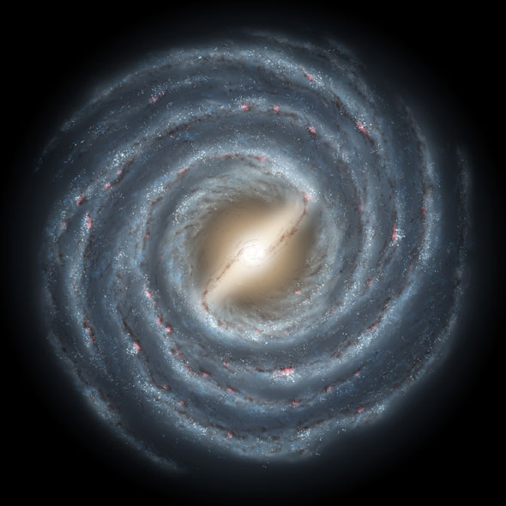
Even if the colonized region expanded at the leisurely rate of 0.0001c, it would take only 1 billion years to colonize our entire galaxy.
Our galaxy is about
10 billion years old.
More than enough time to have been colonized many times over.

Slide 6

Given plausible assumptions, colonization times are shorter than the age of our galaxy (10 billion years).
The exponential growth of
colonized regions is in conflict with the static assumptions of the Drake Equation.
If colonization does happen, the
Drake Equation dramatically
underestimates the number of possible inhabited systems.
“So? Where is everybody?”

Slide 7
The Fermi Paradox is a statement about the rapidity of colonization, not about how often civilizations arise.
Galaxies are ~10 billion years old.
A long-lived, star-faring civilization could colonize an entire galaxy 100s or 1000s of times over.
But, it only has to happen once or twice.
Ian Crawford, 2000, SciAm, 283, 38
The paradox is why this hasn’t happened already.
Notes:
The paradox is a conflict between the large numerical scale and probability favoring the existence of
advanced civilizations and the rapidity of colonization on the one hand, and the lack of any substantive
evidence of advanced civilizations on the other.
Figure Source: Ian Crawford, Where are They?, Scientific American 283, 38 - 43 (2000) doi:10.1038/scientificamerican0700-38

Slide 8
If life and intelligence are very rare, but civilizations are long-lived, you should get at least a few…
The Drake Equation:
Number over the age of the Galaxy:
2 x (10 Gyr/5 Gyr) = 4 civilizations

Slide 9
Even if life & intelligence are common, but civilizations are short-lived, there could be a very large number:
The Drake Equation:
Number over the age of the Galaxy:
64 x (10 Gyr/200yr) = 3.2 billion civilizations
Notes:
200 years = 100 years to develop radio & spaceflight technologies, live only 100 years after that (pick your favorite doomsday).

Slide 10
Three basic types of solutions have been proposed to
resolve the Fermi Paradox:
1) Advanced civilizations are very rare.
There is at most one per galaxy (and we’re it).
2) Civilizations are common, but they have not
colonized the galaxy.
3) Civilizations have colonized the galaxy, but we
remain unaware of them.

Slide 11
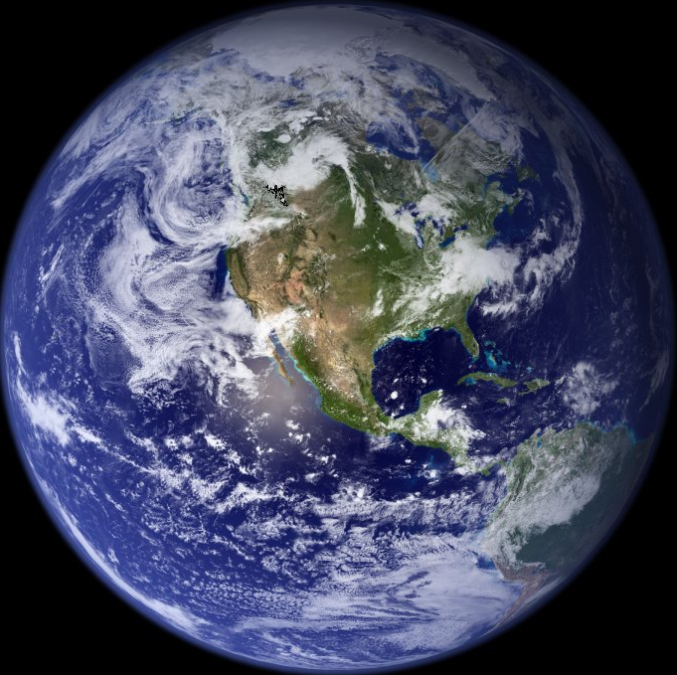
1a) Advanced civilizations are very rare because…
they seldom develop.
The Rare Earth Hypothesis
Perhaps we result from a series of
unlikely circumstances:
We live inside a narrow “galactic habitable zone”.
We orbit around the right kind of star.
NASA
Earth has a moon that stabilizes its rotation…
Implication: we are the only intelligent species in our galaxy.
Notes:
Galactic Habitability:
Away from X-rays and Gamma-rays from a central AGN?
Outer galaxy has less iron, silicon, & oxygen to make terrestrial planets?
Regions of recent star formation have sterilizing supernovae?
Need the right kinds of planets/moons to make Earth habitable for geological timescales
The most thorough recent version is by Peter Ward & Donald Brownlee, Rare Earth: Why Complex Life is Rare in the Universe (2000)
“Galactic Habitable Zone” idea is due to Guillermo Gonzalez, The Privileged Planet (2004), which is an extended riff on intelligent design.

Slide 12

1b) Advanced civilizations are very rare because…
they destroy themselves.
The Doomsday Hypothesis
Advanced technology is dangerous, because of deliberate aggression & inadvertent mistakes.
Nuclear war
Biological war
Environmental catastrophe
Nanotechnology catastrophe
Zombie apocalypse
DOE

Slide 13
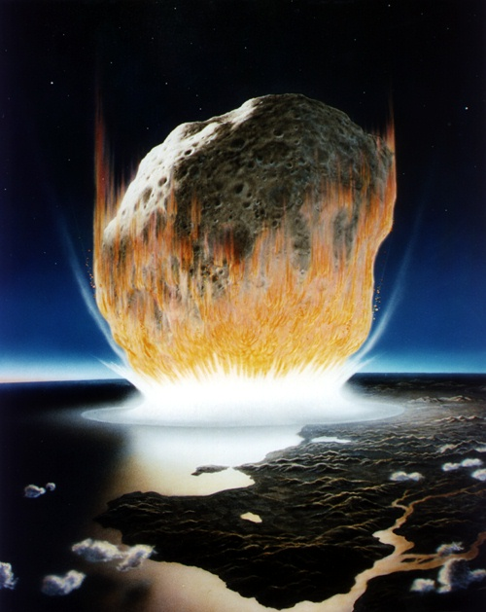
1c) Advanced civilizations are very rare because…
Natural disasters destroys them.
Inhospitable Universe Hypothesis
Earth’s geological past records
multiple mass extinction events.
Perhaps Earth life has survived
them by good luck.
Asteroid or Comet Impacts.
Supervolcanism (Deccan Flood)
Deep ice age (Snowball Earth).
Supernova or Gamma-Ray Burst sterilizes the planet.
NASA

Slide 14

2a) Civilizations have not colonized the galaxy
because… it is too difficult.
Sending generation ships (‘arks’) between the stars is an enormous investment of resources.
However, sending robotic probes is a lot cheaper.
Why haven’t we encountered alien robotic probes?
Aurora, Kim Stanley Robinson (2015)

Slide 15
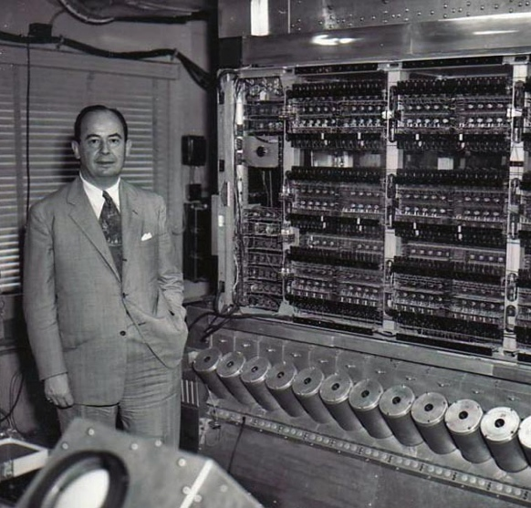
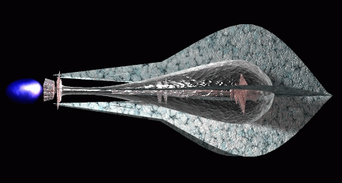
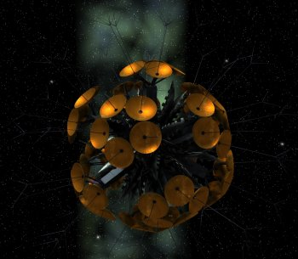
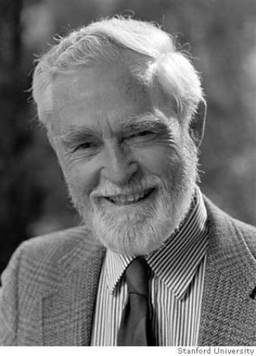
1948:
John von Neumann proposed making
self-replicating machines (robots
programmed to copy themselves).
Von Neumann Machines
David Darling
1960:
Ronald Bracewell proposed sending out
space probes with artificial intelligence
to meet with extraterrestrials.
Bracewell Messenger Probes
Notes:
Bracewell Probes in Fiction:
Gregory Benford, The Ocean of Night (1977)
Arthur C. Clarke, The Fountains of Paradise (1979)
David Brin, Existence (2012)
For a decidedly genocidal variation, see Fred Saberhagen, Berserker (1967)

Slide 16
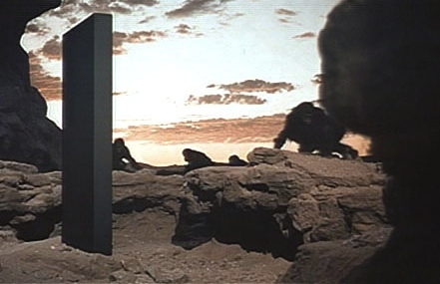
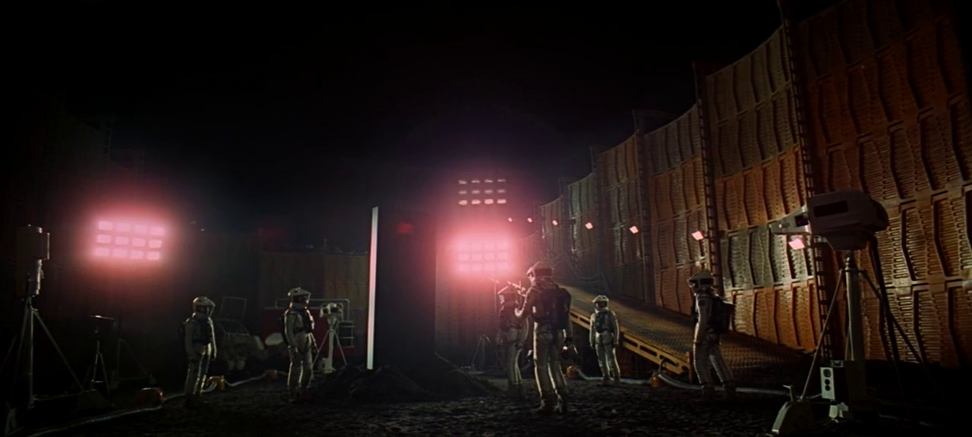
Bracewell probes can engage in a dialogue with the inhabitants of a planetary system.
2001: A Space Odyssey (1968)
[MGM]
Bracewell probes can be hidden in places inaccessible until
the locals develop sufficiently advanced technology.

Slide 17
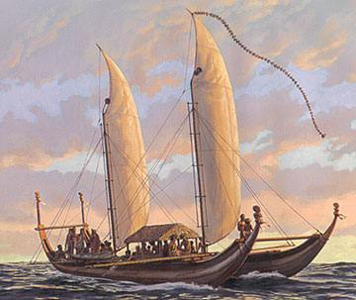

2b) Civilizations have not colonized the galaxy
because… they don’t want to.
No precedent in human history
for whole peoples staying in
one place.
While individuals and some
communities adopt monastic
lifestyles, would an entire
species do this?
A counterargument:
We are young. Is exploration a “phase” that
an advanced species eventually grows out of?

Slide 18
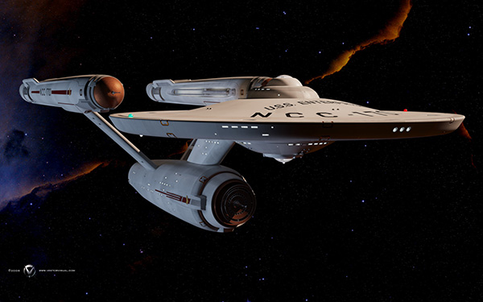
3a) Civilizations have colonized the galaxy, but…
they aren’t telling us.
Zoo Hypothesis:
Earth is protected from dangerous
outside contact until we are ready.
“Prime Directive” Hypothesis:
Ethics of contact with less
advanced civilizations.
Paramount Pictures
Many examples of “fatal impacts” between peoples in human
history, even when well-intentioned.
Notes:
Olaf Stapeldon, Star Maker (1937)
Arthur C. Clarke, Childhood’s End (1953), The Sentinel (1950) and 2001: A Space Odyssey (1968)

Slide 19
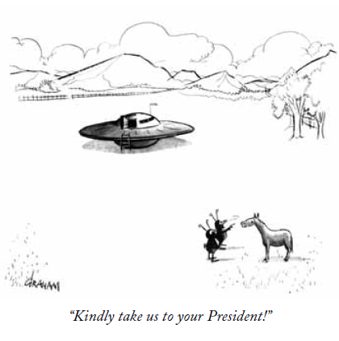
3b) Civilizations have colonized the galaxy, but…
the government is covering it up.
Fuzzy photographs and anecdotal accounts are not strong proof.
Claims of government conspiracy
to hide definitive evidence.
Congress can’t pass a budget
much less keep secrets for years…
A.S. Graham, New Yorker, 1953
There are unexplained sightings, but failure to explain them
does not justify wild leaps of the imagination.

Slide 20

3c) Civilizations have colonized the galaxy, but…
we haven’t noticed yet.
Perhaps aliens live among us, covertly monitoring our culture.
Maybe they’ve been guiding
our cultural evolution all along.
Perhaps aliens use a form of communication that we haven’t developed yet...
This makes our radio and microwave eavesdropping useless.
Notes:
Example: Arthur C. Clarke, Childhood’s End (1953).

Slide 21
3d) Civilizations have colonized the galaxy, but…
variations on a theme:
The Late-to-the-Party Hypothesis:
Earth was visited in the distant past long before humans.
(Earth’s history is 99.95% human free).
The Low-Rent Hypothesis:
Our part of the galaxy is out of the way and boring
and not worth the resources to visit.
The Predator Hypothesis:
There are a few nasty predator civilizations in the galaxy,
and sensible civilizations keep a low profile.
Notes:
The predator hypothesis is a popular theme of science fiction:
Greg Bear, The Forge of God (1987)
David Weber’s Safehold series (2007-present)
Cixin Liu’s The Dark Forest (2008), part of his Remembrance of Earth’s Past trilogy

Slide 22

A recent variation of the predator hypothesis is called the “Dark Forest Hypothesis”.
Inspired by the title of the 2nd novel in
Liu Cixin’s (劉慈欣) Remembrance of
Earth’s Past trilogy.
That there is a Fermi Paradox is a sign
that we should avoid making contact
with other civilizations.
Civilizations that speak up risk fatal
problems after first contact.
It is too dangerous to transmit, so
everyone is just listening silently.
Notes:
Often incorrectly called the “Three-Body Problem Trilogy” after the first award-winning novel in the trilogy.
Author’s name is pronounced “lee-oo tsi-sheen”
That everyone is listening but nobody is transmitting is sometimes called the “SETI Paradox”

Slide 23
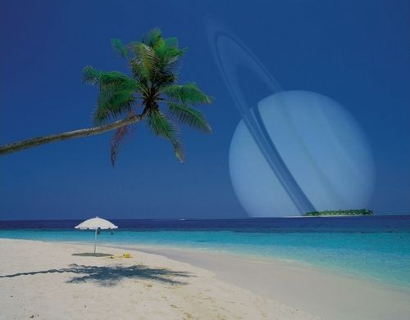
A proposed alternative to the Fermi Paradox is called “The Great Silence”.
Advanced civilizations may
rise and fall, but are so rare
the chances of two or more
sharing the galaxy at the
same time are very small.
user.astro.columbia.edu/~astrobio/ProjectsII.html
Alternatively, some have suggested the Great Silence is a
respectful silence kept by older species to not disturb those
younger species just emerging into maturity.
Notes:
See G. David Brin, 1983, QJRAS, 24, 238 [adsabs.harvard.edu/abs/1983QJRAS..24..283B]

