Slide 1
Age and Time
How old are we?
Astronomical Time, Geological Time,
Dynamic Time (climate)
The Universe began with the Big Bang
13.8 Gyrs ago
The Solar System is 4.57 Gyrs old
Dynamic variations, such as climate change
(global warming), occurs at hundreds
to thousands of years,
Weather patterns change seasonally and
even daily

Slide 2
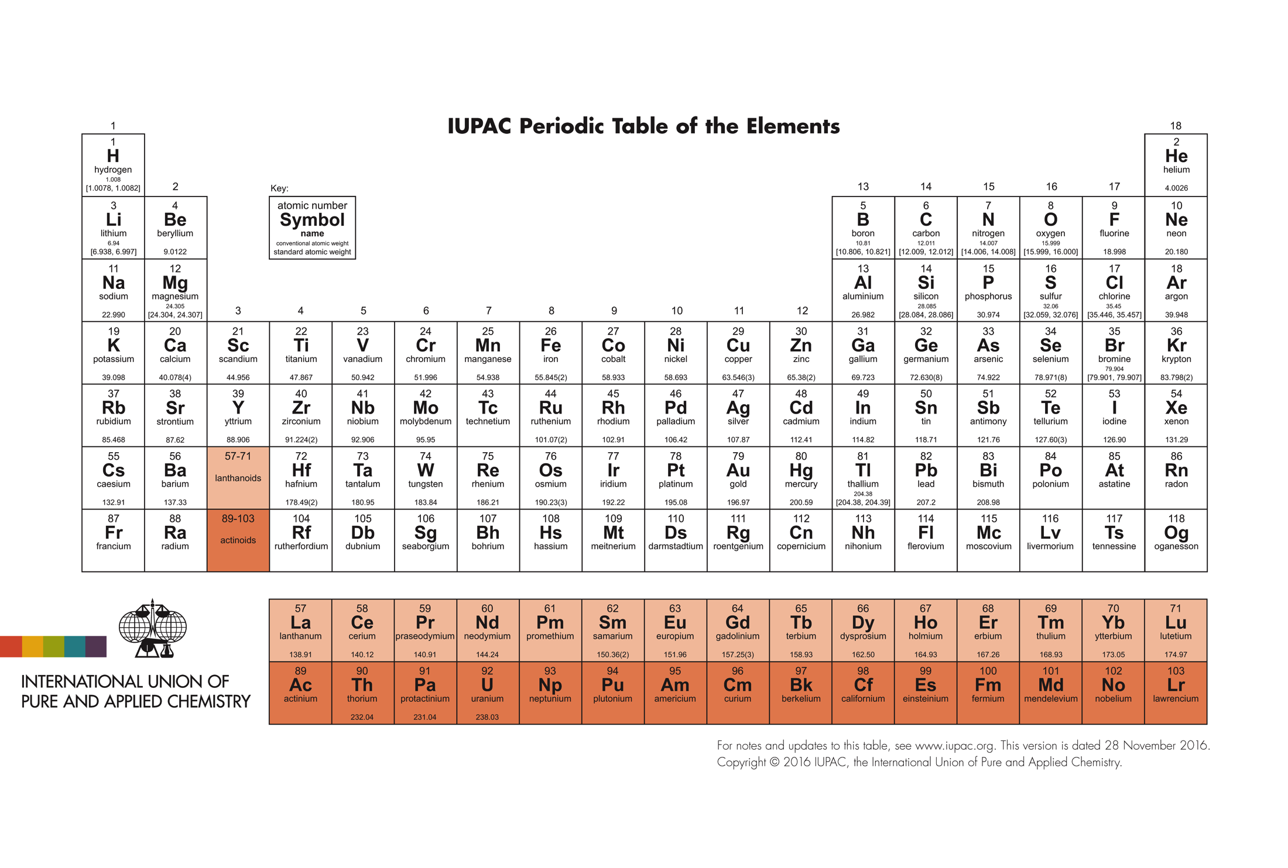
Matter & Energy
Astronomy 1141

Slide 3
Matter and Energy
Atoms are made of protons, neutrons, &
electrons: atoms can bond together to form
molecules.
Energy cannot be created or destroyed;
it can only change form.

Slide 4






An atom, as now defined, has a nucleus of protons & neutrons, surrounded by a cloud of electrons.
Elements are defined by the number of protons in the nucleus.
Number of protons = Atomic Number of the element:
  1 proton = Hydrogen
Proton
  2 protons = Helium
Neutron
  3 protons = Lithium ... and so on
Notes:
Count of proton, most void for most macro-object because of EM force

Slide 5
The eight most abundant elements in the universe:
Hydrogen
Helium
Oxygen
Carbon
Neon
Nitrogen
Silicon
Iron (Fe)
The main elements of life on Earth are C, H, O, & N.
The Earth itself is mostly composed of Fe, O, & Si.

Slide 6
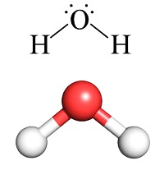
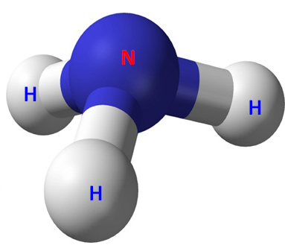
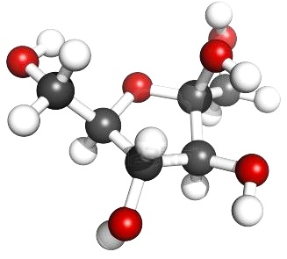
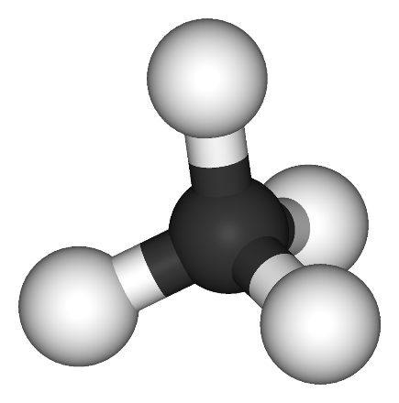
Most atoms (except helium or neon) join together to form molecules.
water
(H₂O)
ammonia
(NH₃)
Organic molecules, by definition, are molecules that contain carbon.
methane
(CH₄)
fructose (C₆H₁₂O₆)

Slide 7
The best method for measuring the ages of rocks is to use radiometric dating
Photon
(energy)
Radioactive
Atom
Alpha
Particle
Some atomic nuclei are unstable.
They undergo radioactive decay, emitting particles to become a smaller, stable nucleus.

Slide 8
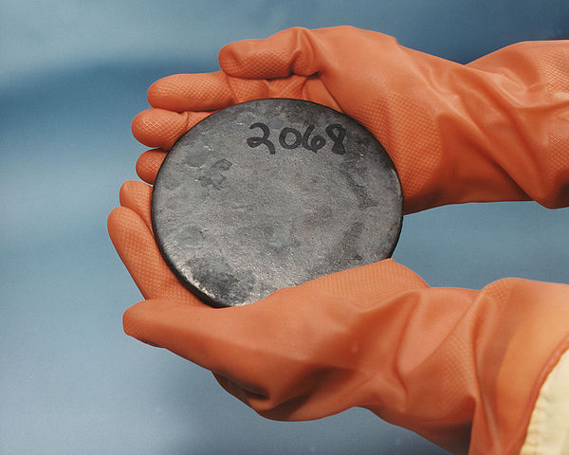
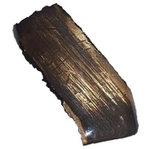
Examples of unstable nuclei:
Uranium-235: (92 protons + 143 neutrons = 235)
Decays to Lead-207
(82 protons + 125 neutrons = 207)
Half-life = 704 million years
Wikimedia Commons
Uranium-238: (92 protons + 146 neutrons = 238)
Decays to Lead-206
(82 protons + 124 neutrons = 206)
Half-life = 4.47 billion years

Slide 9
The radioactive decay of unstable nuclei is a random process.
We cannot say when any particular unstable nucleus is going to decay.
²³⁵U nucleus
We can only tell you the half-life: the time it takes for half of the nuclei in a sample to decay.

Slide 10
Start with: 100 atoms of ²³⁵U
0 atoms of ²⁰⁷Pb
²³⁵U
100
5 half-lives later:
3 atoms of ²³⁵U
97 atoms of ²⁰⁷Pb
Number of Atoms
50
0
²⁰⁷Pb
1
2
3
4
5
6
7
Number of Half-Lives

Slide 11
Example calculation:
t/τ

Slide 12
Half-life analogy: the decay of beer foam
17 cm
The half-life of Erdinger beer foam is ~190 sec
8.5 cm
190 sec
A. Leike, "Demonstration of the Exponential Decay of
Beer Froth,” 2002, Eur. J. Phys., v. 23, p. 21-26.

Slide 13
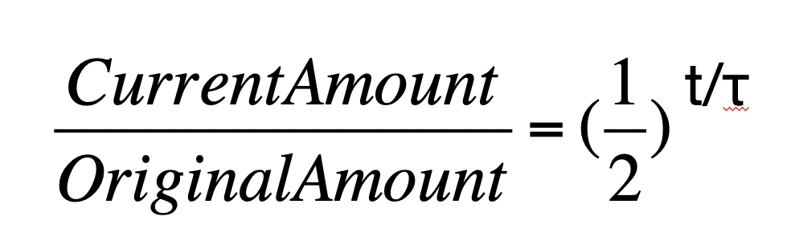
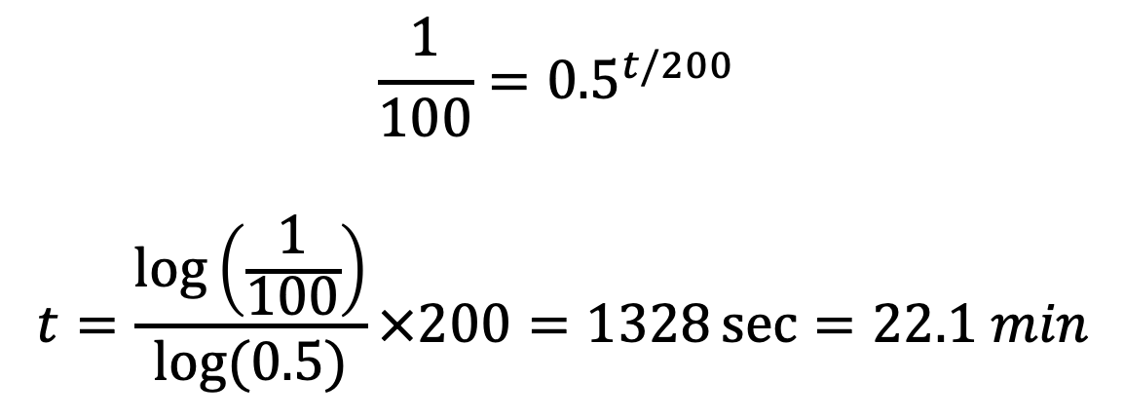
In class activity: When is beer foam gone?
(don’t shave it off!)
Assuming half life = 200 sec
Calculate how long do you have to wait until the foam decreases to 1% of its original thickness
$$\frac{1}{100}={0.5}^{t/200}$$
$$t=\frac{\log\left(\frac{1}{100}\right)}{log⁡(0.5)}×200=1328\sec{=22.1 min}$$

Slide 14
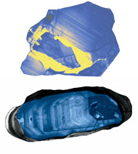
Zircon crystals form with inclusions of uranium
embedded in the crystal.
But, zircon strongly rejects any
chemical inclusion of lead
during formation.
Zircons start out with some
uranium but no lead.
UW Madison
As time passes:
Uranium isotopes decay into Lead
Less Uranium and more Lead as the zircon ages.

Slide 15

Start
4.5 Gyr Later…
²³⁸U
²³⁵U
²³⁸U
²³⁵U
50% left
1.2% left
²⁰⁶Pb
²⁰⁷Pb
²⁰⁶Pb
²⁰⁷Pb
1 half-life
6.4 half-lives
Start with Uranium,
but NO Lead
Mix of Uranium and Lead

Slide 16
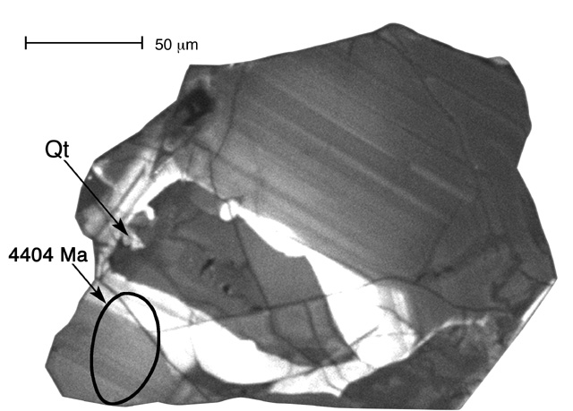
Zircon crystals are hard to destroy, but easy for geologists to identify.
UW Madison
Find zircons in old rocks.
Grind them up and do a chemical analysis.
Measure the lead/uranium ratios:
Pb-207/U-235 and Pb-206/ U-238.
Compute the number of half-lives that have elapsed.

Slide 17
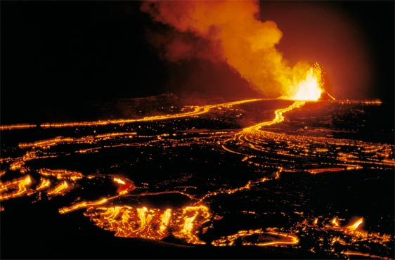
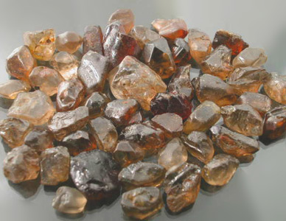
Caveat: if a zircon melts, the chemically-rejected lead gets locked out when the zircon re-solidifies.
USGS
Melting a zircon resets
the radiometric clock!
The age of a rock found by radioactive dating measures the time since the rock solidified.

Slide 18
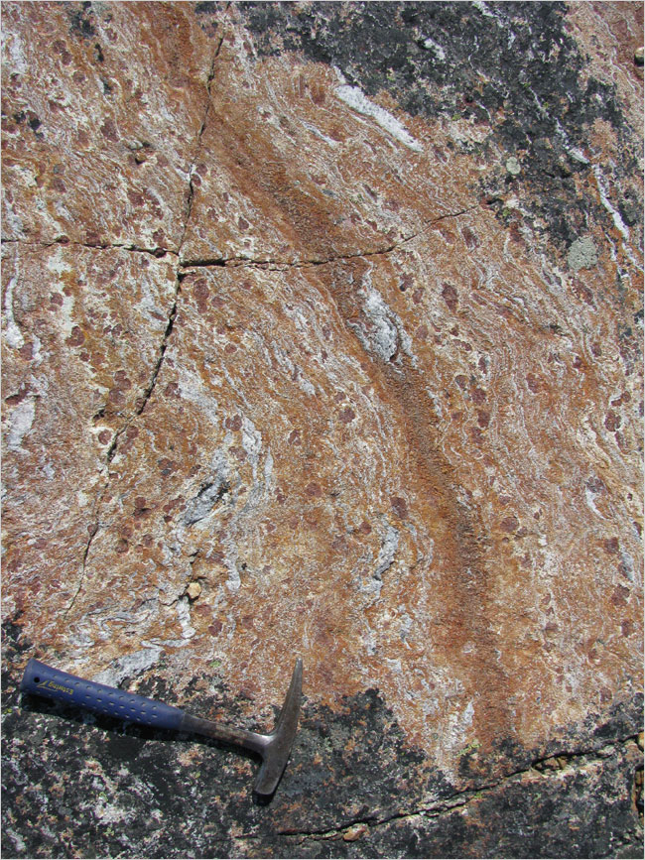
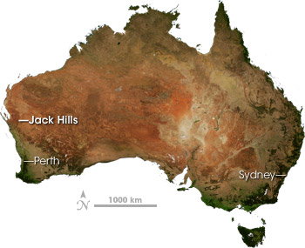
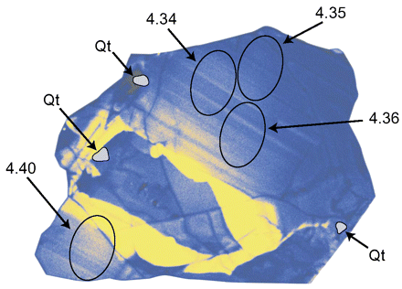
Because Earth is geologically active, you must find the oldest Earth rocks.
Most of Earth’s crust is less than 100 Myr old.
The World’s Oldest Rocks:
Jack Hills in Australia (4.4 Gyr)
Acasta Gneiss in Canada (4.03 Gyr)
Isua Greenstone in Greenland (3.8 Gyr)
4.28 Gyr rock in Canada

Slide 19
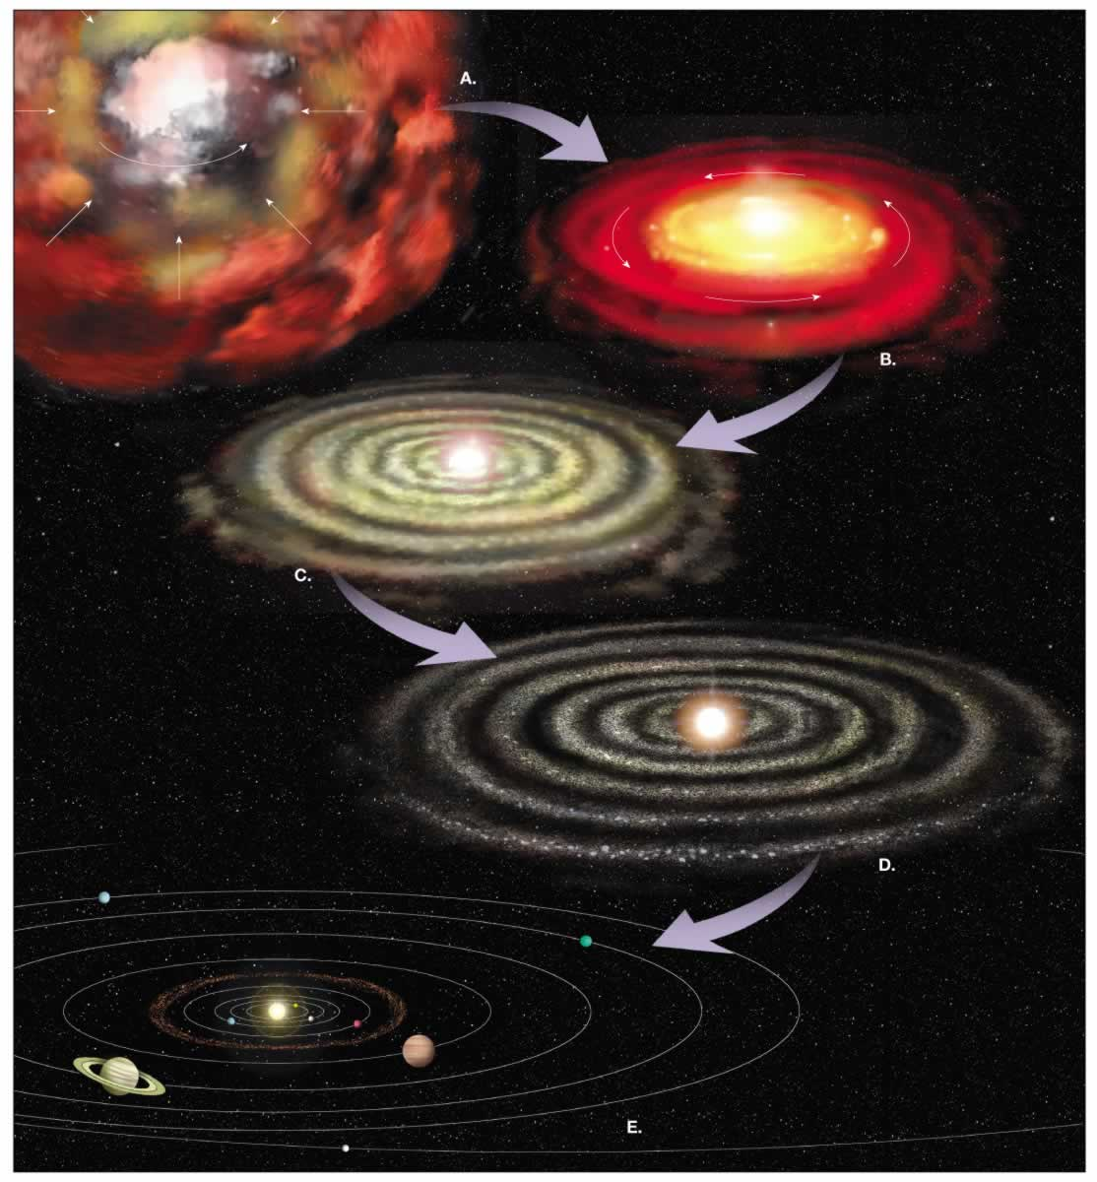
The best estimate for age of the Solar System:
The Sun, meteorites, & planets all formed about
4.57±0.05 billion years ago.
However,
The Solar System formed
from a gas cloud when
the universe was already
about 9 billion years old…
NASA
Notes:
I’m as old as my tongue, and slightly older than my teeth.
I’m 54 – my teeth have a range of ages, all younger than 54.

Slide 20
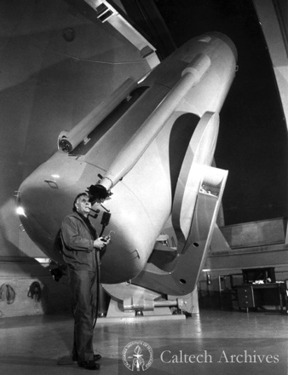
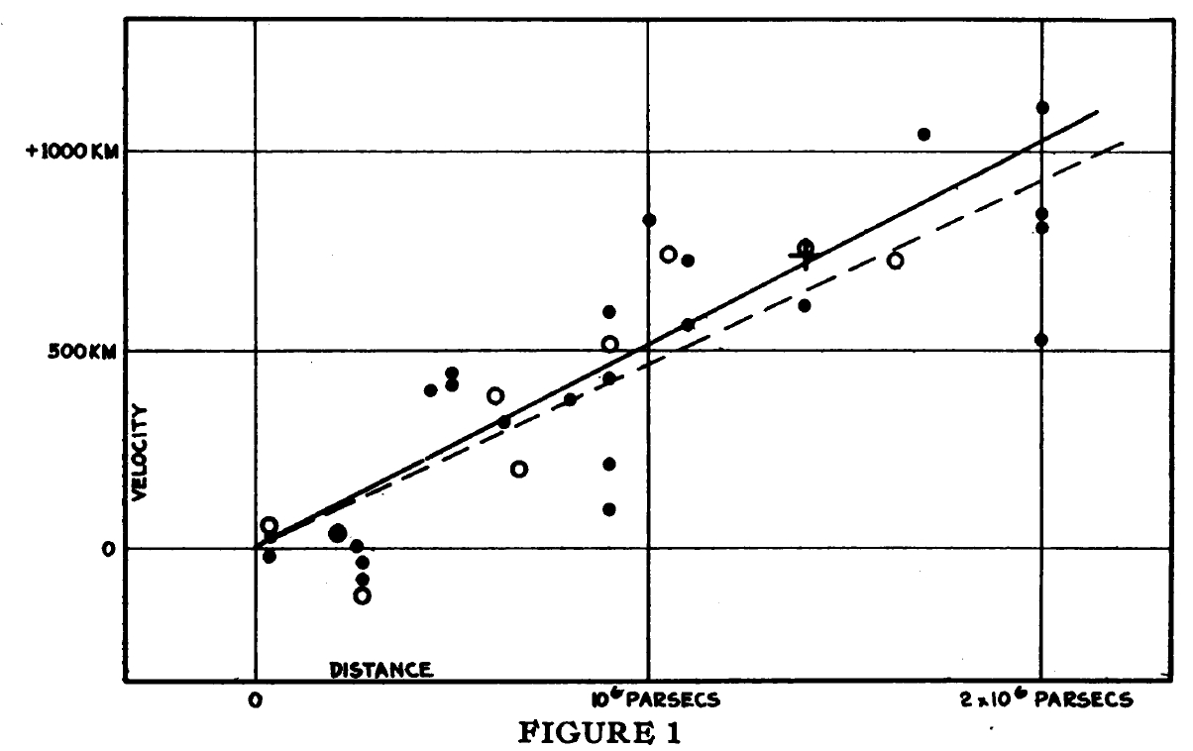
In 1929, Edwin Hubble discovered that distant galaxies are moving away from us, with a speed proportional to their distance.
Hubble’s Law: V = Ho D
Ho: Hubble Constant = V/D → 1/Time
Age of the Universe = 1/Ho
Hubble 1929, PNAS, 15, 168
Faster
Velocity
Slower
Closer Farther
Distance
Caltech Archives, Photo ID 10.12-17

Slide 21
Hubble had discovered the systematic expansion of space and time.
Earlier
Later: Universe is 2x larger
Galaxies are 2x further apart

Slide 22
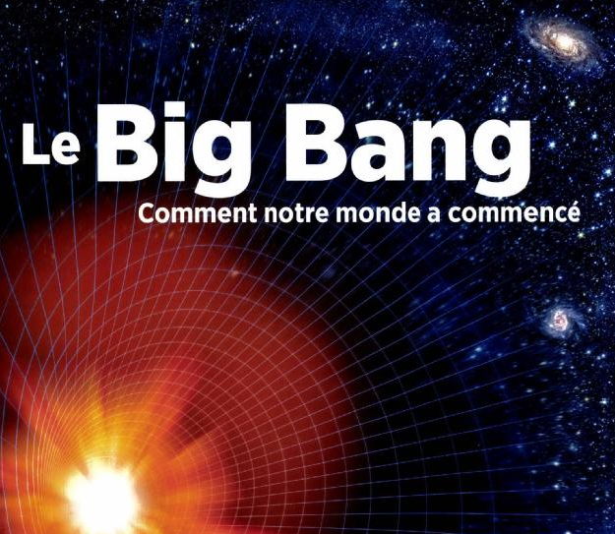
Extrapolating backward in time, we find that the expansion began about 13.8 billion years ago.
The universe began in an hot, dense, opaque state we call the Big Bang.
As the universe expanded, it cooled and became the transparent universe we see today.
Galaxies formed, containing stars, planets, and (in at least one case we know of) life.

Slide 23
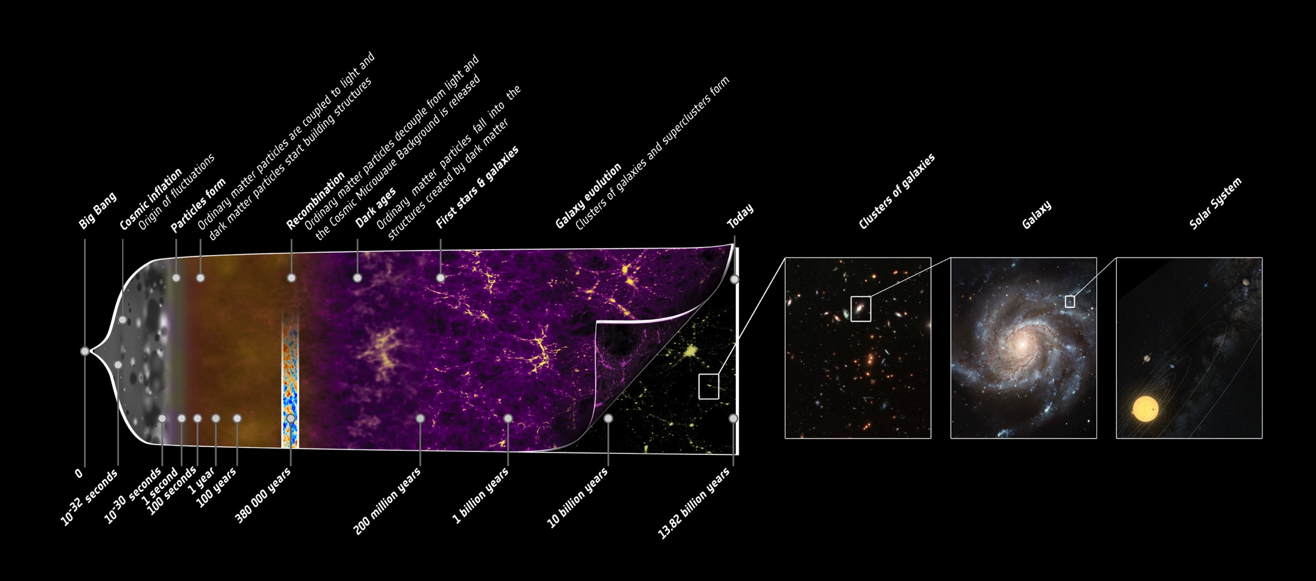
History of the Universe
Credit of ESA

Slide 24
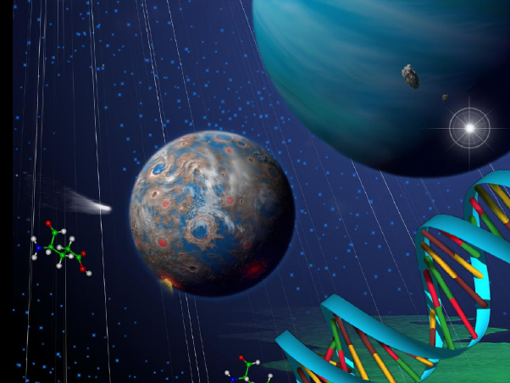
The lessons from the study of the universe are at once humbling and hopeful.
The Earth and Sun do not occupy a special place in the universe.
The universe is vast in size
and very old (13.8 Gyr), but
we are relatively young.
The same physical laws found on Earth apply throughout the universe, thus the physical processes that make life possible here should also operate elsewhere…

Slide 25
Matter and Energy
Atoms are made of protons, neutrons, &
electrons: atoms can bond together to form
molecules.
Energy cannot be created or destroyed;
it can only change form.
Disorder, or entropy, has a natural tendency
to increase.

