Slide 1
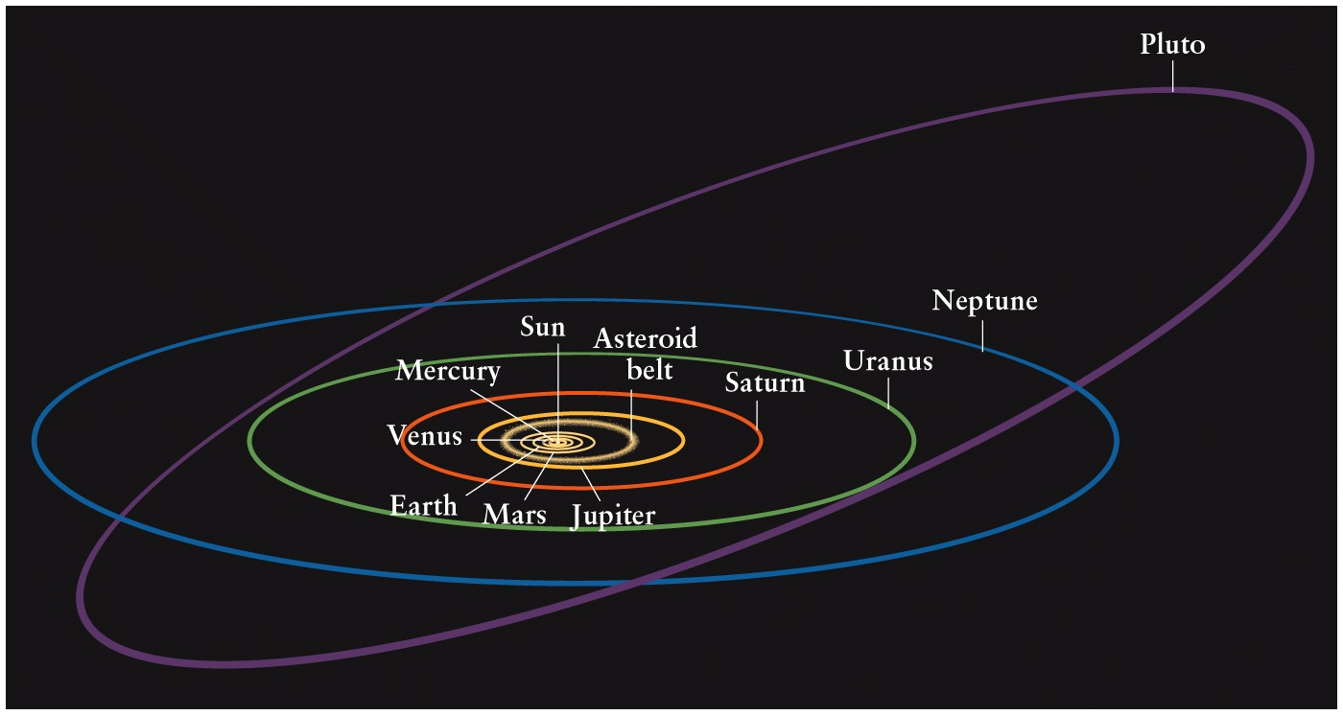
The Planets

Slide 2
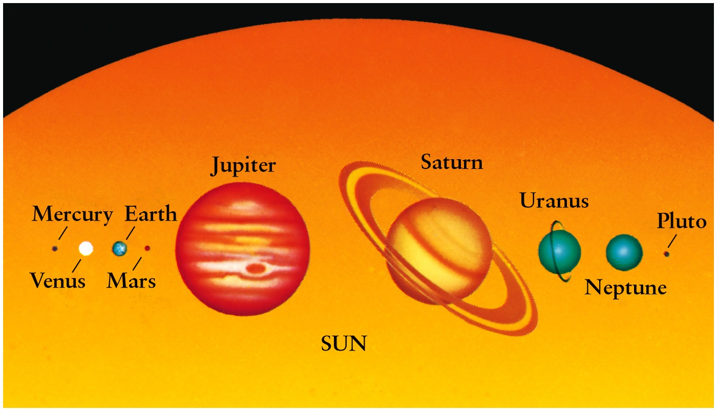
Planets and the Sun: Two Groups and Pluto
The Sun contains 99.9% of the mass in the solar system
Terrestrial - With a solid surface; Jovian – Gaseous atmospheres and interior

Slide 3
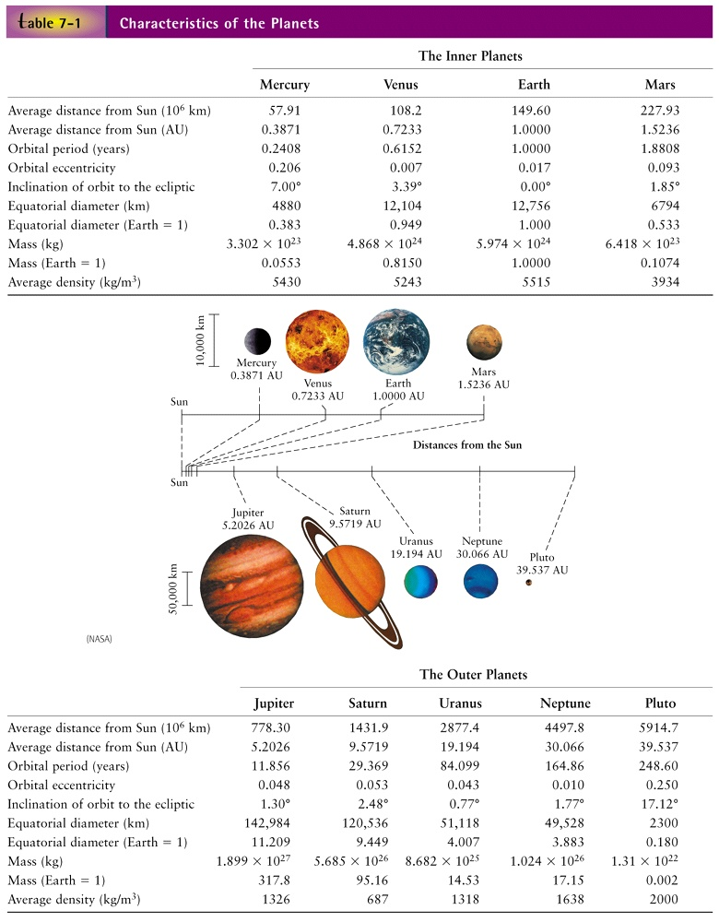
Planetary Statistics

Slide 4
Solar System: Overview
Planet S-P (AU) Feature(s)
Mercury 0.4 Smallest, metallic
Venus 0.7 Brightest, dense, acidic
Earth 1.0 Life !
Mars 1.5 Red, flowing water!
Asteroid Belt (2.8 - 3.2 AU)
Jupiter 5.2 Largest
Saturn 9.5 Rings
Uranus 19.2 Tipped on one side !
Neptune 30.1 Cloudy, twin like Uranus
(x)Pluto 39.4 Minor planet, planetesimal
Kuiper-Belt Objects, Comets, Oort Cloud

Slide 5
Terrestrial and Jovian Planets
Terrestrial: Mercury, Venus, Earth, Mars
- Composition: Rocks and Metals
- Largely Refractory Elements, with high boiling point, e.g. Silicon, Sulfur, Iron, etc.
- Density: 3-5.5 g/cc (Density = M / V)
Jovian: Jupiter, Saturn, Uranus, Neptune
- Composition: Gases and Ices (but solid core)
- Largely Volatile Elements, low evaporation temperatures, e.g. H, He, C, N, O, Ne
- Density: 1-1.5 g/cc

Slide 6
Retention of Planetary Atmospheres
Jovian planets are massive and cool
Have high escape velocities due to large gravity which enables retention of extensive atmospheres, therefore retain light volatile elements like H and He that would otherwise evaporate easily
Terrestrial planets have low gravity and are warmer, therefore allowing volatile elements to escape, leaving behind heavier refractory elements

Slide 7
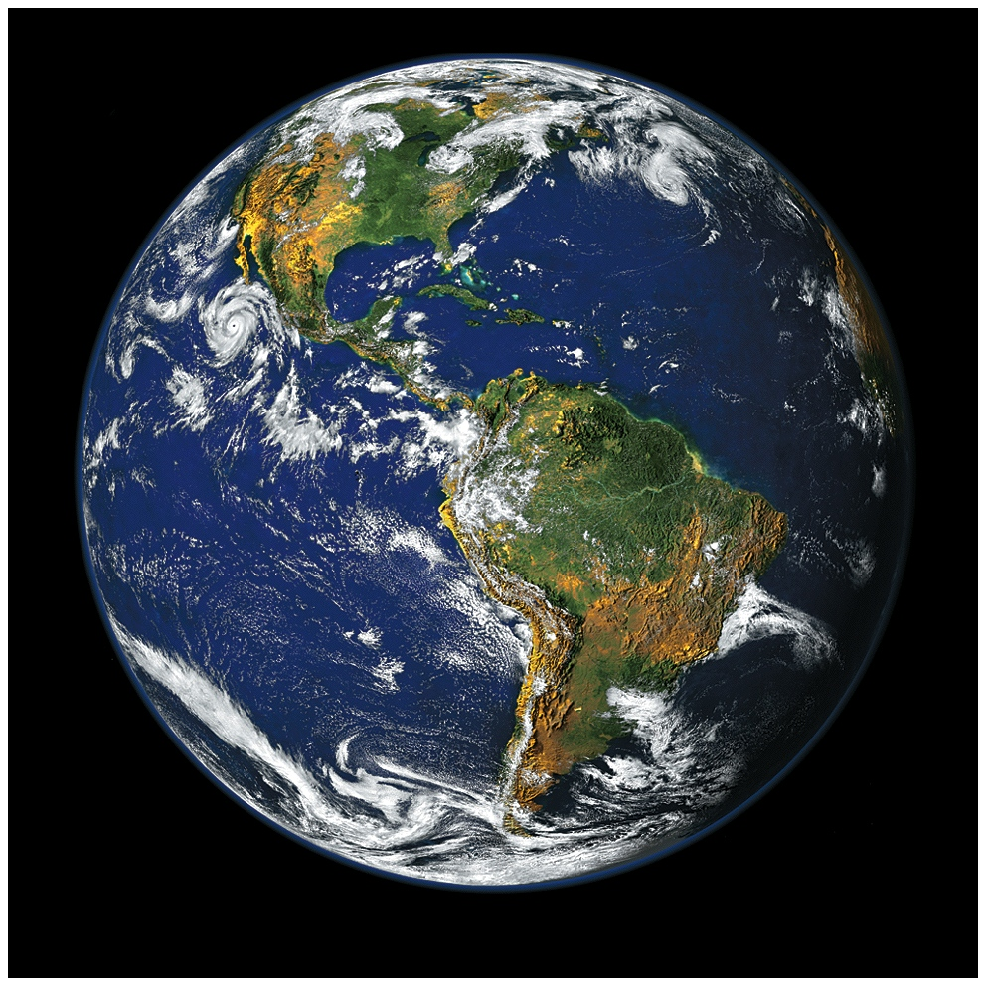

Slide 8
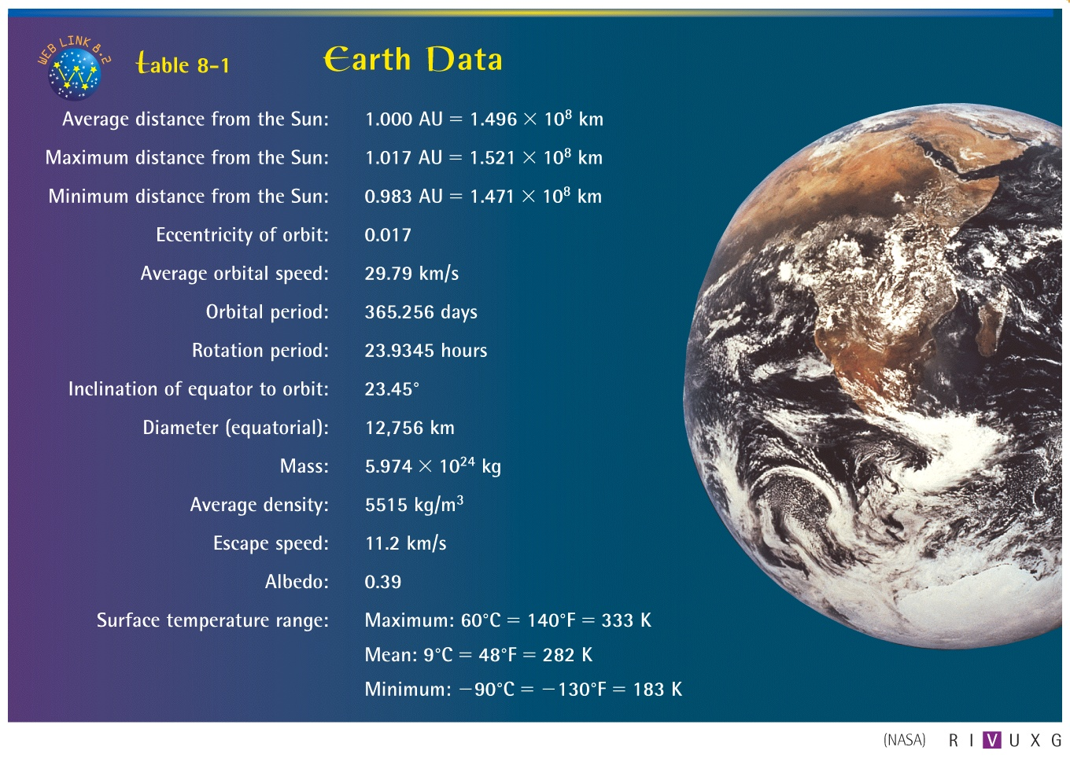
Earth Data

Slide 9
Albedo and Atmosphere
Albedo: Reflectivity – percentage or fraction of energy reflected from the surface
Earth’s albedo is 0.39; Venus is 0.72 and Moon’s only 0.11
What is the earth’s atmosphere composed of? What is it there you are breathing mostly?

Slide 10
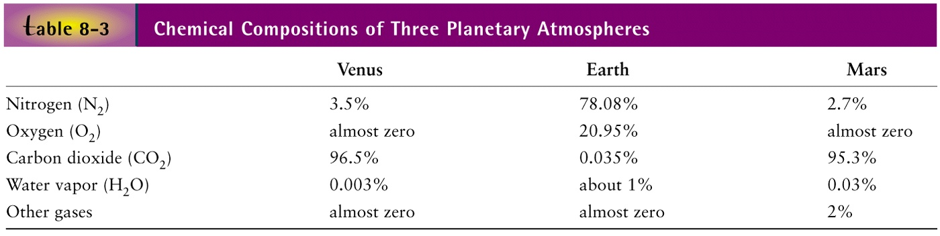
Atmospheric Compositions:
How did they evolve ?

Slide 11
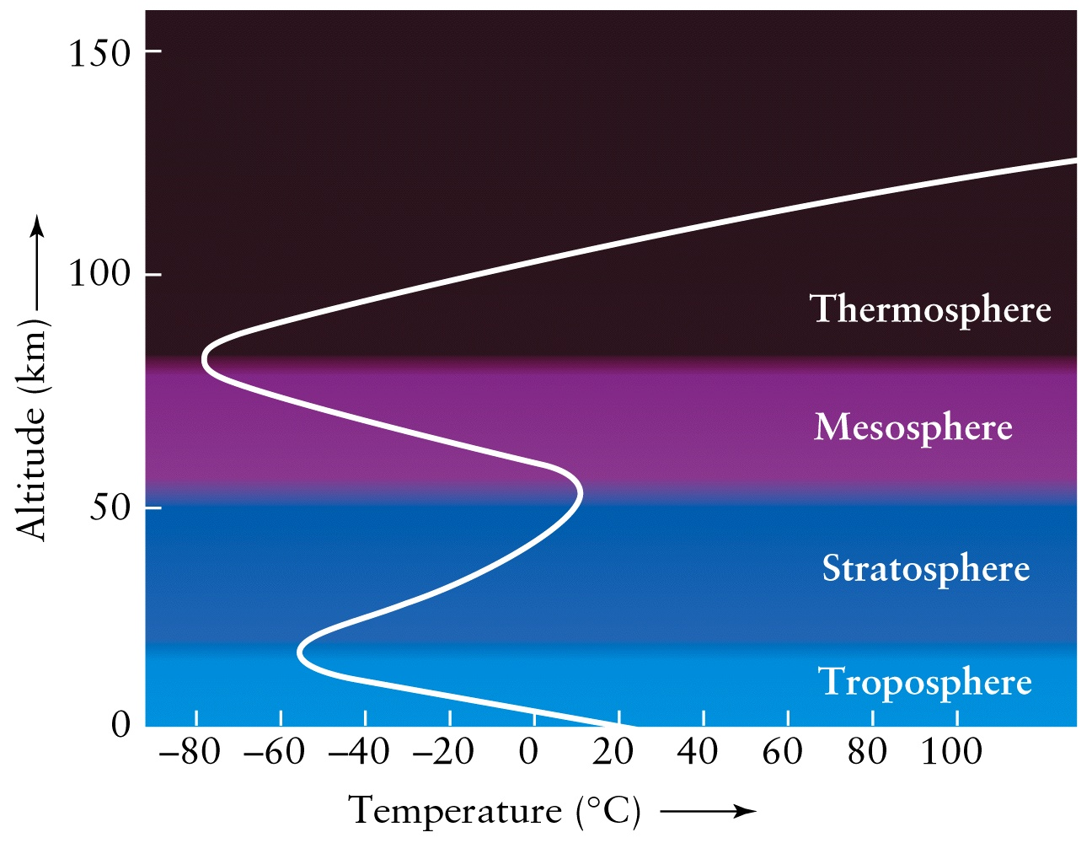
Atmospheric layers: Height vs. Temp

Slide 12
Structure of Earth’s Atmosphere
Troposphere: < 10 Kms, dense,
-100º C < T < 50 C, Clouds, planes, weather currents
Stratosphere: < 80 Kms, above clouds, cold but an embedded ozone (O₃) layer is hot! (why?)
Mesosphere (Thermosphere, Exosphere): > 80 Kms, molecules O2,N2 etc. break-up into atoms
Ionosphere: Atoms break-up (ionize) into ions and electrons (why?), reflects radio waves → radio transmission

Slide 13
Ionosphere
Broadcast radio signal
Receive radio signal ?
The Ionosphere reflects radio waves back to the Earth

Slide 14
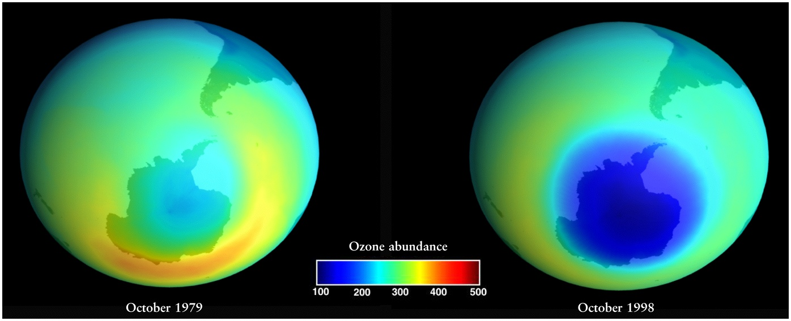
Ozone “Hole” over Antarctica
What destroys Ozone ?
Chloro-Fluoro-Carbons (CFC’s) – in spray propellents

Slide 15
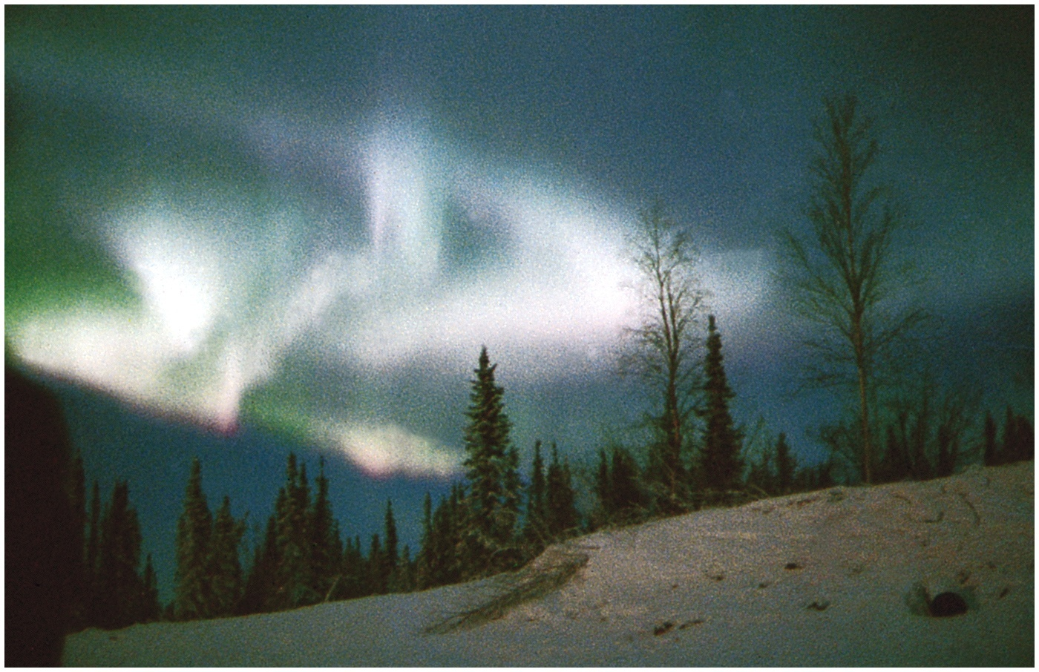
Northern Lights – Aurora Borealis
Charged particles in the ionosphere interact with the Earth’s atmosphere, particularly around polar regions

Slide 16
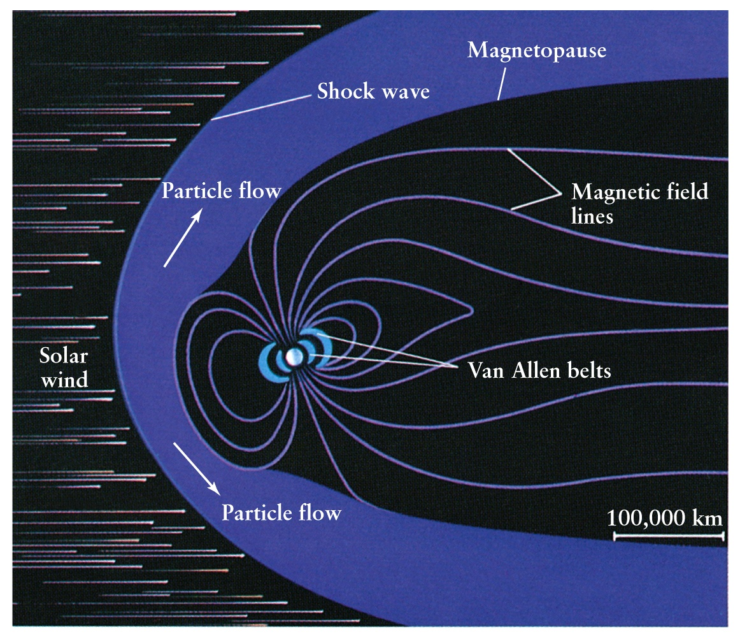
Magnetosphere and Van Allen Radiation Belts: The First Line of Defense
Charged particles from the Sun in the solar wind are deflected by Magnetosphere,
Or trapped in Van Allen radiation belts extending out to thousands of miles

Slide 17
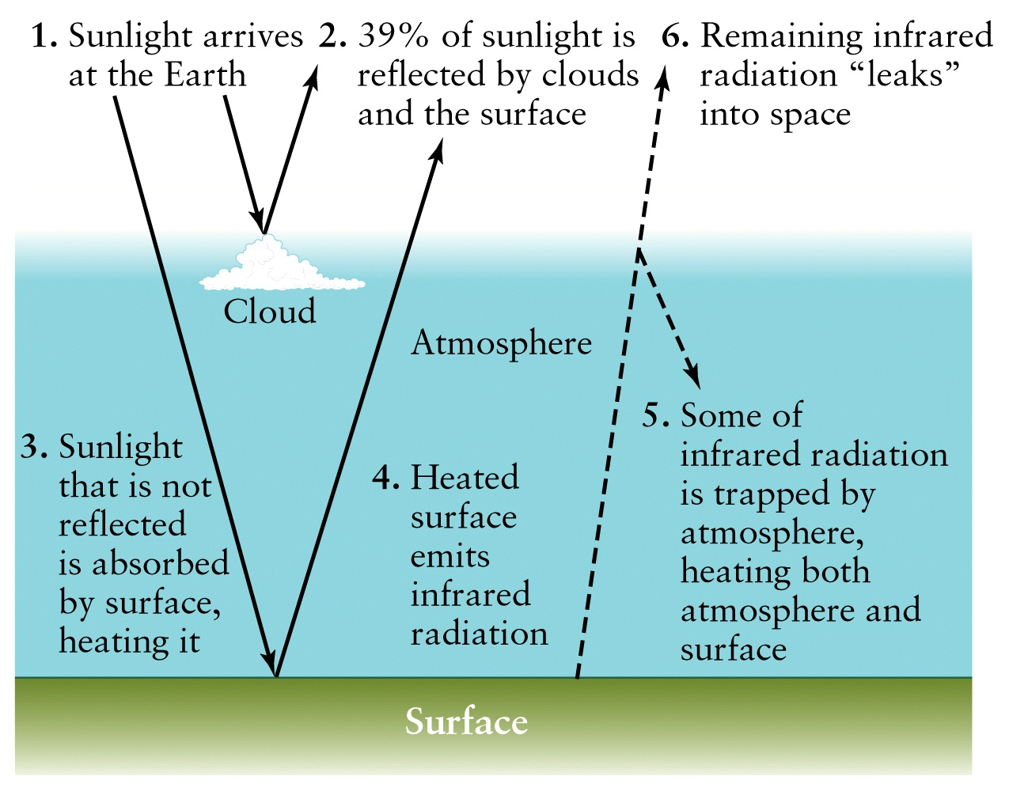
The Greenhouse Effect
H₂O,CO₂,SO₂
Trap IR.
Increase in
these
compounds
would heat
oceans,
leading to
increased
H₂O in the
atmosphere
How can the GH effect go into a “runaway” cycle ?

Slide 18
Greenhouse Effect and the Atmosphere
Composition of the atmosphere is critical to maintain the greenhouse effect in balance
Even relatively small changes in chemical composition could alter global balance and result in a “runaway” cycle (as on Venus) –
more contaminants ←→ more heating
(due to increased IR trapping)
In the absence of the GH effect, the Earth’s temperature would be 260 K, ONLY 30 degrees lower on average, BUT oceans would freeze !!

Slide 19
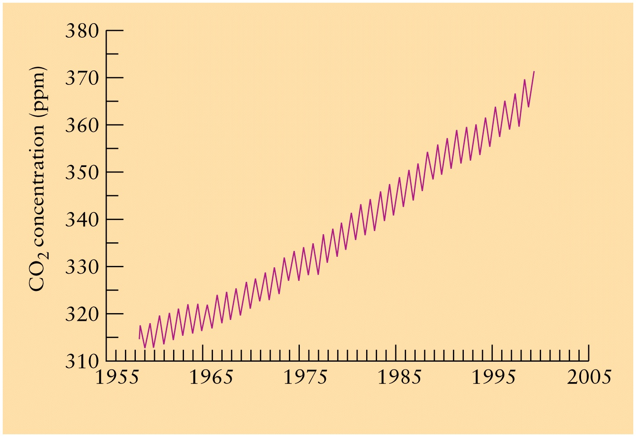
Increase in CO₂ fraction with time

Slide 20
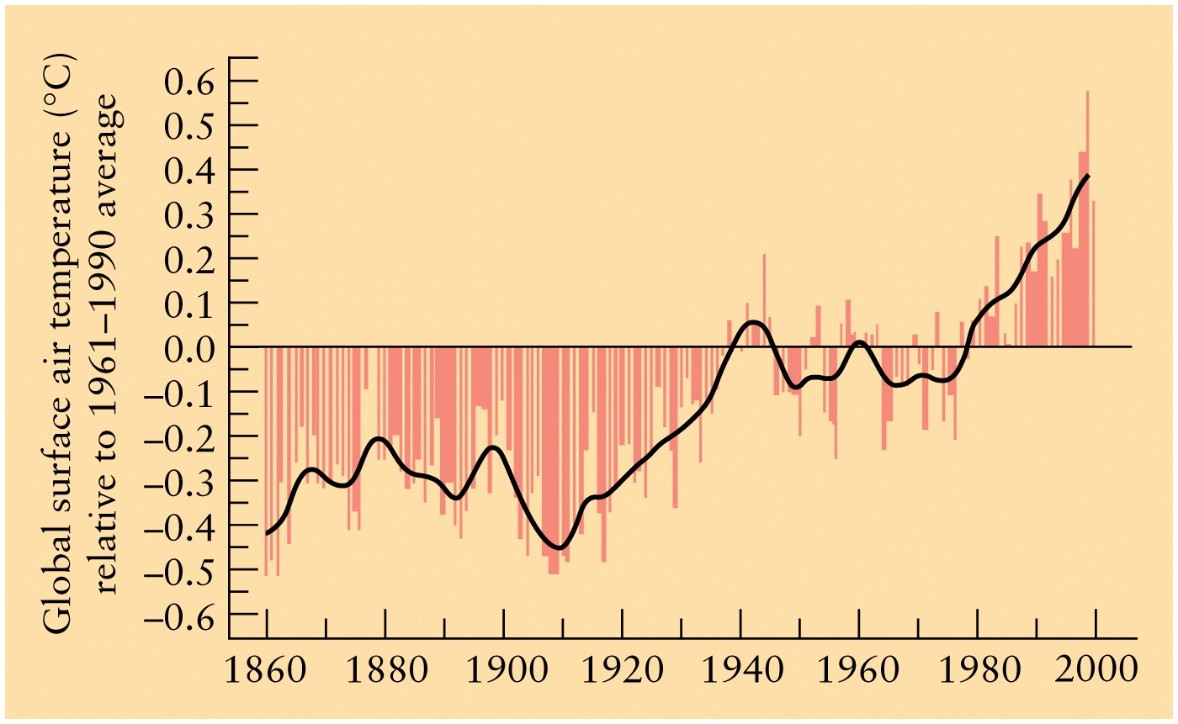
Global Warming

Slide 21
Earth’s Geology and Astronomy
The solar system formed about 4.6 billion year ago
Astronomical Age must coincide with geological age determined from rocks (radioactive dating)
Terrestrial planets lost H, He (primary and primordial constituents of the solar nebula), but Jovian planets retain large atmospheres
Iron ‘sinks’ to the core
Iron is the heaviest element made from stellar nucleosynthesis (nuclear fusion in stars)
The core remains hot due to radioactive decay of very heavy trace elements such as Uranium (found in rocks)
Oceans → water (where did it come from?)

Slide 22
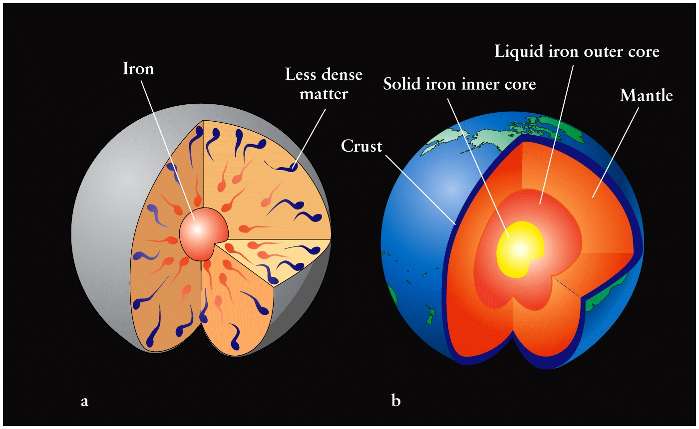
Internal Structure of the Earth

Slide 23
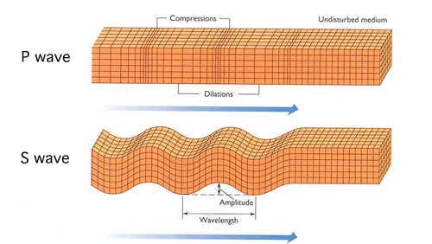
Earthquakes create seismic waves that pass through the Earth.
S-waves are Shear waves that
pass through solids, but are
reflected/absorbed by liquid
(molten) regions.
USGS
P-waves are Pressure waves
that pass through both solid &
molten regions.
USGS

Slide 24
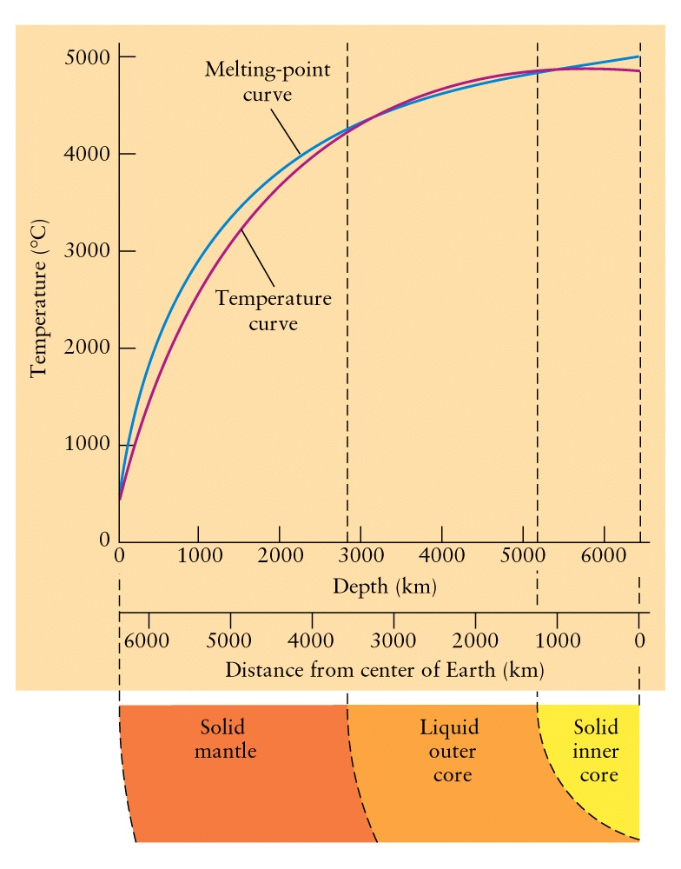
Melting point temperature vs. pressure
The Earth’s iron core is ‘solid’ and at higher temperature than the liquid core

Slide 25
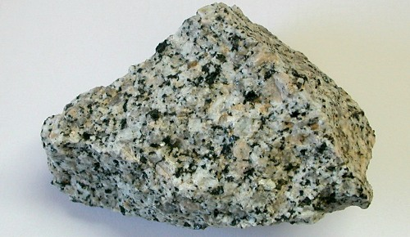
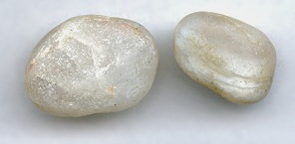
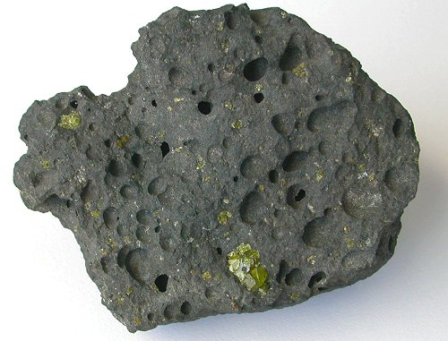
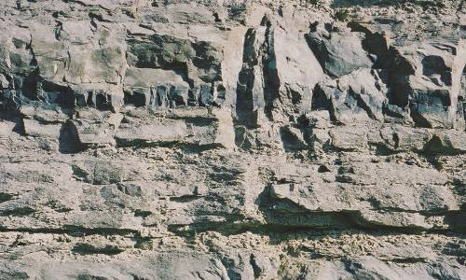
Earth’s surface is composed of silicates, iron-rich basalts, & carbonaceous rocks.
Silicate Rocks (granite, quartz)
Iron-rich Rocks (basalts)
Carbonaceous Rocks (limestone)
Notes:
https://www.nationalgeographic.com/science/earth/inside-the-earth/rocks/#close

Slide 26
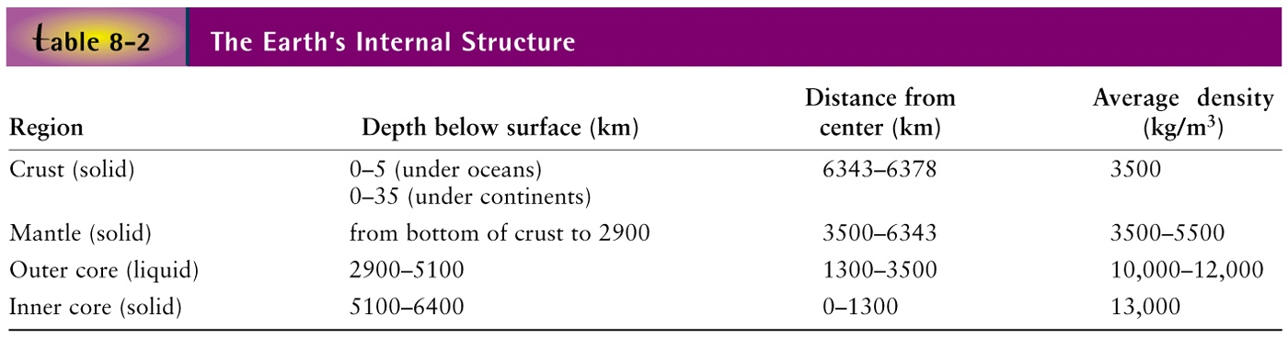
Crust, Mantle, Core of the Earth
Oceanic Crust – Basalt; Continental Crust - Granite
Mantle – Silicate rocks, solid and partially molten (magma inside, lava outside)
Upper mantle + Crust → LITHOSPHERE (< 100 Km)
Core – Molten iron in liquid core is responsible for the magnetic field. Why?
Electrically charged (ionized) convection currents create a
“dynamo effect”→ electromagnet (Electric current ←→ Magnetic Field)

Slide 27
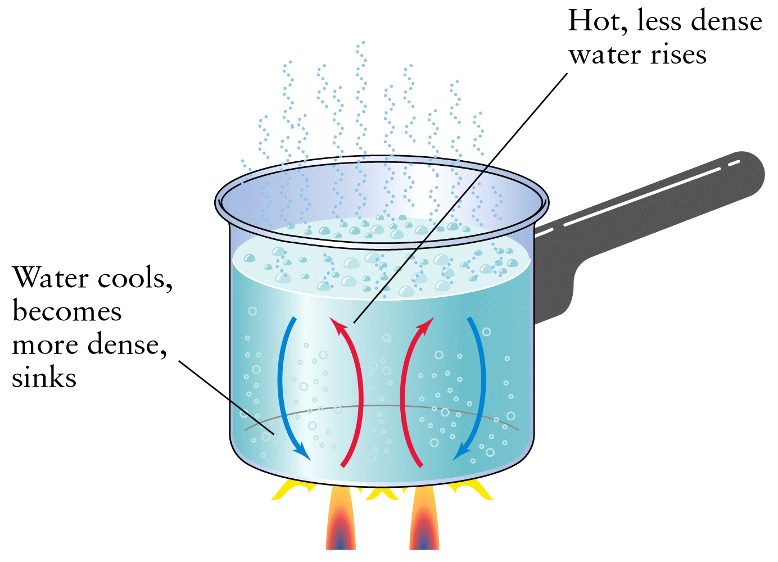
Convection Currents

Slide 28
Magnetic Field:
Electricity and Magnetism are unified
Moving electrical charges give rise to magnetism → Electromagnet; viz. electrons moving through a wire constitute electric current, surrounded by magnetic field
Presence of an appreciable magnetic field requires all three criteria to be met
1. Metallic interior to that atoms are closely packed to enable movement of electrons among them
2. Hot liquid state to enable flow
3. Fast rotation to enable convection currents

Slide 29
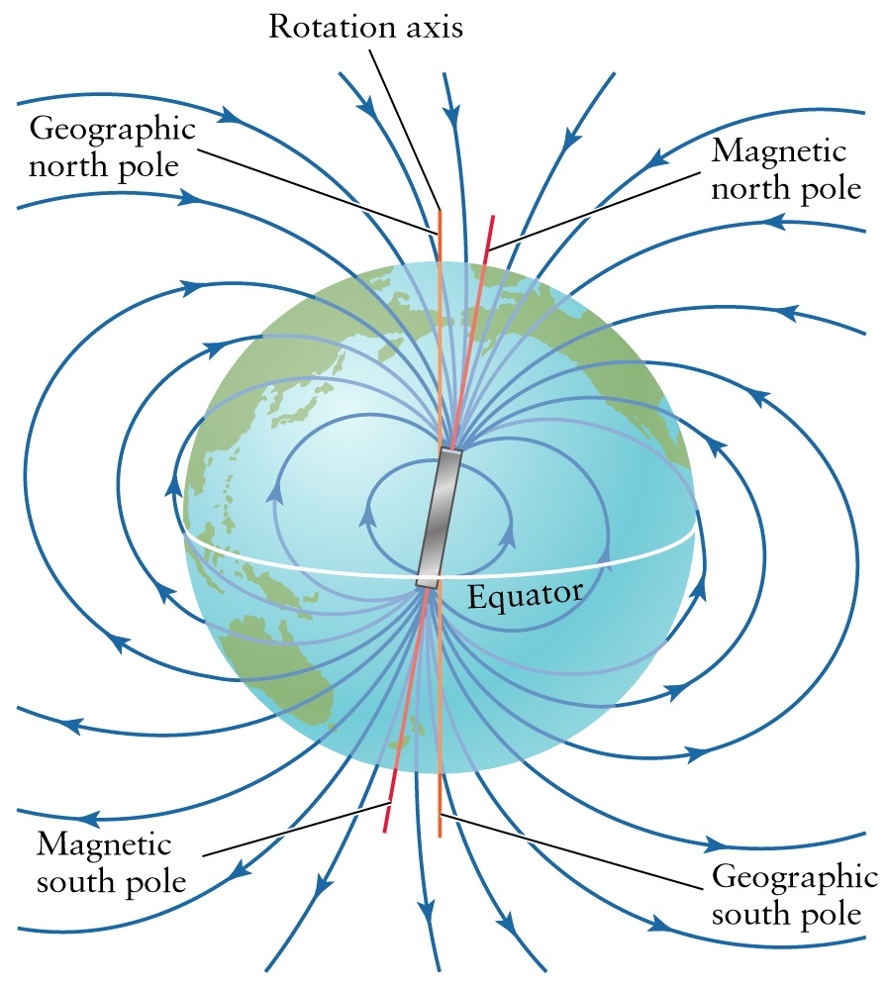
Magnetic and Rotation Axes

Slide 30
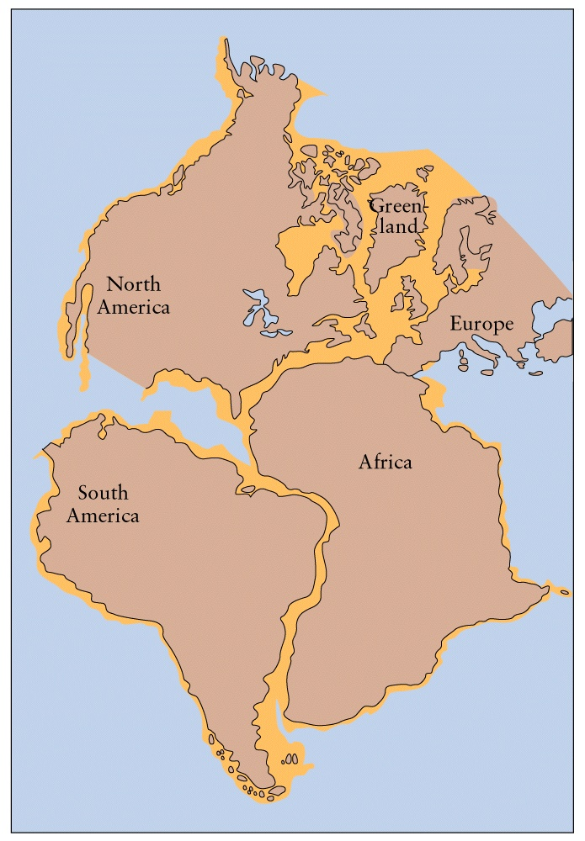
Pangaea – Primordial Land Mass

Slide 31
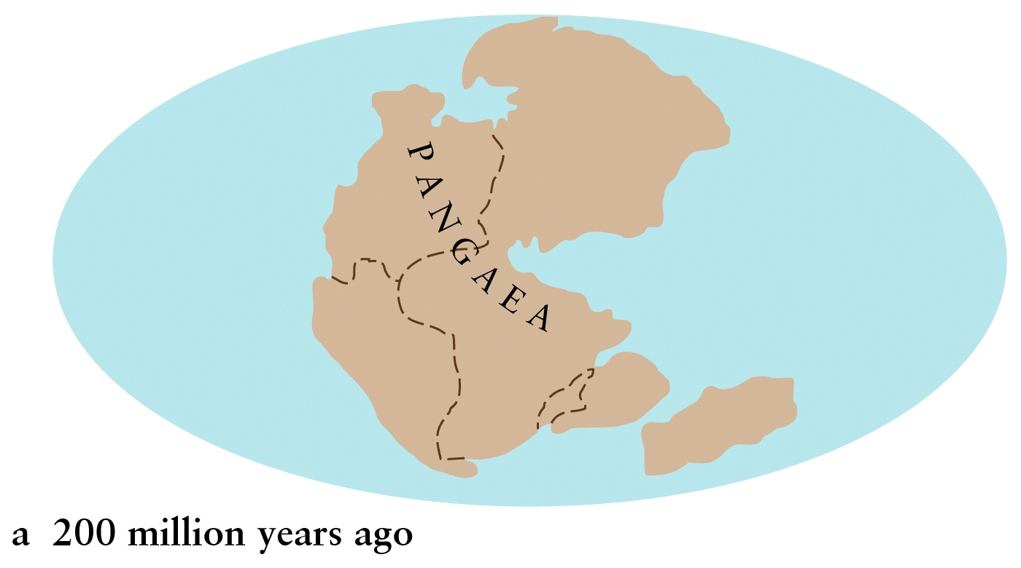
Evolution of Pangaea

Slide 32
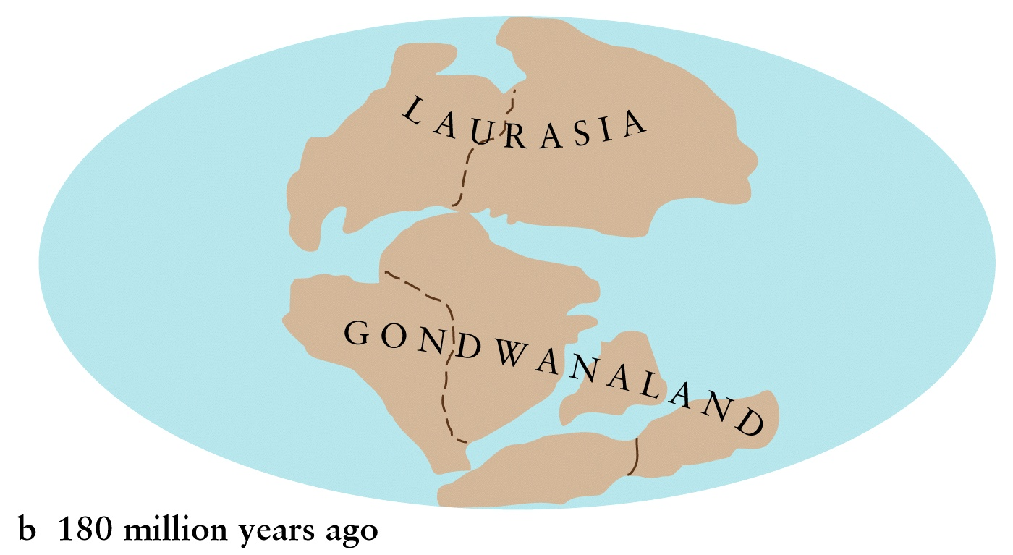
Breakup of Pangaea into “Plates”
Via Plate Tectonics

Slide 33
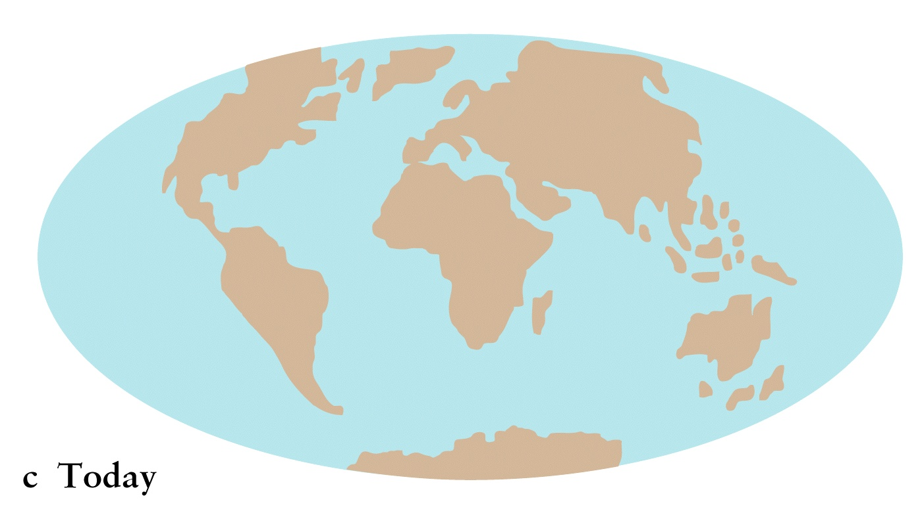
Plate Tectonics and Geography

Slide 34
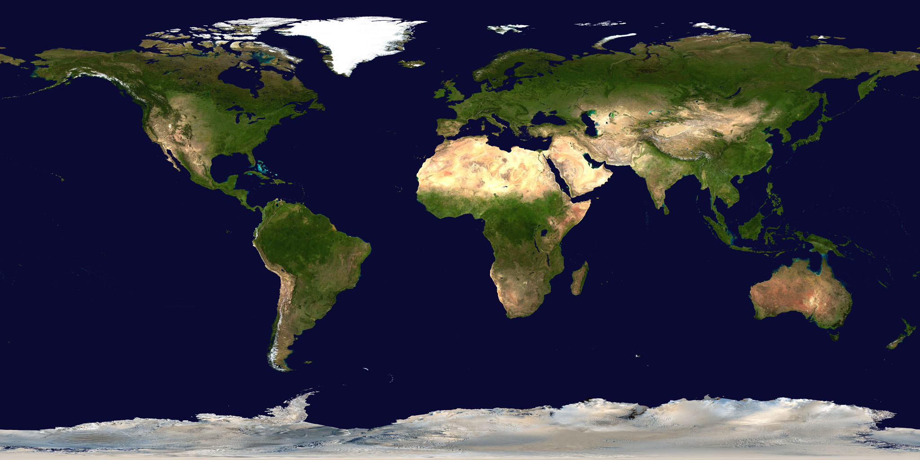
The Earth’s surface is mostly oceans (about 71%) with 29% solid land.
NASA

Slide 35
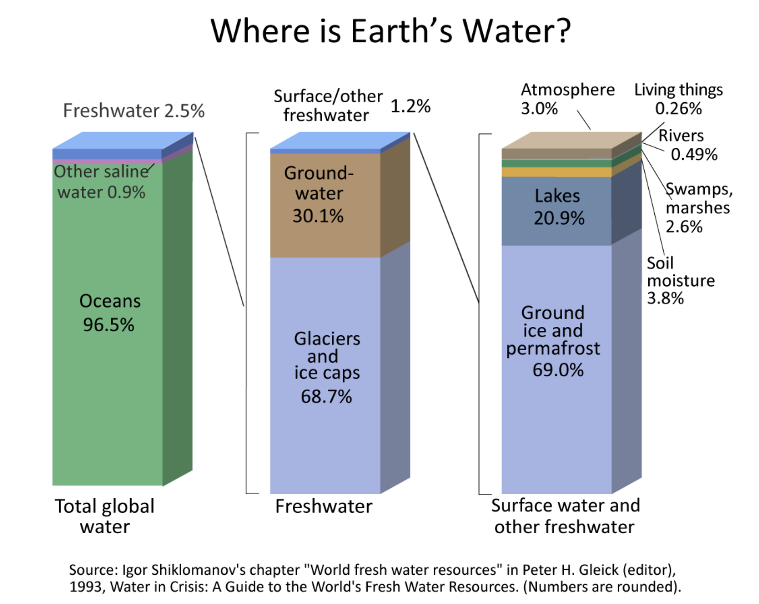

Slide 36
How much water is there in Earth (in volume)?
A: 50%
B: 10%
C: 1%
D: 0.1%
Notes:
Take a guess

Slide 37
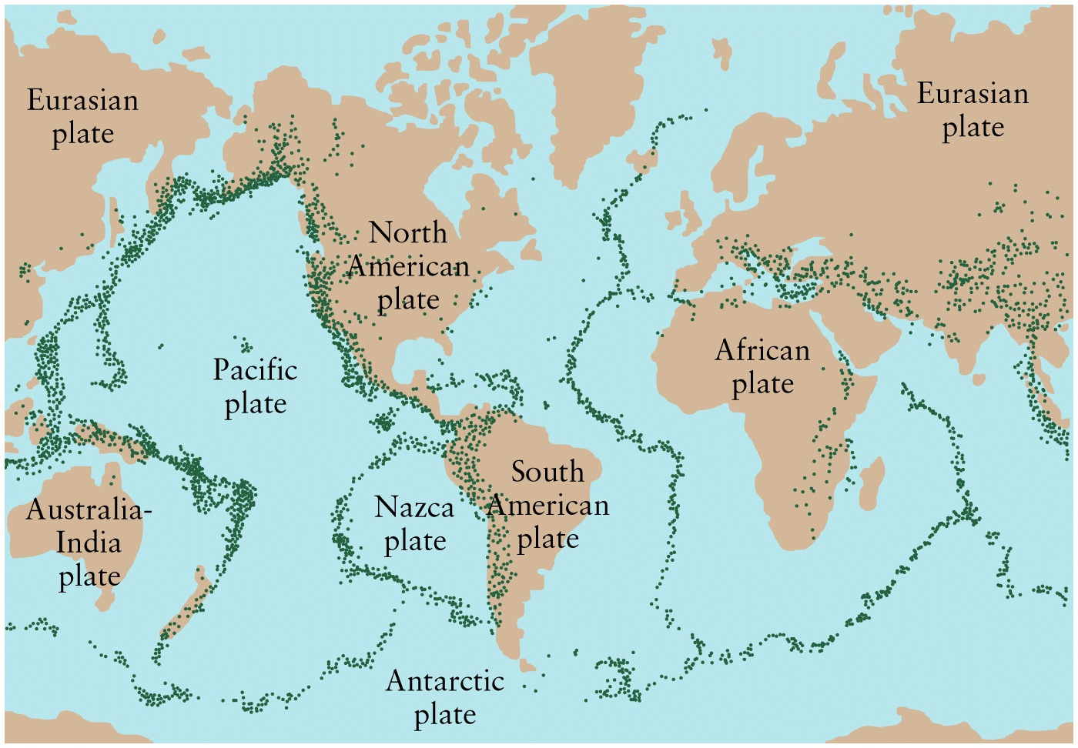
Geological Activity at Plate Boundaries
Earthquakes, Volcanoes, “hot spots”

Slide 38
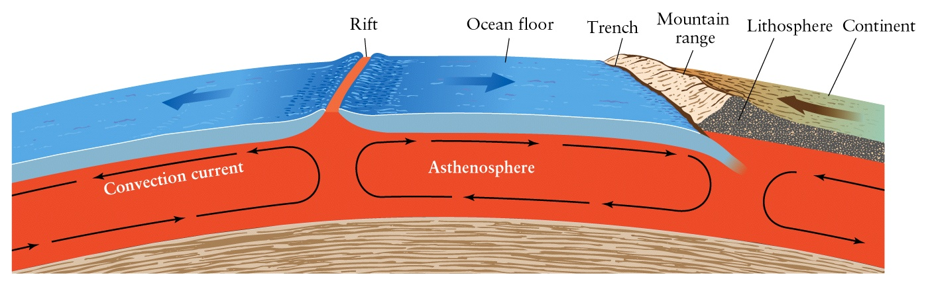
Lithosphere and Mantle

Slide 39
Plate Tectonics: Movement and Activity
Lithosphere is divided into 16 plates with oceans and continents
Rift Zones: Plates pulling apart along a ridge, which may show volcanic activity, e.g. mid-Atlantic ridge, “Ring-of-Fire” volcanoes along the pacific rim
Subduction Zones: Plates colliding → one plate forces under the other (e.g. oceanic Japan trench), or rising to form mountains (e.g. Himalayas)
Fault Zones: Crustal plates sliding along each other – plate boundaries are called “faults” (e.g. San Andreas
“Hot-Spot” Volcanoes – Hawaiian islands

Slide 40
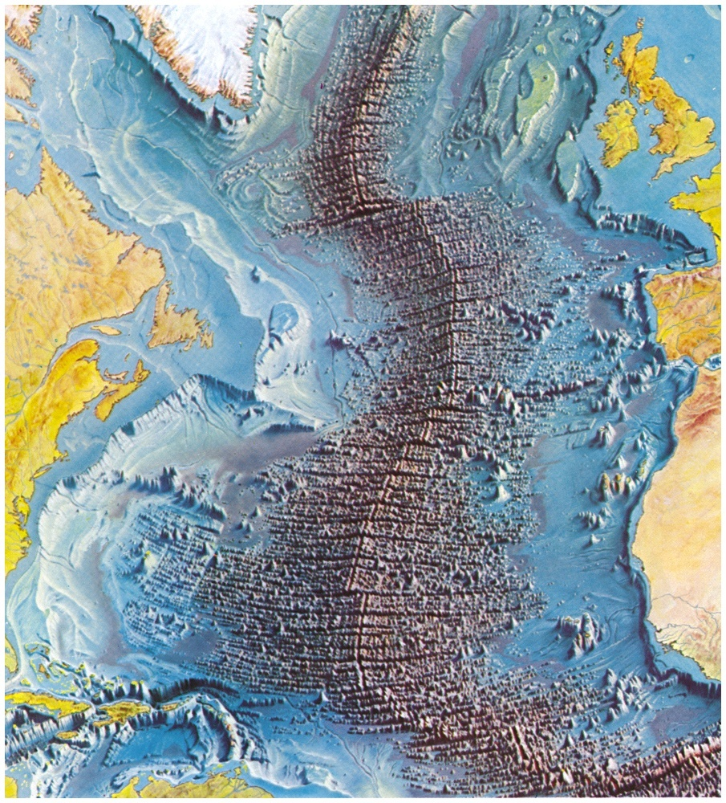
Mid-ocean Ridge, Rift Zones

Slide 41
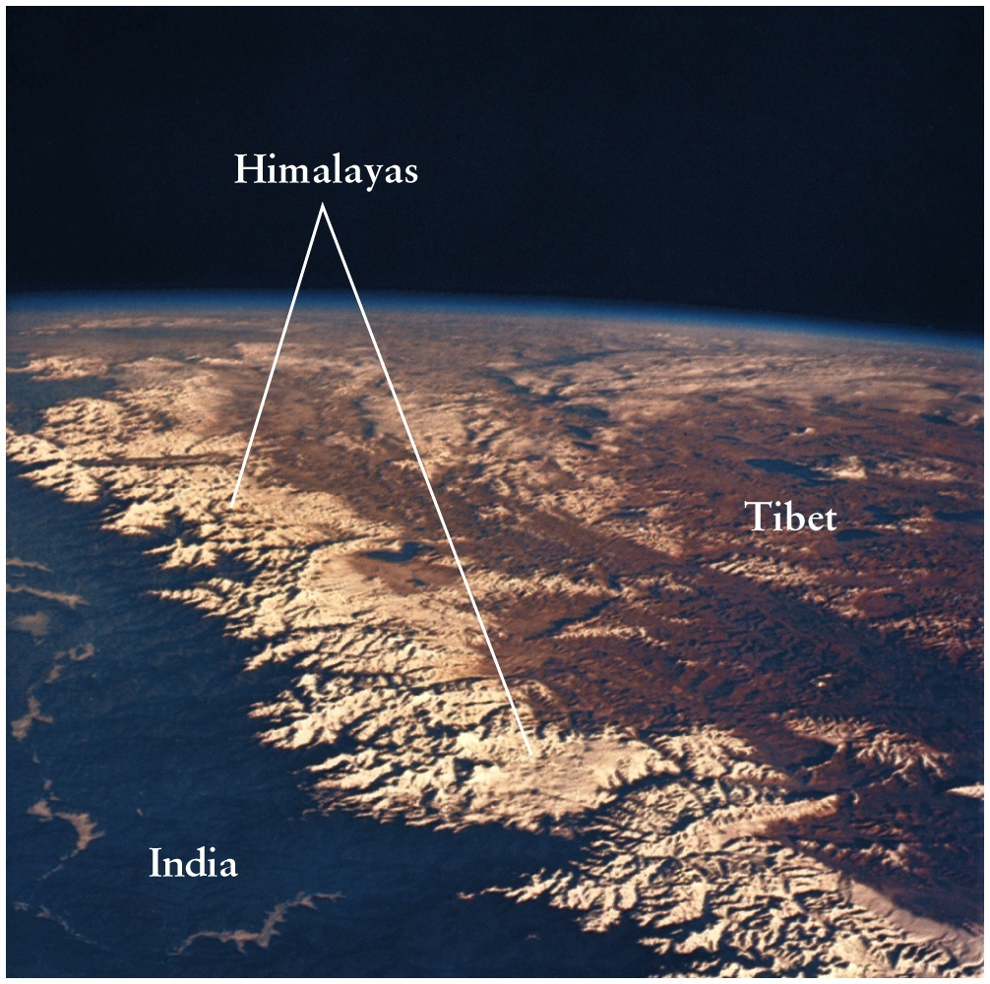
Colliding Plates → Mountains

Slide 42
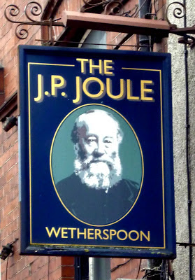
James Joule is honored by scientists because he helped to develop a very important idea...
The Law of Conservation of Energy
Energy cannot be created or destroyed, it
can only change from one form of energy
to another.
This is the First Law of Thermodynamics.

