Slide 1
Atomic and Molecular Radiation Physics:
From Astronomy To Biomedicine
Light and Matter → Spectroscopy
Generalized interactions → Radiation
Atomic physics
Astrophysics
Plasma physics
Molecular physics
Biophysics

Slide 2
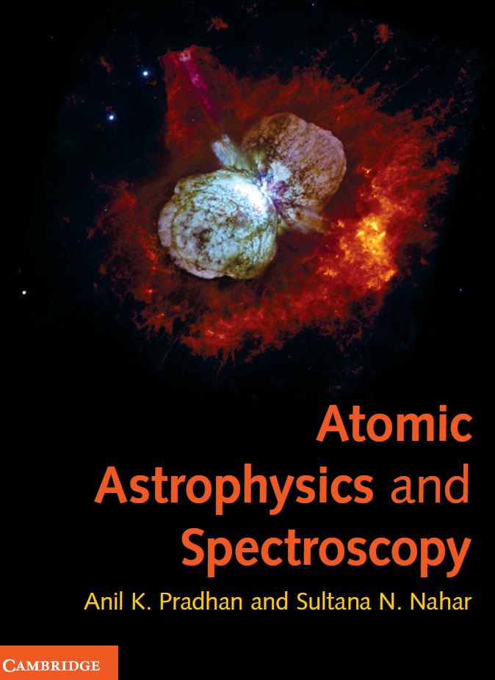
Eta Carinae Nebula
Massive Stellar Eruption
Binary Star System
Symbiotic Star
~100 M(Sun)
~1,000,000 L(Sun)
Pre-supernova phase

Slide 3
Imaging vs. Spectroscopy
Imaging → Pictures
Spectroscopy → Microscopic (or Nanoscopic) science of light and matter
Pictures are incomplete at best, and deceptive at worst

Slide 4
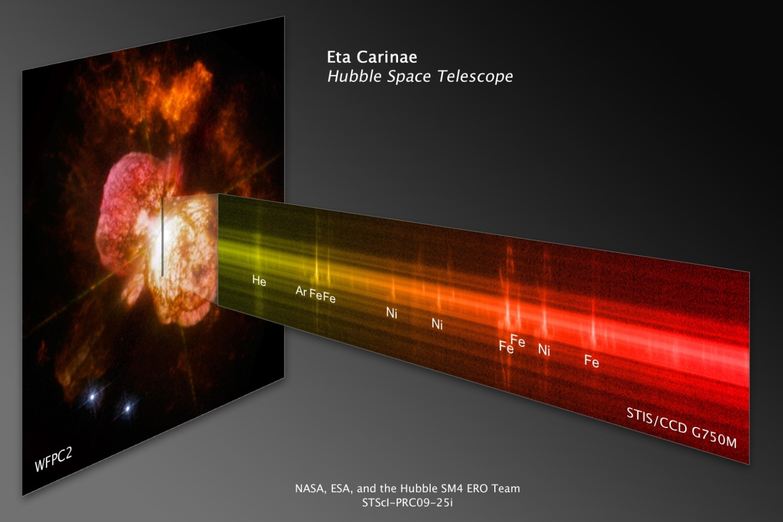
Image + Spectrum

Slide 5
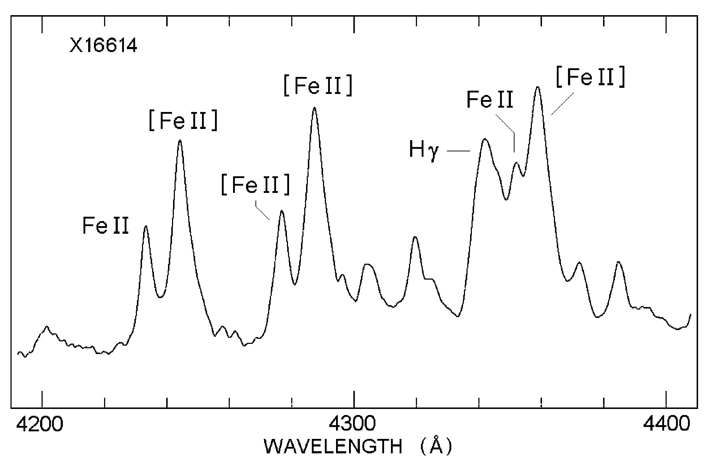
Spectrum of Eta Carinae: Iron Lines

Slide 6
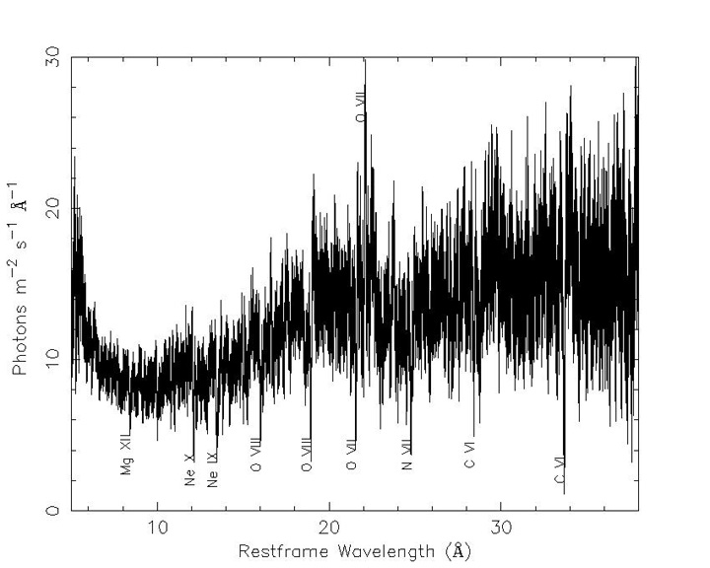
NGC 5548, central region, spectral bar code

Slide 7
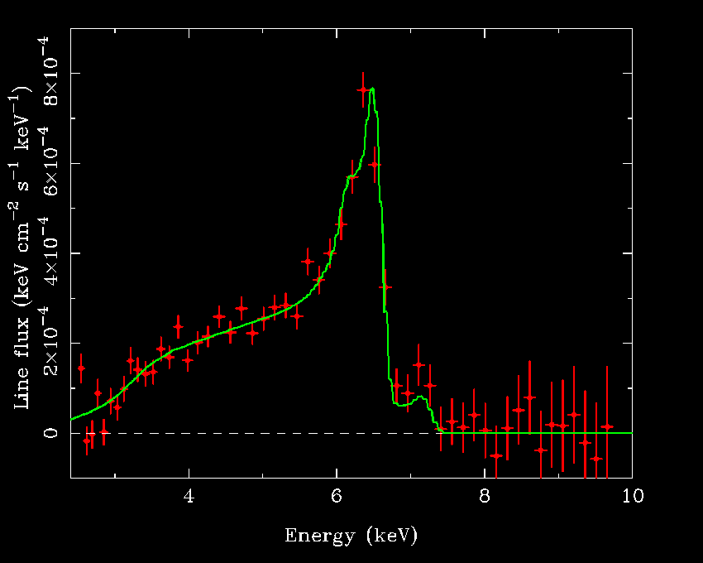
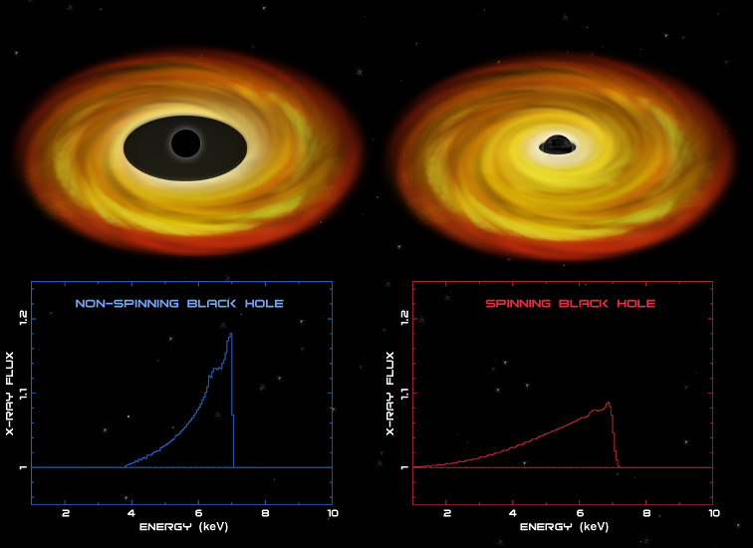
X-Ray Astronomy: Evidence for Black Hole
Relativistic Broadening of Iron Kα (6.4 keV)
2p → 1s transition array
Due to gravitational potential of the black hole photons lose energy
Asymmetric broadening at decreasing photon energies < 6.4 keV

Slide 8
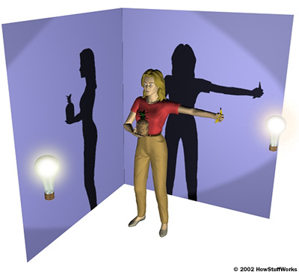
CATSCAN: Image Depends on Viewing Angle
Woman holding a pineapple if viewed from the right;
Or a banana if viewed from the front
N.B. The Image is formed by ABSORPTION not EMISSION,
as in an X-ray
NEED 3D IMAGE → CATSCAN

Slide 9
Biophysics: Imaging → Spectroscopy
Spectroscopy is far more powerful than imaging
“A spectrum is worth a thousand pictures”
Every element or object in the Universe has
unique spectral signature (like DNA)
Radiation absorption and emission highly efficient at resonant energies corresponding to atomic transitions in heavy element (high-Z) nanoparticles embedded in tumors
Spectroscopic imaging, diagnostics, and therapy

Slide 10
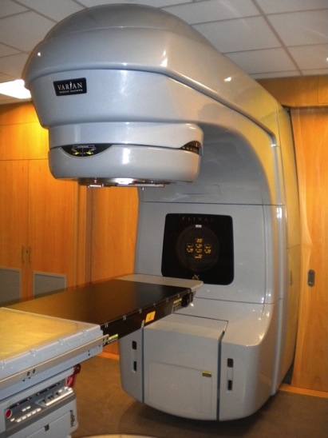
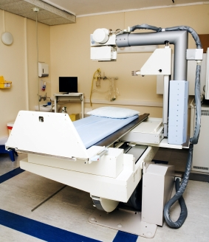
Medical X-Rays: Imaging and Therapy
6 MVp LINAC
Radiation Therapy
100 kVp
Diagnostics
How are X-rays produced?
Roentgen X-ray tube → Cathode + anode
Tungsten
Anode
Intensity
Electrons
Cathode
Peak
Voltage
kVp
Bremsstrahlung
Radiation
X-ray Energy

Slide 11
High-Energy-Density Physics (HEDP)
Laboratory and astrophysical sources
Energetic phenomena → AGN, ICF, lasers
Temperature-Density regimes → Fig. (1.3)
Opacity: Radiation ←→ Matter
Opacity Project, Iron Project
Iron Opacity Project → Theoretical work related to the Z-pinch fusion device at Sandia, creating stellar plasmas in the lab and measuring iron opacity

Slide 12
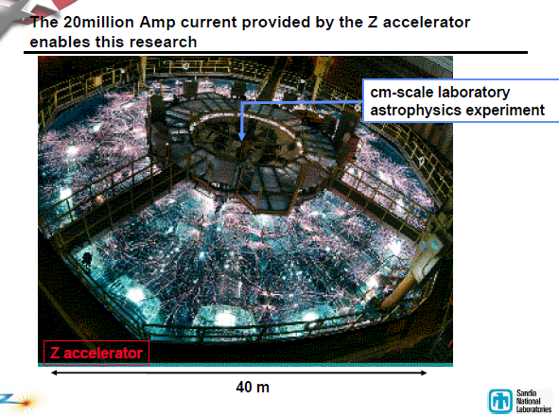
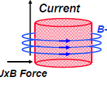
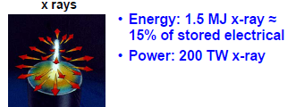
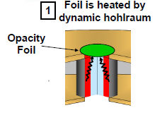
HED Plasma at Solar Interior conditions:
ICF Z-Pinch Iron Opacity Measurements
Z-pinch
Iron
Mix

Slide 13
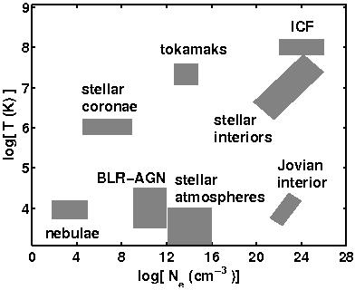
Temperature-Density In HED Environments
Adapted From
“Atomic
Astrophysics
And
Spectroscopy”
(Pradhan and
Nahar, (Cambridge
2011)
Non-HED
HED
Z
ISM

Slide 14
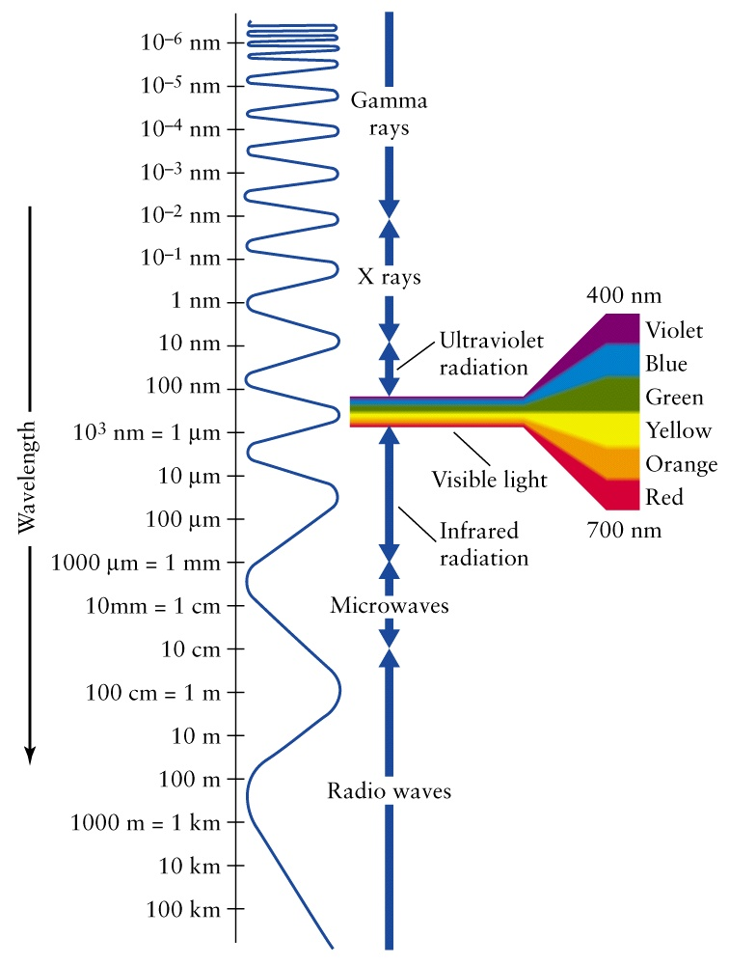
Light: Electromagnetic Spectrum
From Gamma Rays to Radio
Astronomy
Medicine
Gamma rays are the most energetic (highest frequency, shortest wavelength),
radio waves are the least energetic.

Slide 15
Light
Electromagnetic radiation: Gamma – Radio
Units: 1 nm = 10 A, 10000 A = 1 μm
Nuclear → Gamma
Atomic → X-ray, UV, O, IR, Radio (Fig. 1.2)
UV → NUV (3000-4000 A), FUV (1200-2000 A), XUV(100-1200 A) (Lyα 1215 A, Lyman edge 912 A)
O → 4000-7000 A (Balmer Hα,…: 6563-3650 A)
IR → NIR (JHK: 1.2, 1.6, 2.0 μm), FIR (5-300 μm)
Ground-based astronomy: UBVGRIJHK Bands
Molecular → sub-mm, Microwave (cm), Radio (m – km)
Gamma, X-ray → keV, MeV, GeV
Units: Rydbergs → Ang (Eq. 1.27)

Slide 16
Matter
Atoms, molecules, clusters, ions, plasma
Astrophysics → ISM, Nebulae, Stars, AGN
Compact objects → White dwarfs, Neutron stars (degenerate fermions)
Black holes ?
Laboratory → BEC (bosons; viz. alkali atom condensates)

Slide 17
Universal Matter-Energy Distribution
Cosmic abundances
Mass fractions → X, Y, Z (H, He, “metals”)
Solar composition → X: 0.7, Y: 0.28, Z: 0.02
All visible matter ~4% of the Universe
Dark Matter ~ 22%
Dark Energy ~ 74%

Slide 18
Spectroscopy (Ch. 1, AAS)
Light + Matter → Spectroscopy
Fraunhofer lines → Fig. 1.1
D2-lines
Optical H,K lines of Ca II (UV h,k lines of Mg II)
Stellar luminosity classes and spectral types
Atomic LS coupling (Russell-Saunders 1925)
Configurations → LS, LSJ, LSJF (Ch. 2)
Atomic structure is governed by the Pauli exclusion principle (Ch. 2), more generally by the Antisymmetry postulate

Slide 19
Energy-Matter Micro-distributions
Blackbody, luminosity, Planck function (Eqs. 1.4-1.6)
Example: The Sun (Figs. 1.4, 1.5)
Quantum statistics
Particle distributions: Maxwell, Maxwell-Boltzmann
Fermions, Bosons: Fermi-Dirac (FD), Bose-Einstein (BE)
FD, BE → Maxwellian, as T increases
Entropy: Evaporate from the Fermi-sea

Slide 20
Spectrophotometry
Broadband “colors” → high-res spectroscopy
Spectrophotometry maps an object in one spectral line, e.g. map the entire disk of the Sun in O III green line at 5007 A (filter out rest)

Slide 21
Syllabus and Overview
Methodology, approximations, applications
Atomic structure and processes: unified view
Radiation scattering, emission, absorption
Plasma interactions:
→ Line Broadening, Equation-of-state, opacities
Nebulae, stars, galaxies, cosmology
Molecular structure and spectra
Biophysics and nanophysics

