Slide 1
Lecture 3: Atomic Processes in Plasmas
Recall:
→ Individual atomic properties (intrinsic)
→ Plasma processes (extrinsic)
Electron-Ion processes: spectral formation
→ Electron impact excitation
→ Radiative decay and photo-excitation
→ Photoionization
→ Recombination

Slide 2
Electron-Ion Processes
Fig. 3.1 → Excitation
Fig. 3.2 → Excitation - Radiative decay
Figs. 3.3, 3.4 → Excitation – Autoionization
Fig. 3.5: Unified model
Inverse processes
Photoionization – Recombination
Autoionization – Dielectronic Recombination
Fig. 3.6

Slide 3
Ch. 3: Theoretical Framework
Coupled channel approximation
Quantum superposition of wavefunctions
Channels:
(electron-ion) or (e+ion) interaction pathways
Fig. 3.7

Slide 4
R-Matrix Method
Coupled channel (e+ion) wavefunction
Target of core ion wavefunction + free electron wavefunction
Determine target wavefunction a priori and independently
Couple free electron wavefunction with all target states considered
Solve coupled integro-differential equations
Eq. (3.45)
Approximations: Born, Coulomb Born, Distorted Wave
R-Matrix configuration space: Fig. 3.8

Slide 5
Ch. 5: Electron Impact Excitation
e(E) + X⁺_{i} → e(E’) + X⁺_{j} (level i → j excitation)
Fig. 5.1 → Excitation/Ionization of O II
Eq. 5.1 → Excitation Cross section
Fig. 5.2 → Electron-ion scattering
Eq. 5.5 → Collision strength
Sec. 5.3.1 → Isoelectronic sequence

Slide 6
Electron Impact Ionization and Auger process
e + X⁺ → e₁ + (X⁺ + e₂)
Two electrons in final continuum states
RHS has a component like EIE
Resonances in EIE
BUT → resonances appear as stepwise in cross sections: Fig. 5.9
Auger decays: Fig. 5.11

Slide 7
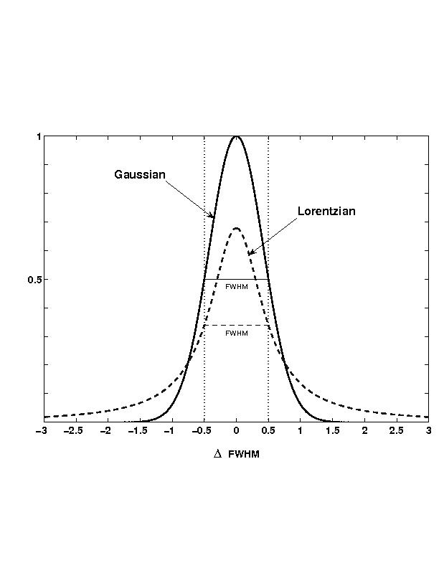
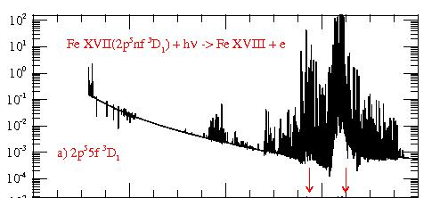
Resonances: Bound and continuum states
(Coupled wavefunctions)
Uncoupled bound states
Symmetric line profile
Coupled bound and continuum states (channels)
Autoionization
Asymmetric resonance profile
Coupled channel approximation

