Slide 1
Lecture 5: Molecular Physics and Biophysics
Comparison with atoms
No spherical symmetry → symmetry groups
Molecules have three degrees of freedom
Electronic, Vibrational, Rotational
Wavelengths: Optical/UV, IR, microwave/radio

Slide 2
Simplest Molecule: H₂⁺
Two protons share an electron
Gerade and Ungerade states

Slide 3
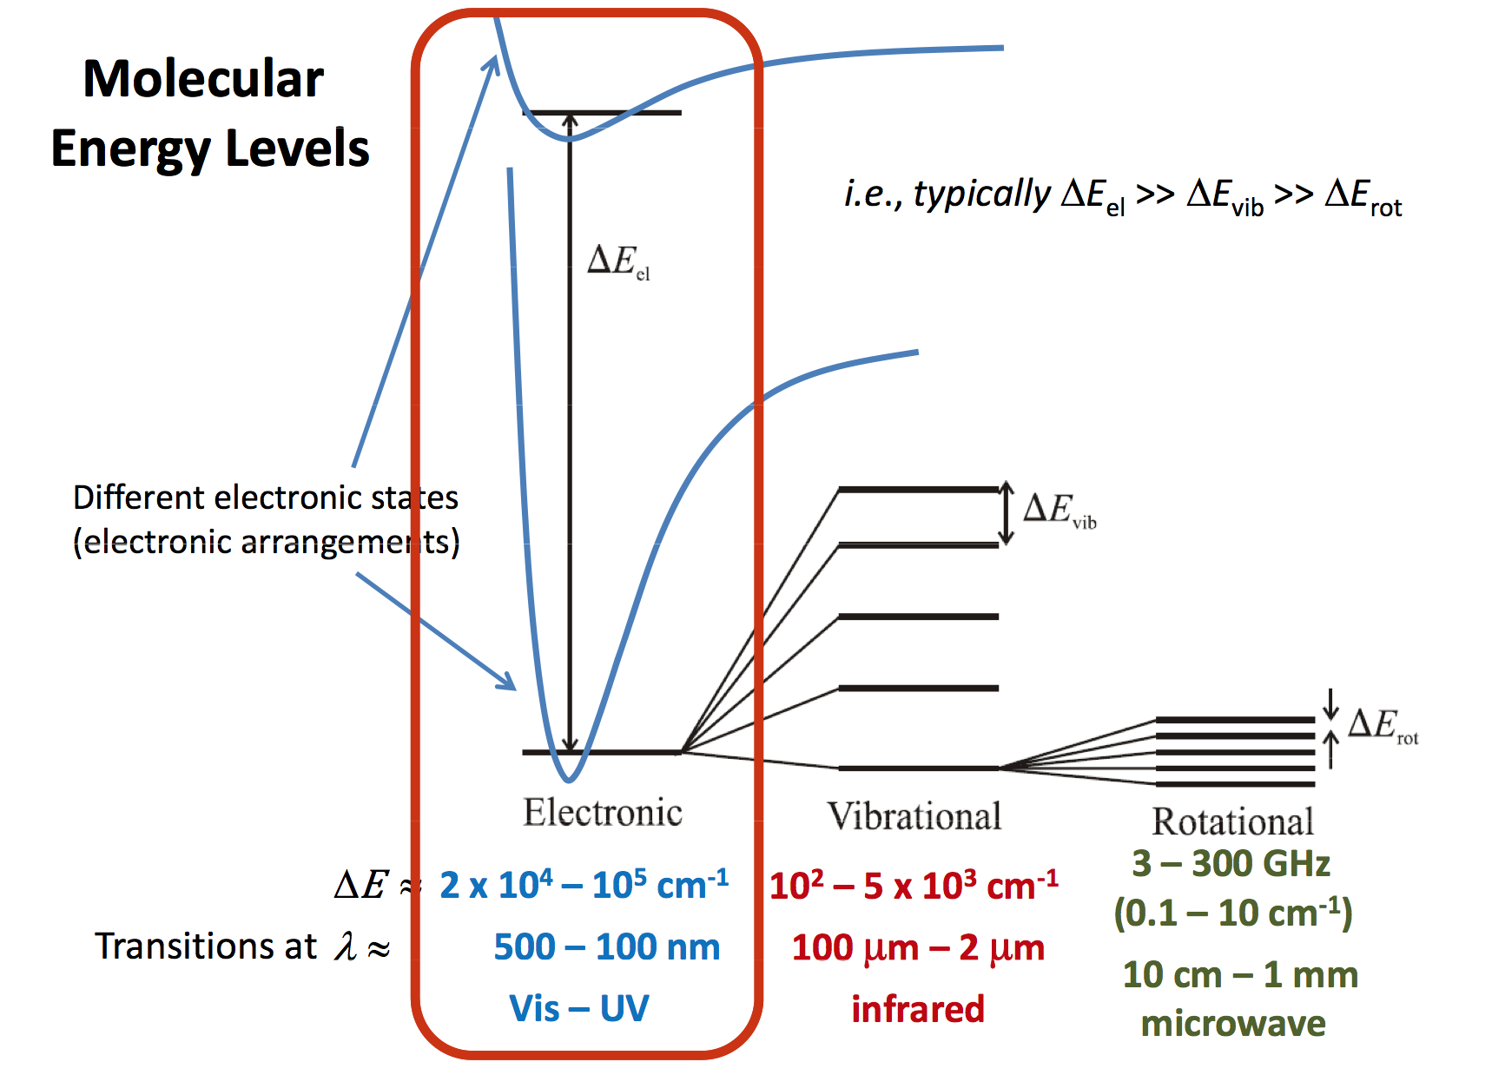

Slide 4
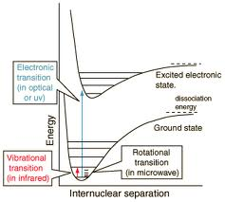
Electronic, Vibrational, Rotational

Slide 5
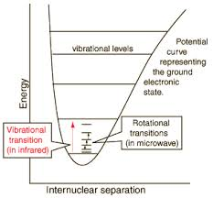
Ro-vibrational Transitions

Slide 6
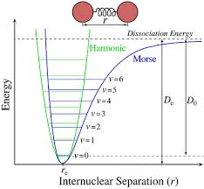
Morse Potential
Depth minimum of potential well: D_{e}
Dissociation energy: D_{o}

Slide 7
Vibrational and Rotational Energies
We treat the molecule's vibrations as those of a harmonic oscillator (ignoring anharmonicity). The energy of a vibration is quantized in discrete levels and given by
E(v) = hν (v+1/2)
Where v is the vibrational quantum number and can have integer values 0, 1, 2..., and ν is the frequency of the vibration given by:
ν = (1/2π) (k/μ)^{1/2}
Where k is the force constant and μ is the reduced mass of a diatomic molecule with atom masses m₁ and m₂, given by
Μ = m1m2 / (m1+m2)
We treat the molecule's rotations as those of a rigid rotor (ignoring centrifugal distortion). The energy of a rotation is also quantized in discrete levels given by
E(r)= (h^{2/}8π²I) J(J+1)
Rotational constant B = (h^{2/}8π²I)
In which I is the moment of inertia, given by
I=μr²
Where μ is the reduced mass from above and r is the equilibrium bond length.

Slide 8
Morse Potential Terms
The potential energy, V(R), of a diatomic molecule can be described by the Morse potential
V(R) = D_{e} = [1 – exp(-β (R – R_{e})]
where De is the well depth, R is internuclear distance, Re is the equlibrium internuclear distance (bond length), and
β = πν_{e} (2μ/D_{e})^{1/2}
ν_{e} is the vibrational constant and µ is the reduced mass.
Energies may be calculated from
SHO + Anharmonic terms

Slide 9
Rotational Transition Energies
J-selection rules:
ΔJ = +1 → R Branch
ΔJ = -1 → P Branch
For a given vibrational level:
ΔE=hν₀+hB[J(J+1)−J′(J′+1)]

Slide 10
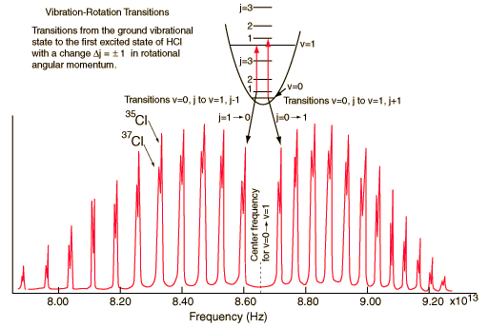
R and P Branches of Ro-vibrational Spectra

Slide 11
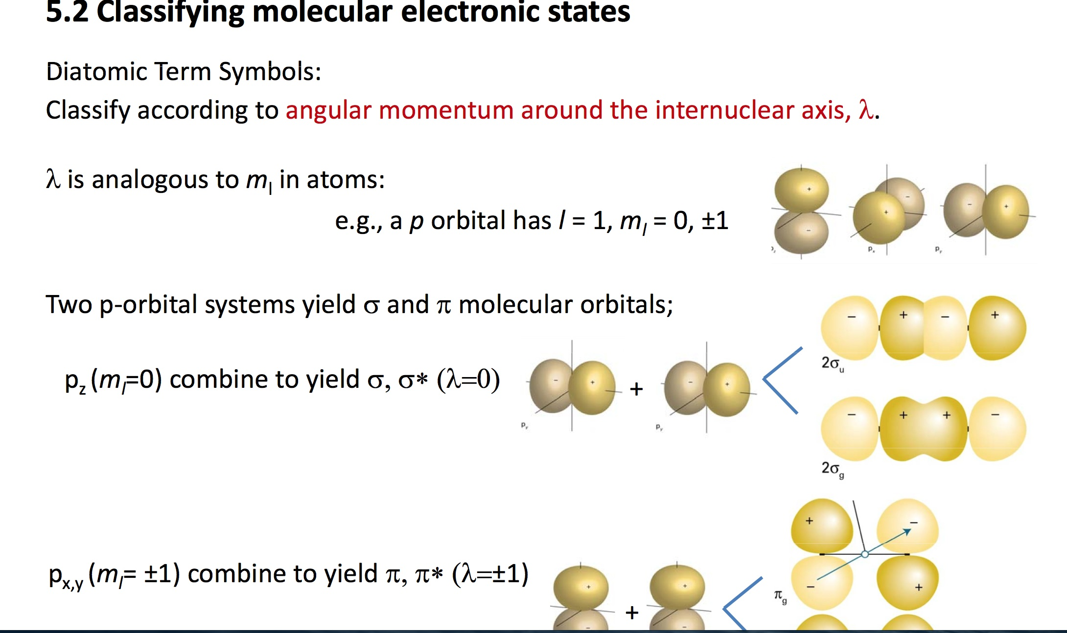
Molecular Orbitals and States

Slide 12
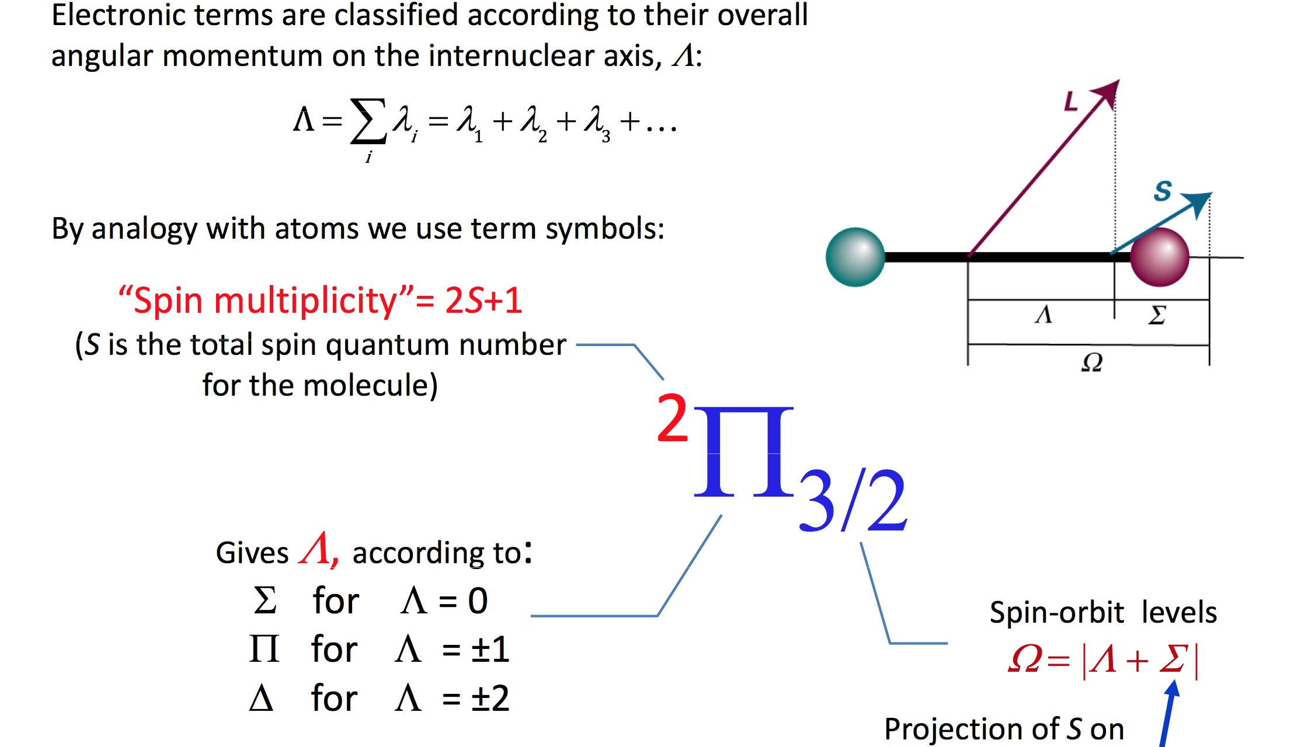
Molecular States and Terms

Slide 13
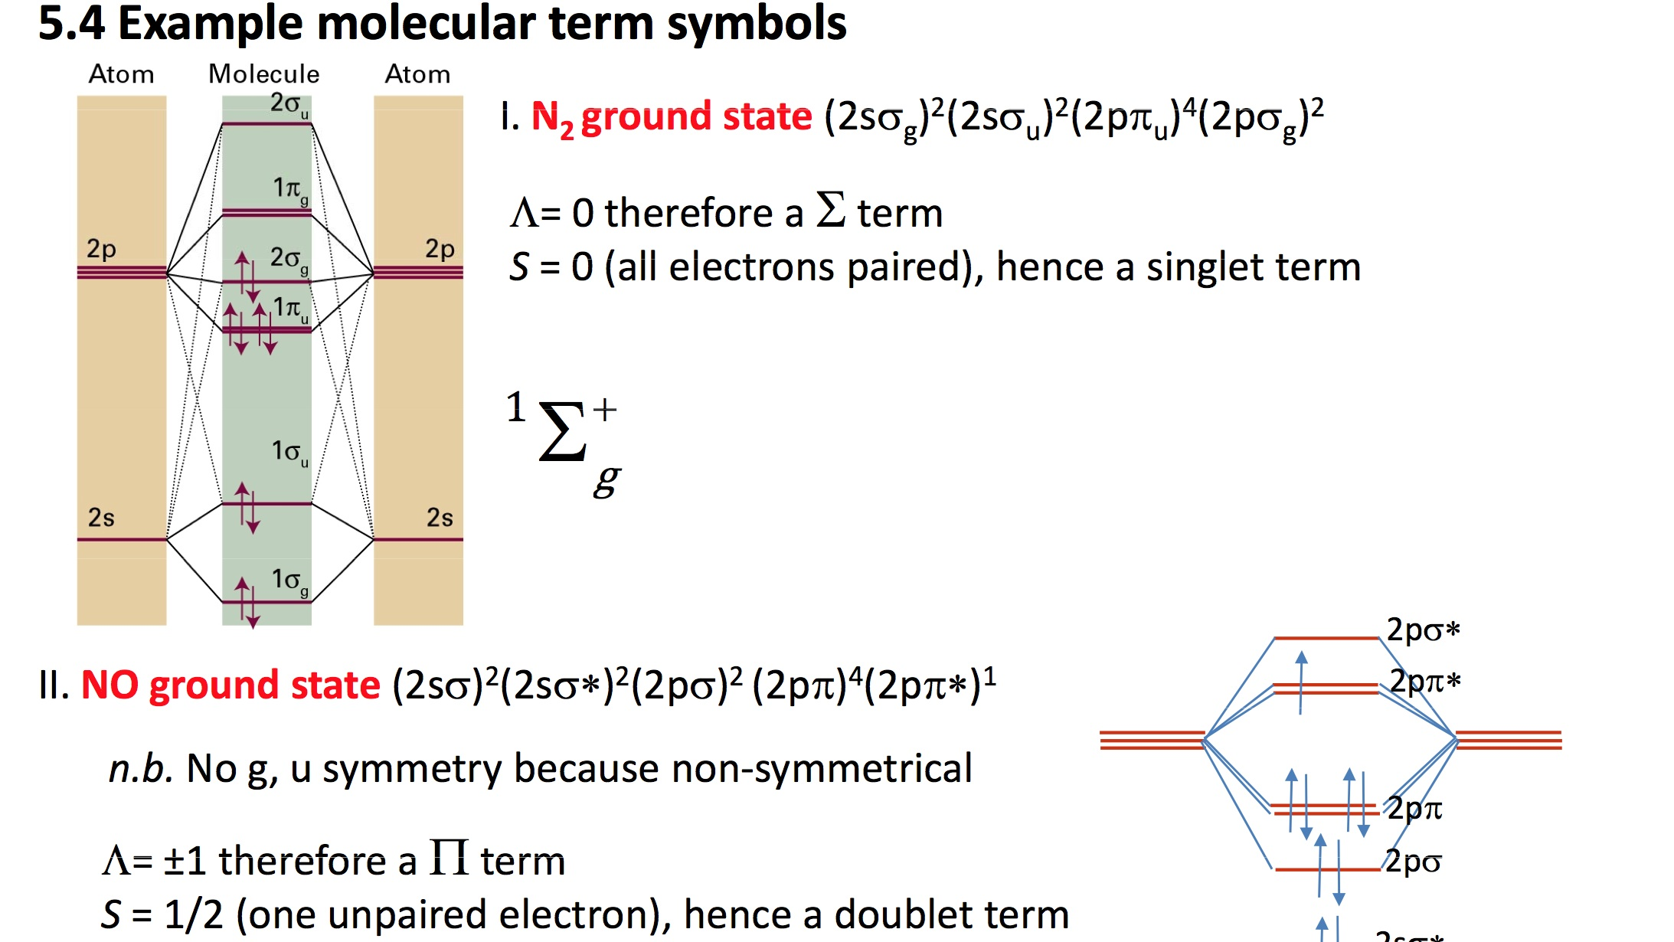

Slide 14
Elements of X-Ray Biophysics
X-ray devices emit broadband radiation
Cathode-Anode: Electron beam → high-Z target
Bremsstrahlung radiation: 0-V_{p} (peak voltage)
X-ray machines, CTscanners ~ 100 KV_{p}
Linear Accelerators: 6-15 MV_{p}
Broadband bremsstrahlung radiation is harmful because it is not energy specific to targeted tissue for imaging or therapy

Slide 15
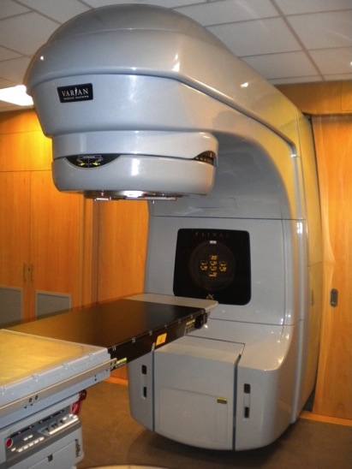
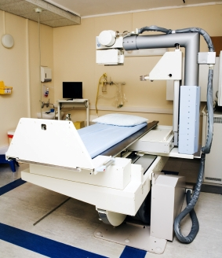
Medical X-Rays: Imaging and Therapy
6 MVp LINAC
Radiation Therapy
100 kVp
Diagnostics
How are X-rays produced?
Roentgen X-ray tube → Cathode + anode
Tungsten
Anode
Intensity
Electrons
Cathode
Peak
Voltage
kVp
Bremsstrahlung
Radiation
X-ray Energy

Slide 16
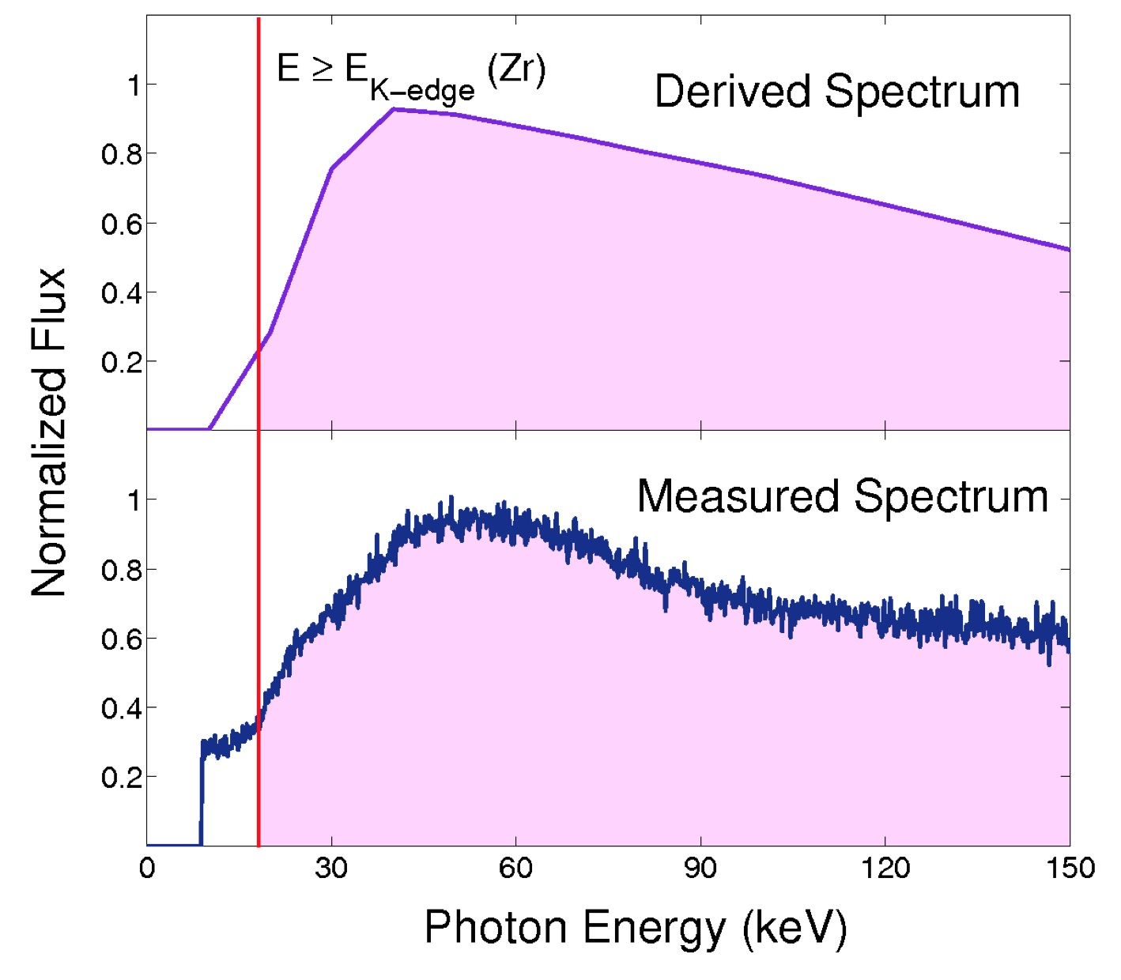
Bremsstrahlung X-Ray Spectrum
Low-energy filtered
Bremsstrahlung-to-monochromatic conversion

Slide 17
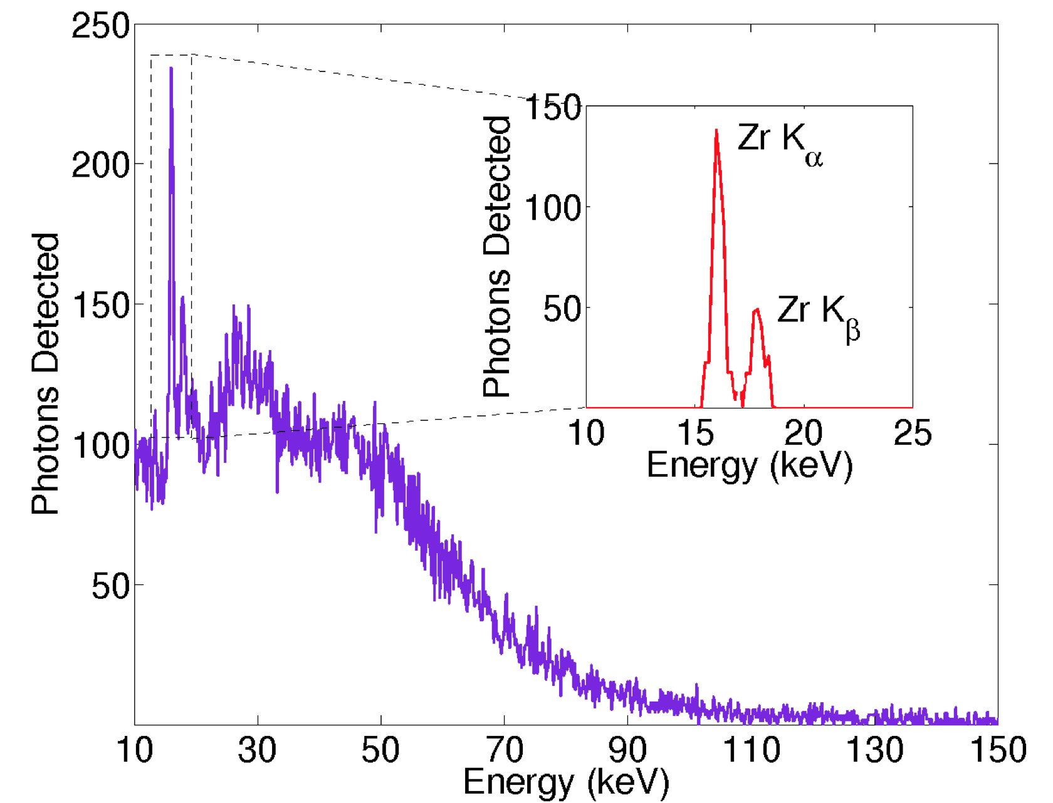
Bremsstrahlung-to-Monochromatic
X-Ray Production: Zr K_{α}, K_{β}

Slide 18
Biophysics: Imaging → Spectroscopy
Radiation absorption and emission highly efficient at resonant energies corresponding to atomic transitions in heavy element (high-Z) nanoparticles embedded in tumors
Need monochromatic X-ray source to target specific atomic features in high-Z atoms
Resonant Nano-Plasma Theranostics

Slide 19
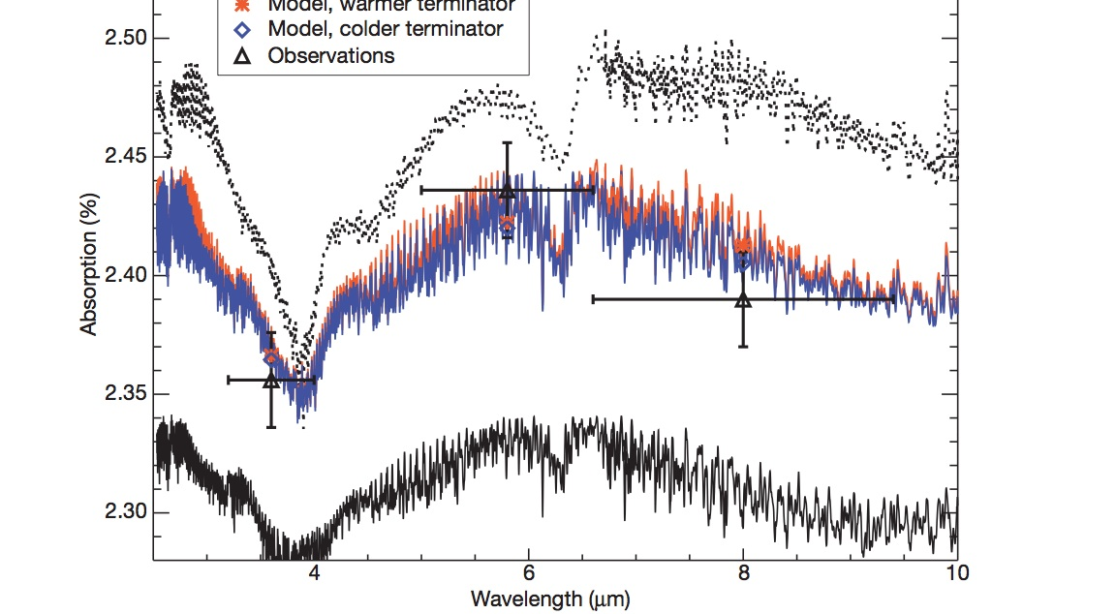
Water in Extra-Solar Planet !
Tinetti et al.
Nature, 448,
169 (2014)

