Slide 1
Education becomes enriched, only when, it is linked up with STEM and is Holistic
Dr. P. Basak Shares as Chief Guest
In 2nd workshop of Women in STEM Roadshow (WSR)
JMI in Delhi on Feb 7, 2018

Slide 2


What is STEM?

Slide 3




Acronym for Science, Technology,
Engineering & Math
Acronym for Science, Tech, Engg, Arts & Math
Acronym for Science, Technology,
Robotics, Engg, Arts & Math,

Slide 4
Family & Consumer Sciences
(FCS)
& its link up with
One of the first STEM linked
Discipline was HOME SCIENCE in India, also known as FCS (Family & Consumer Sciences) in USA

Slide 5

What is FCS ?
It is a branch of Science established by
Ellen Swallow Richards
Prof. MIT, USA

Slide 6

Founded Home Economics, which applied science to housework
1842 - 1911
This allowed women, to spend less time in chores, and give them time to pursue higher education & careers

Slide 7
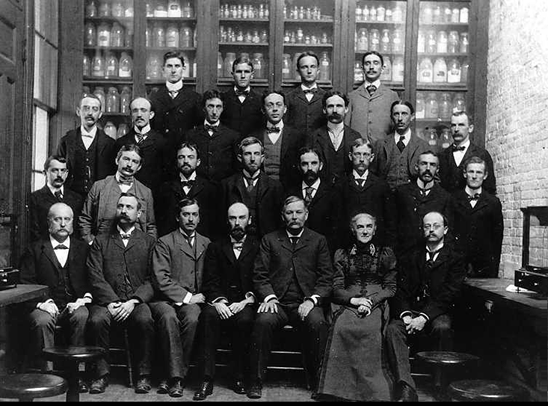
Dr. Swallow in MIT, USA in early 1900
Dr Swallow quickly impressed the anti-Swallow camp of MIT with her scientific acumen.
William Ripley Nichols, a professor of chemistry, who initially objected, to allowing a woman into the labs. Worked with her

Slide 8
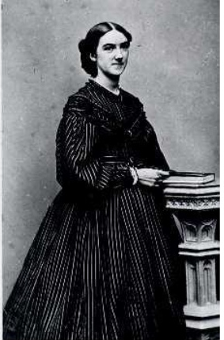
Ellen H. Swallow Richards
(1842 – 1911)
The most prominent female chemist of the 19th Century
Was a pioneer in Sanitary Engineering and a founder of Home Economics in USA
She was the first to suggest that the public water, be treated with chlorine

Slide 9
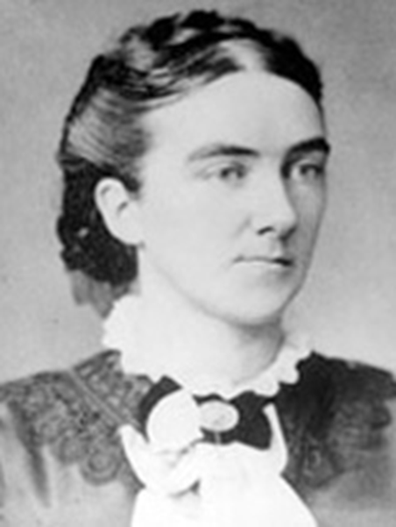
Ellen Swallow Richards
Founded Family & Consumer Sciences (FCS)
Ellen lived 1842-1911 when filth, disease & suffering was common. Only half of the children lived to adulthood.
Ellen became a scientist, philosopher and change agent at MIT.
She felt science and research would have a stronger impact if it applied, to improve living environments.
Ellen Swallow Richards
FCS Pioneer 1842-1911

Slide 10
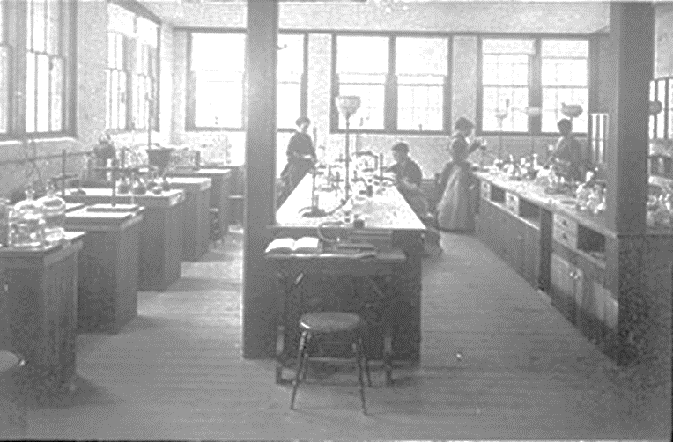
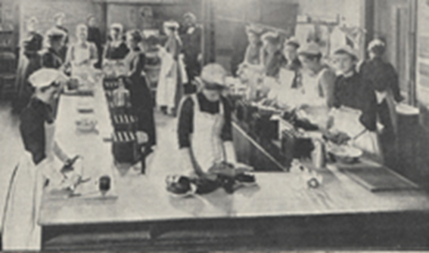
Our first STEM connection
She was dedicated to this new field of connecting scientific knowledge to practical applications.
She addressed food safety, water quality and safe home environments.

Slide 11

Overall STEM Education…
Integrates science, technology, engineering,
& math into one learning experience
Uses project-based learning
Reinforces real world application
Prepares students for integrated careers
Develops “soft” & technical skills

Slide 12
STEM SKILLS

Slide 13
STEM Skills
Technical skills,
  troubleshooting, repairing, and utilizing software and modern equipment
Communication and cooperation skills
to listen to customer needs with project partners.
Teamwork skills for successful project completion.
Creativity to solve problems and develop new ideas.
Leadership skills to lead projects or help customers.
Organization skills to keep track of different information
Time management skills to function efficiently.

Slide 14
STEM in
FCS
(Family & Consumer Science)

Slide 15
STEM is FCS
Creative Problem Solving
Consumer & Family Resources
Demonstrate management of individual and family resources such as food, clothing, shelter, health care, recreation, transportation, time, and human capital
Teamwork, Leadership, & Time Management
Career, Community & Family Connections
Analyze strategies to manage multiple roles and responsibilities (individual, family, career, community, and global)

Slide 16
STEM is FCS
Math Skills
Food Production & Services
Apply principles of
inventory management,
labor cost & control, and
facilities management
to front and back of the house operations
Curiosity & Imagination
Education & Early Childhood
Demonstrate integration of curriculum and instruction to meet children’s developmental needs and interests

Slide 17

Integrated Content:
• Kitchen Math
• Food Chemistry
• Reality Learning vs. Abstract Math Problems
• Financial Literacy
• Problem Solving and Synthesis
• Interdisciplinary Content
…and more!

Slide 18

All FCS Careers are
based in…
FCS
(Family Consumer Sciences)
Also known as Home Science
All FCS Careers are
Based in ….
CONTENT KNOWLEDGE
Family & Consumer Sciences
Biology
Design
Business
Nutrition
Economics
(financial literacy)
Sociology
Architecture
(housing styles)
Microbiology
Food Safety
Chemistry
(cooking/baking)
Psychology
(consumer decision making)
Engineering
(fashion/textiles)
Ecology
(family studies)
Anthropology
(family studies)
Communications
& Media
Physics

Slide 19

Identifying STEM in Textiles & Apparel
Biology: Animal fibers
Botany: Plant fibers
Physics: Functional clothing
Physiology & Anatomy:
Thermal regulation, garment
motion studies, fitting
Chemistry: Synthetic fibers,
textile treatment, laundry

Slide 20

Physical
Education
Emotional
Education
Holistic Education means education in 7 sectors together and running parallelly
Environmental
Education
Spiritual
Education
Intellectual
Education
Education becomes perfect, only when
Education is Holistic and it is linked up with
STEM or
STEAM or
STREAM
Social
Education
Occupational
Education

Slide 21
Seven Sectors of Holistic Education
All sectors move together,
from lower KG to PhD
Physical Edu
Health and Fitness through Yoga, Medttation, Exercise, sports and relaxation to control
Stress in Body & Mind
Aging Process
Weight & Cholesterol
Substance use (Alcohol, drugs)
Emotional Edu
Management of Anger, Anxiety, Grief, Desperation, Love, Fear of failure
Development of Personality, Hardiness, Serenity, Joy, Self
Happiness,
Environmental Edu
Knowledge of Declining Resources &
Increasing Population Growth,
Increasing Waste, Recycling,
Pollution and its control
Biodiversity and web of life
Ecology
Spiritual Edu
Ahimsa, Peace, Harmony,
Conflict resolution,
Tolerance, respect others
Honesty & Integrity
Character building
Meditation, Concentration
Eco-spirituality, Nature,
Intellectual Edu
Imagination, Creativity
Intuition & sixth sense
Analysis,& Synthesis
Organized thinking,
Goal Setting &focus Communication Skills
Education becomes perfect, only when
Education is Holistic and it is linked up with
STEM or
STEAM or
STREAM
Social Education
Social Values & Communication
Mannerism & Leadership
Societal involvement and
Responsibility sharing, Equity
Aparigraha (Non greedy)
Occupational Edu
Carrier planning
Skill development
On the job learning
Leadership dev
Time Management

Slide 22
THANK YOU

