Slide 1
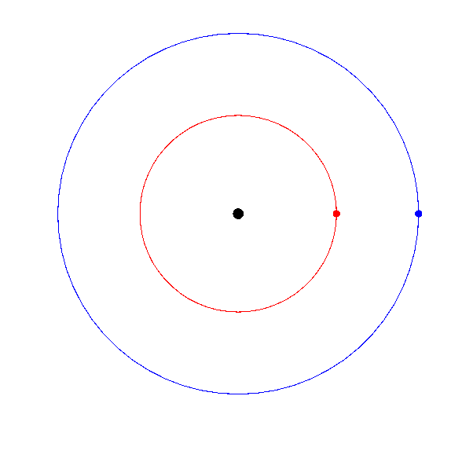
Sun
Jupiter
R=5.2 AU
P=11.8 yr
Saturn
R=9.5 AU
P=29.5 yr

Slide 2
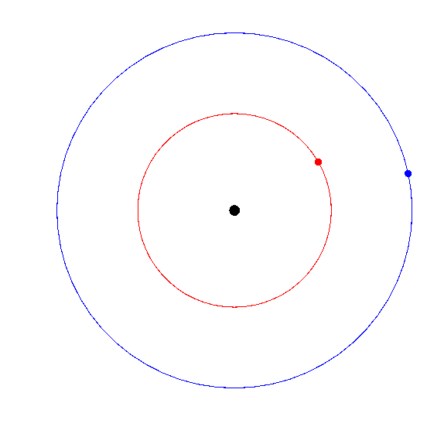

Slide 3
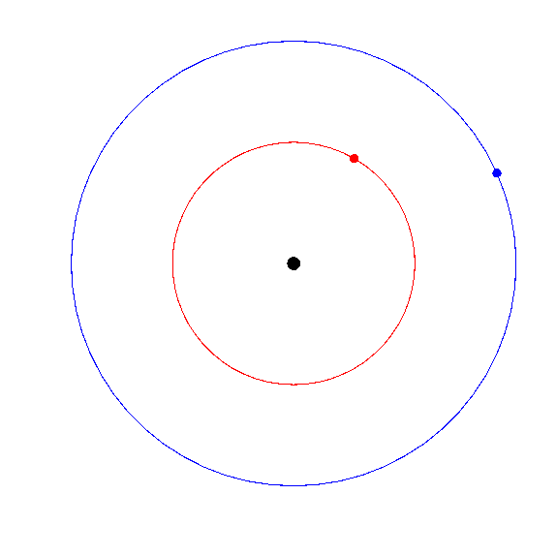

Slide 4
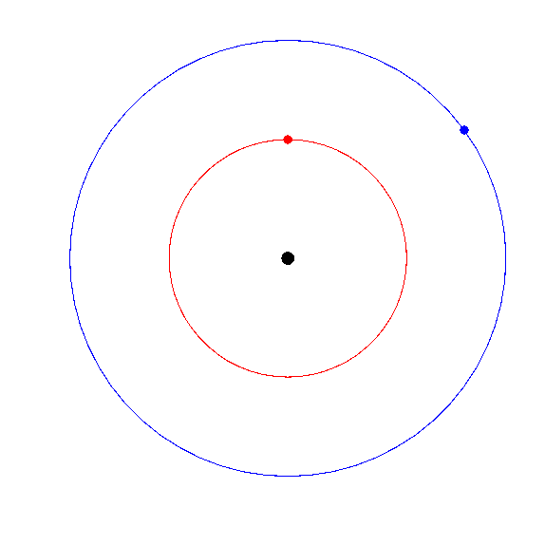

Slide 5
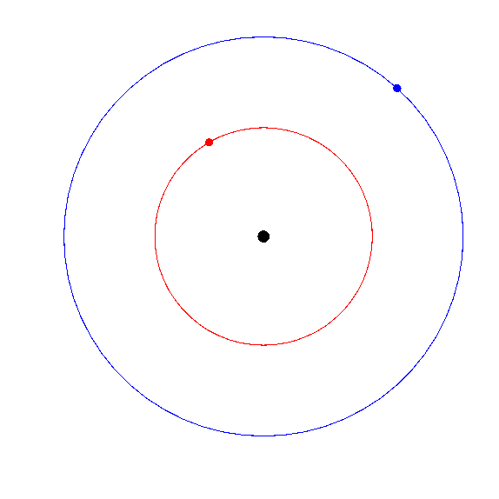

Slide 6
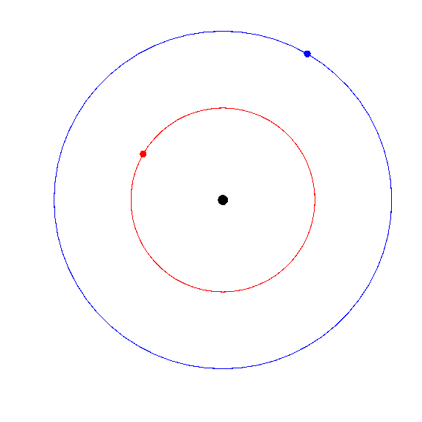

Slide 7
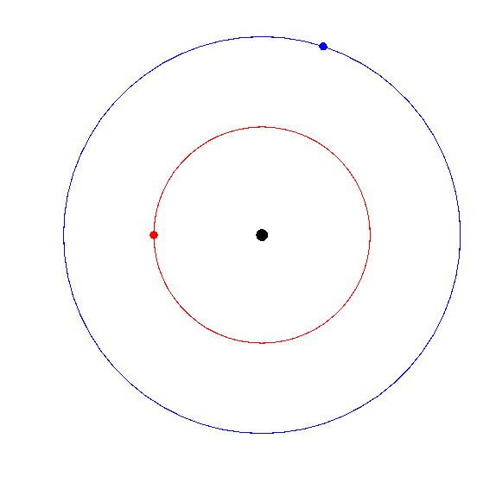

Slide 8
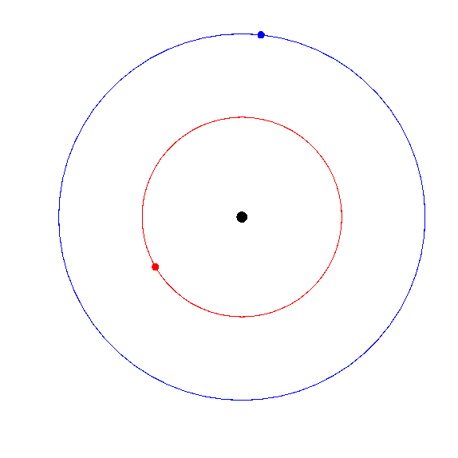

Slide 9
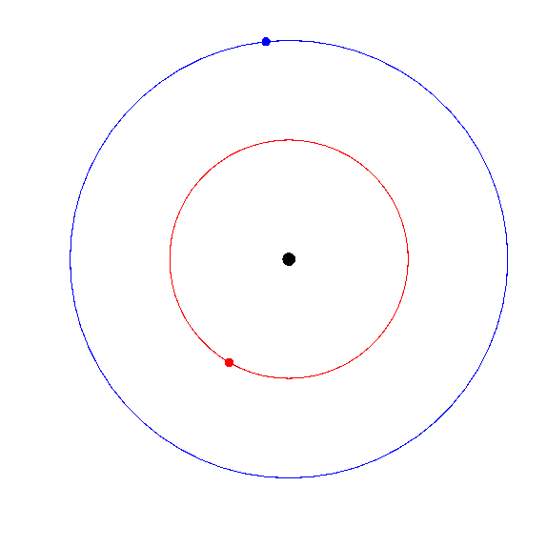

Slide 10
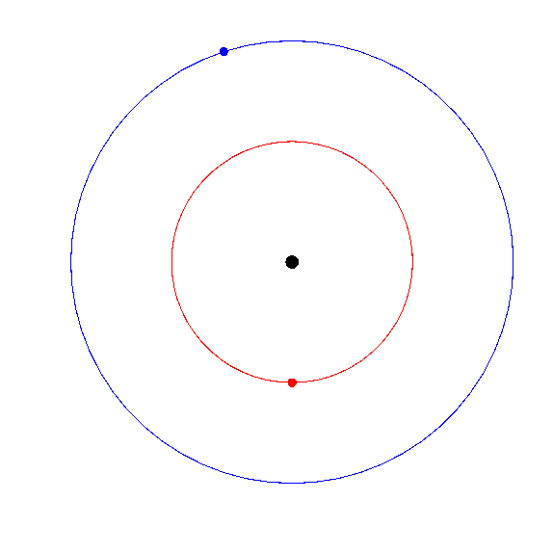

Slide 11
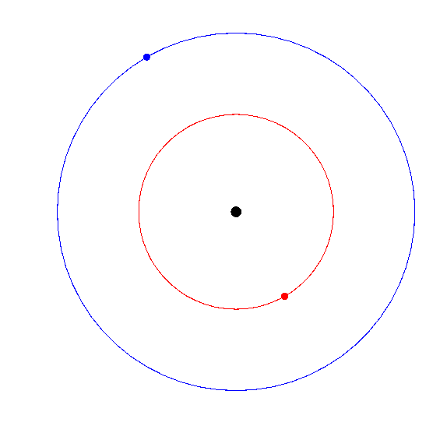

Slide 12
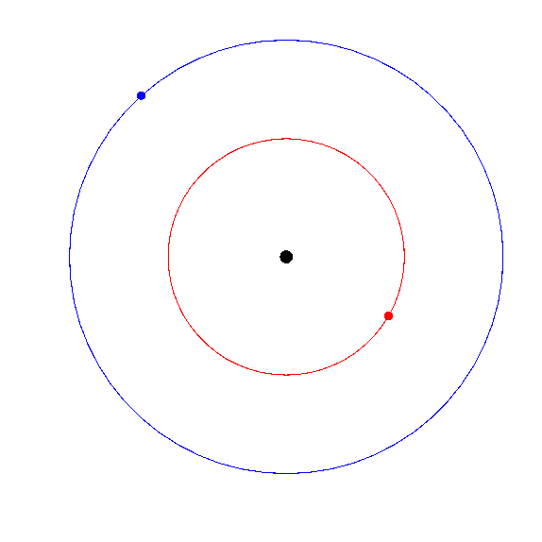

Slide 13
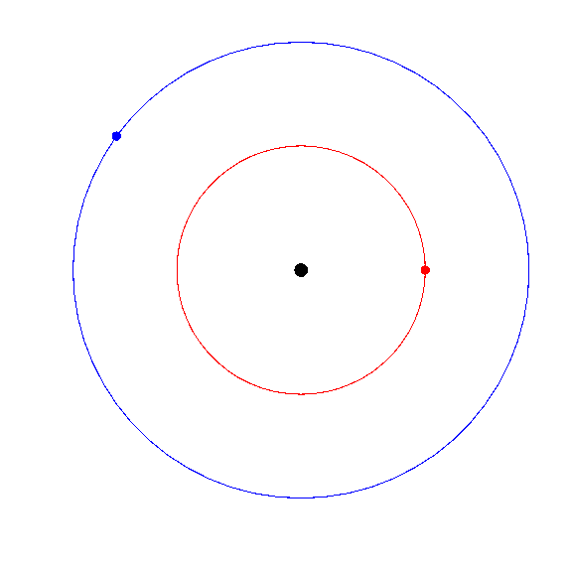

Slide 14
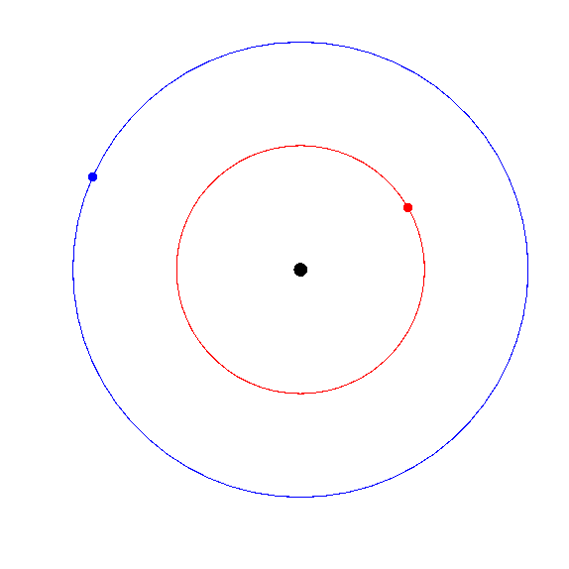

Slide 15
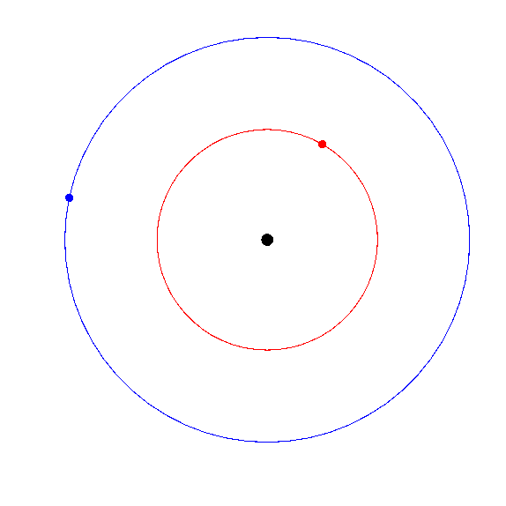

Slide 16
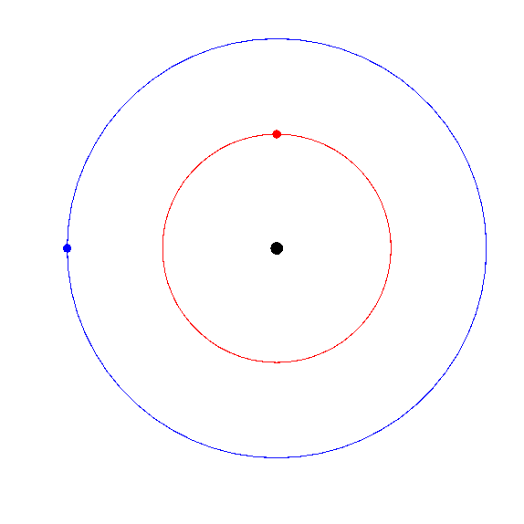

Slide 17
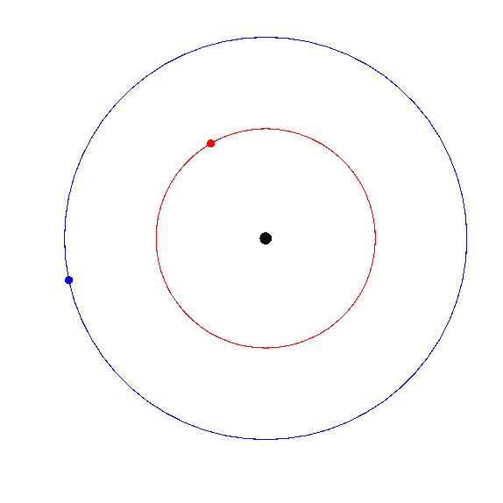

Slide 18
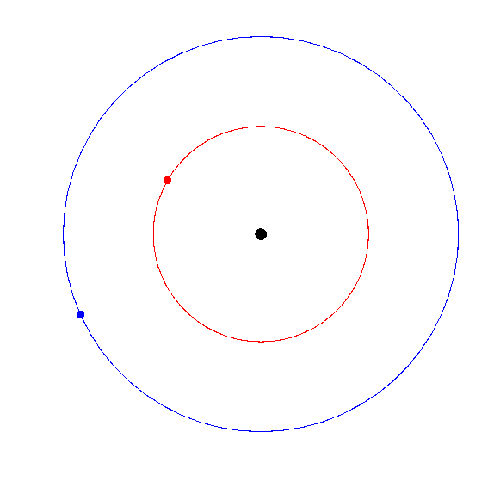

Slide 19
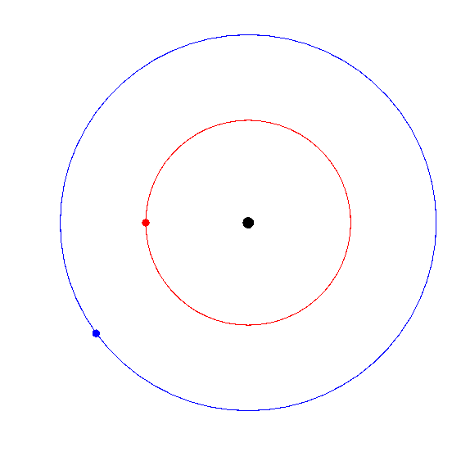

Slide 20
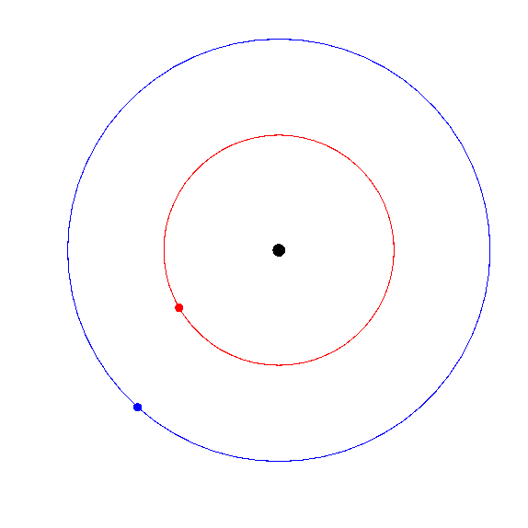

Slide 21
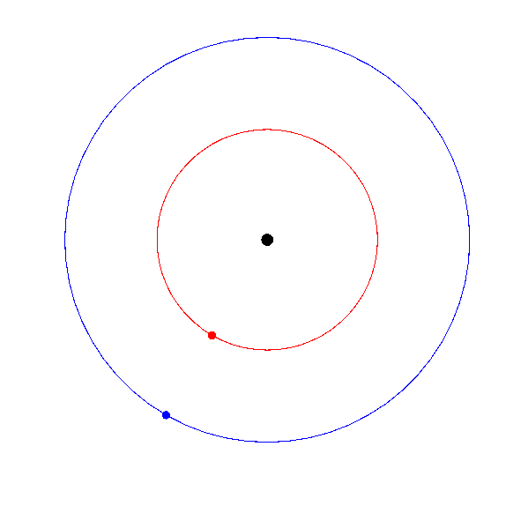

Slide 22
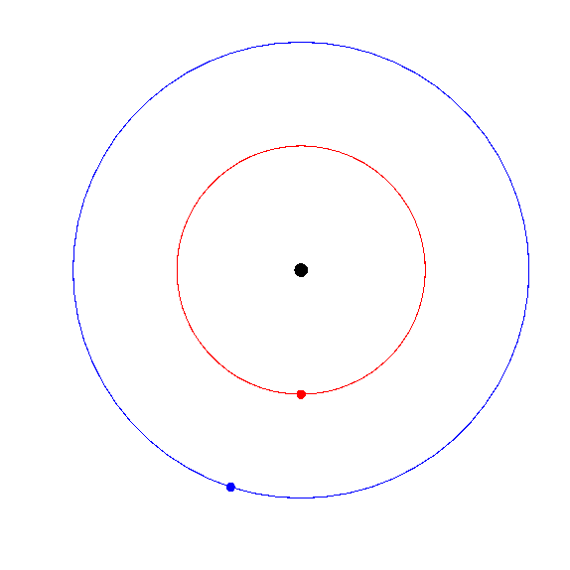

Slide 23
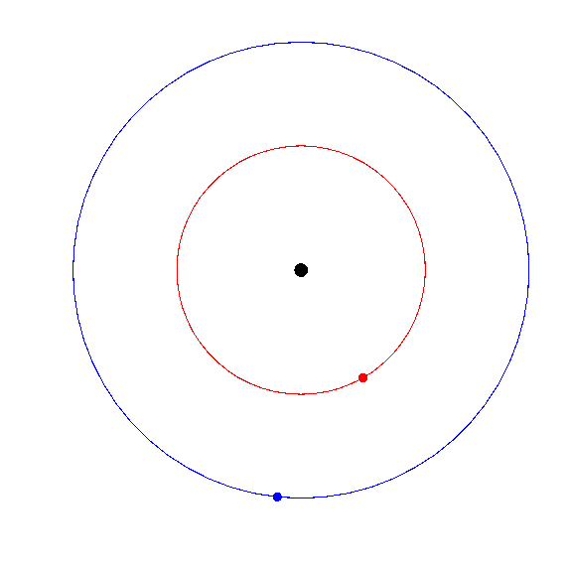

Slide 24
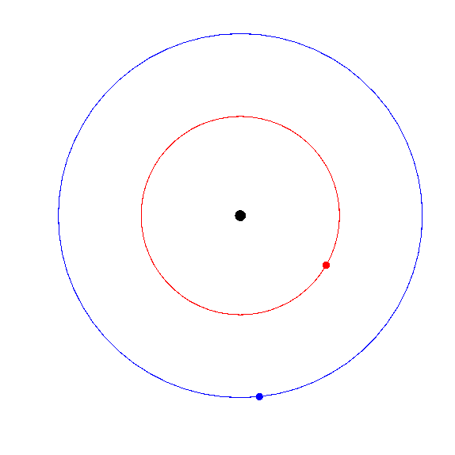

Slide 25
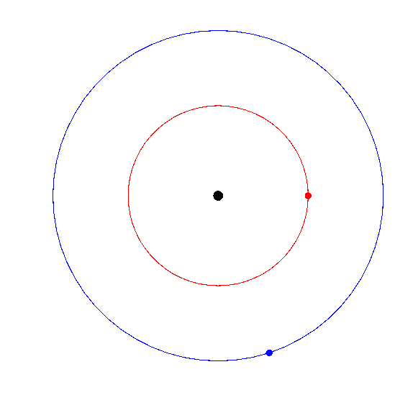

Slide 27
M_{jup} / M_{sun} = 1/1000
M_{sat} / M_{sun} = 1/3500
Configuration 1
Jupiter is speeding up and Saturn is slowing down
Jupiter is slowing down and Saturn is speeding up
Jupiter and Saturn are both speeding up
Jupiter and Saturn are both slowing down
Neither planet is changing speed

Slide 29
Configuration 2
Choose all that apply
Jupiter is moving faster than its average orbital speed
Jupiter is moving slower than its average orbital speed
Saturn is moving faster than its average orbital speed
Saturn is moving slower than its average orbital speed
Both planets are moving at their average orbital speed

Slide 32
M_{jup} / M_{sun} = 1/1000
M_{sat} / M_{sun} = 1/3500
Configuration 3
Jupiter is speeding up and Saturn is slowing down
Jupiter is slowing down and Saturn is speeding up
Jupiter and Saturn are both speeding up
Jupiter and Saturn are both slowing down
Neither planet is changing speed

Slide 33
M_{jup} / M_{sun} = 1/1000
M_{sat} / M_{sun} = 1/3500
Saturn’s average orbital speed is about 10 km/sec.
The gravity of Jupiter probably changes Saturn’s orbital speed by roughly:
1 km/sec
10 meters/sec
10 millimeters/sec
No change at all

