Slide 1
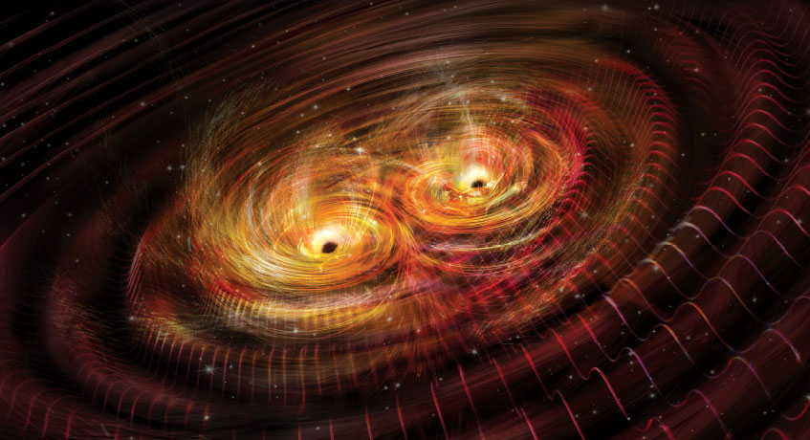
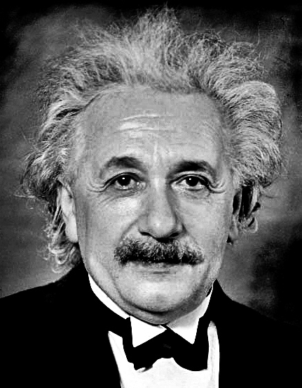
Gravitational Waves
Created by accelerating masses, e.g., orbiting stars or black holes.
Stretch and squeeze distances in an oscillating pattern as they pass.

Slide 2
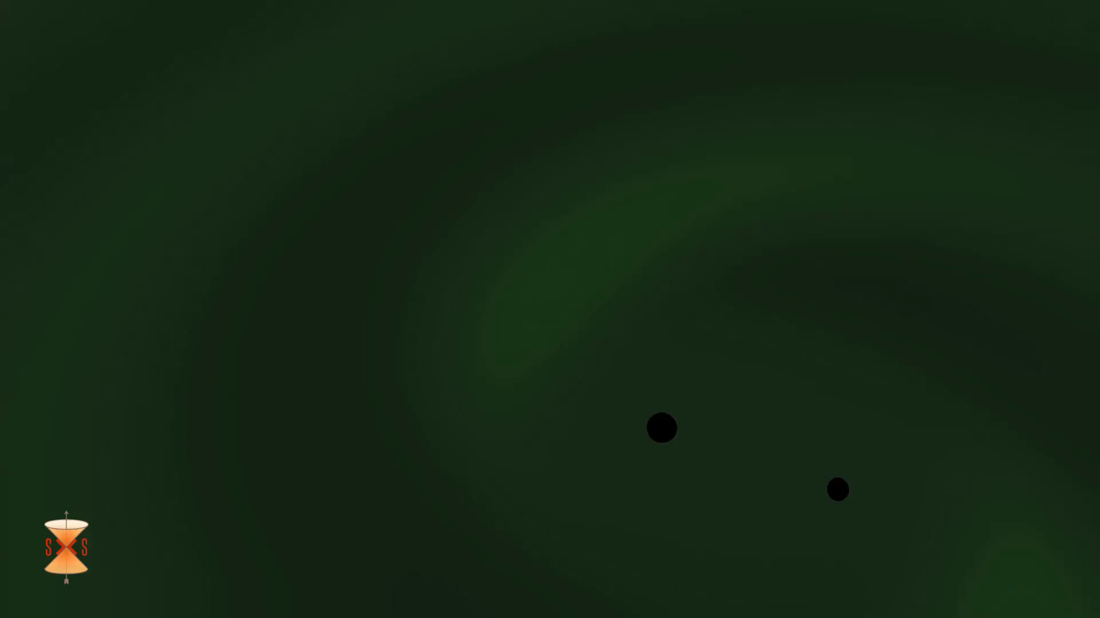
Inspiral of merging black holes
Videos available at ligo.caltech.edu

Slide 3
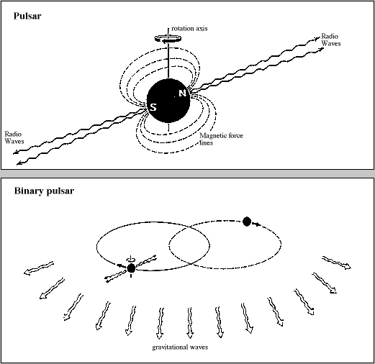
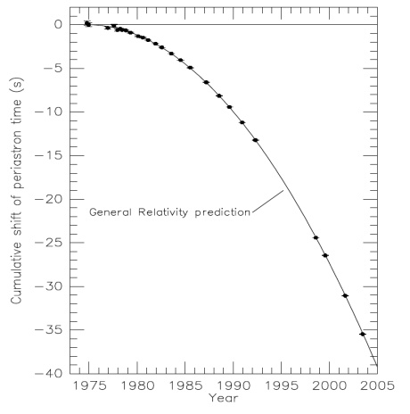
Orbit of binary pulsar (pair of neutron stars) shrinks as they emit gravitational waves that carry off energy.

Slide 4
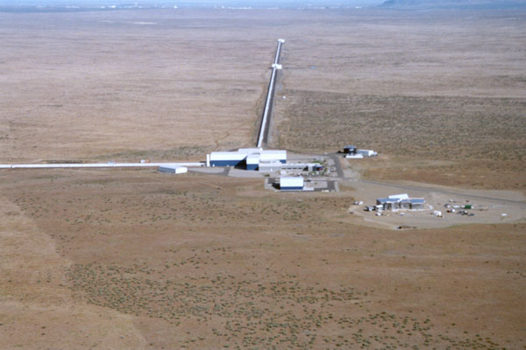
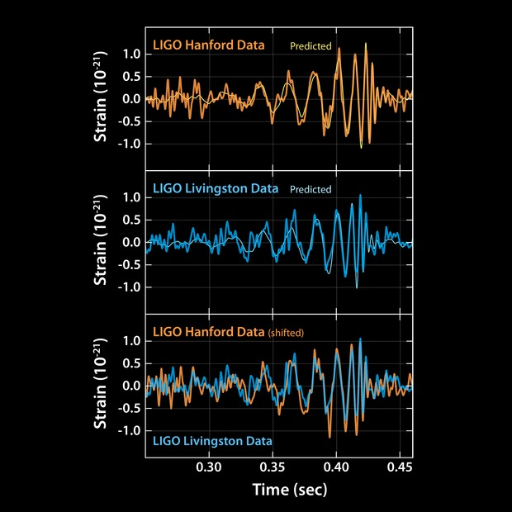
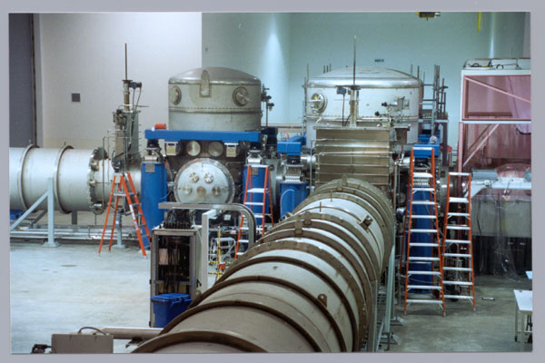

Slide 6
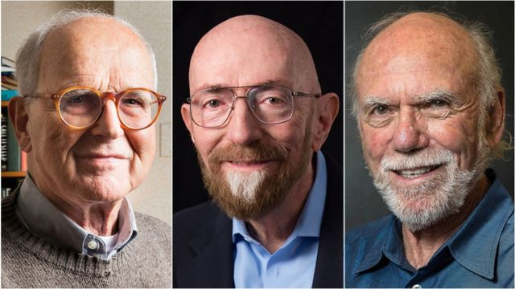
2017 Nobel Prize in Physics
Rai Weiss, Kip Thorne, Barry Barish

Slide 7


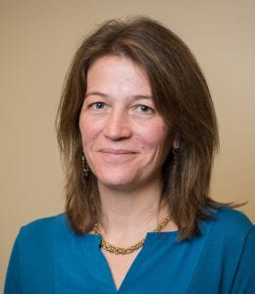

Nergis Mavalvala
Gabriela Gonzales
Laura Cadonati
Vicky Kalogera

Slide 8
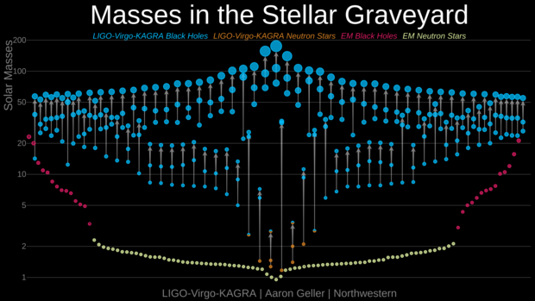
Mergers discovered to date (11/21) by gravitational waves, compared to neutron stars and black holes with known masses found with EM waves.

Slide 9
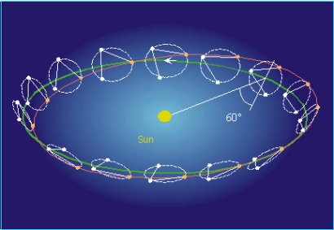
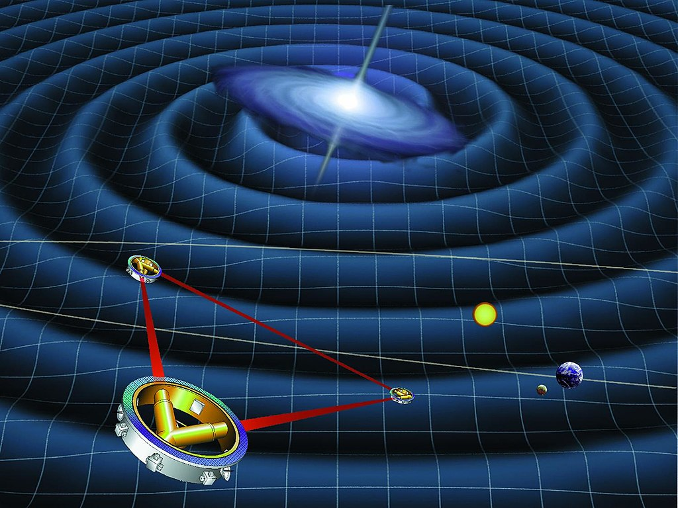
Laser Interferometer Space Antenna (LISA): Currently scheduled for 2027 launch

