Slide 1

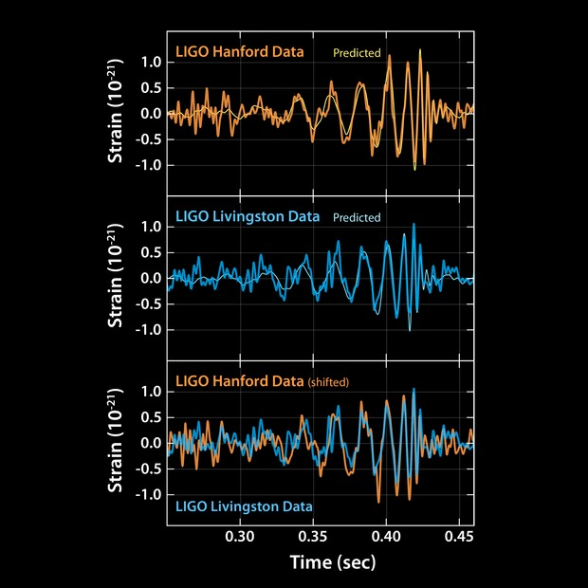
Astronomy 1142: Black Holes
Professor David Weinberg
Autumn 2021

Slide 2
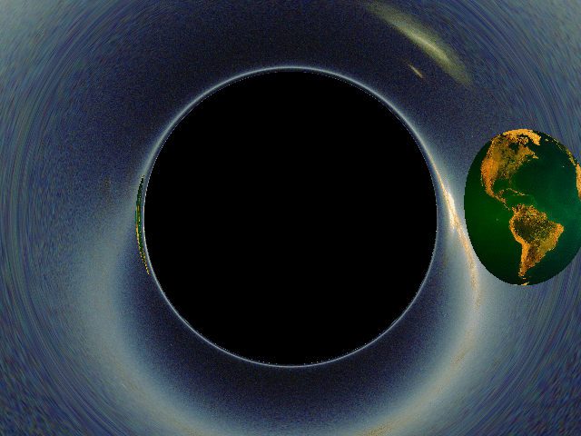

Slide 3
Write down two things you know (or think you know) about black holes.
Write down two questions you have about black holes.

Slide 4
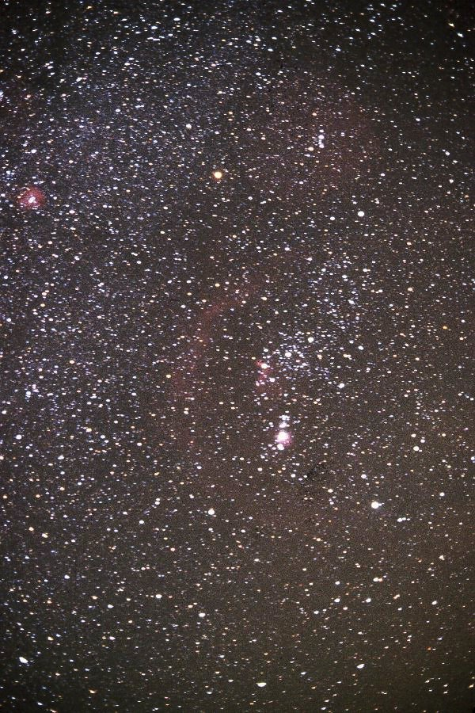

Slide 5
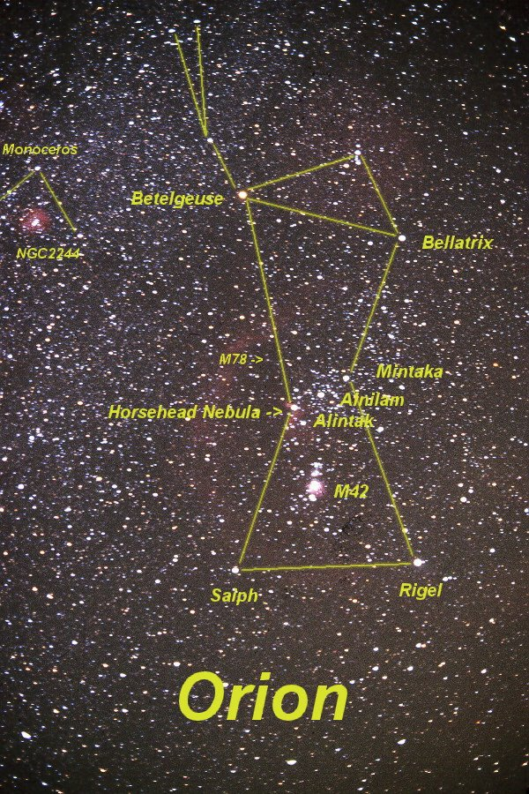

Slide 6
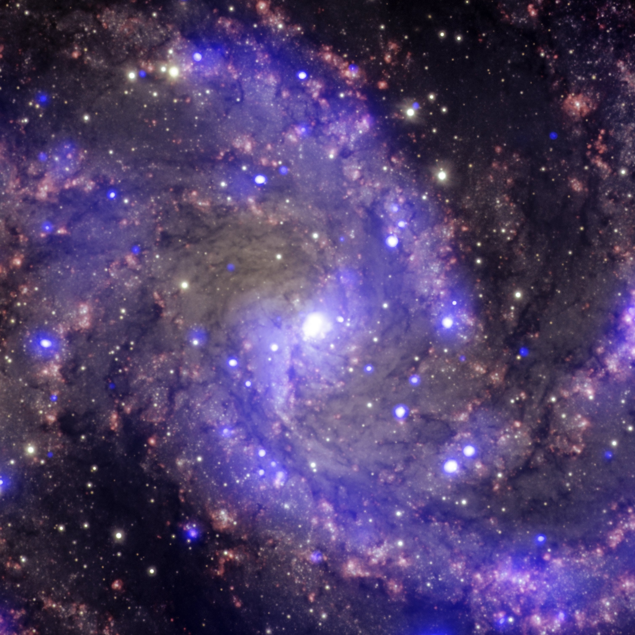
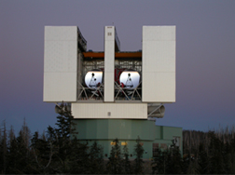

Slide 7
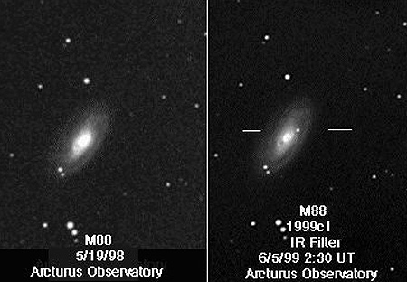
Supernova explosion in a nearby galaxy.

Slide 8
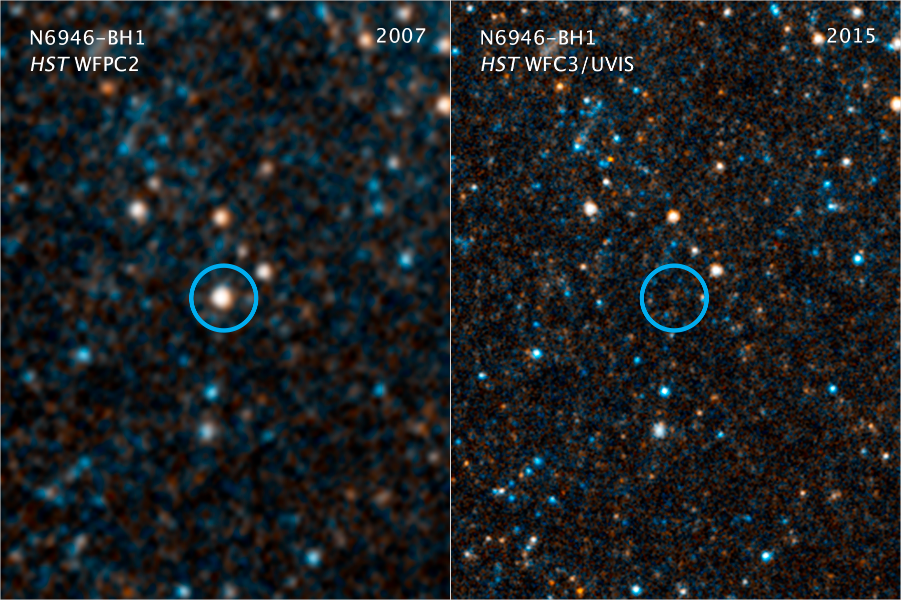
Formation of a “stellar mass” BH (3 – 100 ⨉ M_{sun})

Slide 9
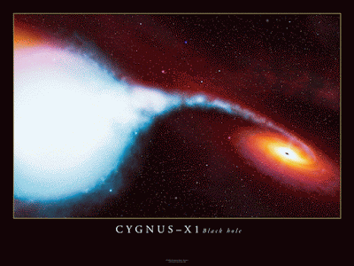
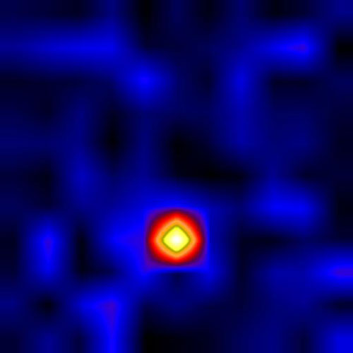
How can we find black holes?
Gas falling towards a BH heats dramatically, glows in X-rays.
X-ray telescope image.
Artist’s conception.
Cygnus X-1, first widely accepted black hole.

Slide 10
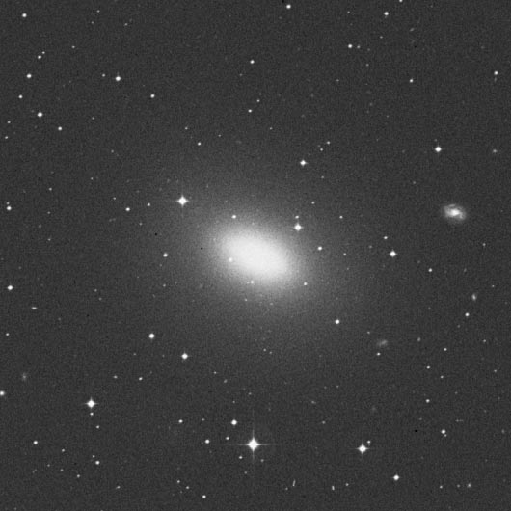
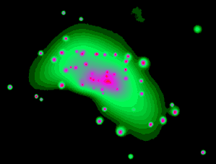
Galaxy NGC 4697
Optical light
X-rays

Slide 11
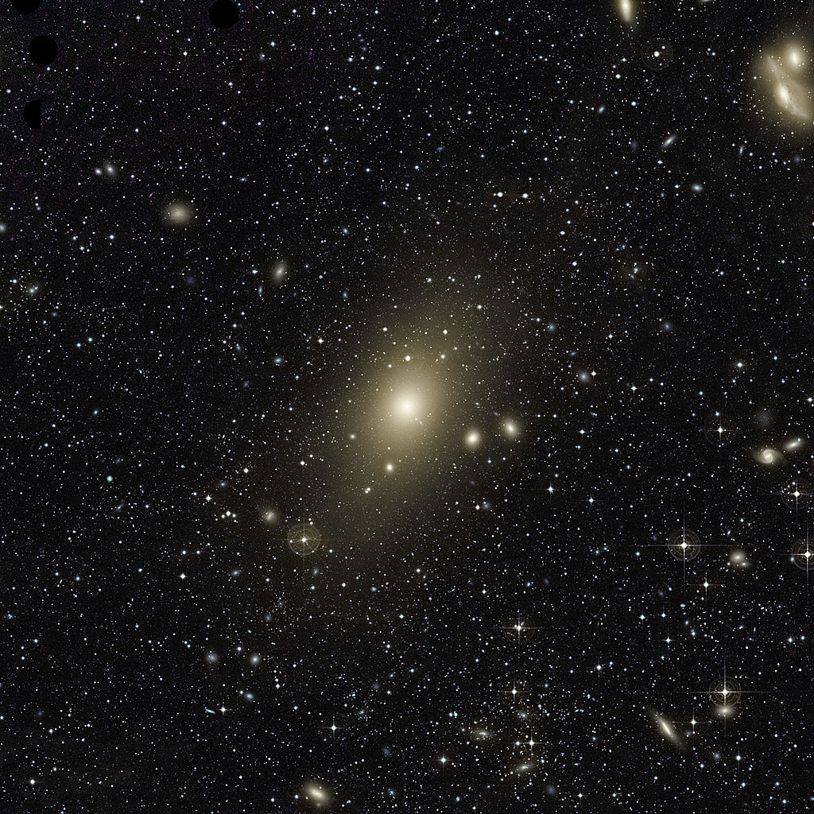
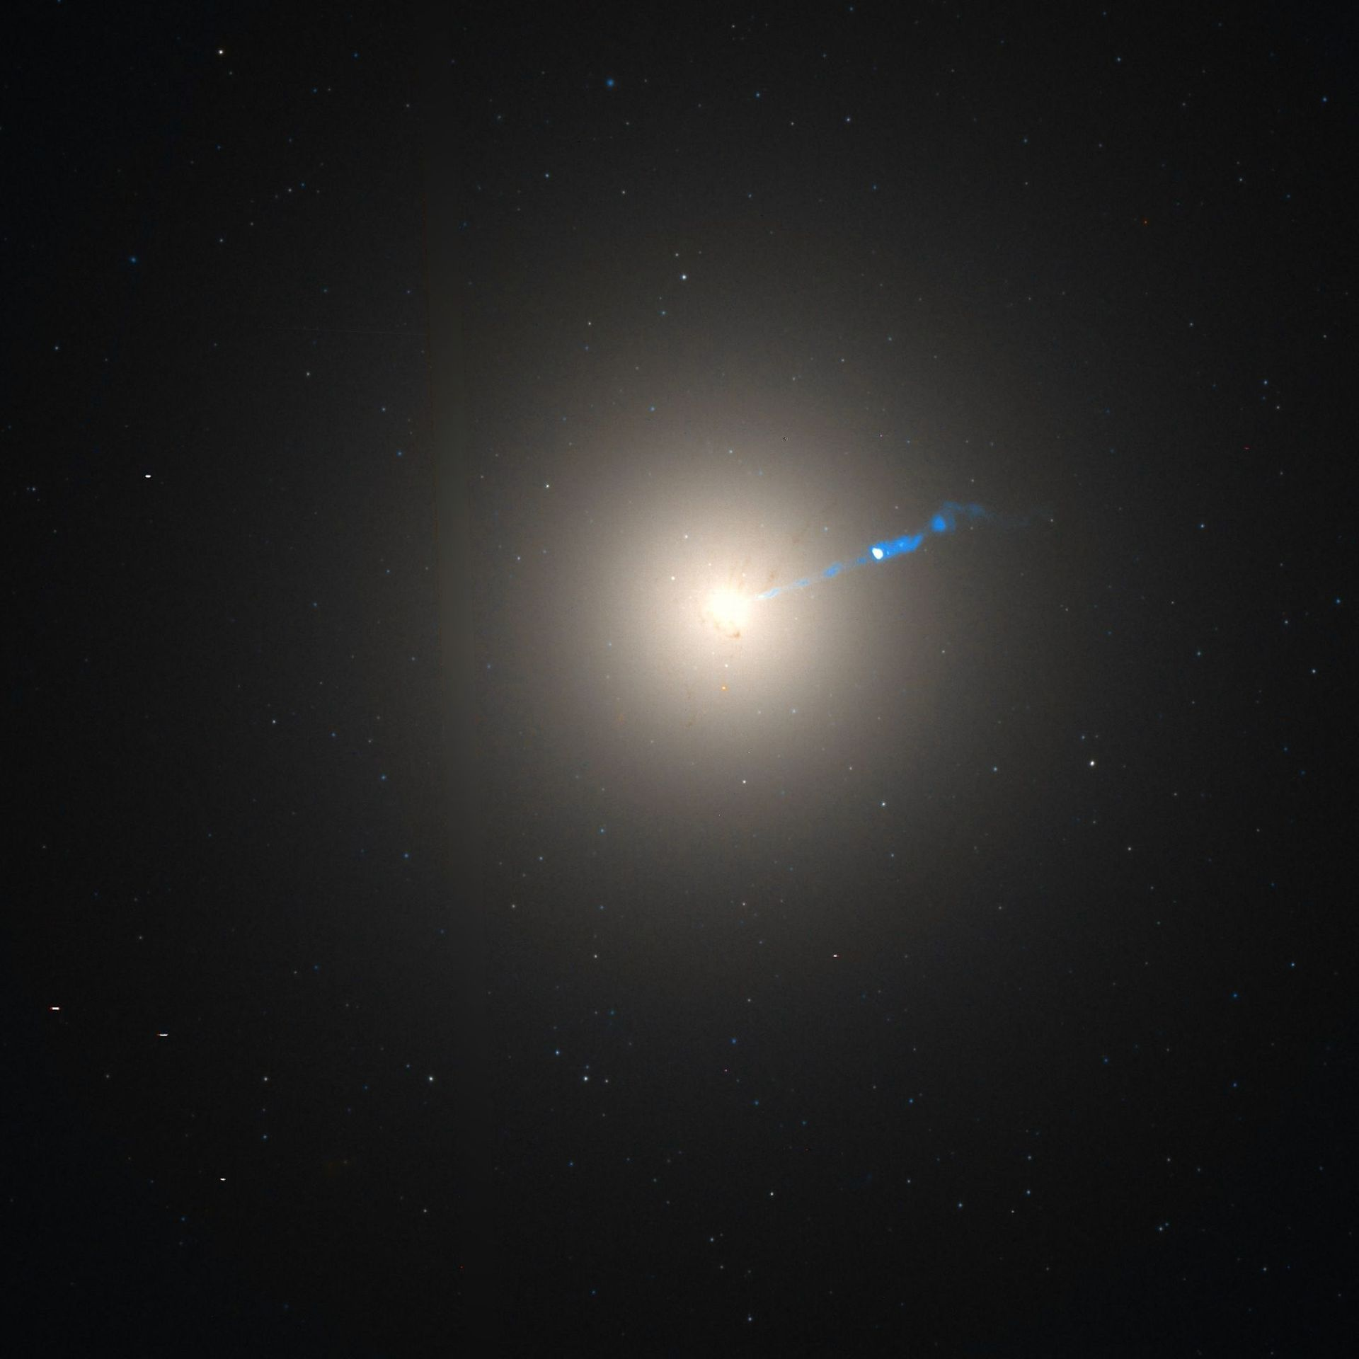
“Supermassive” black holes at galaxy centers (10⁶ – 10¹⁰ ⨉ M_{sun})

Slide 12
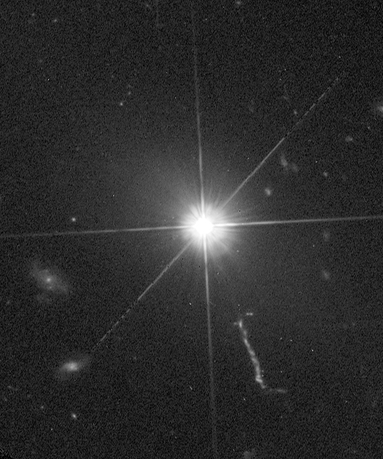
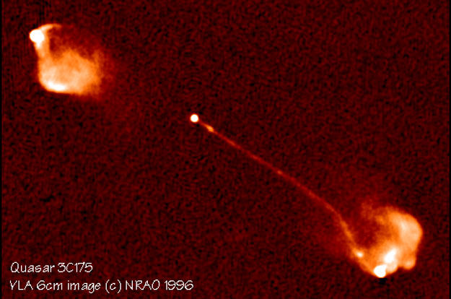
3C 273, optical light (HST)
3C 175, radio waves

Slide 13
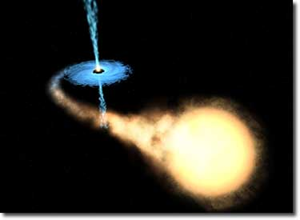
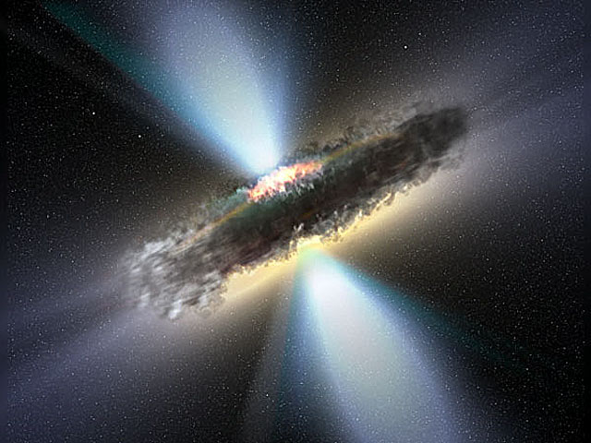
Artist’s conception.
Artist’s conception.

Slide 14
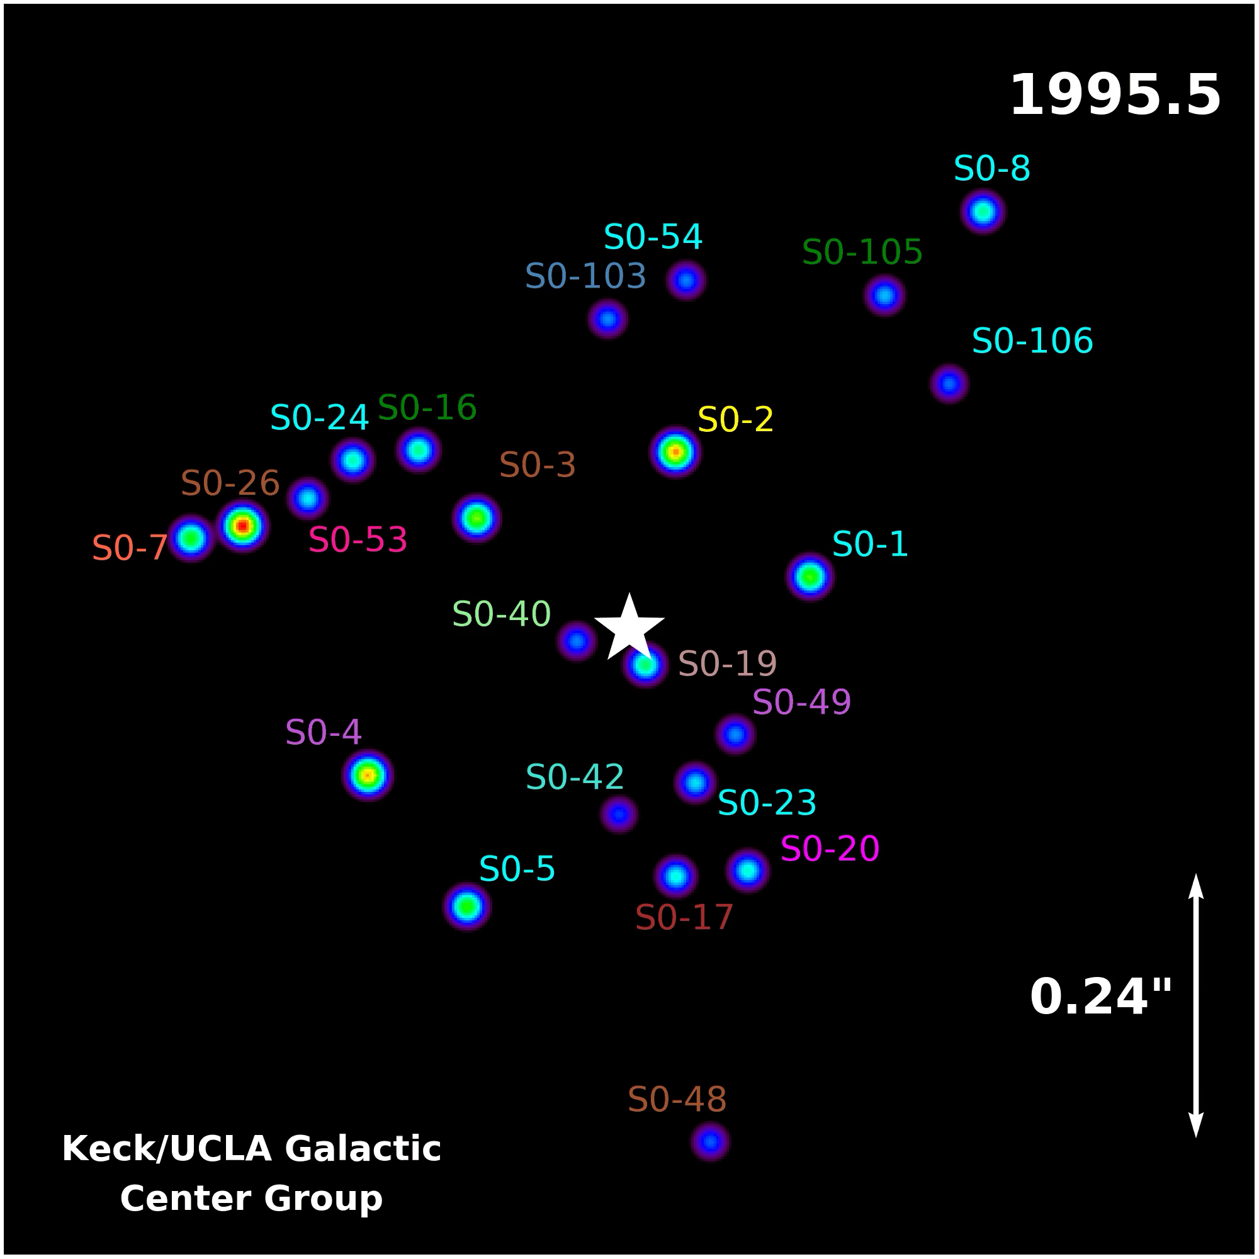
Motion of stars near the center of the Milky Way Galaxy, over 14 years.
Data and visualization by Andrea Ghez and collaborators, UCLA.
Central black hole is four million times the mass of our Sun.

Slide 15

Motion of stars near the center of the Milky Way Galaxy, over 14 years.
Data and visualization by Andrea Ghez and collaborators, UCLA.
Central black hole is four million times the mass of our Sun.
2020 Nobel Prize in Physics
Andrea Ghez
Reinhard Genzel
Roger Penrose

Slide 16

Inspiral of merging black holes
Videos available at ligo.caltech.edu

Slide 17
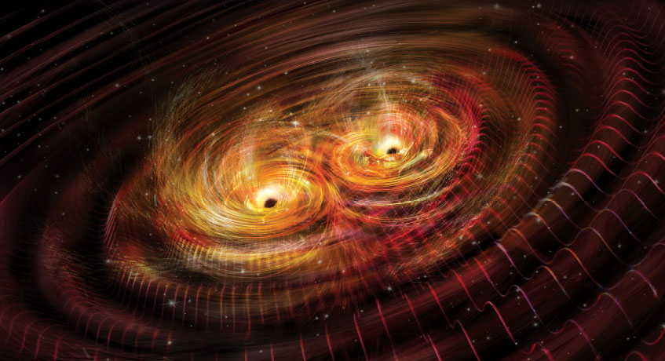
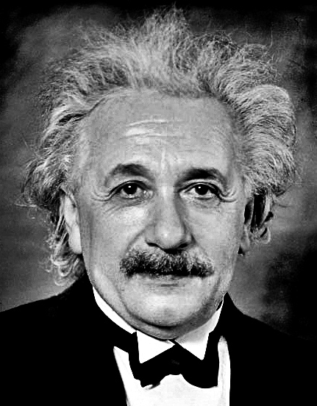
Gravitational Waves
Created by accelerating masses, e.g., orbiting stars or black holes.
Stretch and squeeze distances in an oscillating pattern as they pass.

Slide 18
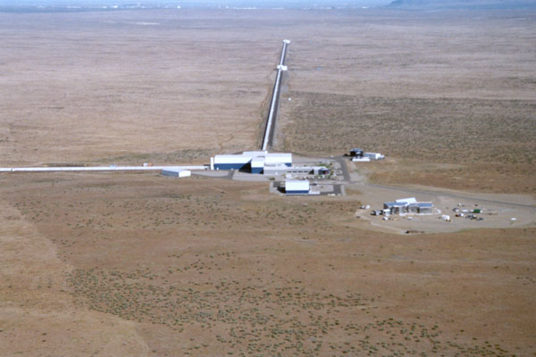
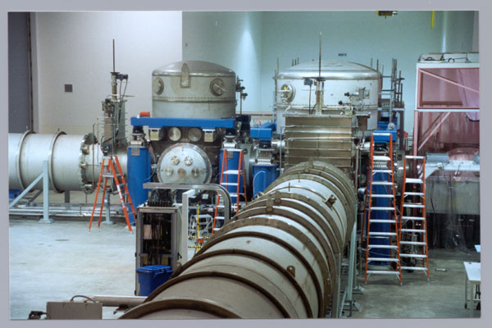

Slide 19
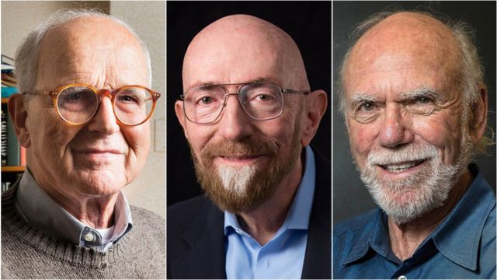
2017 Nobel Prize in Physics
Rai Weiss, Kip Thorne, Barry Barish

Slide 20
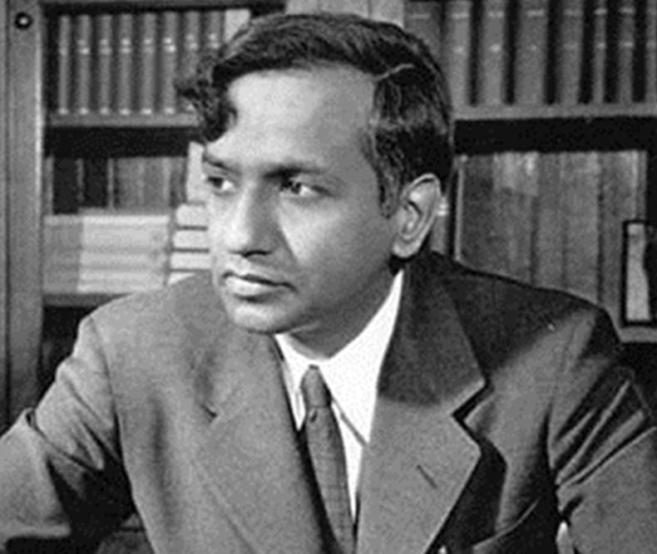



Subramanyan Chandrasekhar
Gabriela Gonzales
Nergis Mavalvala
Vicky Kalogera

Slide 21
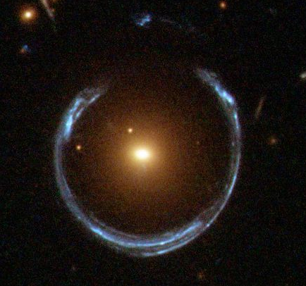
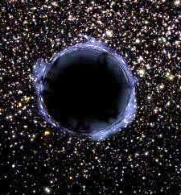
Real telescope image of a galaxy gravitationally lensing a background galaxy.
Artist’s conception of shadowing and gravitational lensing by a black hole.

Slide 22
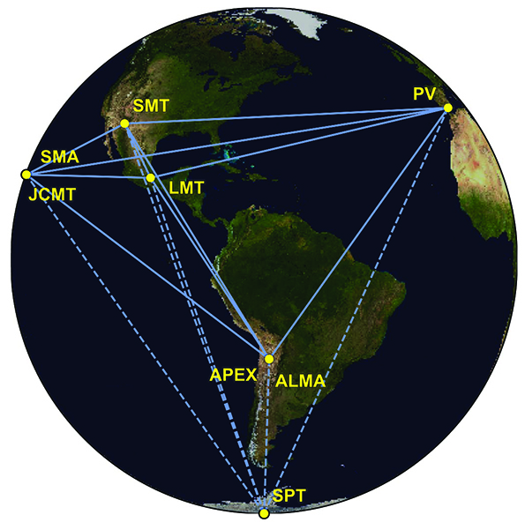

Slide 24
A brief history of an idea
1686: Newton’s theory of gravity
1783: Michell proposes idea of “dark stars”
1796: Laplace popularizes this idea
1800: light consists of waves, not particles
1907-1916: Einstein’s theory of gravity (General Relativity)
1916: Schwarzschild solution to Einstein’s equations, describing black holes
1925-1930: Existence of white dwarfs
1930: Maximum mass of white dwarfs; collapse of massive stars could produce black holes
1930s-1950s: Theory of supernovae and neutron stars. Neutron stars also have a maximum mass.
1960s: Theory of BHs developed further.

Slide 25
A brief history of an idea
1963: First discovery of quasars.
1970: First X-ray satellite. Many bright X-ray sources, some too massive to be neutron stars.
1970s-1990s: Case for stellar mass BHs and supermassive BHs gets stronger, alternatives eliminated.
Late 1990s-2000s: Demonstration that most nearby galaxies have central supermassive black holes.
2000s: Increasing evidence that supermassive BHs help govern the formation of their host galaxies.
2015: First direct detection of gravitational waves from merging BHs, in a galaxy 1 billion light years away.
2019: First direct image of the shadow cast by a BH event horizon, in the galaxy M87.

