Slide 1
Empirical successes of Newton’s theory of gravity
All bodies fall at same rate near earth’s surface.
Moon’s acceleration is 1/60² smaller than acceleration at surface
Explains all three of Kepler’s laws of planetary motion:
  Each planet moves in an ellipse with the sun at one focus
  Planet moves faster when closer to the sun: equal area in equal time
  Period² is proportional to (semi-major axis)³
Jupiter’s moons obey Kepler’s 3rd law with different constant of proportionality
Tides caused by gravity of moon, and sun: two high tides per day
Comets move on highly elongated elliptical orbits
Planets have a small gravitational effect on each other, e.g., Jupiter an Saturn
Planet Uranus discovered with telescope in 1781. Planet Neptune discovered 50 years later because orbit of Uranus is perturbed by gravity of Neptune.

Slide 2
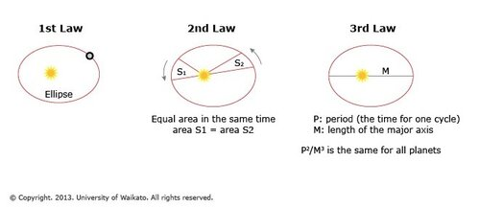
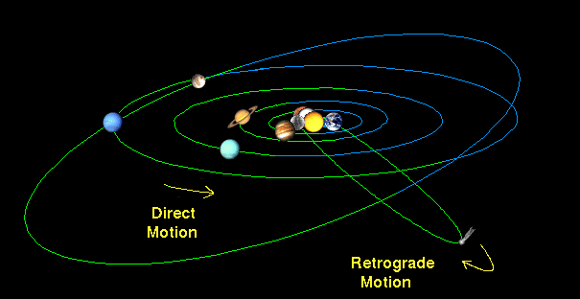

Slide 3
We have now completed our whirlwind overview of Newton's theory of motion and gravity and the empirical evidence that supports this theory.
What did you learn that most surprised you?

Slide 4
