Slide 1
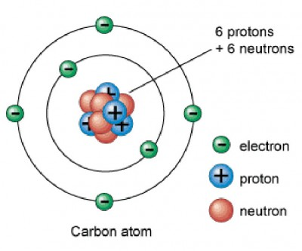
Not to scale! Diameter of the nucleus (protons and neutrons) is about 100,000 times smaller than the diameter of atom.
Mass of a proton and neutron are nearly the same.
Mass of an electron is 2000 times smaller.

Slide 2
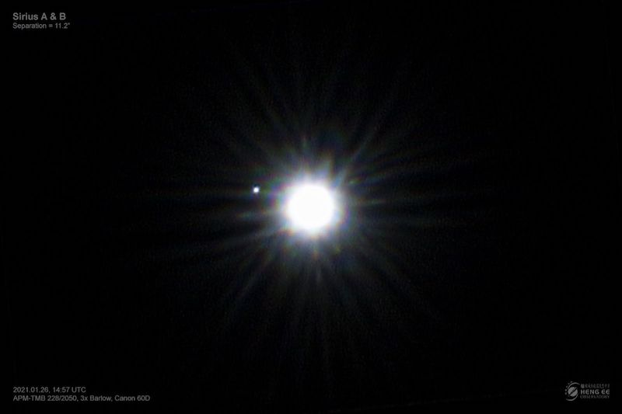
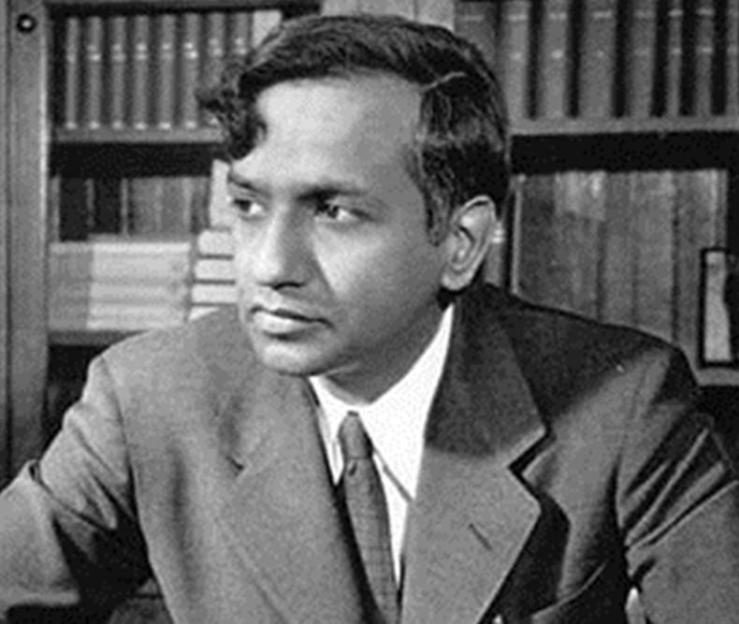
Sirius A: Main sequence star
Sirius B: White dwarf star
Subramanyan Chandrasekhar

Slide 3
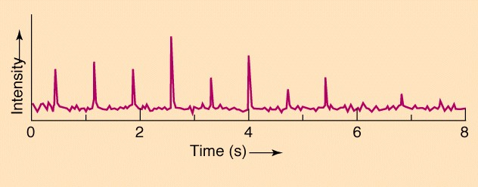
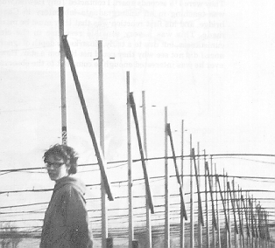
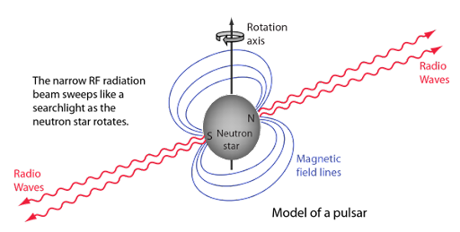
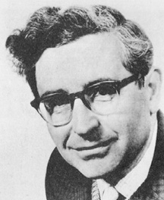
1967: Discovery of first radio pulsar
Jocelyn Bell-Burnell
Antony Hewish
Interpretation: A rotating neutron star beaming radio waves.

Slide 4
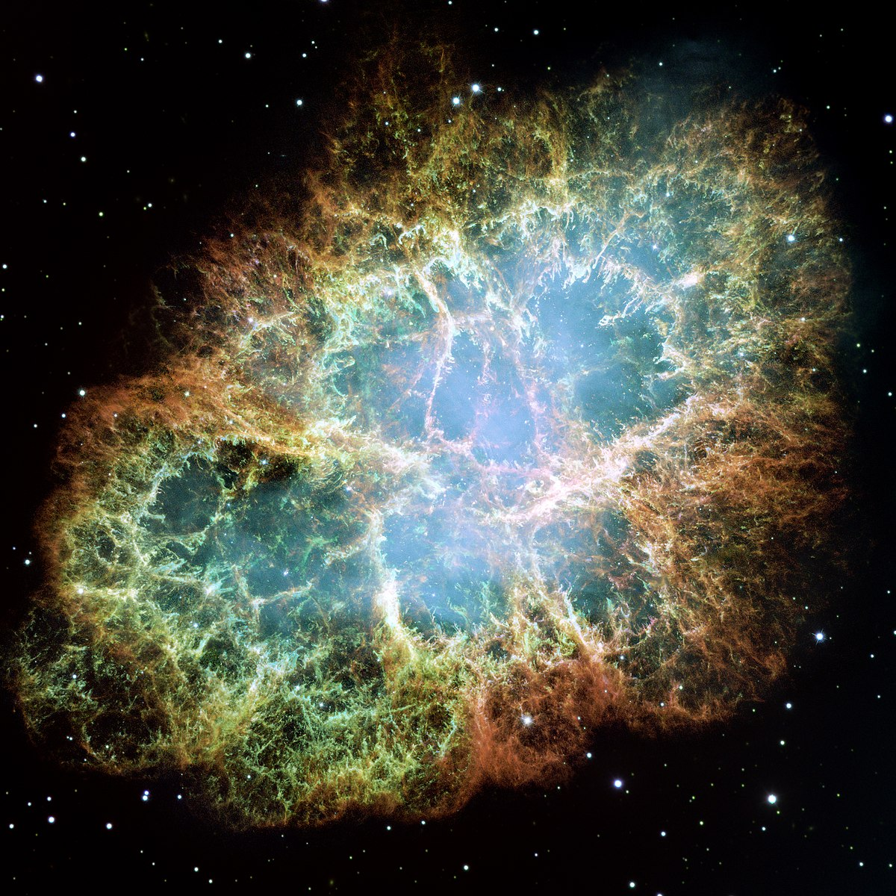

Slide 5
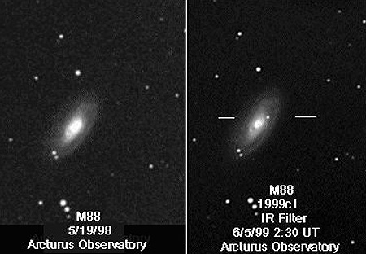
Supernova explosion in a nearby galaxy.

Slide 6
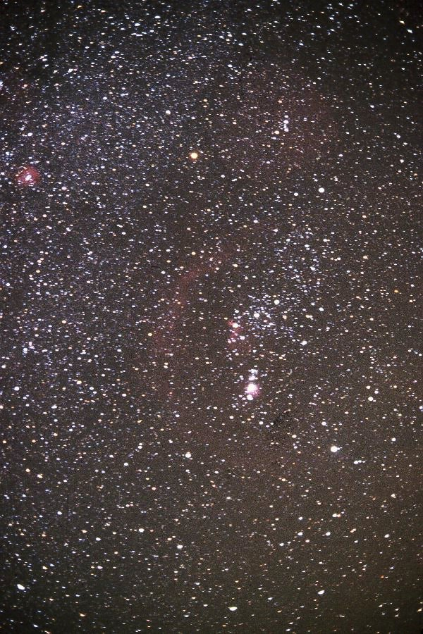
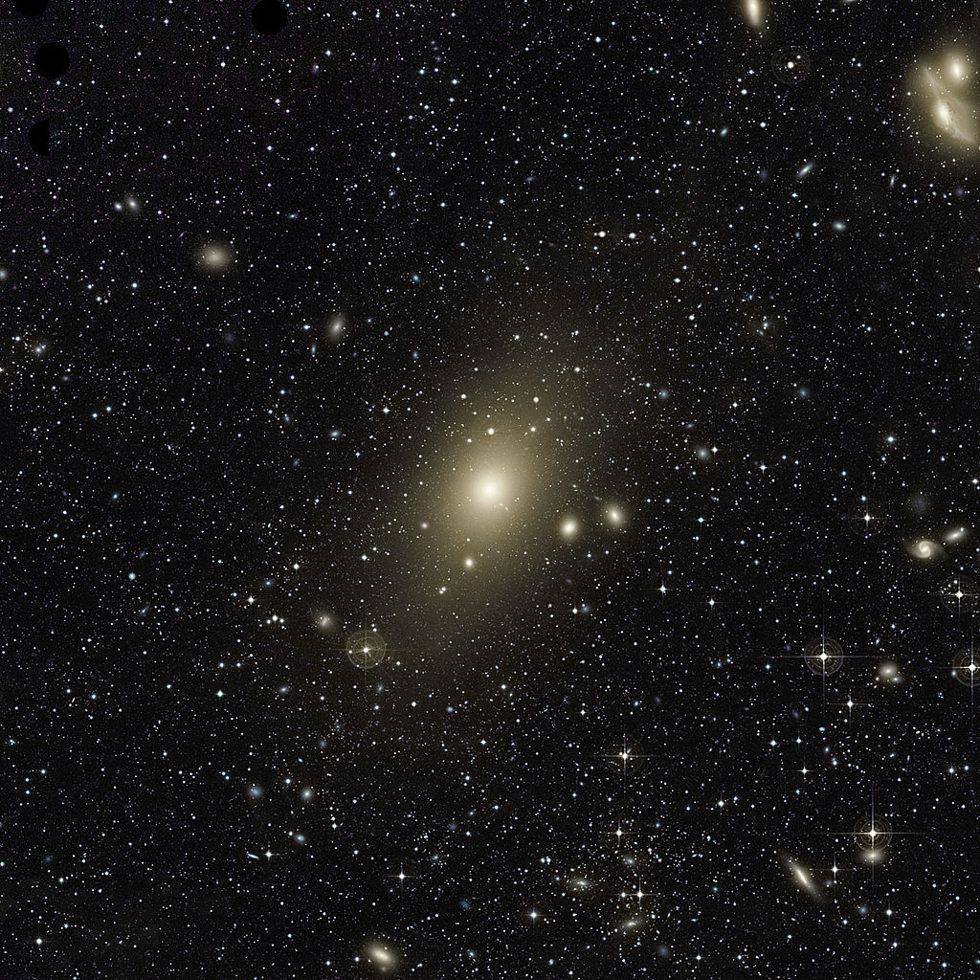

Slide 7
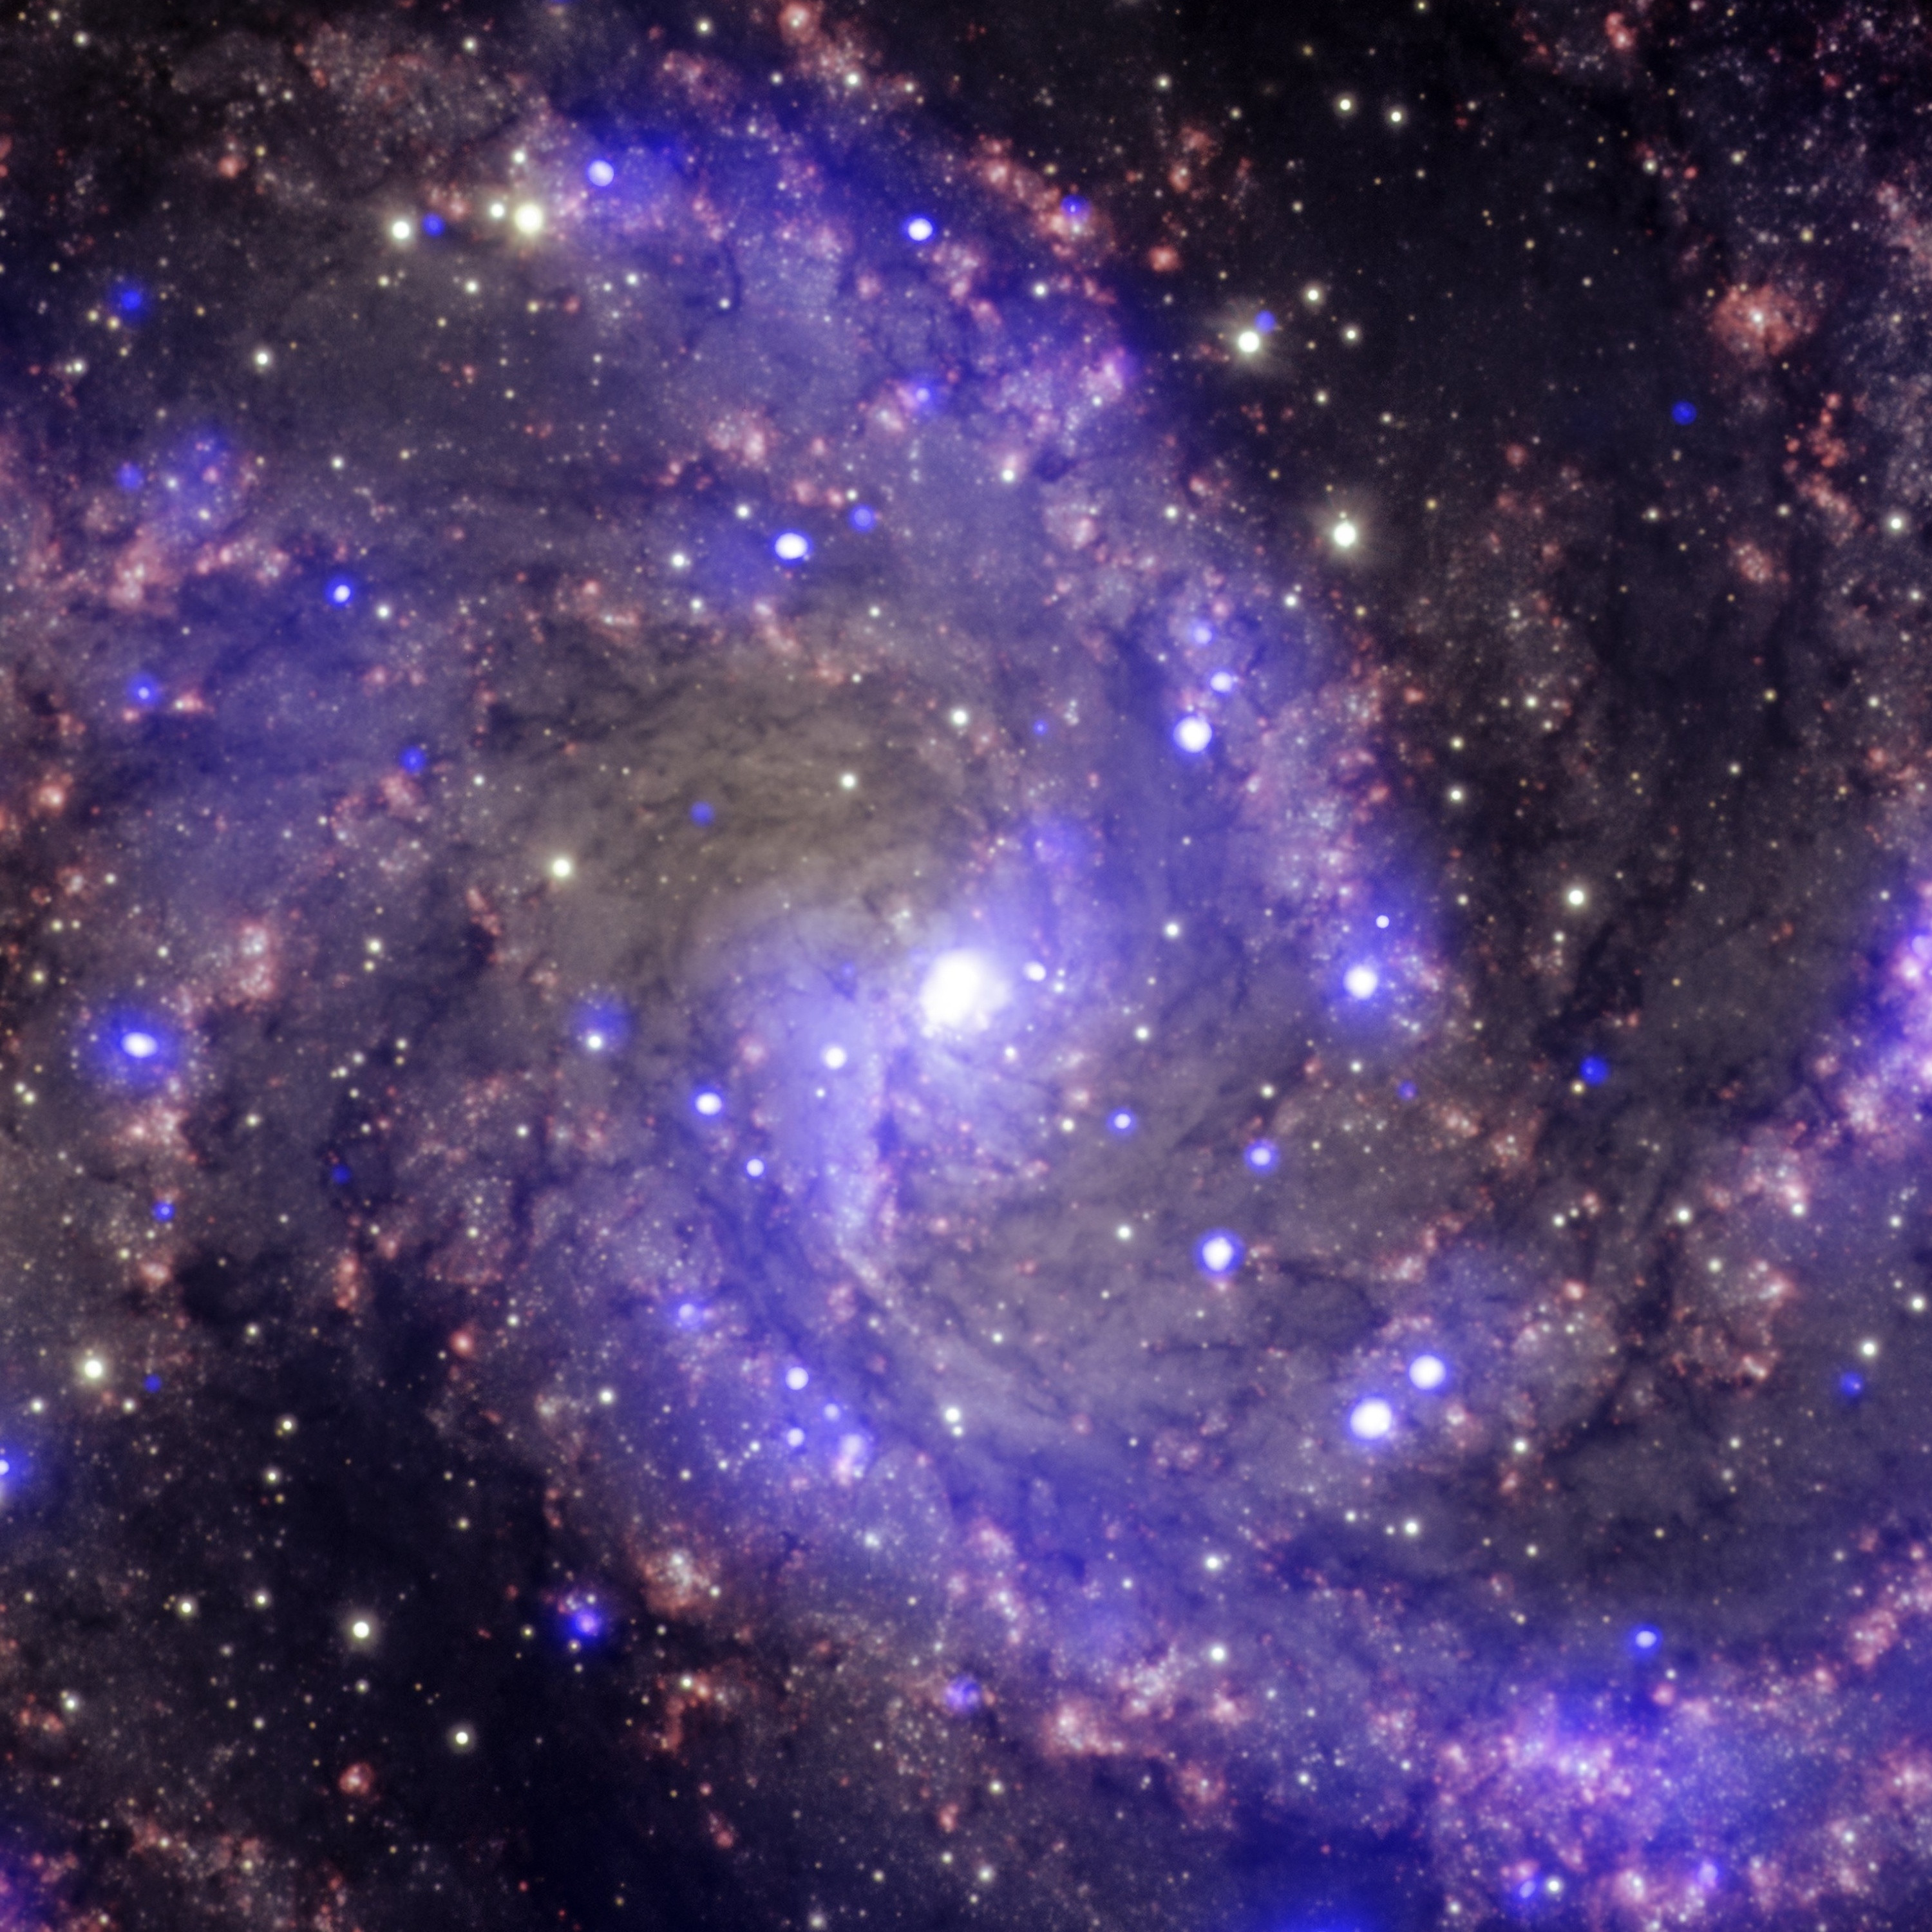
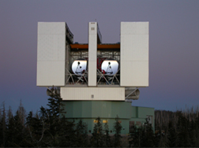

Slide 8
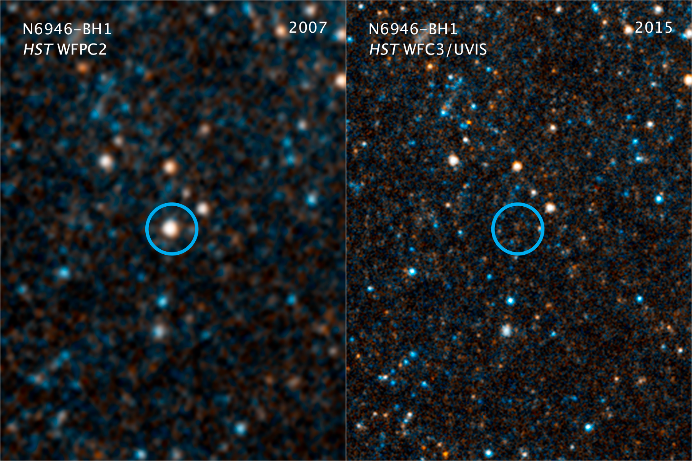
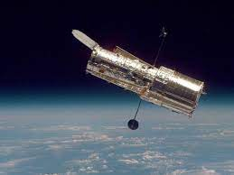
Formation of a “stellar mass” BH (3 – 100 ⨉ M_{sun})

Slide 9
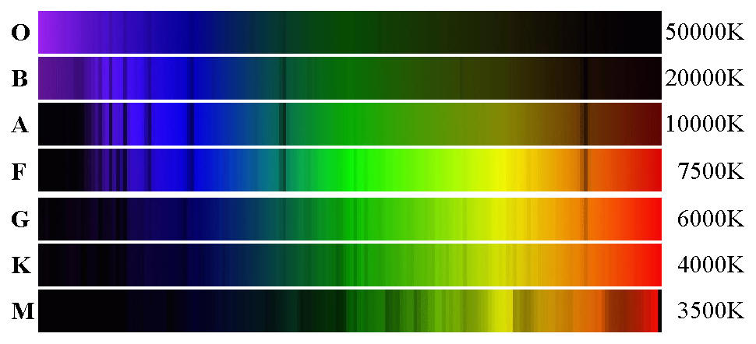
Spectra of Stars
Wavelength

Slide 10
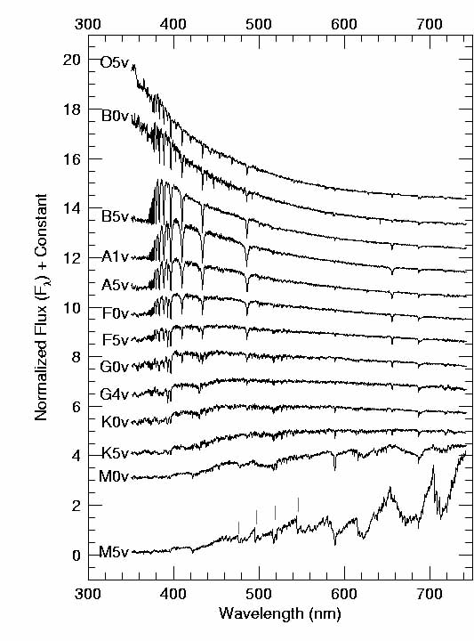

Slide 11
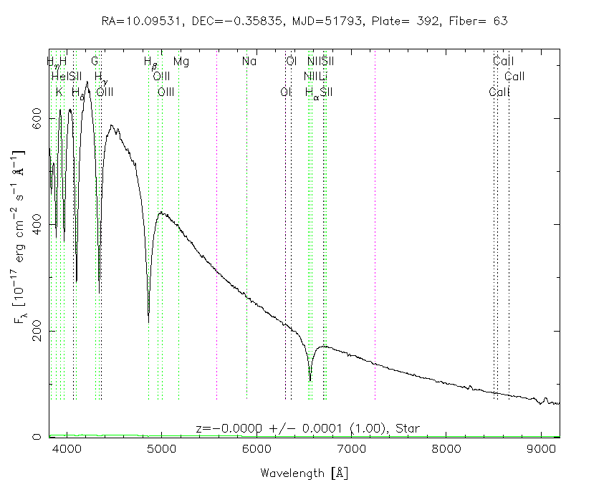
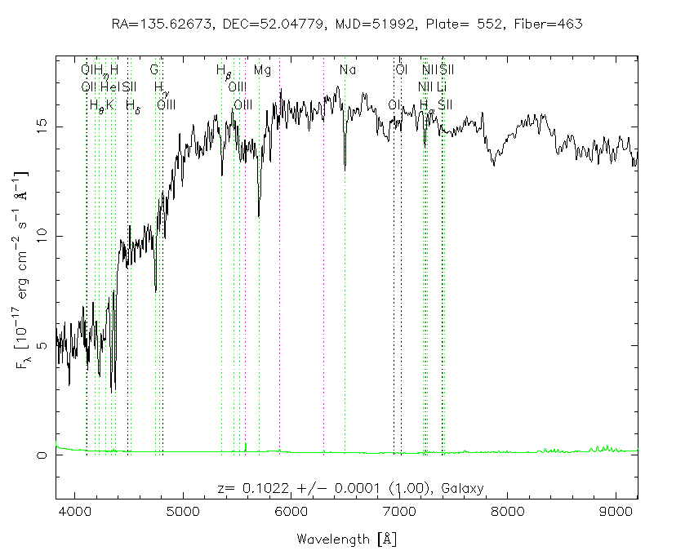
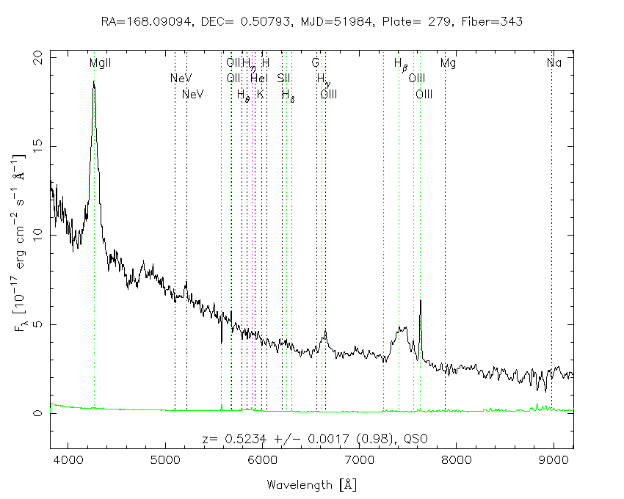
White dwarf
Galaxy
Quasar

Slide 12
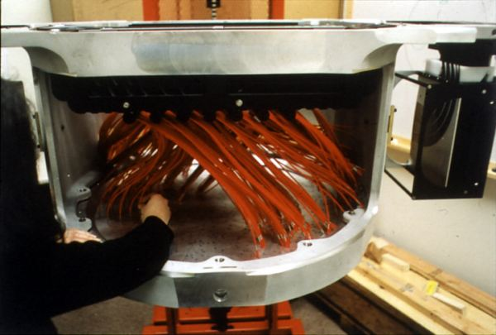
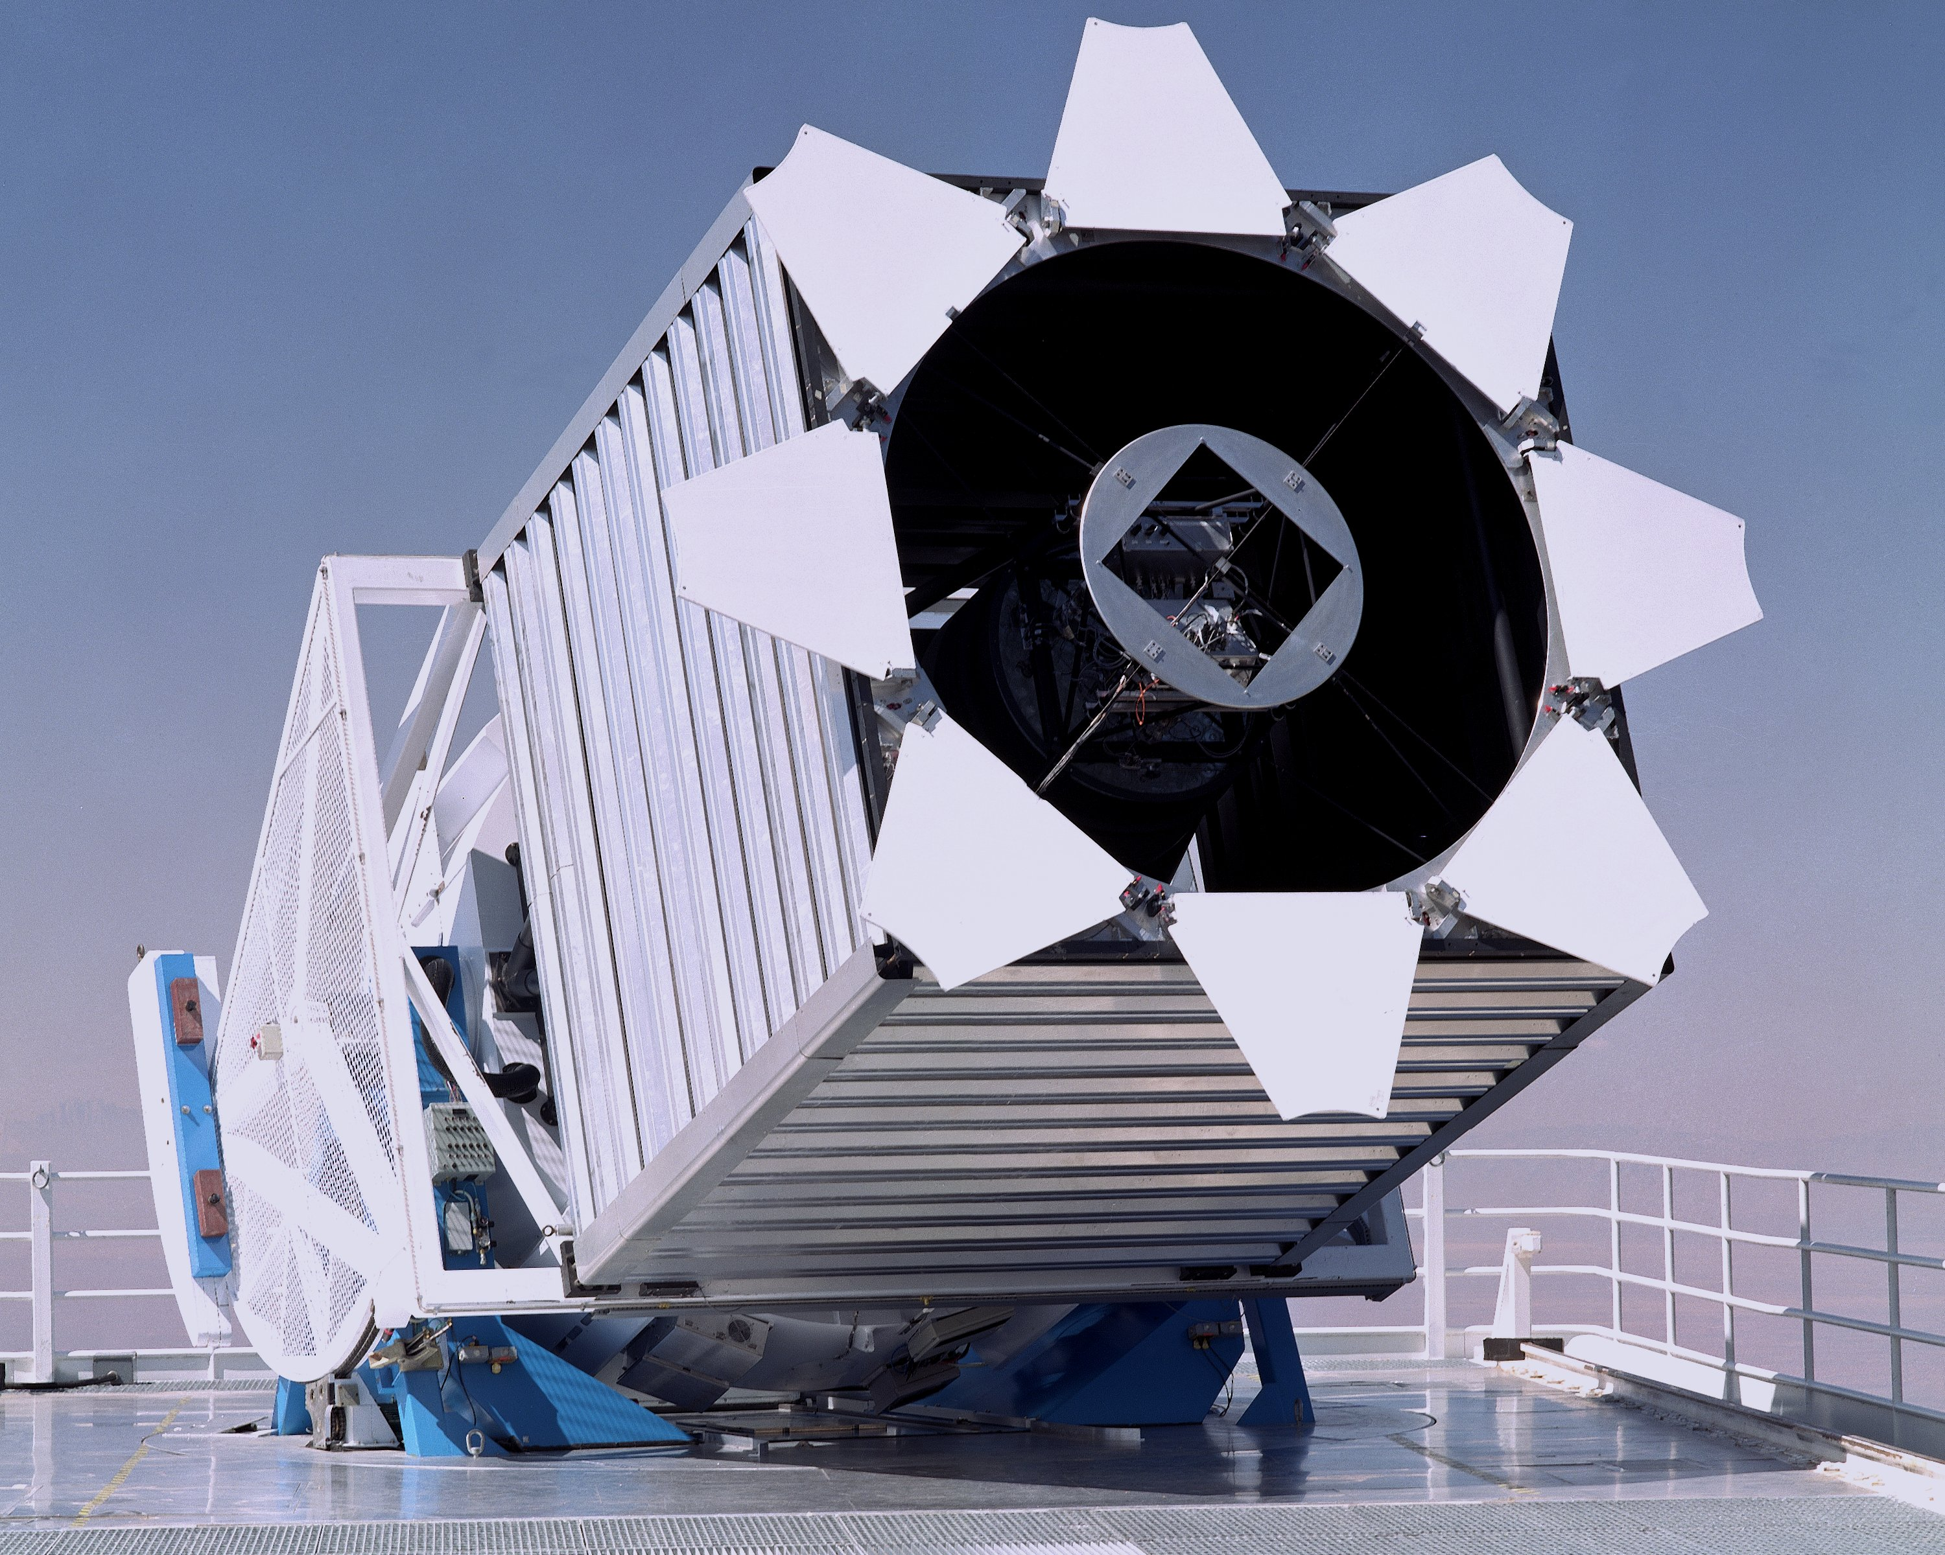
White dwarf
Galaxy
Quasar

Slide 13
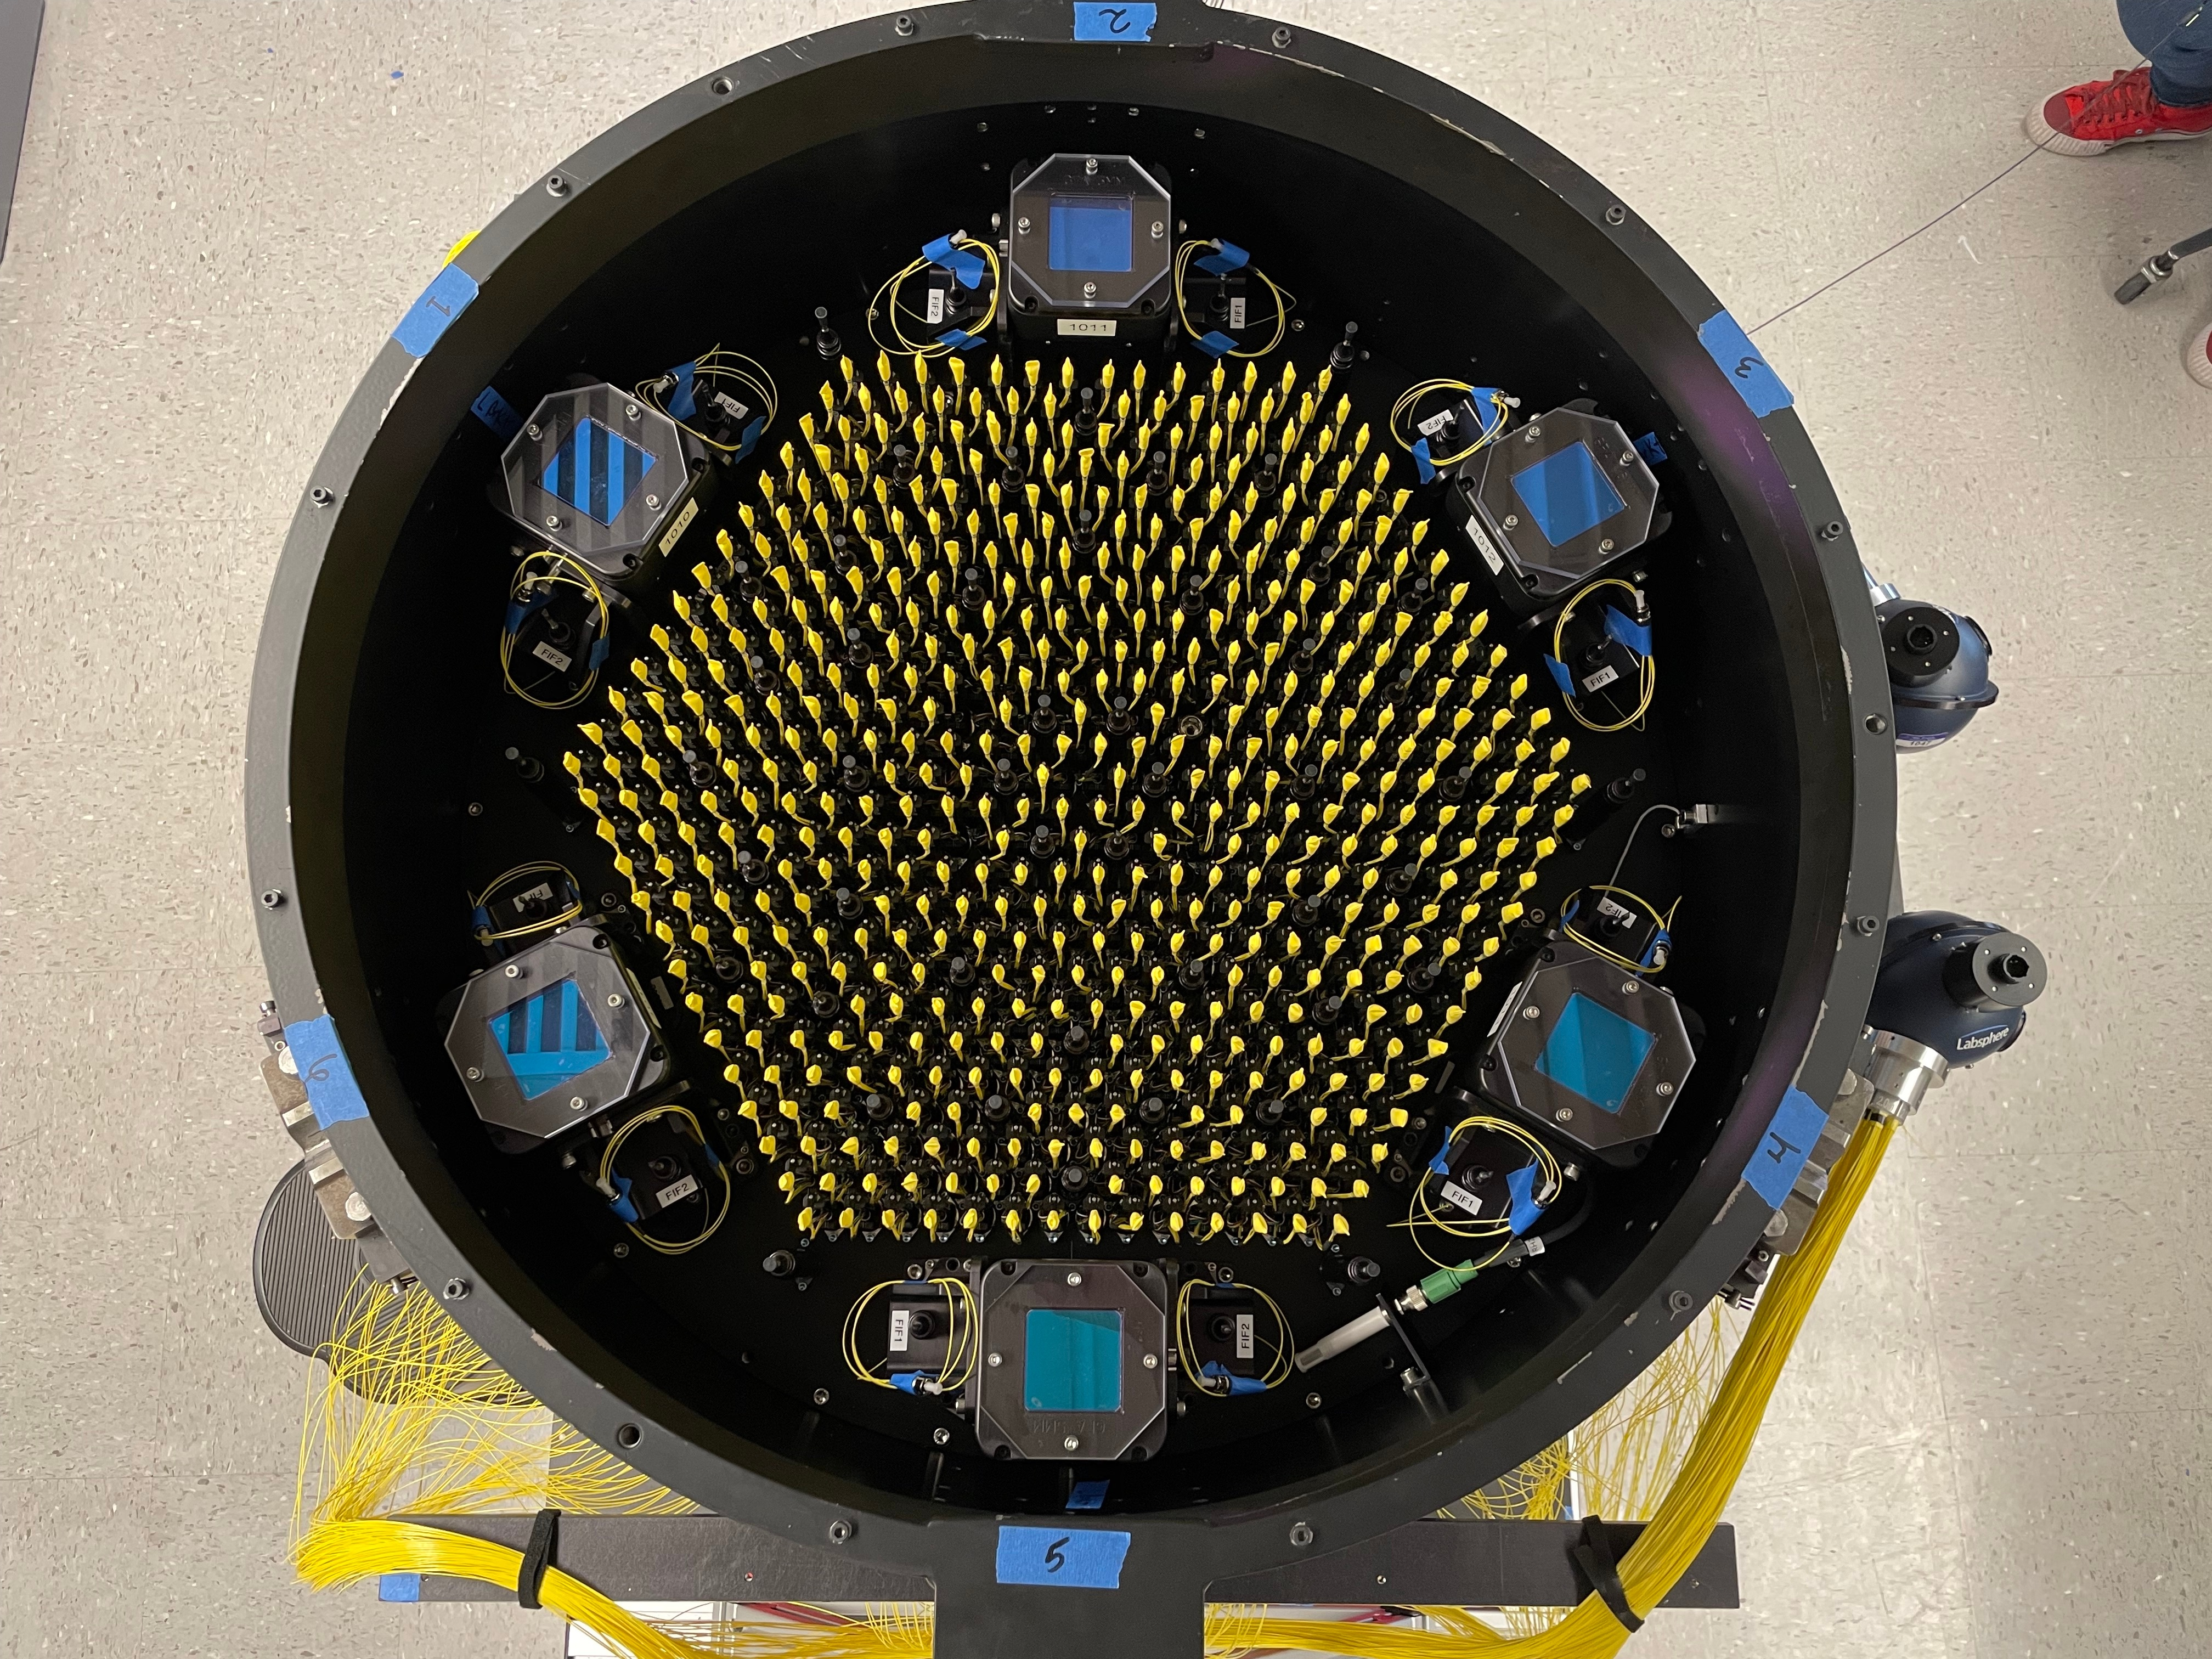
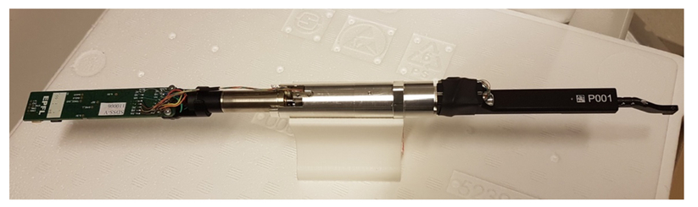
White dwarf
Galaxy
Quasar

