Slide 1
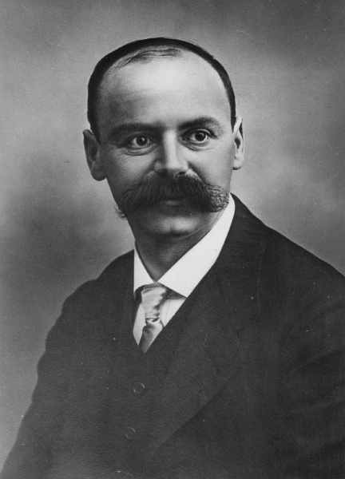
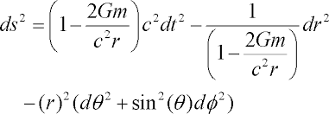
The Schwarzschild spacetime metric
Karl Schwarzschild

Slide 2
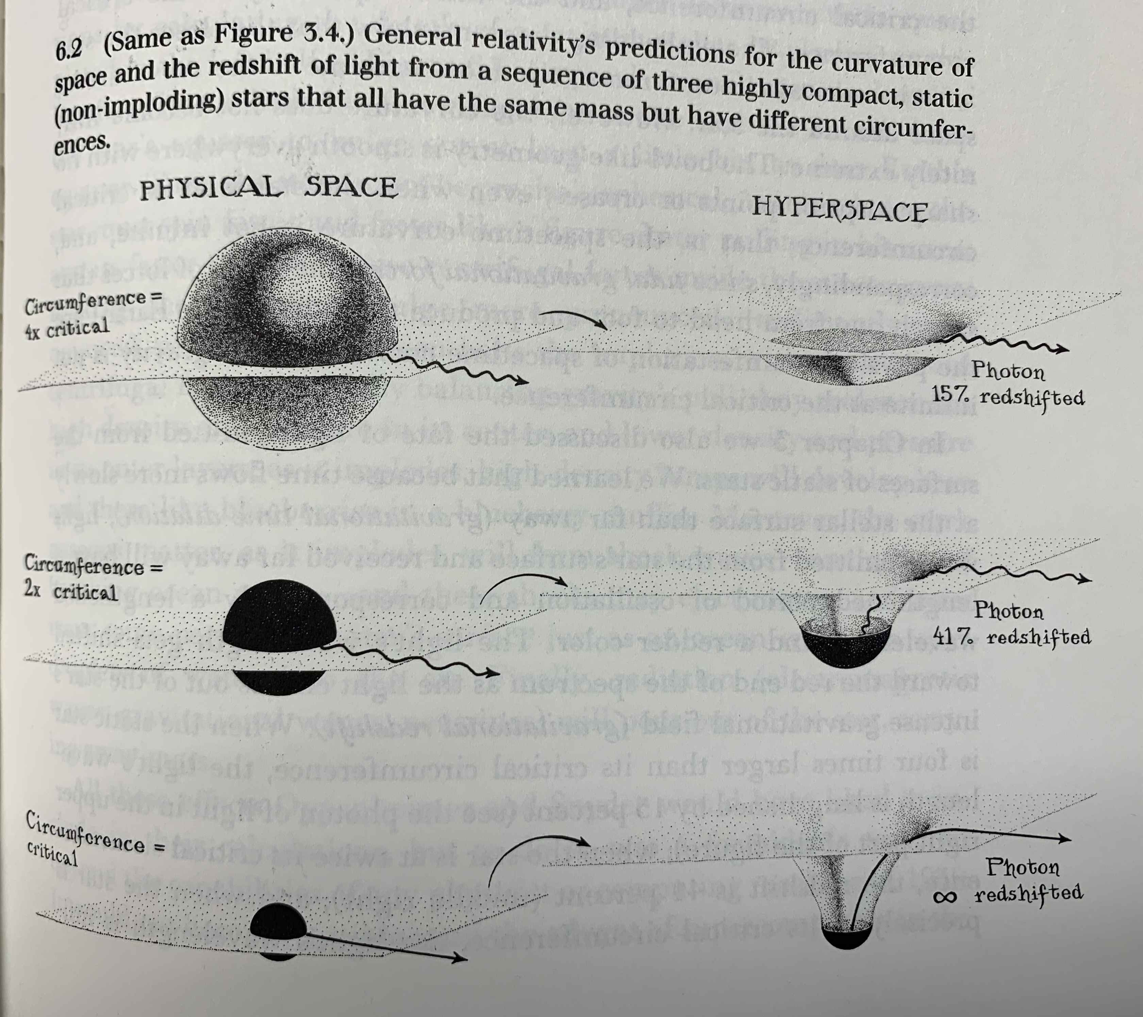

Slide 3
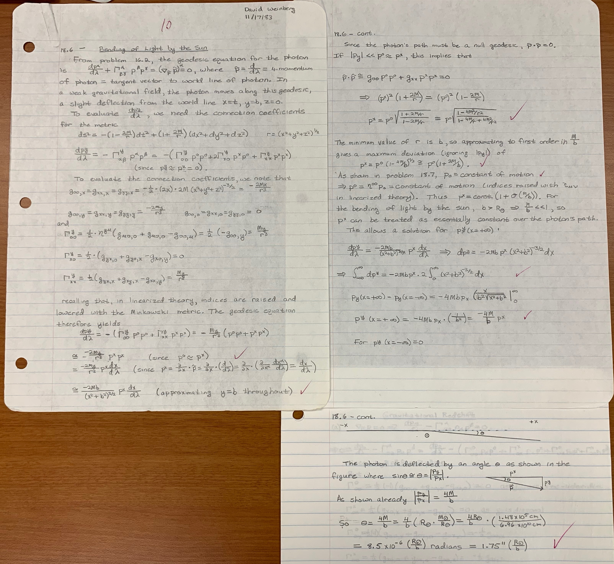

Slide 5
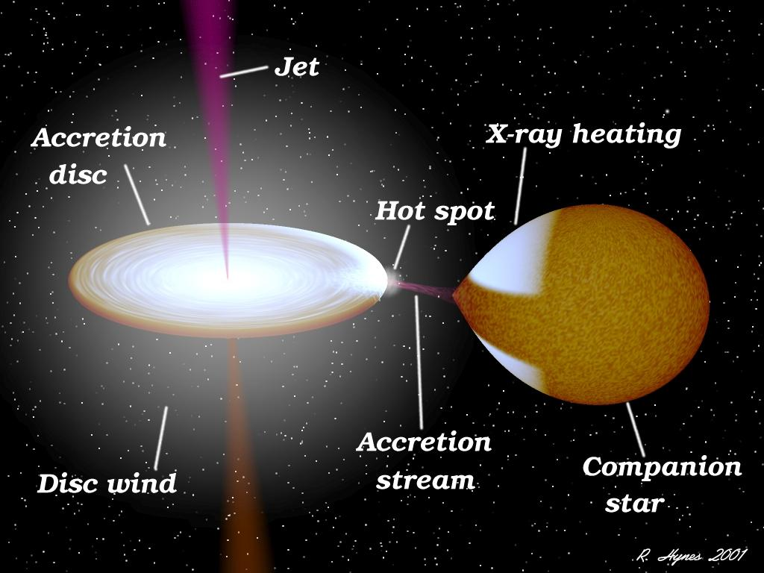

Slide 6
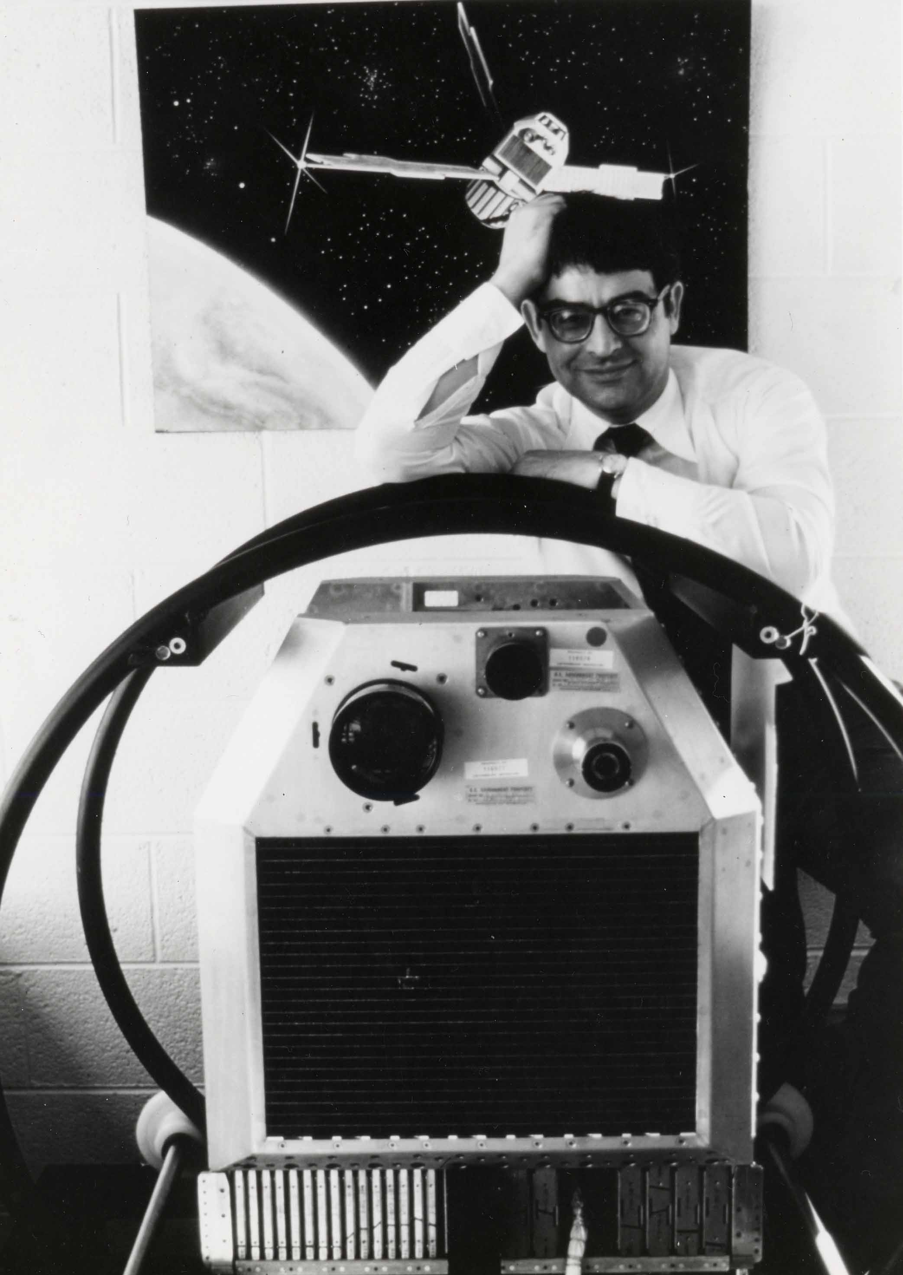
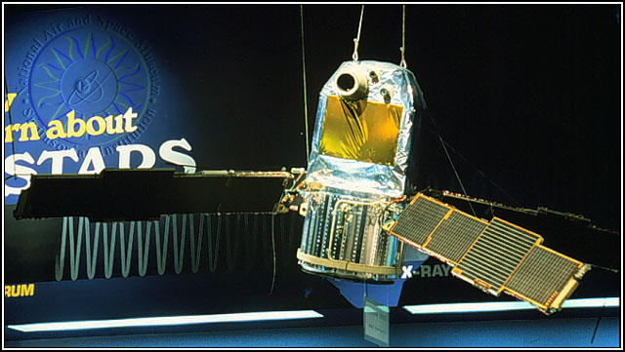
Uhuru satellite, first X-ray telescope
Ricardo Giacconi – Lead scientist of Uhuru, winner of 2002 Nobel Prize in Physics

Slide 7
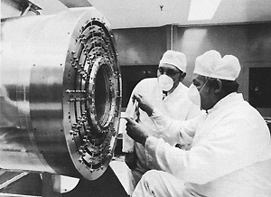
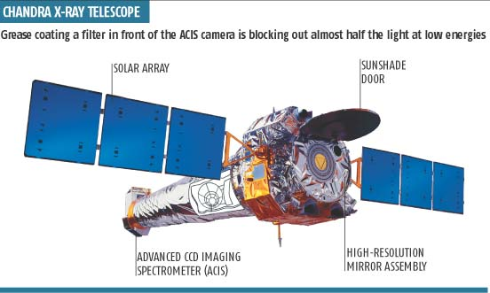
Uhuru satellite, first X-ray telescope
Nested “mirrors” of Chandra X-ray telescope

Slide 8
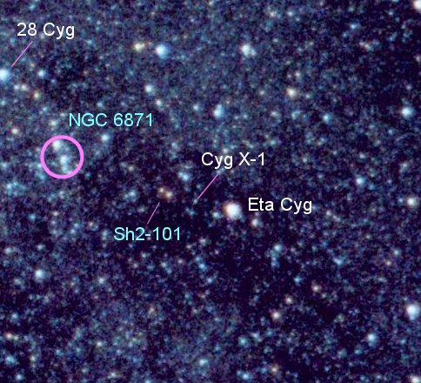
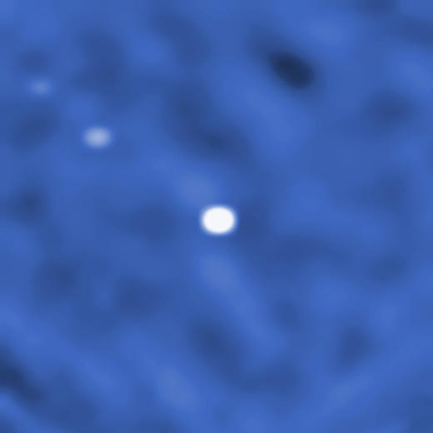
Optical light
Gamma rays
(INTEGRAL satellite, neutron star Cyg X-3 at upper left)

Slide 9
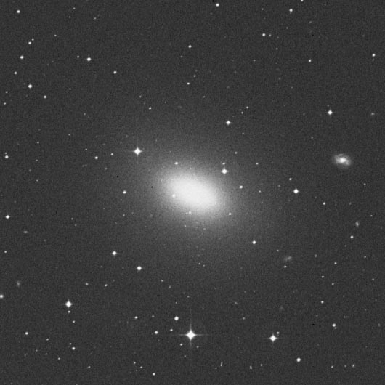
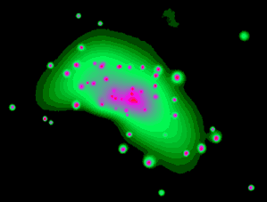
Galaxy NGC 4697
Optical light
X-rays

Slide 11
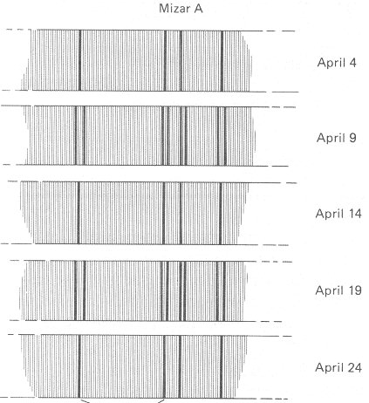
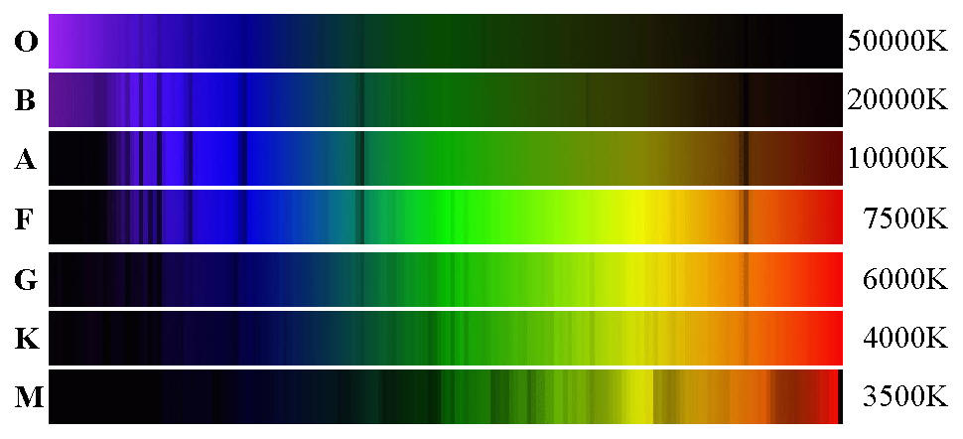
See Thorne Fig 8.3

Slide 12
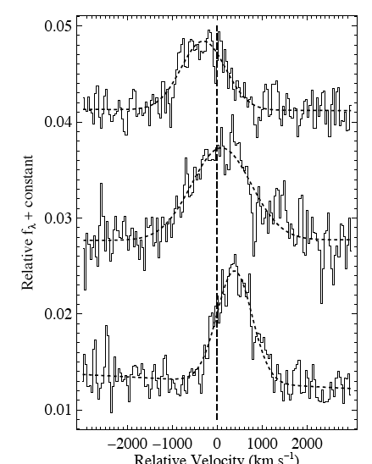
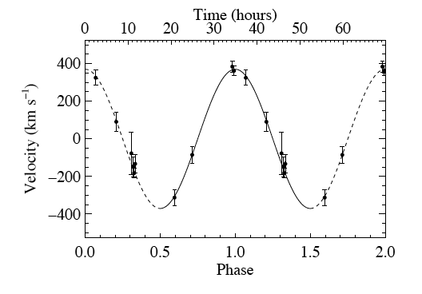
Silverman & Filippenko 2008, confirmation of 33 ± 3 M black hole in a nearby galaxy (IC 10),
Helium emission line

Slide 13
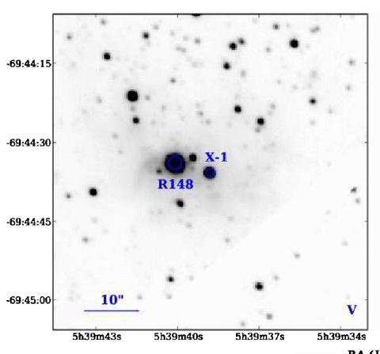
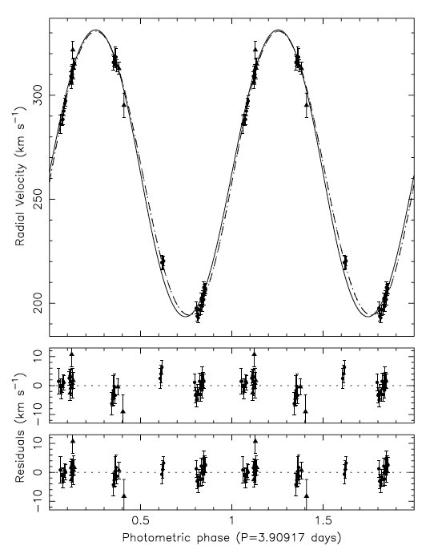
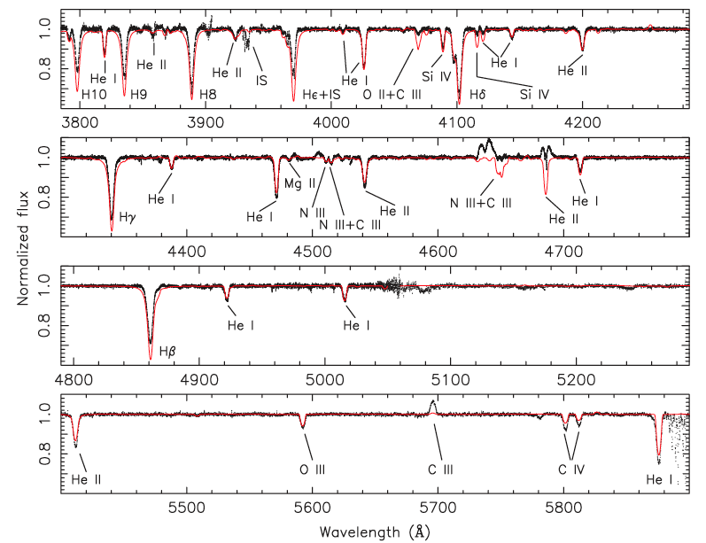
Orosz et al. 2009, LMC X-1, M_{BH} = 10.9 ± 1.4 M

Slide 14
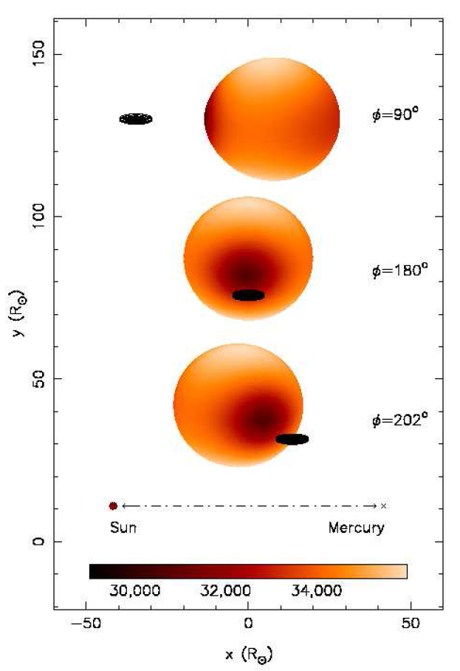
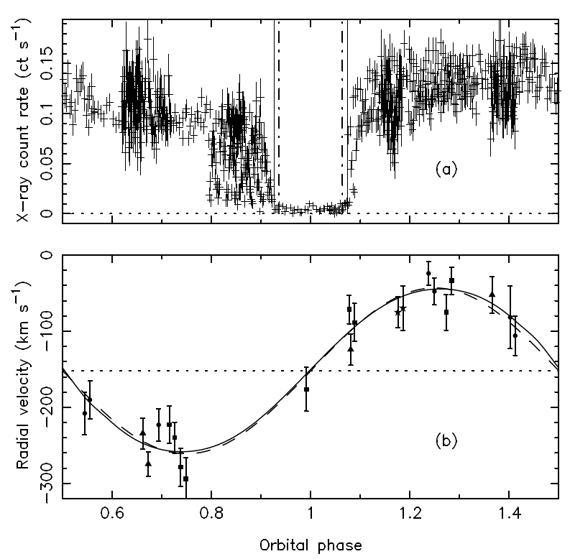
Orosz et al. 2007, a 15.7M BH in nearby galaxy M33, eclipsed by its 70 M companion
Artist’s Conception!
3.5-day period
Data!

Slide 15
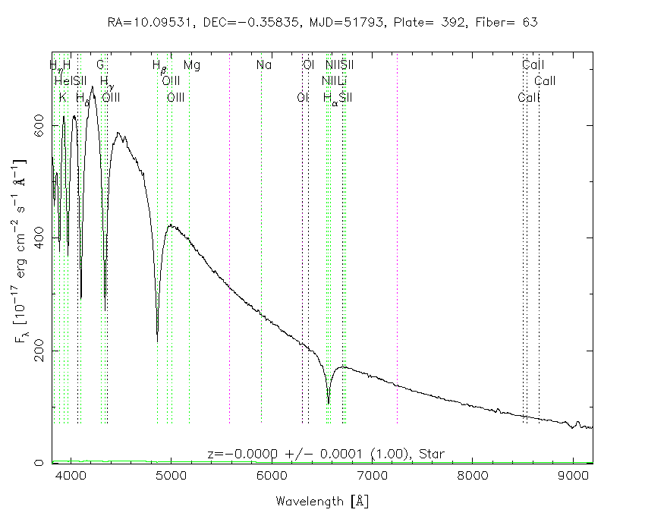
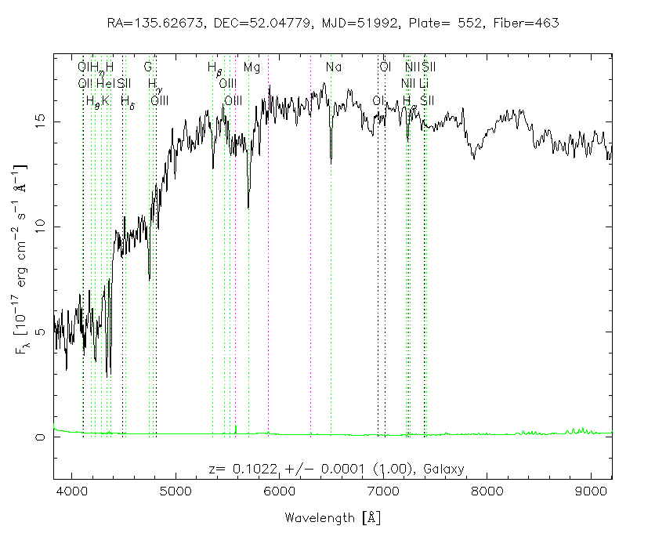
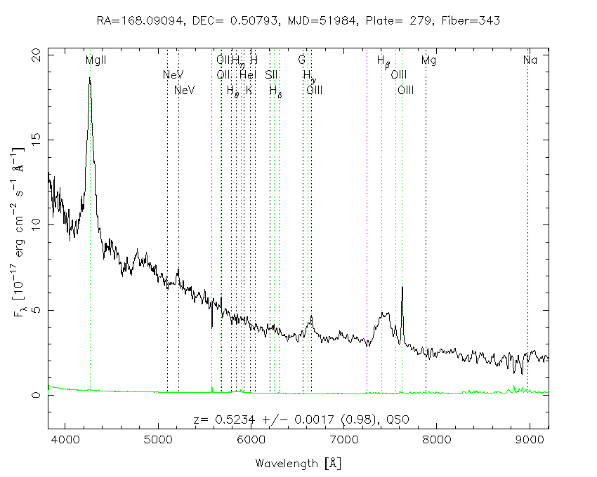
White dwarf
Galaxy
Quasar

Slide 16
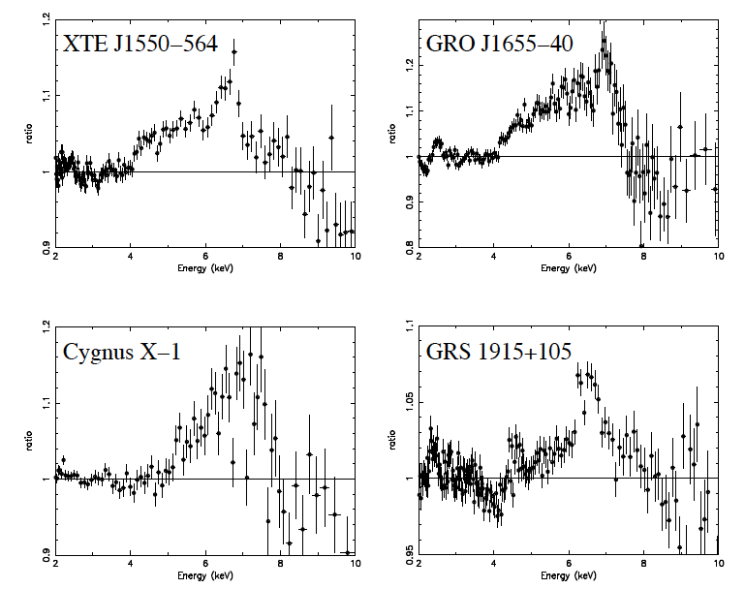
X-ray iron lines of four stellar mass black holes
From Miller 2007, ARAA

Slide 17
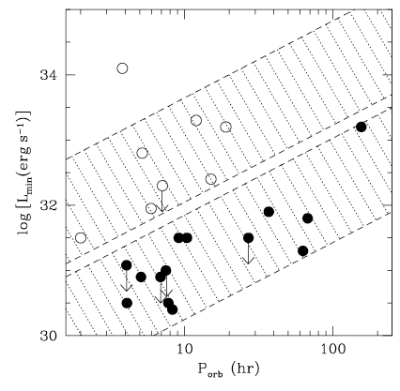
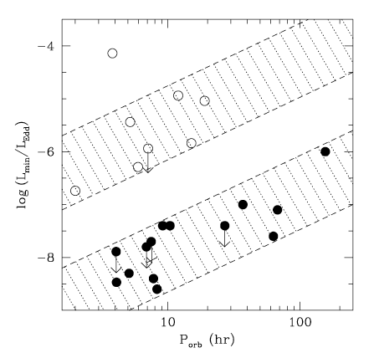
Narayan & McClintock 2008: Minimum X-ray luminosities of X-ray binaries are much higher for neutron stars than for black holes. Suggests the former have a surface, the latter do not.

