Slide 1
Frontiers of black hole research
Black hole astrophysics
Black hole fundamentals
Black hole speculations

Slide 2
Black hole astrophysics
Questions:
Do black holes and gravitational waves have the properties predicted by GR?
How do we unify GR and quantum mechanics into a theory of quantum gravity, allowing discreteness and uncertainty in spacetime itself?
What happens to the information “lost” when a black hole evaporates?
Does quantum gravity only matter near the black hole singularity, or does it affect black hole structure out to and at the event horizon? (See “Fuzzballs”)
Methods:
X-ray, optical, and radio surveys, including time variability, microlensing
X-ray spectroscopy of accreting black holes
Event horizon telescope
Gravitational waves (LIGO, pulsar timing arrays, eventually LISA)
Theoretical models, especially computer simulations of accretion flows

Slide 3
Black hole fundamentals
Questions:
What is the population of “inactive” stellar mass black holes?
Which stars make black holes, and how?
What “seeds” the growth of supermassive black holes?
How do supermassive BHs regulate their host galaxies, and vice versa?
What is the physics of accretion flows and jets?
Could primordial black holes be dark matter?
Are there unexpected sources of gravitational waves?
Does quantum gravity only matter near the BH singularity, or does it affect structure out to and at the event horizon?
Methods:
Event horizon telescope
Gravitational waves, with LISA especially promising because of high-precision measurements
Theory, including string theory and its variants

Slide 4
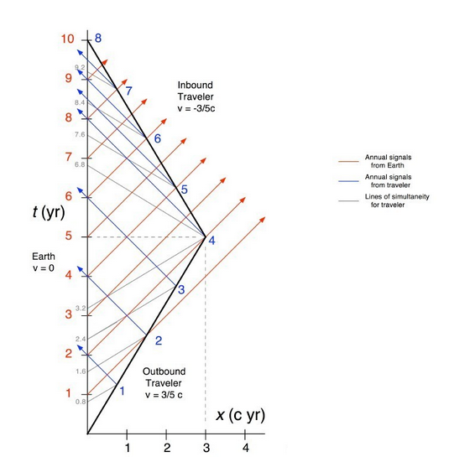
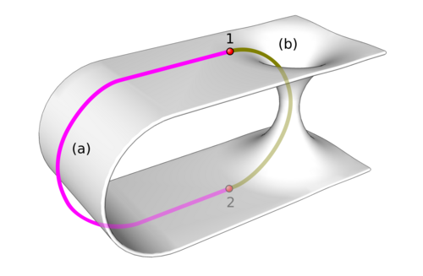
Black hole speculations
Questions:
Could wormholes exist in nature? Could they be usable for traversing large distances?
Is something like “warp drive” physically possible?
Is time travel physically possible?

Slide 5
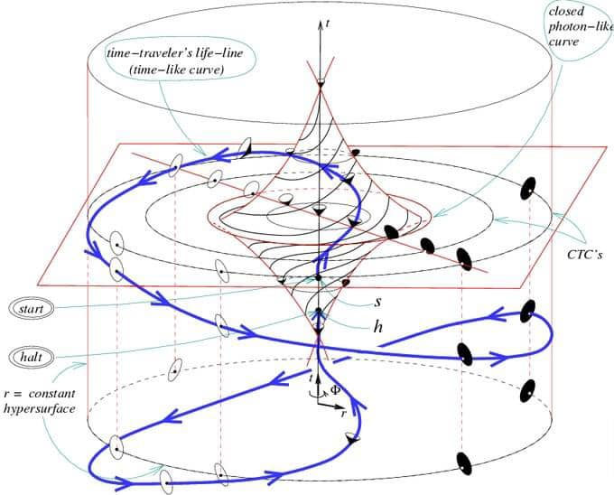
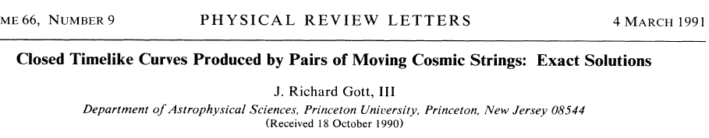
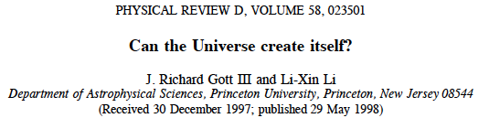
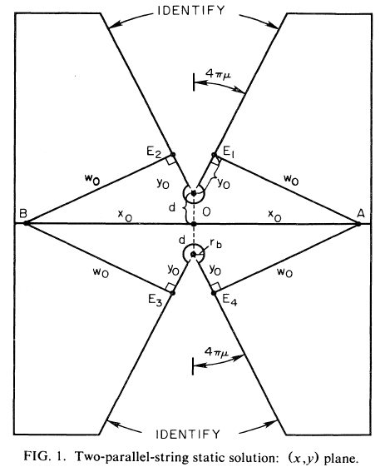
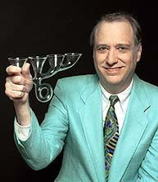
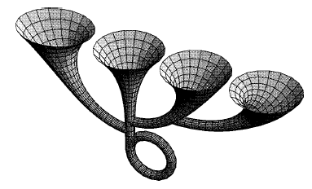
Black hole speculations
Is time travel to the past physically possible?
Godel spacetime

