Slide 1
Waves
Electromagnetic Radiation
Momentum
Energy
Photons

Slide 2
Waves
A wave is a propagating disturbance. For example:
Water wave. Gravity and pressure make the wave propagate.
Stadium wave.
Sound wave: compression and expansion.
The disturbance moves through space, but material in the medium just oscillates back and forth.
Usually waves involve periodic oscillations.

Slide 3
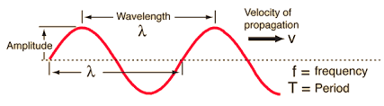
Key features of a wave are:
Period of oscillation [sec] or frequency of oscillation [sec⁻¹]
Wavelength of oscillation [m]
Speed (more accurately, velocity) of propagation [m/sec]
Amplitude [units depend on the kind of wave]
Related by v = (wavelength/period) = wavelength ⨉ frequency
Examples: wave on a rope, water wave, sound wave.

Slide 4
Key features of a wave are:
Period of oscillation [sec] or frequency of oscillation [sec⁻¹]
Wavelength of oscillation [m]
Speed (more accurately, velocity) of propagation [m/sec]
Amplitude [units depend on the kind of wave]
Sound waves in air:
Speed = 300 m/sec. Amplitude determines volume.
Frequency determines pitch. 1 sec⁻¹ = 1 Hertz (Hz)
Piano ranges from about 30 Hz to about 4000 Hz.
Middle C is about 260 Hz, wavelength (300/260) = 1.15 m.

Slide 5
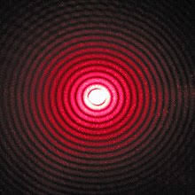
Electromagnetic waves
Experiments around 1800 showed light behaves like a wave, exhibiting diffraction.
But what is waving?
James Clerk Maxwell, building on experimental results by Michael Faraday and others, showed (1864):
Changing electric field produces a magnetic field.
Changing magnetic field produces an electric field.
Maxwell’s equations allow traveling electromagnetic waves. Calculated speed matched measured speed of light,
In 1887, Heinrich Hertz confirmed existence of EM waves, building what is effectively the first radio transmitter & receiver.

Slide 6
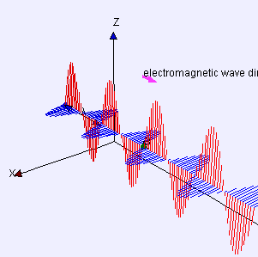
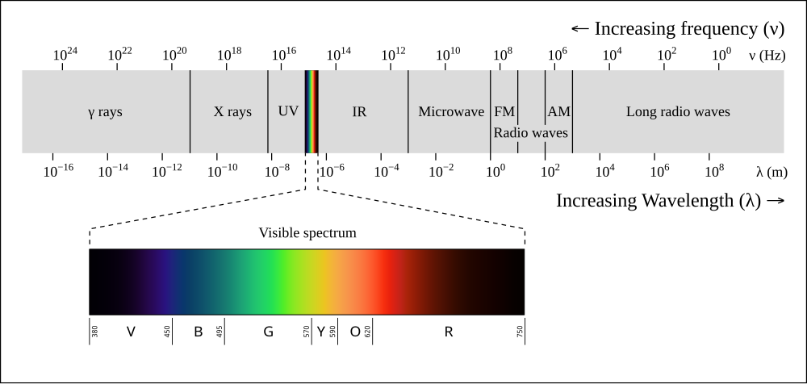
Electromagnetic radiation
EM radiation: waves of electric and magnetic fields that propagate through space.
Visible light is EM radiation with wavelength 400 – 700 nm (1 nm = 10⁻⁹ m), wavelength determines color.
All forms of EM radiation travel (in empty space) at
c = 300,000 km sec⁻¹ = 3 ⨉ 10⁸ m sec⁻¹
Similar to Thorne figure P.2

Slide 7
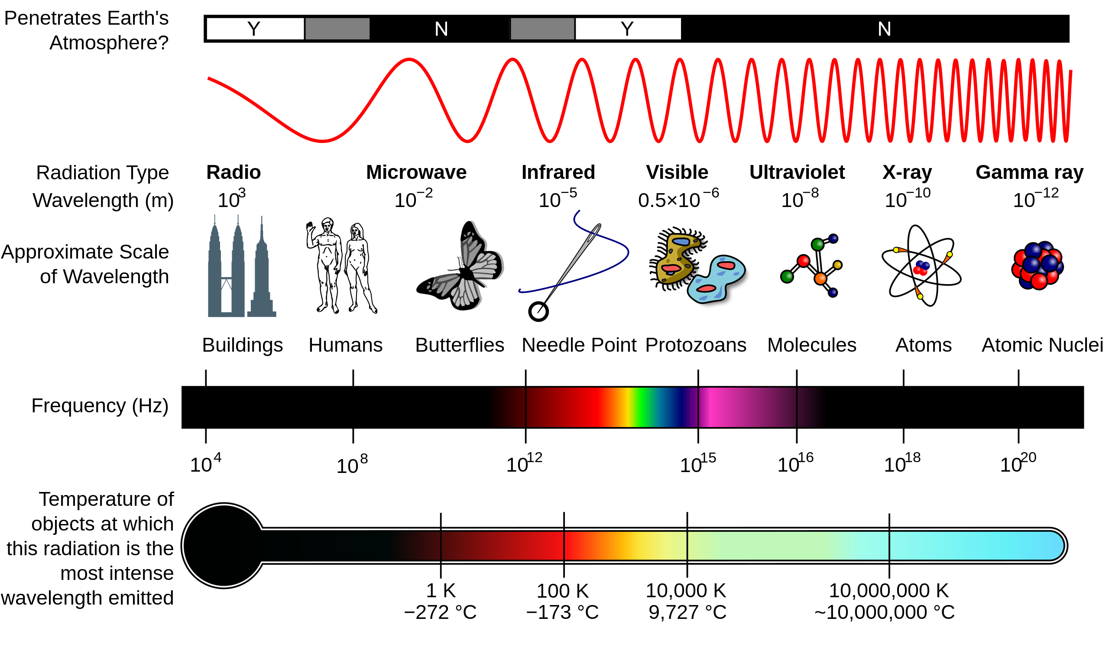
Electromagnetic radiation
Image credit: Wikipedia
WOSU at 89.7 MHz
Wavelength = 3 ⨉ 10⁸ m sec⁻¹ / (89.7 ⨉ 10⁶ sec⁻¹) = 3.34 m

Slide 8
Momentum and momentum conservation
Momentum = “tendency to keep going”
Object of mass m moving at velocity v with v << c has momentum
p = m v (vector, same direction as velocity)
Acceleration = rate of change of velocity, and F = ma, so
F = rate of change of momentum
Newton’s 3rd law ⇒ total momentum doesn’t change if there are no external forces.
Momentum is conserved.

Slide 9
Energy and energy conservation
Energy = “ability to do something”
Physics gives precise definition
Different forms: kinetic (energy of motion), thermal, electrical…
Potential energy, available to be tapped (gravitational, chemical)
Energy can be transformed, but total energy is always conserved.
Key to understanding many problems is “follow the energy”

Slide 10
Photons
EM radiation has many wavelike properties.
In 1905 Einstein (building on work by Max Planck) proposes that EM radiation travels in discrete energy packets, a.k.a. photons
“Particles of light.” Energy depends on wavelength:
E = h c / λ
E = energy of photon λ = wavelength of photon
c = speed of light h = Planck’s constant
Momentum of a photon is p = h / λ
Short wavelength photons (gamma-ray, X-ray) have more energy, more momentum.

