Slide 1


Slide 2


Slide 3


Slide 4
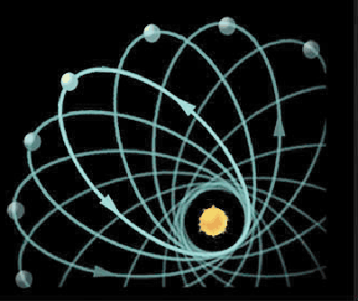
Precession of Mercury’s orbit around the Sun

Slide 5
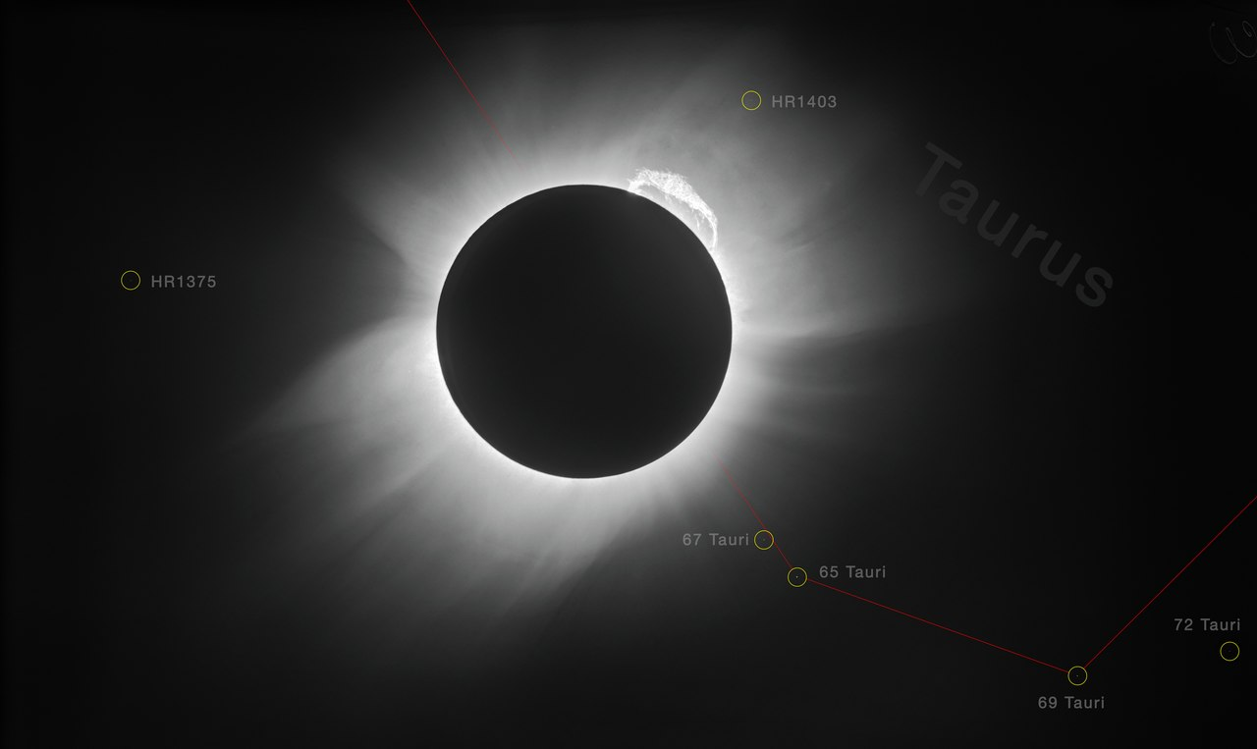
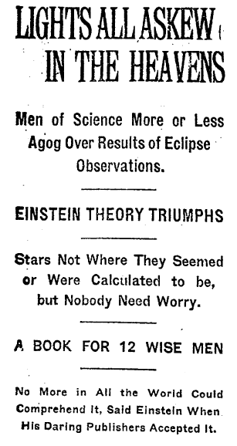
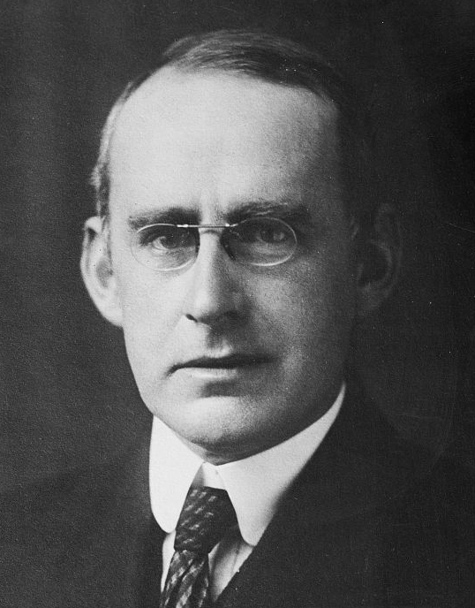

Slide 6
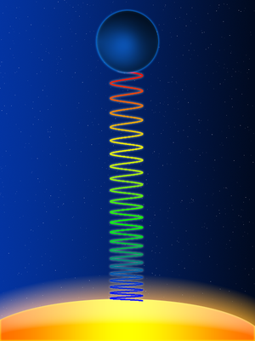
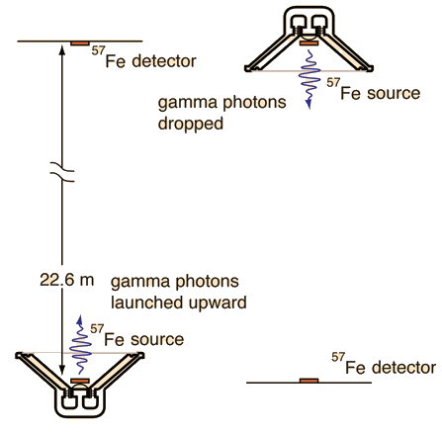
Gravitational redshift

Slide 7
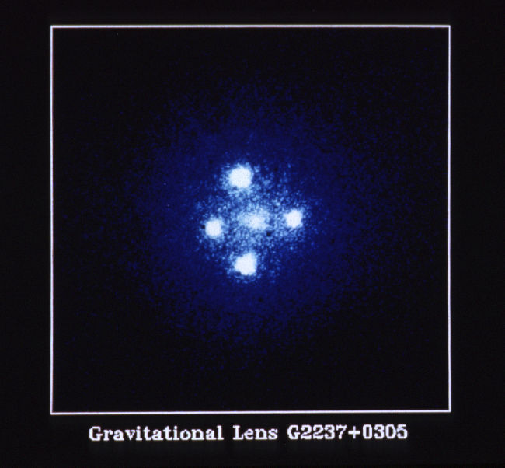
Gravitational lenses

Slide 8
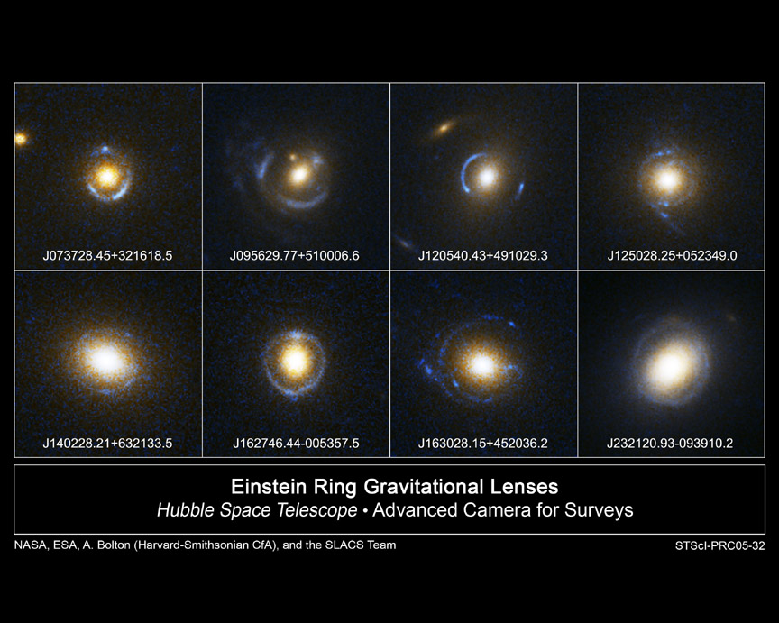

Slide 9
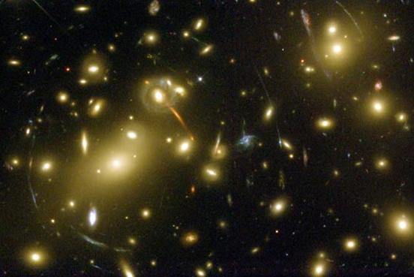

Slide 10
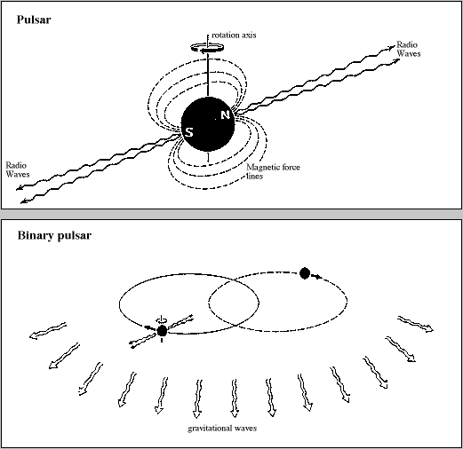
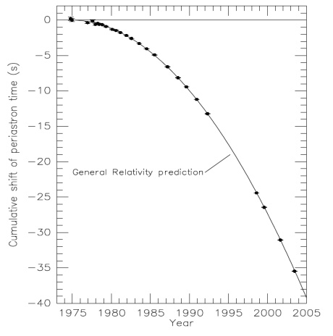
Orbit of binary pulsar (pair of neutron stars) shrinks as they emit gravitational waves that carry off energy.

Slide 11
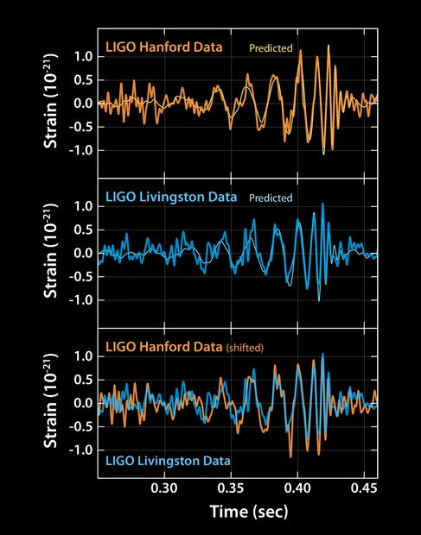
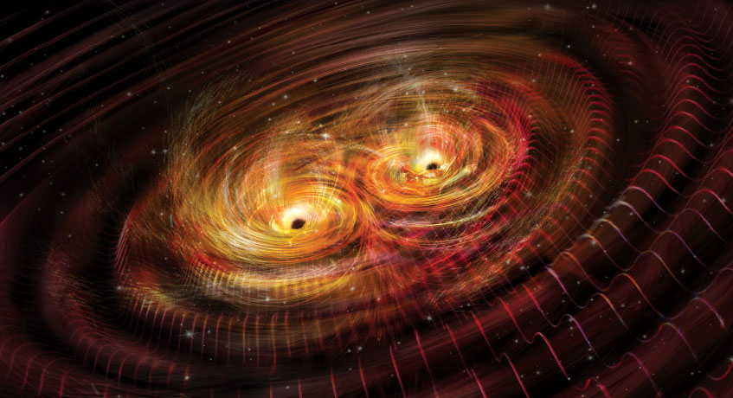
Direct detection of gravitational waves from merging black holes

Slide 12
Theoretically predicted image, perfect resolution
Theoretical image blurred to EHT resolution
Observed image
Bright ring is the “photon ring” arising because light rays go many times around the black hole.
Asymmetry arises from “Doppler boosting” which makes emission from material moving towards us appear brighter. Requires gas moving close to the speed of light; approaching gas on the bottom of the ring.
Central black region is the shadow cast by the event horizon.

