Slide 1
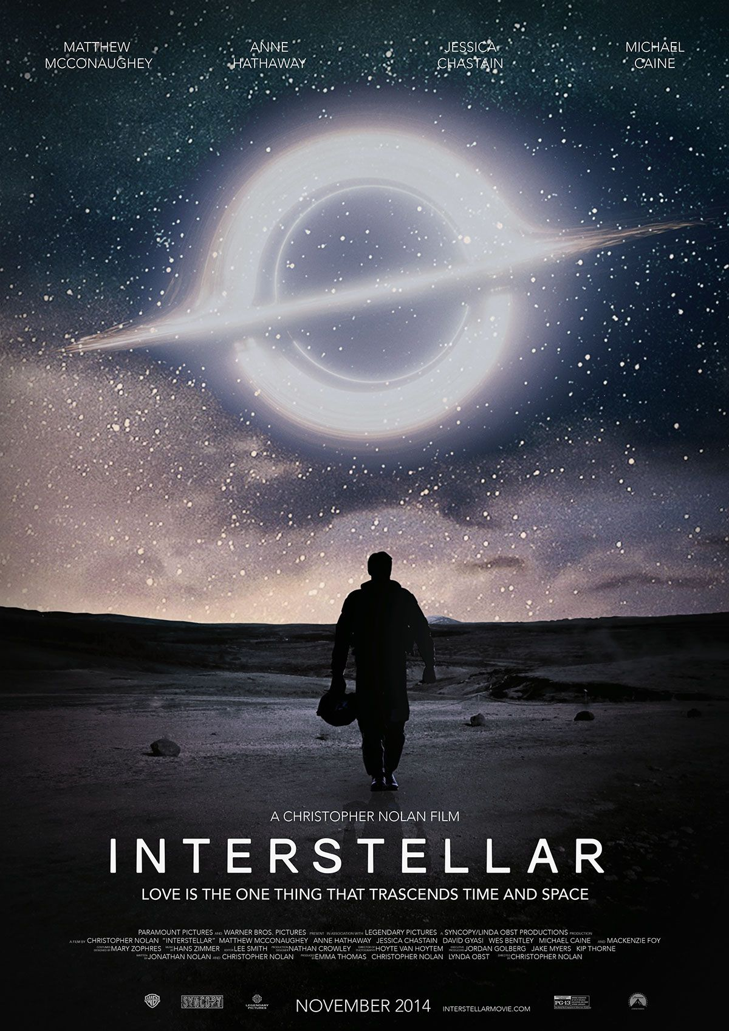

Slide 2
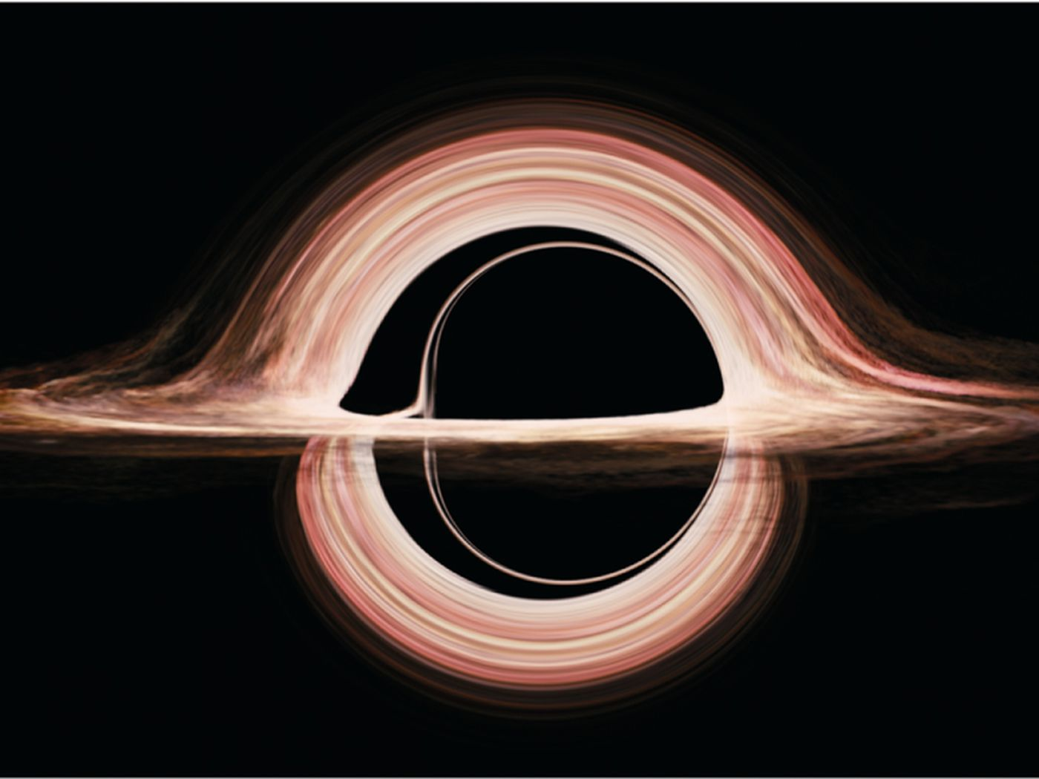
From “Gravitational lensing by spinning black holes in astrophysics, and in the movie Interstellar”,
by James, von Tunzelmann, Franklin, & Thorne, Classical and Quantum Gravity, 2015.

Slide 3
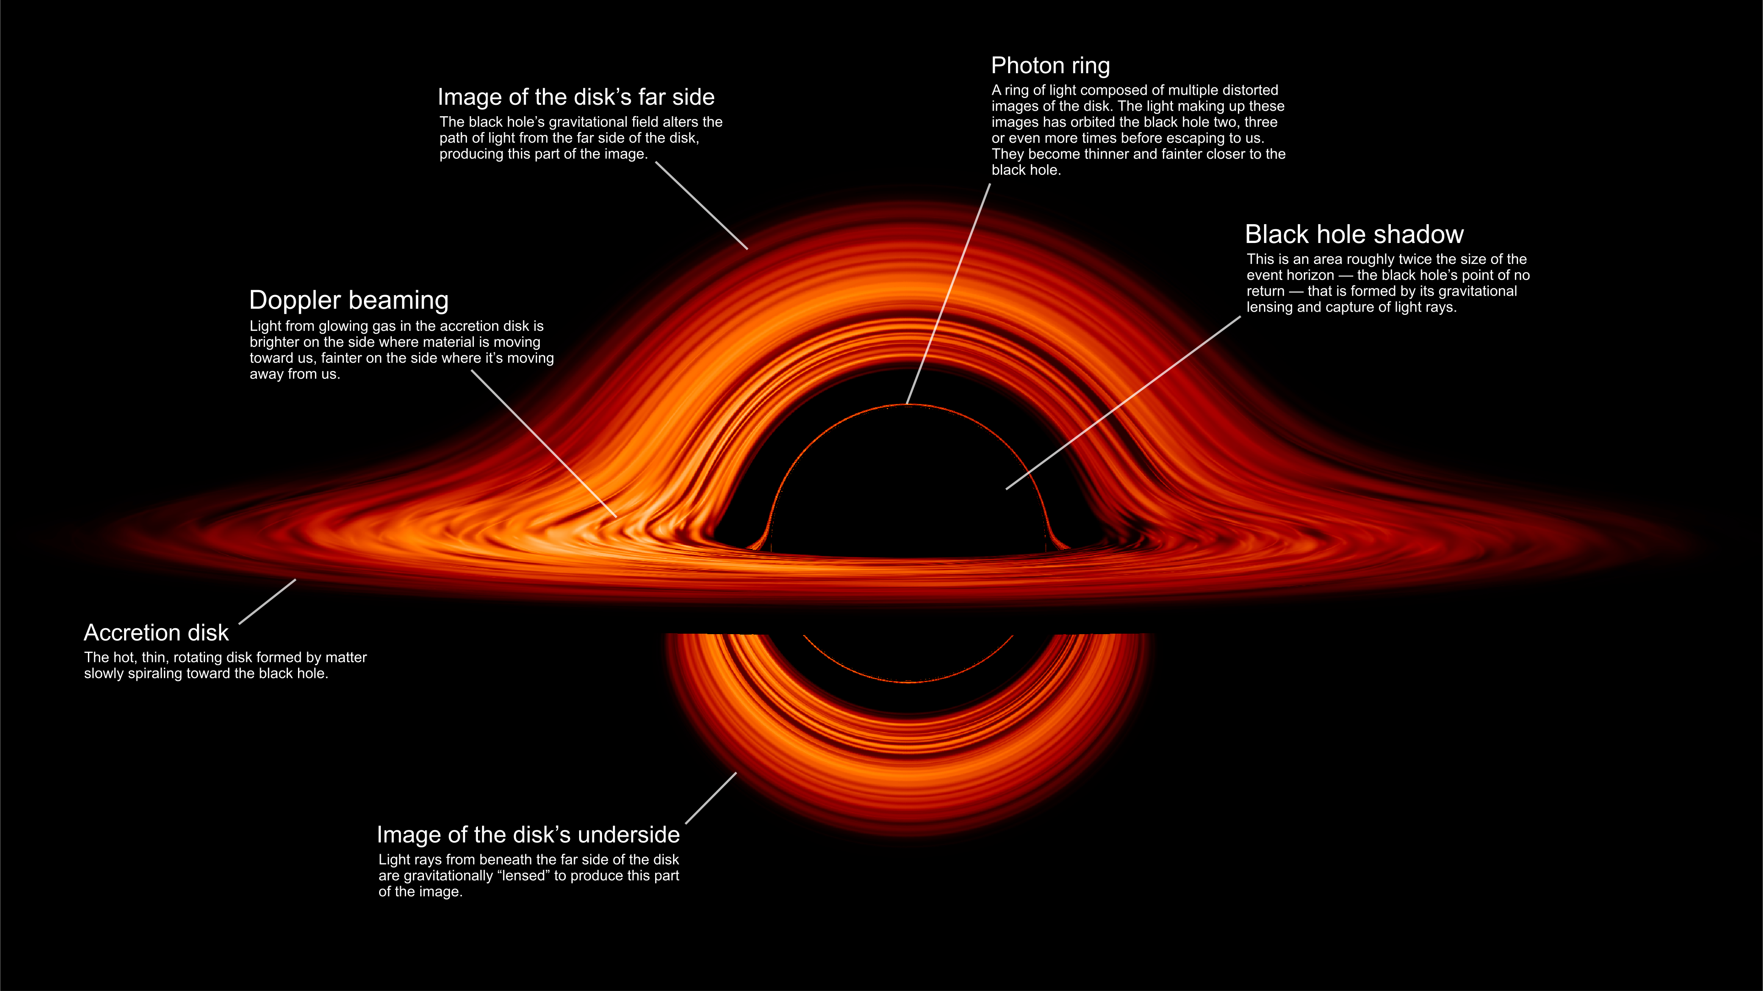
https://www.nasa.gov/universe/nasa-visualization-shows-a-black-holes-warped-world/

Slide 4
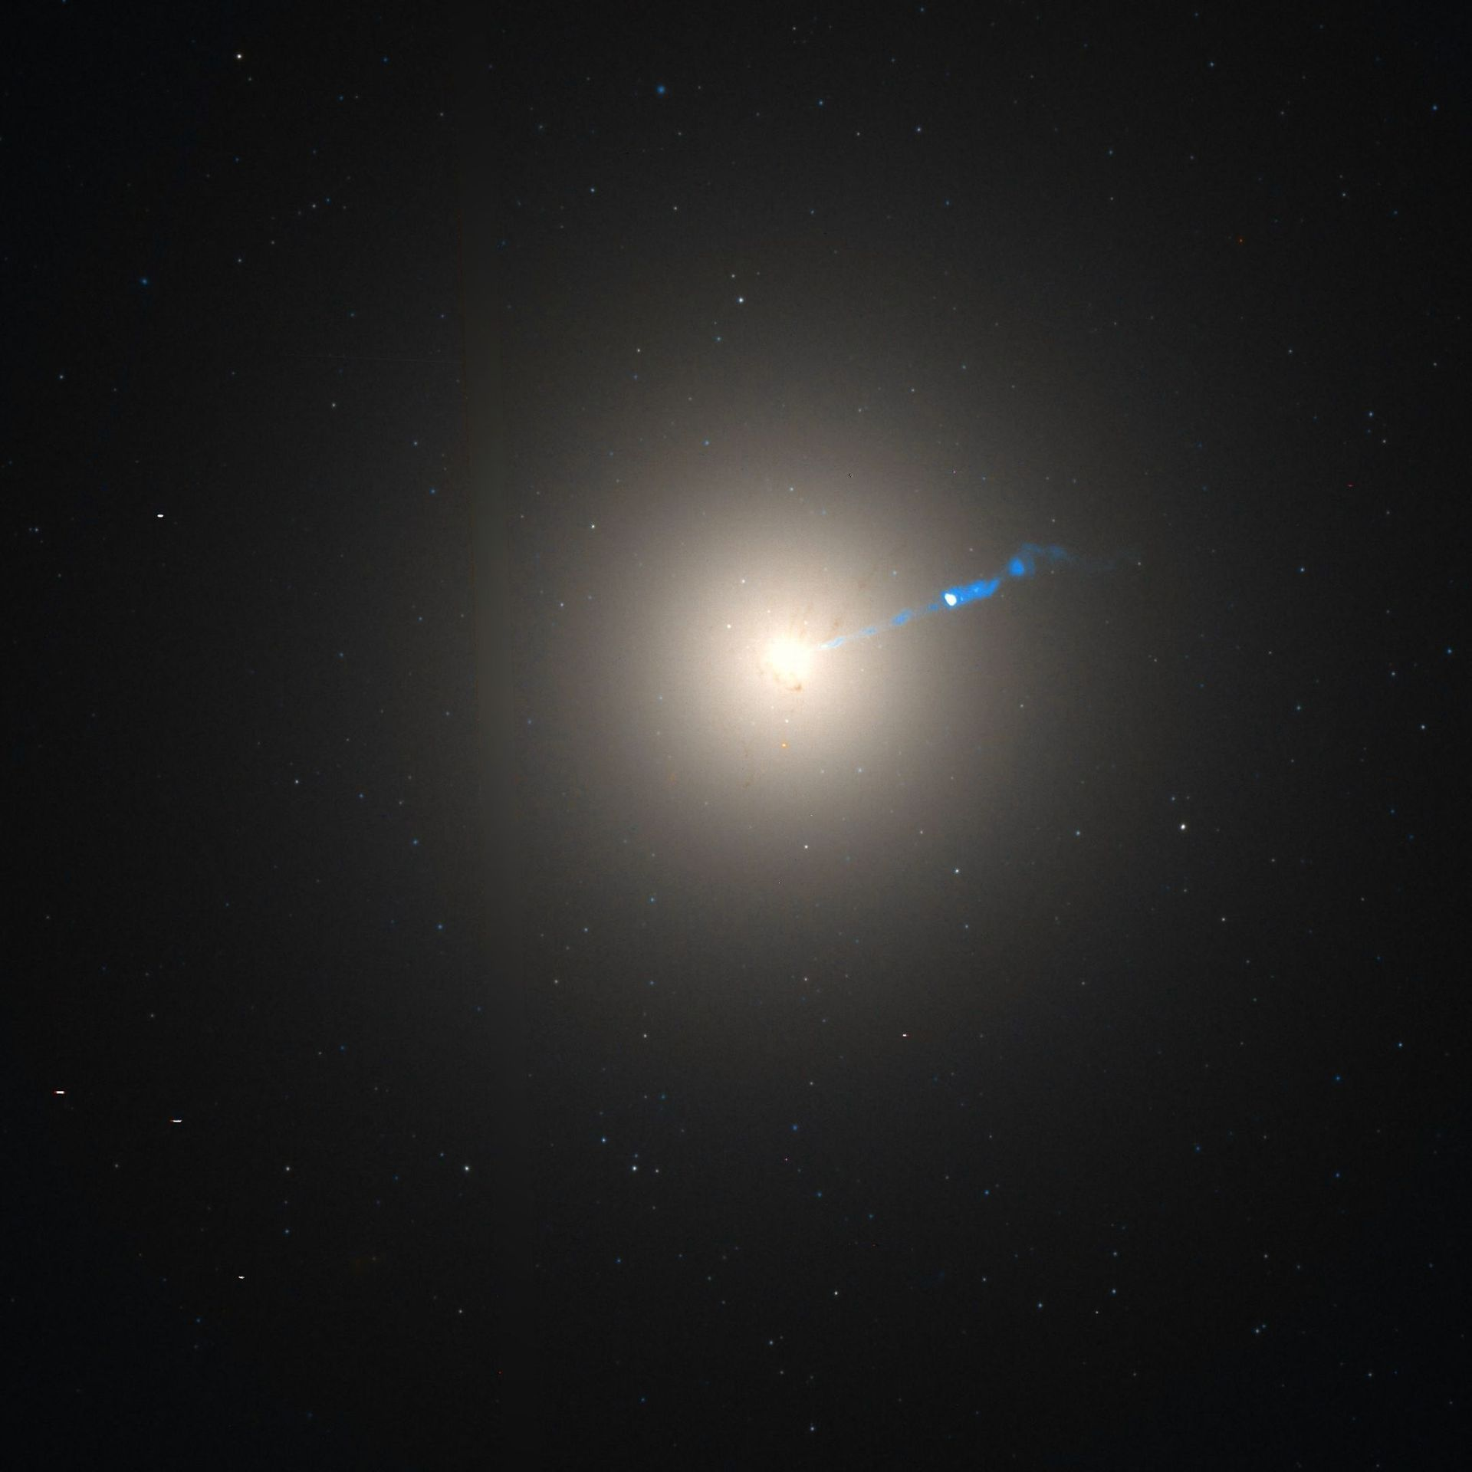
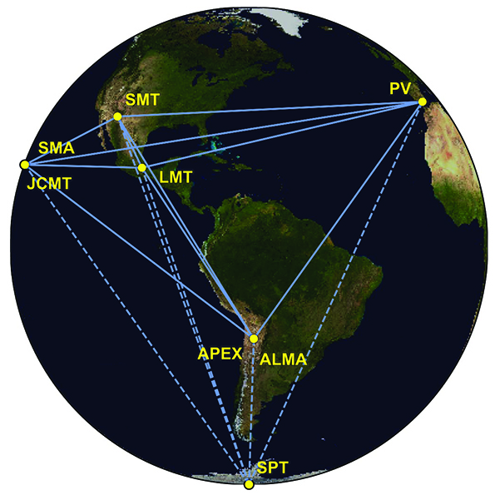

Slide 7
Theoretically predicted image, perfect resolution
Theoretical image blurred to EHT resolution
Observed image
Bright ring is the “photon ring” arising because light rays go many times around the black hole.
Asymmetry arises from “Doppler boosting” which makes emission from material moving towards us appear brighter. Requires gas moving close to the speed of light; approaching gas on the bottom of the ring.
Central black region is the shadow cast by the event horizon.

Slide 8
Johannsen & Psaltis 2010

Slide 9
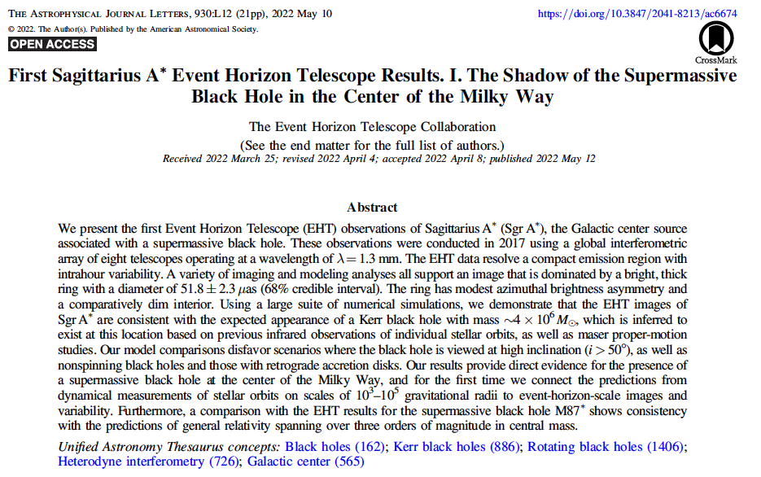

Slide 10
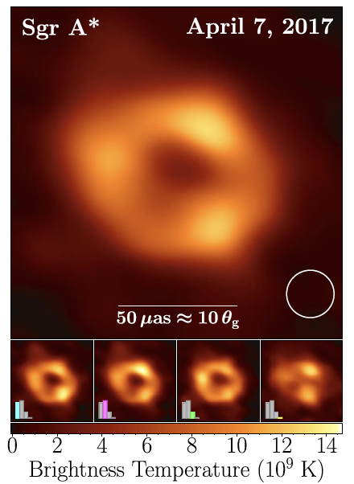
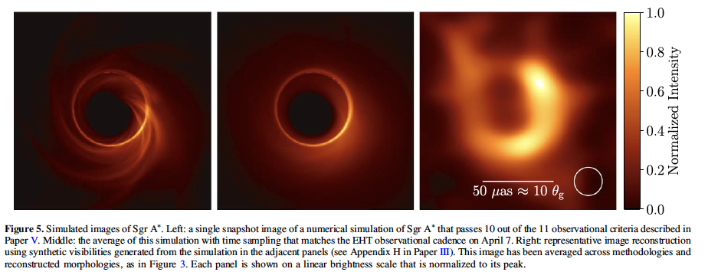
Image of the accretion flow around the Milky Way’s central black hole.
Simulated images

Slide 11
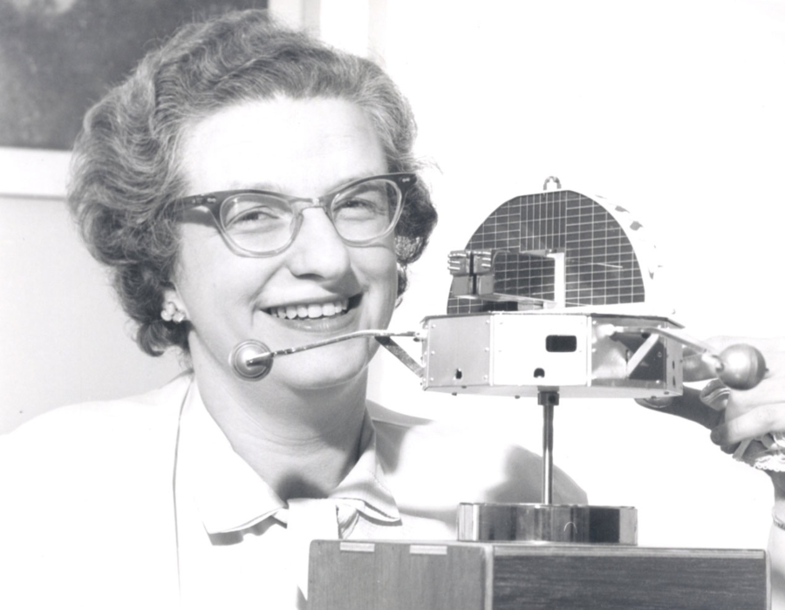
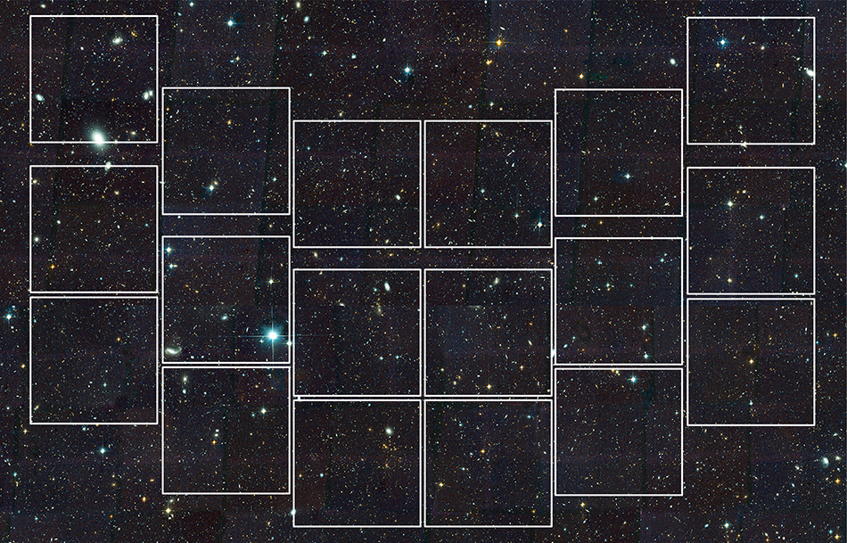
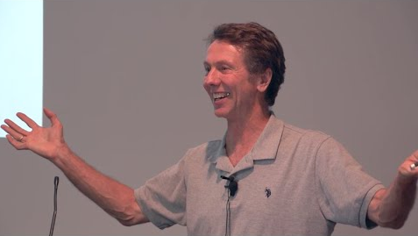

The Nancy Grace Roman Space Telescope
NASA’s Next Great Observatory
David Weinberg, Ohio State University
Co-Spokesperson: Roman Science Collaboration

Slide 12







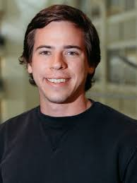









Many current and former participants from Ohio State

Slide 13
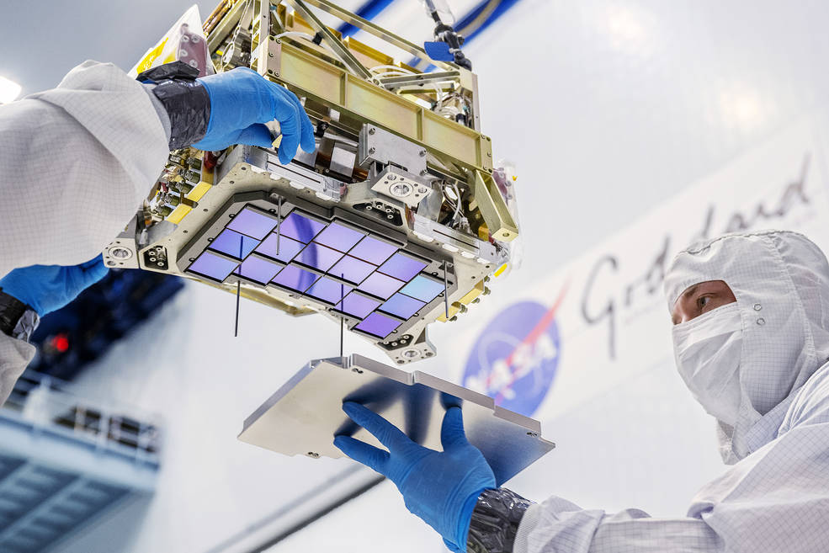
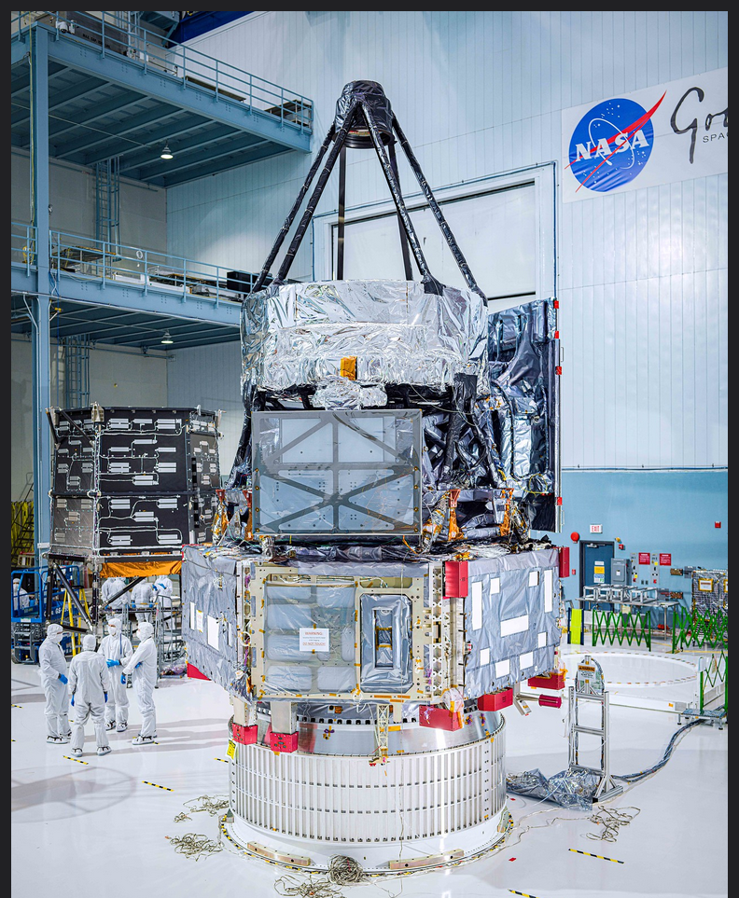
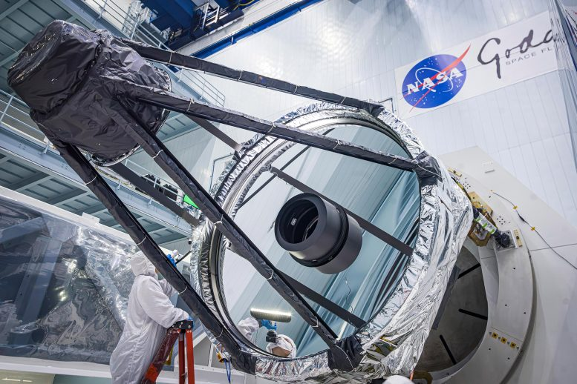
Assembled observatory at NASA Goddard Space Flight Center
Wide Field Camera
2.4-m mirror

Slide 14
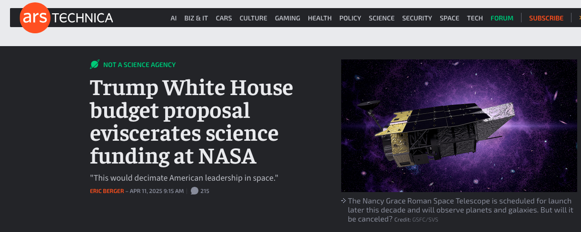
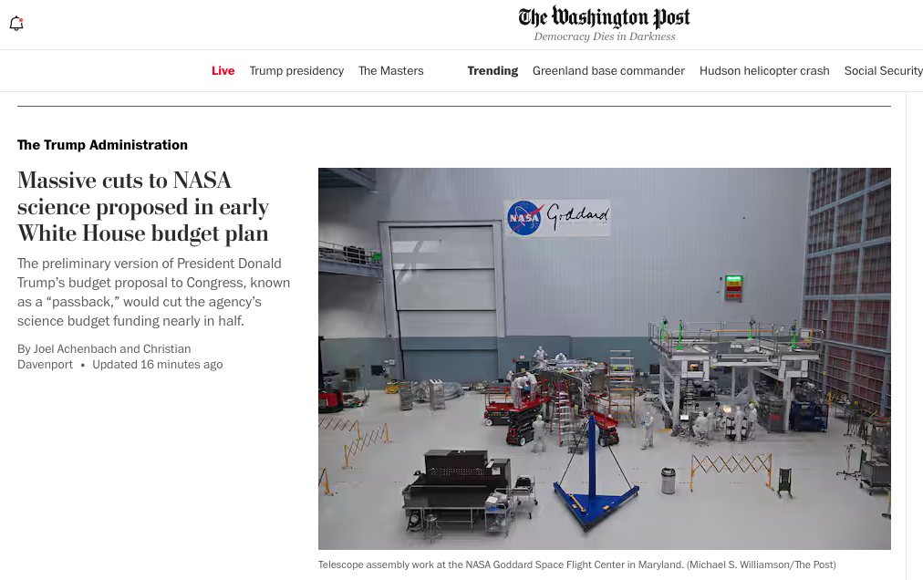
Breaking (bad) news:
Administration’s proposed NASA budget will gut science, cancel Roman.
It’s up to Congress.
You can help.

