Slide 1

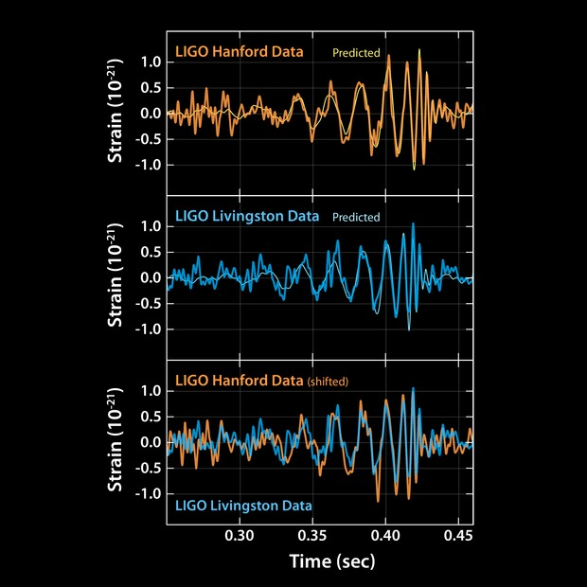
Astronomy 2142: Black Holes
Professor David Weinberg
Spring 2025

Slide 2
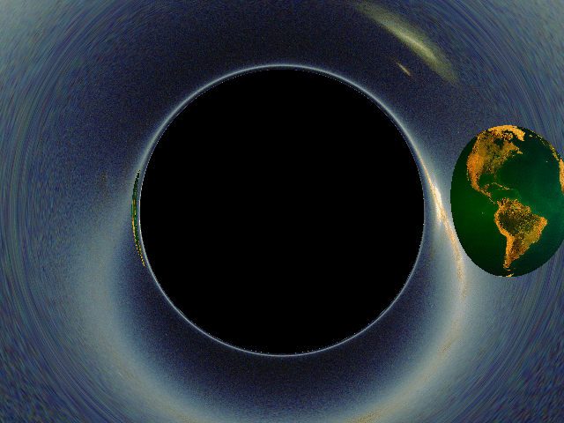

Slide 3
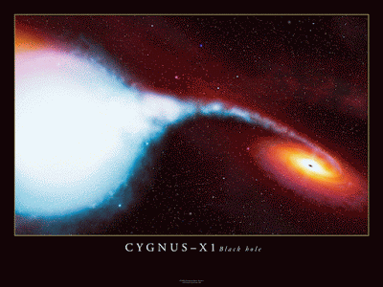
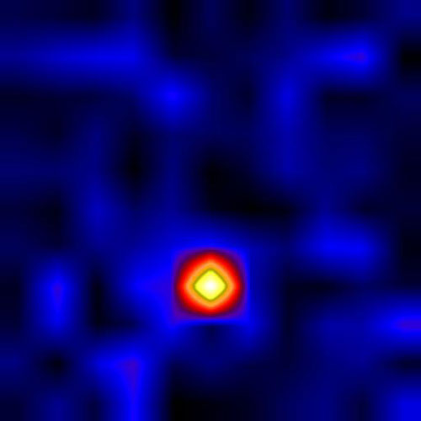
How can we find black holes?
Gas falling towards a BH heats dramatically, glows in X-rays.
X-ray telescope image.
Artist’s conception.
Cygnus X-1, first widely accepted black hole.

Slide 4
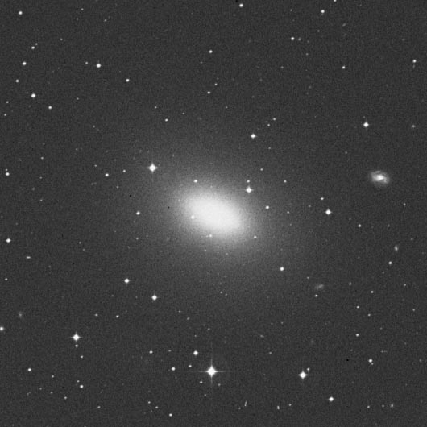
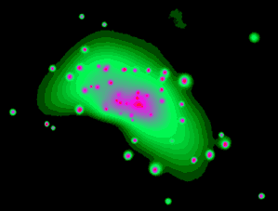
Galaxy NGC 4697
Optical light
X-rays

Slide 5
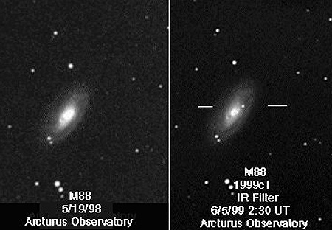
Supernova explosion in a nearby galaxy.

Slide 6
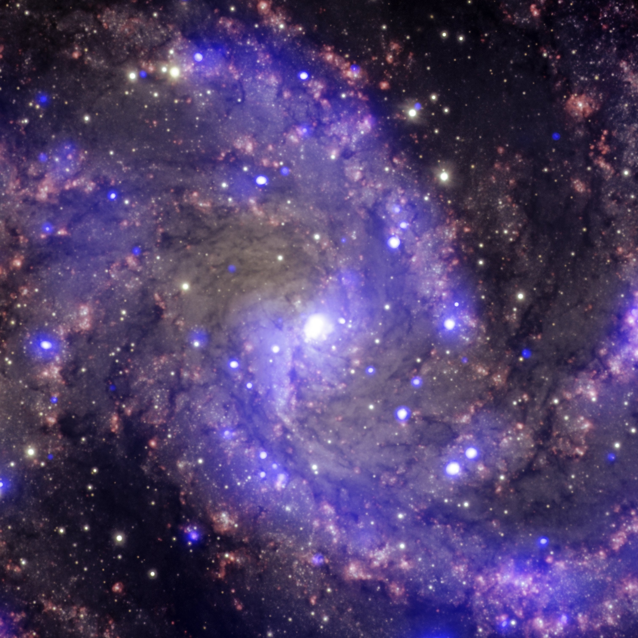
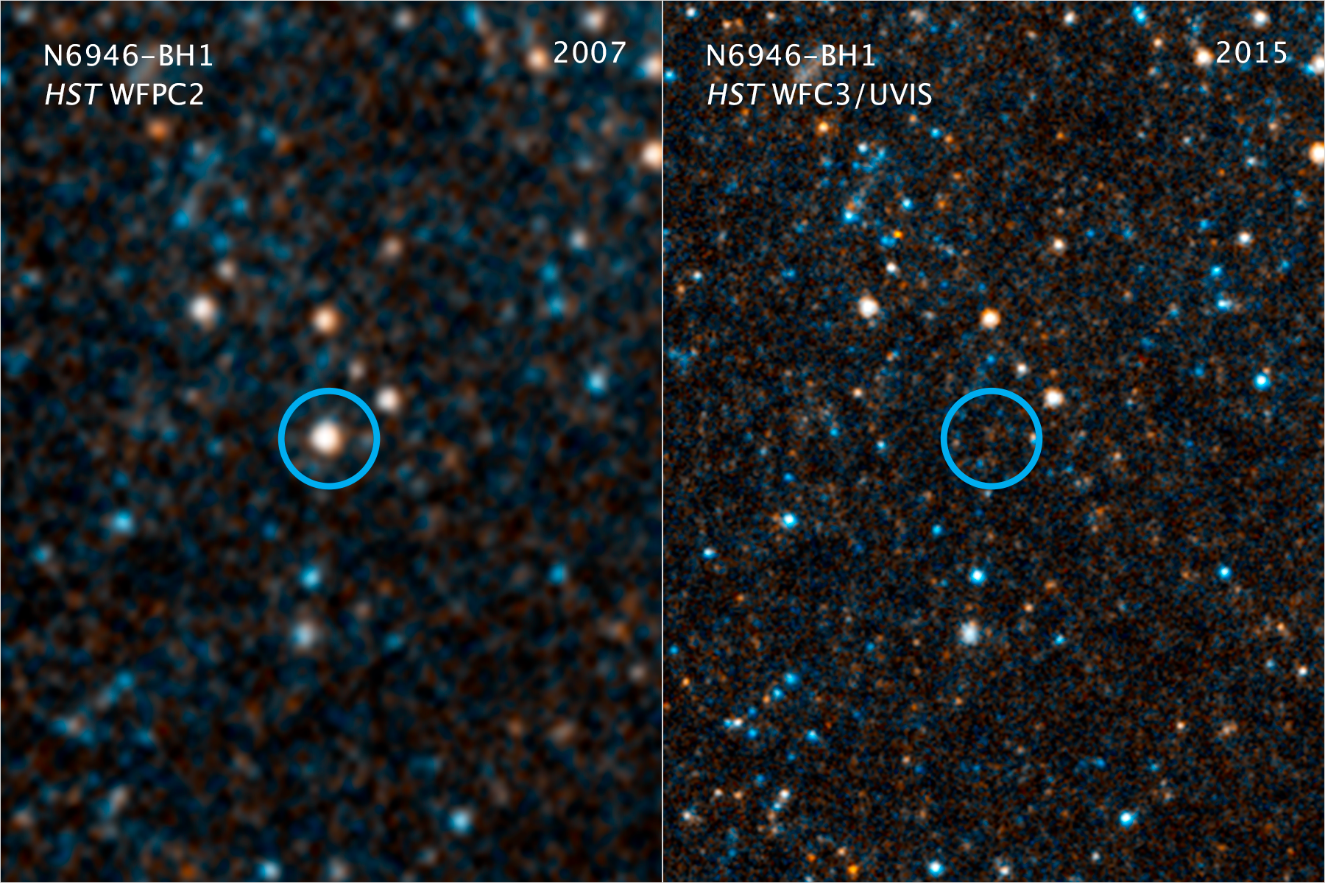
Formation of a “stellar mass” BH (3 – 100 ⨉ M_{sun})

Slide 7
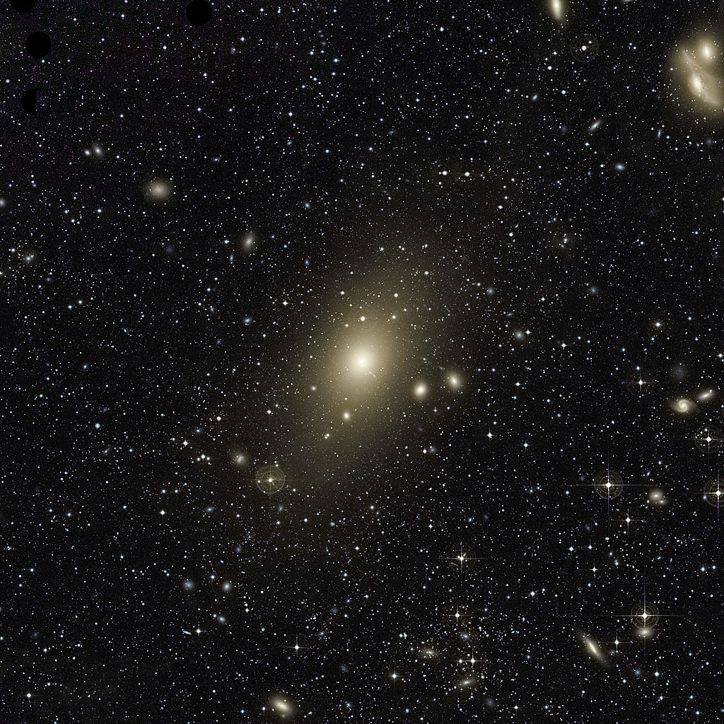
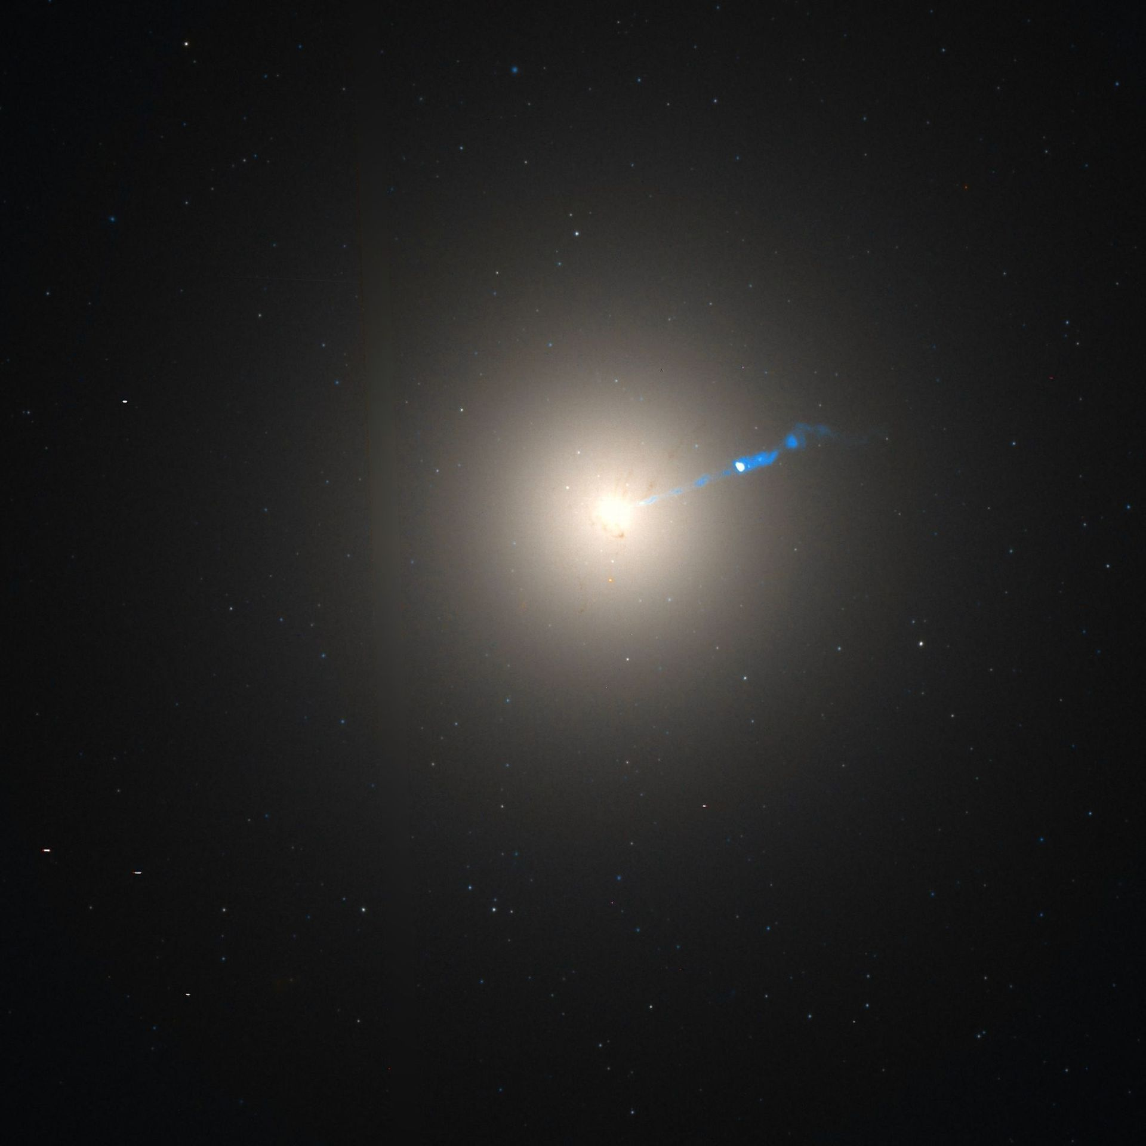
“Supermassive” black holes at galaxy centers (10⁶ – 10¹⁰ ⨉ M_{sun})

Slide 8
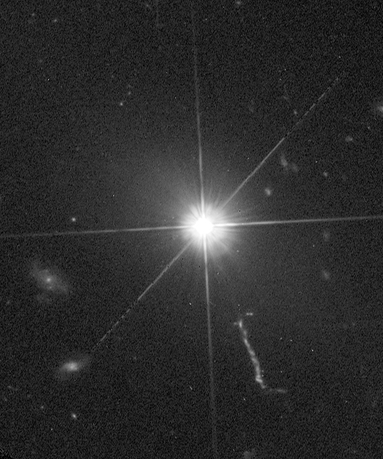
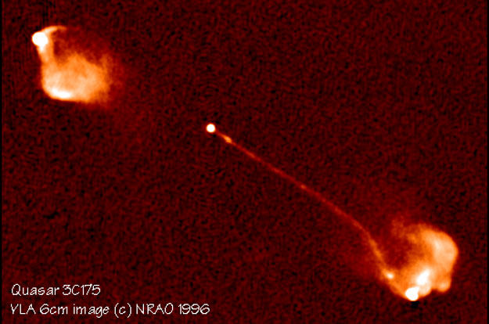
3C 273, optical light (HST)
3C 175, radio waves

Slide 9
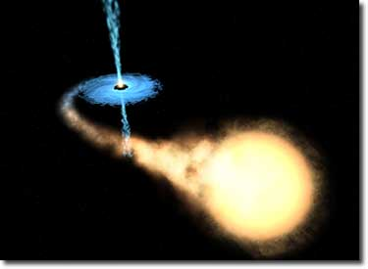
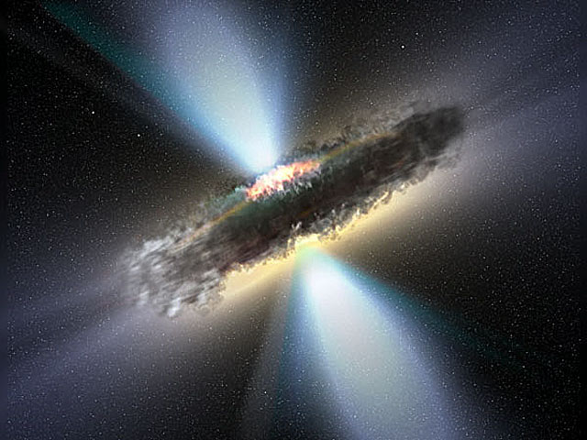
Artist’s conception.
Artist’s conception.

Slide 10
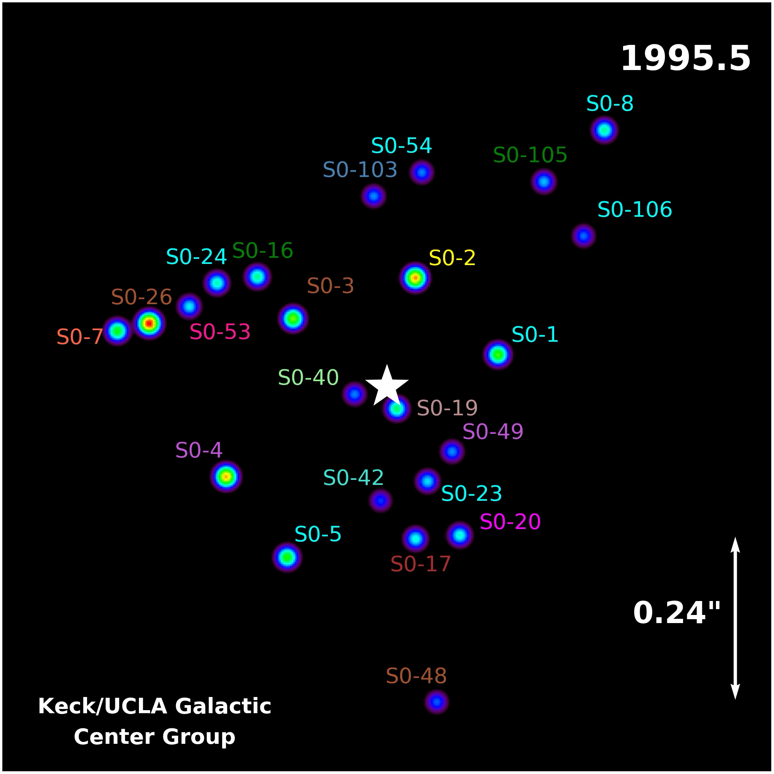
Motion of stars near the center of the Milky Way Galaxy, over 14 years.
Data and visualization by Andrea Ghez and collaborators, UCLA.
Central black hole is four million times the mass of our Sun.

Slide 11

Motion of stars near the center of the Milky Way Galaxy, over 14 years.
Data and visualization by Andrea Ghez and collaborators, UCLA.
Central black hole is four million times the mass of our Sun.
2020 Nobel Prize in Physics
Andrea Ghez
Reinhard Genzel
Roger Penrose

Slide 12

Inspiral of merging black holes
Videos available at ligo.caltech.edu

Slide 13
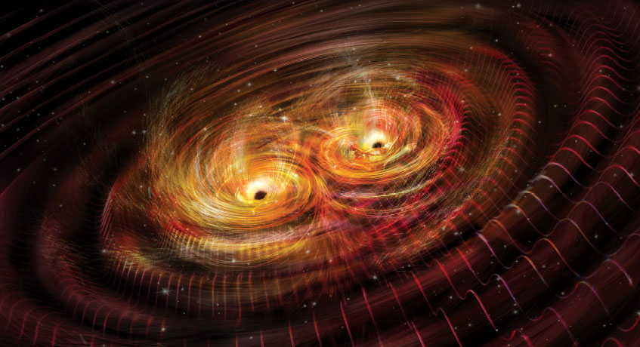
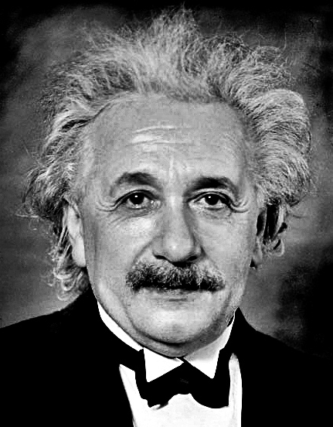
Gravitational Waves
Created by accelerating masses, e.g., orbiting stars or black holes.
Stretch and squeeze distances in an oscillating pattern as they pass.

Slide 14
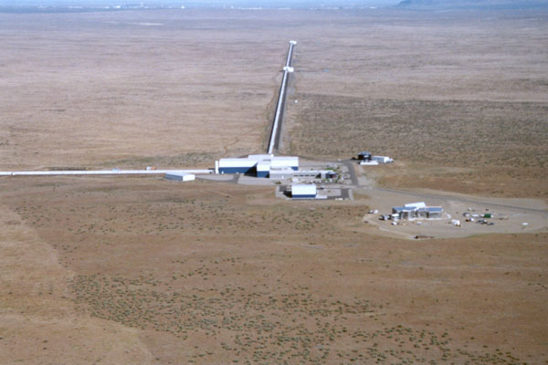
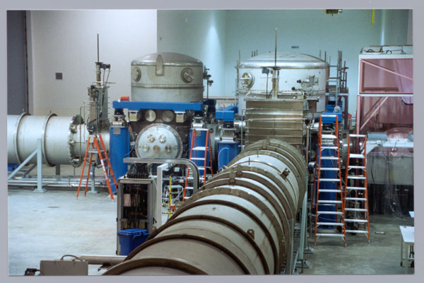

Slide 15
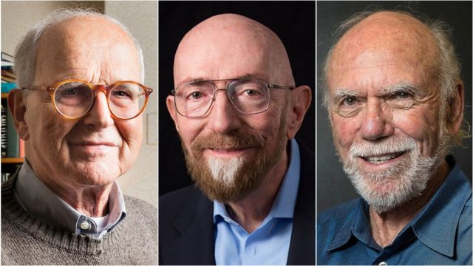
2017 Nobel Prize in Physics
Rai Weiss, Kip Thorne, Barry Barish

Slide 16
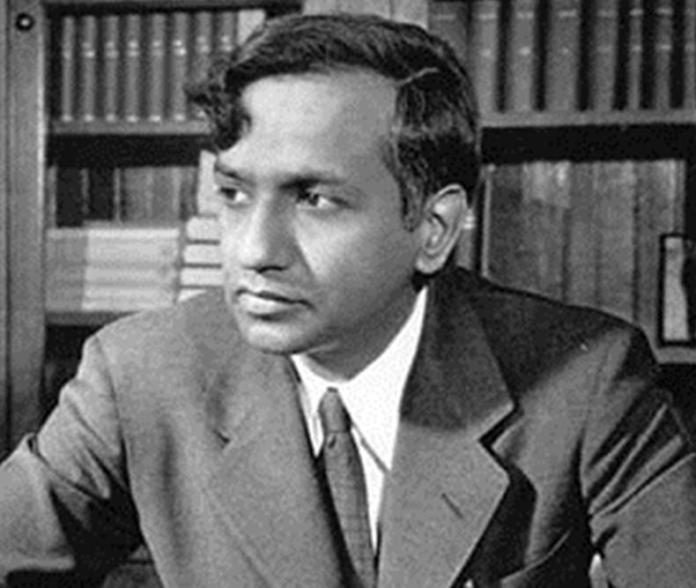



Subramanyan Chandrasekhar
Gabriela Gonzales
Nergis Mavalvala
Vicky Kalogera

Slide 17
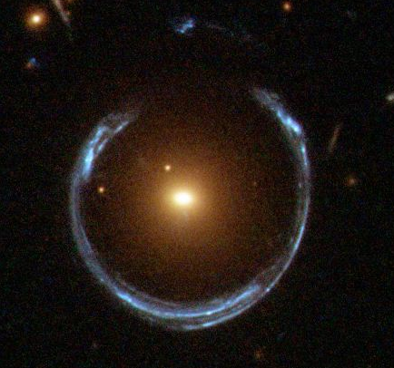
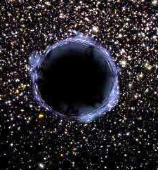
Real telescope image of a galaxy gravitationally lensing a background galaxy.
Artist’s conception of shadowing and gravitational lensing by a black hole.

Slide 18
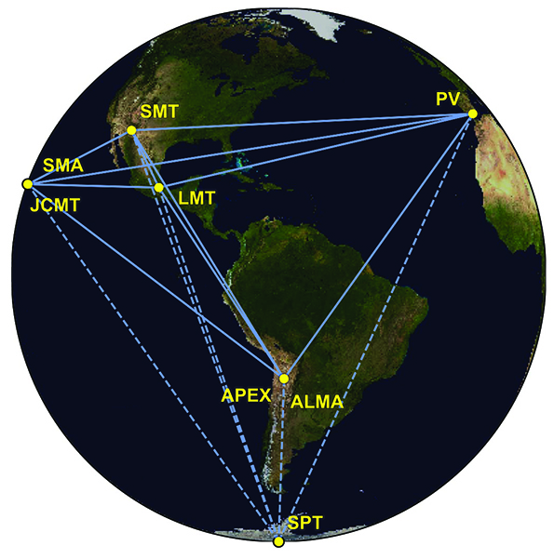
M87, optical image with jet
Event Horizon Telescope network

Slide 19
EHT image of BH at center of M87

Slide 20
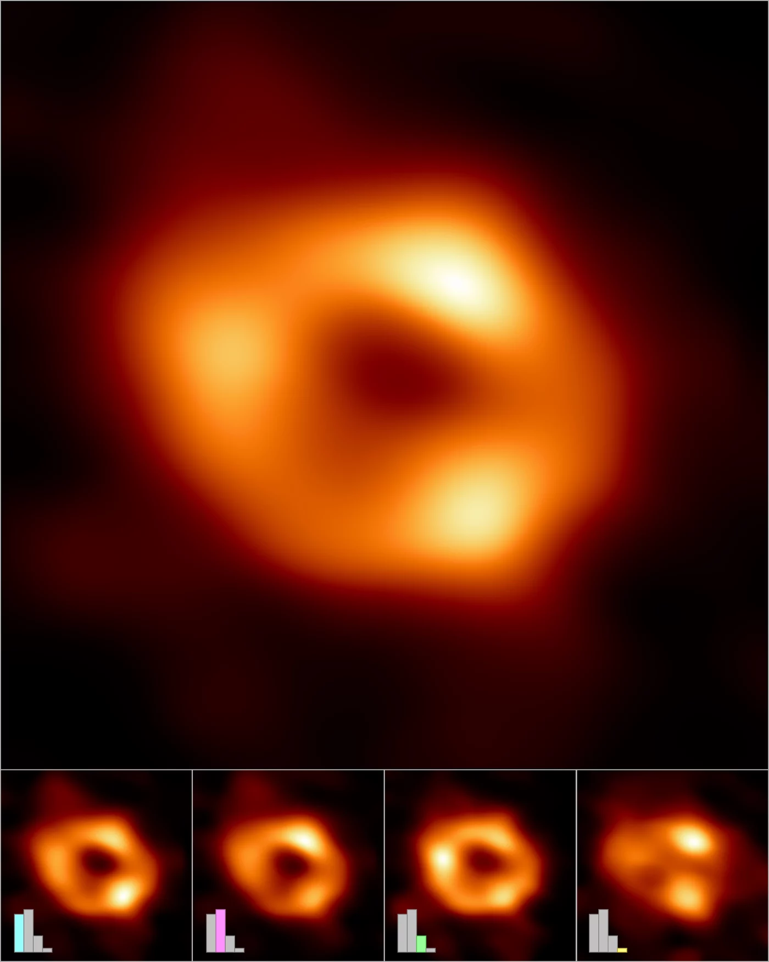
EHT image of BH at center of Milky Way galaxy

Slide 21
A brief history of an idea
1686: Newton’s theory of gravity
1783: Michell proposes idea of “dark stars”
1796: Laplace popularizes this idea
1800: light consists of waves, not particles
1907-1916: Einstein’s theory of gravity (General Relativity)
1916: Schwarzschild solution to Einstein’s equations, describing black holes
1925-1930: Existence of white dwarfs
1930: Maximum mass of white dwarfs; collapse of massive stars could produce black holes
1930s-1950s: Theory of supernovae and neutron stars. Neutron stars also have a maximum mass.
1960s: Theory of BHs developed further.

Slide 22
1963: First discovery of quasars.
1970: First X-ray satellite. Many bright X-ray sources, some too massive to be neutron stars.
1970s-1990s: Case for stellar mass BHs and supermassive BHs gets stronger, alternatives eliminated.
Late 1990s-2000s: Demonstration that most nearby galaxies have central supermassive black holes.
2000s: Increasing evidence that supermassive BHs help govern the formation of their host galaxies.
2015: First direct detection of gravitational waves from merging BHs, in a galaxy 1 billion light years away.
2019: First direct image of the shadow cast by a BH event horizon, in the galaxy M87.
Today: ~ 100 gravitational wave events, Milky Way BH event horizon has also been imaged.

