Slide 1
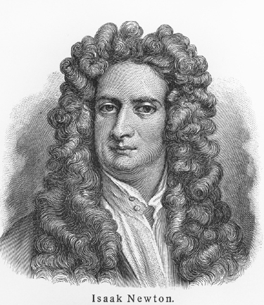
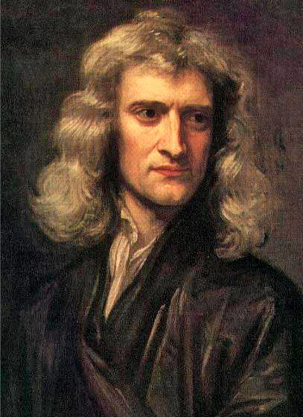

Slide 2
Isaac Newton (1642 – 1727)
Premature baby, raised by grandmother
As an undergraduate at Cambridge, invented calculus
Became Cambridge professor at age 26
Later jobs included Member of Parliament, Warden of the Mint
Lived at time of great political upheaval and scientific progress.
Leader among many great contemporary scientists & mathematicians.
Embroiled in numerous priority disputes.

Slide 3
Contributions and publications:
Created mechanics (physics of motion) in its modern form.
Discovered law of gravity and many of its applications.
Major contributions to theory of light and optics.
Outstanding experimenter. Largely established the modern practices of experimental physics.
Major publications: Philosophiae Naturalis Principia Mathematica (a.k.a. Principia), 1687, and Opticks, 1704
Other letters and shorter publications.
Enthusiastic alchemist, lots of bogus experiments and theories.
Wrote enormous treatises on theology, the bible, early Christian history. Extreme Anti-Trinitarian.

