Slide 1
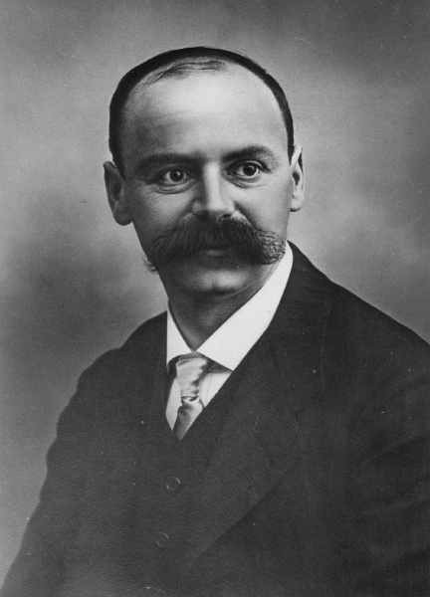
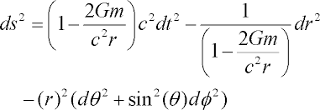
The Schwarzschild spacetime metric
Karl Schwarzschild

Slide 2
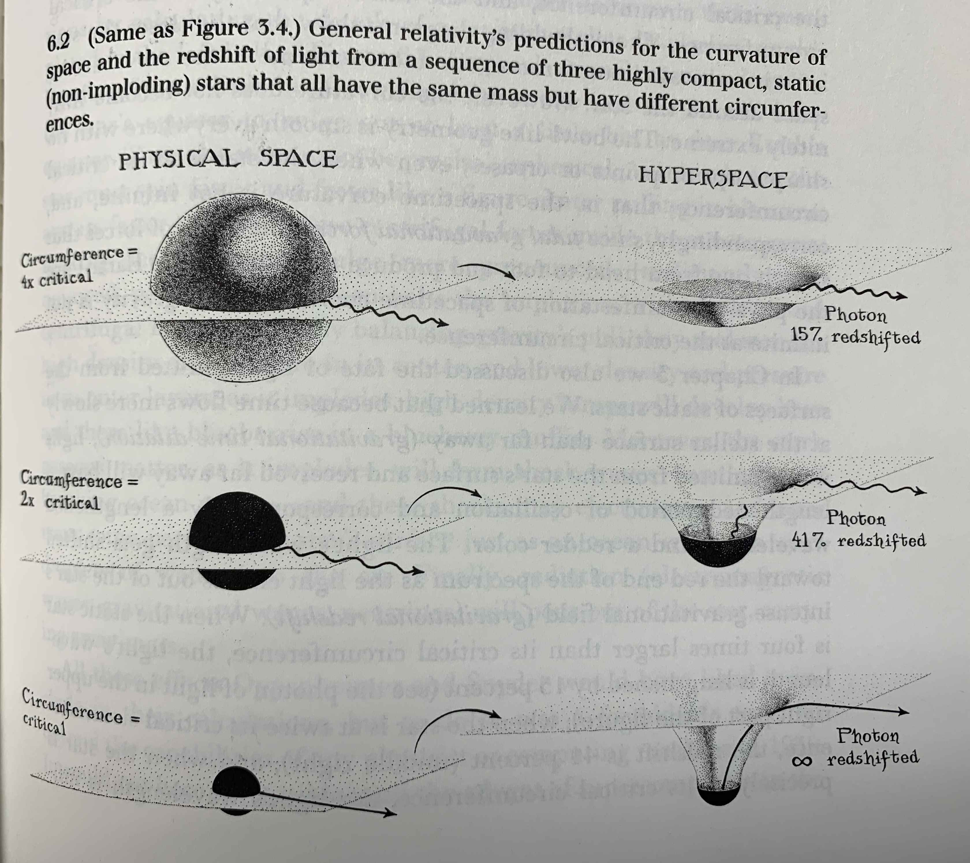

Slide 3
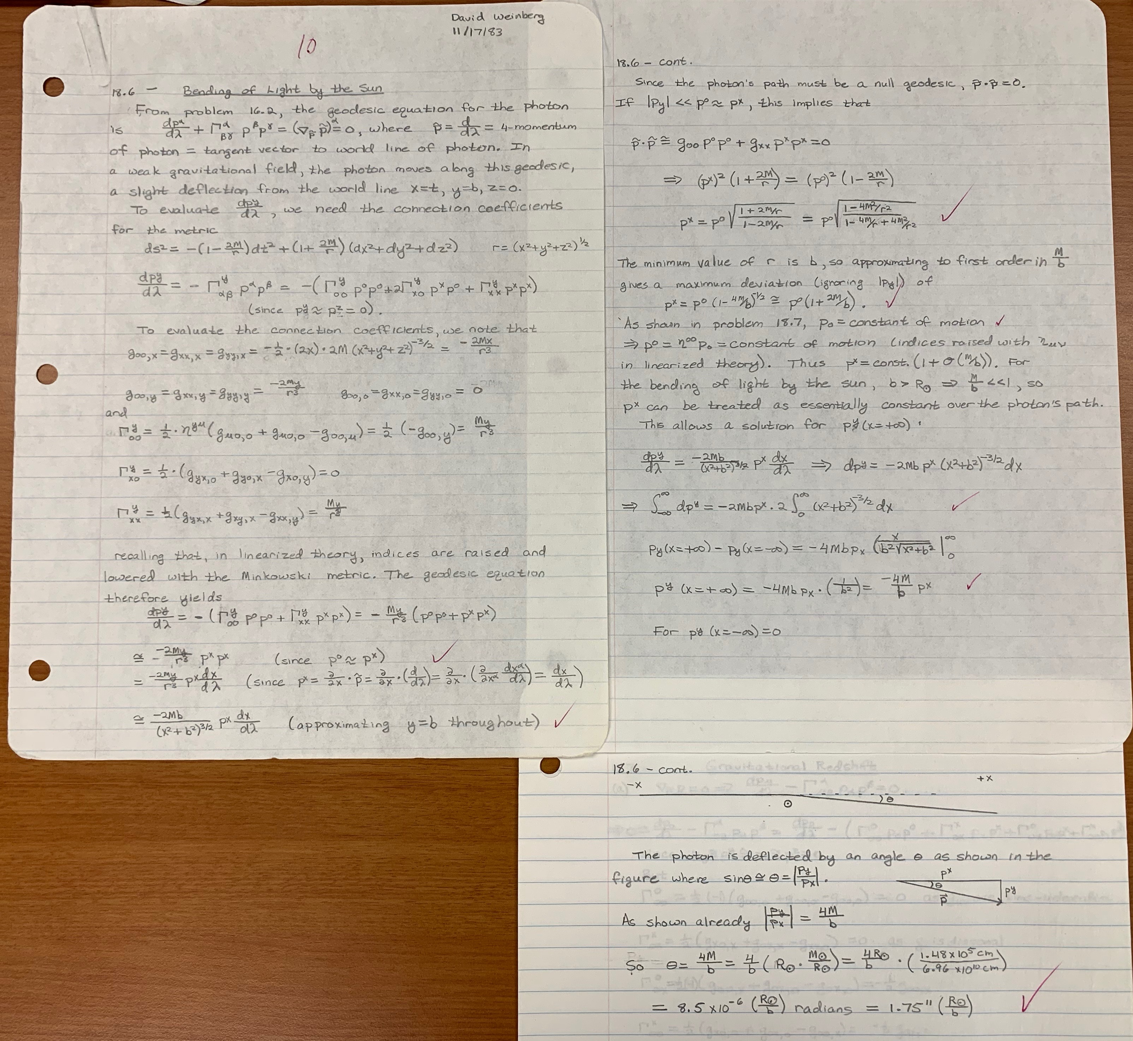

Slide 5
Theory of black holes: brief history
1915: Einstein completes theory of General Relativity (GR).
1916: Schwarzschild discovers exact solution. Einstein and others reject the idea of “Schwarzschild singularities” with event horizons.
1930s:
Chandrasekhar -- maximum mass of white dwarfs.
Zwicky – neutron stars, formed in supernovae
Oppenheimer & Volkoff – maximum mass of neutron stars
Oppenheimer & Snyder – calculations of stellar implosion. “Frozen star” or “collapsed star” depending on reference frame.
1960s
Finkelstein (1958) – “Non-fishy” description of Schwarzschild spacetime.
Wheeler (1967) – coins the term “black hole”.
Various – Proof that departures from spherical symmetry don’t prevent collapse.
Kerr (1963) – New exact solution to Einstein’s equations, describes the spacetime around spinning black holes.
Pulsars (spinning neutron stars) are discovered in 1967.

Slide 6
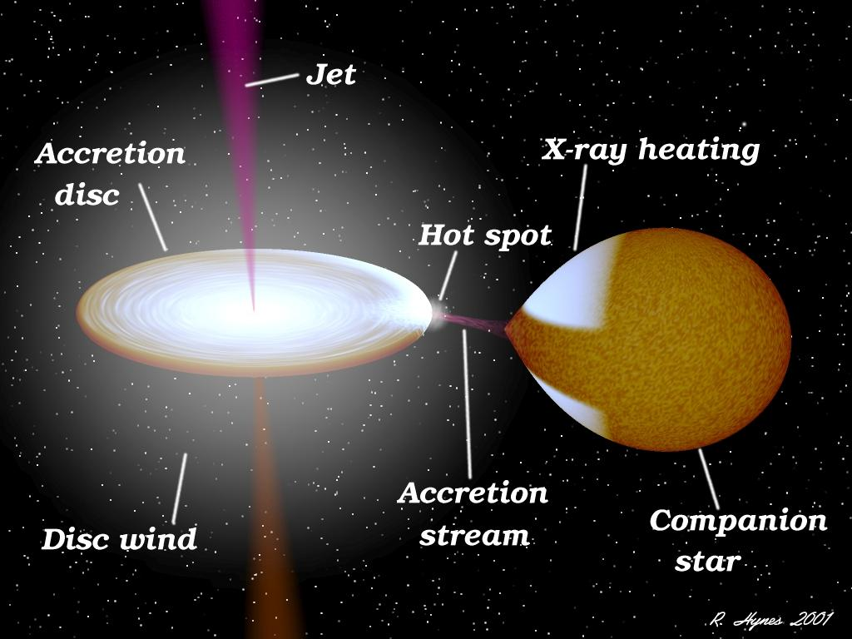

Slide 7
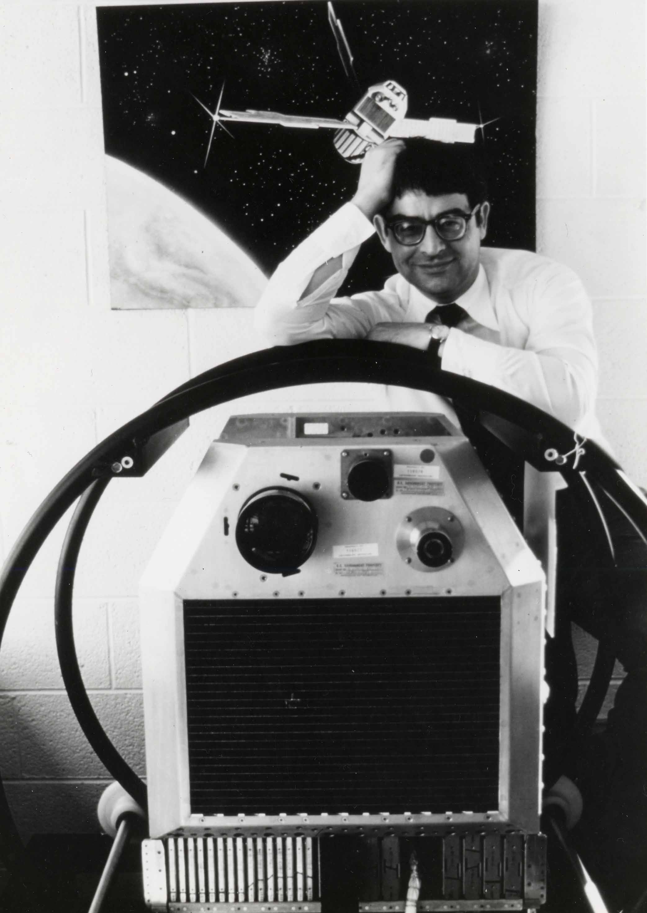
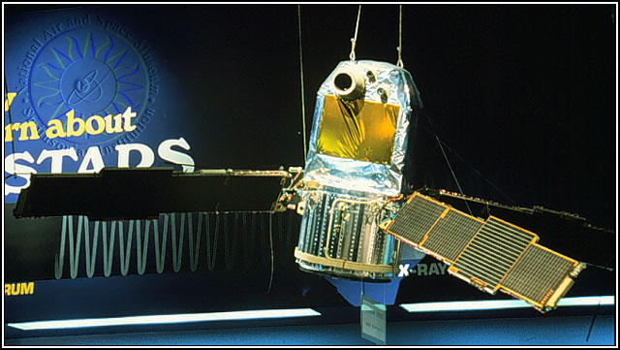
Uhuru satellite, first X-ray telescope
Ricardo Giacconi – Lead scientist of Uhuru, winner of 2002 Nobel Prize in Physics

Slide 8
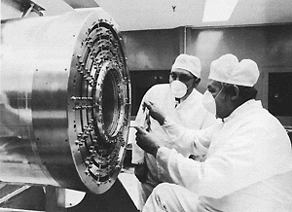
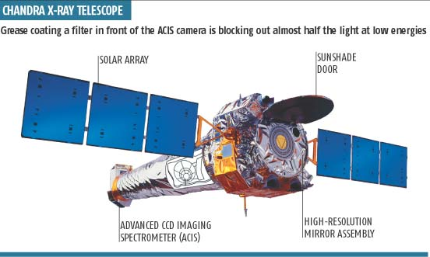
Uhuru satellite, first X-ray telescope
Nested “mirrors” of Chandra X-ray telescope

Slide 9
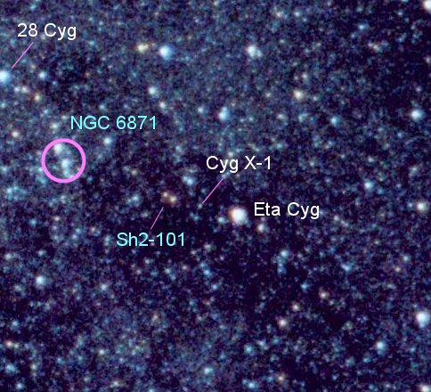
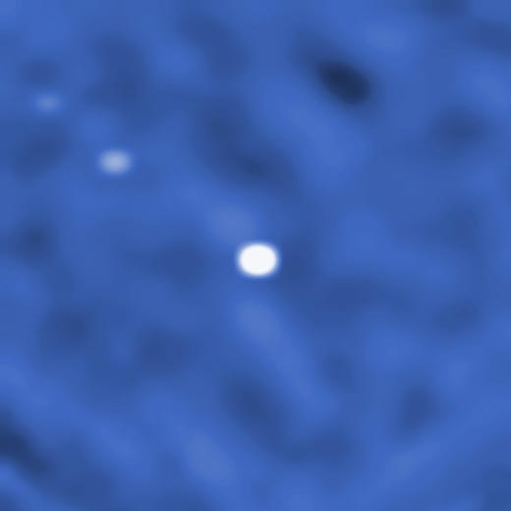
Optical light
Gamma rays
(INTEGRAL satellite, neutron star Cyg X-3 at upper left)

Slide 10
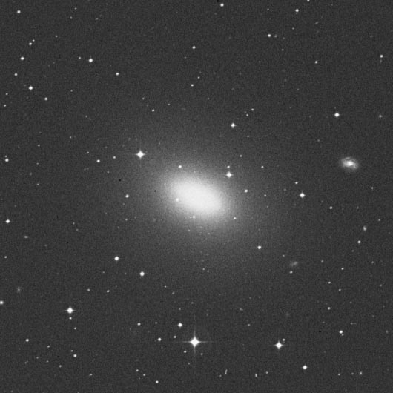
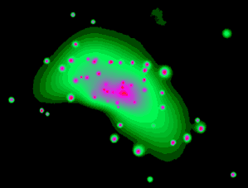
Galaxy NGC 4697
Optical light
X-rays

Slide 12
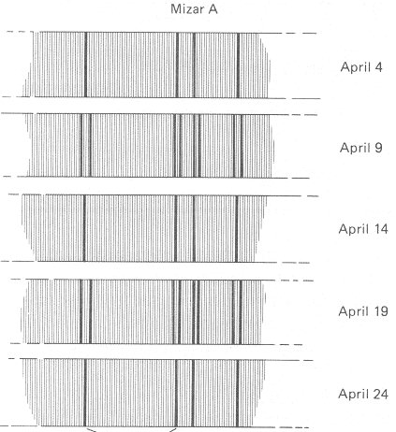
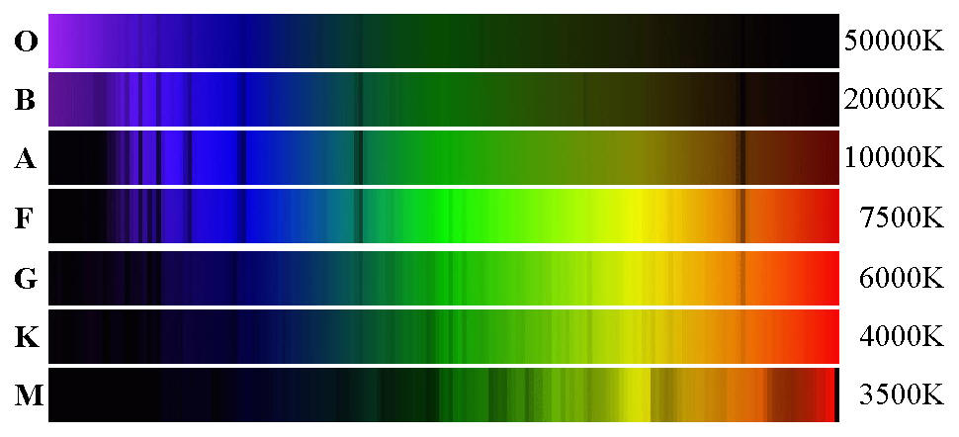
See Thorne Fig 8.3

Slide 13
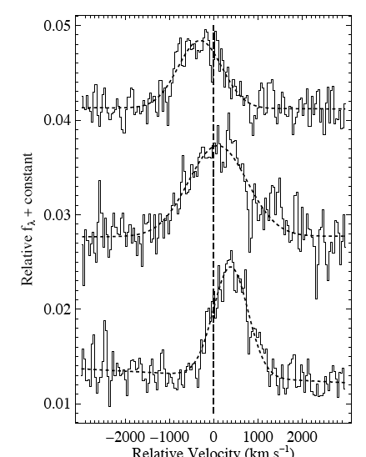
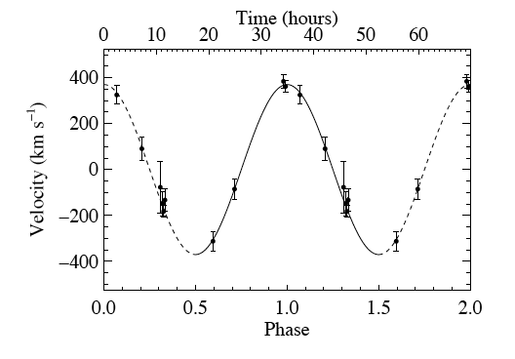
Silverman & Filippenko 2008, confirmation of 33 ± 3 M black hole in a nearby galaxy (IC 10),
Helium emission line

Slide 14
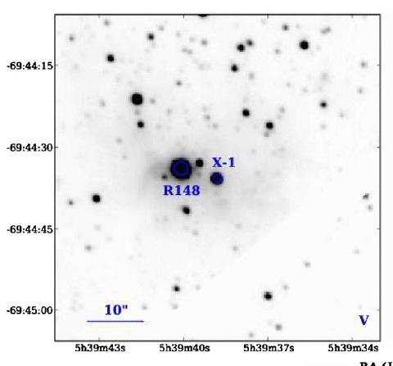
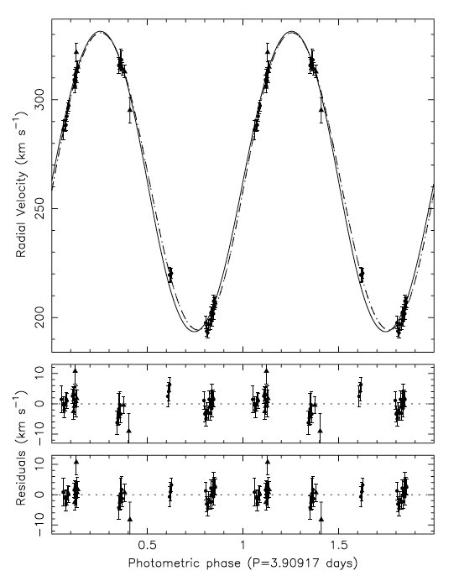
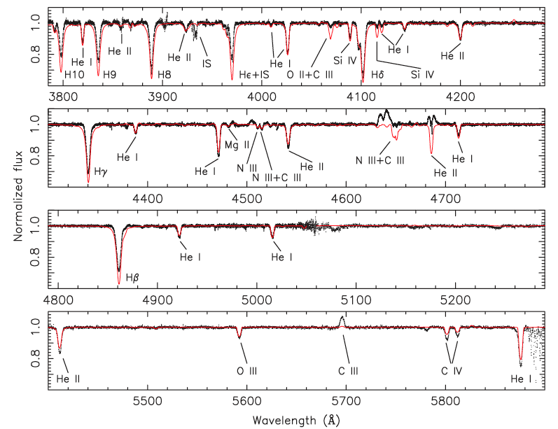
Orosz et al. 2009, LMC X-1, M_{BH} = 10.9 ± 1.4 M

Slide 15
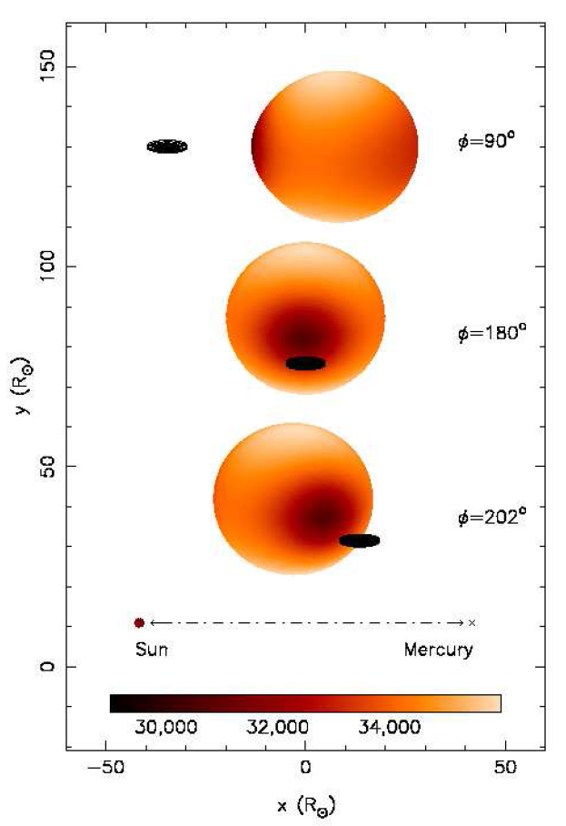
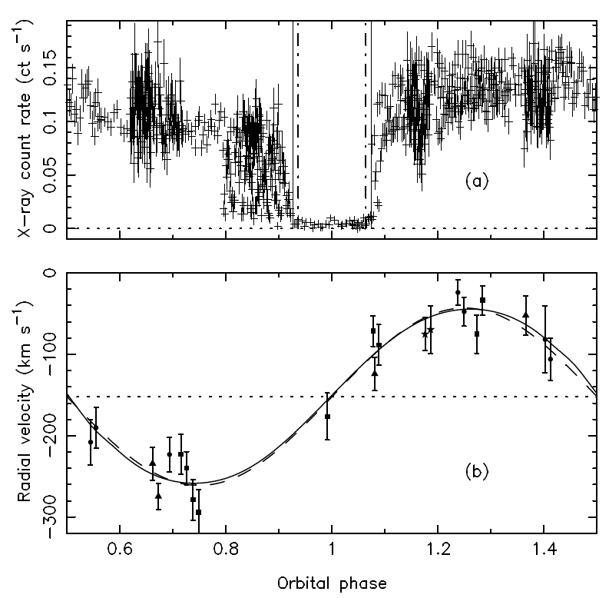
Orosz et al. 2007, a 15.7M BH in nearby galaxy M33, eclipsed by its 70 M companion
Artist’s Conception!
3.5-day period
Data!

Slide 16
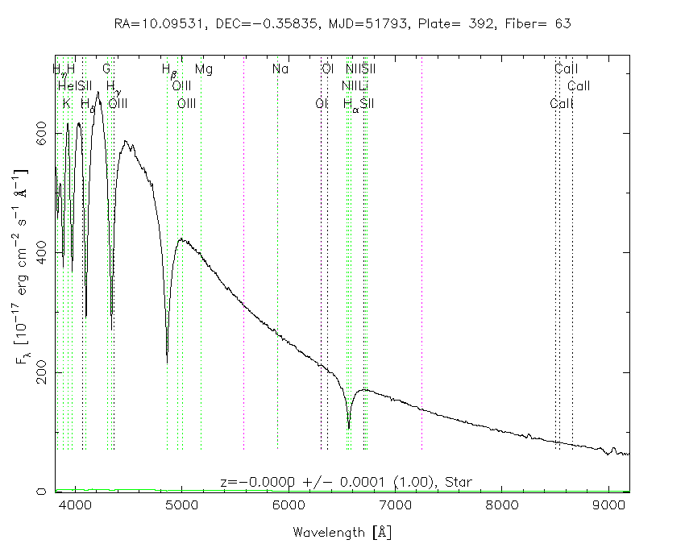
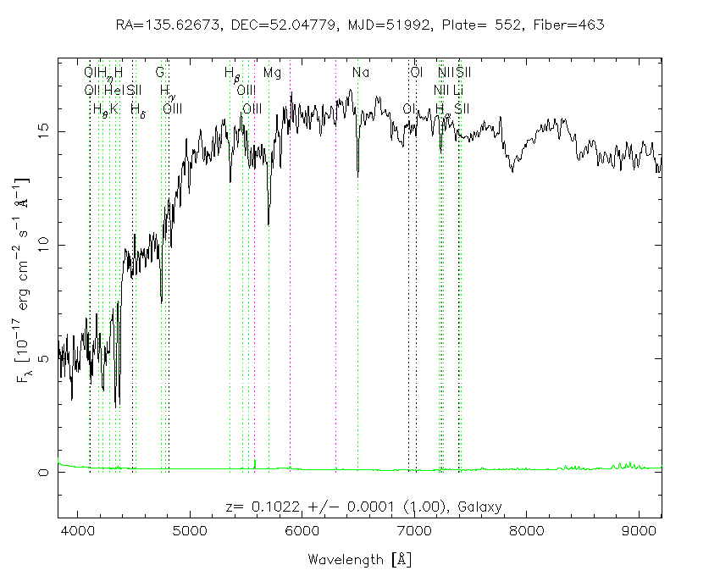
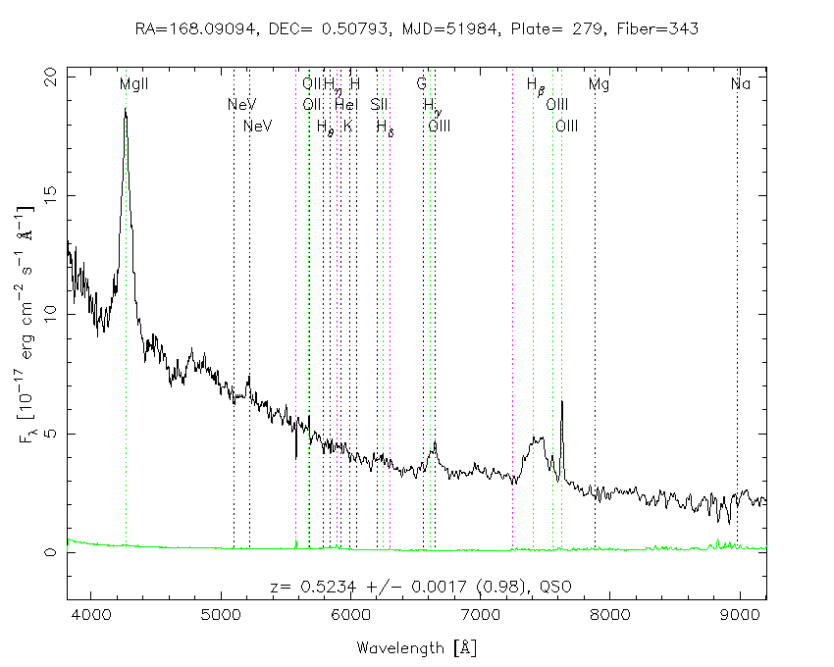
White dwarf
Galaxy
Quasar

Slide 17
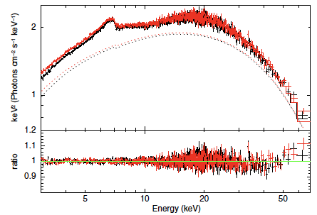
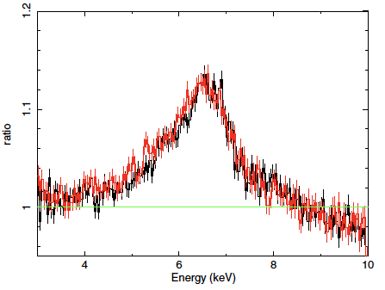
X-ray spectra of stellar BH candidate GRS1739-278
Miller et al. 2015

Slide 18
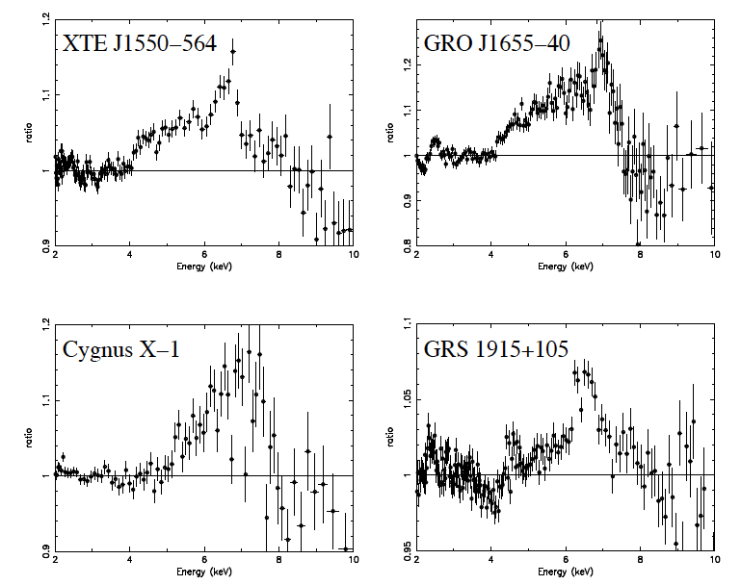
X-ray iron lines of four stellar mass black holes
From Miller 2007, ARAA

Slide 19
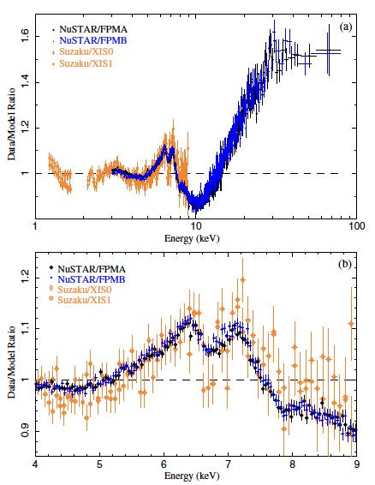
X-ray spectrum of stellar mass black hole Cygnus X-1.
Broad iron line shows evidence of high BH spin and absorption at 6.7 keV.
Tomsick et al. 2014

