Slide 1
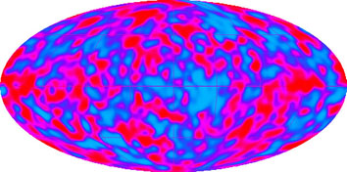
Cosmic Background Explorer (COBE), 1992++

Slide 2
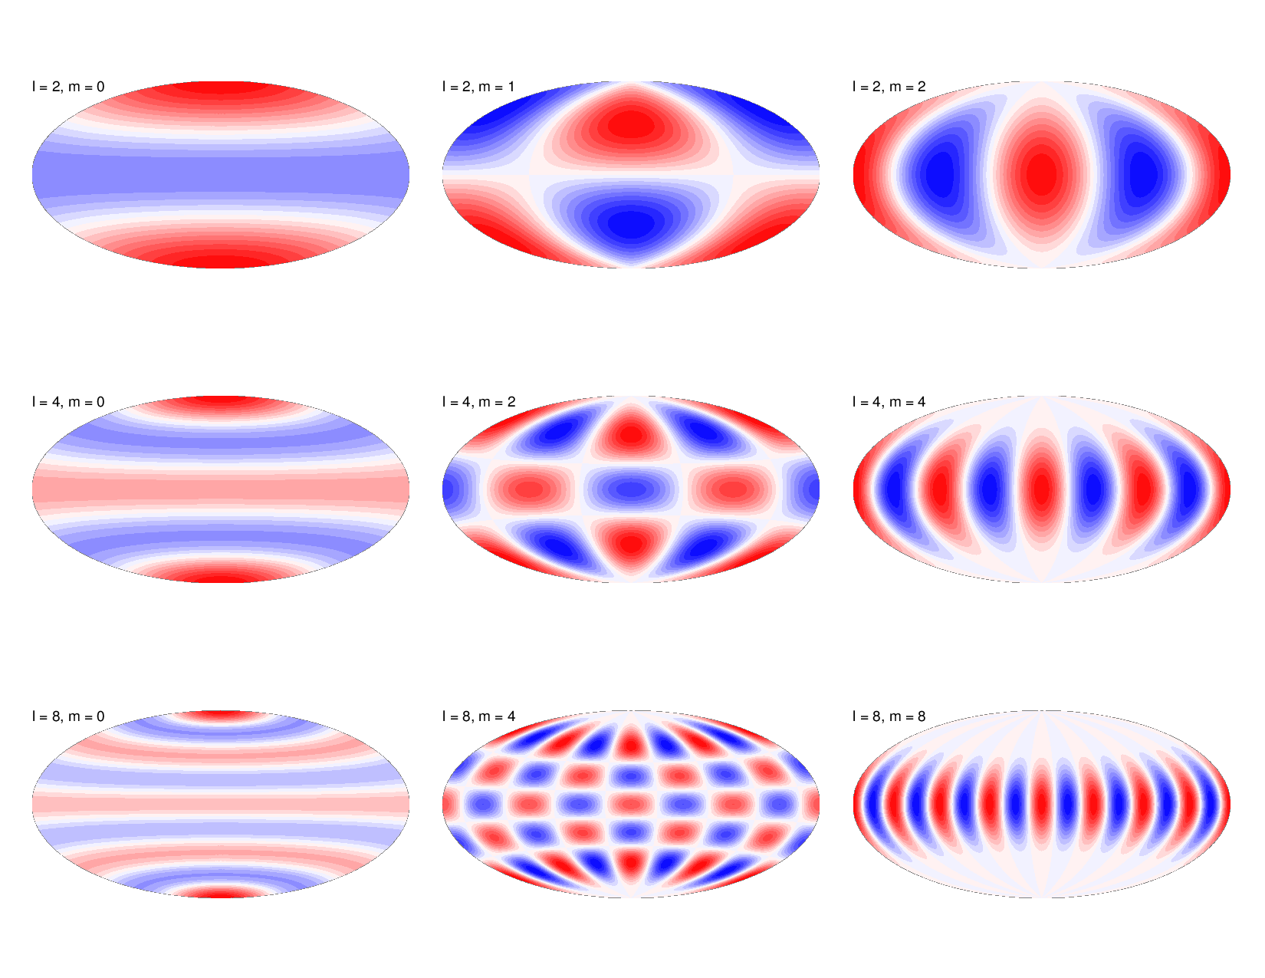

Slide 3
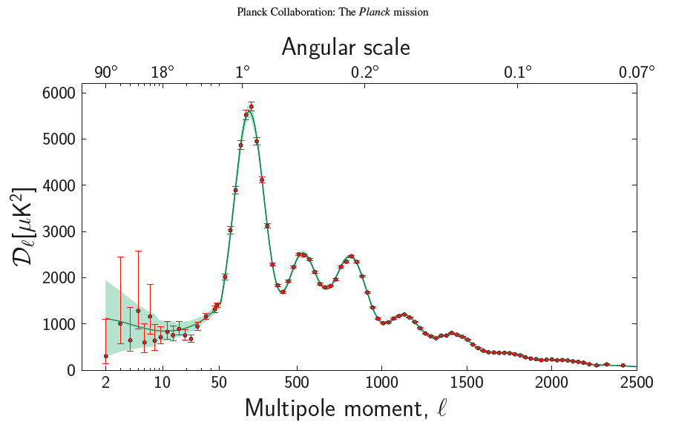
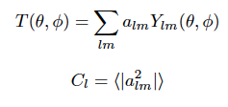
Qualitatively: Mean-squared temperature fluctuation on angular scale 200/l degrees.

Slide 4
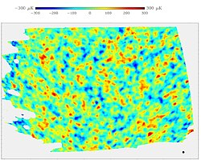
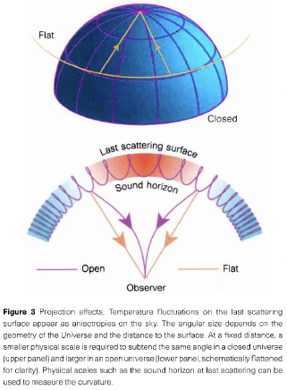
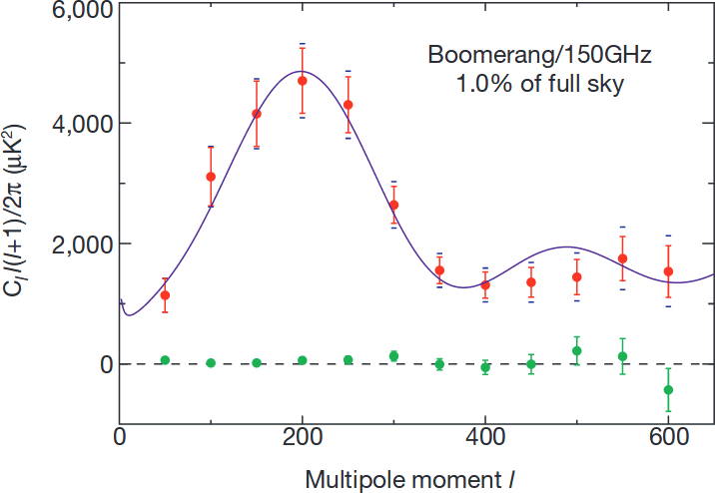
Boomerang Balloon CMB Map, 2000
Hu, Sugiyama, & Silk 1997

Slide 5
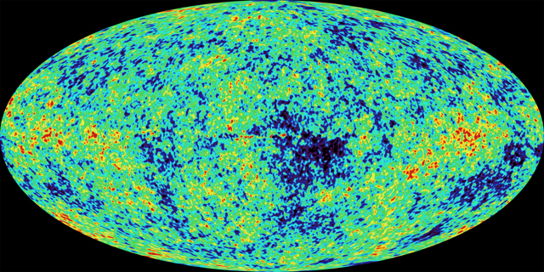
Wilkinson Microwave Anisotropy Probe (WMAP), 2001-2010
First results 2003, ”Final” results ~2009.

Slide 6
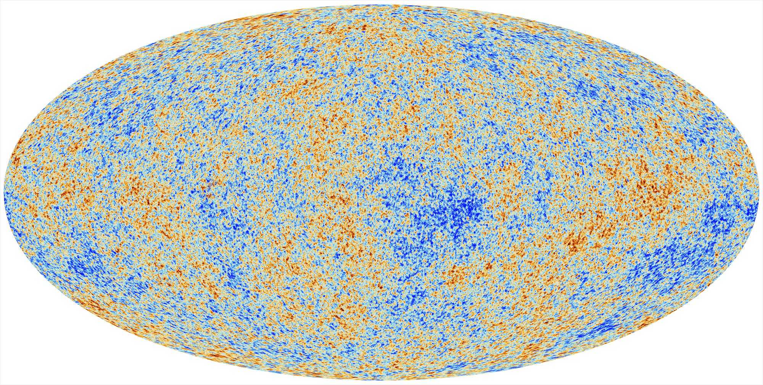
Planck CMB mission, 2009-2013 [“Final” results ~ 2018]

Slide 7
Qualitatively: Mean-squared temperature fluctuation on angular scale 200/l degrees.

Slide 8
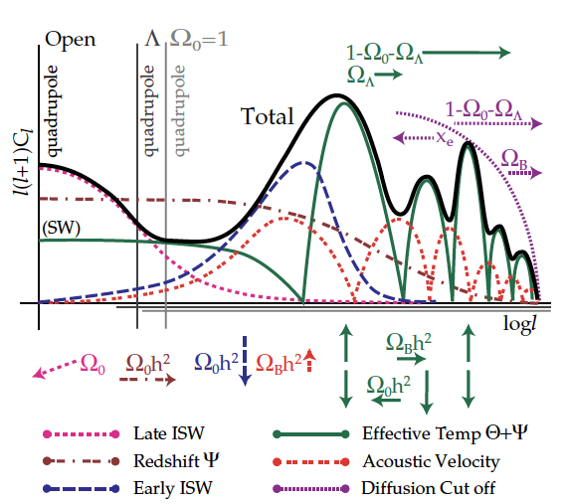
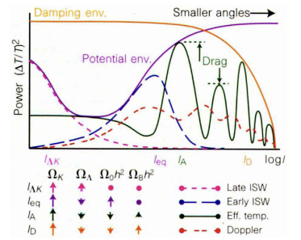
Hu, Sugiyama, & Silk
Astro-ph/9504057
Nature, 386, 37, March 6 1997

Slide 9
Hu, Sugiyama, & Silk Astro-ph/9504057

