Slide 2
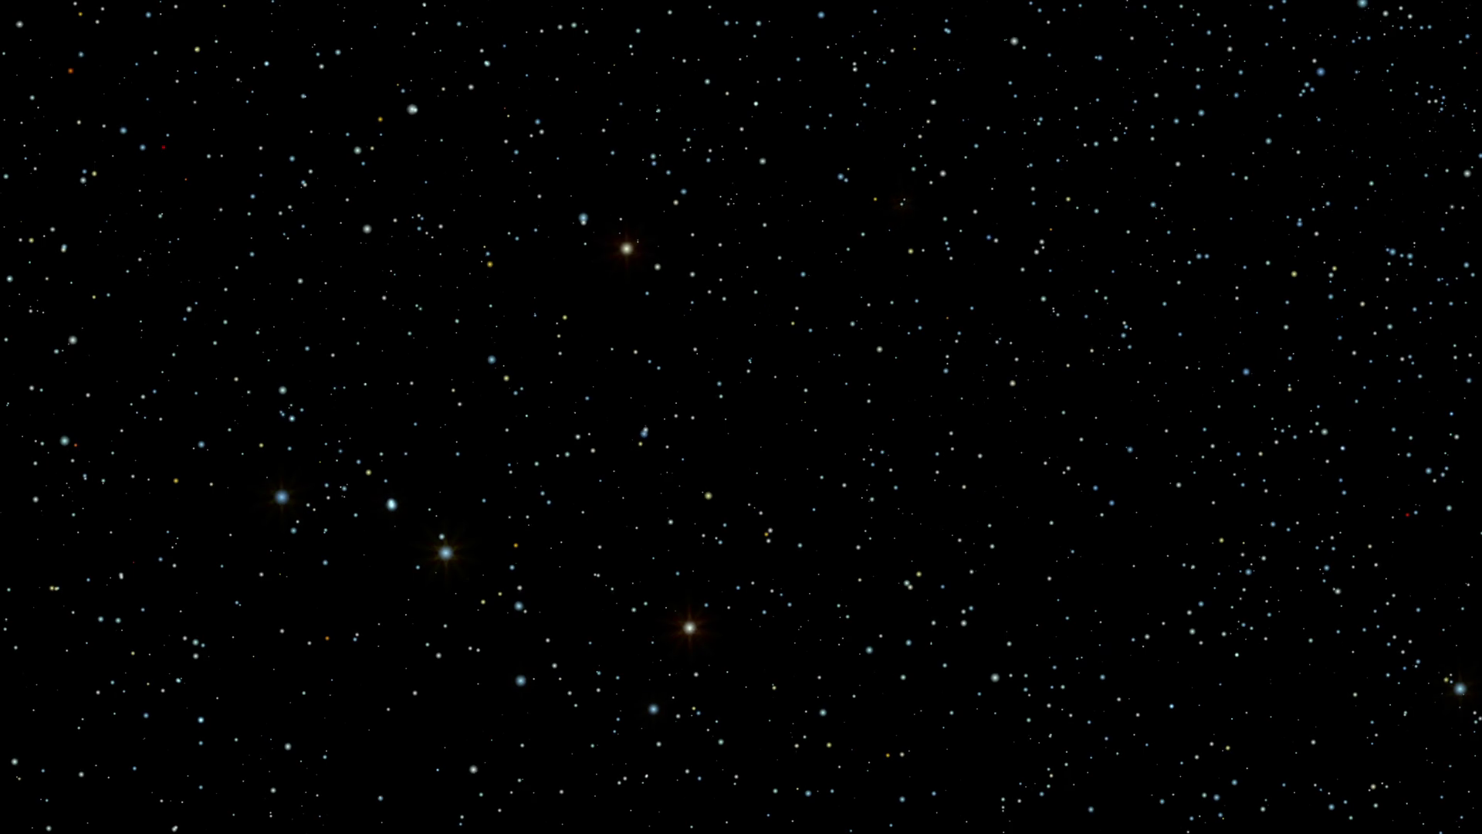

Slide 3
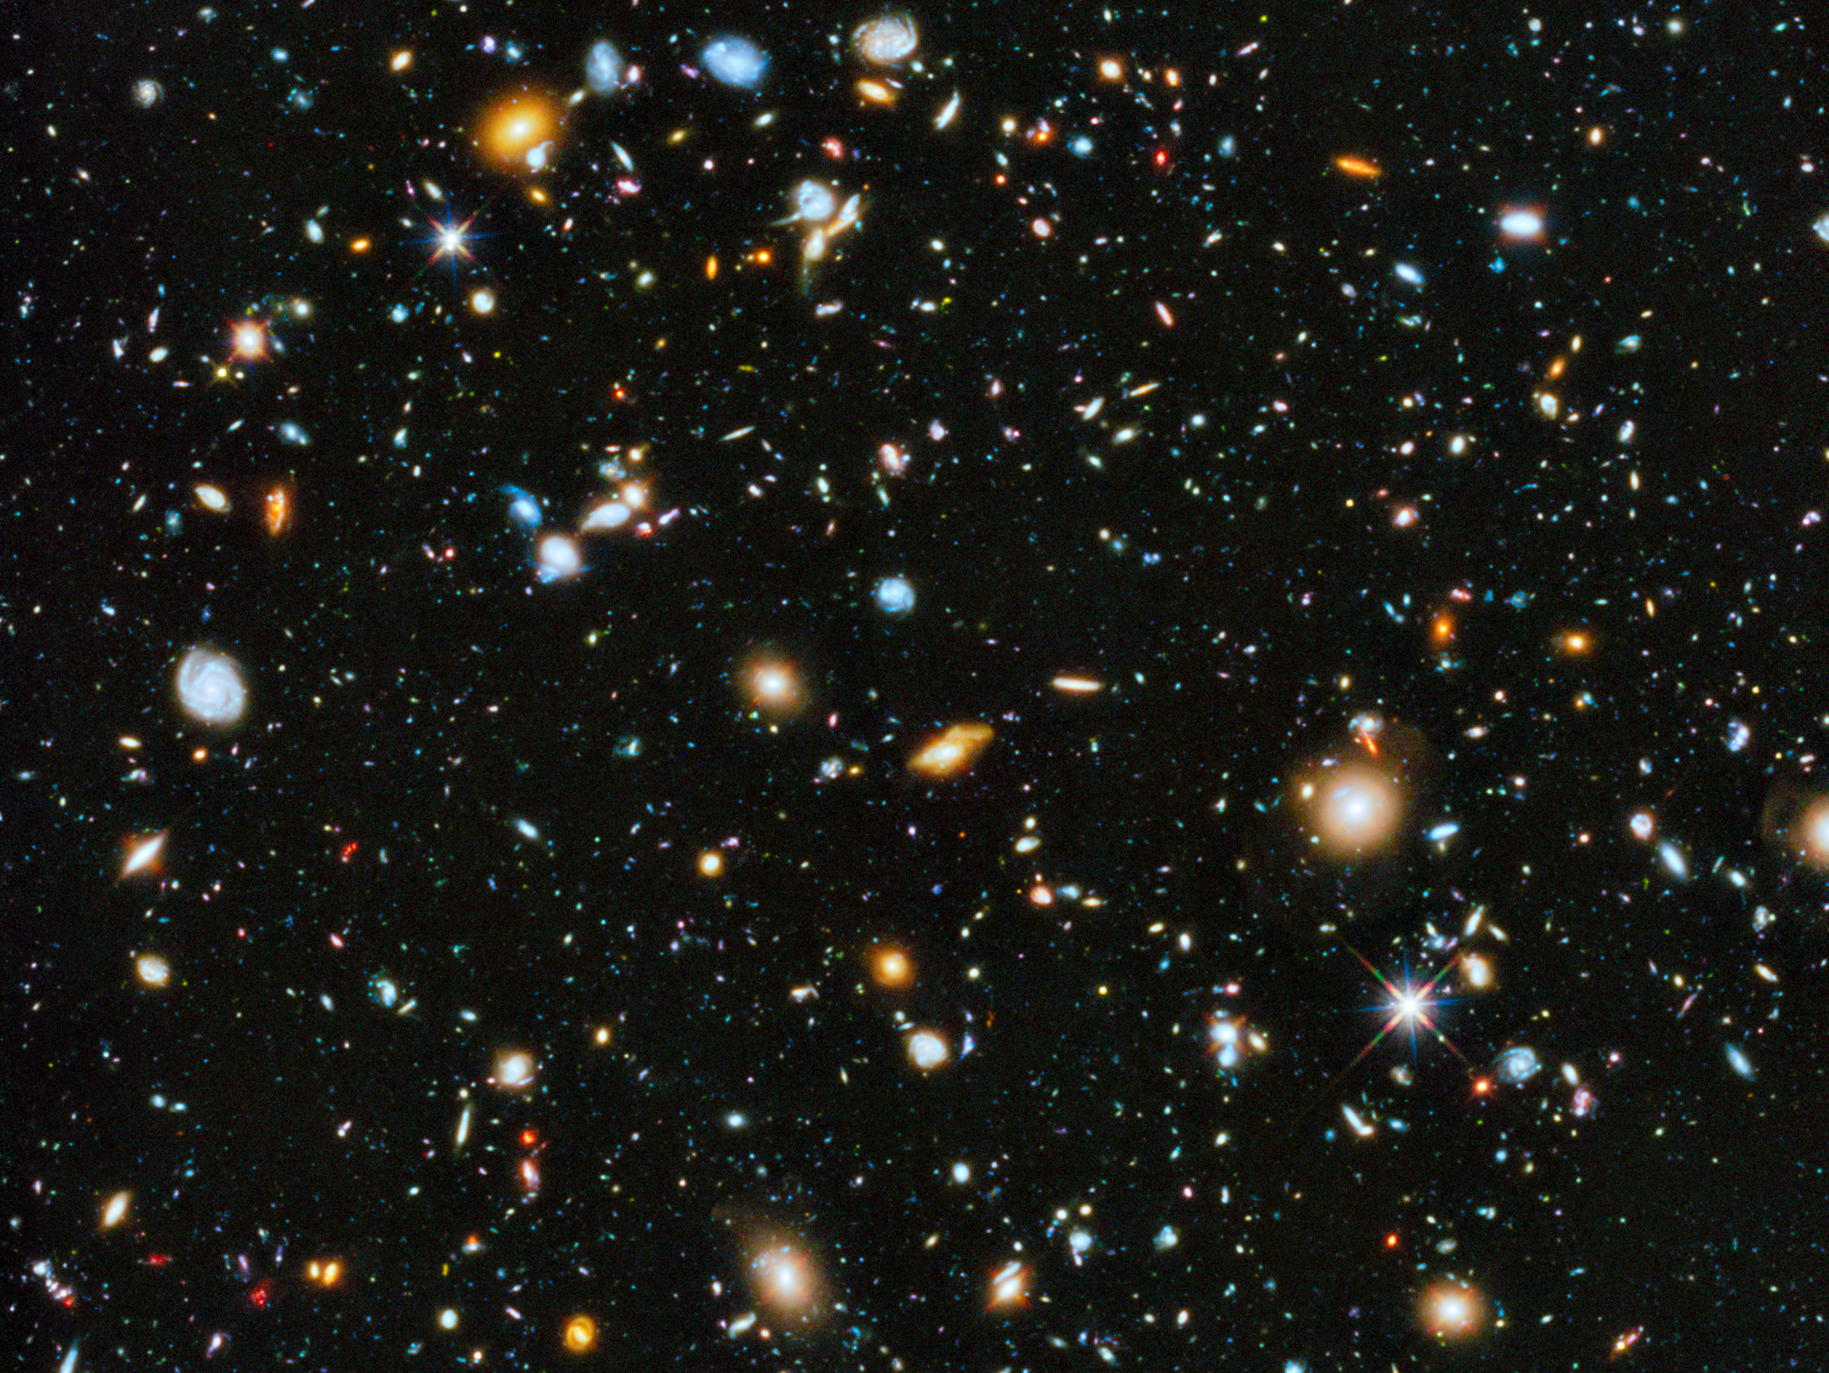
Hubble Ultra Deep Field

Slide 4
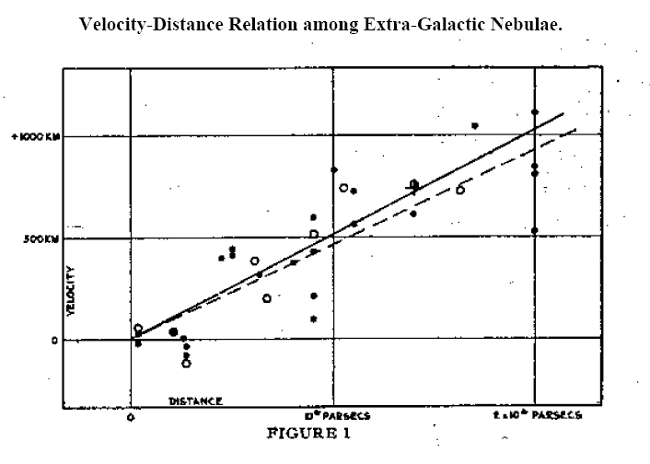
Hubble 1929

Slide 5
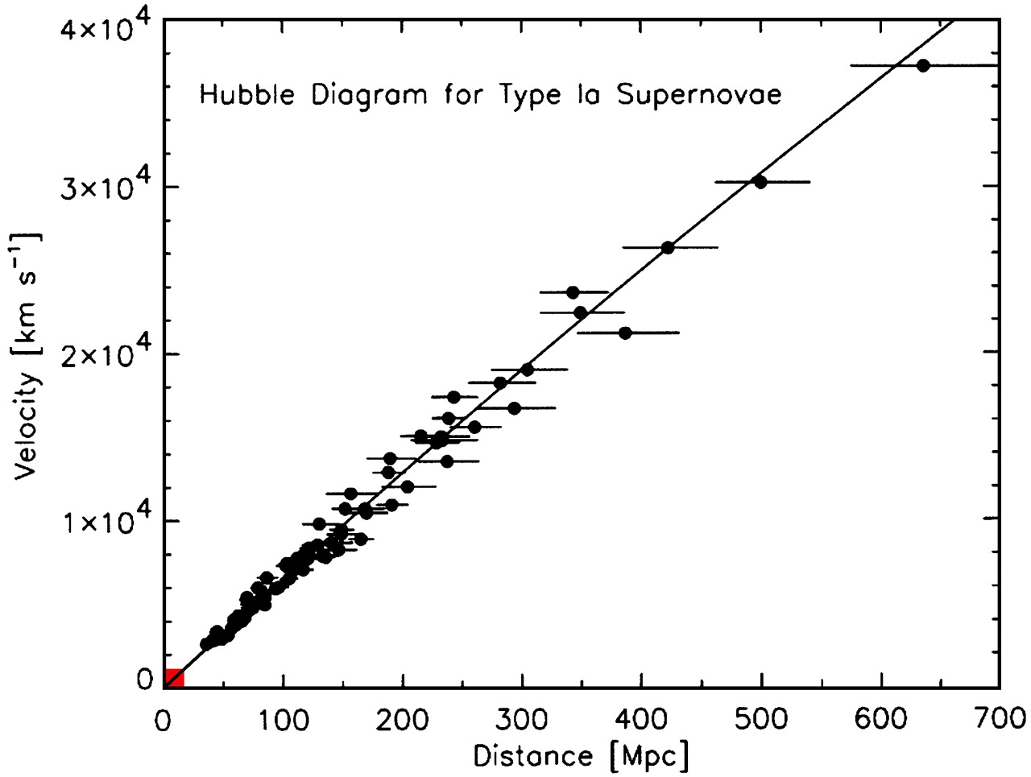

Slide 6
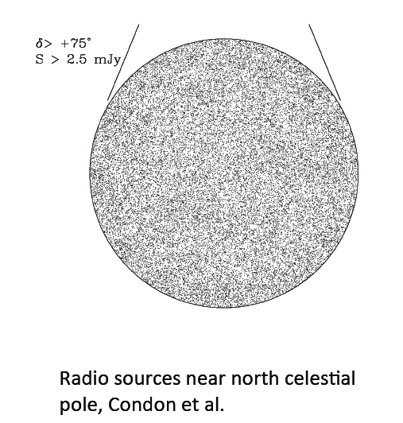

Slide 7
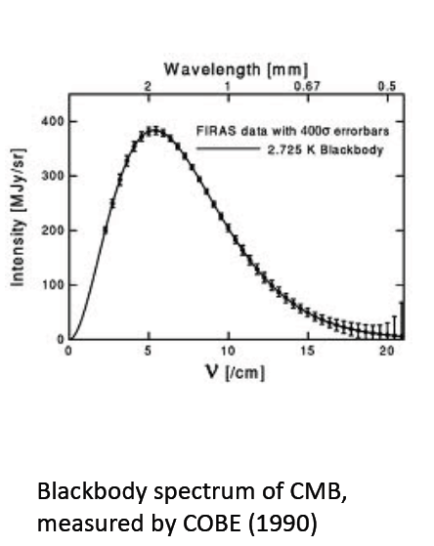

Slide 8
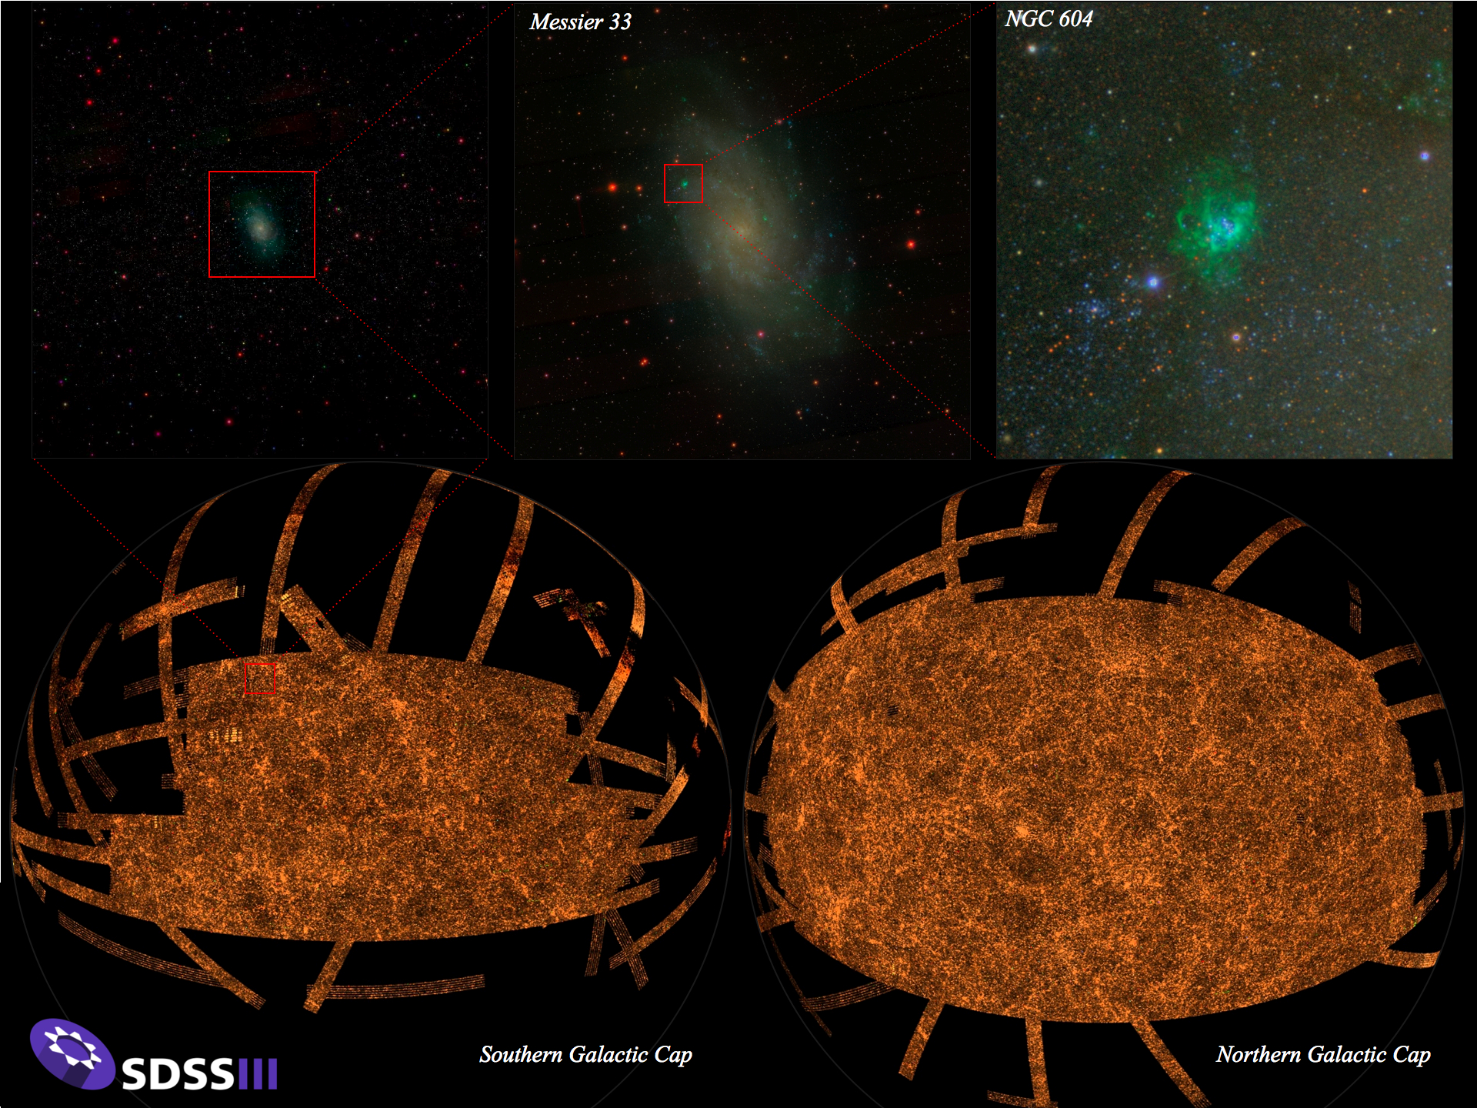

Slide 9
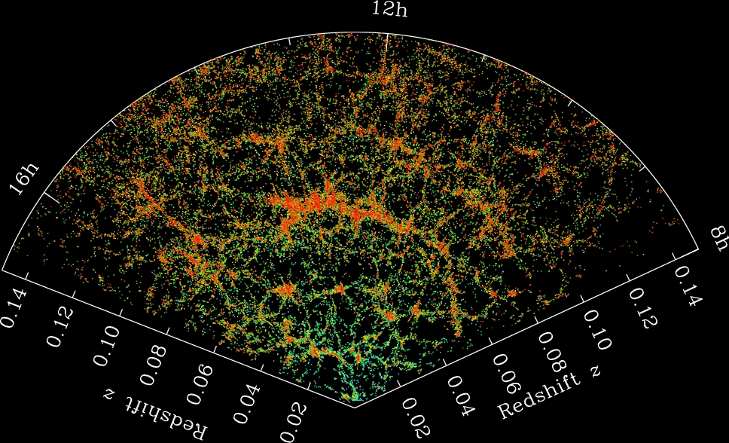
Slice through 3-d SDSS
Galaxy Map

Slide 10
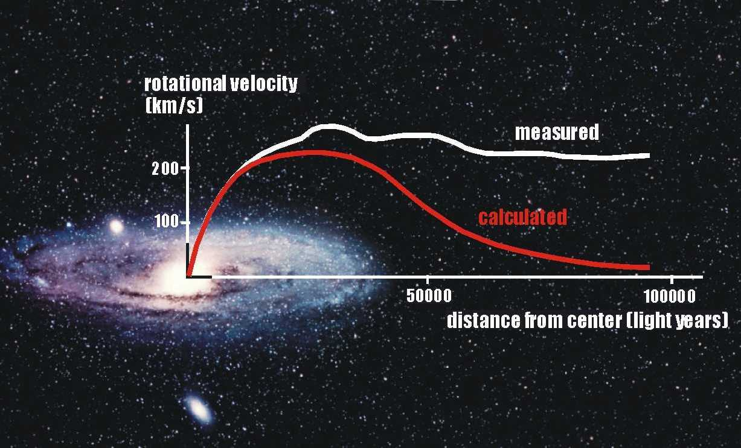
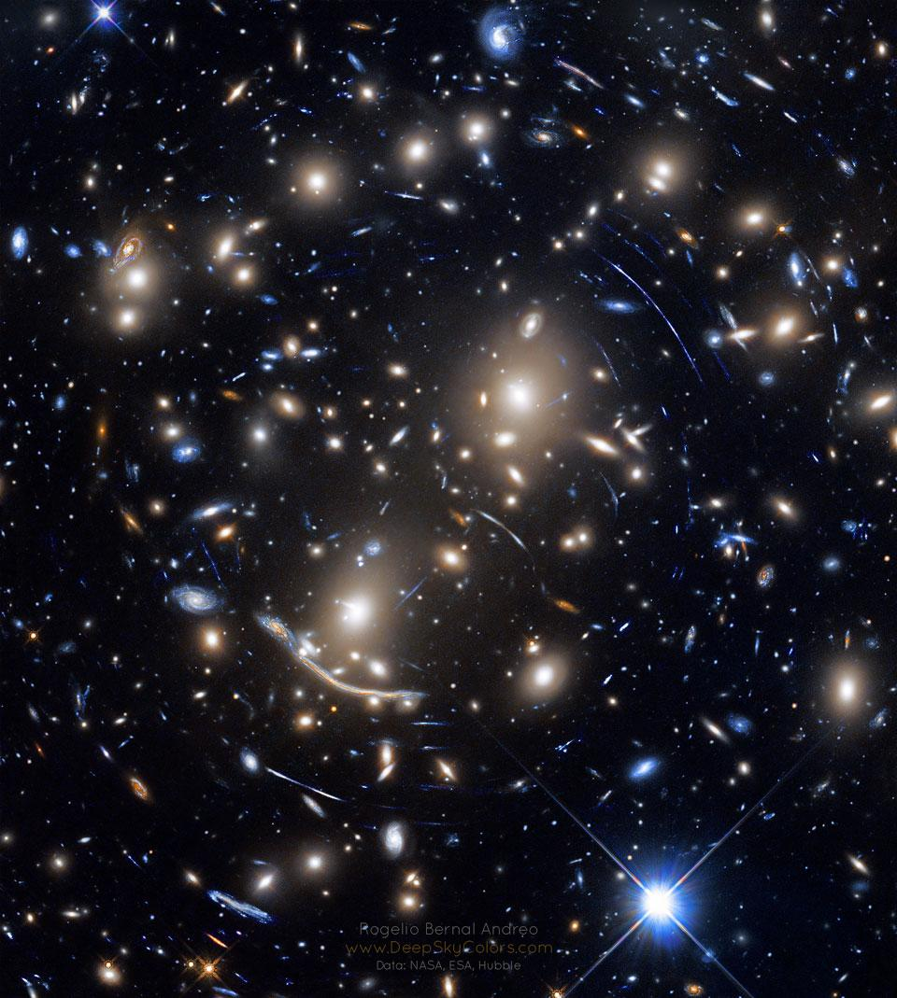

Slide 11
Hubble Ultra Deep Field

Slide 12
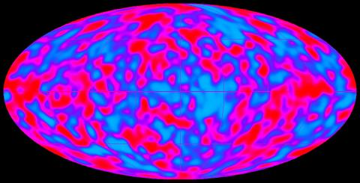

Slide 13
Scolnic et al. 2017

Slide 14
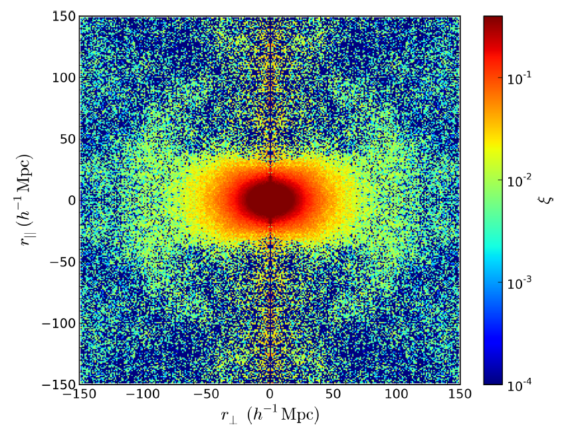
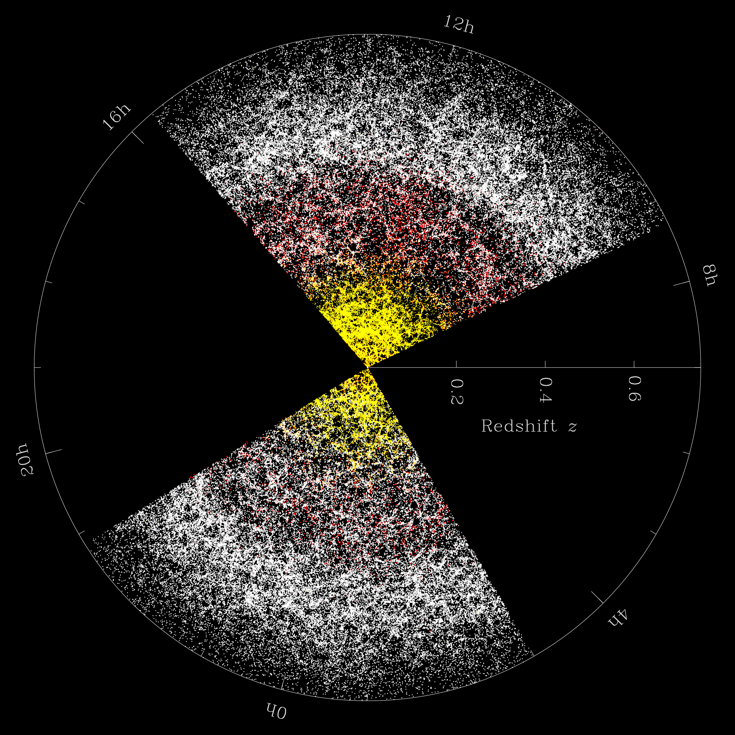
2-d galaxy correlation function:
Redshift-space distortion and the BAO ring.
line-of-sight
transverse
Samushia, Reid, White et al. 2014

Slide 15
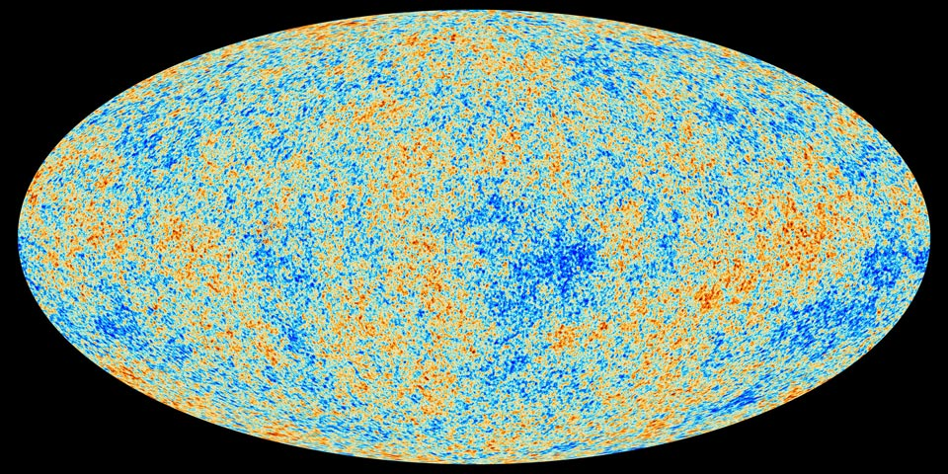
Planck CMB map

Slide 16
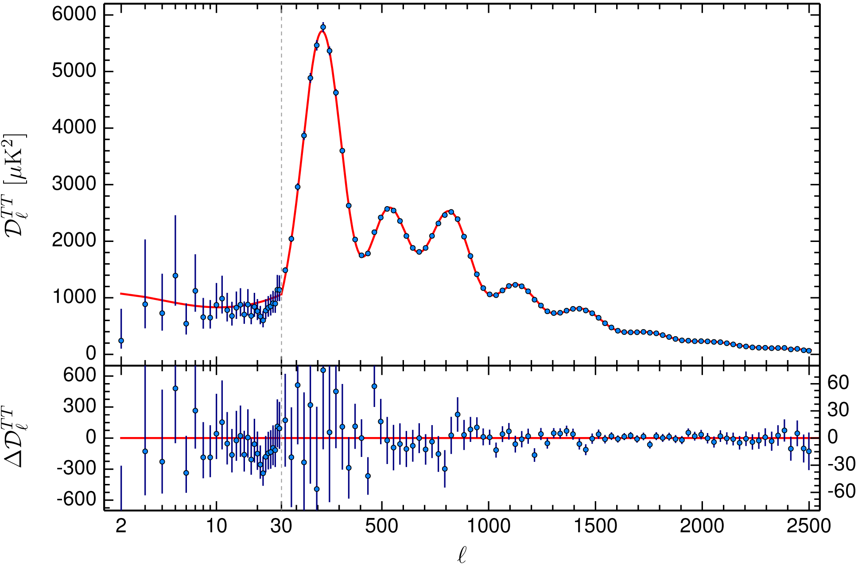
Planck CMB Power Spectrum + ΛCDM model fit

