Slide 1

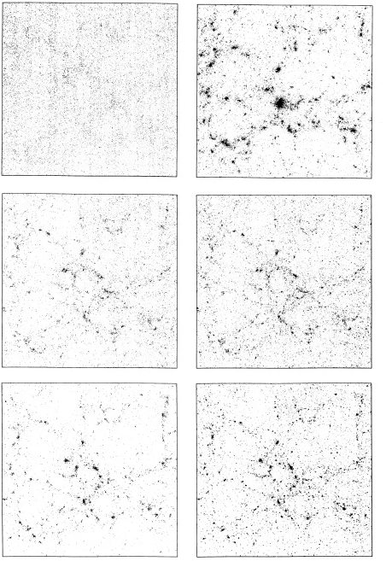
A
D
A-D are a time sequence in an Ω_{m}=1 model.
E, F are a time sequence in an Ω_{m}=0.2 model.
B
E
C
F

Slide 2
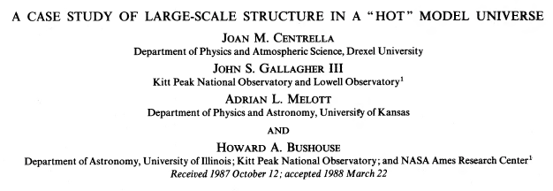
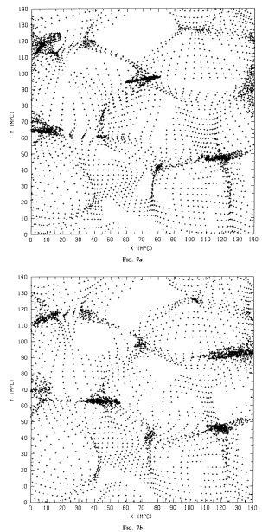
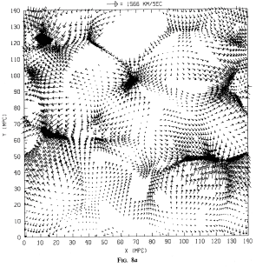

Slide 3
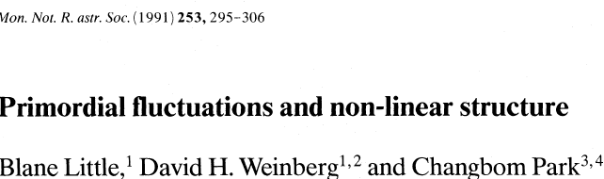
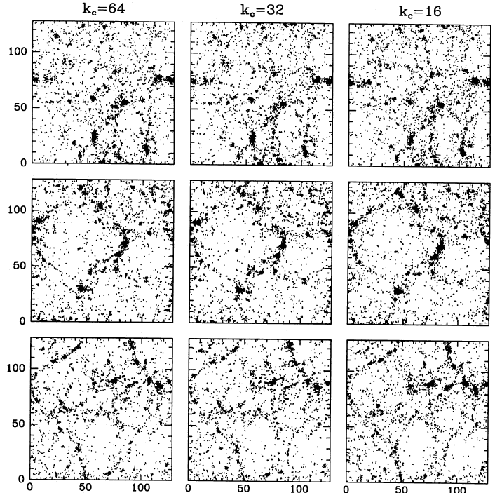
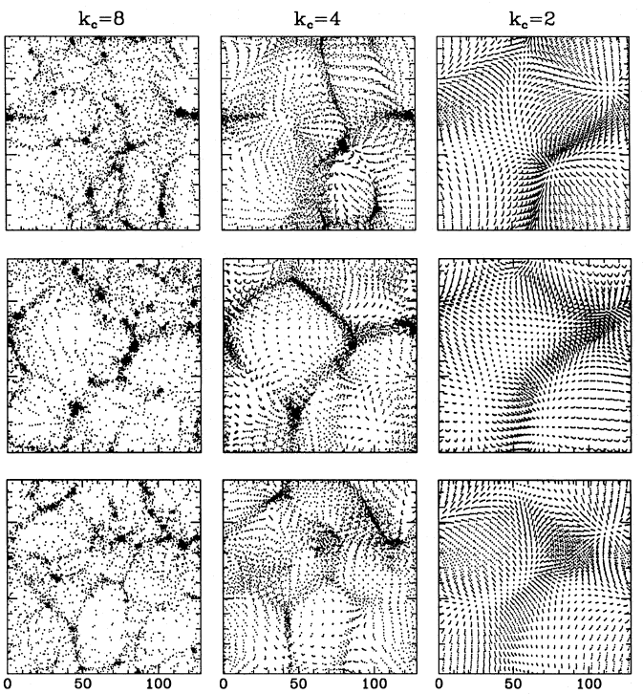

Slide 4
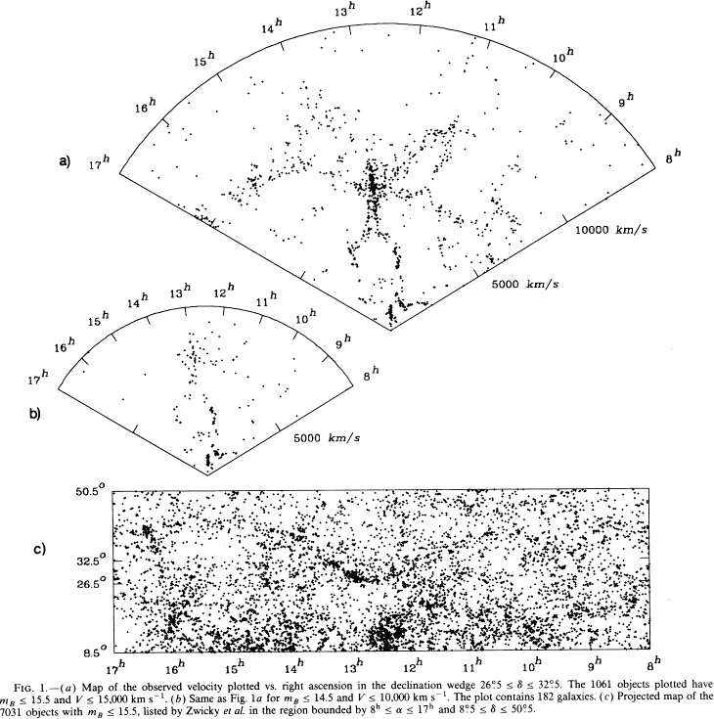

Slide 5
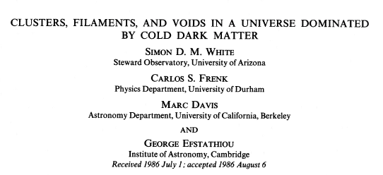
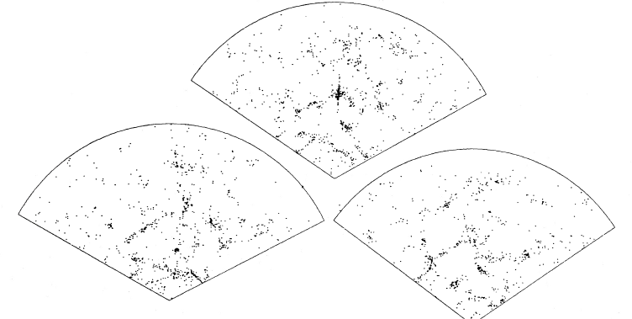

Slide 6
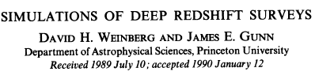
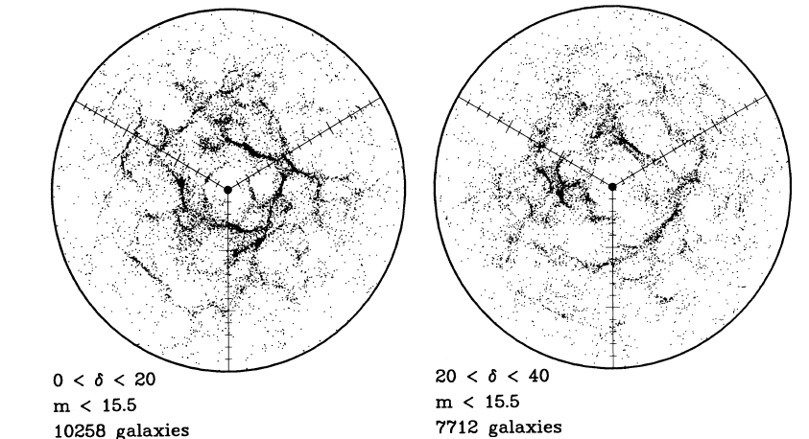

Slide 7
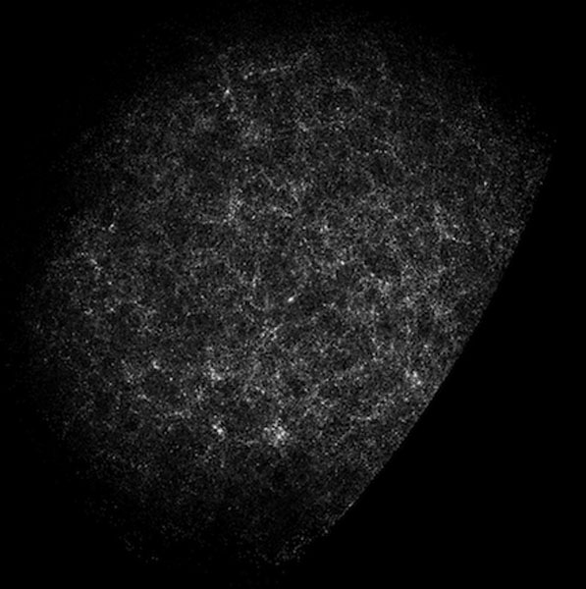
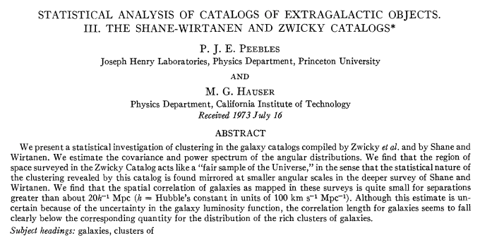
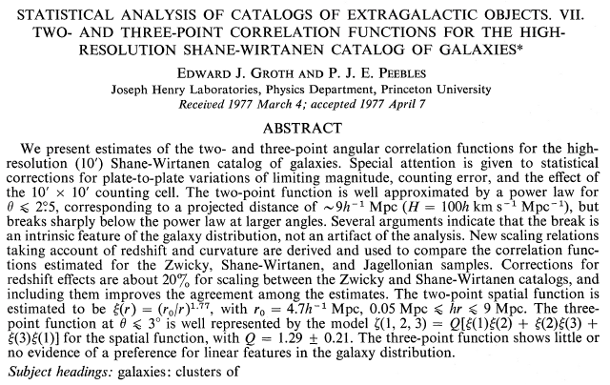
Shane & Wirtanen 1954

Slide 8
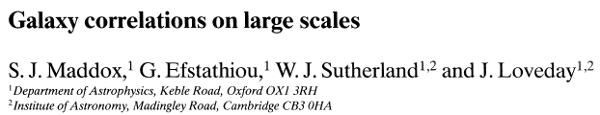
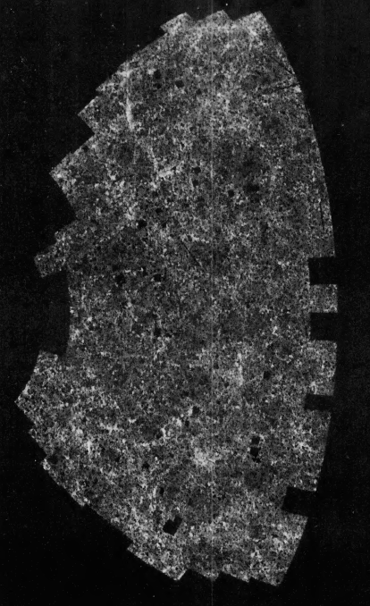
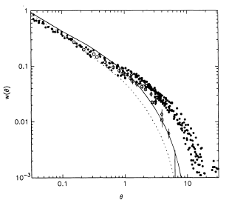
APM angular correlation vs. linear CDM prediction with Ω_{m}=1 and h=0.5 (dotted) or 0.4 (solid). “Excess large scale power.”

Slide 9
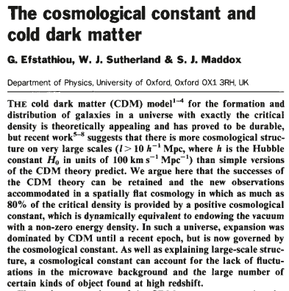
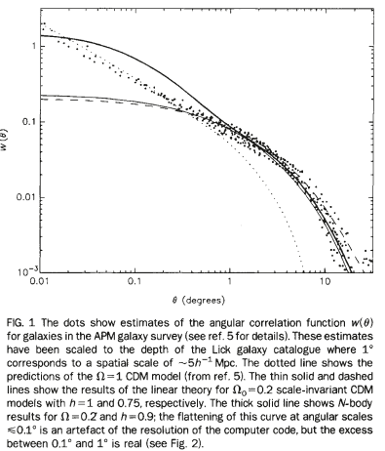
1990

Slide 10
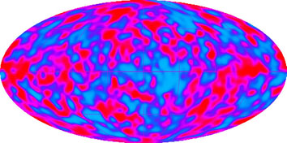
Cosmic Background Explorer (COBE), 1992++

Slide 11

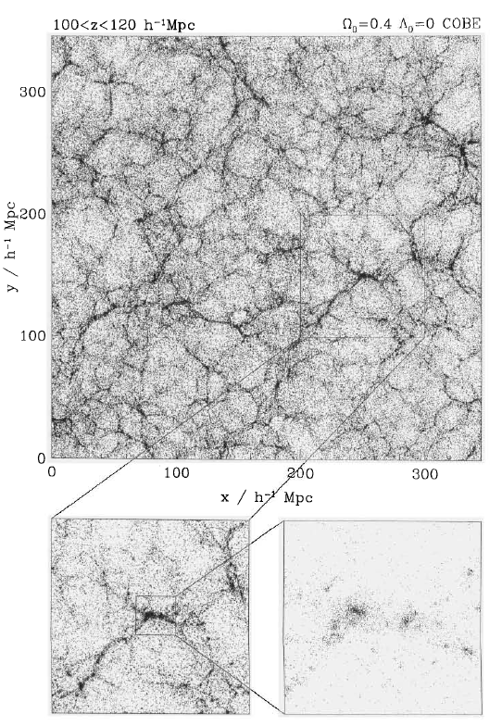
1997

Slide 12
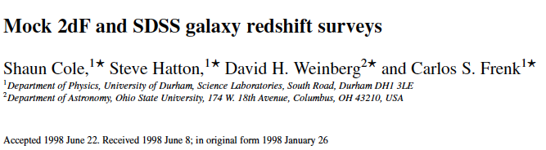
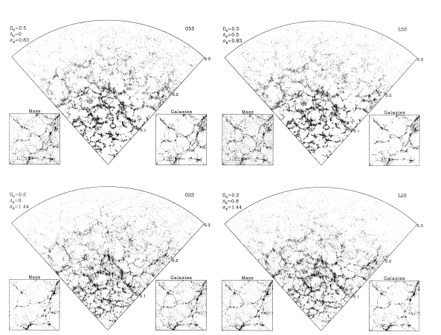

Slide 13
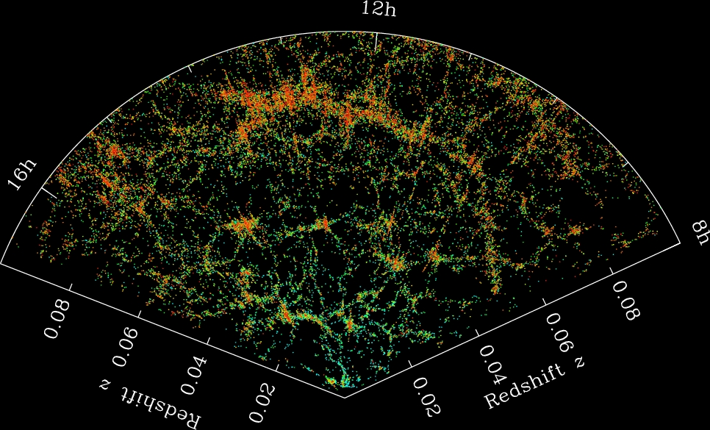
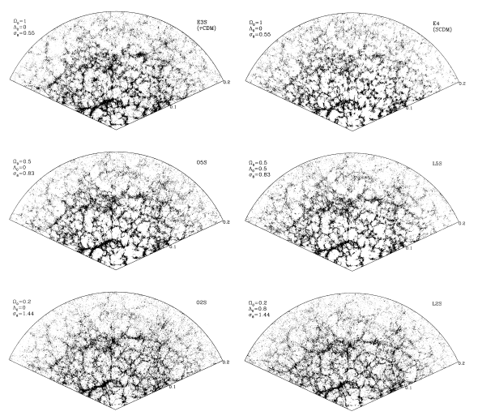

Slide 14
Cosmic Background Explorer (COBE), 1992++

Slide 15
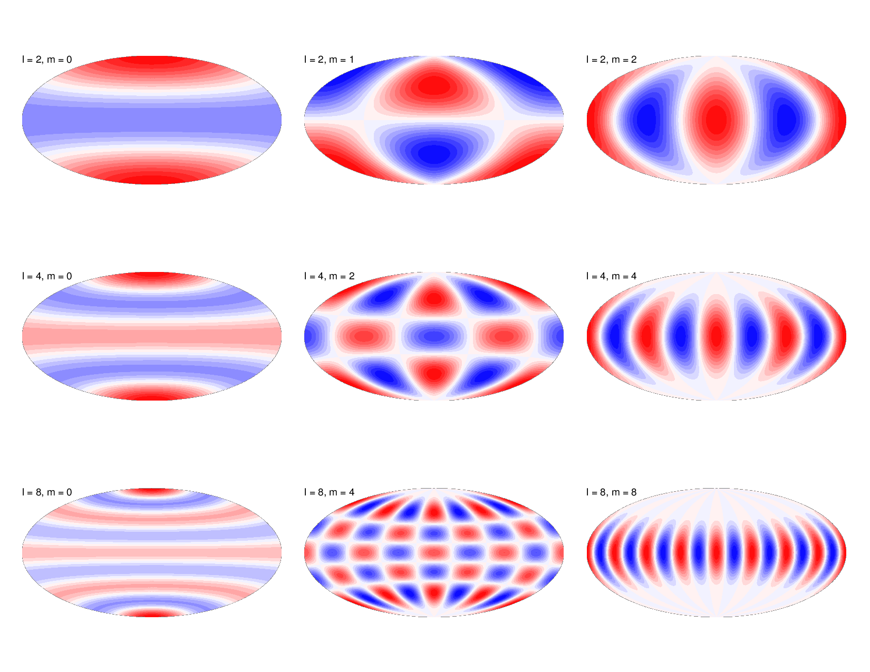

Slide 16
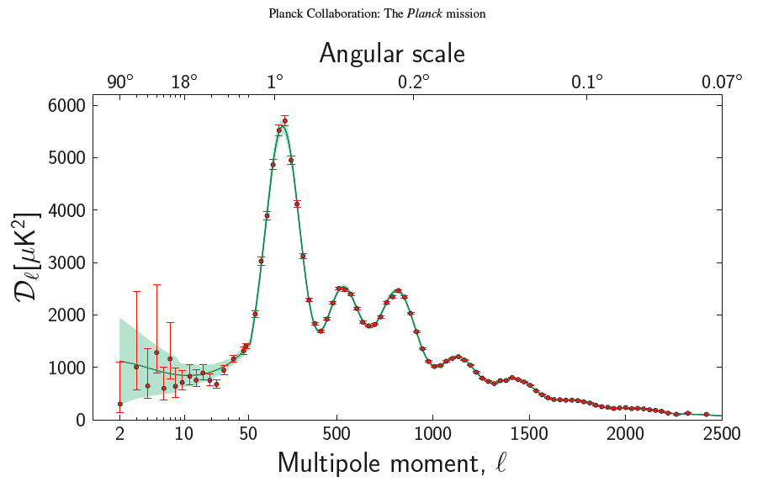
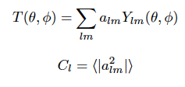
Qualitatively: Mean-squared temperature fluctuation on angular scale 200/l degrees.

Slide 17
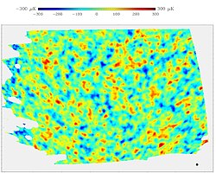
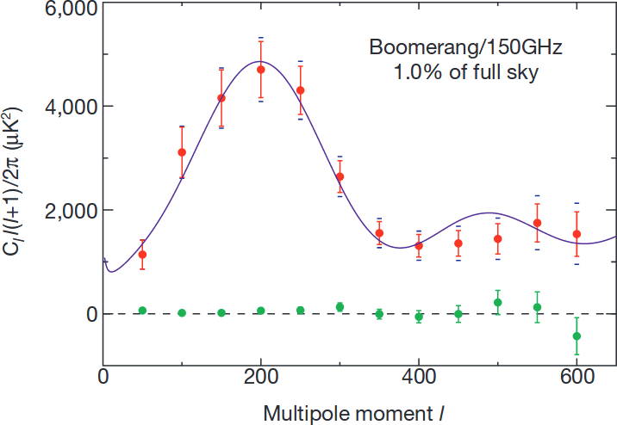
Boomerang Balloon CMB Map, 2000

Slide 18
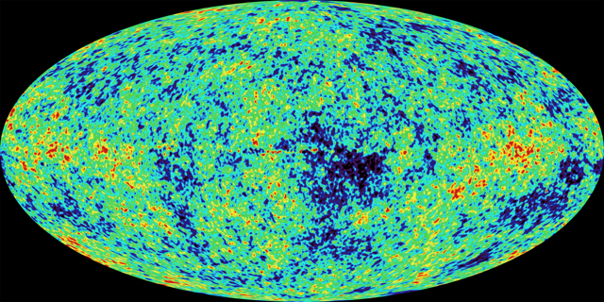
Wilkinson Microwave Anisotropy Probe (WMAP), 2001-2010
First results 2003, ”Final” results ~2009.

Slide 19
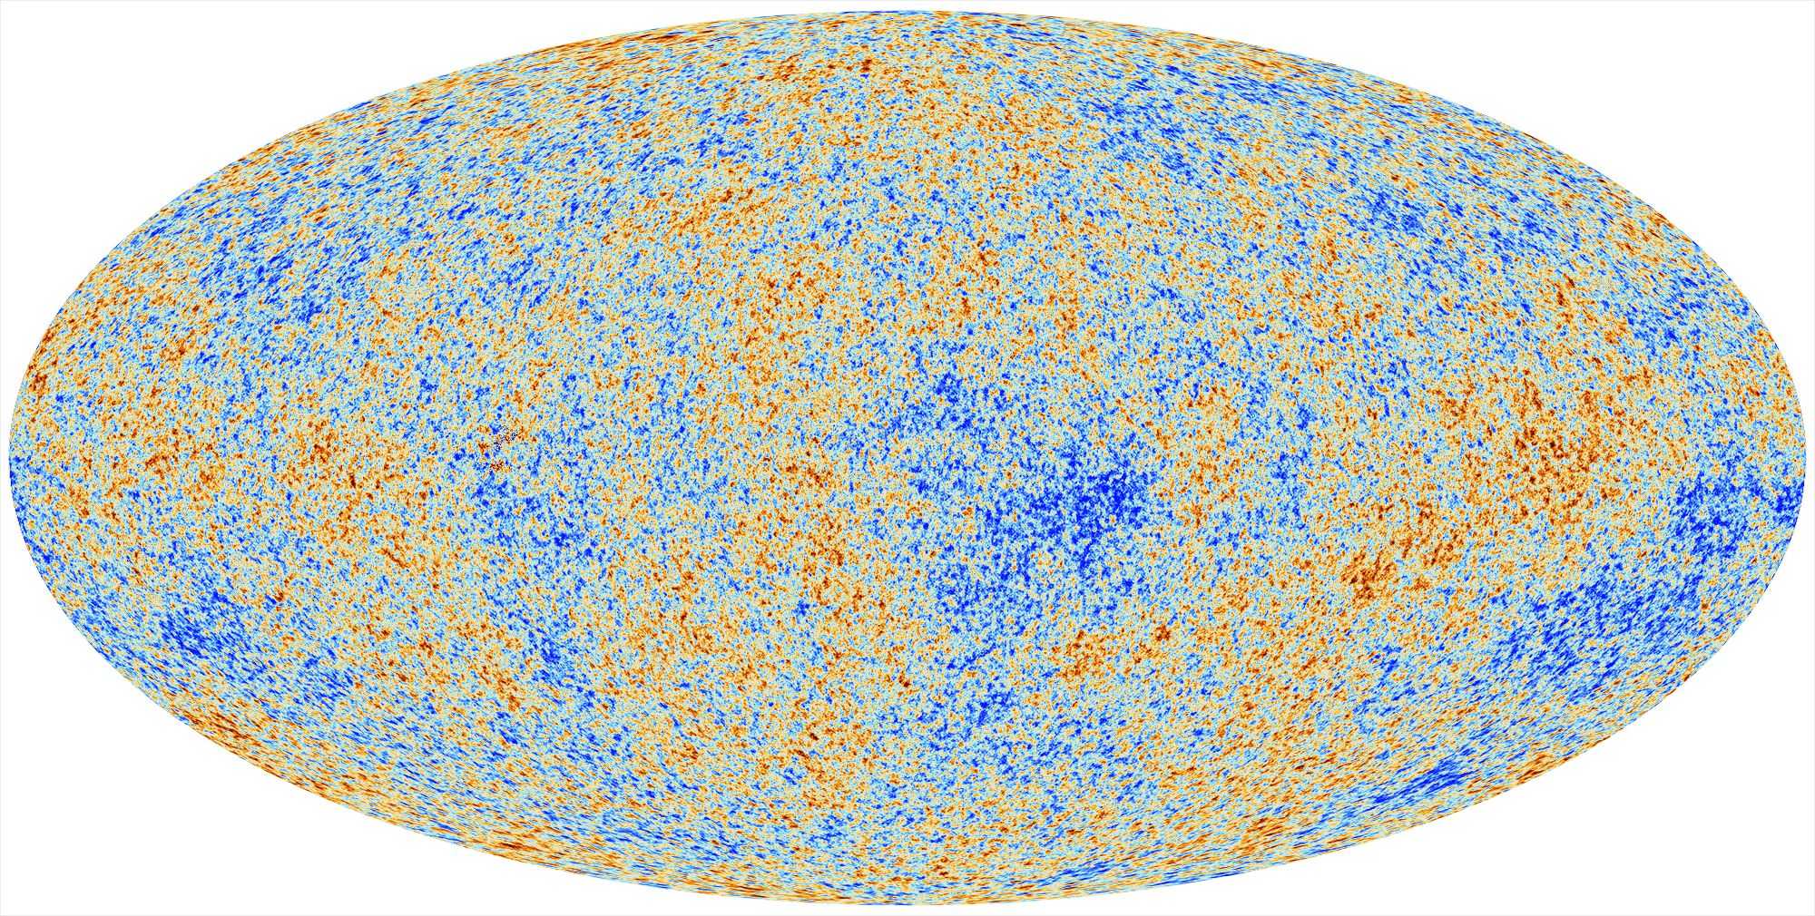
Planck CMB mission, 2009-2013 [“Final” results ~ 2018]

Slide 20
Qualitatively: Mean-squared temperature fluctuation on angular scale 200/l degrees.

Slide 21
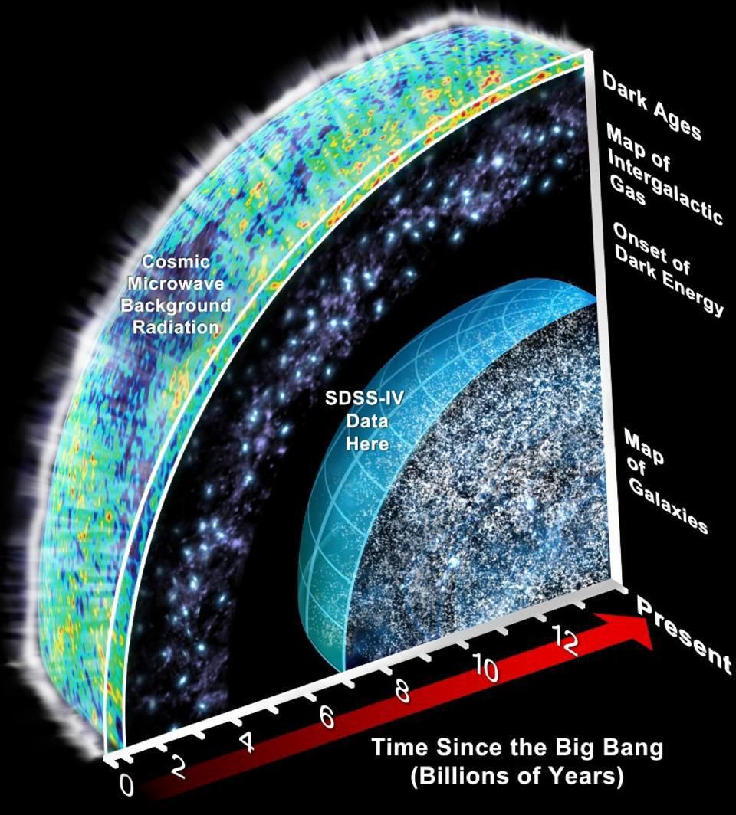
Notes:
David: Another depiction of cosmos centered on us. Most distant thing we see is the CMB. For structure to form, must be anisotropy.

