Slide 1
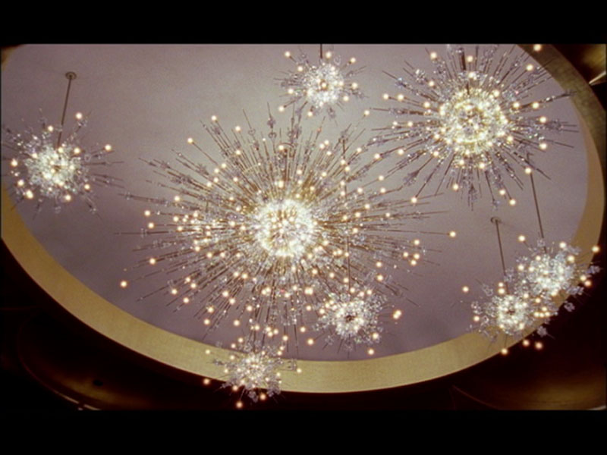
Notes:
Josiah

Slide 2

Notes:
Josiah

Slide 3
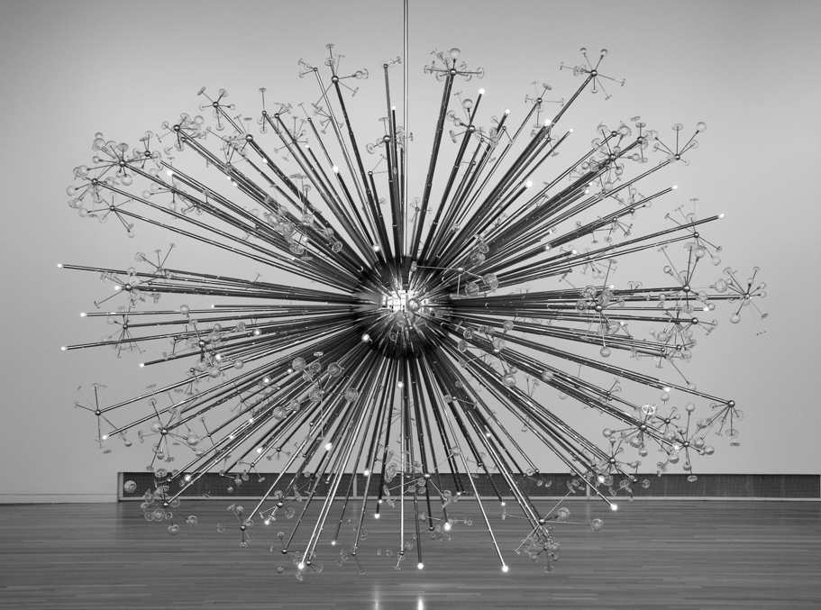
Notes:
Josiah

Slide 4
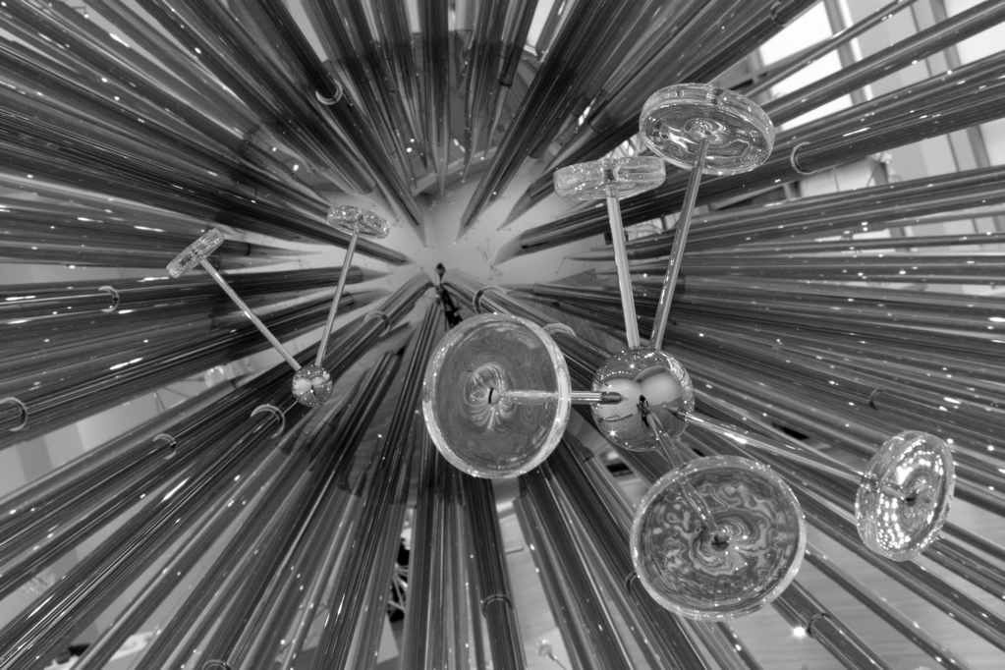
Notes:
Josiah. First galaxies appear at redshift 30, when universe is about 100 million years old. Small disks, one or two at a time. .Longer rods mean later time, lower redshift, galaxies get bigger and come in bigger clusters. Second cluster here might be from when universe is a billion years old. (Universe today is 14 billion years old, so this is still “early”.)

Slide 5
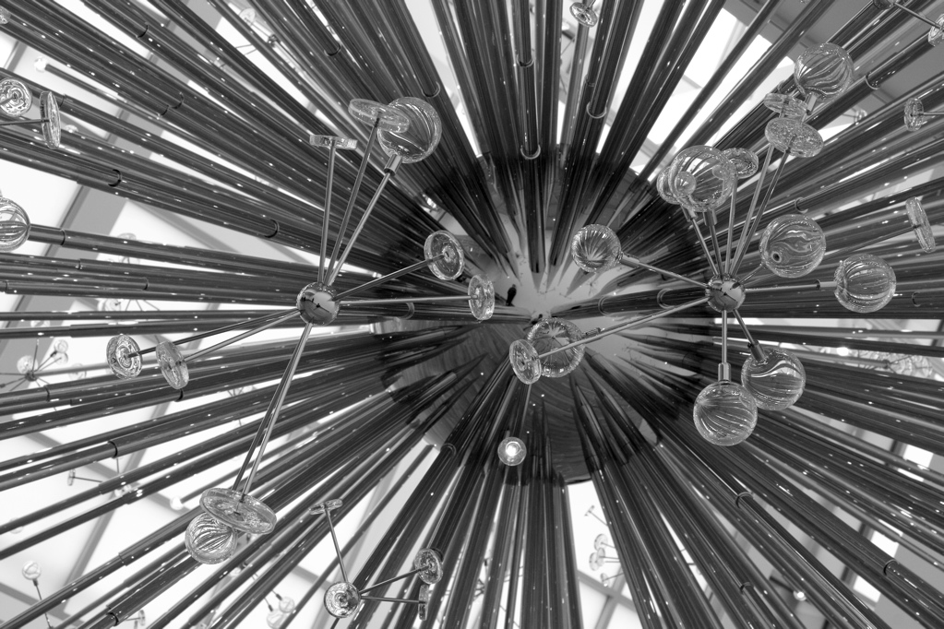
Notes:
Josiah: Elliptical galaxies start to appear, formed by mergers of disks. Larger clusters, first quasar lamps.

Slide 6
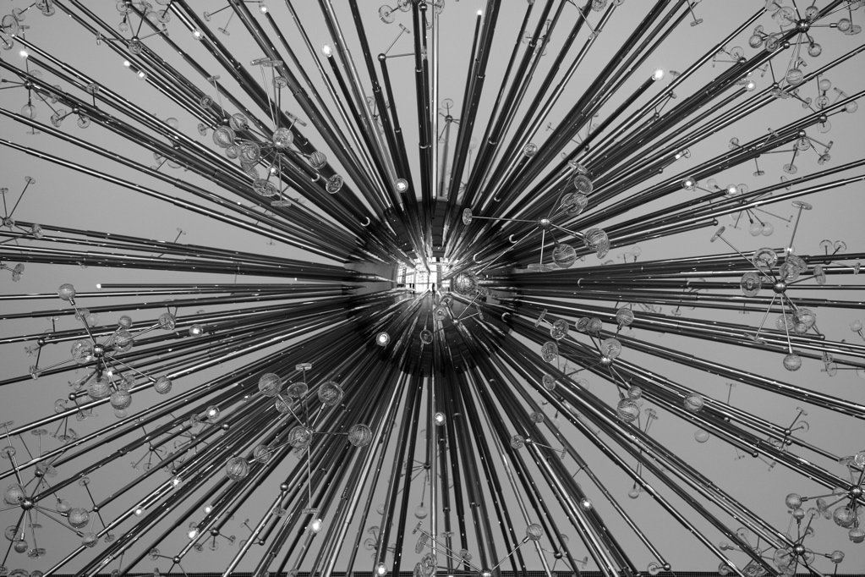
Notes:
Josiah: Larger structures as we approach present. Quasars peak in number and brightness at redshift 2, when universe is a few billion years old.

Slide 7
Notes:
Josiah

Slide 8
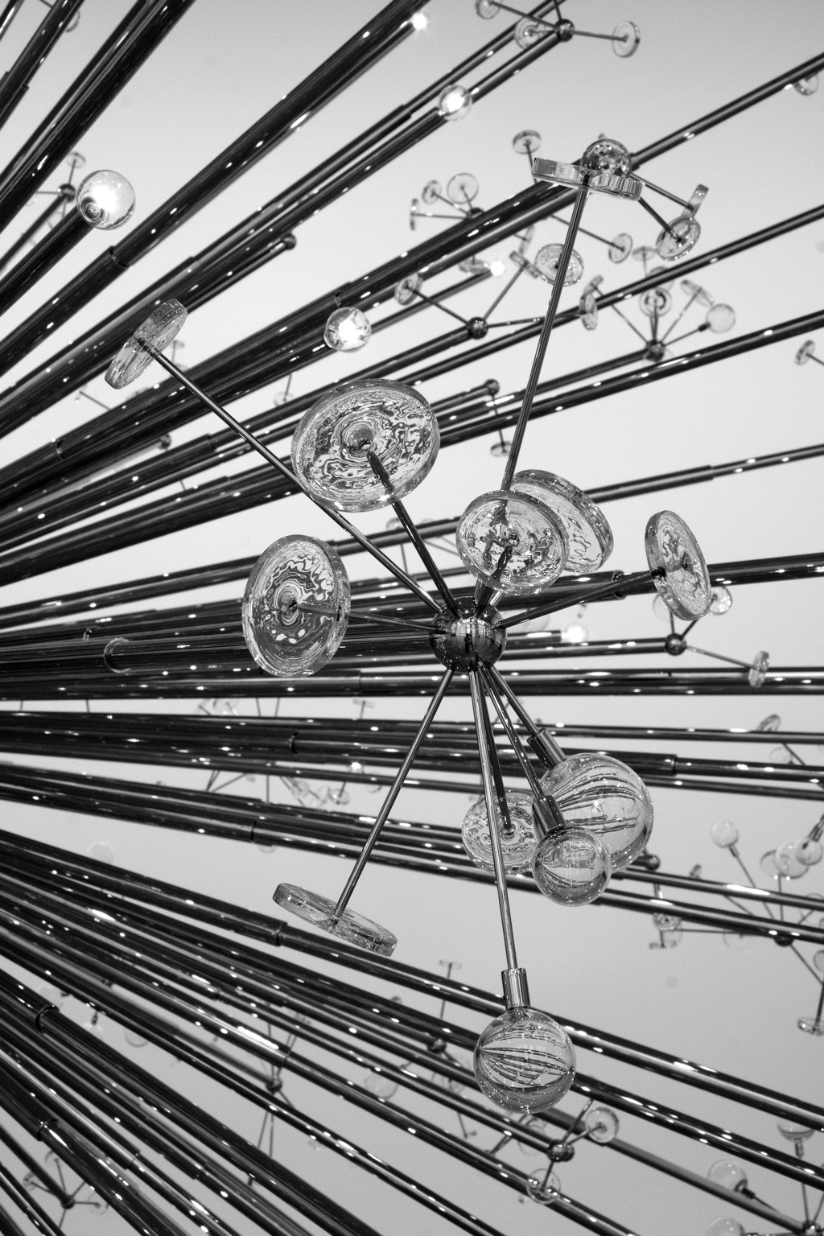
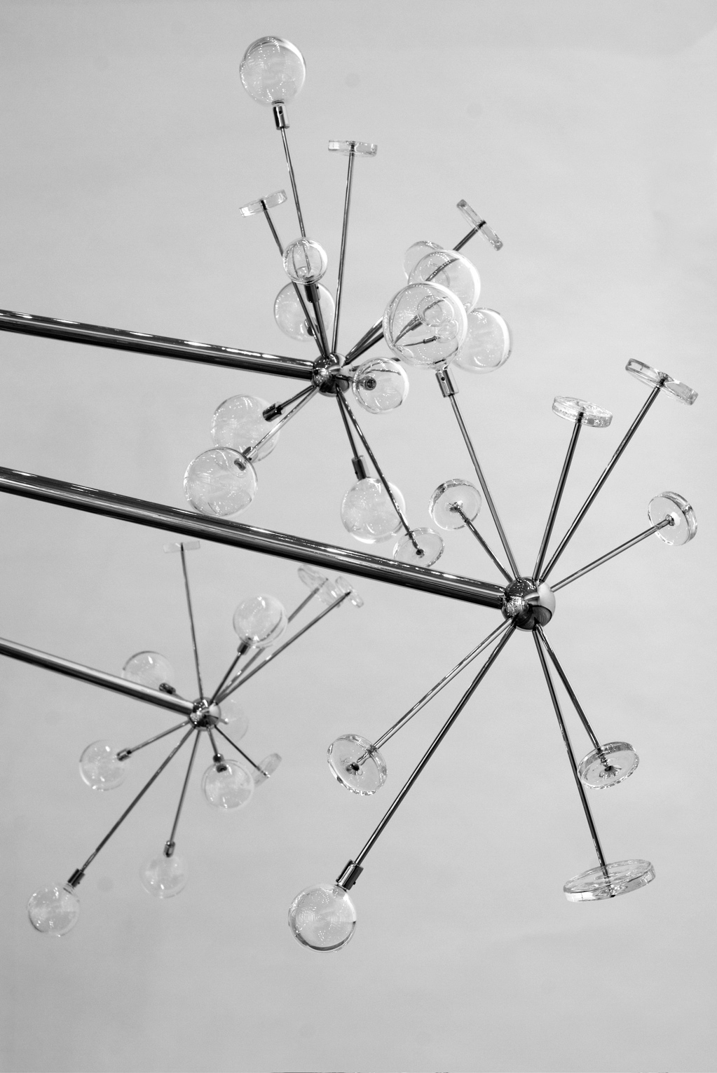
Notes:
Josiah: Largest and most complex structures at present day. Talk about some visual effects – glints, lensing, reflections, etc.

Slide 9

Notes:
Josiah

Slide 10
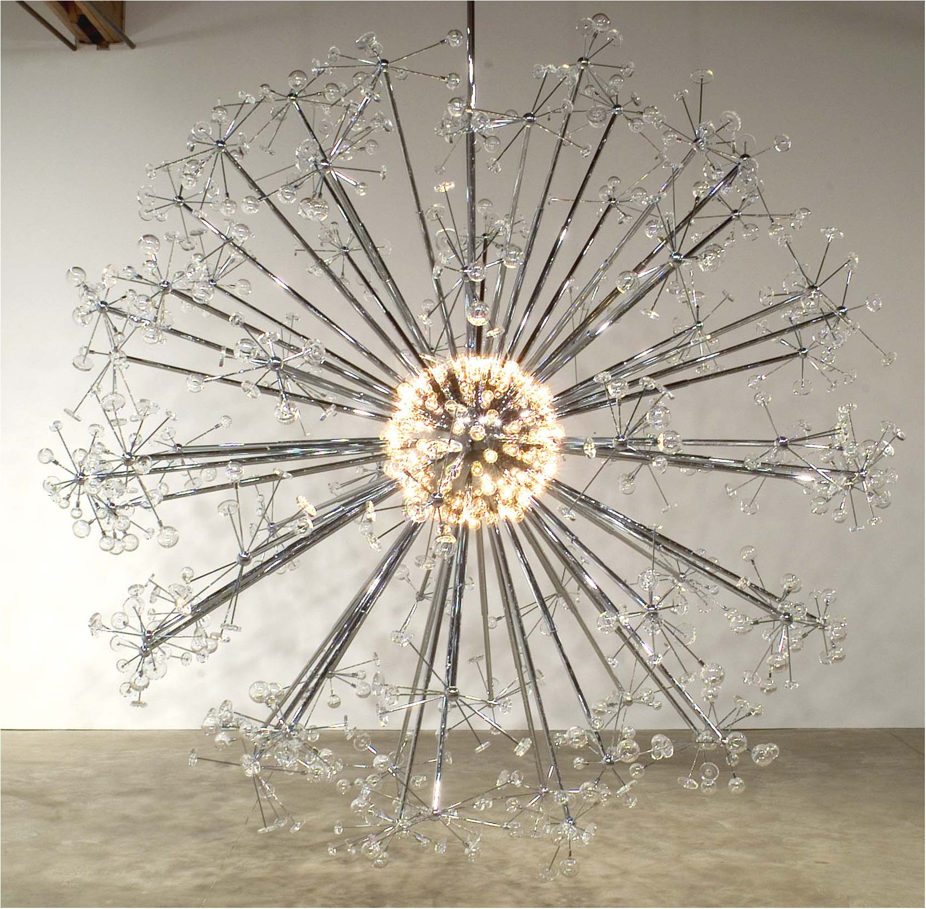
Notes:
David starts this slide, explaining that lamps trace COBE map of CMB.
Josiah takes over in this and next couple of slides, describing themes of LSS, origin of rich structure from small initial imperfections.

Slide 11
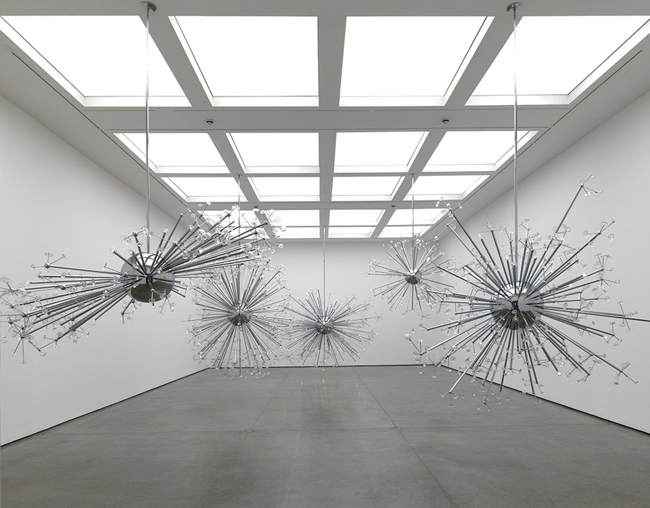
Notes:
Josiah: Island Universe at White Cube. The room is part of the work. The viewer walks through the inflationary sea.

Slide 12
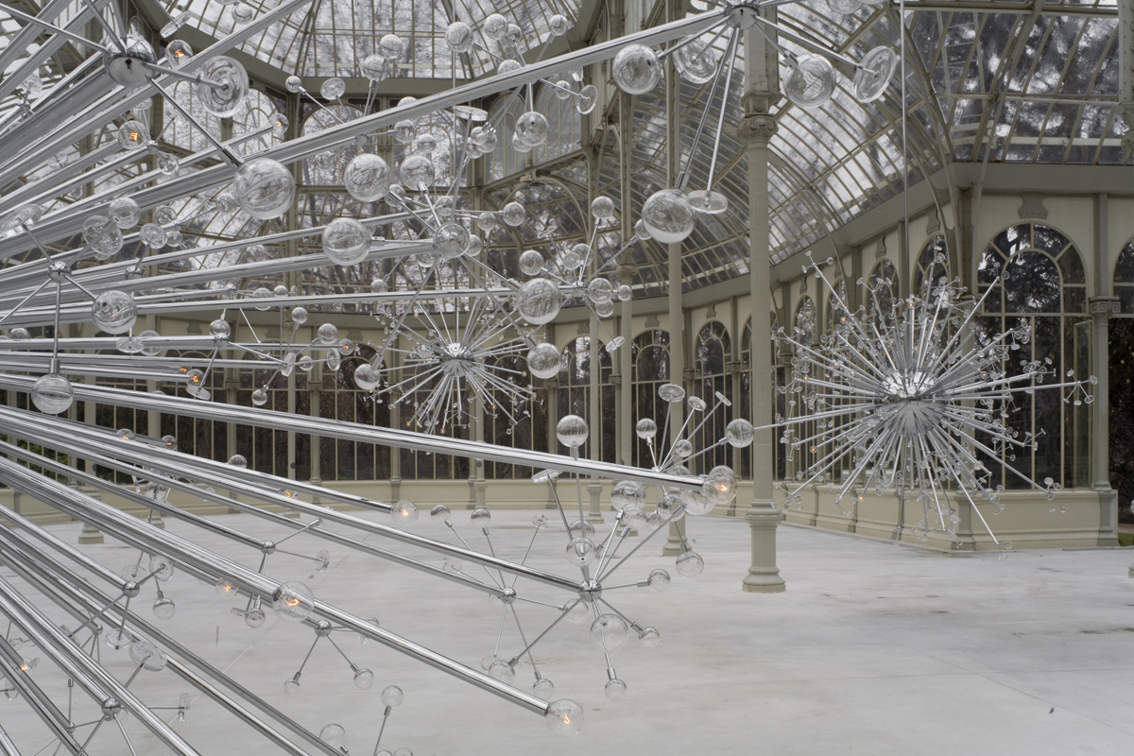
Notes:
Josiah: Island Universe in Madrid.

Slide 13
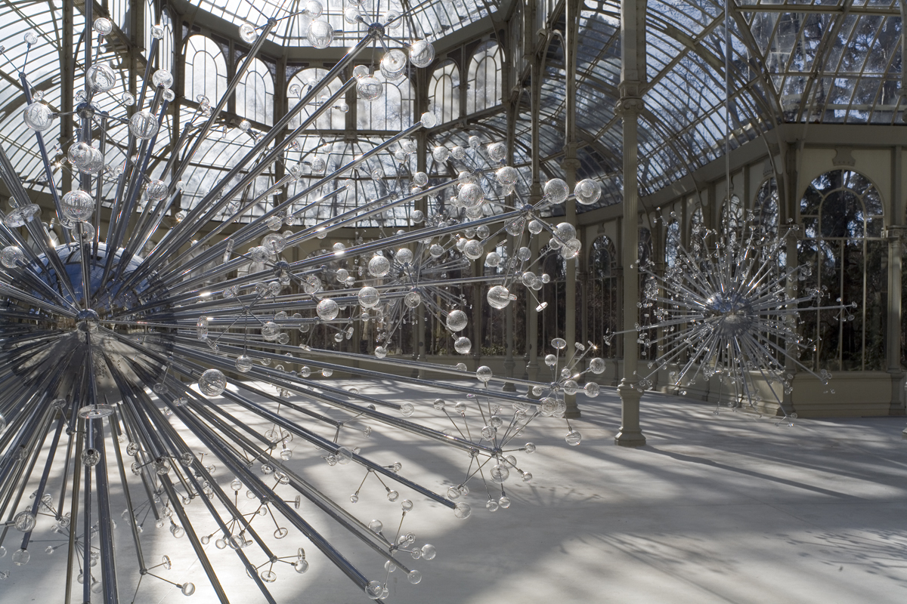
Notes:
Josiah.

Slide 14
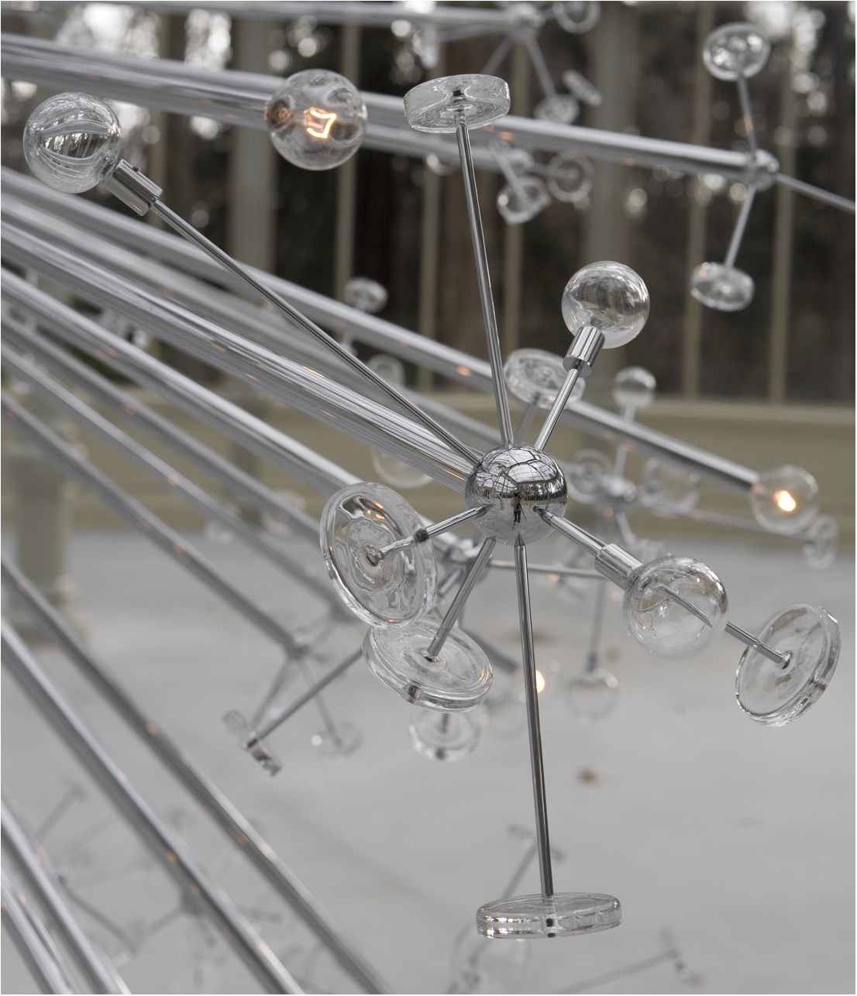
Notes:
Josiah. Reflection of the crystal palace in the galaxy support.

Slide 15


Slide 16
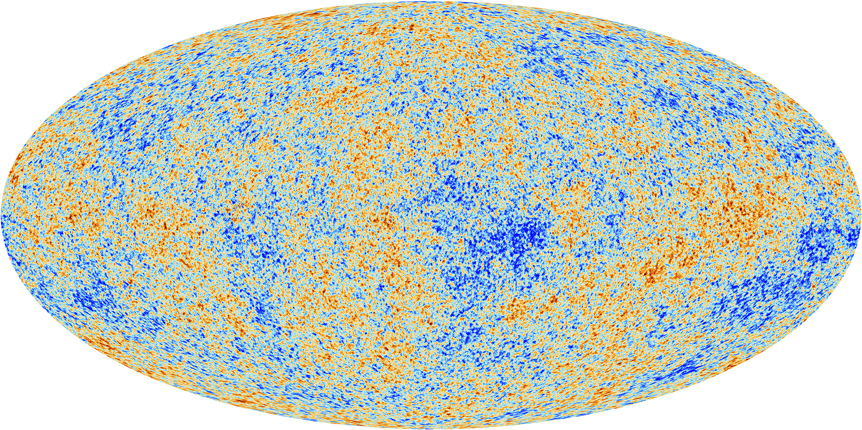
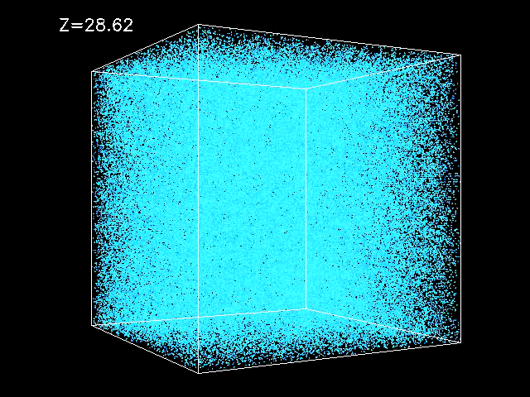
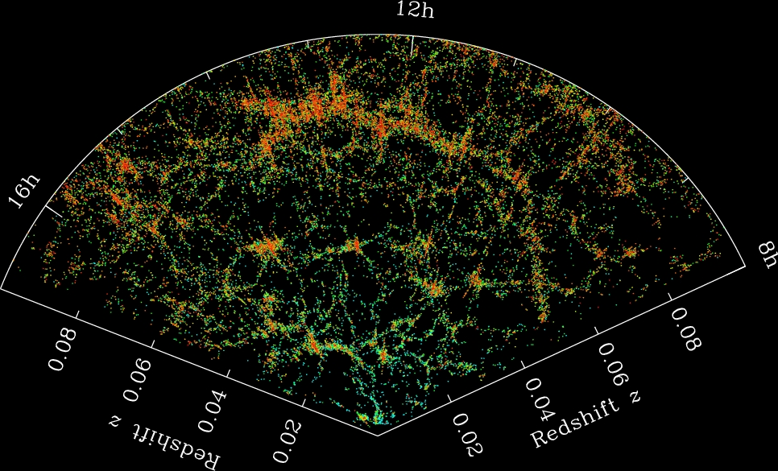
Simulation by
A. Kravtsov

Slide 17
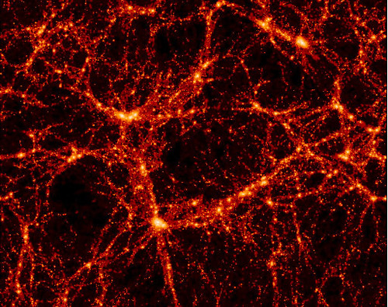
Virgo Consortium

Slide 18
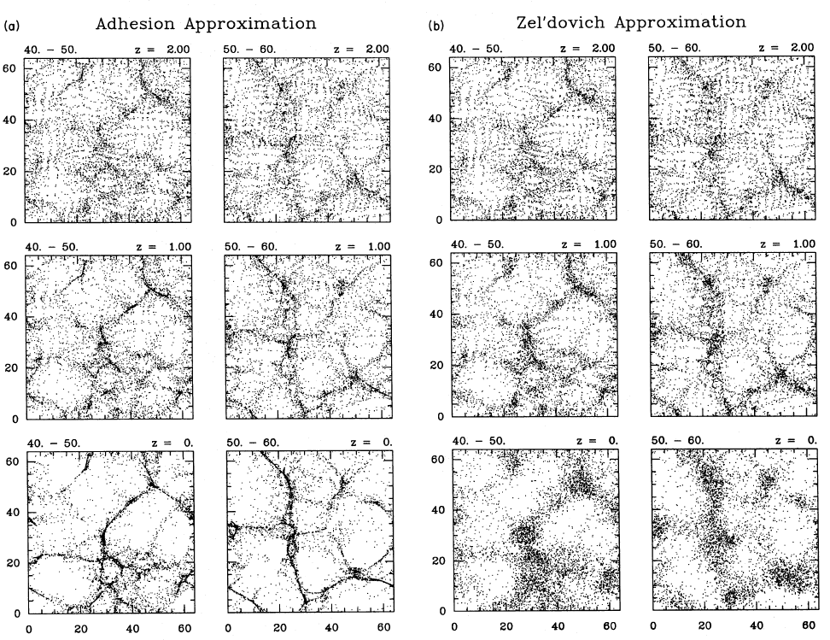
Weinberg & Gunn 1990
Large Scale Structure and the Adhesion Approximation

Slide 19
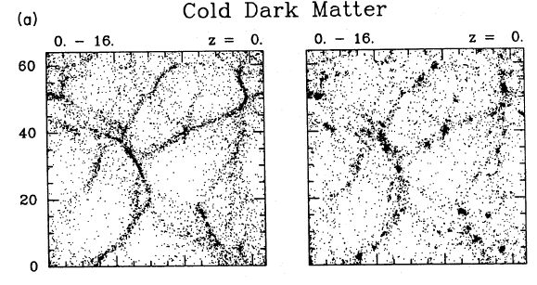
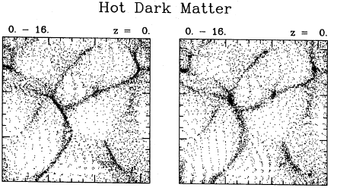
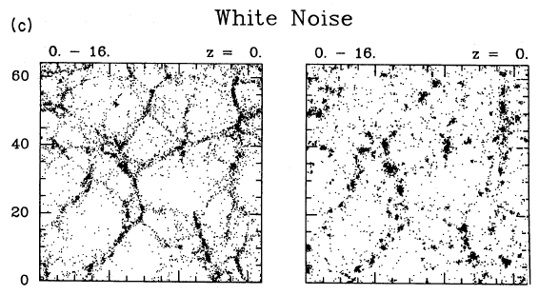
Adhesion vs. N-body

Slide 20
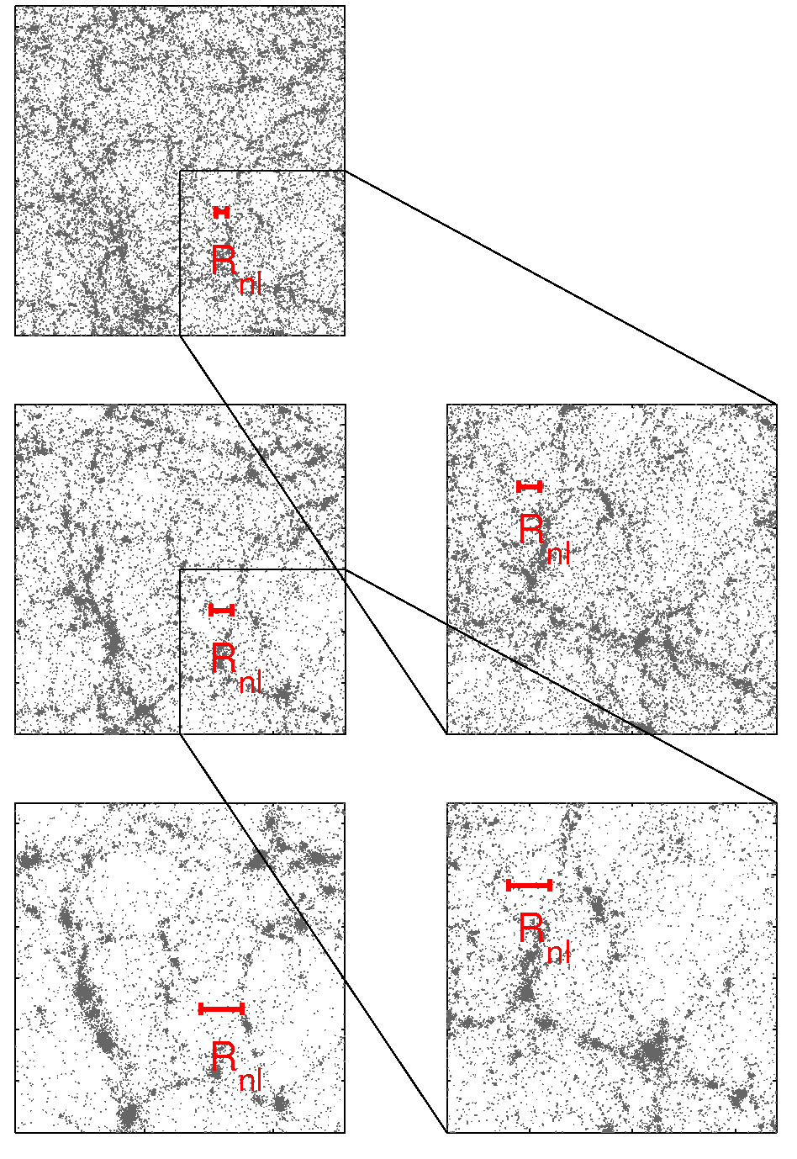
Self-similar clustering evolution
P(k) ~ k⁻¹
Ω_{m} = 1
C. Orban, PhD thesis

Slide 21
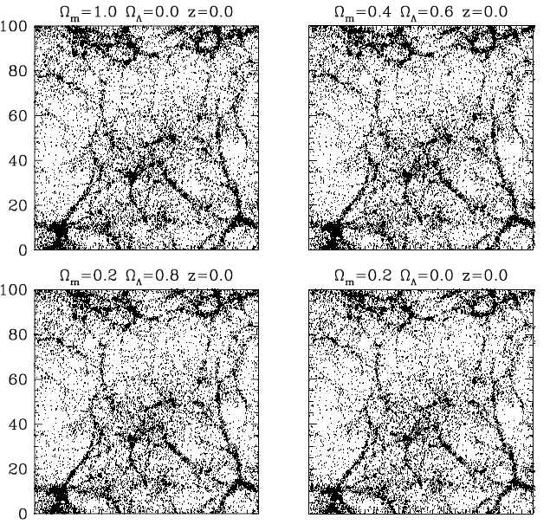
Zheng et al. 2002
N-body simulations evolved from same linear density field (to same σ₈) with different cosmological parameters.

Slide 22
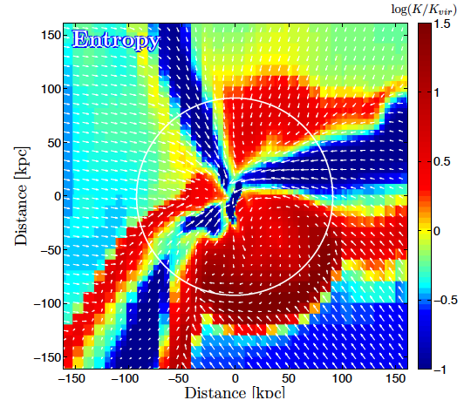
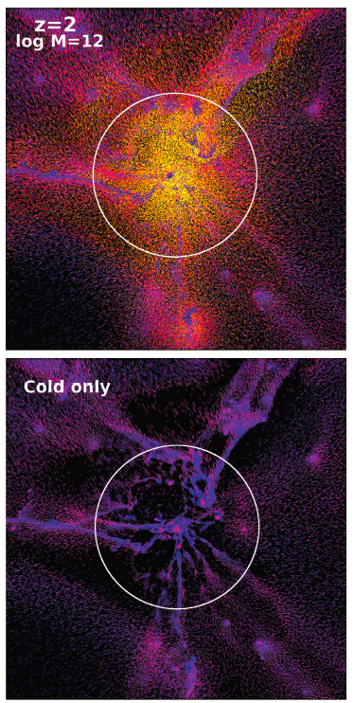
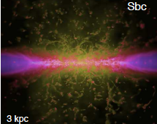
Dekel et al. 2009
Keres et al. 2009
Hopkins et al. 2012

Slide 23
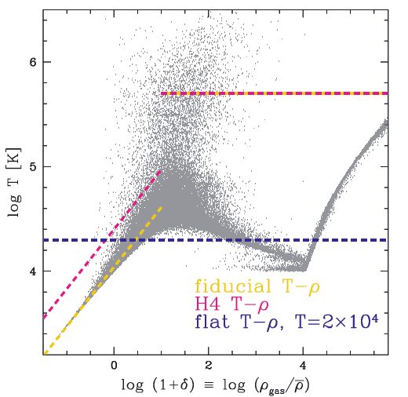
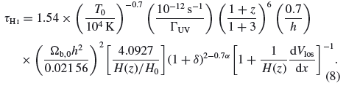
Peeples et al. 2010
The Lyman-alpha forest
Discovered observationally in 1971
Physical picture emerged from cosmological hydro simulations in the mid-1990s
Physically intuitive understanding from the “Fluctuating Gunn-Peterson Approximation” (Weinberg et al. 1998)

